Slide 1
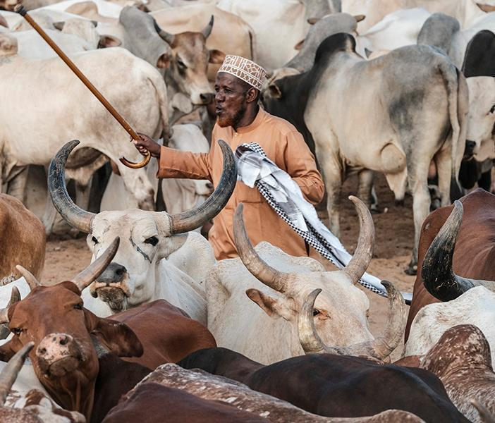
Monitoring and evaluation and impact assessment in the Livestock CRP
Helen J. Altshul, Jane Poole, Caroline Kanyuuru, Alice Njehu and Nils Teufel
CGIAR Livestock review and planning meeting, 12 June 2020

Slide 2
This session
Identify priority activities in the coming 18 months to help generate evidence on the value and contributions of the CRP's approach, products and outcomes
Notes:
Page title minimum of 30 points and maximum
of two lines
Main point 6 point smaller than slide title
Bullet points 4 point less than main point
Font type is Calibri
It is advised in one slide maximum 6 bullets
We recommend you use images on slides
You can change partner logos on front page
You have to duplicate this slide for more inside pages

Slide 3
Format
A short presentation - Helen
Small group breakout conversations / google slides
Short plenary
Notes:
Page title minimum of 30 points and maximum
of two lines
Main point 6 point smaller than slide title
Bullet points 4 point less than main point
Font type is Calibri
It is advised in one slide maximum 6 bullets
We recommend you use images on slides
You can change partner logos on front page
You have to duplicate this slide for more inside pages

Slide 4
CRP targets towards impact
System Level Outcomes (SLOs) are a core component of the CGIAR Strategic Results Framework (SRF) and include aspirational CGIAR and partners’ development targets to 2022 and 2030 across 10 indicators. During CRP phase 2 proposal development, CRP livestock identified its contribution to specific indicators as below.
System Level Outcomes
30 million people, of which 50% are female, assisted to exit poverty (2022)
Livestock: 4,128,000 people
2. 100 million more farm households have adopted improved varieties, breeds or trees, and/or improved management practices (2022)
Livestock: 6,520,000 HH
3. Improve the rate of yield increase for major food staples from current <1% to 1.2-1.5%/year (2022)
Livestock: 3.5% / yr (average)
4. 30 million more people, of which 50% are female, meeting minimum dietary energy requirements (2022)
Livestock: 11,574,000 people
5. Reduce agriculturally-related greenhouse gas emissions by 0.2 Gt CO2-e yr–1 (5%) compared with business-as-usual scenario in 2022
Livestock: 0.08 Gt CO2-e yr-1
6. 55 million ha degraded land area restored (2022)
Livestock: 13,687,000 ha

Slide 5
How do we show impact?
Monitoring, Evaluation, Learning and Impact Assessment studies
MELIA studies are components of planning (POWB) and reporting (AR) cycles
They provide evidence to report on contribution to System Level Outcomes
Difficult to obtain rigorous enough data to demonstrate outcomes and impact
PMU has funds to support one or two key studies that would help to make our case for the CRP
Examples
System Level Outcomes (SLOs) – Example of evidence: rigorous adoption and/or impact data e.g. ex-post Impact Assessment or Adoption Study, supported by either OICR Level 3 or peer reviewed paper
Outcome Impact Case Reports (OICRs) - ‘outcome stories’
  Level 3 (sphere of interest) - Policy and/or practice changes influenced by CGIAR research has led to adoption or impacts at scale. Examples of evidence: at scale Adoption Study or ex-post Impact Assessment
  Level 2 (sphere of influence) - Policy and/or practice changes influenced by CGIAR research has led to adoption or impacts at scale. Example of evidence: a study of adoption and effects, commissioned at project level.

Slide 6
Progress on evidence
Obtained from Annual Reports (ARs) 2018, 2019 and Plan of Work and Budget (POWB) 2020
MELIA study category | AR2018 | Status | AR2019 | Status | POWB2020 | Status
Ex-post impact assessment | 1 | Completed | 2 | Extended 1 Cancelled 1 | 0 | NA
Ex-post adoption study | 1 | Cancelled | 4 | Cancelled 1 Extended 2 Completed 1 | 0 | NA
Program/project impact assessment | 0 | NA | 2 | Extended 1 Completed 1 | 4 | Ongoing
Qualitative outcome study | 0 | NA | 1 | Extended | 0 | NA
Program/project evaluations or reviews | 1 | Ongoing | 0 | NA | 0 | NA
Synthesis/secondary studies | 0 | NA | 0 | NA | 1 | Ongoing
Other MELIA studies | 0 | NA | 8 | Completed | 2 | Ongoing

Slide 7
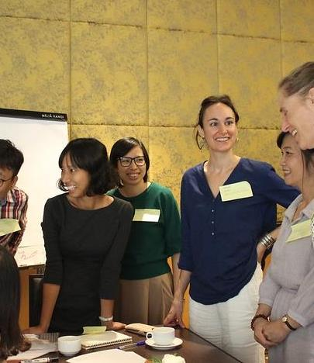
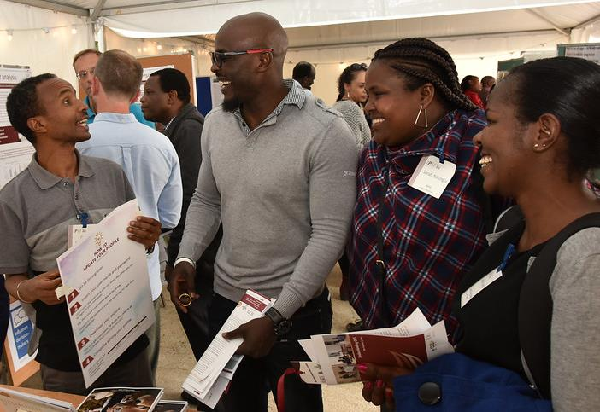
Assignment
In the next 18 months, what are the most important evaluative studies or other actions that projects, flagships and the CRP as a whole can do to demonstrate impact?
What could you contribute from your project(s) to help us show impacts?

Slide 8
Group work summary – General messages
External evaluation of large bilaterals (e.g. ACGG, ADGG) – CRP-funded
(External) large-scale study at CRP-level impacts (Q: where, for what change?), could be beyond household level beneficiaries (e.g. the underlying evidence of impact stories)
Inventory of released products, assessment of impact on communities
Scenario analysis & ex-ante impact assessments (although does not evidence SLO)
Ex-post IA linked to OICR, could identify through product lines, also look at unintended impacts, involve partners, capture data continuously, aim at sector level (e.g. dairy in E Africa)
Use impact pathway (ToC) as framework – conduct qual & quant studies
Need to think of evaluation (classic IA as well as other methods) EARLY, ensure designs allow for later evaluation (often too late, lack of resources, projects let by natural scientists, donors not interested in counterfactual sites etc.
Scaling-ability assessment of integrated packages (priority countries)
Ex-post IA and adoption may not be possible (funds, time, covid-19) – investigate qualitative studies on outcomes

Slide 9
Group work summary – Specific ideas 1
LMP – policy impact (Et, India) use and implementation of investment plans (LLAFS – Sirak, Karl)
Trace back forage use in SE Asia (F&F – Alan D?)
Institutional change (e.g. Et national research system) (LLAFS - Girma)
3 impact assessments planned (ICARDA – LLAFS - Girma)
Priority countries – baseline / endline household level, adoption studies?, use of results by other actors (e.g. Vt - district government, Ug/Tz – private sector) (All)
Influence on policy-makers and others on sheep fattening intervention in Et (F&F – Jane)
HEARD – has potential for scaling (and then ex-post IA), also has M&E embedded (Health)
ADGG – adoption of better bulls (but time-lag); digital extension – change in milk yields, women’s participation (Genetics - Chinyere)
ACGG – assessment of end users (not just financial, incl. social & environmental) (Genetics – Iddo?)
Dual-purpose crops (SPIA said no as limited impact on adoption and number of HH; could look instead at HH level – ICRISAT are trying this) (F&F – Michael B)

Slide 10
Group work summary – Specific ideas 2
Ex-post study on change in disease mortality & morbility on small ruminants in Et (baseline from 2015) (Health - Biruk)
PRM piloting in Tz & Ken – follow-up on baseline and evaluate; JVLUP in Tz – Baseline? done but not yet written-up, need independent review of baseline (Env – Fiona)
Crop-livestock integration ZimCLIFFS study already done (LLAFS – Manyawu)
Seed systems – registration of varieties, availability of new material; uptake by NGOs & others in scaling forage technologies (F&F – Uwe)
Carbon credits through improved grassland technologies, national-level actor demand for quantification of climate benefits of forages & contribution to climate-smart policy targets; heat stress in pig adaptions – interest of policy & NGO partners (Env – Birthe)
Seed sales data from private sector partners – challenges in needing to estimate how much goes to smallholders (or impact) (F&F)
A new vaccine / diagnostic in production by a commercial company (Health)
Public policy released for sustainable livestock in Columbia (F&F – Stefan)

