Slide 2
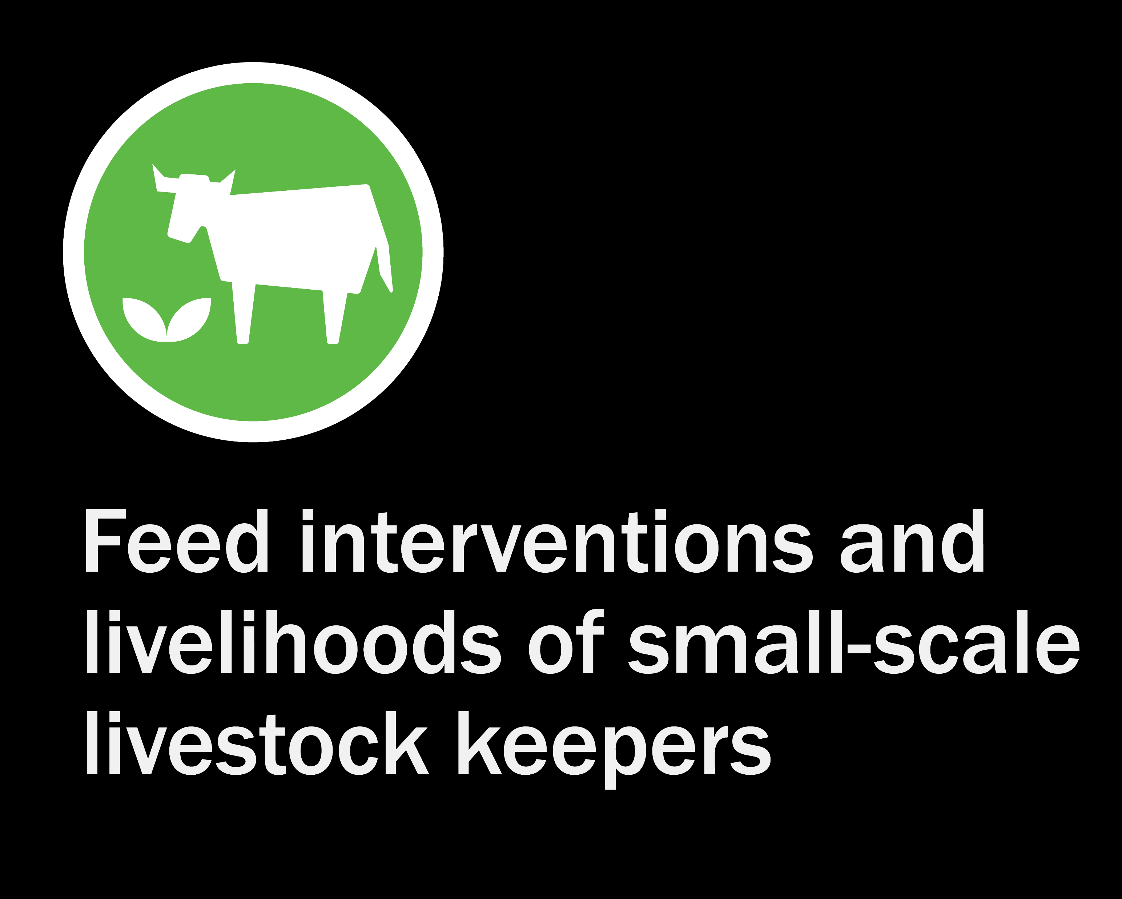









Learning from the review
Isabelle Baltenweck
Debbie Cherney
Alan Duncan
Erin Eldermire
Ricardo Labarta
Edda Tanga Lwoga
James Rao
Nils Teufel
Steve Staal
Develop recommendations on the promising strategies to improve livestock feeding for improved productivity and ultimately farmer livelihoods
Presented by Isabelle Baltenweck at the Ceres2030: On the Farm Findings: What works? presentation to BMGF” on November 19, 2020.
Notes:
The assessment of the effectiveness of incentives should account for tradeoffs between economic and environmental outcomes.
The measure of outcomes should also account for the tradeoffs among different types of incentives — or how market, non-market, regulatory and cross-compliance incentives could complement one another to achieve the desired outcomes.

Slide 3
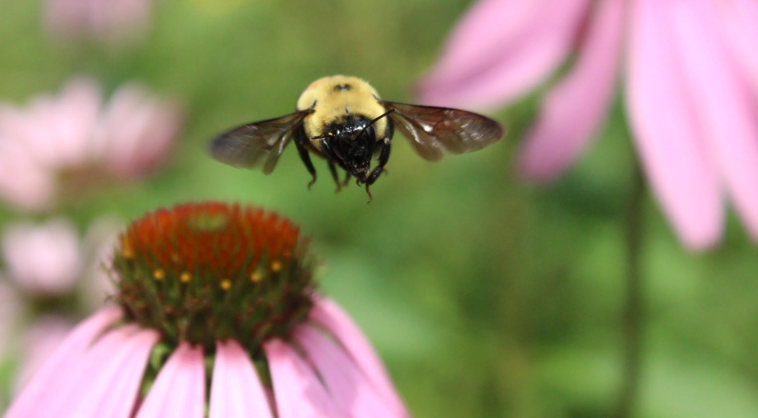
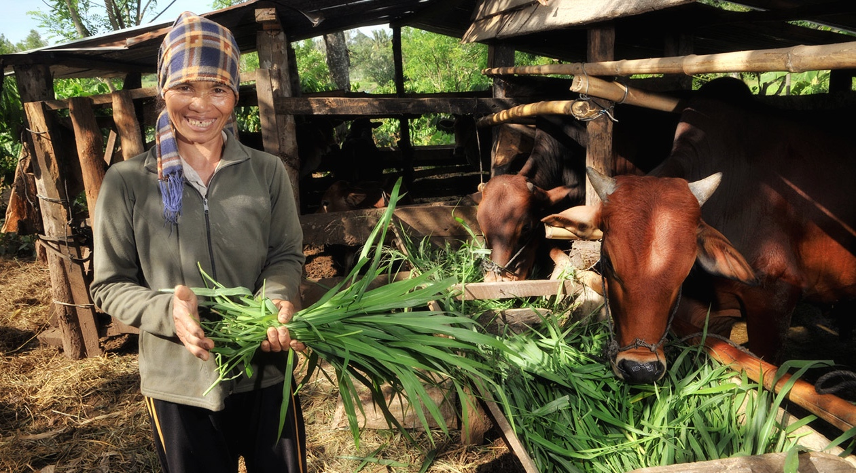
Motivation
Livestock: a neglected sector in R4D,
yet supporting one billion poor people in LMICs
Much lower productivity in LMICs –
e.g. milk yield in East Africa 5% of W. Europe
Improved feeding practices most practical way to increase productivity
Sizeable research on ‘feed interventions’

Slide 4
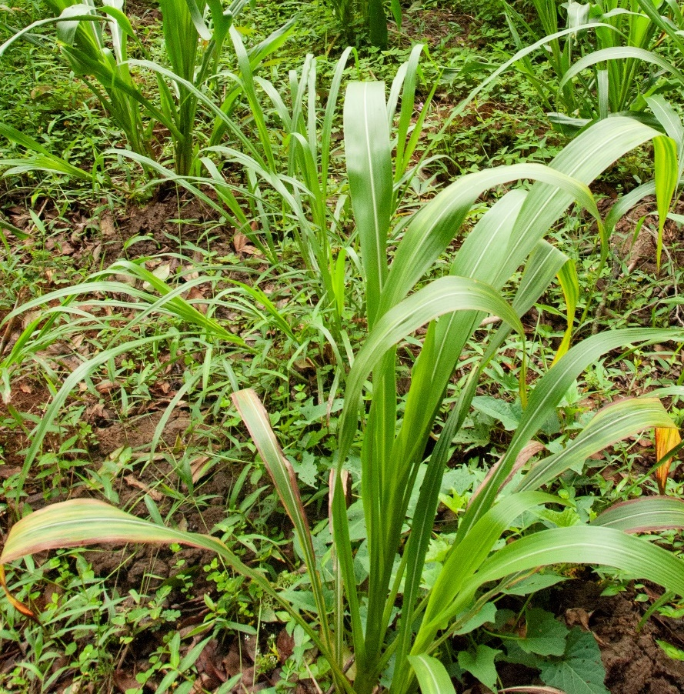
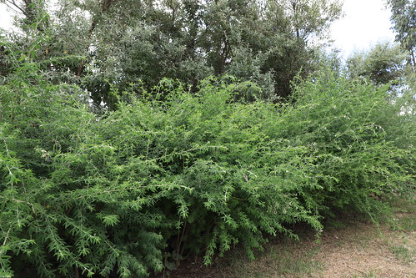
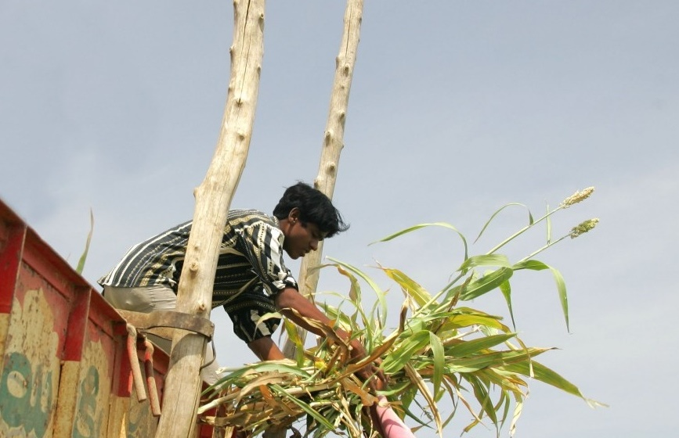
What are livestock interventions?
A change in feeding practice to provide more or better feed to increase livestock productivity
Interventions categorised by feed source type
  Improved grasses and legumes
  Multi-purpose trees
  Increasing intake and nutritive value of crop residues

Slide 5
Research question
What is the impact of ruminant feed strategy interventions on livelihoods among small scale and agro- pastoral livestock keepers in LMICs in Africa, Asia and Latin America?
23,018 articles
543 eligible for full text screening
73
uptake of improved livestock feed options by small producers
effect of this uptake on ruminant livestock productivity
degree to which this improves smallholder farmer livelihoods
  Many papers are feeding trials, either on farm or on station
  Also excluded articles that focused on characterization of an existing feeding system

Slide 6
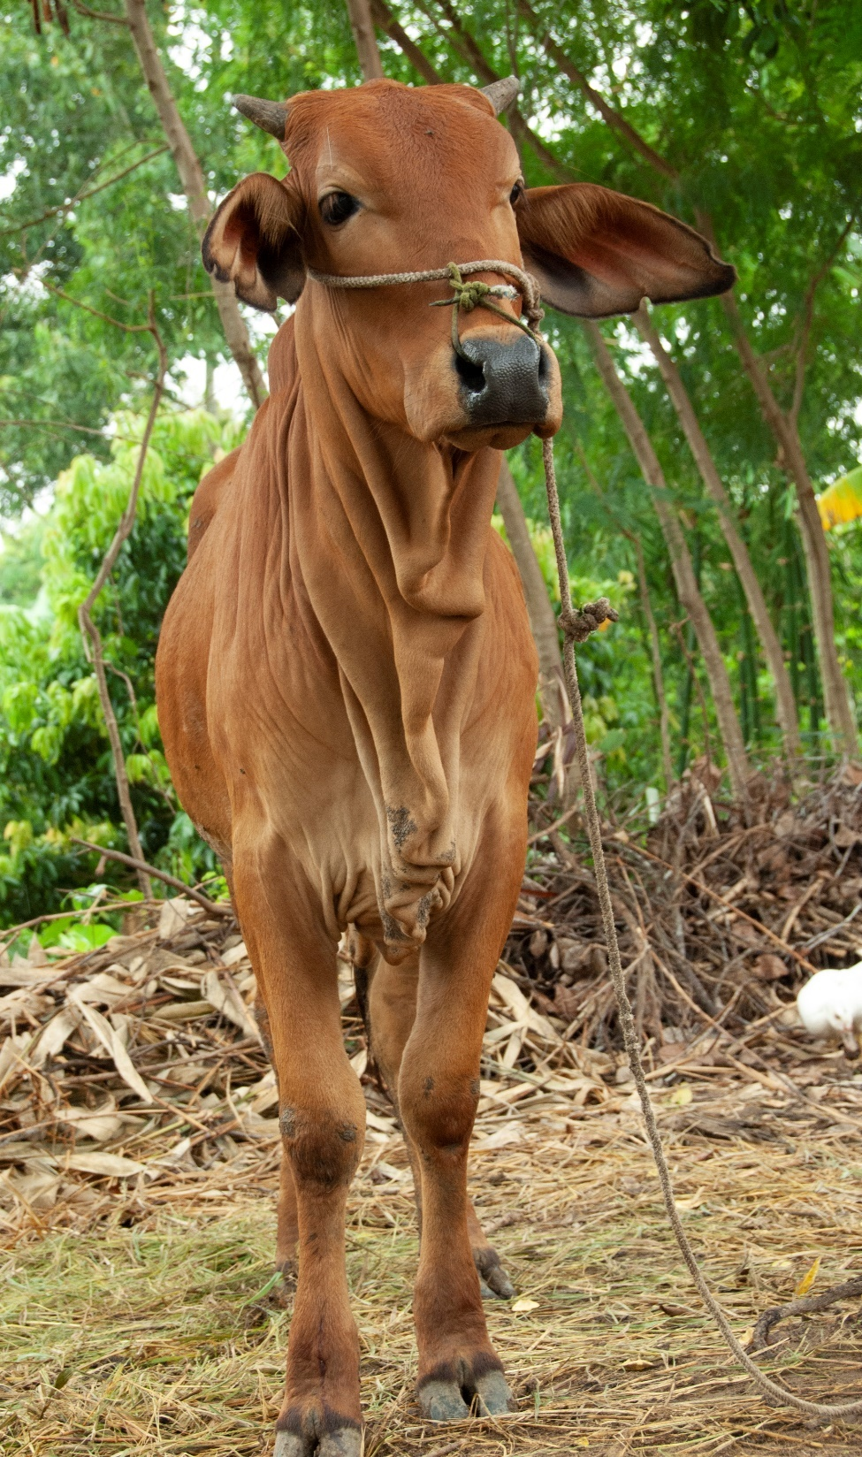
Results: Feed interventions and impact pathways
The majority of papers (53) dealt with planted fodder, agroforestry was the topic of 26 papers, crop residues in 7 papers
In terms of impact pathway from adoption to livestock productivity and household livelihoods
  58 papers on adoption
  19 papers on livestock productivity increases
  (milk yield, weight gain, better body condition or herd growth)
  22 papers on household livelihood indicators
  (income from livestock or reduced workload)
  Only 6 analysed the entire pathway, reporting evidence of adoption, effect on productivity leading to livelihood changes

Slide 7
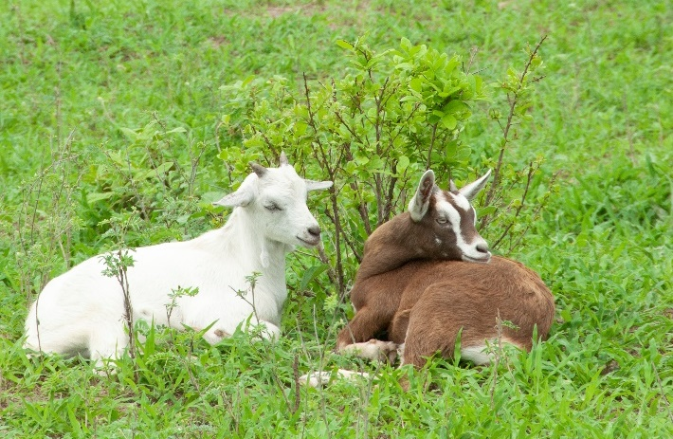
Results: Analysis of the reported results
Range of adoption EXTREMELY large
Effect on productivity- only 9 papers
Livelihood indicators- only 14 papers
Forage: 0 - 90%
Agroforestry: 8 - 87%
Crop residues: 20 - 86%
Range: 7 - 61%
Household income change (8 papers) 6 - 285%
Gross margin change (3 papers) 58 - 519%
Labour or workload change (5 papers) -24 to -70%.
Not all papers reported data that could be used for analysis
  E.g. 43 studies reported adoption of forages, only 32 included data that could be used to estimate adoption

Slide 8
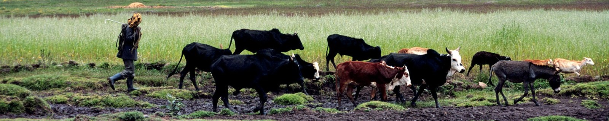
Surprises Gaps
So few papers answering research questions
Greater focus on agro-forestry than crop residues, yet
  Potential for improved productivity is high for crop residues, and
  Easier to disseminate through well established delivery systems for (staple) crop seeds
Balance heavily skewed to technical papers on recommendations for individual forages:
how it should be grown, cut, stored and fed.
Not much on whether livestock keepers would actually adopt such a feed intervention.
No gender disaggregated data, yet we know that social and gender norms affect uptake

Slide 9



Recommendations
Don’t start with the technical problems, use a more holistic, system approach
Focus on farmers with resources and incentive to make needed investments
Farmers oriented towards home consumption of livestock products are unlikely to invest in new feed technologies.
Resource requirements for feed options need careful consideration. If other uses for land and labor are more lucrative, livestock keepers will not invest in new feed options
For decision makers/development agents, exploring feed options: consider factors far beyond biophysical suitability, extending to the social, economic and knowledge domains

Slide 10

Thank you
Please contact
Isabelle Baltenweck
i.baltenweck@cgiar.org

