Slide 1

Summary of the Africa 1 Regional Multi-Stakeholder Online Meeting.
Presented by Shirley Tarawali ILRI’s DDG, at the GASL Global Online Multi-Stakeholder Meeting 14 - 18 September 2020

Slide 2
Summary: Africa 1 Regional Meeting
2, 3 September 2020
Organizing committee: Bernard Kimoro, State Department for Livestock, Ministry of Agriculture, Livestock, Fisheries and Cooperatives (MOALFC), Kenya; Cynthia Mugo, ILRI; Martin Barasa, VSF-Germany; Michael Victor, ILRI; Mohammed Abubakar, Federal Ministry of Agriculture, Nigeria; Robin Mbae, State Department for Livestock, Ministry of Agriculture, Livestock, Fisheries and Cooperatives (MOALFC), Kenya; Shirley Tarawali, ILRI; Simplice Nouala Fonkou, AUC-DREA
Many colleagues supported the meeting through participation, presentation, communications, moderation, technology………..
#livestockdialogue | #whylivestockmatter | #GASL2020 | #Africa

Slide 3
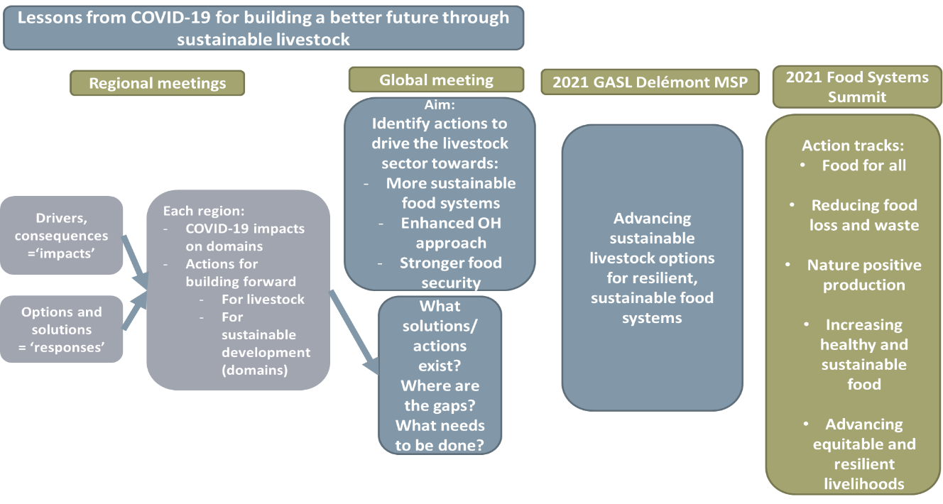
Global Objectives of the GASL Online MSP

Slide 4









Participant demographics
45 Academics/Research
Total number 215
of registered participants
(about 100 joining for each of 3 sessions)
43 NGOs
27 Private sector
32 Countries
29 Multi-lateral
52 Public Sector
16 Countries in Africa
9 Donors
6 Social movements

Slide 5
Workshop Programme (3 Sessions, 2 Days)
Session 1 [ 2 Sep 1400 – 1600 EAT]
Introductions
{Virtual Share Fair open}
2. Session 2 [ 2 Sep 1700- 1900 EAT]
Share Fair (presentations); ‘pandemic’ panel discussion;
3. Session 3 [3 September 1400 – 1600 EAT]
Pandemic Planning (group work)
framing ‘pandemic’ presentations
Group discussions ‘impact of pandemic on livestock sector’
Reflection and wrap up
Closing reflections
Review of Actions/ Key Messages
Closing Remarks

Slide 6
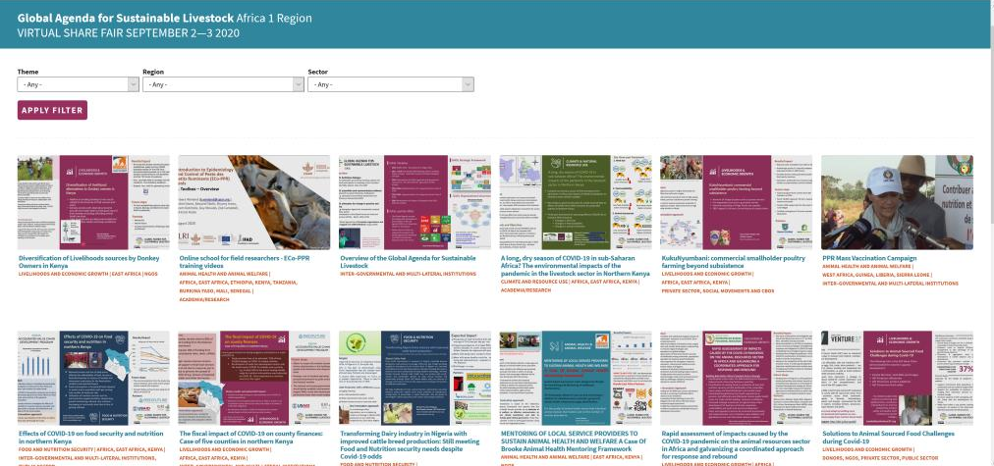

Slide 7
Challenges
Reduced consumption and demand
(loss of consumer confidence; reduced purchasing power)
Increased nutritional deficiency
Wastage
Reduced income impacts food security
Supply chain disruption
Opportunities
Local markets; shorter value chains
Policy congruence viz. One Health
New technologies; digital opportunities (perhaps realized faster), including for trade
Recognition of importance of animal source foods
More equitable opportunities (gender, small scale)
Responses
More attention to smaller scale, local production/sale
Family/farm labour focus
Increased access to online information/tools

Slide 8
Challenges
Market collapse or restriction – loss of income and livelihoods
Disrupted input supplies; food loss/waste
Trade and border movement restricted
Impacts hard to measure, especially on equity dimensions
Opportunities
New technologies and digital solutions – enhance resilience
Increased biosecurity at local markets – continued operations
Improve capacity to control pathogens/threats at source
Responses
Food (incl. livestock) exempt from movement restrictions
Tax relief (some)
Increased partnerships eg small/local producers and government

Slide 9
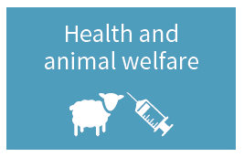
Challenges
Movement restrictions impact input access (drugs, feeds, pastures etc)
Vet services hampered – risk of new disease outbreaks
Animal welfare: vaccines, drugs and feeds limited – suffering and mortality
Reduced surveillance; increase unregulated environments
Opportunities
Promotion of One Health
Application of ICT for information, training and monitoring
Increased preparedness; controls throughout value chains
Responses
Resources diverted to public health and COVID-19
Animal health recognized as essential
Stricter regulation and surveillance
Animal health and welfare

Slide 10
Challenges
Movement restriction – limits access to natural resources; causes welfare issues
Unable to sell animals or products means increased pressure on natural resources
Opportunities
Importance of local breeds/traits for resilience to multiple shocks
Increased multi-stakeholder coordination – including for climate change solutions
Rethinking large scale industrial production
Responses
Increased collaboration among different stakeholder groups
Livestock management and welfare sometimes de-prioritized
?reduced env. impact

Slide 11
Building better
Academic/research
Digital solutions
Multi-disciplinary One Health
Solutions for resilience
Promote update of research solutions – partnerships
Evidence
NGOs
Support local capacity, contingency for better resilience
Policy advocacy
Local evidence – COVID-19 and livestock solutions
Private sector
Scale / tailor packaging, distribution of inputs
Innovative business models
Rebuild markets, value chains
Social movements
Ensure inclusion – no one left behind
Support advocacy
Engage across different scales/ production systems
Donors
Go beyond ‘agric’ – wider development issues..humanitarian etc
Support sector assm’t to inform priorities
Invest in digital / new solutions
Public sector
Support multi stakeholder engagement
Policies and resources for an enabling environment – small scale to large private etc
Multilateral
Enhance collaboration for One Health solutions
Evidence and messaging for advocacy
Strengthen re-building and resilience at local levels

Slide 12
What did we learn?
Many issues cross cutting and inter-related throughout sustainability domains
Major concerns around food security and especially food system resilience; new prominence to One Health
New technologies, especially digital ones are being deployed – perhaps faster than would otherwise have been the case
Several reports of small-scale local systems faring better that large, industrial scale
Rethinking business models
Recognition that livestock need to be part of building forward sustainable, resilient food systems – messaging and evidence to support this is needed
All stakeholders recognize the importance of dialogue and coordinated solutions across different groups- no single typology can address alone
  Example (AU): Inter-Ministerial dialogues (eg. Agriculture, Trade, Finance and Health) have increased through COVID task forces etc - drawing attention to the Food and Nutrition Security and raising profile for more investments Government, Private Sector and Development Partners

