Slide 1
Livestock feed and forage action research and scaling in the Ethiopian highlands: Africa RISING experience
Kindu Mekonnen
International Livestock Research Institute (ILRI)
Zimbabwe scientists visit
23 June 2022

Slide 2
Introduction
Livestock pop in Ethiopia –cattle, shoats and equines =137.2 million, cattle=60 million (CSA, 2018)
Constraints for livestock production in Ethiopia (Feed, health and breed related)
Imbalance between feed demand and supply (Table 1)
Table 1. Feed balances for the different livestock production systems under different climatic conditions
Agro-ecological systems | Total livestock population | Feed demand (t yr⁻¹) | Feed supply- good year (t yr⁻¹) | Feed supply- average year (t yr⁻¹) | Feed supply- bad year (t yr⁻¹)
Lowland grazing (60%) | 52265228 | 47,666,865 | 68,290,410 | 51,326,540 | 34,183,279
Mixed systems –RF deficient (15%) | 25424149 | 28,975,954 | 28,076,555 | 19,209,548 | 15,173,235
Mixed systems- RF Sufficient (25%) | 38734106 | 53,350,275 | 48,853,394 | 38,004,014 | 31,920,918
Total | 116423483 | 129,993,094 | 145,220,359 | 108,540,102 | 81,277,432
Source: Ethiopia Livestock Master Plan -ELMP (2015)

Slide 3
Africa RISING approaches to address feed and forage related problems
Selected representative sites in consultation with local partners in four regions
Diagnosed feed and forage situation (FEAST, PCA, RTS)
Identified potential intervention options (CGIAR partners)
Validated feed and forage intervention options (on-farm)
Demonstrated best bet feed and forage options, and post-harvest management and utilization practices (within and outside AR sites) to enhance adaptation by users
Explored different options for forage seed multiplication (cooperatives, unions, model farmers, FTCs, local Universities and research centers)
Facilitated wider scaling (development partnership arrangement)

Slide 4
Achievements/ contributions
Farmers have started allocating more land for forage production – from 100 m² to more than 1000 m² -because of the project effort on awareness creation (field days, demonstration, training, visits)
AR validated feed and forage technologies are now mainstreaming through partner organisations without direct AR involvement
AR project managed to reach and benefit more than 96,432 farmers from 2017 to 2021 with feed and forage options through direct and partners engagement (NGOs, extension, ILSSI, TAAT, Grass2cash project, local Universities and research centers)- (Table 2).

Slide 5
Table 2. Number of beneficiary farmers from 2017 to 2021.
Technological options | 2017 | 2018 | 2019 | 2020 | 2021
Oat/vetch | 1503 | 6647 | 5146 | 21689 | 4,806
Desho grass | 1018 | 517 | 112 | 4125 | 2
Sweet lupin | 106 | 113 | 0 | 0 | 0
Alfalfa | 3 | 32 | 226 | 581 | 164
Faba bean/forage intercropping | 16 | 0 | 0 | 0 | 0
Tree luceren | 11388 | 12535 | 10788 | 9483 | 1819
Feed trough | 25 | 137 | 237 | 837 | 1,097
Fodder beet | 0 | 0 | 61 | 122 | 198
Elephant grass | 0 | 0 | 99 | 302 | 77
Total | 14059 | 19981 | 16669 | 37481 | 8242
Total number of beneficiaries in 2017-2021 from feed and forage intervention= 96,432
Targets from 2017 to 2021= 126,059

Slide 6
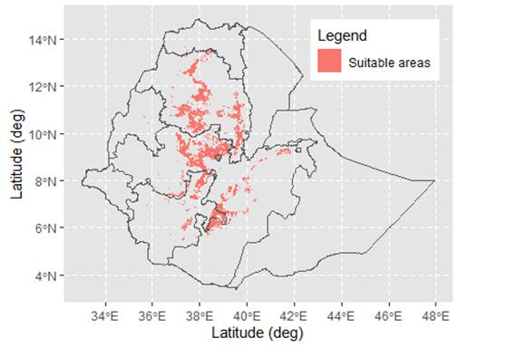
Producing suitability maps of the feed and forage options for further investment by any interested groups (e.g. TL)
Based on the preliminary result, tree lucerne (TL) can be grown on 125K ha of land, which can produce a dry matter of 1.0 -1.25 million t y⁻¹ .

Slide 7
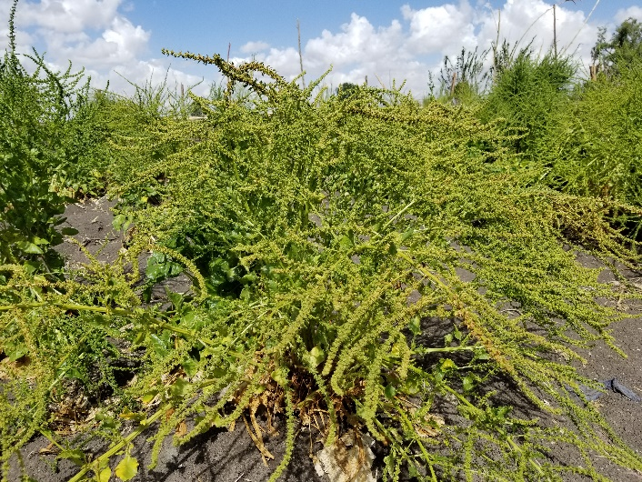
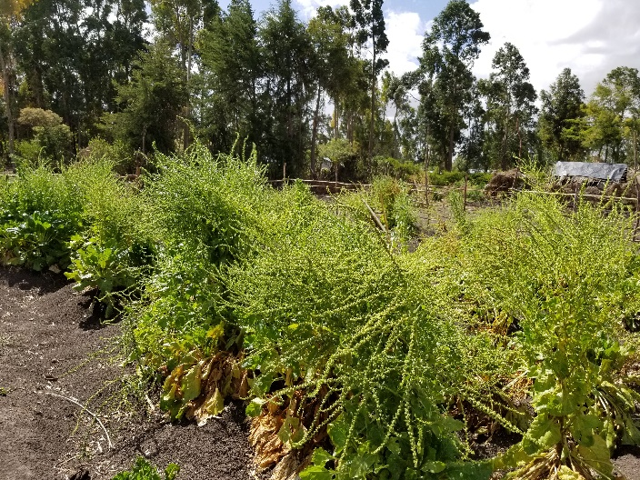
Challenges
Lack of good quality seeds of the improved forage options to facilitate wider scaling, Example - fodder beet
Unaffordable seed price– alfalfa- USD 35 per kg of seed
Competing use of forages- feeding at early stage rather than managing a portion for seed production
Wider scaling through DPs demand fund allocation
Lack of proper varietal release policy and seed certification?
Fodder beet seed production in Africa RISING site in Sinana, Ethiopia

Slide 8
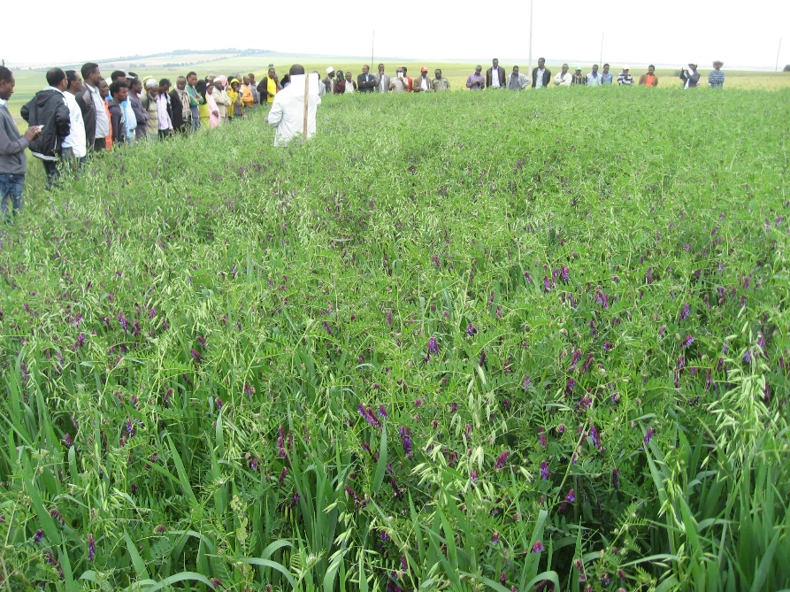
Livestock feed and forage management and utilization practices- Examples
Oat-vetch mixture provides high biomass yields (12 t ha⁻¹ of DM). It is a balanced diet in terms of protein and energy. Milk yield improvement as a result of supplementation: oat-vetch >50%

Slide 9
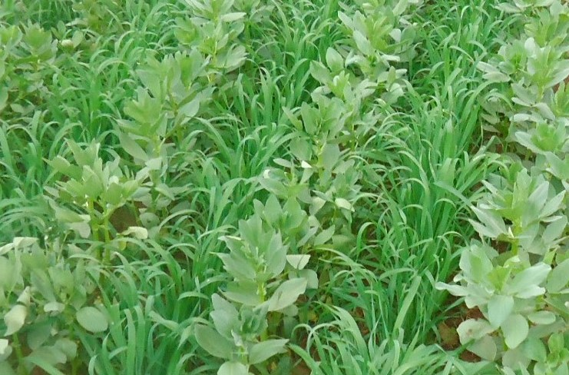
Oat-vetch mixture
Intercropping selected faba bean varieties with improved forage crops: The intervention provides both grain for the hh and feed for the hh’s livestock.

Slide 10
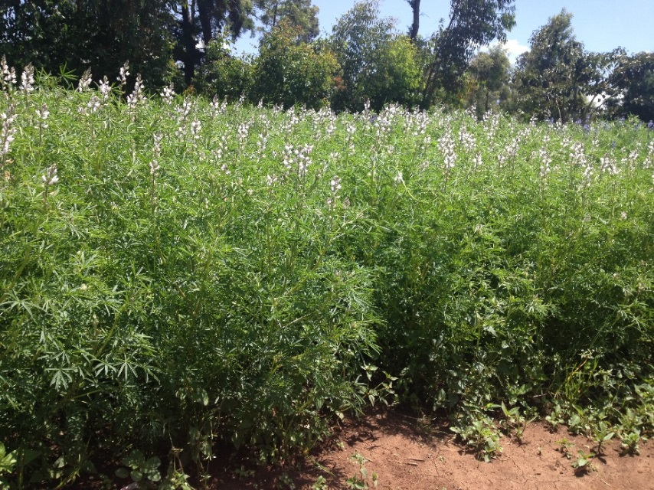
Sweet lupin: yields up to 3 t ha⁻¹ of grain and 8 t ha⁻¹ of haulm. Supplementation of 200 g of sweet lupine grain daily to fattening sheep results in a daily body weight gain of about 75 g.

Slide 11
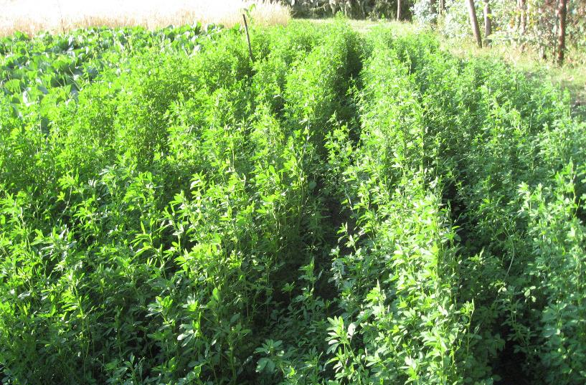
Alfalfa: biomass yield of 20 t DM ha⁻¹ can be obtained from 6 to 8 cuts under farmers’ fields and management conditions.

Slide 12
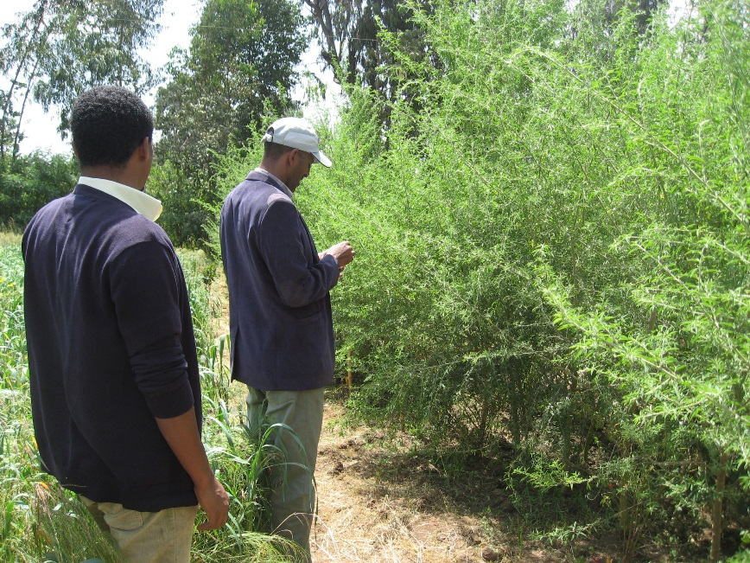
Tree Lucerne: produce more than 7 t ha⁻¹ of dry biomass year⁻¹. A 1 kg supplement of dried TL leaf feed to a lactating dairy cow can give up to 1.2 litres of extra milk.

Slide 13
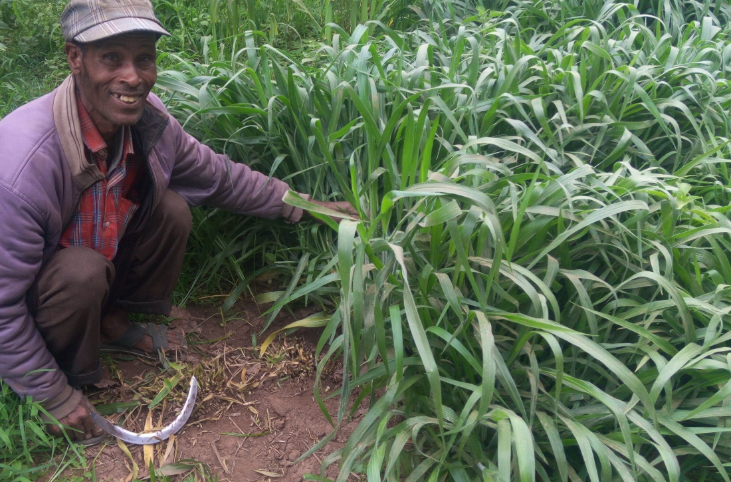
Brachiaria: produce 8.5 -10 t ha⁻¹ DM. Propagated by seed, cuttings and root split.

Slide 14
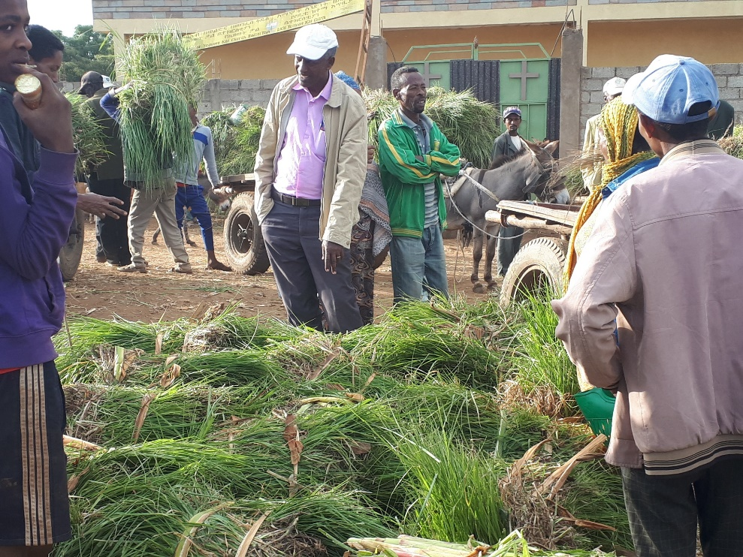
Desho grass: produce 4-5.5 t ha⁻¹ DM, harvesting can be done 3-4 times per year depending on the environment.

Slide 15
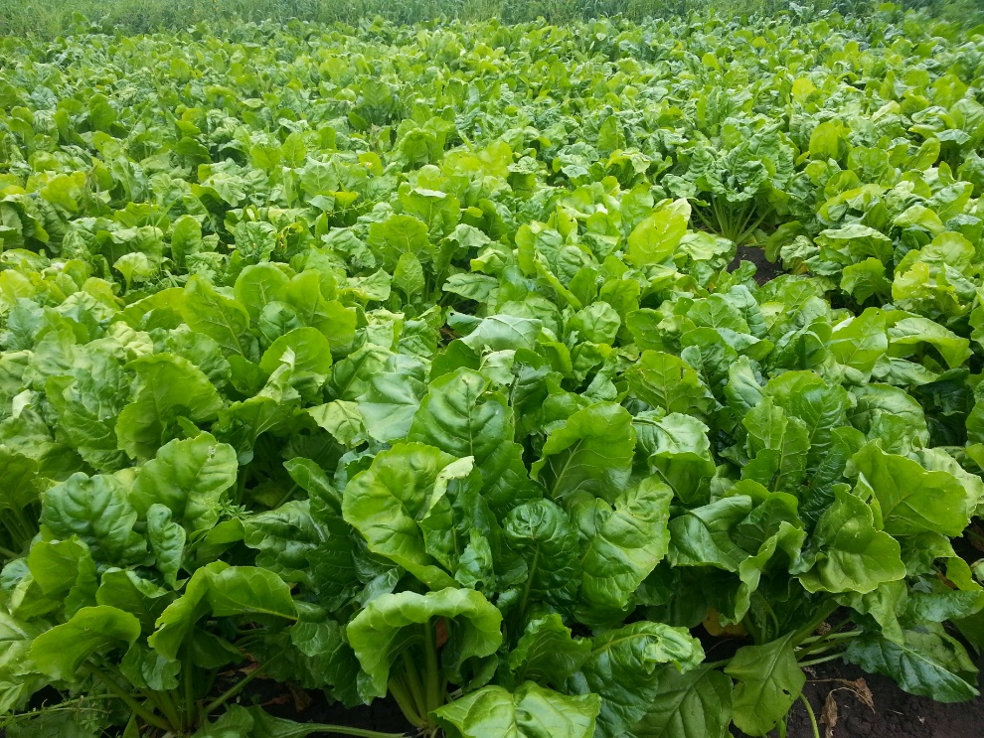
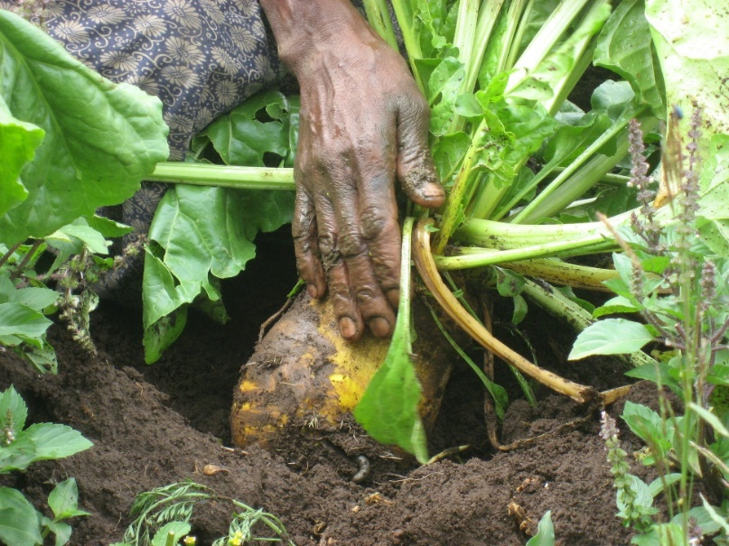
Fodder beet: high biomass yield= 20.2±5.26 t DM ha⁻¹. Milk yield improvement as a result of supplementation: up to 33%.

Slide 16
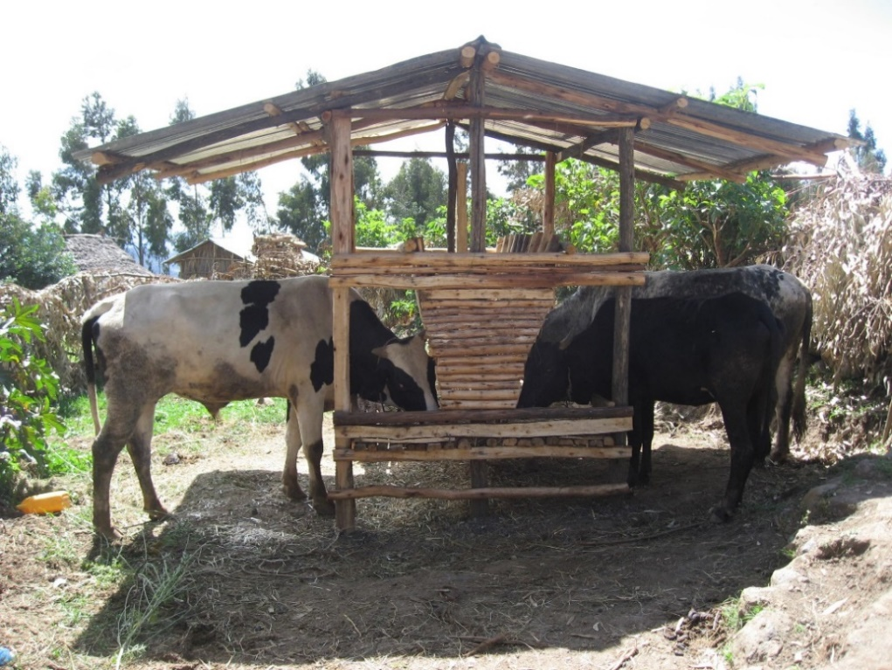
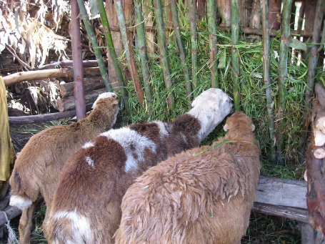
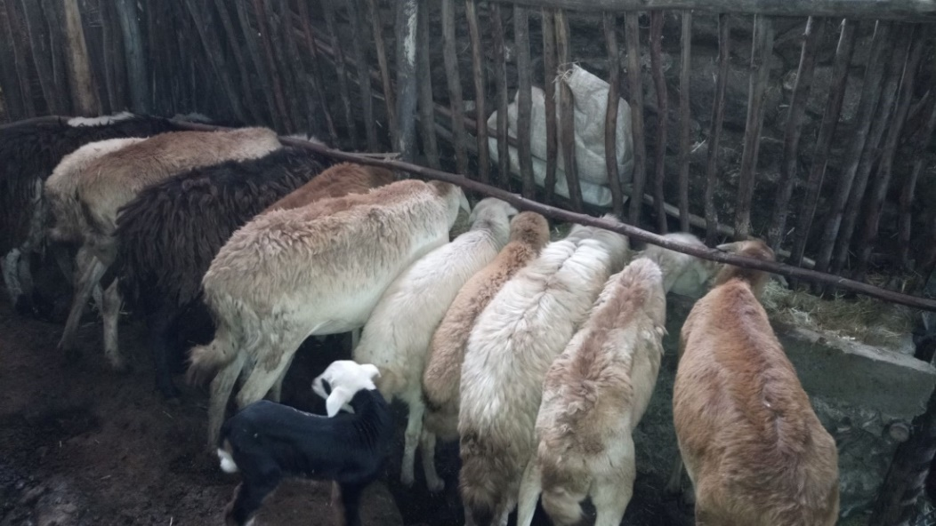
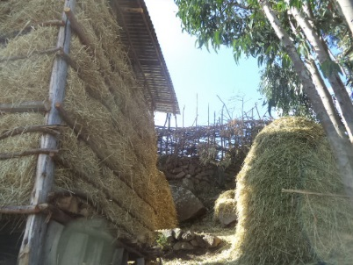
Feed trough and feed shed: reduce wastage (30-50 %), save 10-20% of labor time for feeding.

