Slide 1
Situating CGIAR’s Climate work within the broader Climate Change Science and Policy Landscape: CGSpace repository helps in synthesizing CGIAR’s research
Dr. Aditi Mukherji
Director, CGIAR Climate Change Impact Platform
30th August, 2023
ILRI Addis Campus (online)

Slide 2

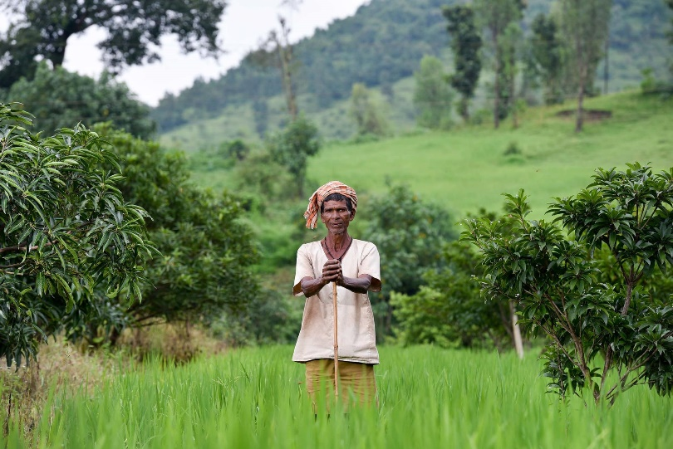





[Purpose] Climate Impact Platform: Bringing Together CGIAR’s Climate Research
Convene community of practice
CoP: CGIAR & Beyond
Deepen CGIAR and Partner Capacity
Facilitating research on gaps
Amplify external profile
Collaborate with leading climate voices
Advise portfolio level management and strategy
Track initiative outcomes
Primary Impact Area
Climate Adaptation & Mitigation

Slide 3
What are the climate imperatives identified by IPCC and what is CGIAR doing in those science and policy spaces?
Major insights from the IPCC AR6 assessment
Thematic classification of CGIAR’s climate work based on a quick analysis of 2022 PRMS (all on CG space)
400 climate =2 outputs
  70% reports and journal articles
CGIAR Climate Science serves three functions:
  Understanding impacts of CC
  Innovating/collating methods
  Providing solutions

Slide 4
Climate change basics: Humans are responsible, but not all are responsible equally
A.1 Human activities, principally through emissions of greenhouse gases, have unequivocally caused global warming, with global surface temperature reaching 1.1°C above 1850–1900 in 2011–2020.
Global greenhouse gas emissions have continued to increase, with unequal historical and ongoing contributions arising from unsustainable energy use, land use and land-use change, lifestyles and patterns of consumption and production across regions, between and within countries, and among individuals (high confidence). {2.1, Figure 2.1, Figure 2.2} IPCC SYR

Slide 5

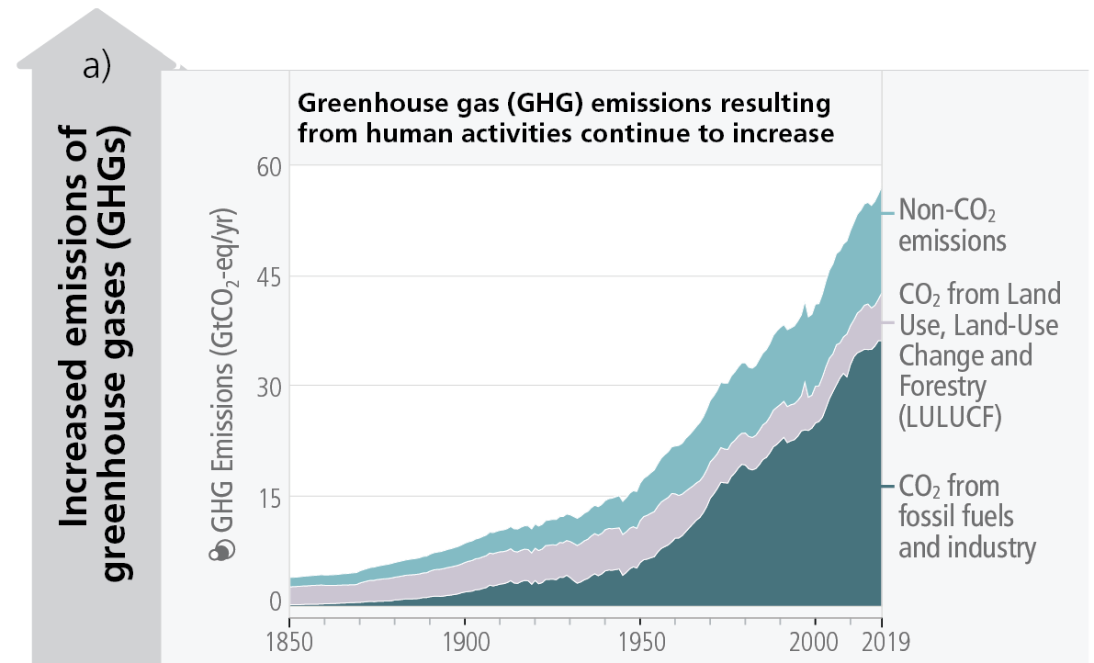
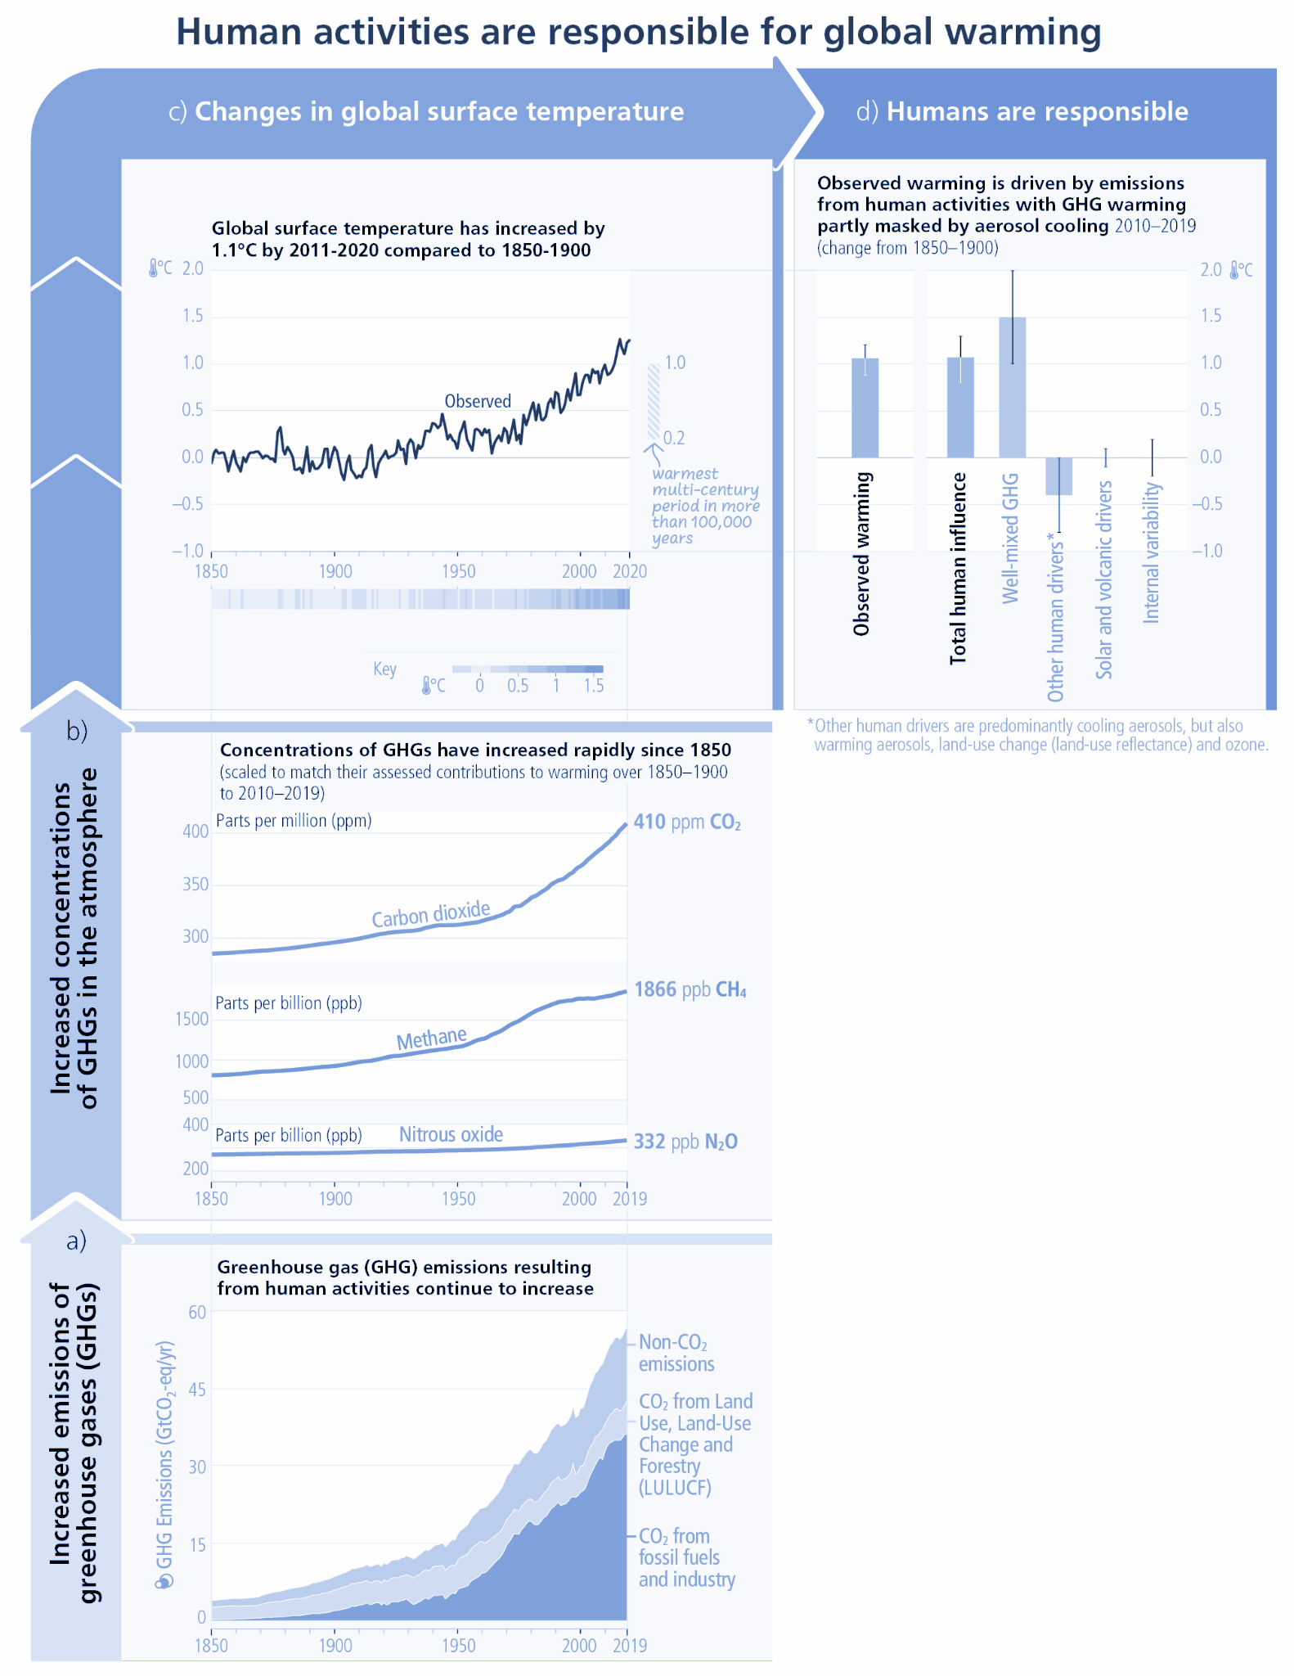
SIXTH ASSESSMENT REPORT
Human activities are responsible for global warming
IPCC AR6 SYR Figure 2.1a

Slide 6
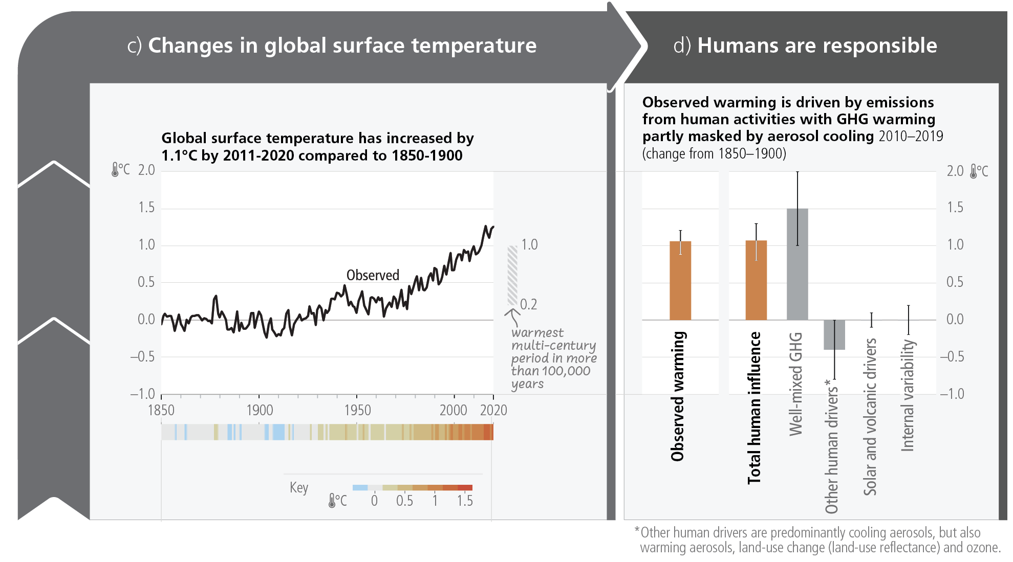
SIXTH ASSESSMENT REPORT
Human activities are responsible for global warming
IPCC AR6 SYR Figure 2.1c-d

Slide 7
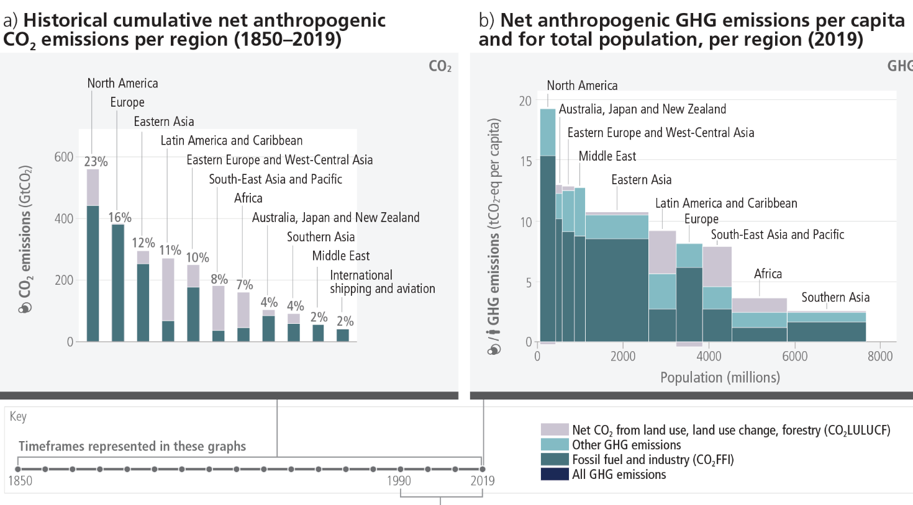
Emissions have grown in most regions but are distributed unevenly,
both in the present day and cumulatively since 1850
SIXTH ASSESSMENT REPORT
Global South countries where we work are where most of the agri-food systems originate from
IPCC AR6 SYR Figure 2.2a-b

Slide 8

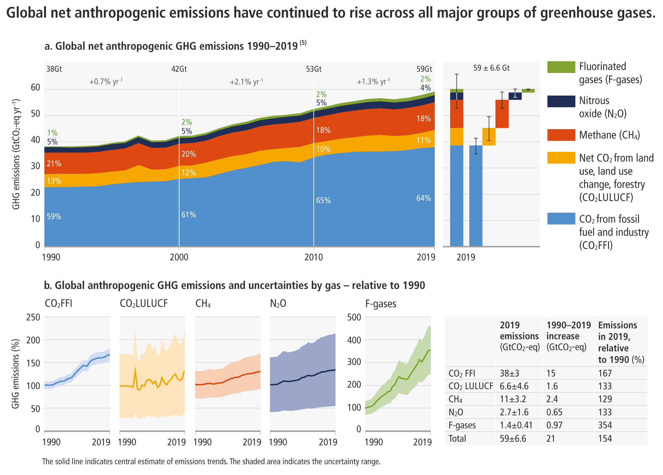
Emissions are at their highest level in human history and we are responsible
Agri-food sector
~30% of global
GHG emissions
[IPCC WGIII Figure SPM.1; Chapter 2, Figure 2.4; Chapter 12.4]
Notes:
In the next 20 minutes we will set out our key findings, showing where we are in terms of greenhouse gas emissions, where we are headed, and what action we can take to limit global warming.
[CLICK]
The reality is that greenhouse gas emissions, which are causing global warming, are at their highest levels in human history.
[NEXT SLIDE]

Slide 9
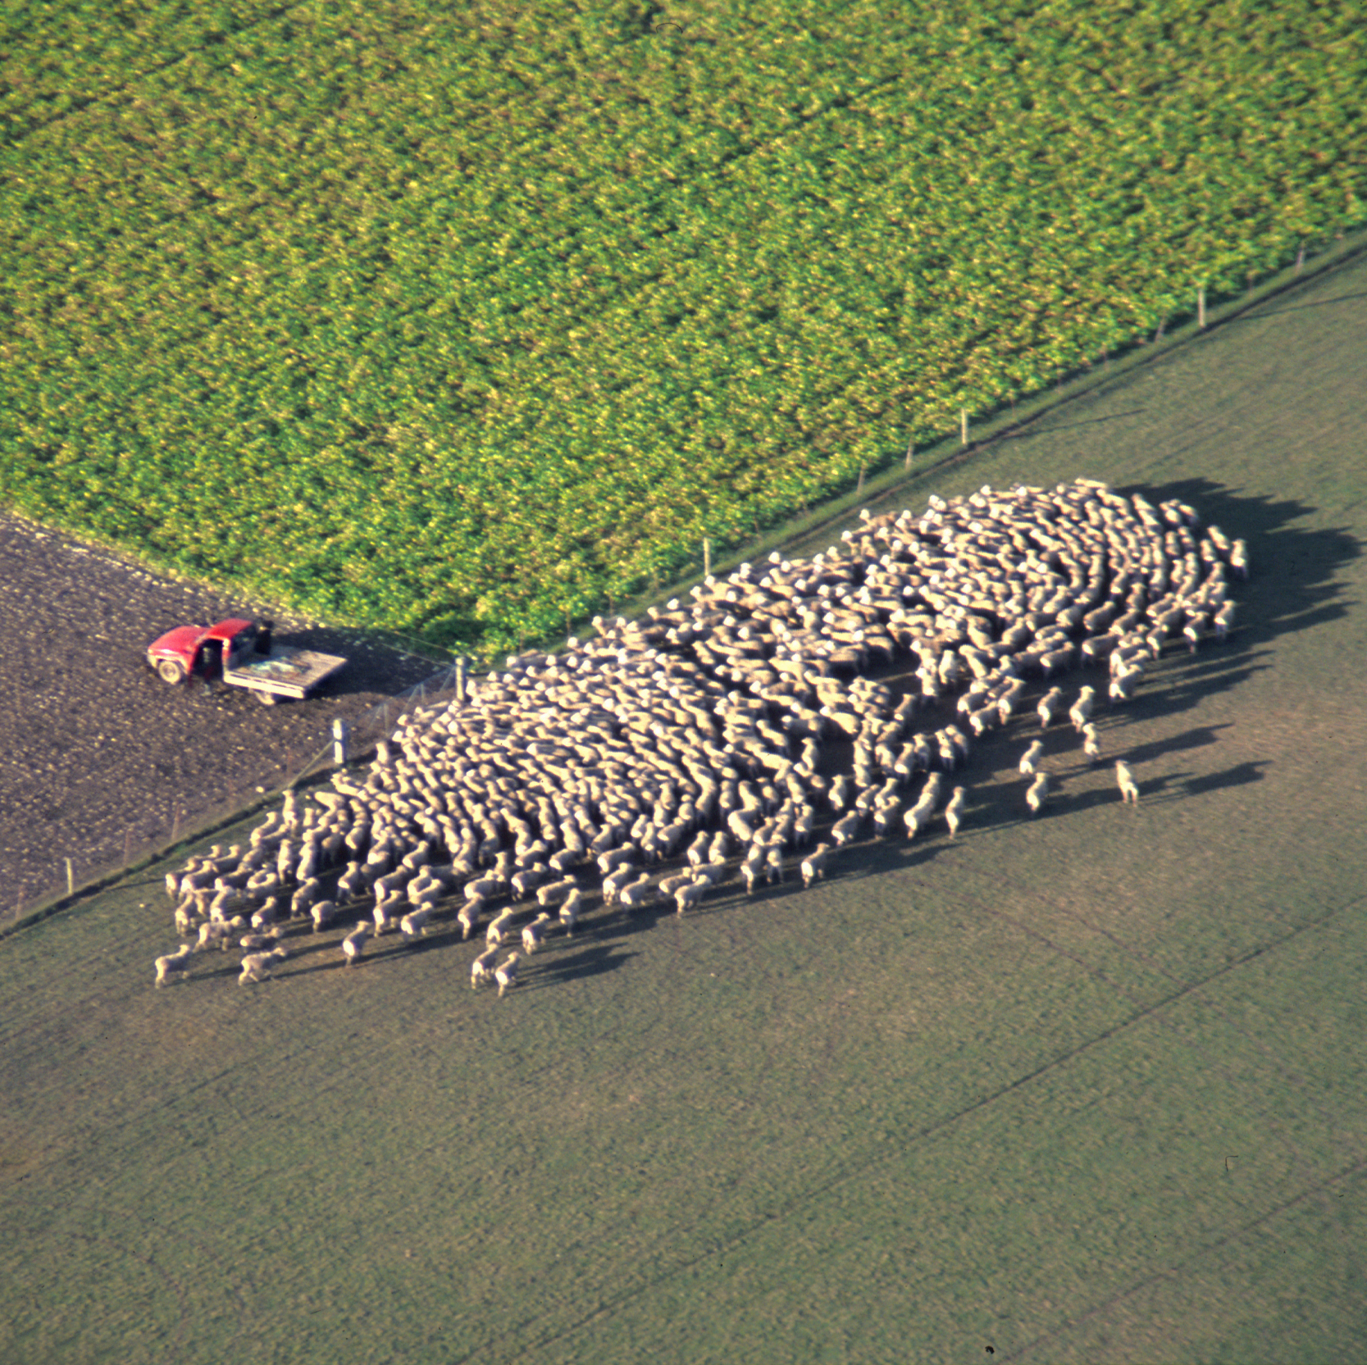
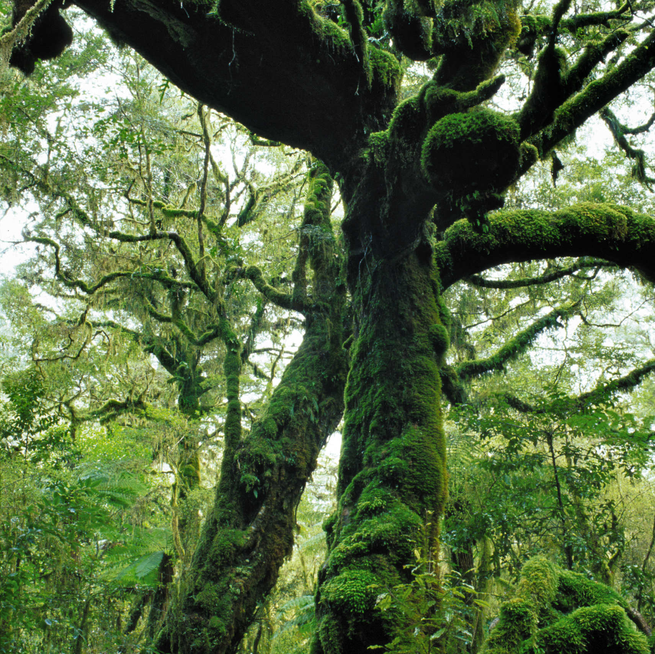
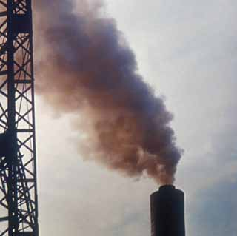
Agri-food system emission sources
Production, processing, distribution, consumption of food and management of food system residues; estimated 23-42% of all global GHG emissions
  Agriculture
Direct emissions from livestock and crop production systems; 6.3 Gt CO₂-eq
  Land-use change
Land use, land-use change and forestry, including peatland drainage; 4.0 Gt CO₂-eq
  Energy, industry, waste
Processing, transport, storage, preparation, food waste;
6.5 Gt CO₂-eq
The share of energy, industrial process and waste emissions occurring as part of the food system has grown from ~28% in 1990 to ~38% in 2018
WGIII Chapter 12.4

Slide 10
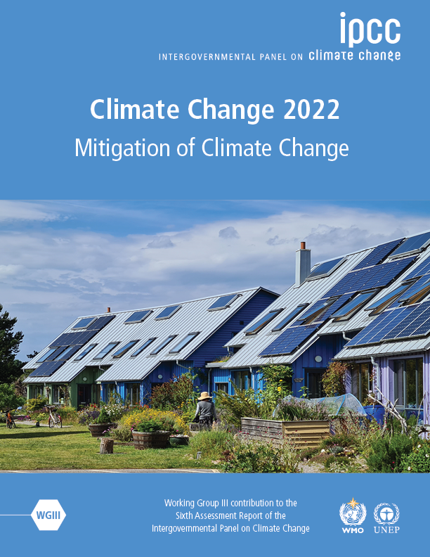
Unless there are immediate and deep emissions reductions across all sectors (including agri-food systems), 1.5°C is beyond reach.
[Matt Bridgestock, Director and Architect at John Gilbert Architects]
Notes:
In the next 20 minutes we will set out our key findings, showing where we are in terms of greenhouse gas emissions, where we are headed, and what action we can take to limit global warming.
[CLICK]
The reality is that greenhouse gas emissions, which are causing global warming, are at their highest levels in human history.
[NEXT SLIDE]

Slide 11
However, stringent mitigation to keep within 1.5-2°C will lead to severe food insecurity in Sub Saharan Africa and South Asia
Robust finding is that by 2050, stringent climate mitigation
policy, if implemented evenly across all sectors and regions,
would have a greater negative impact on global hunger and
food consumption than the direct impacts of climate change
Hasewaga et al. Nature Climate Change, 2018
https://www.nature.com/articles/s41558-018-0230-x#citeas
Land based mitigation actions like energy crop expansion,
non-CO2 emissions reduction in agricultural sector and
afforestation lead to lowered availability of calories,
increase in population at risk of hunger,
higher agricultural commodity prices
Fujimori et al. 2023, Nature Food
https://www.nature.com/articles/s43016-022-00464-4#citeas

Slide 12
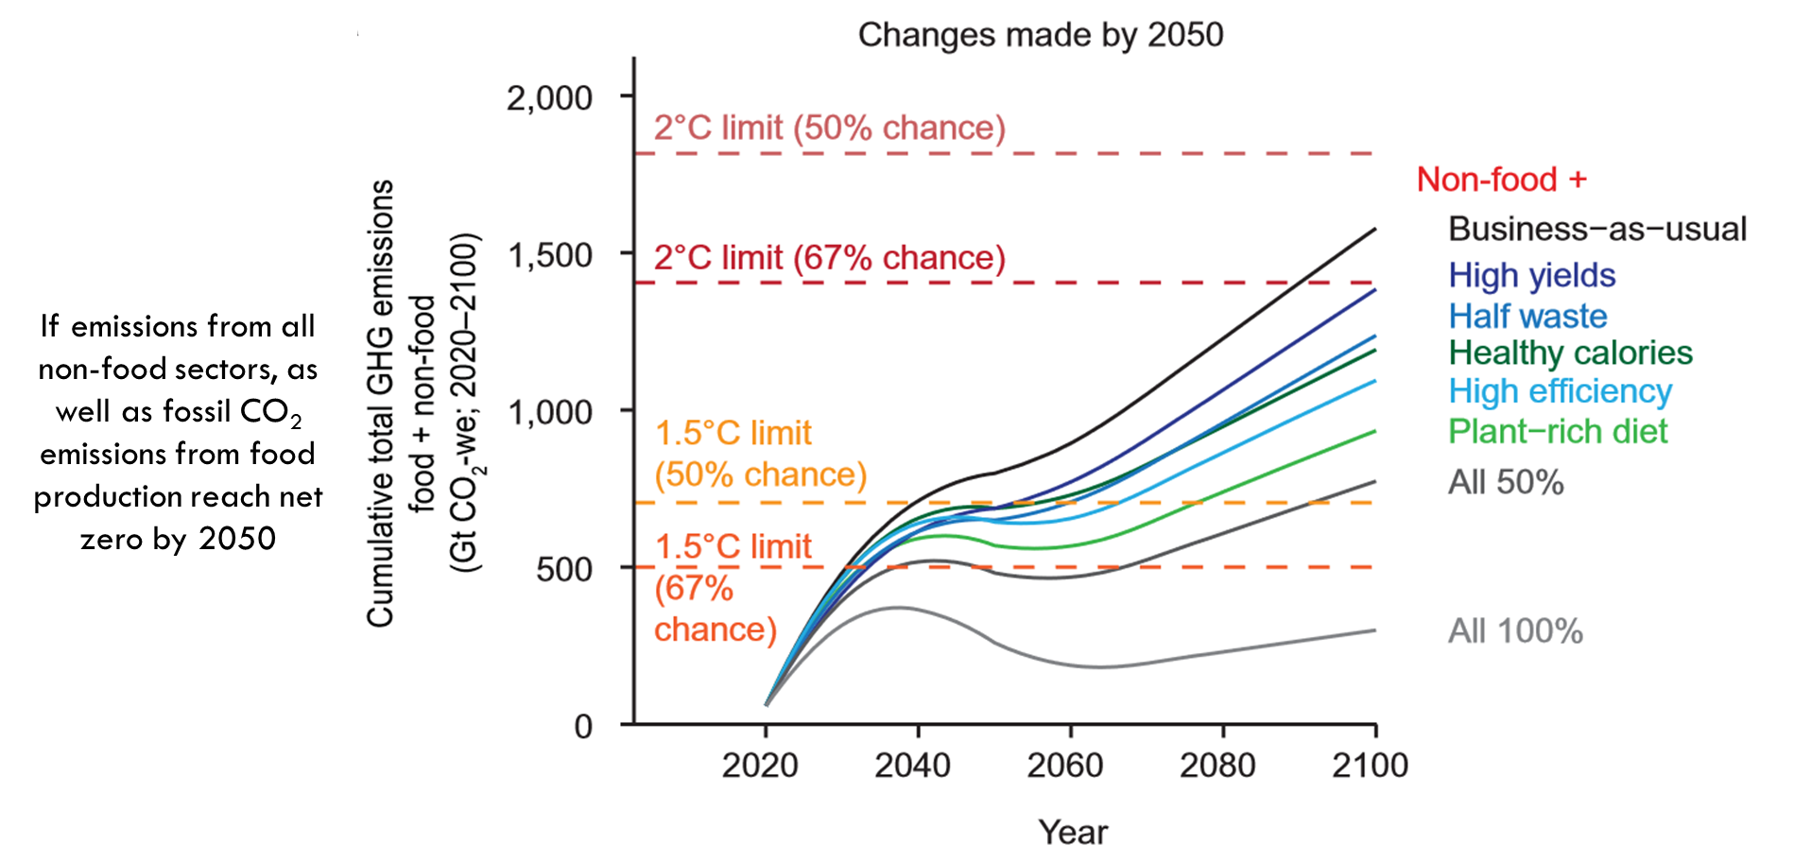
Global food system emissions could preclude achieving the 1.5° and 2°C climate change targets
https://www.science.org/doi/abs/10.1126/science.aba7357

Slide 13
We have a catch-22 situation here
Mitigate we must to keep global warming levels within Paris agreed goals of 1.5 to 2ºC to keep the climate impacts at its minimum (we come to the impacts in a moment).
But mitigation at needed scale will lead to hunger and food insecurity for people in the Global South who CGIAR works for:
CGIAR can play a very important role in solving this Catch-22 situation by working collectively towards:
“Just transitions in agri-food sector”

Slide 14
What is CGIAR doing in the mitigation space?
Ways of measuring emissions (22 outputs) Methods
Livestock enteric methane emissions
Reducing emissions (20 outputs)
Solutions
From Livestock
From Rice: AWD
Others
Agroforestry and forests
Rice: Methane, NoX
Pastoral and silvopastoral systems
Others
AFOLU MRV and carbon credits
Economic feasibility
From fertilisers
From water use/irrigation
Carbon credits
Source: Analysis using PRMS/CGSpace 2022

Slide 15
Current warming of ~1.2°C has widespread impacts on natural and human systems; with disproportionate impacts on those who have emitted the least
A.2 Widespread and rapid changes in the atmosphere, ocean, cryosphere and biosphere have occurred. Human-caused climate change is already affecting many weather and climate extremes in every region across the globe.
This has led to widespread adverse impacts and related losses and damages to nature and people (high confidence).
Vulnerable communities who have historically contributed the least to current climate change are disproportionately affected (high confidence). {2.1, Table 2.1, Figure 2.2 and 2.3} (Figure SPM.1) IPCC SYR

Slide 16
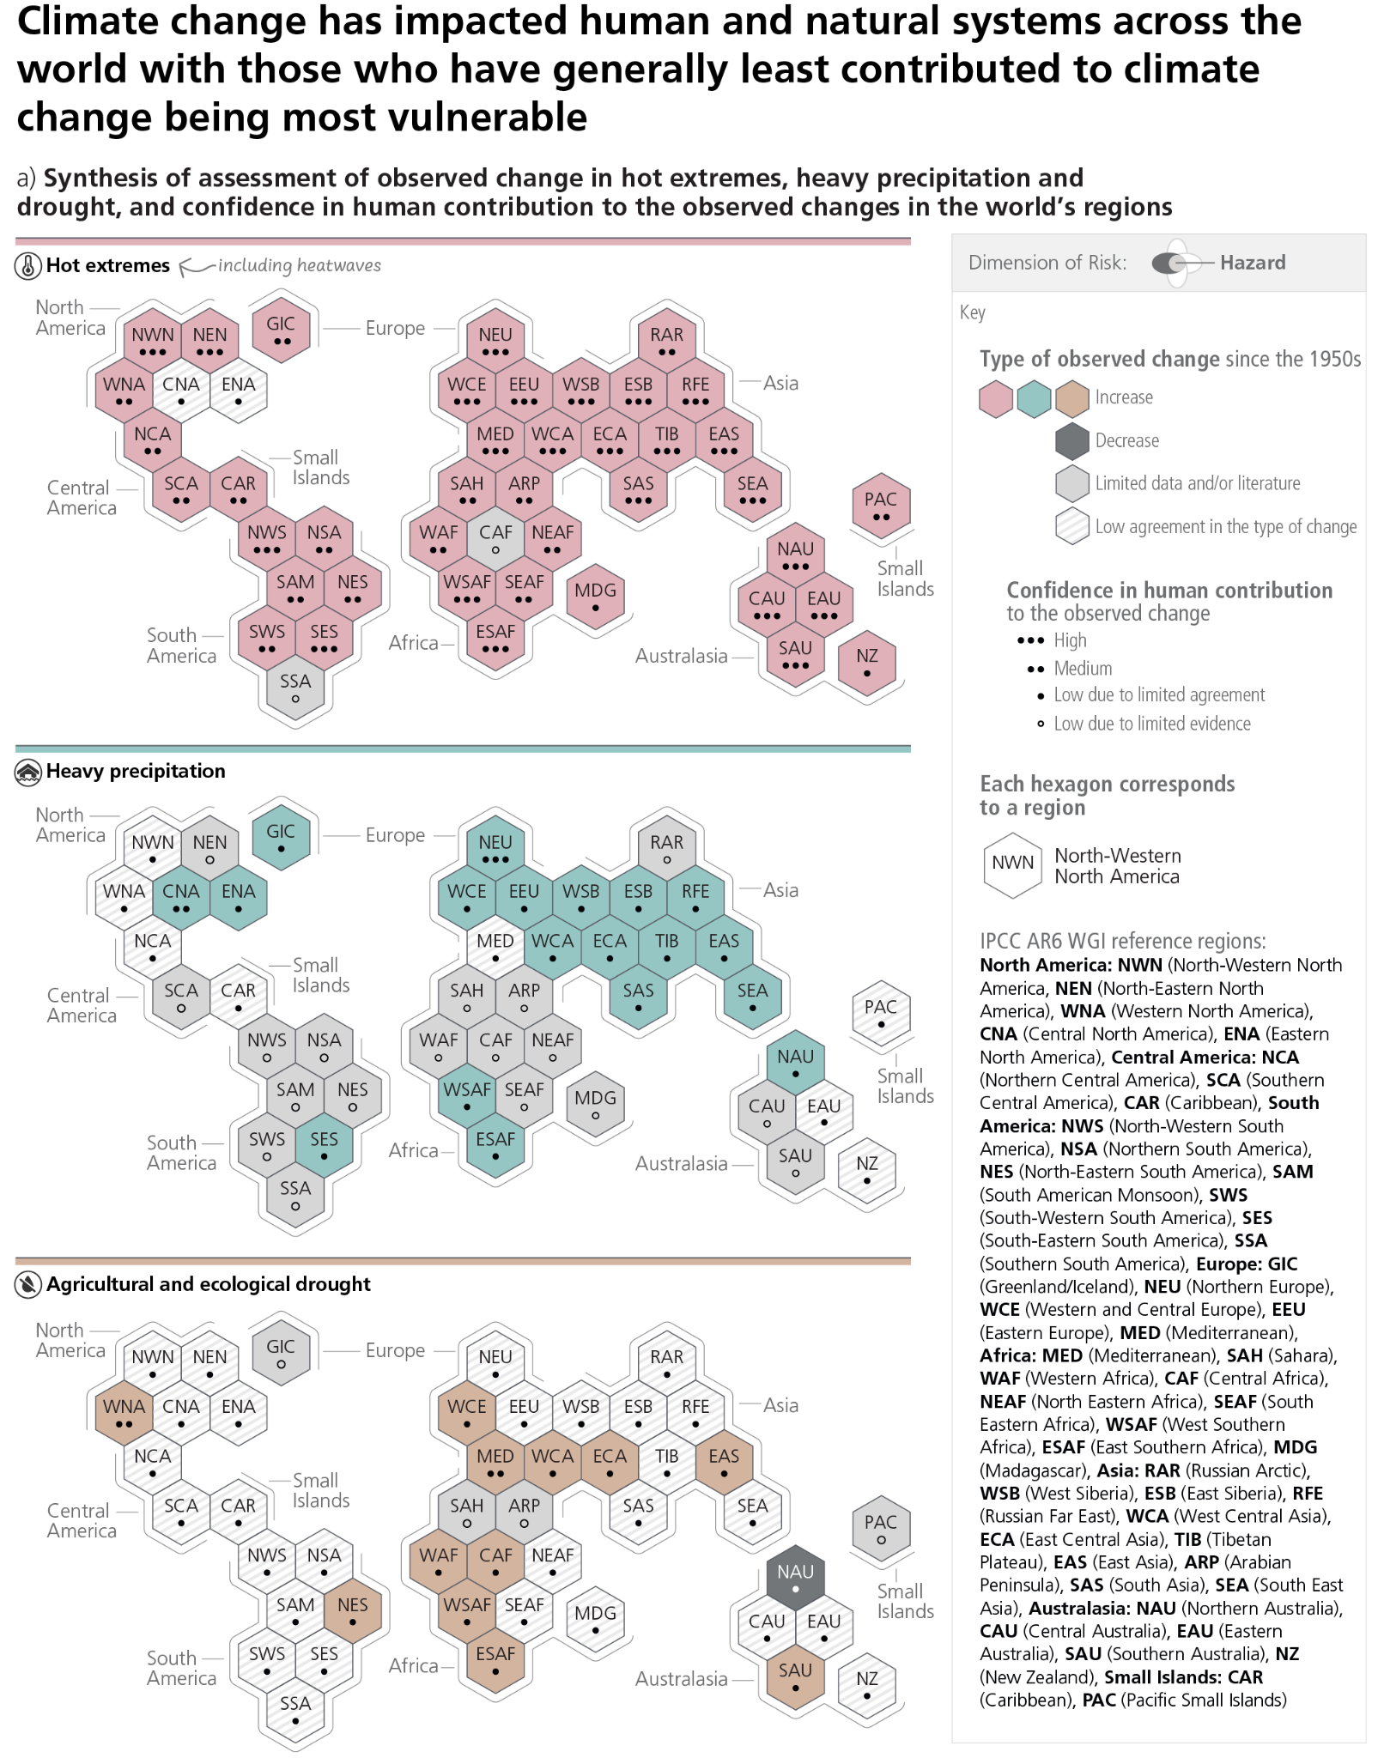
SIXTH ASSESSMENT REPORT
Hot extremes including heat waves have increased on most places on earth
since 1950s
Is CGIAR looking at impacts of heat stress on crops, livestock, and livelihoods? Not a lot is what my cursory look at CGSpace tells me
IPCC AR6 SYR Figure 2.3a

Slide 17
SIXTH ASSESSMENT REPORT
Heavy precipitation has increased in many places since 1950s.
Is CGIAR looking at impacts of heavy precipitation on crops, livestock, and livelihoods? Yes
Grey data scarce areas are where we work. Can we make those regions less data scarce? Can we curate all that CGIAR does in those grey regions?
IPCC AR6 SYR Figure 2.3a

Slide 18
SIXTH ASSESSMENT REPORT
Agricultural and ecological drought has increased in many places since 1950s
Is CGIAR looking at impacts of droughts on crops, livestock, and livelihoods? Yes, a lot of our work is on droughts – drought resilient seeds, drought forecasting, drought insurance. CGSpace repository can help us tell this story in a compelling manner.
IPCC AR6 SYR Figure 2.3a

Slide 19
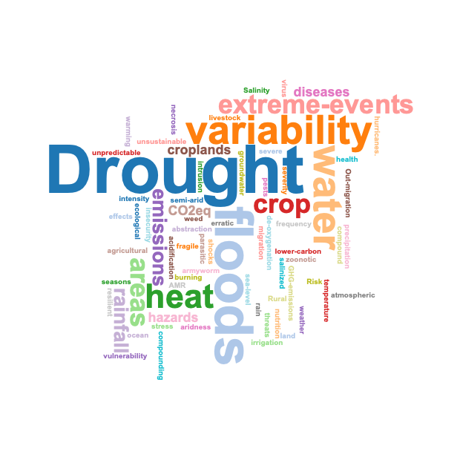
A word cloud on hazards that Initiatives are tackling
Source: Text analysis based on ToC of initiatives and written answers by Initiatives

Slide 20
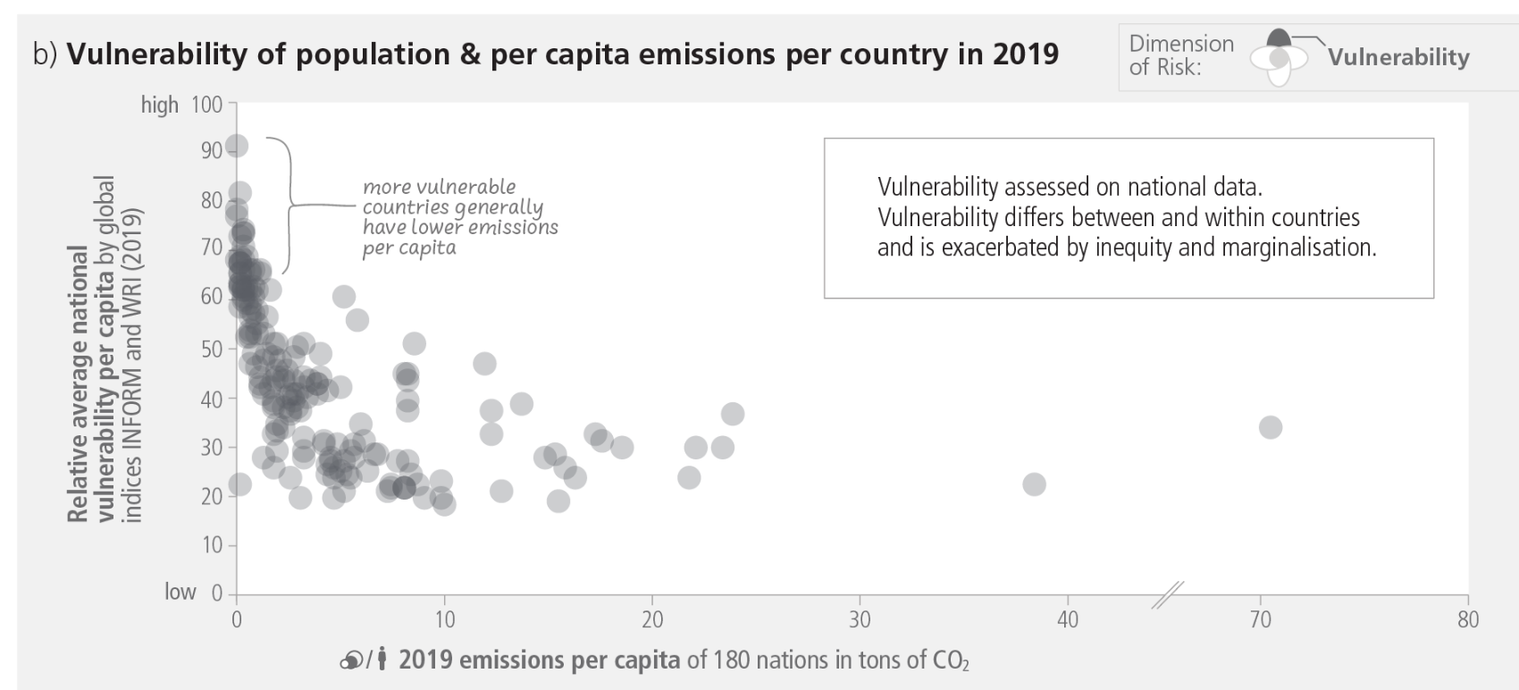
SIXTH ASSESSMENT REPORT
People and regions that are seeing the most impacts of climate change
have also emitted the least. Those are the countries we mostly work in
Is CGIAR looking at Climate Justice? Not really. Loss and Damage in Agri-food systems is an area we should engage in– what’s there in CGSpace on Loss and Damage?
IPCC AR6 SYR Figure 2.3b

Slide 21
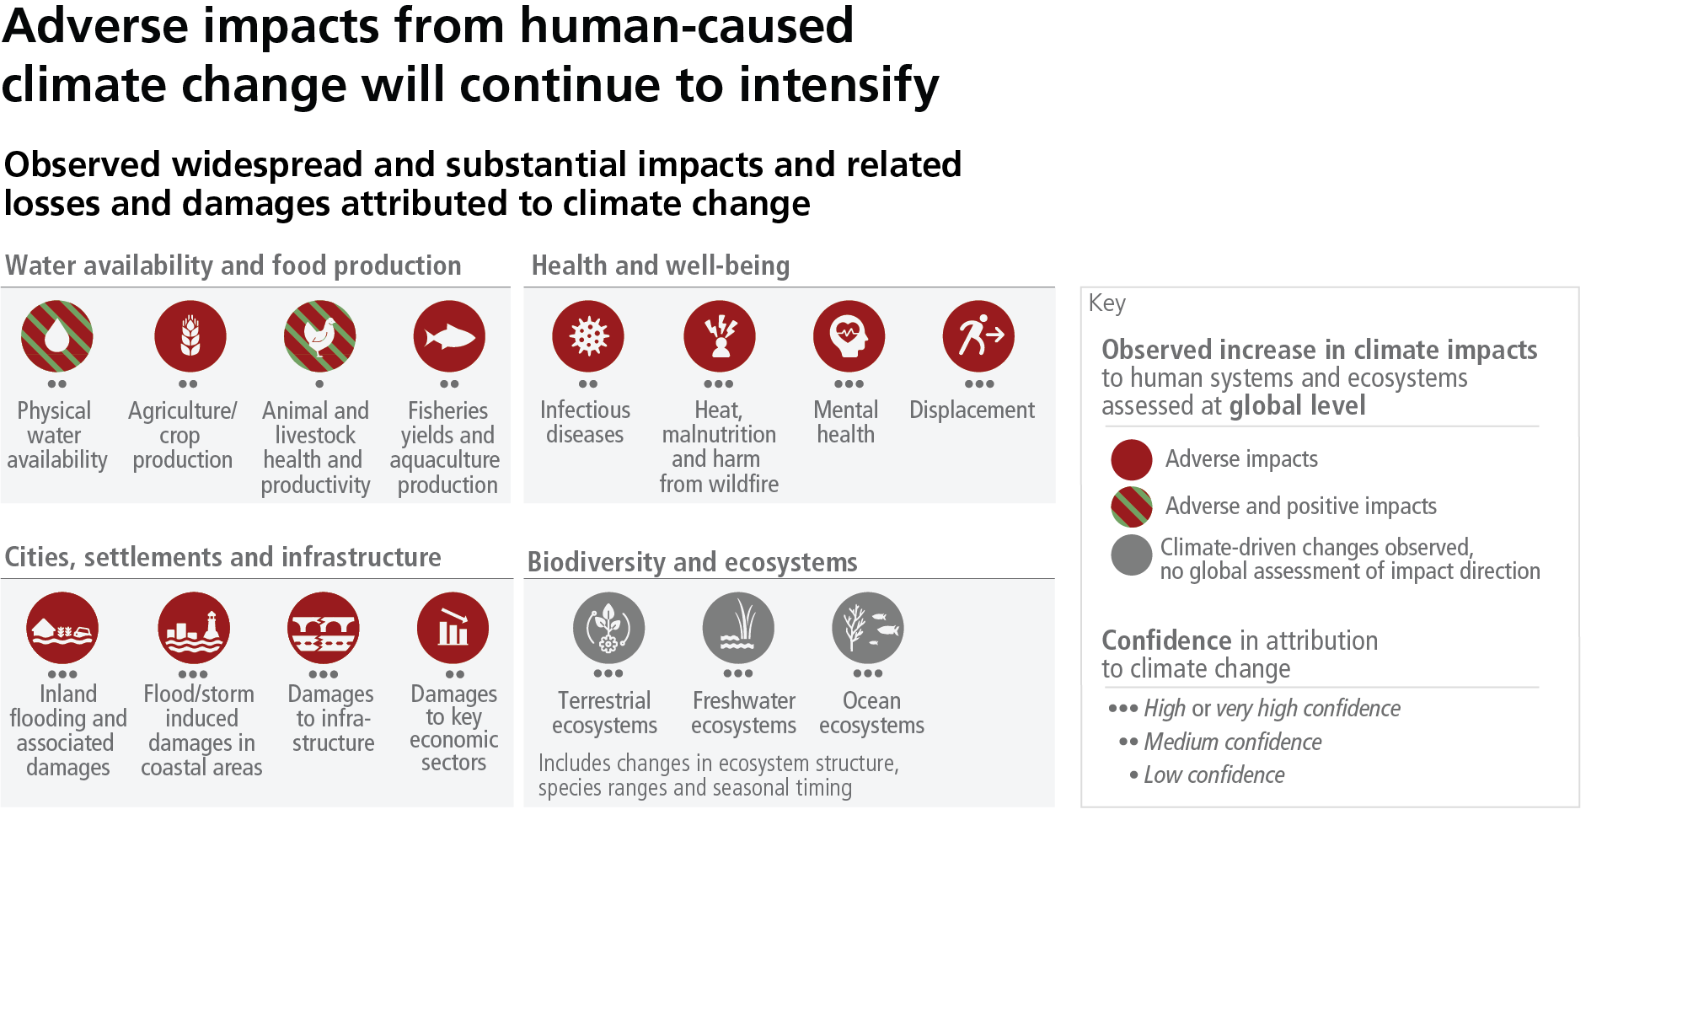
SIXTH ASSESSMENT REPORT
CGIAR looks at impacts of Climate Change on Water, Crops, Livestock, Fisheries (?), diseases and pests for plants and animals; impacts of flooding: What’s there on each of these on the CG Space?
IPCC AR6 SYR Figure SPM.1a

Slide 22
What is CGIAR doing in the climate impact space?
Impacts due to climate change
(n=62)
On food systems, crops, livestock and fish: production, productivity, nutrition content, diseases and agricultural outcomes: Wheat, Rice, Chickpea, livestock feed availability (n=18)
On climate security, including migration (n=11)
On natural systems: forests, soils, hydrometeorological extremes, groundwater recharge (n=18)
On human systems including gender: Livelihoods, pastoral systems, gendered impacts (n=15)
Source: Analysis using PRMS 2022/CGSpace

Slide 23
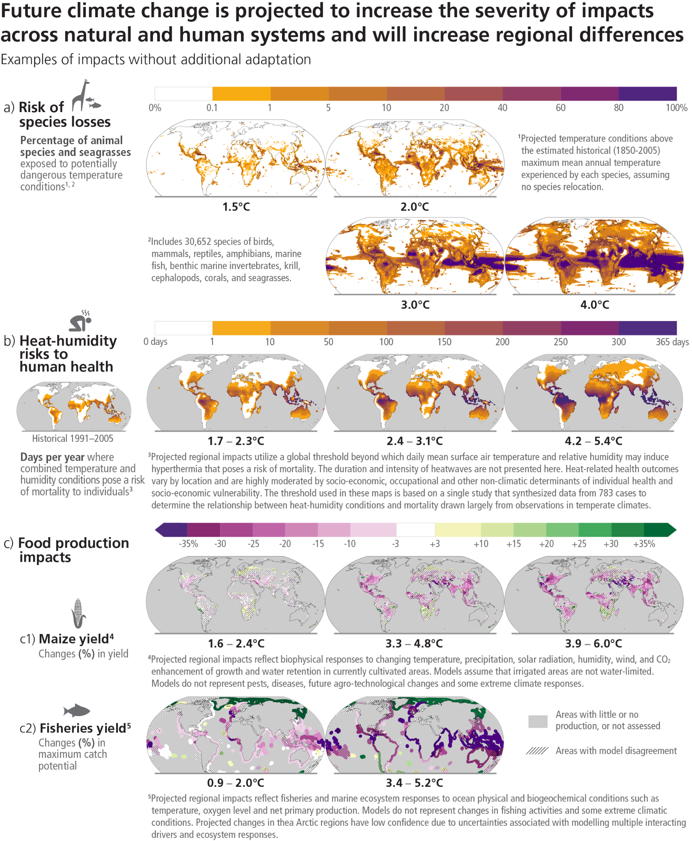
SYR Figure SPM.3
Future climate change is projected to increase the severity of impacts across natural and human systems and will increase regional differences
SIXTH ASSESSMENT REPORT

Slide 24
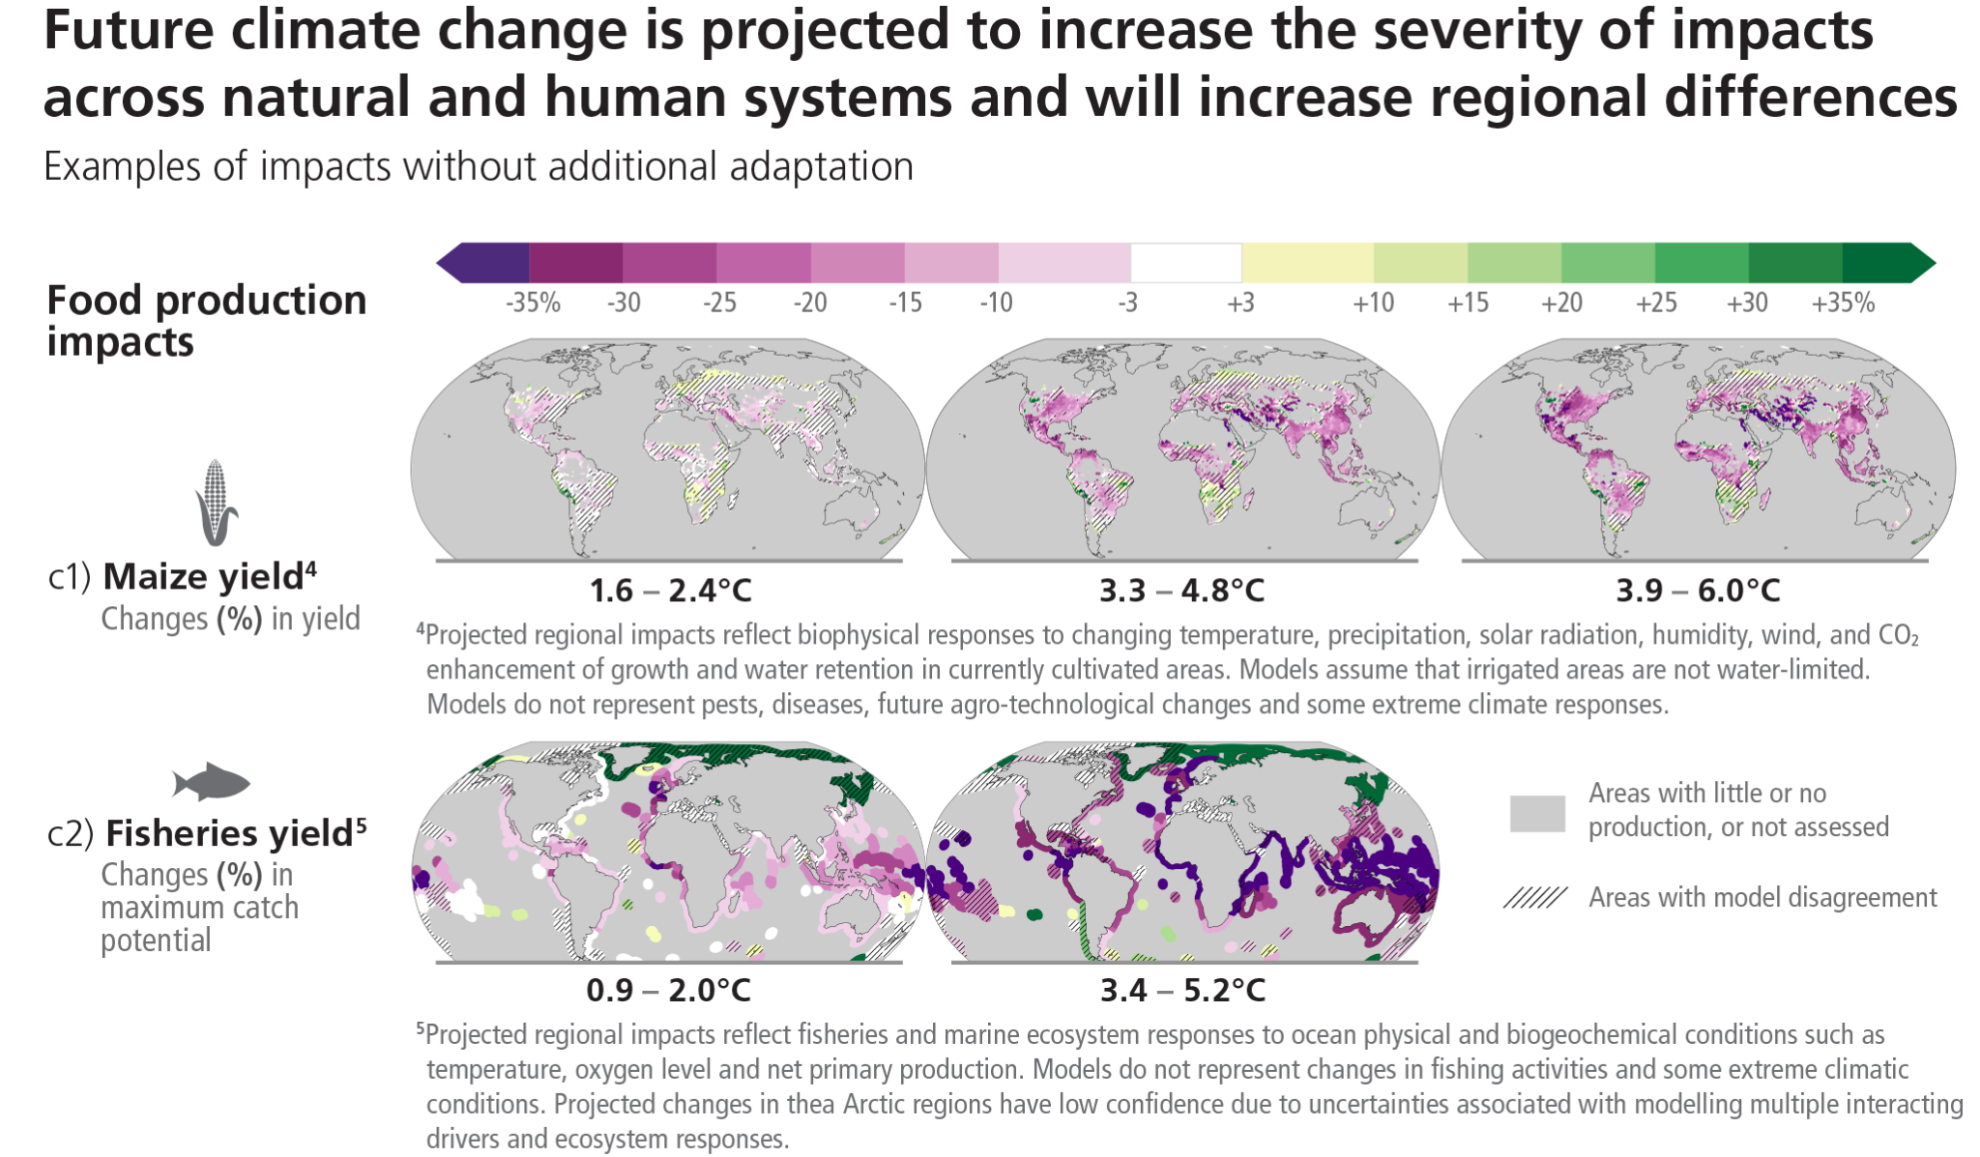
SIXTH ASSESSMENT REPORT
Does CGIAR work in the space of future impacts of climate change on agri-food systems? Not sure from 2022 data. What’s there on CGSpace?
IPCC AR6 SYR Figure SPM.3c

Slide 25
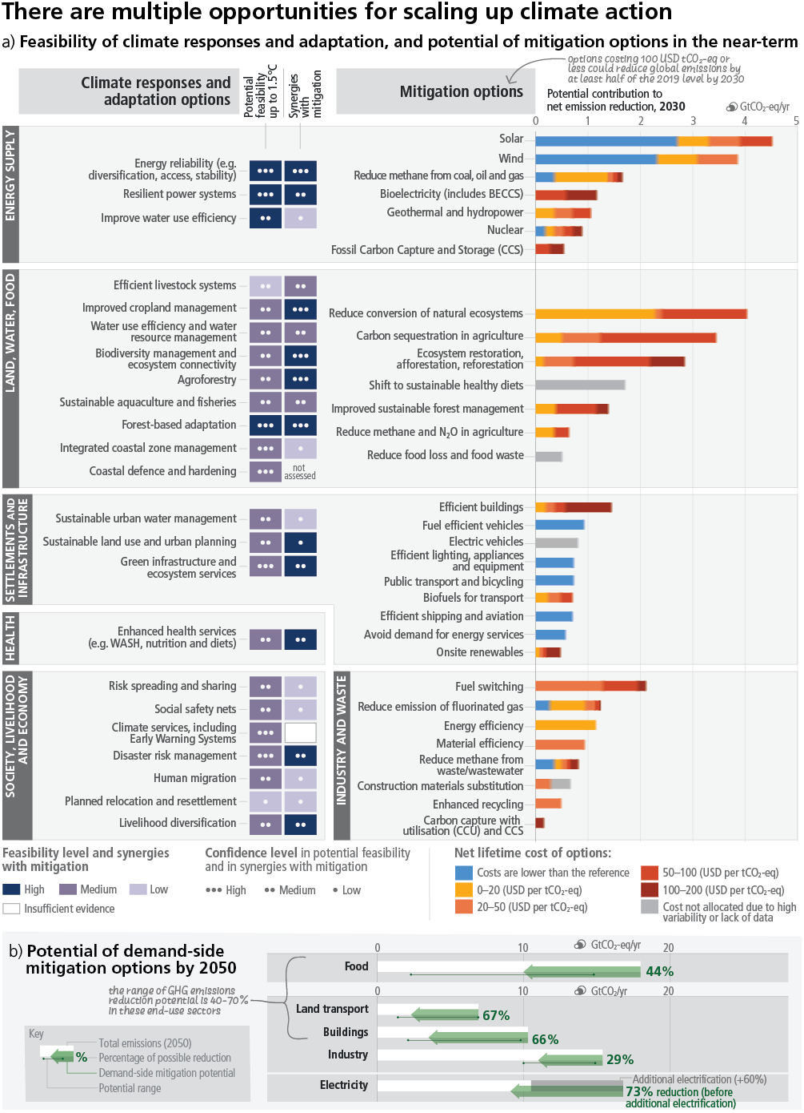
SYR Figure SPM.7
There are multiple opportunities for scaling up
climate action
SIXTH ASSESSMENT REPORT
Credit

Slide 26
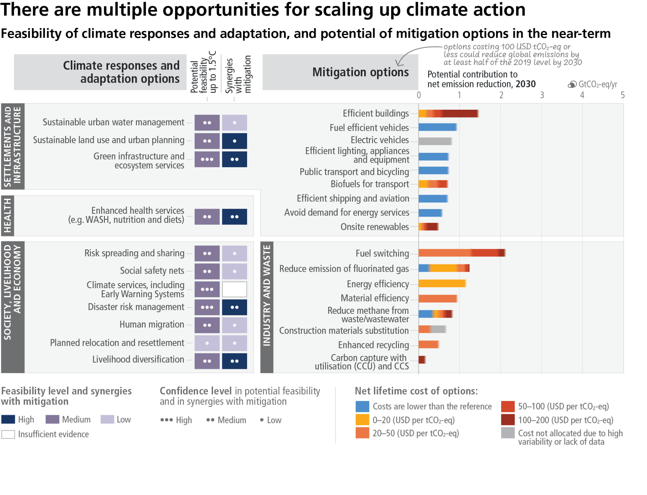
SIXTH ASSESSMENT REPORT
CGIAR works on all adaptation responses circled above, from CGSpace, we can get more concrete evidence
IPCC AR6 SYR Figure SPM.2c

Slide 27
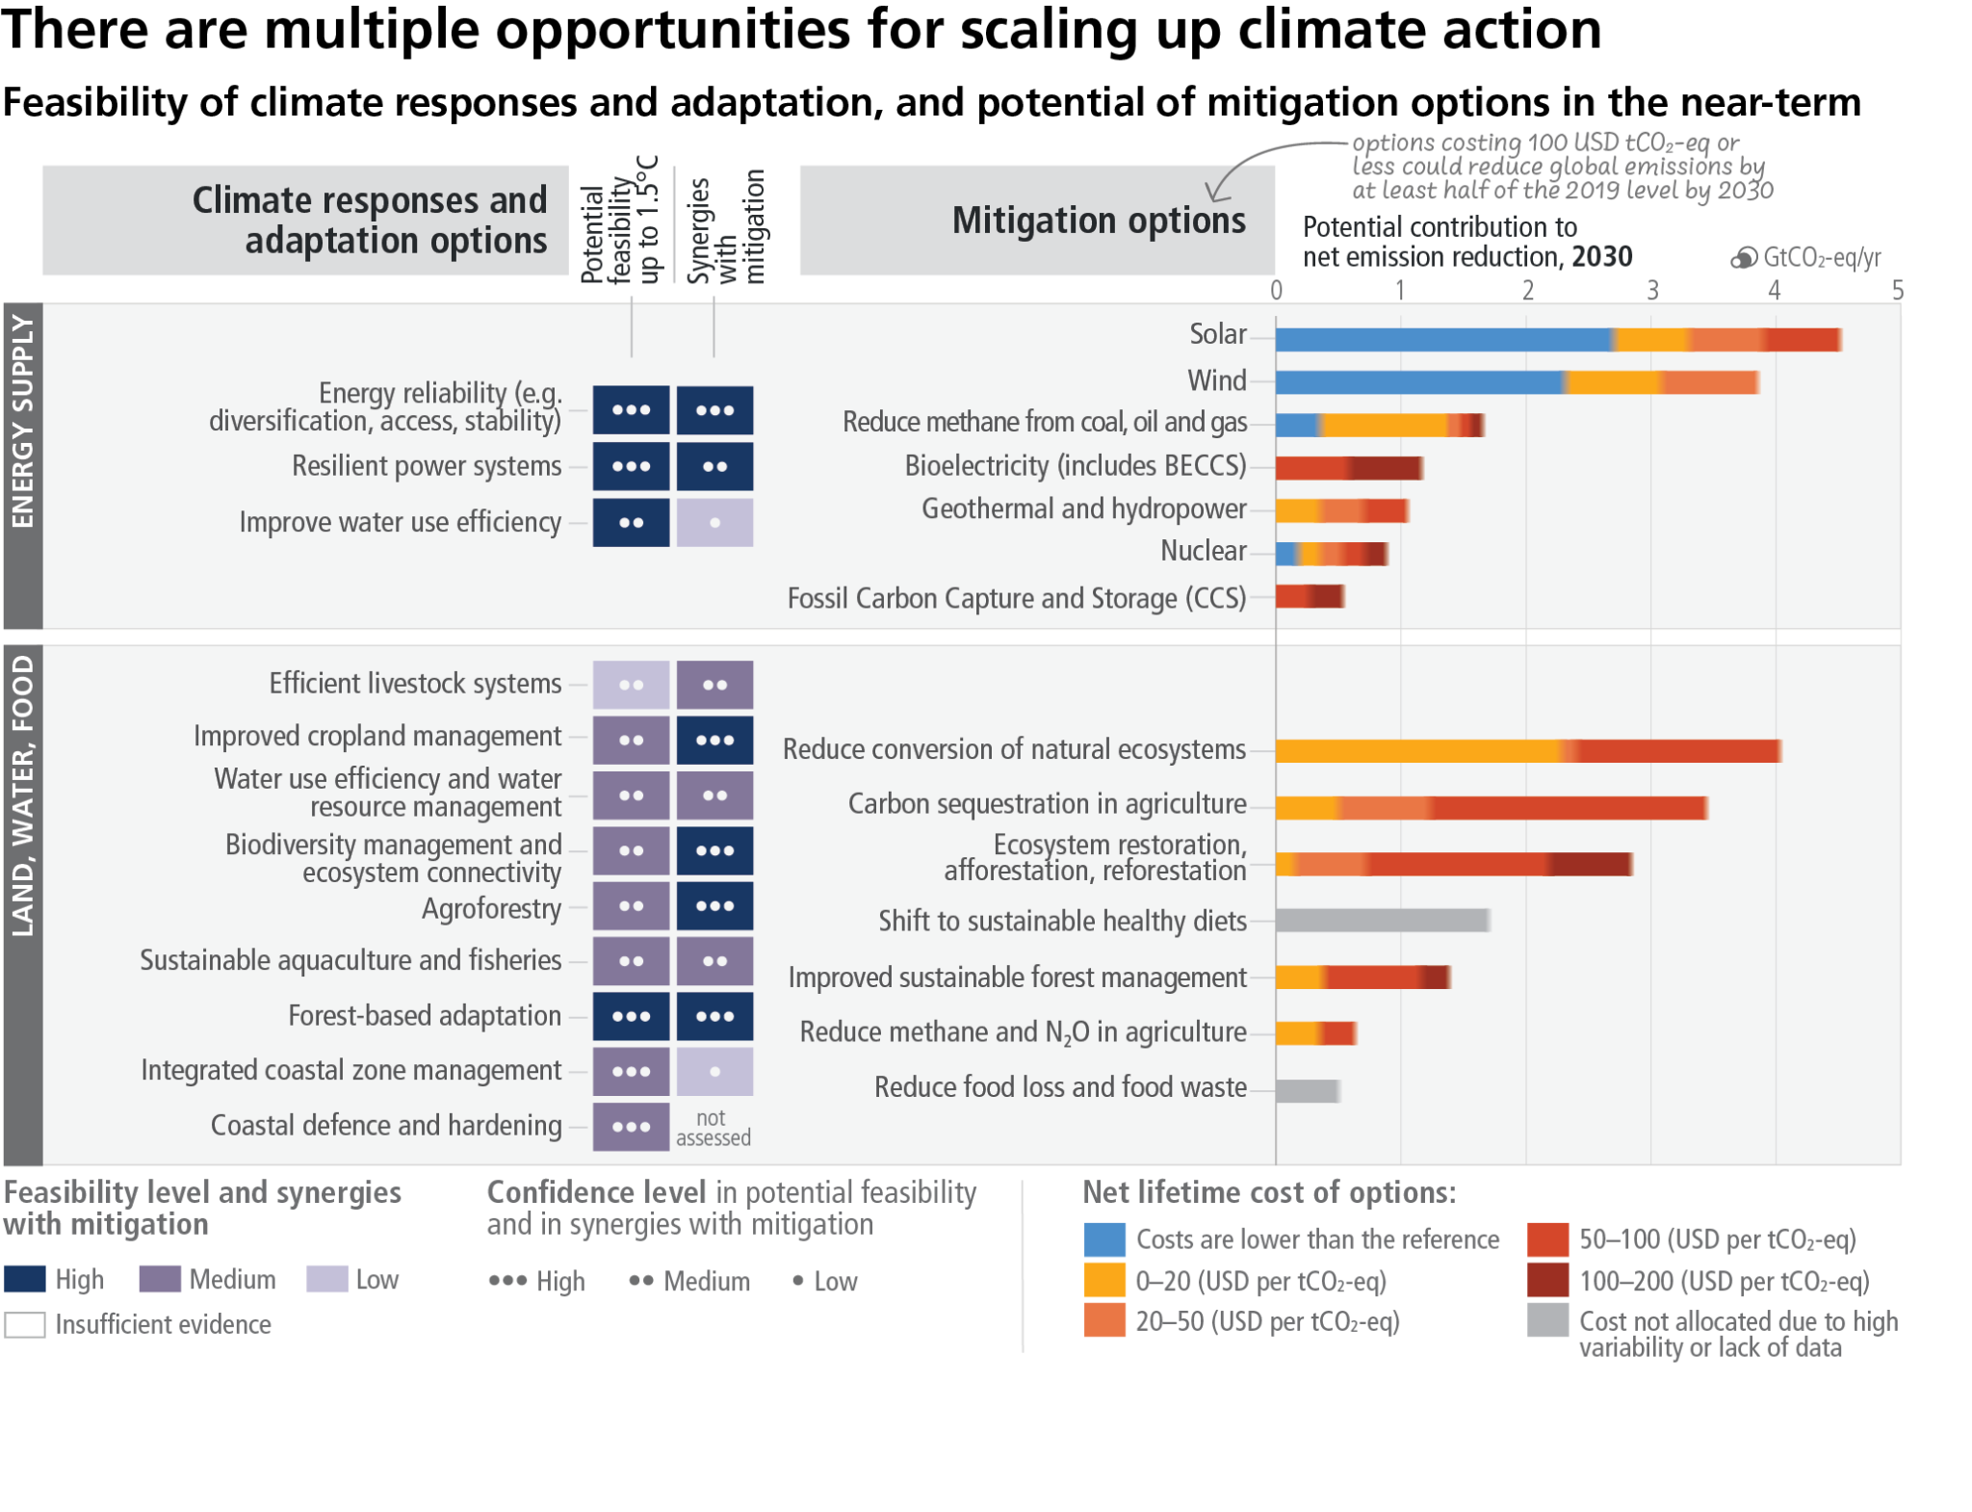
SIXTH ASSESSMENT REPORT
CGIAR works on all/most adaptation responses and mitigation measures circled above above
IPCC AR6 SYR Figure SPM.2c

Slide 28
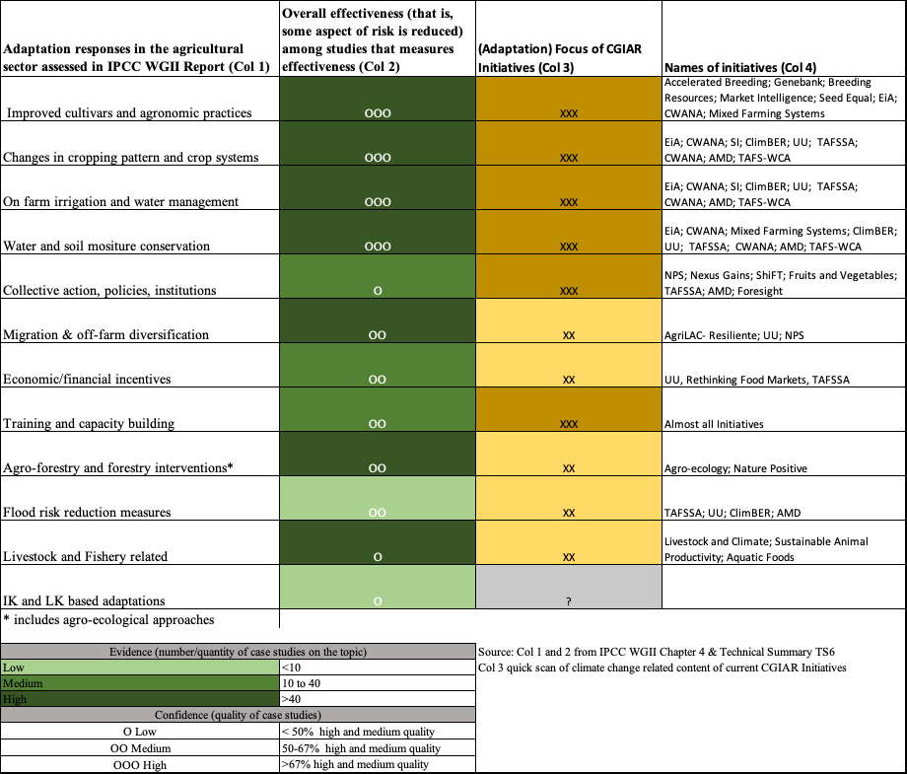
A snapshot of climate & adaptation focus of 33 current CGIAR Initiatives
Various initiatives are working on the major adaptation options highlighted by the IPCC Report
Are they transformative enough?
Are we able to measure the effectiveness of adaptation in reducing climate risks?
13
13

Slide 29
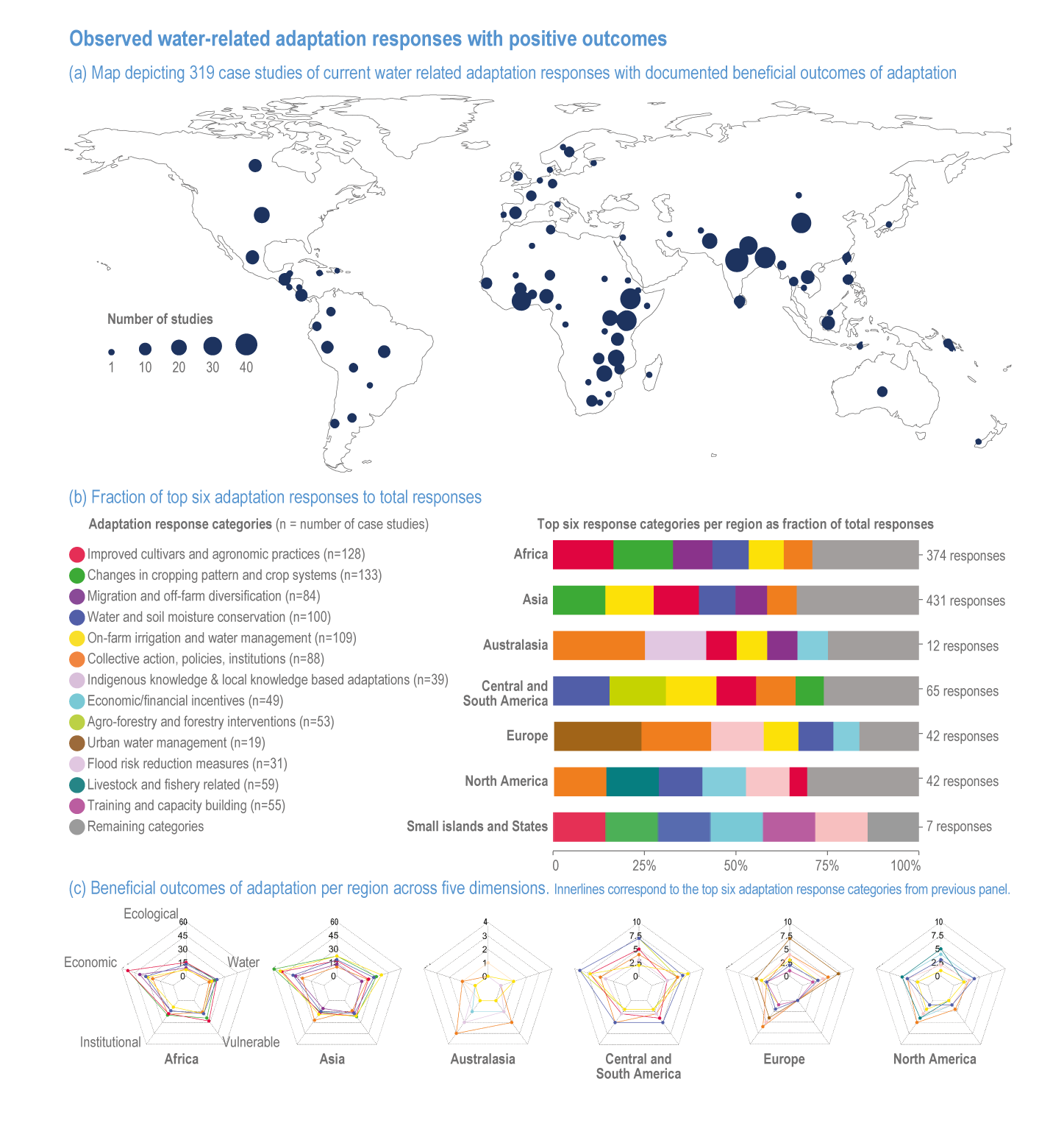
Adaptation is happening, but not at the pace needed
and not transformational, and we do not know if they
are effective
A.3 Adaptation planning and implementation has progressed across all sectors and regions, with documented benefits and varying effectiveness. Despite progress, adaptation gaps exist, and will continue to grow at current rates of implementation. Hard and soft limits to adaptation have been reached in some ecosystems and regions. Maladaptation is happening in some sectors and regions. Current global financial flows for adaptation are insufficient for, and constrain implementation of, adaptation options, especially in developing countries (high confidence). {2.2, 2.3}
https://www.ipcc.ch/report/ar6/syr/resources/spm-headline-statements
Source: Water Chapter, WGII, AR6, IPCC

Slide 30
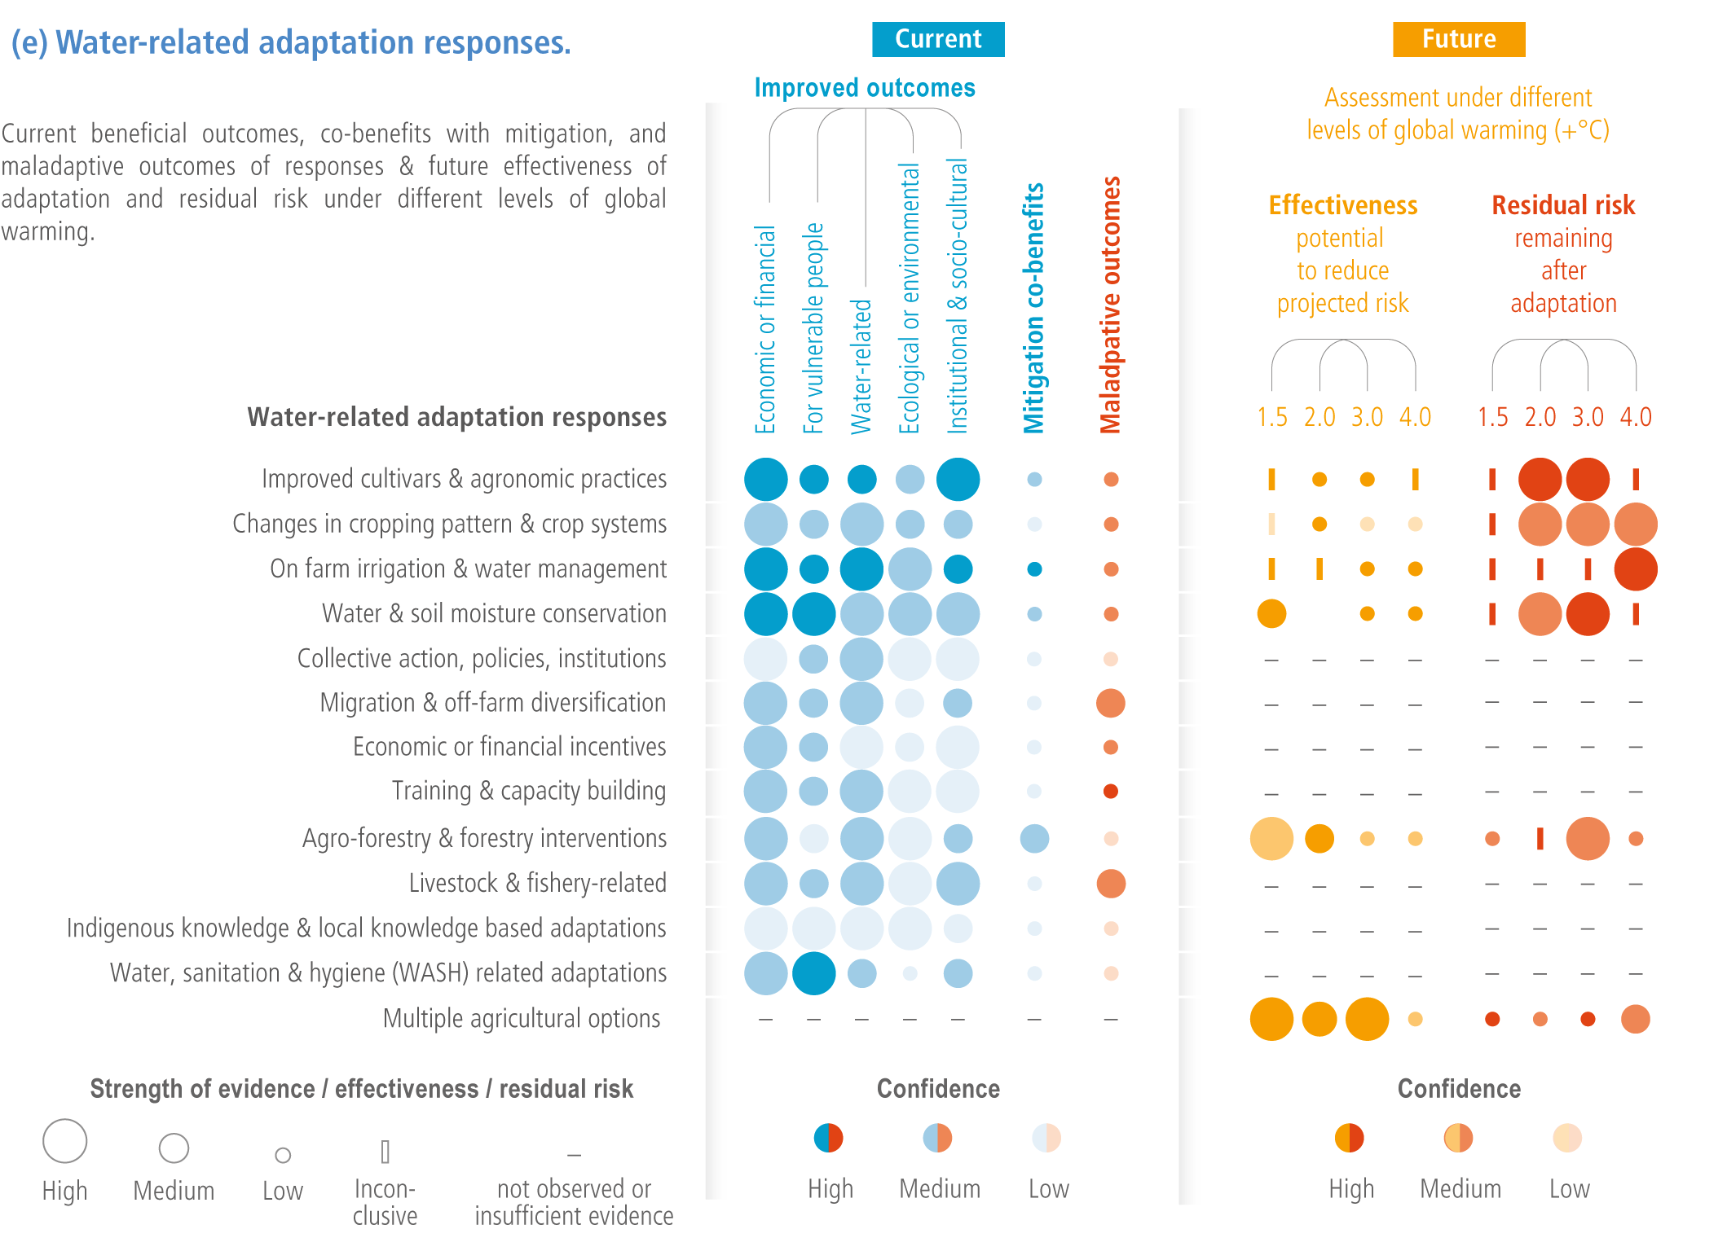
Effectiveness of adaptation declines at higher level of
global warming
B.4 Adaptation options that are feasible and effective today will become constrained and less effective with increasing global warming. With increasing global warming, losses and damages will increase and additional human and natural systems will reach adaptation limits. Maladaptation can be avoided by flexible, multi-sectoral, inclusive, long-term planning and implementation of adaptation actions, with co-benefits to many sectors and systems. (high confidence) {3.2, 4.1, 4.2, 4.3}
Source: Water Chapter, WGII, AR 6, IPCC
CGIAR is NOT looking at future effectiveness of adaptation
Notes:
Tabea: effective adaptation option exist, but higher warming makes adaptation less effectoive

Slide 31
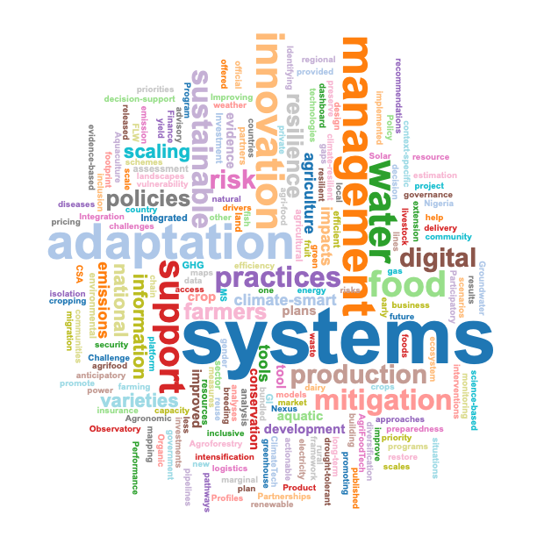
A word cloud on solutions implemented by Initiatives
Source: Text analysis based on ToC of initiatives and written answers by Initiatives

Slide 32
What is CGIAR doing in the climate solution space
Breeding for resilience (n=29)
Mitigation with adaptation co-benefits (n=20)
Solutions (119 outputs)
Adaptation (n=53)
Policies and institutions (n=7)
Finance
(n=10)
Drought, heat, floods, pests resilient breeds – Rice, Wheat, Chickpeas, Tubers
Climate Information Services; Climate Smart Agriculture, Agronomy, Irrigation; Transformative Adaptation
Reducing enteric emissions; Agro-forestry; AWD; Solar irrigation; Variable rate of fertiliser application etc.
Social Safety net; Repurposing subsidies
Source: Analysis using PRMS 2022/CGSpace

Slide 33
Methods
Methods (n=135)
Participatory methods (n=32)
Measuring emissions (n=22)
Modelling and/or Remote Sensing and GIS (n=17)
Breeding for resilience (n=14)
Economic and/or policy analysis (n=14)
Adaptation tracking (n=10)
Literature review (n=7)
Others (n=21)
Machine learning (n=5)
Social media analysis (n=5)
Needs assessment (n=3)
Others (n=8)
Source: Analysis using PRMS 2022/CGSpace

Slide 34
Climate Platform’s Plan to use CGSpace repository
Showcase the best of CGIAR’s climate related work in policy relevant ways
Rooted in research, written by scientists, and packaged by C&O as a comms product
USP: CGIAR research, innovation and partnerships help provide end to end solutions for major climate hazards and its work on mitigation also help reduce these hazards in the long term
”From seeds to policies: And everything in between”

Slide 35
Adapting to Hazard entry point: Droughts
Methods
Impacts
Solutions
What will a drought story from impacts to solutions lens look like?

Slide 36
Drought: Impacts to Solutions
Drought (e.g. in horn of Africa or MENA- Illustrative impacts on crops, livestock, livelihoods
Drought forecasting/early warning systems and climate information services
Drought resilient seeds and breeds for all, and for women and marginalised seeds
On farm agronomic practices including water management
A box on how these solutions paid attention to gendered vulnerabilities
Bundled insurance products

Slide 37
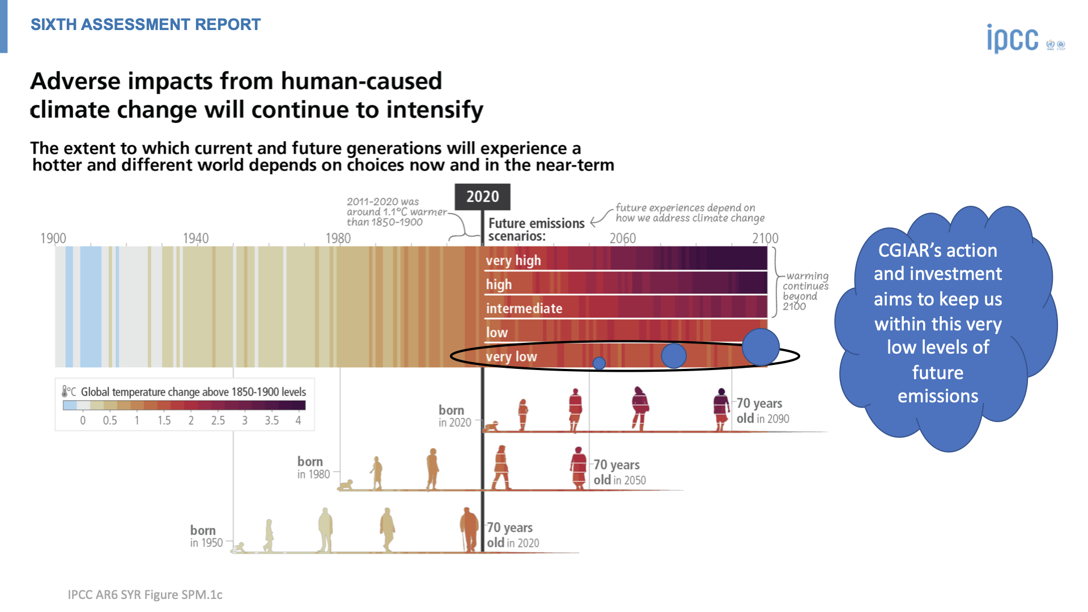
Our collective climate challenge: Keeping within the lowest future emissions scenarios while not compromising food security and welfare of our small scale food producers

Slide 38



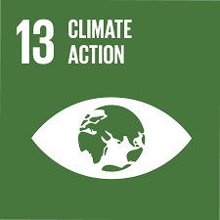
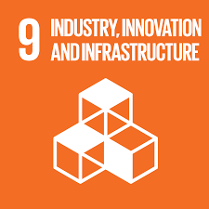
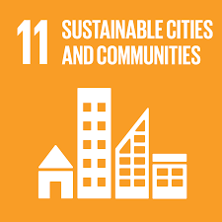
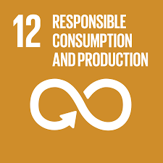

Climate adaptation & mitigation outcomes in CGIAR strategy
Turn agriculture and forest systems into a
net sink for carbon by 2050
Equip 500 million small-scale producers to be more resilient by 2030
Support countries in implementing NAPs and NDCs, and increased ambition in climate actions by 2030
Building up from
previous work
2

Slide 39
Situating CGIAR’s work within global climate science and policy
We need to keep within 1.5-2°C to minimize impacts on the most vulnerable people in the Global South – impacts are severe
However, stringent mitigation also can make the same people food insecure – that’s the space CGIAR needs to work on – reaching climate goals without compromising food security
Building resilience is a part of the solution – we need transformative adaptation and we need to be able to measure if adaptation reduces risks, without causing maladaptation
We need to look at future impacts and future effectiveness of adaptation
CGIAR climate science is uniquely poised to to deliver: we do end to end solutions, e.g. tackling droughts (from seeds to early information to insurance & social nets to repurposing subsidies)

Slide 40
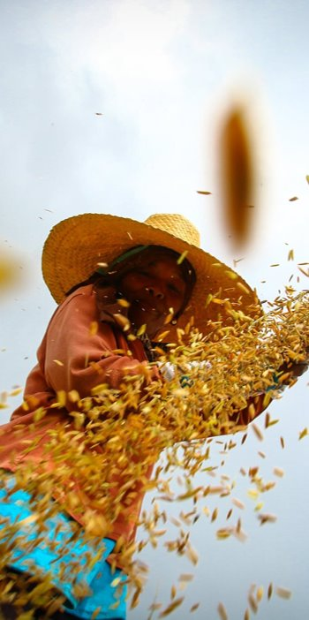
  Thank you
  a.mukherji@cgiar.org
23

