Slide 1
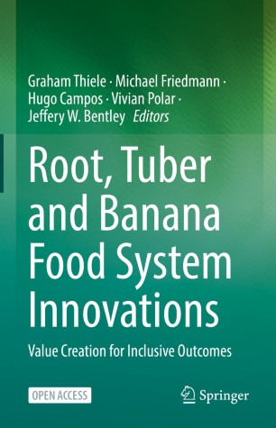


RTB Book launch!
Graham Thiele on behalf of the team
Lima, peru
April 26, 2022

Slide 2

Outstanding model of CGIAR collaboration made achievements reported in this book possible!
Broad based collaborative platform
350+ partners for co-innovation
77 innovations
Notes:
2

Slide 3
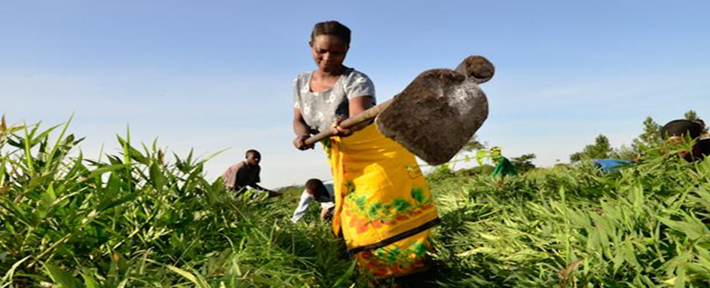
Roots, tubers and bananas
Over 400 million smallholder farmers depend on them for livelihoods
High yield potential
Sustain diverse food and integrated food systems with potential value-added post harvest
Mostly locally produced so alternative to more volatile grains
Especially important for women
BUT major bottlenecks require innovation to access yield potential and diversify uses

Slide 4
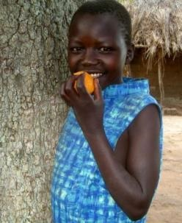
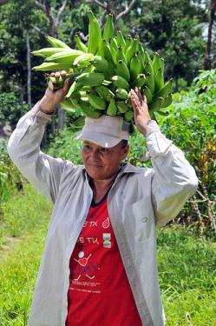
Expanded use of roots, tubers and bananas requires innovation in:
Scaling (“innovation in innovation”)
Reducing perishability and adding value post harvest
Managing pests and disease
Seed systems and improved varieties
Nutrition

Slide 5
17 chapters around food system innovations and value creation
overview, institutional change and scaling (3)
processing, marketing and distribution (5)
enhancing productivity (8)
  Pests and disease (innovative digital technologies)
  Seed systems (Toolbox)
  Gender responsive breeding
improving livelihoods (1)
  Scaling biofortified RTB crops

Slide 6
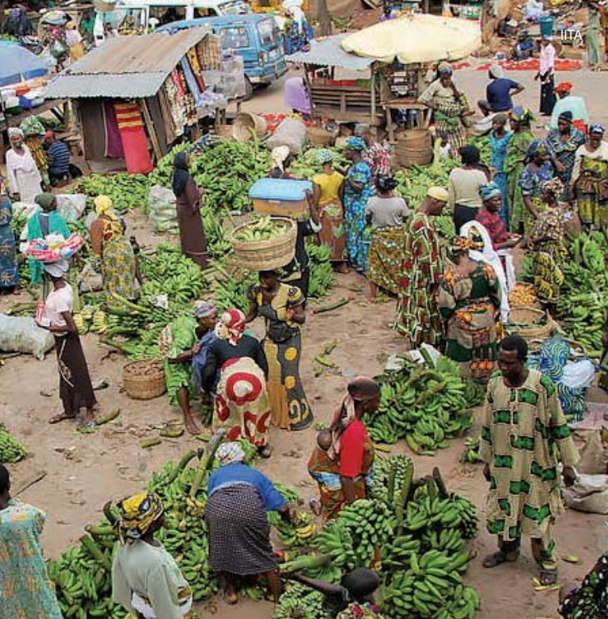
Innovation focus
Scaling and “end to end” innovation at the heart of the book and RTB program!

Slide 7
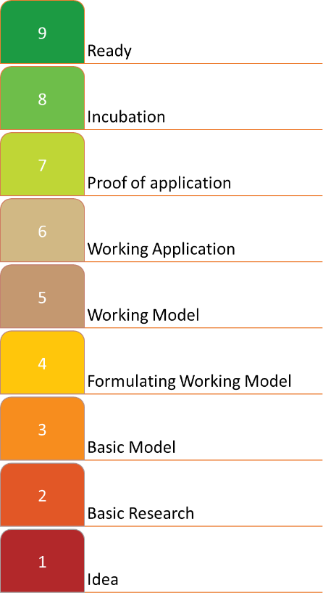

Scaling Fund
Innovation readiness scale
Foster the scaling of the most promising RTB innovations to reach their scaling potential
Manage “end to end” innovation across RTB portfolio

Slide 8
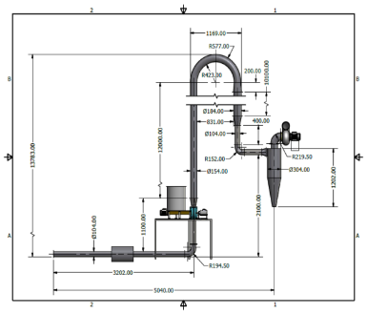
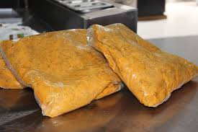
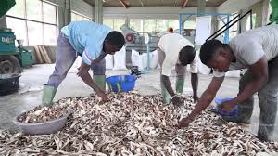
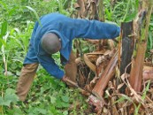
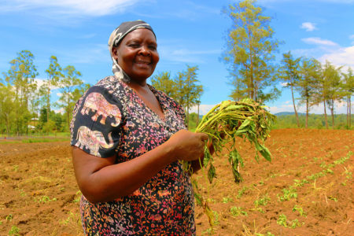
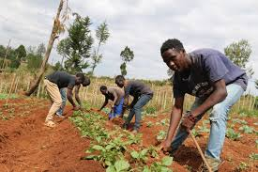
“End to end” innovation through the scaling fund (six chapters!)
4. Small-scale cassava flash-drying technology
5. OFSP Puree for bakery sector
6. Cassava peels for quality animal feed
10. Banana bacterial wilt management
12. Triple S (Storage in Sand and Sprouting) system for sweetpotato
13. Market-driven scaling of novel potato varieties with rooted apical cuttings

Slide 9
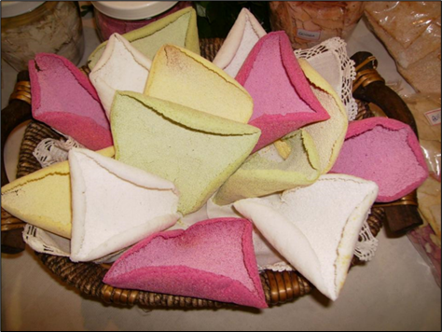
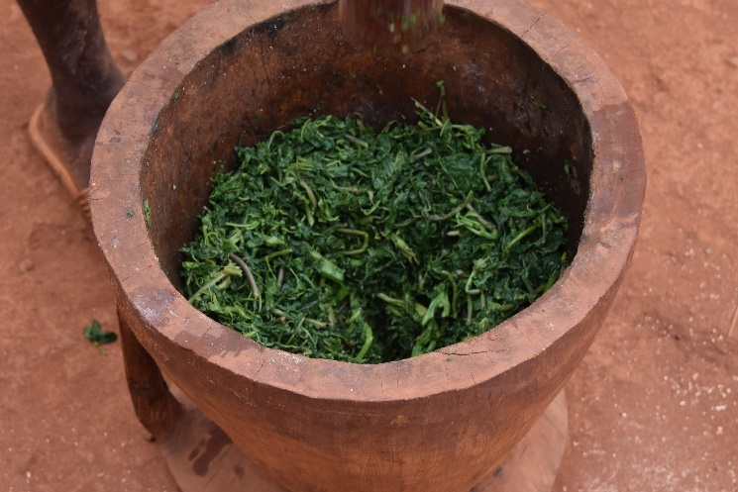
Complementary perspectives from non-CGIAR authors
Chapter 7
Transferring cassava processing technology from Brazil to Africa
Alfredo Augusto Cunha Alves, Luciana Alves de Oliveira, and Joselito da Silva Motta
Chapter 8
Improving Safety of Cassava Products
Linley Chiwona-Karltun, Leon Brimer, Jose Jackson

Slide 10
Let your
20,000 downloads in two weeks and counting… and friends know!
https://link.springer.com/book/10.1007/978
20k downloads and counting!-3-030-92022-7

Slide 11

Thank you

