Slide 1
Africa RISING – NAFAKA: GIS ACTIVITIES AND ACHIEVEMENTS 2018/2019
FRANCIS MUTHONI
INTERNATIONAL INSTITUTE OF TROPICAL AGRICULTURE
AFRICA RISING - NAFAKA PROJECT ANNUAL REVIEW AND PLANNING MEETING
3 – 4 JULY 2019, DAR ES SALAAM, TANZANIA

Slide 2
VARIETY SUITABILITY MAPS
Mapped suitability of 14 maize varieties and 2 common beans varieties to :
  Guide spatial targeting of demonstration plots in new cropping season
  Better estimate demand of inputs such as seeds
Two approaches used to generate suitability maps:
  Utilise yield data for previous seasons
  TOSCI variety release criteria for fast estimation of suitability for varieties that yield data is not available

Slide 3
VARIETY SUITABILITY MAPS: MAIZE
Mapped suitability maize & fertilizer packages based on previous seasons yield data.

Slide 4
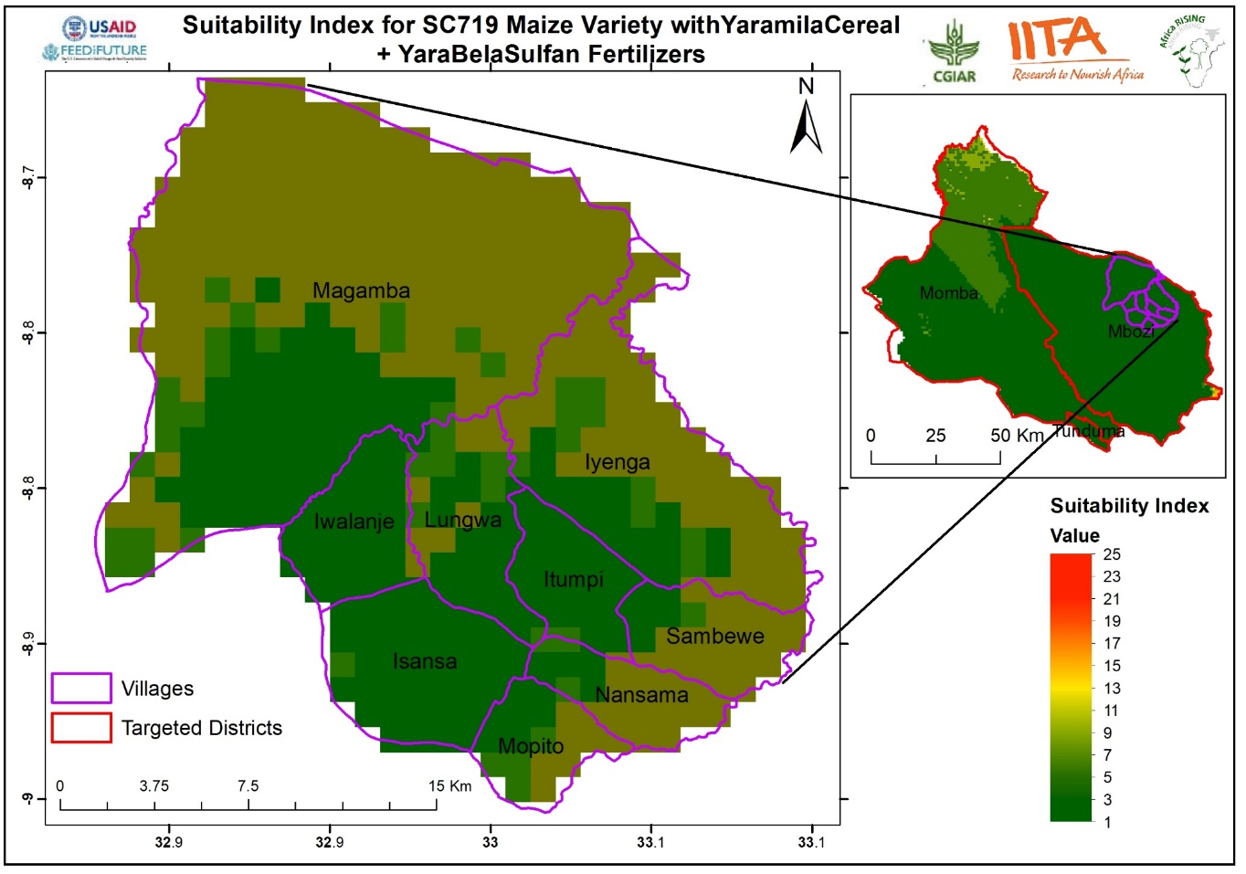
VARIETY SUITABILITY MAPS: MAIZE
Maize & fertilizer packages zoomed at ward level

Slide 5
VARIETY SUITABILITY MAPS: MAIZE
Mapped suitability of 14 maize varieties based on TOSCI criteria

Slide 6
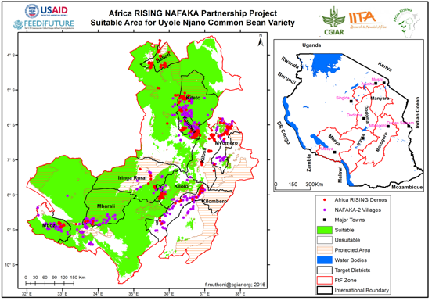
VARIETY SUITABILITY MAPS: COMMON BEANS
Mapped suitability of 2 common beans varieties based on TOSCI criteria.

Slide 7
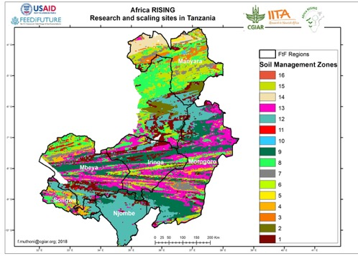
MAPPING SOIL MANAGEMENT CLUSTERS
Soil management zones developed and characterized to guide targeting
Zones can be targeted for specific soil amendments

Slide 8
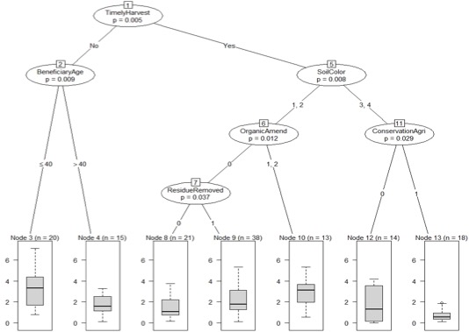
IMPACTS OF ADOPTION OF TECHNOLOGY AT DIFFERENT AEZ’S
Which SLM technologies increase yield at different agro-ecologies?

Slide 9
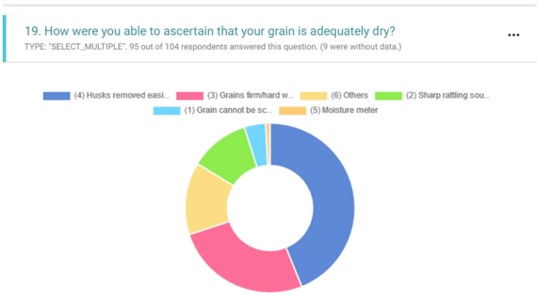
DEVELOPMENT OF ODK TOOLS FOR DATA COLLECTION
Kobo-Collect Tool for assessing knowledge on rice quality.
Save time and improve efficiency through auto generated reports & maps.

Slide 10












PARTNERS
Notes:
ESA Africa

