Slide 1
Operationalizing One Health in pastoralist settings

Slide 2
Module 1: Principles and applications of One Health

Slide 3

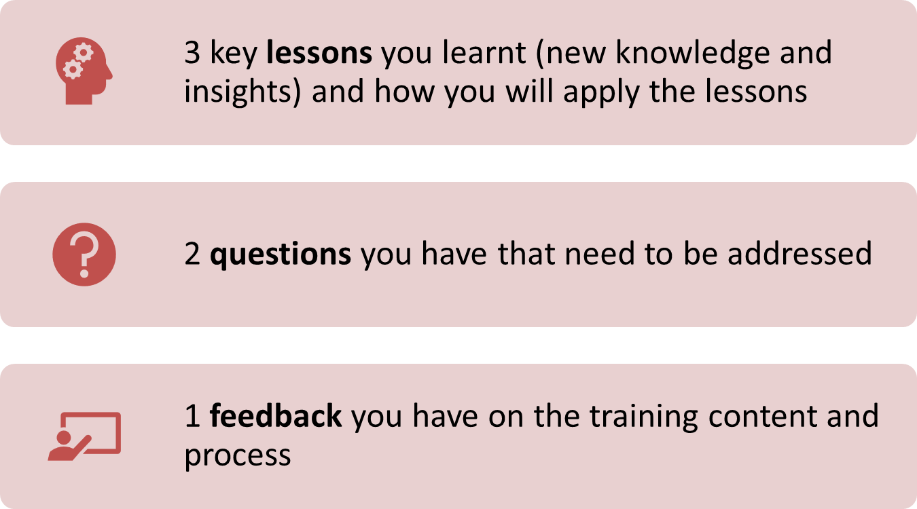
Re-cap Day 2
Reflection
Write down your key lessons from yesterday
Be prepared to share your responses in plenary
30 minutes

Slide 4
Multi-sectoral collaboration and coordination in One Health

Slide 5

Intended learning outcomes
By the end of today, you will be able to:
define the concepts of collaboration, coordination, teamwork, team building, conflict, and conflict resolution;
describe different types, attributes, benefits, and challenges of collaboration;
discuss the factors influencing success of collaboration and teamwork;
identify sources of conflicts in the workplace; and
use conflict management techniques to resolve disputes

Slide 6
Topics
Definition of collaboration and coordination
Types of collaboration
Benefits of and challenges to collaboration and coordination in One Health
Keys to successful collaboration and coordination
Skills and attitudes for effective collaboration

Slide 7
Experiences with collaboration and teamwork
Interactive plenary discussion
What have been your experiences with collaboration and teamwork?
  What was the reason for the collaboration?
  Who was involved in the collaboration?
  Did the other people have similar or different backgrounds to their own? (Consider gender, culture, education, technical skills)
  Did it work well or were there challenges?
  What factors contributed to success/failure?
60 minutes

Slide 8
Case study on collaboration and coordination
Drought in arid zones of Kenya, 2021
Facilitator will hand out copies of the case study
At your table, discuss the case study using the questions on the next slide as prompts
Be prepared to share your discussion in plenary
45 minutes

Slide 9
Case study on collaboration and coordination
Small group discussion
Discussion questions:
  What do you see in the pictures?
  What were the main problems caused by the drought? Consider impacts on humans, animals, and the environment.
  What sectors were involved in addressing these problems?
  How did sectors collaborate to address the problem? How did they coordinate to address the problem?
  Is it the same or different when there is a drought in your woreda/district?
40 minutes

Slide 10
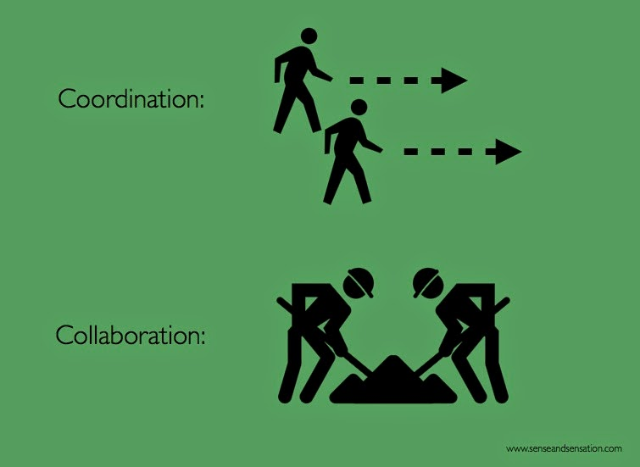
Definition of collaboration and coordination
Coordination: to work separately towards a common goal
  Specific roles and inputs
  Distinct efforts are aligned for sake of efficiency
Collaboration: to work together towards a common goal
  Shared responsibility, authority and accountability for achieving results
  Result is changed by input of all contributors (co-creation)

Slide 11
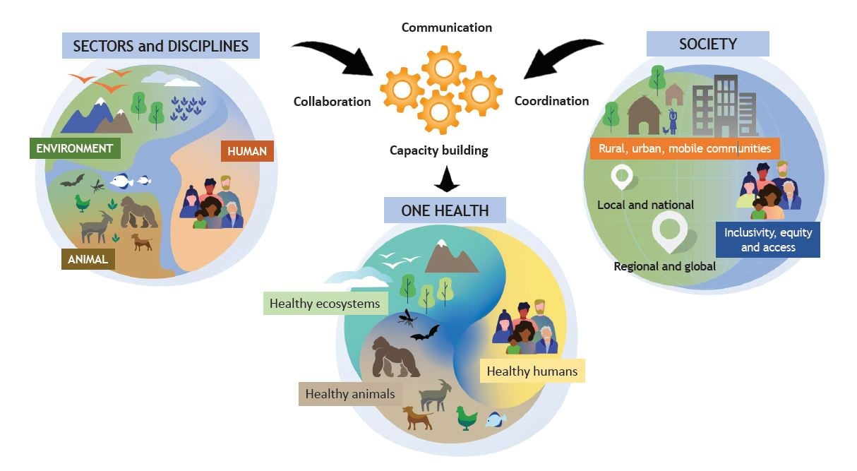
Recall the 4 C’s of One Health
One Health is operationalized by enhancing collaboration, communication, coordination and capacity building between sectors, disciplines, and different groups in the society (communities, policymakers, and researchers)
In One Health initiatives, sectors work together and separately toward the common goal of achieving healthy people, healthy animals, and healthy ecosystems
Sectors plan together, pool expertise and material resources together, complement and influence each, often through a coordinating mechanism, such as a One Health platform or taskforce

Slide 12
Types of collaboration
Different disciplines/practitioner groups
Community and government stakeholders
Multi-disciplinary
Interdisciplinary
Transdisciplinary
Methods B
Solution
Defining a problem
Shared methods
Methods A
Solution
Defining a problem
Shared methods
Solution
Solution
Solution
Same or similar problem
Methods C
Solution
Solution
Combination of ideas or methods from different disciplines. Teams from human, animal and environmental health work either concurrently or in sequence, but the activities of their respective disciplines run parallel and do not blend
Integration of ideas and methods from different disciplines. Teams from human, animal and environmental health work together to jointly frame a problem, agree on a methodological approach, and analyze it. May come up with different solutions.
Creation of new ideas and methods informed by diverse perspectives. Goes beyond interdisciplinary collaboration, to include participatory approaches that engage multiple levels of stakeholders, including the community, academia, and government
Notes:
Collaboration in One Health is said to be both interdisciplinary and transdisciplinary. One Health practitioners collaborate with people outside their sector/discipline, sharing knowledge and resources and promoting integrated approaches to health challenges (interdisciplinary collaboration). In addition, One Health practitioners engage stakeholders and society at large using participatory approaches in order to identify and implement solutions to health challenges (transdisciplinary collaboration).

Slide 13
Collaboration – common attributes
Willingness to work together towards an agreed purpose
Non-hierarchical relationship between collaborators
Sharing of expertise and resources between collaborators
Open-mindedness and willingness to learn and reflect on experiences
Trust and respect for collaborators
Teamwork and collaborative learning

Slide 14
Benefits and challenges to collaborating with other sectors
Panel discussion
Facilitator will select 3 participants to constitute a panel
Questions to the panel:
  How does your sector benefit from collaborating with other agencies/organizations?
  What are the challenges to working collaboratively with other sectors in your workplace/community?
  Other questions?
Other experiences?
40 minutes

Slide 15
Benefits of collaboration and coordination in One Health
Increase access to resources
Make more efficient use of resources
Enhance accountability
Enhance sharing of knowledge and technology
Stimulate innovation
Creates lasting relationship
Promote sustainable development
Notes:
Collaboration and coordination are considered key to operationalizing One Health because they:
Increase access to resources – different parties contribute human, financial and/or material resources to address a shared problem
Make more efficient use of resources – by reducing duplication across member agencies
Enhance accountability – parties hold each other accountable for the obligations and tasks assigned to them or which they committed to
Enhance sharing of knowledge and technology – parties share their approaches, inventions, innovations, and methodologies
Stimulate innovation – learning across disciplines leads to new insights and different perspectives
Creates lasting relationship – parties discover others’ capacity and potential that they can harness in the future
Promote sustainable development – different parties can complement or takeover from others when funding comes to an end

Slide 16
Challenges to collaboration and coordination in One Health
Territorialism and competition due to power imbalance across disciplines/sectors and segments of society (e.g., culture, gender, social class)
Potential for misinterpretation due to differences in terminology
Perceptions that disciplinary expertise is not understood, acknowledged, or valued
Reverting to ‘siloed’ approaches because they are perceived to be easier or faster

Slide 17
Keys to successful collaboration and coordination
Small group discussion (brainstorming)
Discussion questions:
  What factors influence successful collaboration and coordination between sectors?
  What practical approaches can we use to enhance collaboration and coordination between sectors?
30 minutes

Slide 18
Keys to successful collaboration and coordination
According to the Network for the Evaluation of One Health, who designed a framework for evaluating One Health initiatives, initiatives that score highly have (amongst other things):
  Shared aims and objectives that are clear to all
  Frequent meetings with all disciplines present
  Joint decision making
  Well-functioning teamwork
  Clear roles between team members
  High level of stakeholder engagement throughout the initiative

Slide 19
Success of collaborations influenced by…
Individual characteristics of the people involved
Tips for One Health practitioners
  Beyond technical skills, practitioners need skills in communication, negotiation, conflict resolution; need to practice open-mindedness; and need to adopt values and attitudes that promote social, cultural and gender equity and inclusiveness
4Cs

Slide 20
…and the way you work as a team
Shared vision – articulates a common goal
Shared leadership e.g. rotating between sectors
Joint decision-making
Joint planning
Trust – built through mutual respect for each person’s experience, knowledge, and contribution
Open communication – transparent flow of information with clear means for voicing concerns or suggestions
Learning together
Flexibility – not hinging on 1 person

Slide 21
Stages of group development
Interactive plenary discussion
Think of a time when you were working as part of a team to achieve something in your woreda/district.
  Did the team work effectively from the beginning?
  What factors contributed to the team’s success/failure?
5 minutes

Slide 22
Stages of group development
Think-pair-share
Facilitator will distribute copies of Tuckman’s stages of group development
Individually, reflect on the following questions:
  How does Tuckman’s stages of group development help you understand group dynamics?
  Can you relate to these phases from your own experiences with teamwork? How? Give examples.
  What approaches can we use to enhance team building?
Share your reflections with your neighbour
In pairs, be prepared to share your reflections in plenary
40 minutes

Slide 23

What is a team?
Team: group of individuals with complementary abilities and skills committed to a common purpose and accountable for performing tasks that contribute to achieving common goals
  In One Health, teams comprise of men and women with different technical skill sets who come from different parts of society

Slide 24
Requirements for effective teamwork
Clear understanding and commitment to a common task and overall purpose
Clear idea of your own job and how it relates to other team members’ jobs
  Understand the work and duties of other members, particularly where there is an overlap in functions
Flexibility so that the work of your team does not collapse when one member is absent
Creating a good learning and training environment in the workplace
  Team leader should encourage and stimulate this process

Slide 25
Requirements for effective teamwork (continued)
Ensuring stability and continuity of your functions by avoiding frequent changes of members
Mobilizing sufficient resources to carry out the team’s functions
Developing good relationships within yourselves by being open, understanding, and willing to help each other
Developing ways of measuring and recognizing your team’s functionality, achievements, and success
Developing a strong sense of cohesiveness and loyalty, which will enable you to work well and tackle problems successfully

Slide 26
Approaches to team building
Organise simple social activities – to encourage team members to spend time together
Personal development – to foster skills that help you work more effectively in teams e.g. emotional intelligence and cultural competence
Team development activities – group-dynamic games designed to reveal how individuals approach a problem and how the team works together
Analysis of team roles, and training in how to work better together

Slide 27
Conflict and conflict resolution
Interactive plenary discussion
What do people disagree over in your woreda/district?
How do such disagreements affect the implementation of One Health initiatives in pastoralist settings?
10 minutes

Slide 28
Conflict and conflict resolution
Role play 1
Facilitator will ask for 2 volunteers to act out a scenario
As you watch the role play, be ready to discuss:
  What was the conflict in this scenario?
  How did the characters respond?
  What did you like and not like about how the characters handled the conflict?
  How would you have handled the same conflict if it happened in your life?
20 minutes
Notes:
Following the discussion, explain that this is an example of interpersonal conflict. Such conflicts typically arise due to conflicting ethics, beliefs, and values. These differences in opinions should be discussed openly so that a solution can be reached. Both people should have an opportunity to share their viewpoint and listen to the other person’s viewpoint. Perhaps the reasons for their behavior are not what it seems? (e.g., Samuel might be dealing with difficult situation at home). Both people should speak with respect and not out of anger. If a resolution is not possible between them, then the matter should be escalated to a supervisor. In raising it with a supervisor, Michael should mention the tension and seek actions to reduce it.

Slide 29
Conflict and conflict resolution
Role play 2
Facilitator will ask for 3 volunteers to act out a scenario
As you watch the role play, be ready to discuss:
  What was the conflict in this scenario?
  How did the characters respond?
  What did you like and not like about how the characters handled the conflict?
  How would you have handled the same conflict if it happened in your life?
20 minutes
Notes:
Following the discussion, explain that this is an example of miscommunication. Michael places the blame on Daniel, who feels personally attacked. It is common for people to react defensively when they feel attacked. Defensive responses are a mechanism of self-protection; by shifting the attention to the faults of the other person, it makes the person who feels attacked feel better about themself in that moment (i.e., reduces shame). Defensive behaviors are reduced when people feel secure in their group identity, respected, and valued. Sally can help the situation by emphasizing respect and value for Daniel, even if she disagrees with his views or actions. She can also help by suggesting that they learn from this situation; they should take more time to plan adequately and communicate consistently with the community.

Slide 30
What is conflict?
Typically defined as the perceived incompatibility of values, interests, or goals between interdependent people
Normal consequence of human interaction
Often conceived as negative and something to avoid BUT conflict is neither positive nor negative in and of itself
  Conflict is an outgrowth of the diversity that characterizes our thoughts, attitudes, beliefs, perceptions, and social systems/structures
  Way in which people manage the conflict is what determines the outcome

Slide 31
Common causes of conflict in the workplace
Personality differences e.g. personal abilities, traits and skills
Incompatible goals/values – when people perceive that their goals are mutually exclusive or values under threat
Communication problems e.g. misunderstandings, withholding information
Task interdependence – when accomplishment of a goal is reliant on others
Limited resources e.g. money, time, equipment, material goods
Organizational structure and processes e.g. multiple reporting lines, unclear roles/responsibilities

Slide 32
Two dimensions of conflict behaviour
Assertiveness – when people feel there is a threat to their interests
  Best when: you need to make a fast decision, you know you are right, ethically/morally right to take a stance, you have higher power authority
Cooperativeness – when people attempt to cater to other’s concerns
  Best when: you need to manage long term relationships, when both you and the other parties perspective may be right

Slide 33
Conflict resolution strategies
Avoiding – withdraw or ignore conflict (no one wins)
Competing – people enter discussion with intention of winning (I win, they lose)
Accommodating – people give in to the wishes or demands of the other party (I lose, they win)
Collaborating – shared solution that all can support (we all win)
Compromising – each member gives up something (no one loses, but no one really wins)

Slide 34
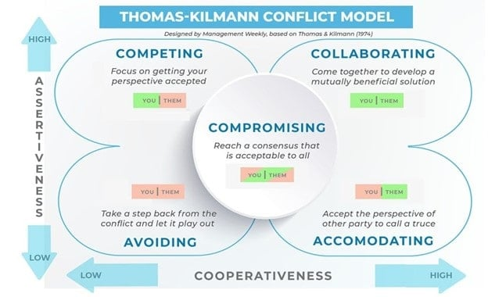

Slide 35
Summary of key learning points from day 4
Collaboration and coordination between sectors is key to operationalising One Health
Sectors can collaborate in different ways ranging from low integration (multi-disciplinary) to high integration/inclusiveness (trans-disciplinary)
Collaboration has numerous benefits but comes with challenges
Fostering skills in teamwork and conflict management can improve implementation of One Health initiatives

Slide 36
Participatory community engagement in One Health
Coming up:

