Slide 1
The race to adapt: learning from adaptation pioneers in East Africa
Adaptation Futures 2023,
Montreal, Canada, 2-6 October 2023
Panel #969: Sectoral and placed-based adaptation challenges and solutions in South Africa, Ghana, Kenya, Senegal and Benin
Birgit Habermann¹, Todd A. Crane¹, Leah Gichuki¹, Tigist Worku¹, Roland Mugumya^{2,} Emmaculate Kiptoo¹
¹ International Livestock Research Institute (ILRI), Sustainable Livestock Systems
² Former International Livestock Research Institute (ILRI), Sustainable Livestock Systems

Slide 2
Objectives
Identify livestock keepers who are better in adapting to the impact of climate change than others in the same circumstances
Understand what these livestock keepers do differently from others before going to scale
Support farmer-to-farmer scaling by these successful livestock keepers/adaptation pioneers

Slide 3
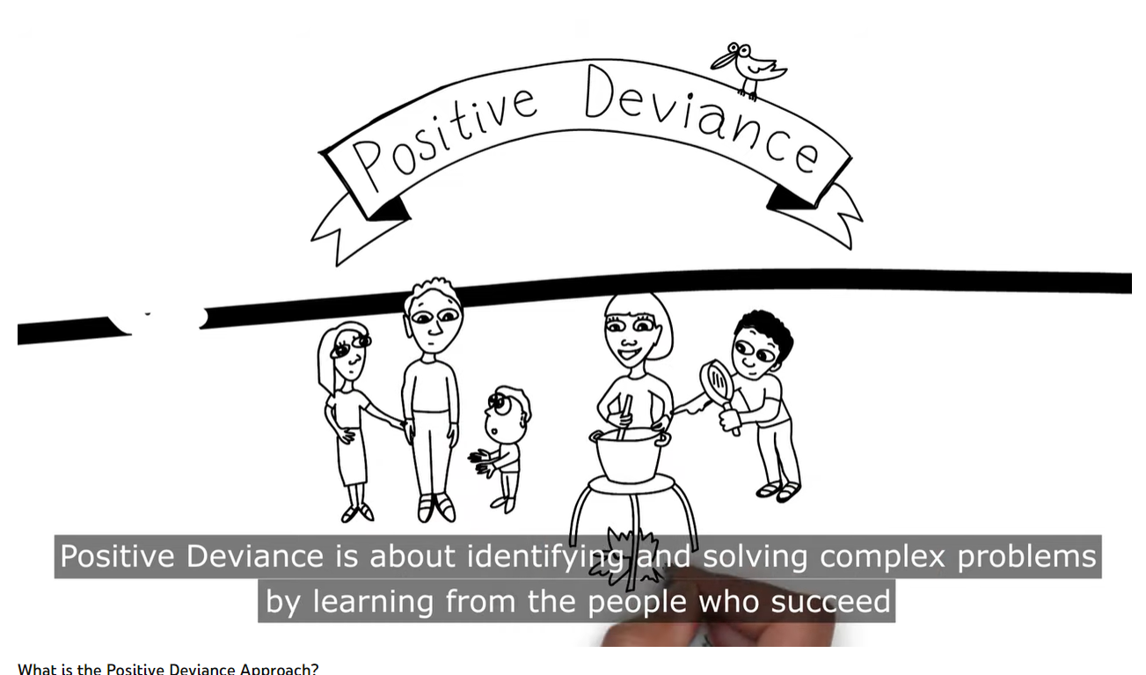
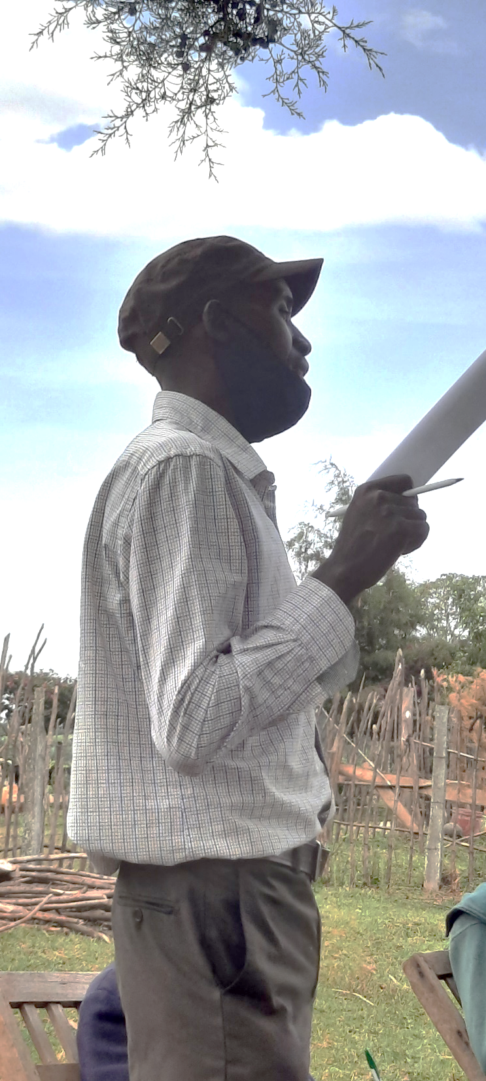
Who is a positive deviant?
https://positivedeviance.org/
https://youtu.be/0ULZWOm5ukg
A positive deviant livestock farmer performs livestock management more successful than others in the same circumstances, successful in terms of securing livelihoods and overcoming the impact of climate change.
Mr. Pius, pioneer farmer, Kenya

Slide 4
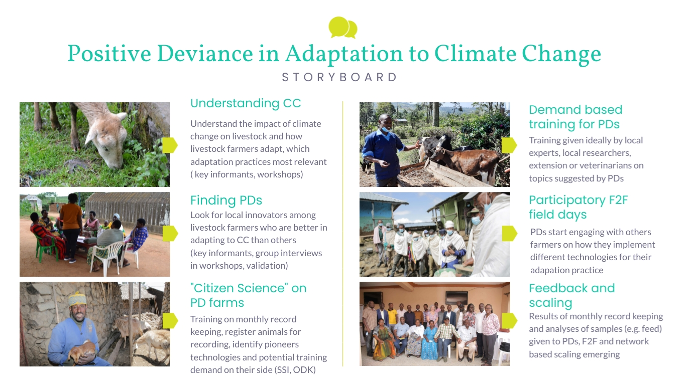

Slide 5
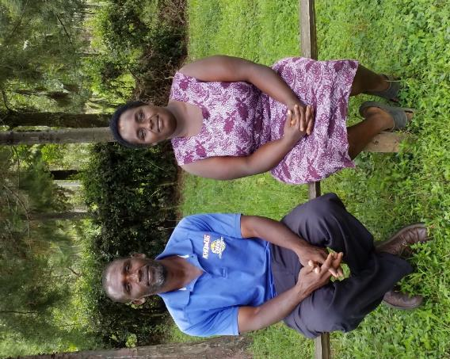
Example from Kenya:
Adaptation pioneer household:
Edwin and Doreen
Conserving feed to keep milk flowing through the dry season in Bomet, Kenya

Slide 6
Climate change in Bomet, Edwin and Doreen's home county in Kenya:
https://cgspace.cgiar.org/bitstream/handle/10568/96282/Bomet_Climate_Risk_Profile_Final.pdf?sequence=1&isAllowed=y

Slide 7
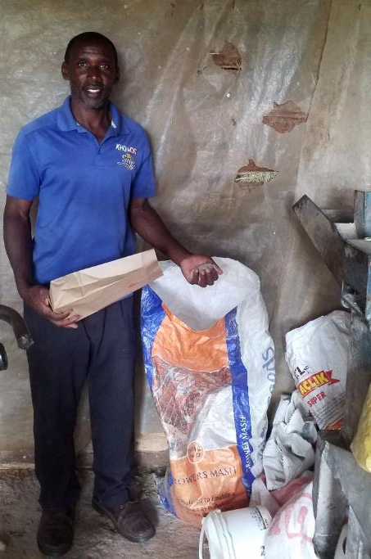
Adaptation pioneer household:
Edwin and Doreeen
Age about 50 years, 6 HH members, 2 farmworkers
Farm size: 16.6 acres (livestock and crops)
30 chickens, eight cows, three heifers, and three calves
Milk: Avg. of 70 litres per day for the farm (max 140 litres per day)
Sold through cooperative, registered breeder
Grows sorghum, oats, Boma Rhodes grass, sunflowers, bananas, sukuma wiki (kale), cabbages, and onions.

Slide 8
Adaptation pioneer household
“When we started preparing silage, it was a lot of work because we only had a few machines, so we were grinding for long; our expertise was low so we were making a lot of mistakes and having a lot of wastage. But now, after doing it for long, we have fine-tuned the process: there are very few days that we need a lot of people, and we have reduced our wastage, so we are doing it more efficiently at the lowest cost.”

Slide 9
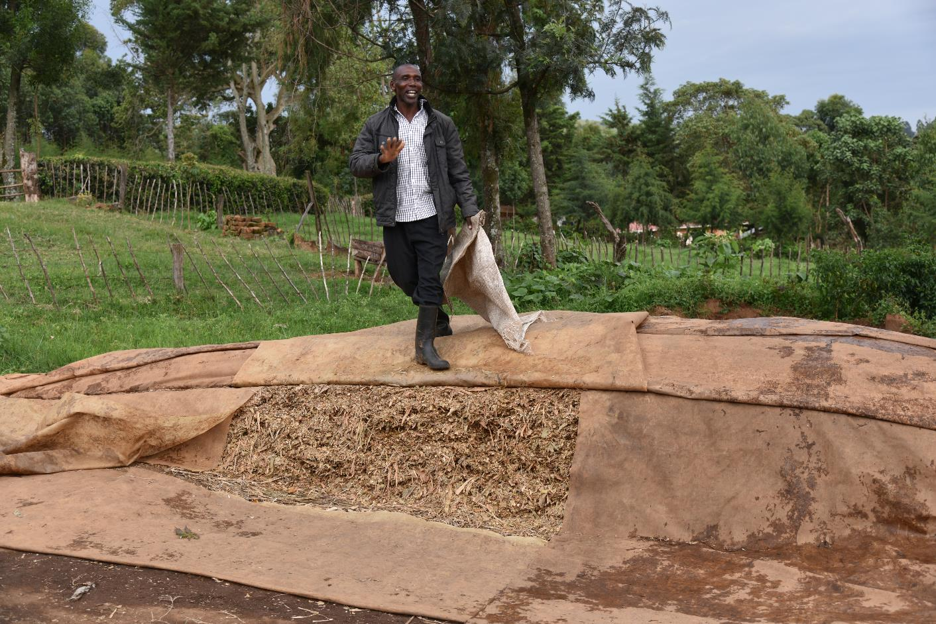
Silage for dairy, made from sorghum

Slide 10
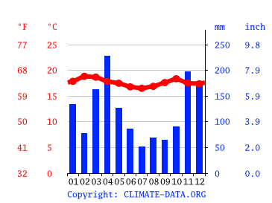
What pioneers learn from each other:
Average monthly milk production/ cow

Slide 11
Summary findings across sites
Challenges arising from climate change are very different, but adaptation practices promoted similar: needs to be more context-specific and farmer-led
Adaptation as a fluid process: pioneers try out and abandon and try again…. – requires a different approach to extension
Our approach can be very responsive to these processes: interaction with adaptation pioneers happens over a longer period of time and frequently
In-depth and dynamic understanding of what drives on-farm decision-making is crucial, consideration of multiple drivers of change always important

Slide 12
Summary findings across sites
Influenced by different HH members: pioneers are not individuals, but families, consider women and youth more
Avoid turning pioneers into local celebrities through creating a larger group of pioneers in a knowledge network
Scaling through positive deviance is a logical continuation of identifying positive deviants and their practices
Connecting with scaling actors in governance systems is crucial for long term success e.g. extension, local governments, cooperatives and researchers

Slide 13
Conclusion
Farmers have an important role as producers and promoters of adaptation practices
More research on scaling strategies through PD is ongoing
Farmers lead co-production of adaptation practices and knowledge
Researchers can engage with farmer-led adaptation in a structured way
Acknowledge diversity of knowledges and solutions developed by pioneer farmers for more sustainable, locally-led adaptation strategies

Slide 14


This work was conducted as part of the CGIAR Initiative Livestock and Climate and is supported by contributors to the CGIAR Trust Fund. CGIAR is a global research partnership for a food-secure future dedicated to transforming food, land, and water systems in a climate crisis.
This work has been partly financed by the Deutsche Gesellschaft für Internationale Zusammenarbeit (GIZ) commissioned by the Government of the Federal Republic of Germany (grant number: 2017.0119.2).

