Slide 1




Accessible and open data on chicken performance supports investment decisions in sub-Saharan Africa
Tadelle Dessie
Open Access Week
Addis Ababa, Ethiopia
23-25 October 2019

Slide 2

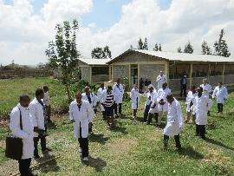
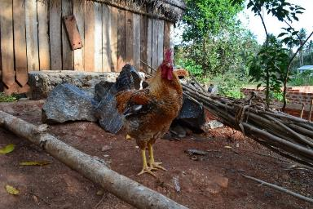
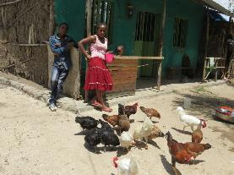
ACGG Vision
The vision of this program is to catalyze public-private partnerships for increasing smallholder chicken production and productivity growth as a pathway out of poverty in sub-Saharan Africa.

Slide 3
What are we doing differently?
Achieve ACGG’s cardinal outcomes:
- Employment creation, Wealth creation and Poverty reduction
  ACGG Six Pillars of Change
High-producing genetics that is well-adapted to low-input production systems;
Farmer preferred breeds of chickens;
Public-private partnership for improvement, multiplication, and delivery;
Women at the center to ensure success; and
Innovation platforms for developing solutions across the value chain.
Innovative solutions to underpin the VC transformation

Slide 4
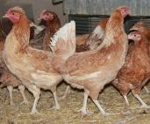
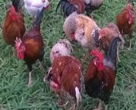
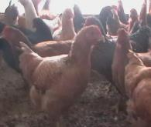
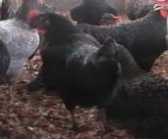
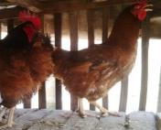
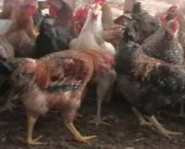
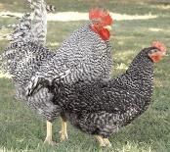
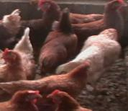
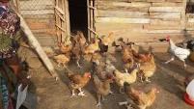
CHICKEN STRAINS tested in ACGG project
COUNTRY | CHICKEN STRAIN
ETHIOPIA | Horro
 | Koekoek
 | Kuroiler
 | Rhode Island Red x Sasso
 | Sasso
NIGERIA | Fulani
 | Funaab Alpha
 | Kuroiler
 | Noiler
 | Sasso
 | Shika Brown
TANZANIA | Kuroiler
 | Sasso
Horro
Fulani
Sasso
FUNAAB alpha
Noiler
Kuroiler
Koekoek
ShikaBrown
Sasso X RIR

Slide 5
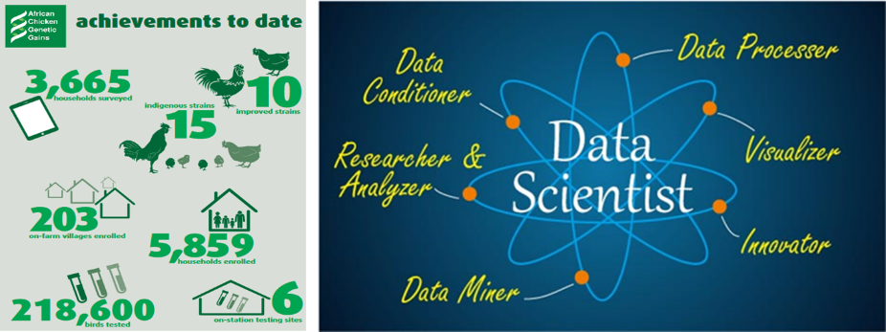
Accessible and open data on chicken performance supports investment decisions

Slide 6

Who is benefiting from the open data?
The right Genetics
Private Company/
Strong PPPs
Genetics/DOCs
Feed
Health
Knowledge
Communication
Technical Support
Policy support
Gender Empowerment
Finance Institution
BU
BU
BU
BU
SME finance/ technology etc
4 week-old brooded vaccinators of chicks
SHF
SHF
SHF
SHF
SHF
SHF
Own Consumption
3 month - males (2.3 kg)
6 month - Eggs
Aggregators/Local Markets/Partial Buy-back

Slide 7

Who is benefiting from the open data?
The right Genetics
DATA Collection and Analysis
Private Company/
Strong PPPs
Genetics/DOCs
Feed
Health
Knowledge
Communication
Technical Support
Policy support
Gender Empowerment
Finance Institution
BU
BU
BU
BU
SME finance/ technology etc
4 week-old brooded vaccinators of chicks
SHF
SHF
SHF
SHF
SHF
SHF
Own Consumption
3 month - males (2.3 kg)
6 month - Eggs
Aggregators/Local Markets/Partial Buy-back

Slide 8
Who is benefiting from the open data?
-Smallholder farmers and mother Units
-Input providers (genetics, feed and health)
-International and National breeding campanies
-Policy and desition makers
-Development & research institutions
-Agregateors and marketers
-Financial institutions
-R&D Investors
The right Genetics
DATA Collection and Analysis
Private Company/
Strong PPPs
Genetics/DOCs
Feed
Health
Knowledge
Communication
Technical Support
Policy support
Gender Empowerment
Finance Institution
BU
BU
BU
BU
SME finance/ technology etc
4 week-old brooded vaccinators of chicks
SHF
SHF
SHF
SHF
SHF
SHF
Own Consumption
3 month - males (2.3 kg)
6 month - Eggs
Aggregators/Local Markets/Partial Buy-back

Slide 9

Key innovation challenges we must address to transform the chicken value chain
How to inform and catalyze effective investments, by all actors in the smallholder chicken value chain which underpin the VC transformation
How to attract and maintain active involvement of private sector actors in the VC transformation
How to equip partners to design and implement breed improvement, multiplication and delivery at scale
How to equip smallholder farmers and others to effectively utilize localy available feed resources

Slide 10
Key innovation challenges we must address to transform the chicken value chain
Private sector led but public sector regulated system
Stable, equitable
and transformed
Small Scale Commercial
chicken value chains
Resources/investments
Reliable and timely information
Workable plans & Targets
Achievable Targets
Right Stakeholders

Slide 11
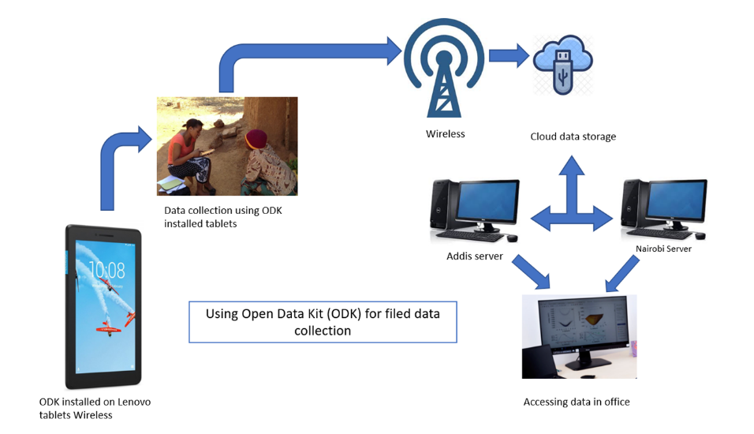
Product 1: New Technology –ODK - harnessed
–in ACGG data collection
Questionnaire, phenotypic measurements, GPS waypoints, pictures, performance records….

Slide 12
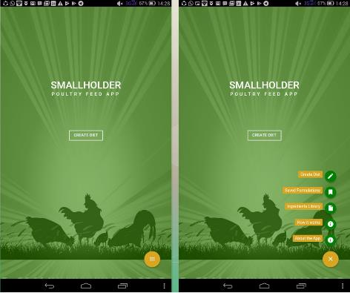
Product 2: Smallholder poultry feed app!
Based on locally available
feed ingredients
http://acggng.com.ng/
http://acggtanzania.com/
https://acggethiopia.com

Slide 13
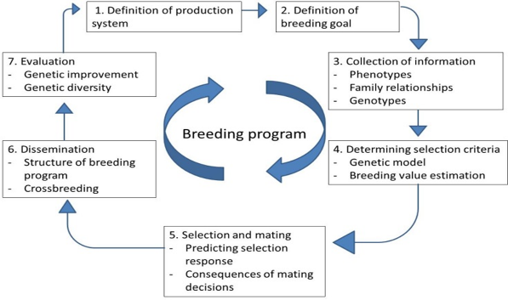

Product 3: MOOC - E-learning on Animal breeding and genetics
https://youtu.be/rHxbQLSoLxc

Slide 14
Product 4: ACGG open source dashboard
ACGG dashboard is graphical user interface which provides at-a-glance views of key production and productivity performance of chicken breeds in different agro-ecologies in Sub-Saharan Africa, relevant to poultry value chain actors to make their business processes and decisions
https://setie.shinyapps.io/ACGG/

Slide 15
Successes so far
ACGG data is publicly accessible (Cloud server for countries)
More productive, tropically adapted and farmer preferred breeds for different production contexts identified
Dashboard on key production and productivity performance of chicken breeds that are relevant to poultry value chain actors to make their business processes and decisions developed and accessible
Capacity of partners on design and implementation of breed improvement, multiplication and delivery built
Local feed ingredients in different agro-ecologies identified and feed app developed and in use

Slide 16


Partners
Partners

Slide 17




































Partners
Partners NOW
Partners now
Kind Palms Ventures
Olorun Osun Farms

Slide 18
