Slide 1

Averting future pandemics:
Legal and illegal trade in animals, meat and wildmeat
Delia Grace
Professor food safety systems, Natural Resources Institute, UK and Joint appointed scientist, International Livestock Research Institute, Kenya
Wildlife trafficking prevention: How can airports support the UN Sustainable Development Goals?
Thursday 2 September 2021

Slide 2
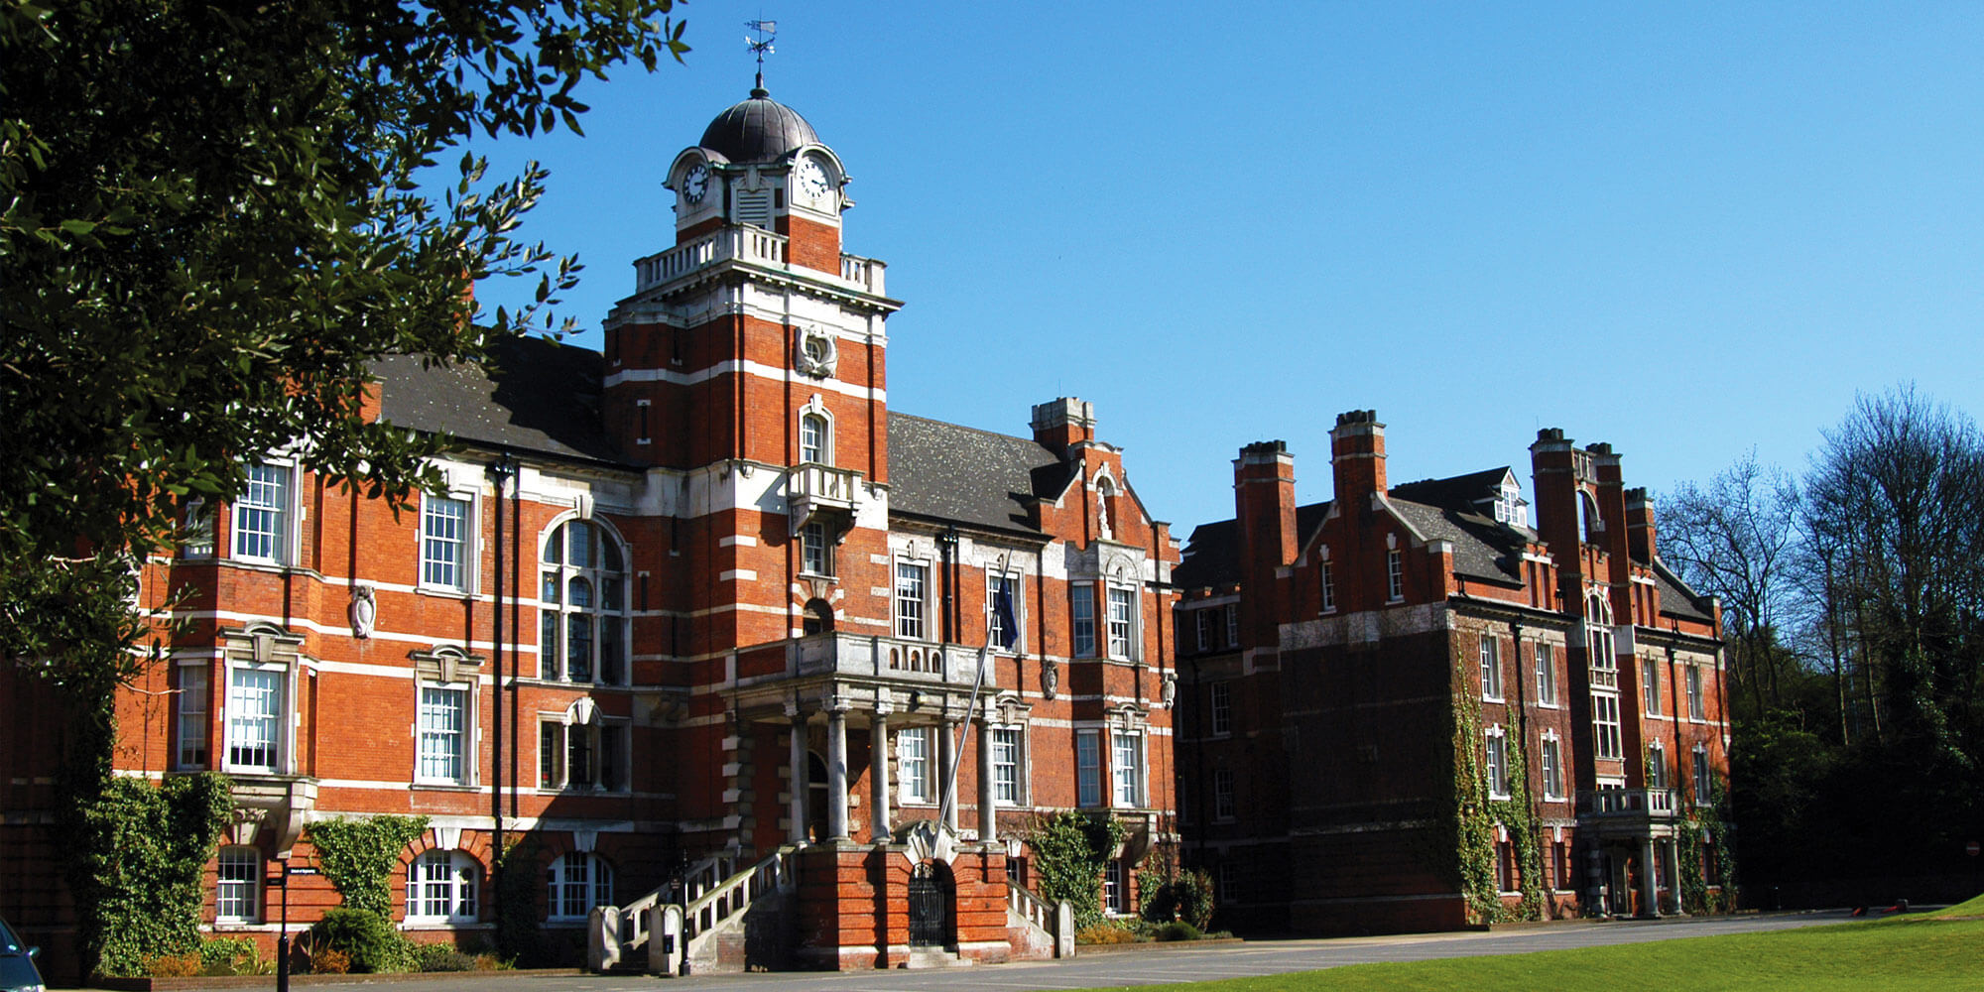
Natural Resources Institute
The Natural Resources Institute (NRI) is a specialist research, development and education organisation of the University of Greenwich, UK, with a focus on food, agriculture, environment, and sustainable livelihoods

Slide 3
ILRI offices and staff worldwide
ILRI is co-hosted by both the governments of Ethiopia and Kenya, with offices in 14 other countries in Africa (Burking Faso, Burundi, Mali, Mozambique, Nigeria, Tanzania, Uganda and Zimbabwe); 4 countries in Asia (China, India, Nepal, Pakistan and Vietnam); and staff hosted in Scotland, England and Costa Rica.

Slide 4
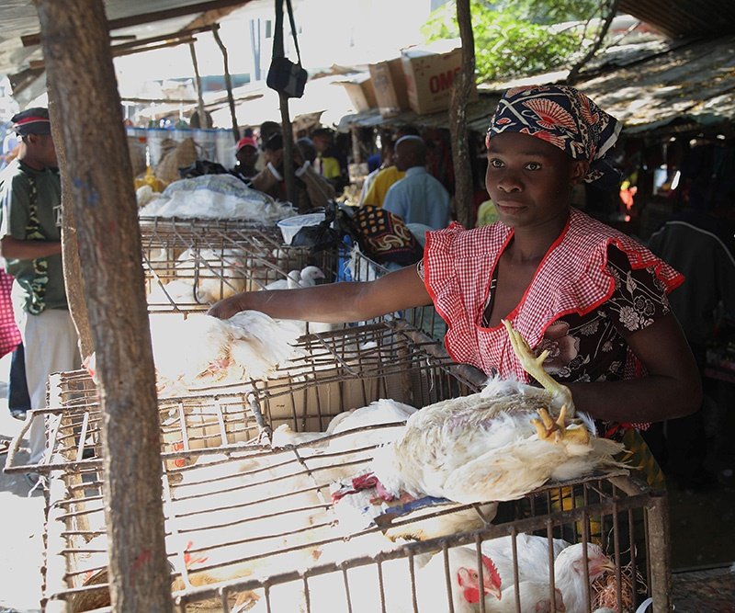
Zoonoses –the lethal gifts of livestock and wildlife
Acquiring diseases
A Few are Legacies
  Paleolithic baseline: yaws, staph, pinworms, lice, typhoid, TB
Most are Earned
  Degenerative diseases: CVD, diabetes, cancer
  Allergies, asthma, autoimmune diseases
  Sexually transmitted infections: HSV-2, gonorrhea
Many are Souvenirs
  Around 60% of human diseases shared with animals
  75% of emerging infectious disease zoonotic
  75% emerge from wildlife (often livestock as a bridge)

Slide 5
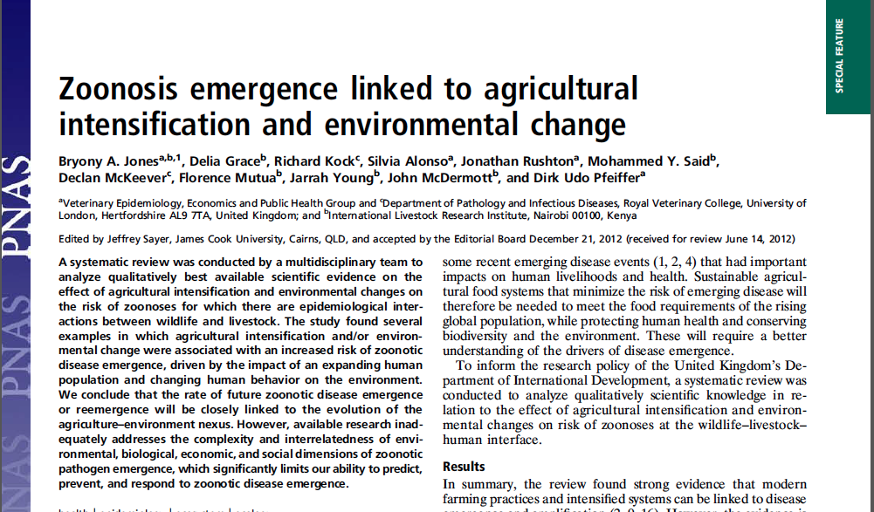
Spillover!
Increasing human population and density
Human behaviour
Expansion of agriculture
Intensification of livestock production
Pathogen flow
Secondary Host (livestock)
Spill-over
Spill-over
Habitat change
Biodiversity
Host density
Vector density
Sylvatic cycle
Vector
Reservoir Host (wildlife)
Secondary Host (human)
Spill-over
Type of pathogen: mutation, heterogeneity, host specificity
Sustained transmission:
peri-domestic or urban cycle
sub-clinical, epidemic, pandemic
Notes:
N.B. other domestic animals not just livestock
Wildlife to human – rabies – dead-end, Ebola – limited transmission, HIV – sustained transmission, Chikungunya – sustained transmission with peri-domestic vectors N.B. taxonomic similarity
Lyme disease, Chagas disease
Wildlife to horses to humans – Hendra, West Nile Virus
Wildlife to cattle, and to humans – Kyasanur Forest Disease
Wildlife to pigs/poultry to humans – JEV, Nipah virus, influenza
Wildlife and livestock to humans - RVF

Slide 6
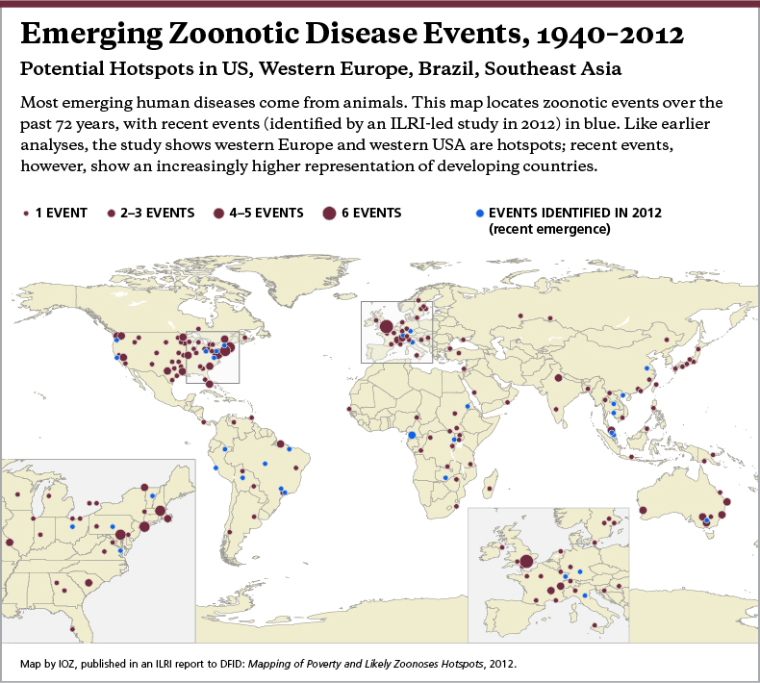

Slide 7
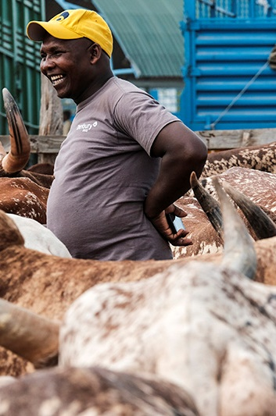
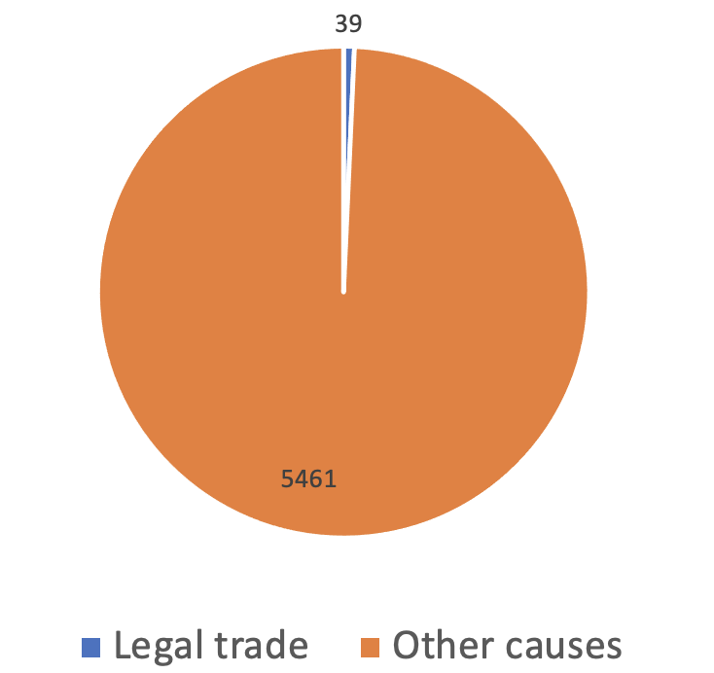
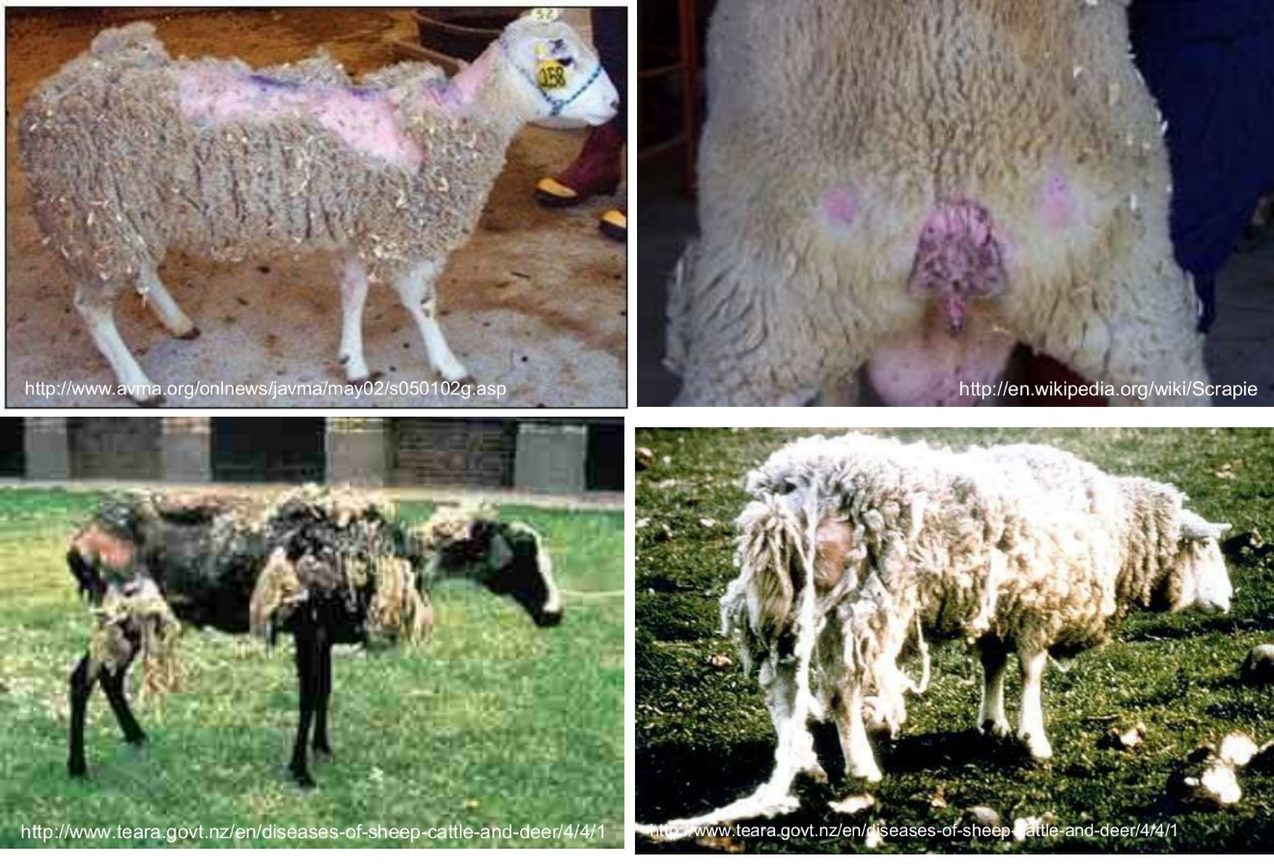
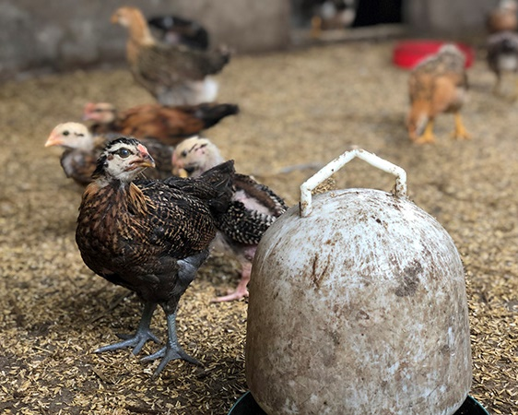
Legal trade : SPS
FBD outbreaks USA
USA (2005-2010)
Hawkes et al.,
Sheep with scrapie

Slide 8
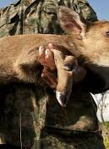
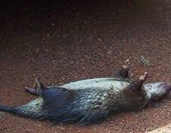
Illegal trade : No control
Livestock products
Bushmeat/wildmeat
  Most from CW Africa
Bushmeat
5 tonnes per week through Paris
4 tonnes per month through Brussels
9 tonnes per year through Geneva/Zurich
>14 tonnes per year through Heathrow

Slide 9
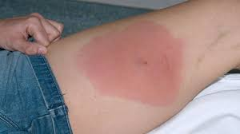
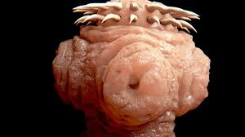
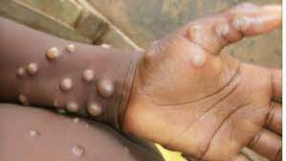
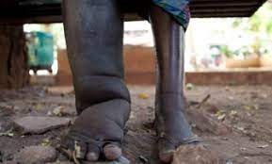
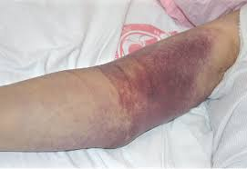
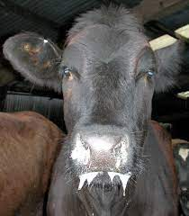
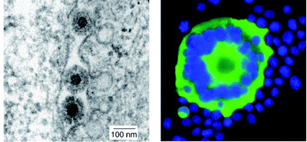
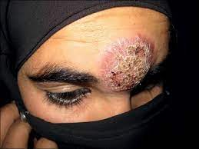
Hazard introduction through smuggled meat
Proven
Potential
Ebola
Marburg
Rabies
Anthrax
Leptospirosis
Rift Valley fever
Henipa

Slide 10
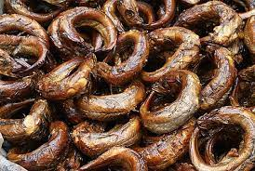

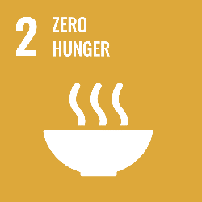



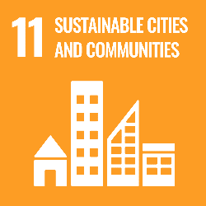


SDGs and Trafficking

Slide 11
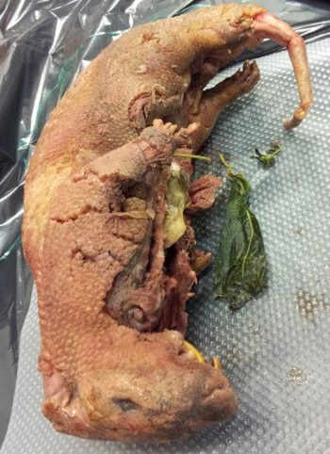
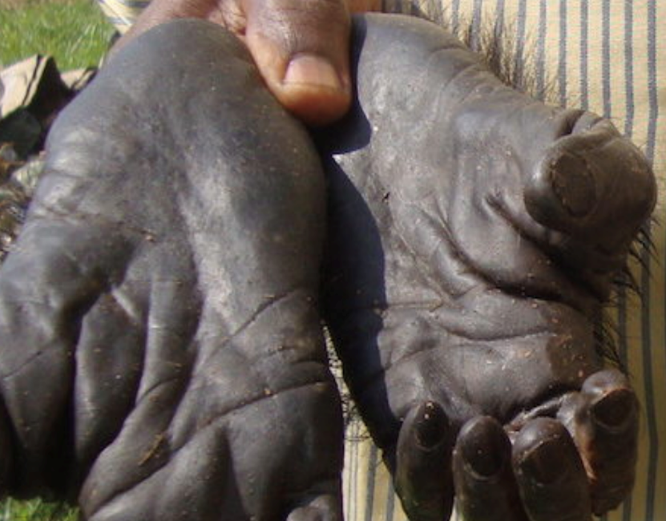
Illegal trade : Drivers
Diaspora communities
  Natural, tasty, healthy, treat
  Status; zootherapy; ritual (muti)
  Home consumption & sale (♀︎dominate)
  Exotic shops/ markets/ restaurants
Rapid increase in bushmeat extraction/technology
Price differential (1kg – $10 DRC $50 EU)
Lack of awareness (sometimes)
Low enforcement capacity
Mindset of officials (find but let through)
Identification (undefined meat)
Corruption
Photo: Tengwood Organization

Slide 12
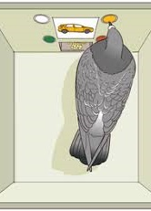
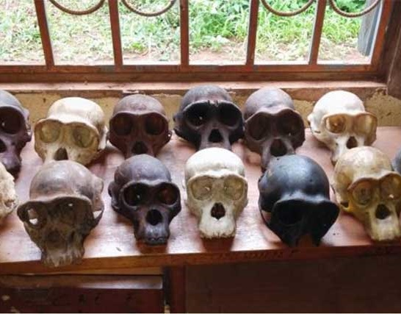
What can be done?
Better data – studies, surveillance
Change social norms - acceleration
Start with most risky (bat, primates, rodents…)
Risk reduction for hunters?
Incentives to search for import information
Strategies for personal & commercial
Make costs can exceed benefits
  Intermittent rewards highly reinforcing
Technology – rapid tests
Photo: Eagle Network
Notes:
Intermittent reinforcement is the delivery of a reward at irregular intervals, a method that has been determined to yield the greatest effort from the subject. The subject does not receive a reward each time they perform a desired behavior or according to any regular schedule but at seemingly random intervals.

Slide 13
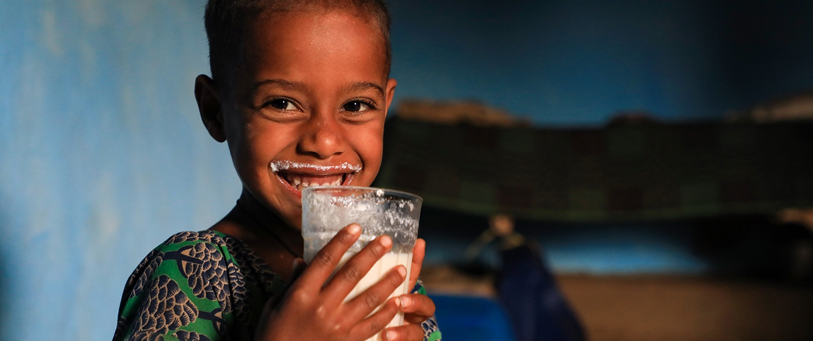
THANK YOU

