Slide 1
2023 Learning and Optimization Process
Inaugural Focus Group Discussion with IDTs
Addis Ababa, 18-19 April 2023

Slide 2
Objectives
Understand
what went well
what didn’t
how we might improve
Focusing on reflect and on Innovation Package Scaling Readiness
….but with space to think and talk more widely
Focusing on reflect and on Innovation Package Scaling Readiness
– but with space to think and talk more widely

Slide 3
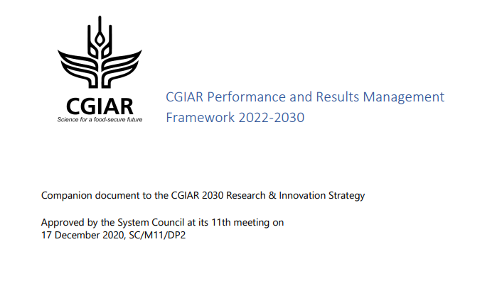
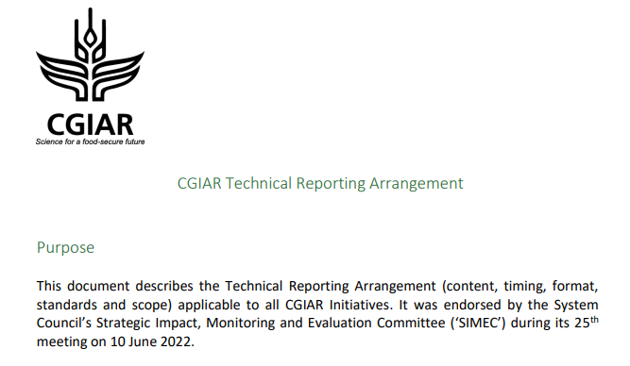


Overview: Technical Reporting progress
Develop and activate a fit for purpose performance and results management solution for CGIAR
Dec 2020
September – November 2022
June 2022
IDT Engagement
Template finalisation
Performance & Results Management System build
https://cgspace.cgiar.org/bitstream/handle/10568/113793/SC11-03b_CGIAR-Performance-and-Results-Management-Framework-2022-30_postmeeting.pdf?sequence=8
https://storage.googleapis.com/cgiarorg/2022/06/CGIAR-Technical-Reporting-Arrangement-June2022.pdf
Pooled funding Technical Reporting
Process & Product
Kicked off in Dec
December 2022
Big picture: We are globally on track
April 2023
Notes:
IDT engagement plan in Annex
Links to draft templates
RF next steps in Annex

Slide 4
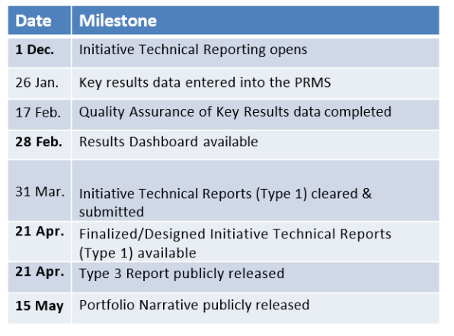
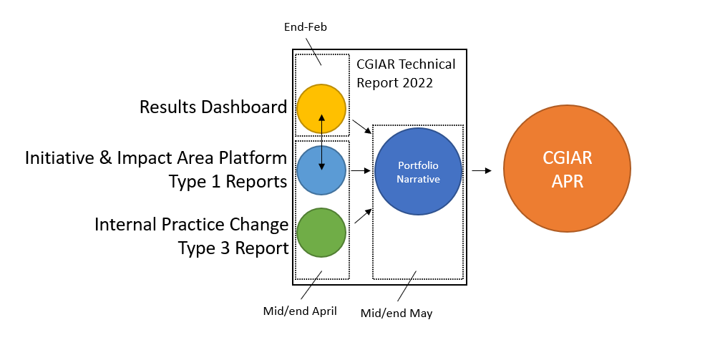
Technical Report delivery schedule
Week 24 April

Slide 5
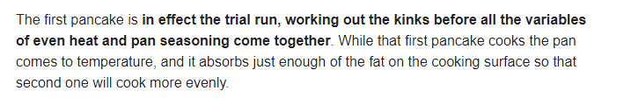


The First Pancake
Common Results Framework
Quality Assured Data
Common template
Dashboard
PRMS
Q2
Reflect Adaptive Management
Innovation Packages & Scaling Readiness
Results linked to TOC

Slide 6
The PPU hive is buzzing…
Innovation Portfolio Management
IATI
IPSR
Type 2
Tech Reporting Arrangement
Quality Assurance
Type 1
Learning & Optimization
PRMF
PRMS
Results dashboard
Portfolio Narrative
SLO Study
Templates
Report Reflect Re-Plan
Type 3
Analytics Machine
IDT support
OECD DAC scoring
Harmonized Tech Reporting

Slide 7
Learning and Optimization – Q2
X-cutting themes
Conceptual
Capacity
Stakeholder groups
Data collection and sensemaking Tools
System
Survey
Focus groups
Deep dive interviews
Pillars
Reflect
IPSR
QA ,
PRMS,
etc
Workflow
Process
Report &
Action Plan
Product

Slide 8
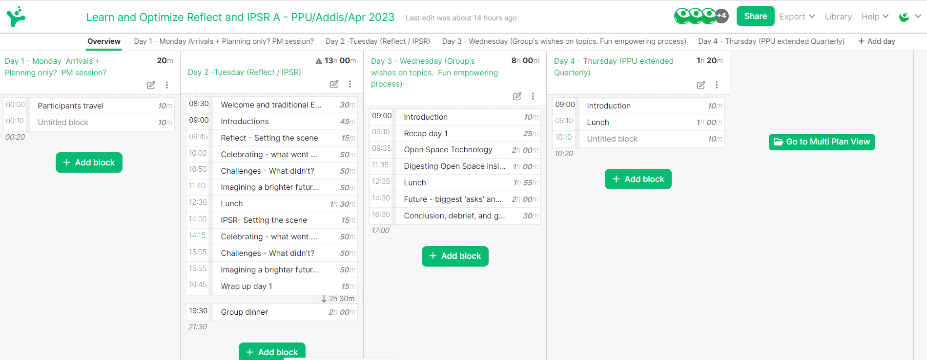
How will we spend these two days together?

Slide 9

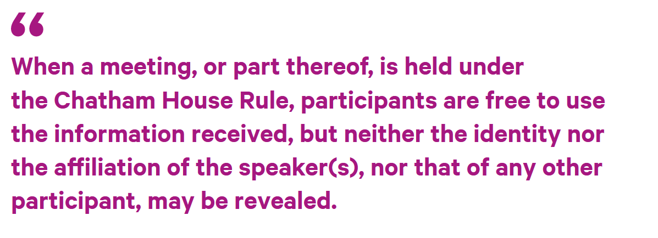
used around the world to encourage inclusive and open dialogue in meetings.
It allows people to speak as individuals, and to express views that may not be those of their organizations, and therefore it encourages free discussion.
People usually feel more relaxed if they don’t have to worry about their reputation or the implications if they are publicly quoted.

Slide 10
Stop here for Intro session

Slide 11
Reflect – setting the scene
The report -> reflect -> re-plan process
Dec.
Jan.
Feb.
Mar.
Apr.
Old regime
Plan
Budgets for the year ahead
Report
On previous year’s performance
New regime
Report
On previous year’s performance
QA
Reflect
On implications for the year ahead
Re-Plan
Update Plans of Results; Update Budget Forecasts
The new approach helps institutionalise
evidence-led adaptive management
Notes:
Summary:
The Report -> Reflect -> Plan sequence is intended to:
Give structured space for Initiatives to exercise learning-driven adaptive management during implementation
Reduce burden on Initiatives by integrating reporting, program management and planning processes
Background:
CRP leaders reportedly found it difficult to adjust financial and staff plans in the year ahead in light of experience gained from the previous year. The systems were complex and slow, and annual reports for the previous year were submitted after the planning was completed for the year ahead.
Changing the annual sequence of reporting and planning for Initiatives gives us the opportunity to change this, and to create a formal process for adaptive management by Initiative leads and co-leads.
This new sequence, set out in the figure below, will see Initiatives report on the previous year’s progress by 25th January. This means that each year, before plans and budgets are set in February, each Initiative will have a window of opportunity to reflect on progress in the current year, on any changes in their operating context, and on any changes to the outlook. On the basis of those reflections, the Initiative can make recommendations to reprioritize budgets and planned activities for the year ahead, between their work packages and within their overall budget envelope. The recommendations would be approved by Science Group Directors, and both reflections and recommendations would be documented in a light-touch way. We are calling this process the ‘reflect’ process.
This process would give Initiative leaders a clear process and mandate to adjust Plans of Results and Budgets for the year ahead – shifting the delivery priorities for their teams, and shifting budgets between Work Packages if necessary, to help the Initiative best navigate towards delivering their End of Initiative Outcomes and maximize their ultimate contribution to impact.

Slide 12
Language matters: four (imperfect) ways to describe this
Report
Reflect
Re-Plan
1
2
What
So What
Now What
3
Hindsight
Insight & Foresight
Action
4
Annual Reporting
Annual Internal 'Stage-gate'
Annual Plan of Results & Budget
Documenting what happened over the previous year (might also require some reflection!!)
Considering whether your Initiative should make any internal reprioritisation decisions for the year ahead
Turning those decisions into action by altering budgets and targets for the year ahead

Slide 13
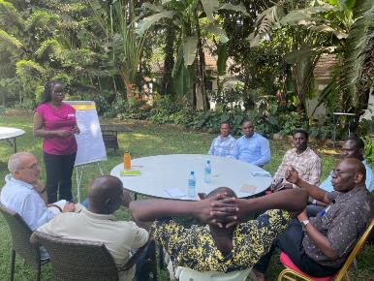


Reflect in progress:
“That's a real improvement over the CRPs! We'll need to make it work….”
Simon Heck, Director General, CIP
(commenting on the new report-reflect-replan sequence)
Initiatives supported with guidance document here, a ‘deep dive’ session on reflect recording is here, and corresponding slides here.
Managing Directors provided steer per AA and timelines for submission of draft recommendations (=section 7 of annual report)
Notes:
Clockwise from bottom left:
U2 reflect workshop
SAPLING reflect workshop
Feedback received so far is positive – we think it is going well and will have a much better sense once Reports are submitted this month.
Initiatives have taken ownership of the process, and reflect in different ways: done intense, in-person weeklong events, others a mix of shorter meetings or even started last year.

Slide 14
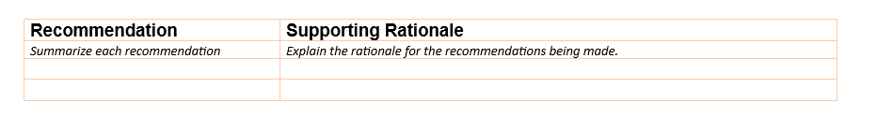
Deliverables: what *must* Initiatives submit for reflect?
One A4 page
containing recommendations for the year ahead, and supporting rationale
approved by SMD
as part of your Annual Report…
…which must be submitted by 31st March
Constitutes Section 7 of the Type 1 Reporting Template

Slide 15
Stop here for Setting the Scene session

Slide 16
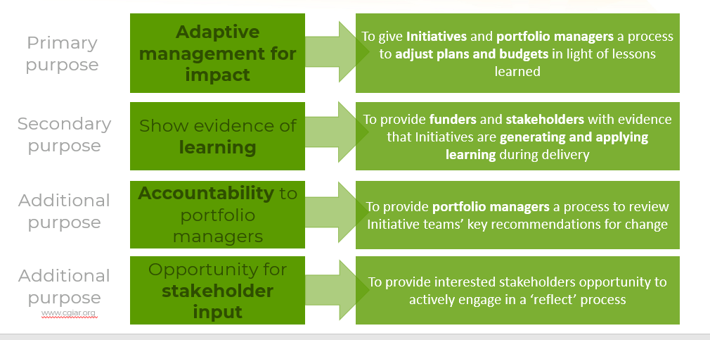
Reflect – celebrating what went well
Recap of purpose
Primary purpose
Adaptive management for impact
To give Initiatives and portfolio managers a process to adjust plans and budgets in light of lessons learned
Secondary
purpose
Show evidence of learning
To provide funders and stakeholders with evidence that Initiatives are generating and applying learning during delivery
Additional purpose
Accountability to portfolio managers
To provide portfolio managers a process to review Initiative teams’ key recommendations for change
Additional purpose
Opportunity for stakeholder input
To provide interested stakeholders opportunity to actively engage in a ‘reflect’ process

Slide 17
Stop here for Celebrating Success

Slide 18


Reflect: imagining a brighter future
Framing 2024
Reflect
Reflect

Slide 19

The next phase of Initiative delivery!
2025
2026
2027
2022
2023
2024
2028
2029
2030

Slide 20

Proposed Portfolio delivery process 2023-24
No doubt this timeline will change! But…
The next reflect period has scope to provide an excellent input into the next proposal development process
2023
2024
Apr
May
June
Jul
Aug
Sept
Oct
Nov
Dec
Jan
Feb
Mar
Apr
May
June
July
Aug
Sept
Oct
Nov
Dec
Transparent, inclusive portfolio co-creation process w/all four stakeholder groups
Proposal Development
Proposals reviewed & approved
SC18 Process endorsement
SB & SC Progress Updates
SC Portfolio approval
SB26 Process endorsement
Regional and thematic consultation: Regional Directors and Impact Area Platform Directors
SB Portfolio Recommendation

Slide 21
Stop here for framing the future

Slide 22
Status Overview
Innovation Portfolio Management
IATI
IPSR
Type 2
Tech Reporting Arrangement
Quality Assurance
Type 1
Learning & Optimization
PRMF
PRMS
Results dashboard
Portfolio Narrative
SLO Study
Templates
Report Reflect Re-Plan
Type 3
Analytics Machine
IDT support
OECD DAC scoring
Harmonized Tech Reporting

Slide 23
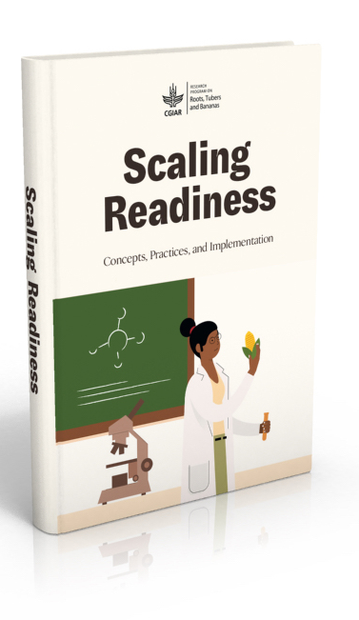
Innovation Packages & Scaling Readiness (IPSR)
IPSR represents the CGIAR use of the Scaling Readiness to:
  Keep overview and track CGIAR Innovations
  Identify CGIAR and partner synergies around country demands and Innovation Packages
  Tackle key bottlenecks for scaling through partnerships
  Inform innovation portfolio management
For the moment, IPSR applies to the pooled portfolio and forms an integral part of the PRMF, and the Type-1 annual reporting arrangements.

Slide 24
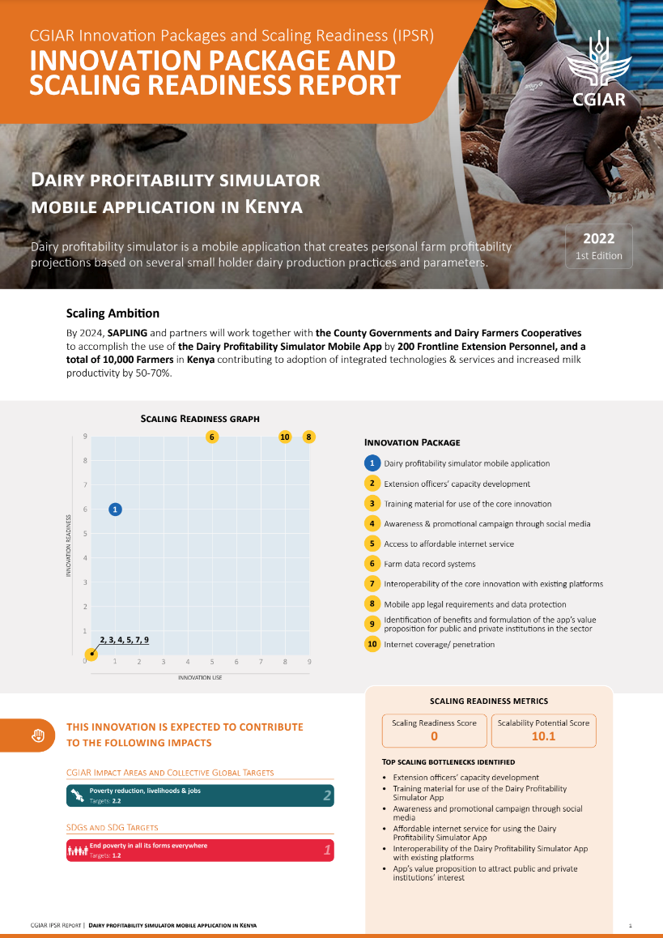
IPSR definitions
Innovation: New, improved or adapted outputs or groups of outputs such as products, technologies, services and institutional arrangements with high potential to contribute to positive impacts when used at scale.
Innovation Packages: Combinations of interrelated innovations and enabling conditions that, together, can lead to transformation and impact at scale in a specific context.
Scaling Readiness: Metric that combines single or average innovation readiness and innovation use scores at innovation package or portfolio level.

Slide 25
Scaling Readiness in CGIAR
2019
2020
2021
2022
2017-18
An idea is born…
Scaling Readiness conceptual design, testing and proof of concept by WUR and IITA under CGIAR Research Program RTB
ILRI I@S launches series of internal scaling sensitization workshops
Initial engagement with SMO
ILRI I@S + Livestock CRP pilot
CGIAR/ RTB Scaling Acceleration Fund adopts Scaling Readiness
Stage-gating workshop
Performance and Results Management Framework (PRMF)
Capacity and buy-in
Conceptual alignment with CGIAR 2030 R&I Strategy
IPSR in Initiative proposals
Living Lab with ILRI I@S
IPSR in Initiative PoRB
IPSR capacity development
FIA/ GIZ encourage CGIAR to report on innovation readiness & innovation use
IPSR course launch
IPSR integration in PRMS/ reporting
IPSR CGIAR pilot
Mini-portfolio pilot
IPSR Innovation Profiling roll-out
Beyond CGIAR interest
First wave of One CGIAR reporting of IPSR core innovations (pooled only)

Slide 26
IPSR overview
Resource mobilisation for prioritized innovation packages with high transformation/ impact potential
Develop context-specific scaling strategies
Scaling Strategies
Design context-specific Innovation Packages for selected innovations
Innovation Packages
Track changes in innovation readiness over time (type 1 reporting)
Profile all CGIAR innovations developed under the pooled portfolio
Innovation Profile
Track changes in Innovation Packages readiness and use (type 1 reporting)
Develop clarity on “What is it that we are trying to develop and scale?”
Fit-for-purpose CGIAR synergies and external partnerships
4
1
2
Innovation
Portfolio
Manage-ment
3

Slide 27
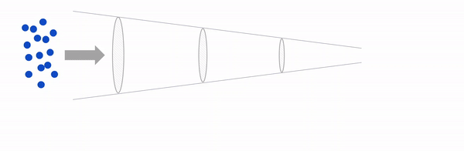
Innovation Packages and Scaling Readiness (IPSR)
2022 IPSR focus
2023 IPSR focus
2024 onwards IPSR focus
1
Profile all CGIAR innovations
outputs
2
Develop innovation packages for scaling ready innovations
outcomes
3
Develop scaling strategies
impact
4
Innovation Portfolio Management

Slide 28

IPSR as scaling the new way in CGIAR
Scaling the old way | Scaling the new way
Lack of a single framework that links science and delivery | Integrated framework that connects science (innovation readiness) and delivery (innovation use)
Unrealistic ideas about innovation and scaling pathways | Track innovation readiness and innovation use along an impact pathway
Limited availability and use of evidence in innovation management | Collect and use evidence in a continuous way to inform quality decision-making
Limited space for (reporting) failure (pilots never fail, pilots never scale) | More space for learning and adaptive management; avoid scaling innovations that are not working
Limited internal collaboration, synergies and co-investment with partners | CGIAR Initiatives, non-pooled projects and partners collaborate on context-specific innovation packages
Limited attention for improving enabling environment | Increased CGIAR and partner investment in enabling conditions that can lever scaling of innovation
Limited innovation portfolio management (prioritization, risk, resource allocation) | Ensure a healthy and diverse innovation portfolio that delivers against short- and long-term goals

Slide 29
Stop here for IPSR setting the scene

Slide 30
What did IPSR set out to do in 2022?
Redesign – Simplify the original Scaling Readiness approach to meet the minimum viable requirements and CGIAR’s implementation reality. Profiling innovations can now be completed in less than an hour, and the more complex innovation package process has been reduced to a 1-day workshop, while still assuring quality data.
Pilot – IPSR products and tools have been successfully piloted with four ‘early adopter’ CGIAR Initiatives, Over 60 innovations were profiled and published and three innovation package design workshops conducted in Tanzania, Kenya and Zambia. An innovation portfolio management pilot with the CGIAR Initiative on Diversification in East and Southern Africa
Integrate – IPSR is now fully integrated into the CGIAR technical reporting arrangement and the Performance and Results Management System (PRMS), which includes a quality assurance process to ensure that scaling readiness assessments are evidence-based. IPSR will feed the CGIAR results dashboard, strategic communication, and portfolio management.
Capacity – A small team at PPU/IPSR and larger group of experts across the system. More than 1,600 students enrolled in an online course on innovation and scaling developed in English, French and Spanish, to strengthen innovation and scaling capacity more broadly in the agricultural sector.
Engage – To nurture broader innovation and scaling culture, the IPSR team is engaging with innovation and scaling champions from across the CGIAR System, set up close collaborations with the scaling teams of BMGF, GIZ etc.

Slide 31
IPSR 2022 and 2024 ambitions
IPSR Components | End 2022 Key Results | End 2024 Key Results
Innovation Profiling | Early-adopter Initiatives have profiled >90% of their innovations | 95% of the Initiatives have profiled their innovations
 | 50% of other Initiatives have profiled at least 5 innovations | 70% of Innovation Profiles have been updated
Innovation Packages and Scaling Readiness Assessment | At least 10 Innovation Packages have been designed and assessed for their Scaling Readiness | At least 20% of profiled core innovations have been included in Innovation Packages design and Scaling Readiness assessment
 |  | At least 30% of Innovation Packages/ Scaling Readiness Assessments have been updated
Scaling Strategy |  | IPSR has supported the design of scaling strategies for 10 innovations with transformative impact potential
Innovation Portfolio Management | Provide an initial searchable database with at least 120 innovations populated into it | An interactive innovation portfolio dashboard is available for innovation developers, Initiative Teams, portfolio managers and/or funders
1
2
3
4

Slide 32
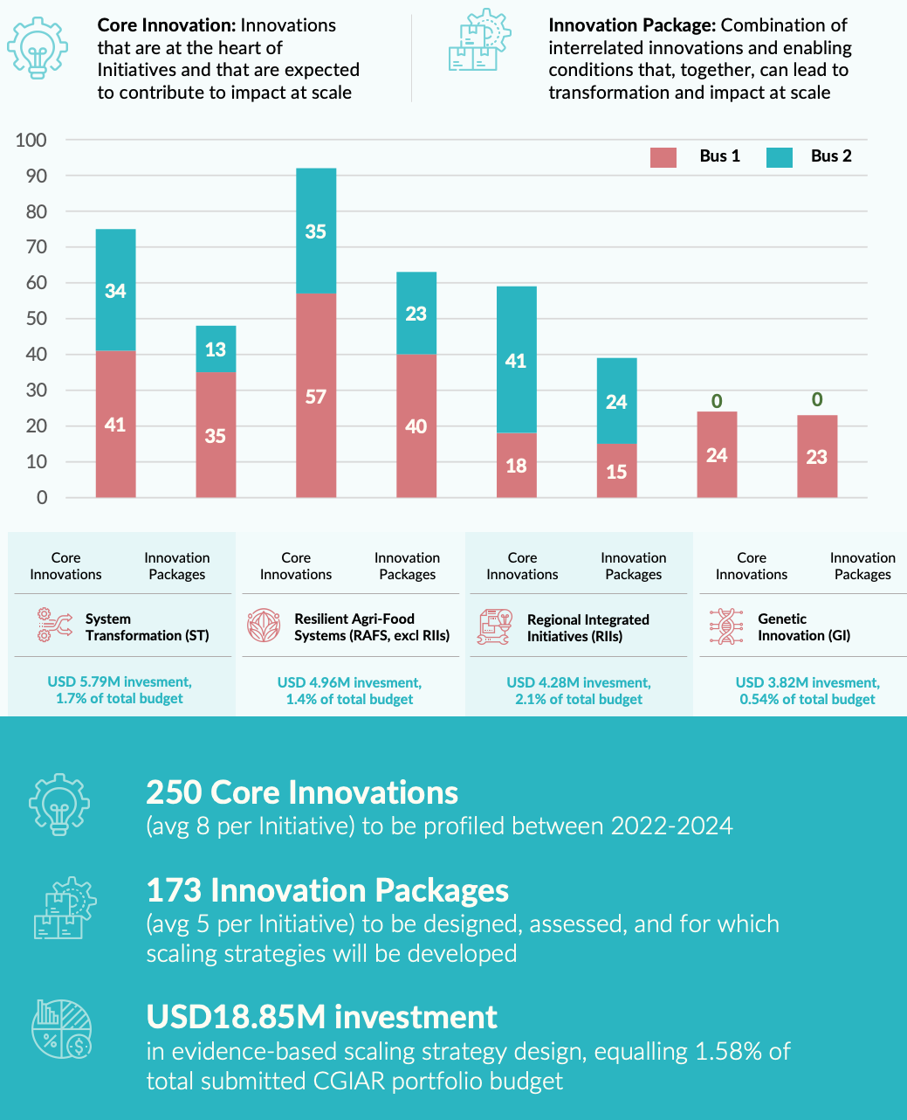
Scaling ambition in Initiative proposals (Dec 2021)
All initiatives included IPSR ambitions and plans in their 2021 proposals
Over the 2022-2024 Cycle, Initiatives collectively aimed to
  profile 250 core innovations at output level; and
  Package 173 Innovations at outcome level

Slide 33
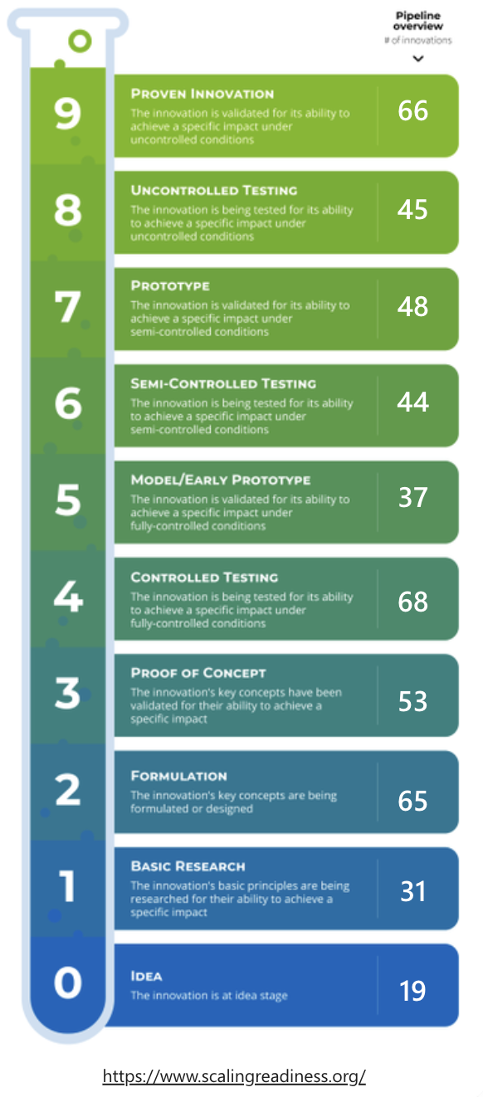
Zooming in on reported CGIAR innovations in 2022
477 CGIAR Innovations reported
Lowest reported # of innovations per Initiative = 2
Highest reported # of innovations per Initiative = 99 (of which 59 breeding pipelines)
58% technological innovations of which 28% new/improved varieties/ breeds
59 Innovation Use cases reported (~4M users)
Top 3 countries: Ehtiopia (54), Kenya (48), Bangladesh (42)
844 unique partnerships on innovation development

Slide 34
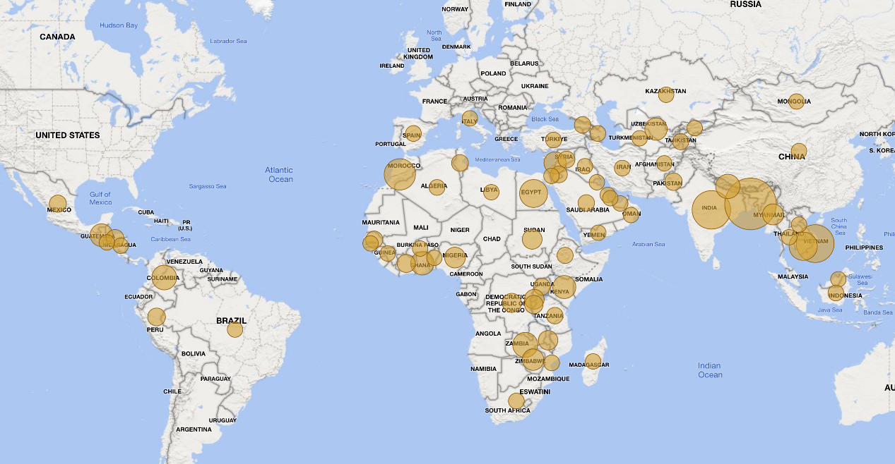
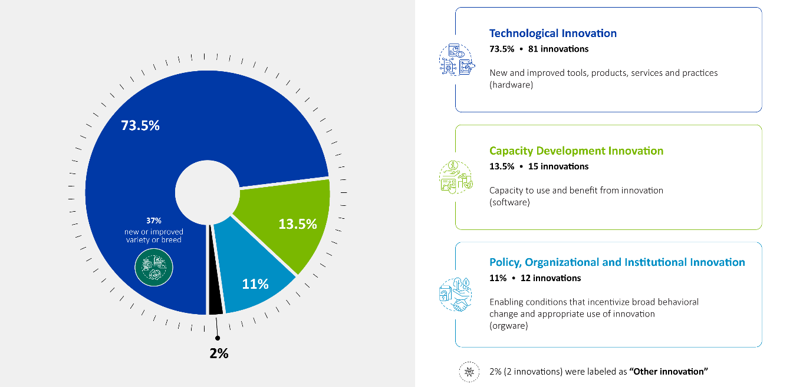
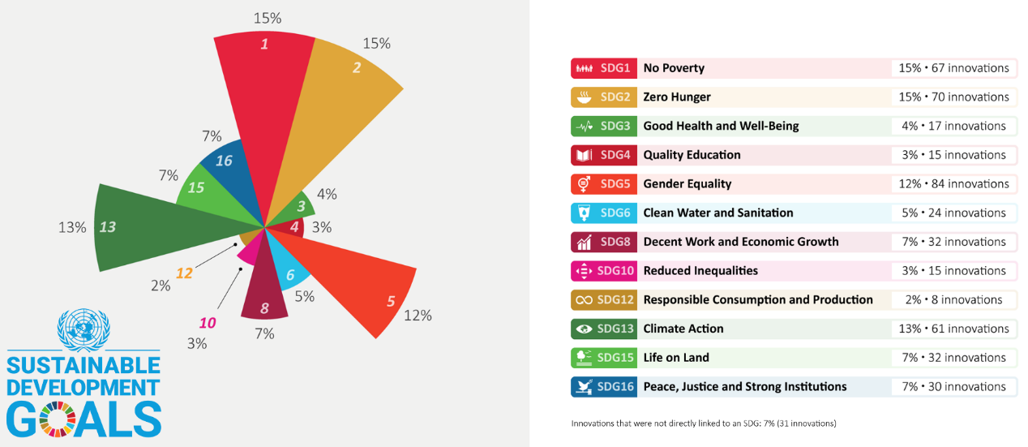
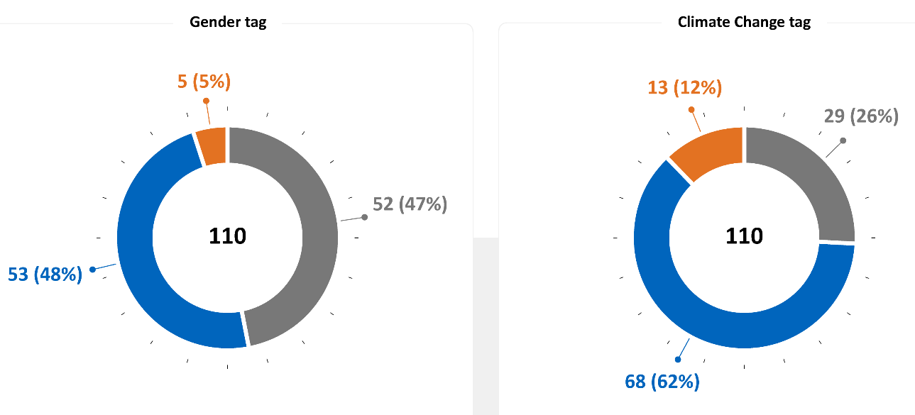
Innovation meta-data overview (a selection)
Notes:
8 Innovations reported as legacy innovations

Slide 35
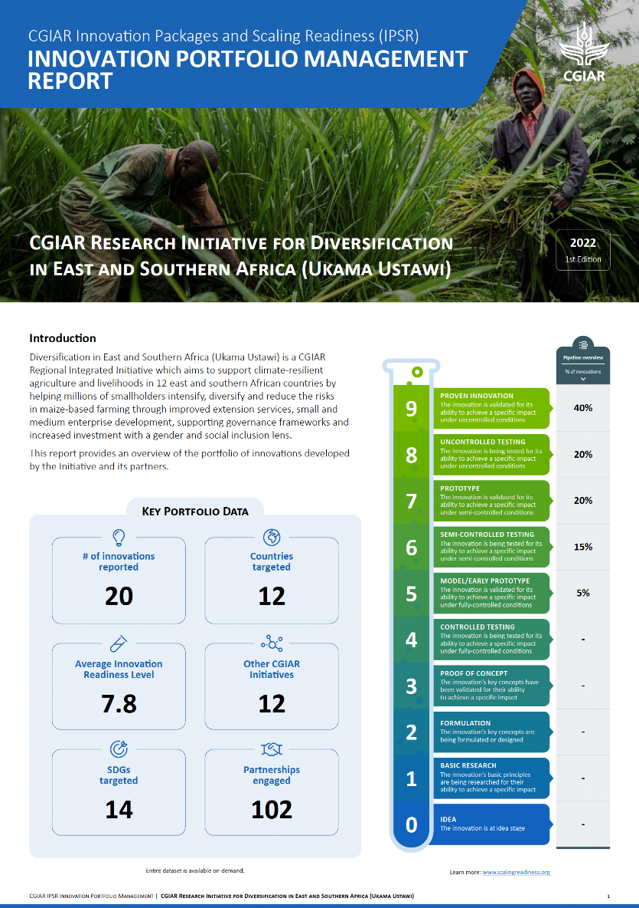
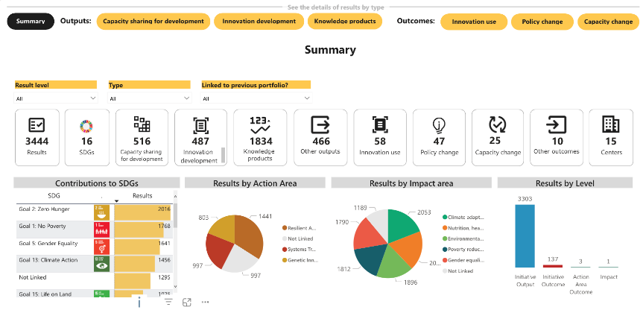
Other types of Innovation Portfolio overviews
At AA/ SG level
At Initiative level
At country level
At CG centre level
Notes:
IPM overviews can be generated for:
System level
Action Area level
Initiative and WP level
Country and regional level
SDG or Impact Area level
Country and Regional level
Thematic level (etc.)
For specific funders or partners

Slide 36

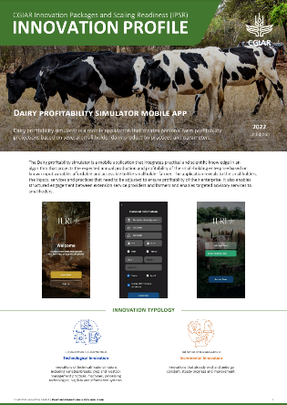
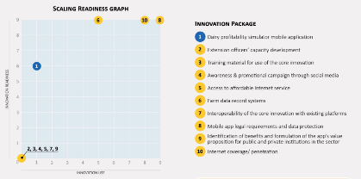
Next steps: IPSR 2023 focus on Innovation Use
From Innovation Readiness → Scaling Readiness for those innovations with readiness level (e.g. >6)
Innovation Packaging
Scaling Readiness assessment (evidence-based)
Initial scaling strategy design
Example of innovation package and scaling readiness report

Slide 37
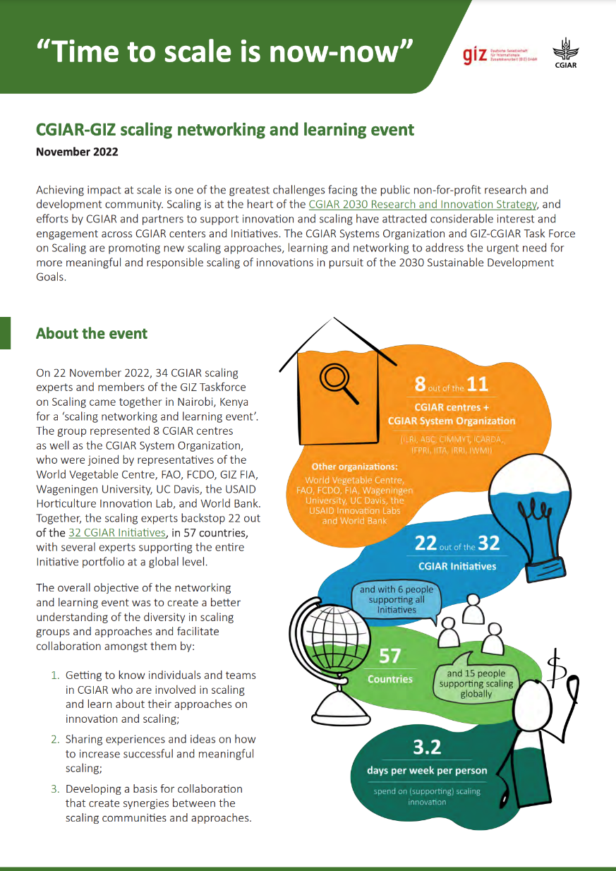
Next steps
From static to dynamic portfolio overviews
Modifications and improvements to innovation reporting systems
ToT workshops planned for May 2023 in Nairobi and Mexico City for CGIAR experts (incl. GIZ scaling taskforce members, WBG Colombia)
Expand ongoing collaborations and impact culture growth
Explore new ways of using the Scaling Readiness approach with CGIAR and partners (e.g. to design a World Bank program on strengthening AIS in Colombia)

Slide 38
Useful links:
CGIAR Performance and Results Management Framework (PRMF)
CGIAR Technical Reporting Arrangement
Type 1 Technical Report Template
Performance & Results Hub
Scaling Readiness website
Online course on Innovation and Scaling
Thank You!

Slide 39
Innovation types definitions
Technological Innovation: Innovations of technical/material nature, including varieties/breeds; crop and livestock management practices; machines; processing technologies; big data, and information systems.
Capacity Development Innovation: Innovations that strengthen capacity, including farmer, extension or investor decision-support services; accelerator/incubator programs; manuals, training programs and curricula; online courses.
Policy/Organisational/Institutional Innovation: Innovations that create enabling conditions, including policy, legal and regulatory frameworks; business models; finance mechanisms; partnership models; public/private delivery strategies.

Slide 40
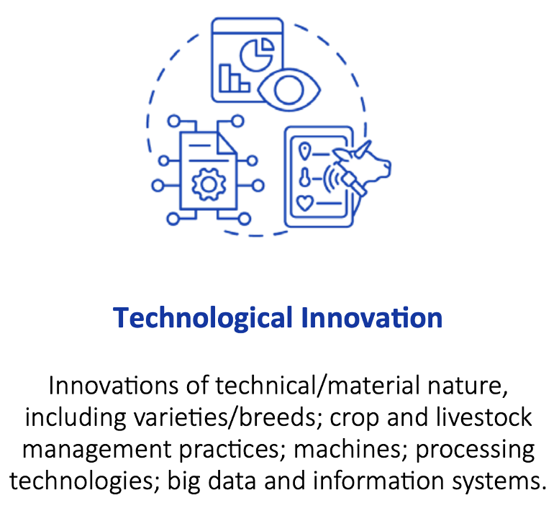
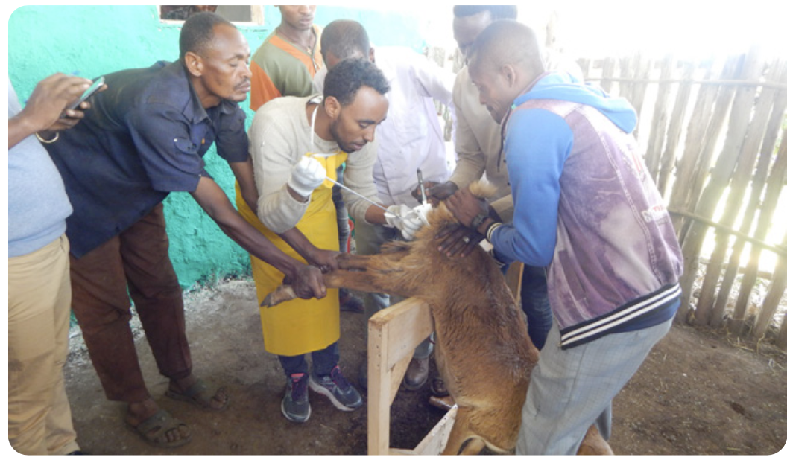
Technological Innovation
CGIAR Example: Reproductive platform delivering reproductive services such as fixed-time artificial insemination and sires’ certification in sheep and goat community-based breeding programs sites and disseminating genetic gain in small and medium-scale livestock systems.
https://hdl.handle.net/10568/127117

Slide 41
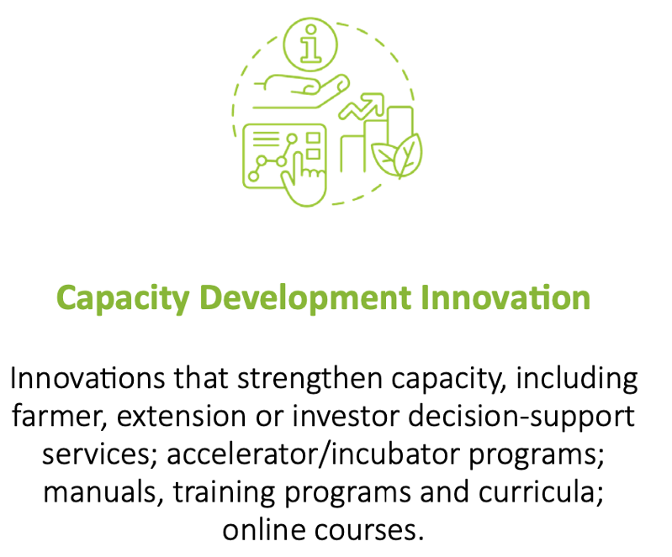
Capacity development Innovation
CGIAR Example: Shamba Shape Up: Using digital channels to deliver bundled agriculture, climate, and financial information services.
Farmers receive key climate information and financial services bundled with agriculture extension and support with climate-smart agriculture solutions through digital channels.
https://hdl.handle.net/10568/126423

Slide 42
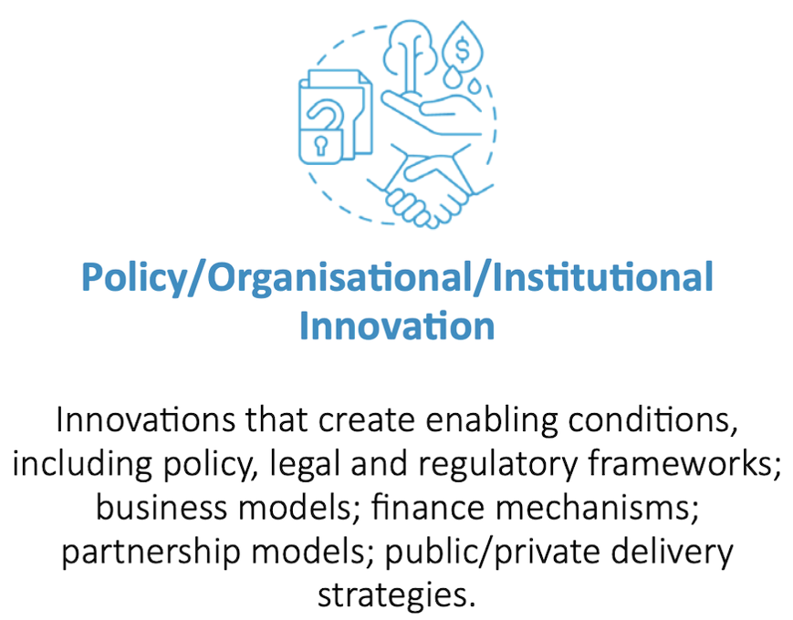
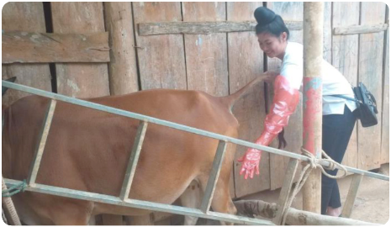
Policy, Organisational, Institutional Innovation
CGIAR Example: Gendered business models for improved cattle artificial insemination service delivery in Vietnam.
Gender-sensitive business models for artificial insemination service providers for cattle in Vietnam, focusing on economic performance and social responsibility.
https://hdl.handle.net/10568/126009

Slide 43
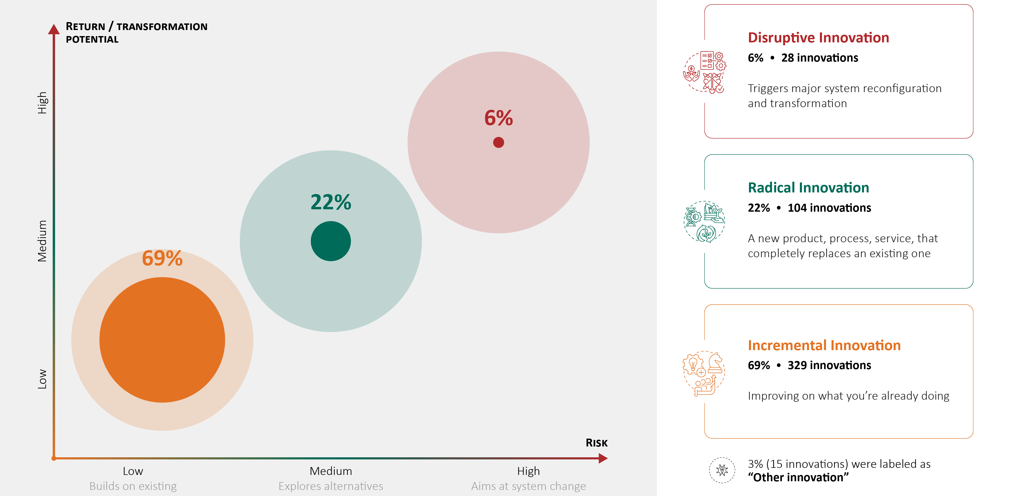
Zooming in: Innovations by nature
Initial analysis: subject to change as data QA is completed
Notes:
Potential talking points:
This breakdown of the innovation portfolio shows quite a healthy picture of the nature of innovations that are being developed by CGIAR and partners
Incremental innovations usually make up the dominant majority of the portfolio, are closely tied to the organization’s core business, and fulfil known demands of clients (farmers) and scaling partners
Radical innovations aim at replacing existing products, services and practices. Demands of clients and partners may not be entirely clear. Failure risks are medium, but also the potential returns are usually higher compared to incremental innovaitons
Disruptive innovation is where traditional approaches, models and systems fail and requires new capabilities. Although the risks of failure are higher, their potential to contribute to system transformation is also higher

Slide 44
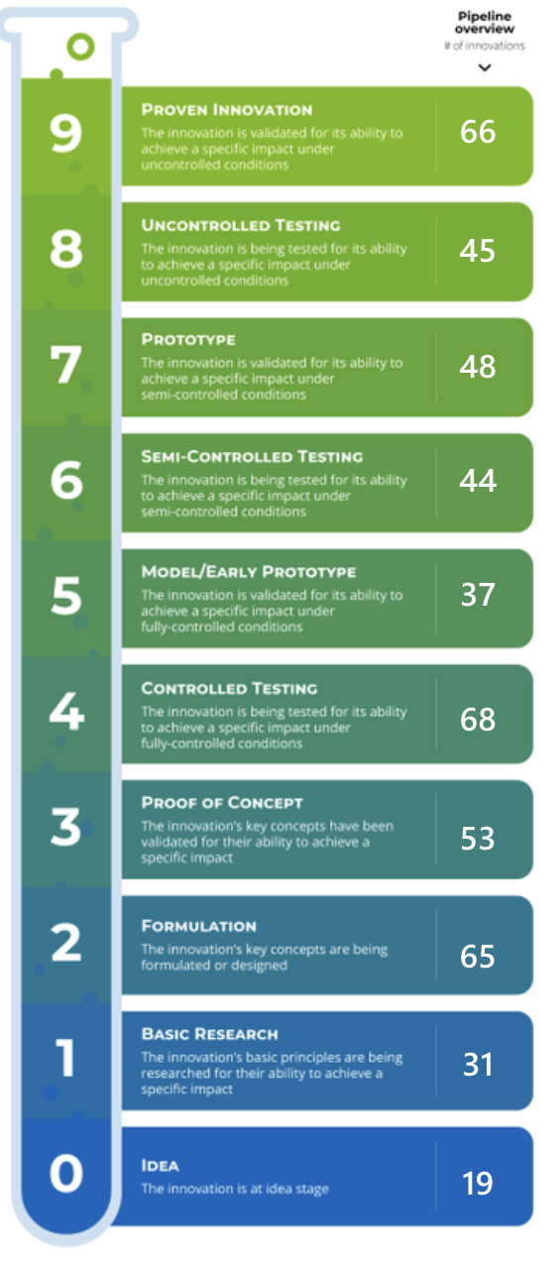
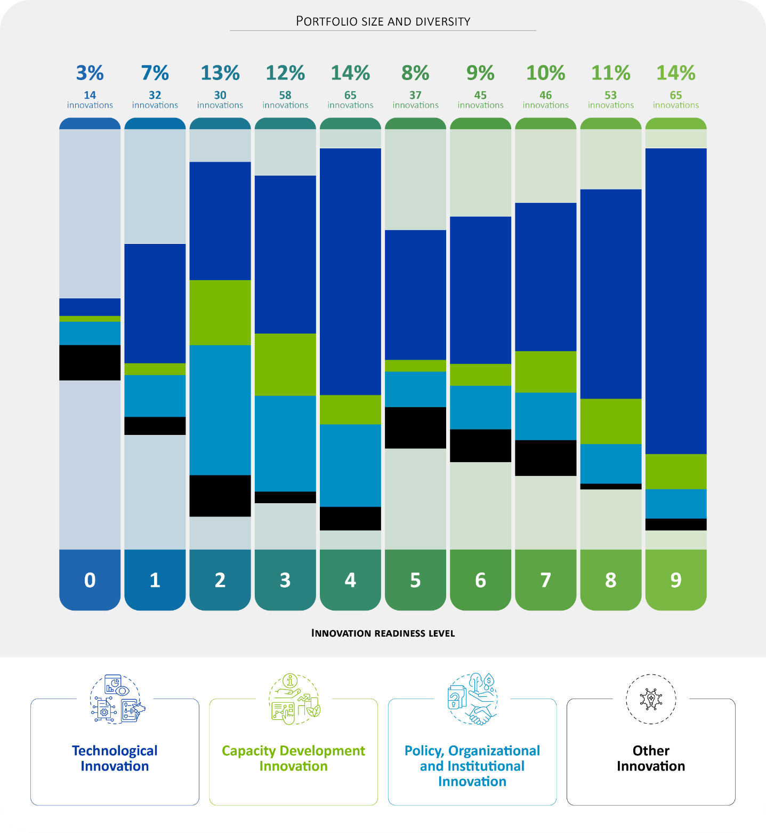
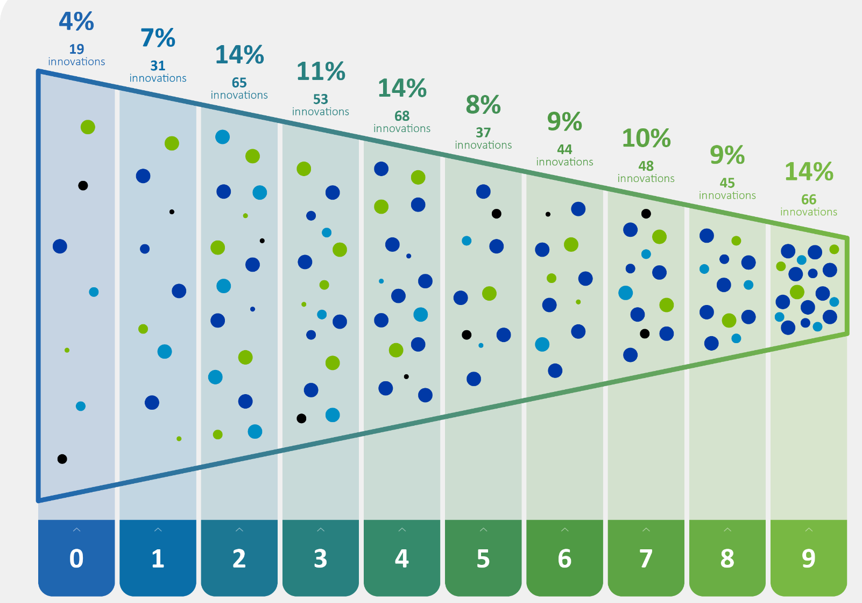
Zooming in: Innovation pipeline
477
innovations profiled
Innovation readiness
Pipeline overview: innovation readiness
Notes:
Potential talking points:
It is very important to have this granular and evidence-based overview of CGIAR innovation development. We can now monitor how innovations move through the pipeline and overall pipeline diversity and health over time.
We can observe concentration around (1) innovations formulation and testing in controlled environment (e.g. lab research) (levels 2-3-4) and (2) innovation testing and validation in uncontrolled environment (level 8-9)
We can also observe that there is relative high number of policy/ organisational and institutional innovations that are being formulated and tested
The currently pipeline does not have the typical funnel shape that reflects investment in many early stage innovations that are then gradually prioritized and filtered as they become more ready for scaling (stage-gating).
Adding in the CGIAR innovations that are being developed under the non-pooled portfolio and linking innovation development to USD investment can provide a more granular image of the pipeline

Slide 45
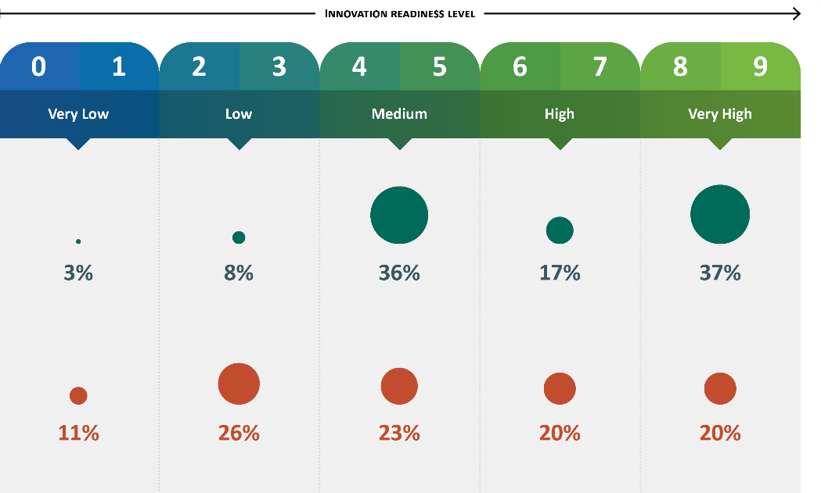
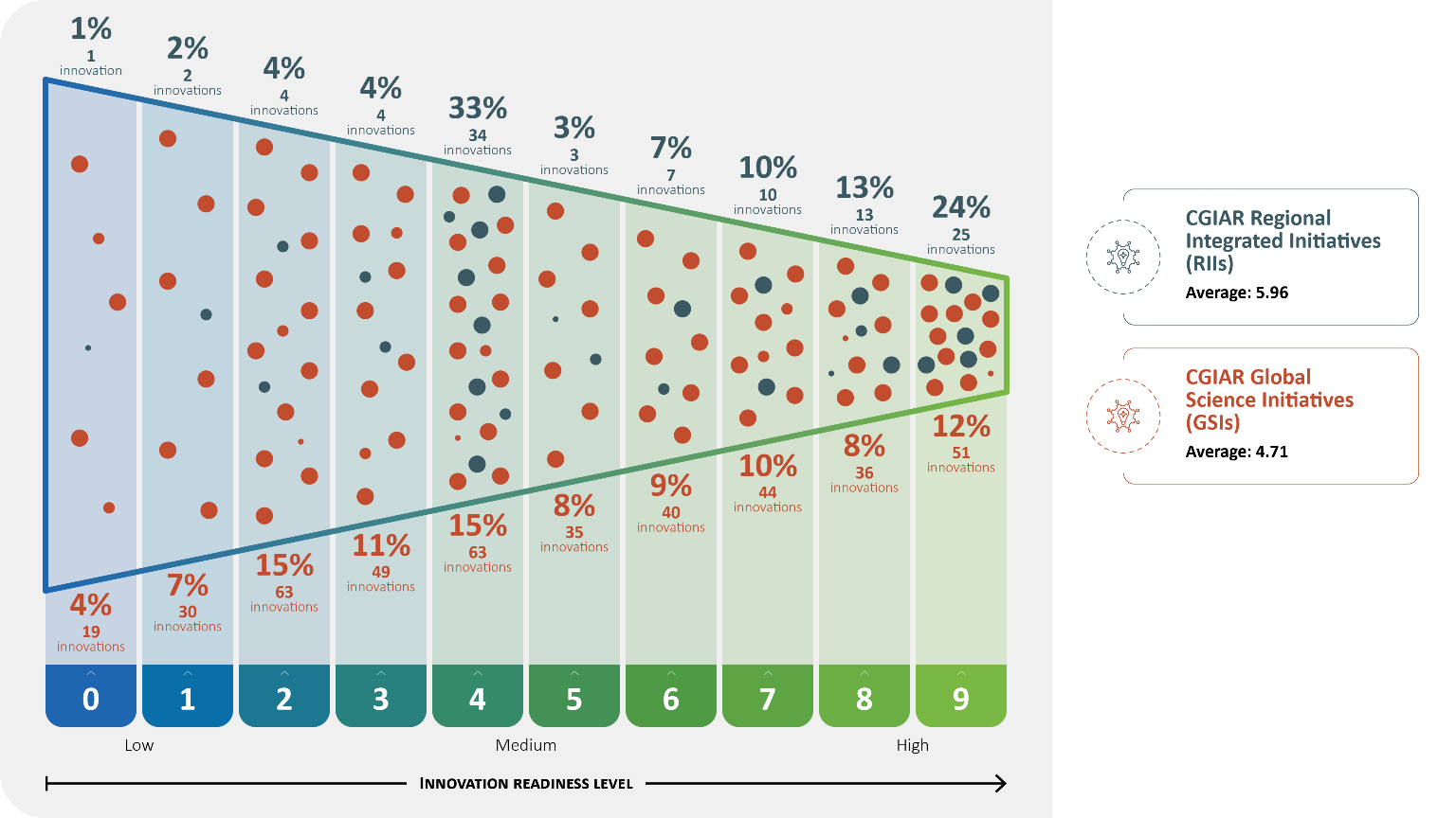
Zooming in: RIIs and Global Science Initiatives
Regional Integrated Innitiative average Innovation Readiness is 1.25 higher than average of Global Science Initiatives
Tells story of how RIIs focus more on innovation adaptation, validation and scaling (medium/high readiness levels), whilst Global Science Initiatives focus more on innovation ideation, formulation and testing (lower/ medium readiness levels)

Slide 46
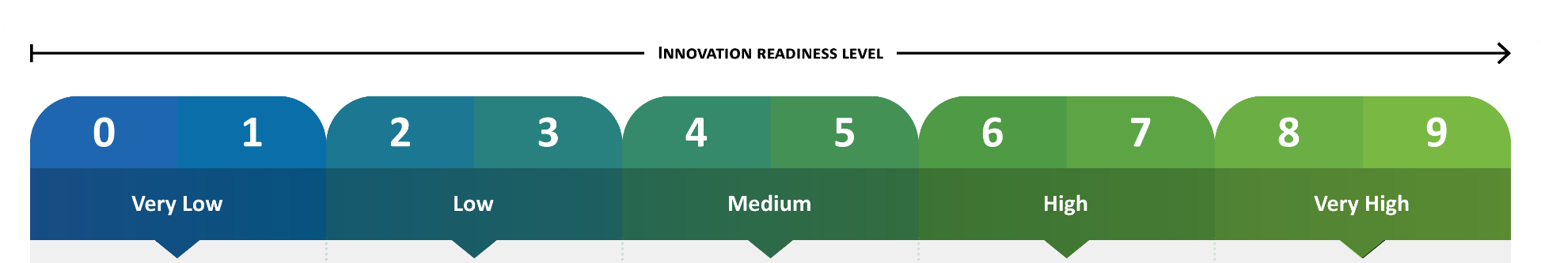
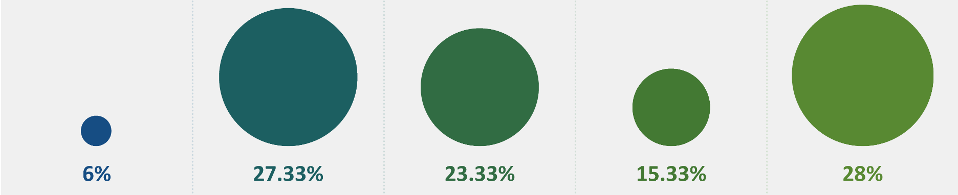
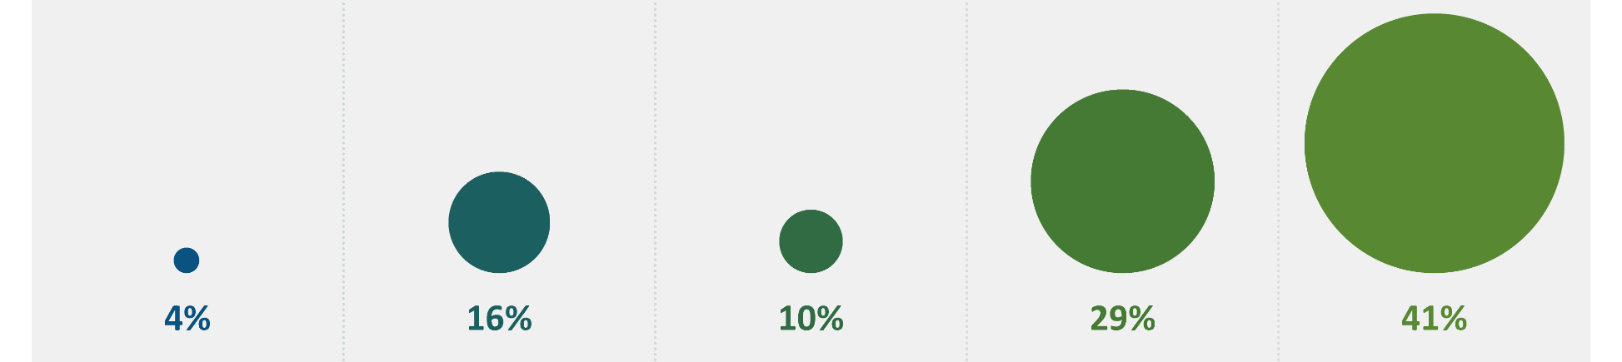
Zooming in: Portfolio complementarity
BMGF pooled investments
(201 innovs)
BMGF bilateral co- investments
(49 innovs)
These are not bilateral projects, but bilateral co-investment in innovation development under Initiatives
Notes:
Potential talking points:
It is very important to have this granular and evidence-based overview of CGIAR innovation development. We can now monitor how innovations move through the pipeline and overall pipeline diversity and health over time.
We can observe concentration around (1) innovations formulation and testing in controlled environment (e.g. lab research) (levels 2-3-4) and (2) innovation testing and validation in uncontrolled environment (level 8-9)
We can also observe that there is relative high number of policy/ organisational and institutional innovations that are being formulated and tested
The currently pipeline does not have the typical funnel shape that reflects investment in many early stage innovations that are then gradually prioritized and filtered as they become more ready for scaling (stage-gating).
Adding in the CGIAR innovations that are being developed under the non-pooled portfolio and linking innovation development to USD investment can provide a more granular image of the pipeline

Slide 47
Next steps: IPSR 2023 focus on Innovation Use
2022 IPSR focus
2023 IPSR focus
2024 onwards IPSR focus
1
Profile all CGIAR innovations
outputs
2
Develop innovation packages for scaling ready innovations
outcomes
3
Develop scaling strategies
impact
4
Innovation Portfolio Management

