Slide 1
Transforming maize-legume value chains
a business case for climate-smart agriculture in Southern Africa
Christian Thierfelder
International Maize and Wheat Improvement Center (CIMMYT)
Climate Resilient Agriculture Success Stories Webinar – Making a Case for Scale Up
28 November 2019

Slide 2
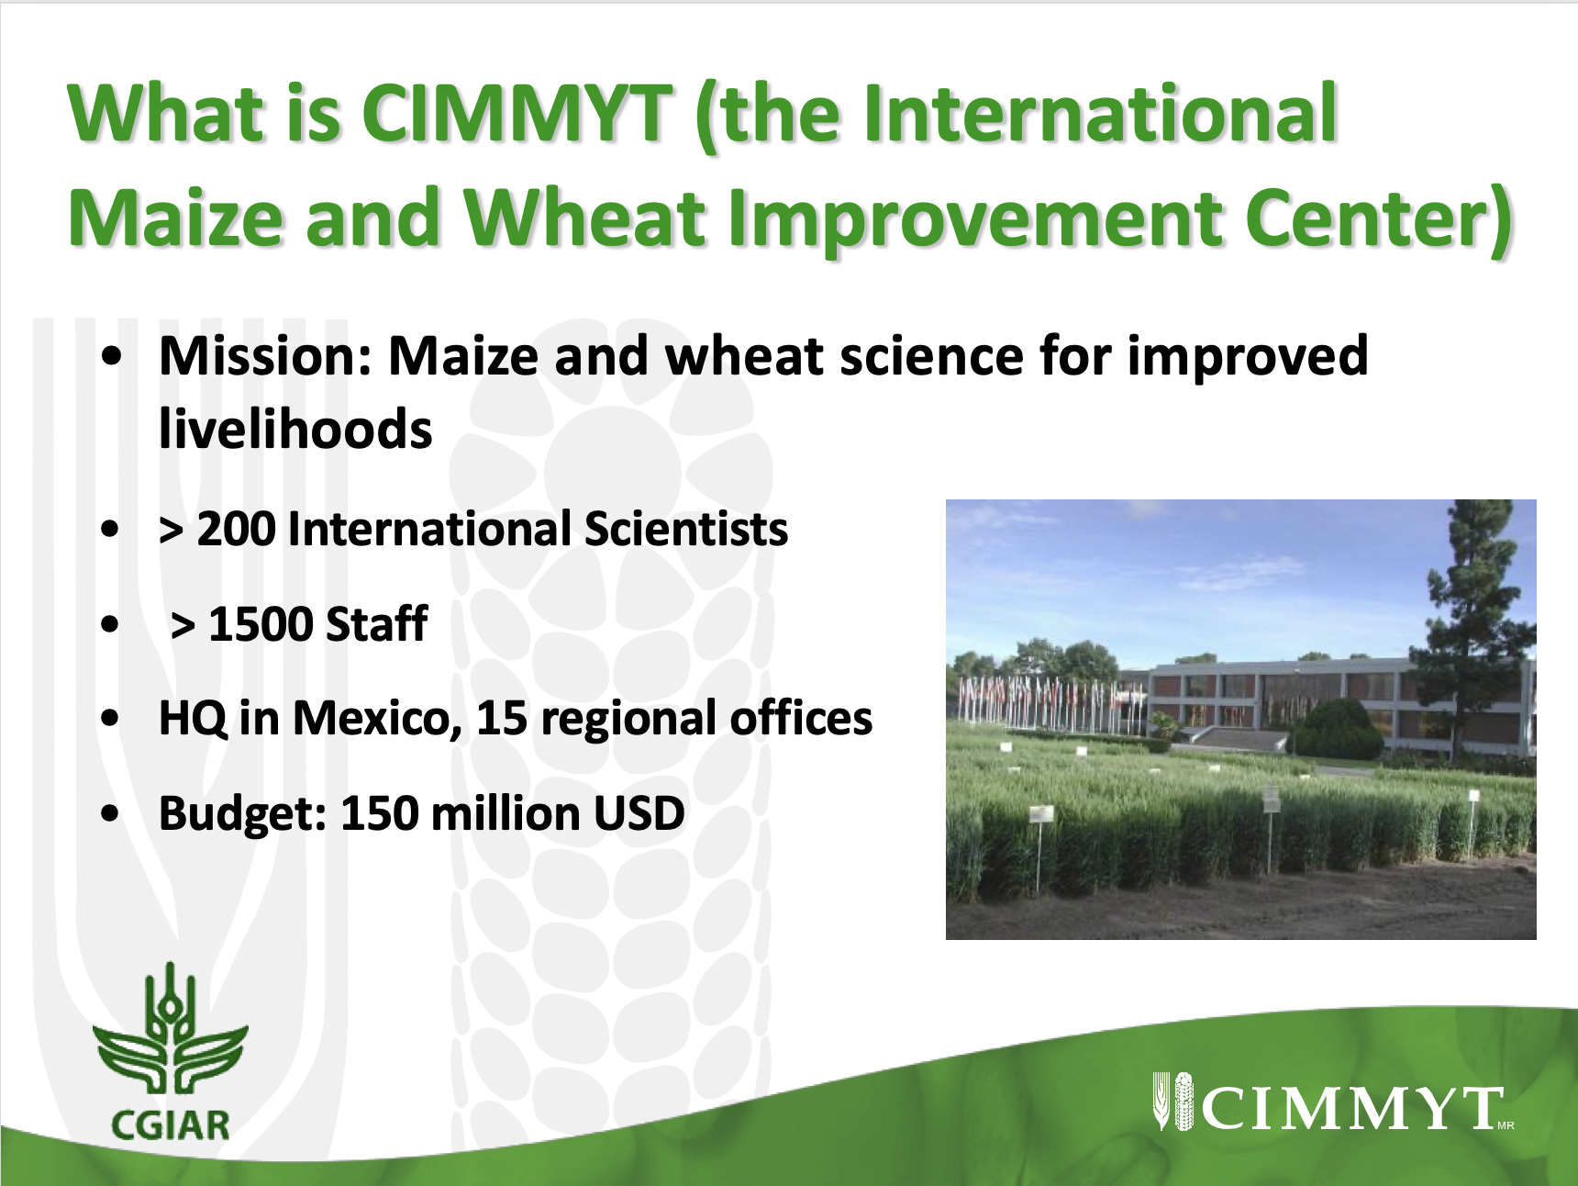

Slide 3
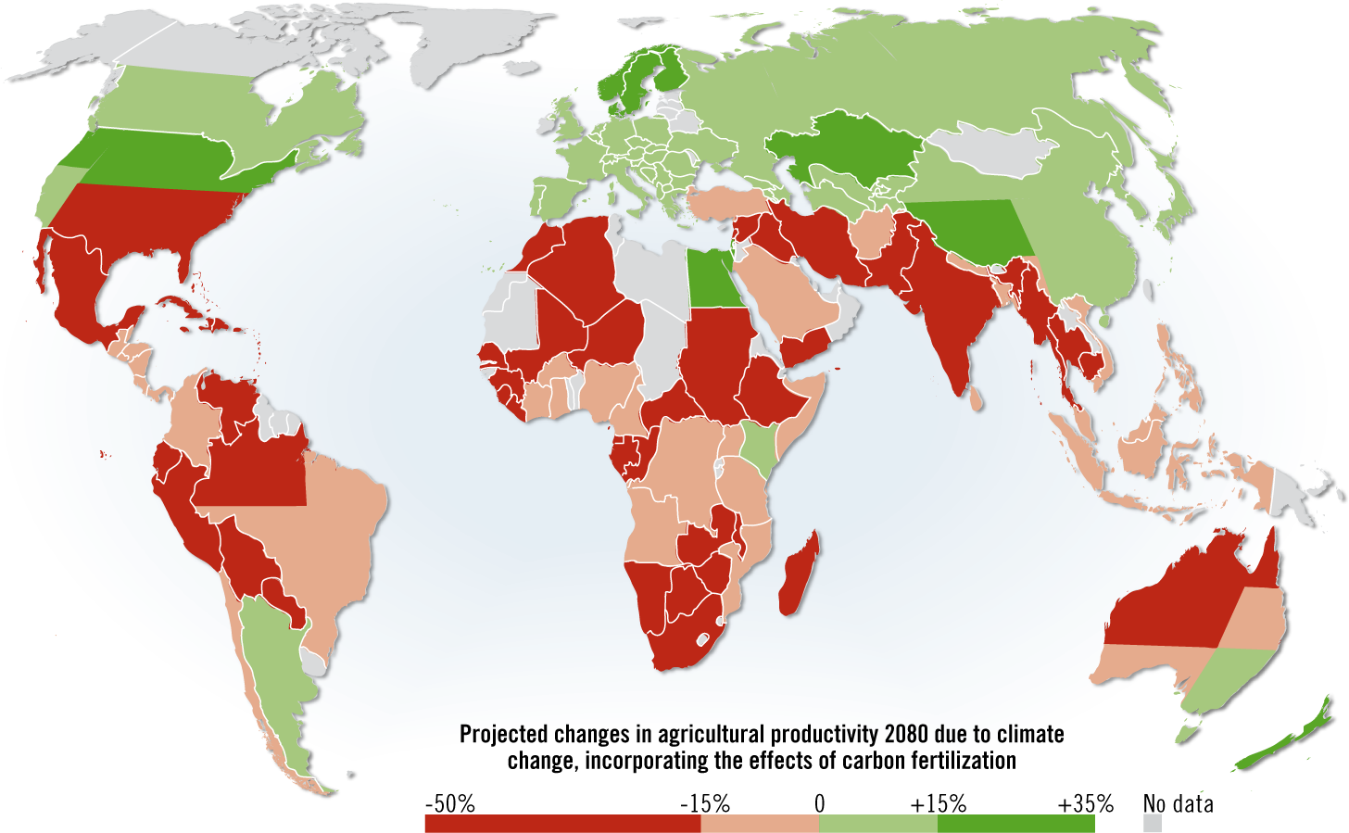
Projected change in agriculture productivity, 2080
Source: Hugo Ahlenius, UNEP/GRID-Arendal.

Slide 4
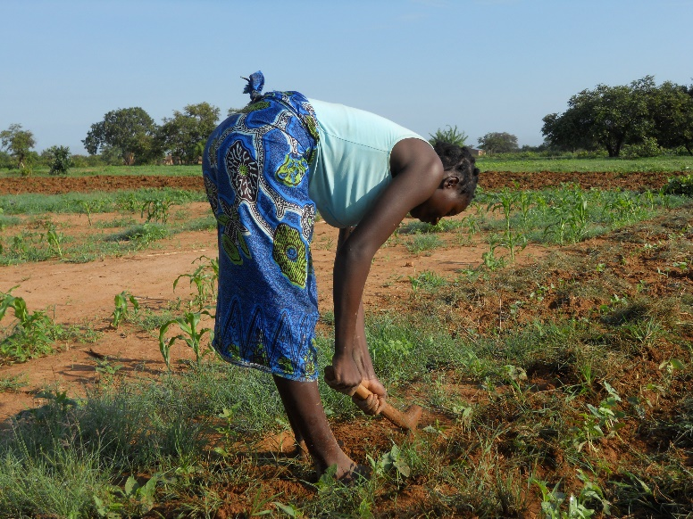
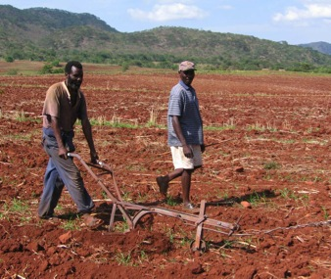
Traditional African smallholder farming systems
Based on tillage (manual/animal traction)
Residue removal
Monocropping of maize
Limited fertilizer use
Based on traditional varieties
Affected by variable climate
Inherently poor soil fertility

Slide 5
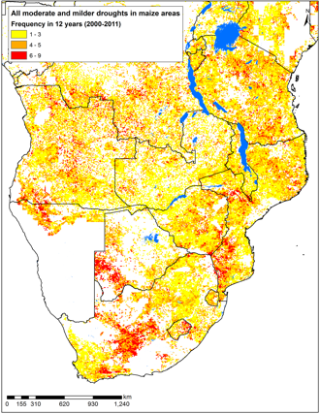
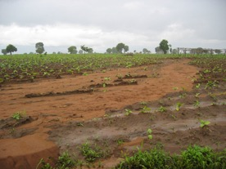
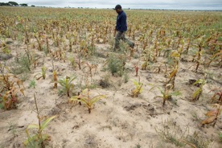
The consequences
Source: Sonder, unpublished

Slide 6
Landscapes with multiple CSA options

Slide 7
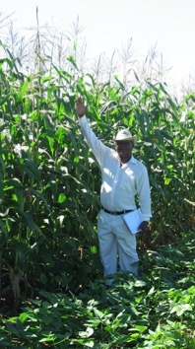
Out scaling climate-smart technologies to smallholder farmers in Malawi, Zambia & Zimbabwe
Adaptation to Climate Change for Smallholder Rural Areas (ACCRA) Project funded by GIZ/CCARDESA
Undertake a climate change Vulnerability Assessment
Piloting CSA technologies on-farm
Prioritization of CSA technologies
Feasibility study
Development of out-scaling Proposals for CSA scaling

Slide 8
Vulnerability assessment - process

Slide 9
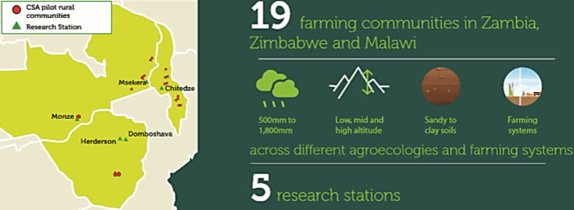
Piloting in CSA in on-farm communities of Southern Africa

Slide 10
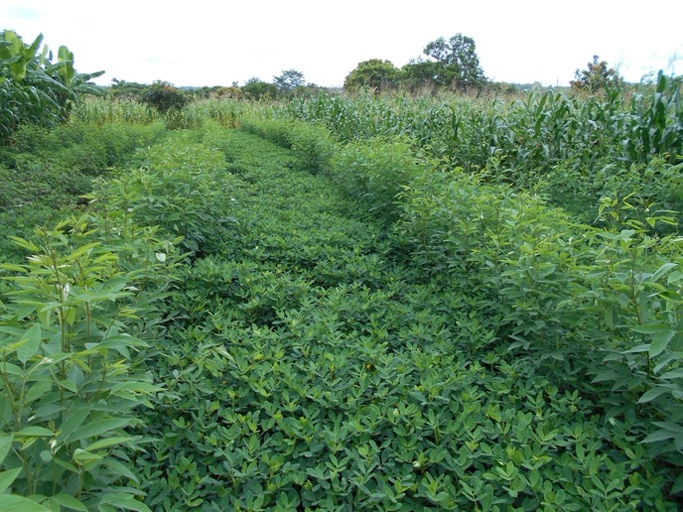
Maize-legume rotation under ca with pigeonpea alley cropping

Slide 11
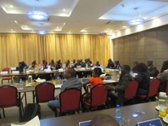
Prioritization of CSA technologies
Process:
Local meetings with key stakeholder in target communities
Regional meeting in Lusaka using the GIZ tool
Ranking based on a ranking matrix

Slide 12
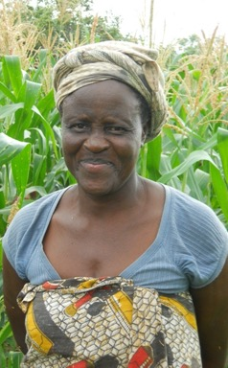
A feasibility study on climate-smart agriculture systems
For an investment proposal we need data on:
Agronomic performance
Economic viability
Environmental impact
Social impact (gender)

Slide 13
Conservation agriculture – a CSA system

Slide 15
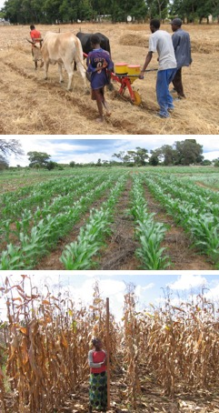
Why focus on Conservation Agriculture?
Combines all positive technologies prioritized above
CA can help to adapt production to climate variability and change ….!
CA is more water-, nutrient-, and energy-use-efficient
CA improves the productivity of current farming systems
Availability of long-term data to do the study

Slide 16
Productivity benefits – On-farm pilots in Malawi, 2019

Slide 17
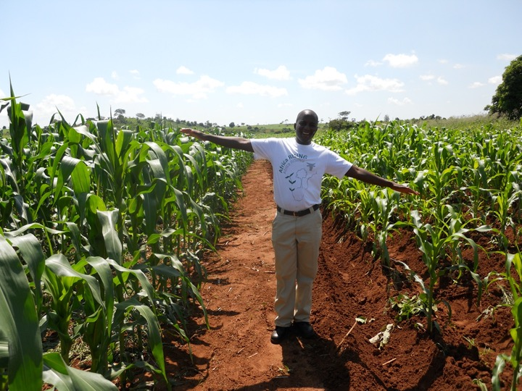

Slide 18
Productivity benefits – long-term

Slide 19
Regional yield response to CA in southern Africa from 2005-2016
Thierfelder et al. 2015a

Slide 20
Manual sustainable intensification practices - net benefits (2012-2016), Eastern Zambia
Mutenje et al. 2016

Slide 21
Economic benefits – Eastern Zambia
NPV – Net present value
RoL – Returns to labour
RoI – Returns to Investment
IRR - Internal Rate of Return

Slide 22
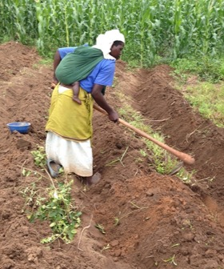
Labour reduction – a key benefit!
Thierfelder et al. 2015b

Slide 23
Environmental benefits – improved Water infiltration

Slide 24
Environmental benefits – increased soil moisture

Slide 25
Environmental benefit – reduced soil erosion

Slide 26
Environmental benefit – gradual increase in soil carbon

Slide 27
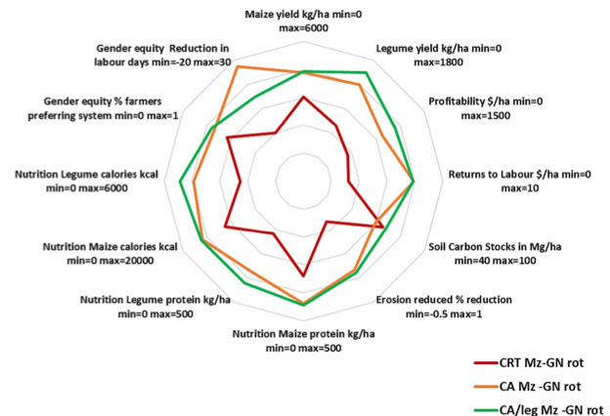

Slide 28
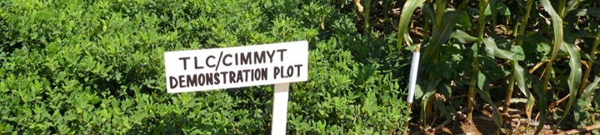
Some pertinent challenges...
Residues: How can we feed both livestock and crops?
Weeds and their control – a major challenge if no herbicides are used
Lack of fertilizer use – what are the alternatives?
Limited crop diversification – too much focus on maize
Lack of evidence and data taking – believe in myths

Slide 29
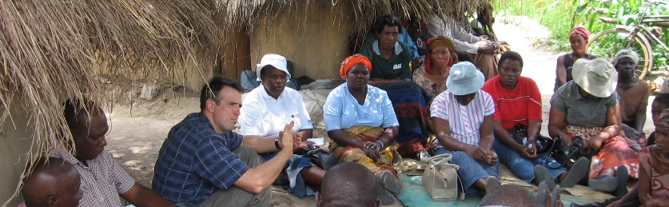
Targeting the wrong systems to the wrong farmers
Donor driven adoption - one-size fits-all approaches
Low adoption – lack of understanding of underlying issues
Ignoring farmers rationale and decision making
The need for new knowledge and co-development of technologies

Slide 30
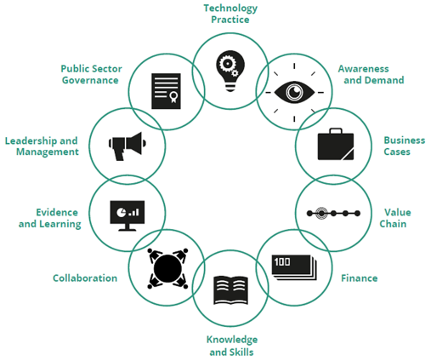
Scaling is more than the technology

Slide 31
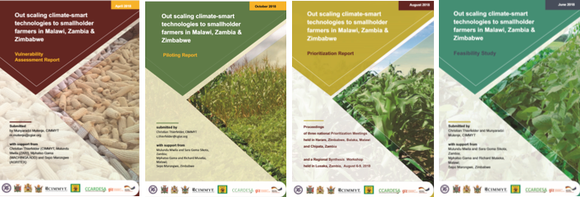
We are ready…….!
Project results have been summarized in 4 project reports in contemporary design –
This is our Business Case!

Slide 32
We are ready…….!
A regional proposal has been developed for southern Africa and will be presented at a COP25 side event:
Work package 1: Scaling out Climate-Smart Agriculture
Work Package 2: Knowledge generation and dissemination
Work Package 3: Aligning policies
We depend on country support

Slide 33
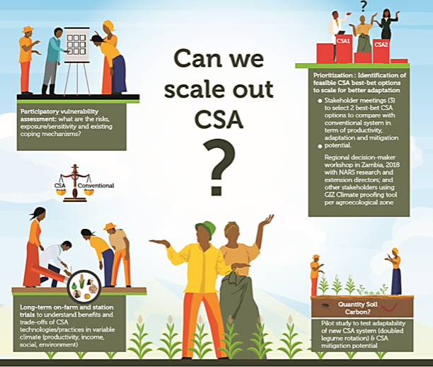
YES
We
CAN!

