Slide 1











TH4.2: Methodologies for researching feminization of agriculture processes: what do they tell us?
A journal paper (in progress)
Cathy Rozel Farnworth, Alessandra Galiè, Bjorn Van Campenhout, Els Lecoutere, Marlène Elias, Markus Ihalainen, Preeti Bharati, Lara Roeven, Ana Maria Paez Valencia, Mary Crossland, Barbara Vinceti, Iliana Monterroso
Cultivating Equality Conference, October 12-15, 2021

Slide 2
Understanding real trends, empowering women and men farmers
Theme 1
Who is a farmer?
Theme 2
Do women/ men farm all their lives?
Theme 3
Who will be future farmers?

Slide 3
Gender and feminization processes in wheat agriculture in South Asia (Cathy Rozel Farnworth, Preeti Bharati)
Scrutinizing the ‘feminization of agriculture’ hypothesis: A study on the gendered evolution of labor force participation in agriculture in Indonesia 1993 – 2014 (Markus Ihalainen, Iliana Monterroso).
Exploring feminization of agriculture through gender dynamics across scales (Alessandra Galiè)
Gender and generational dynamics in land restoration amid male out-migration: Strengthening the evidence base through cross-country analyses (Marlenè Elias, Ana Maria Paez Valencia, Mary Crossland, Barbara Vinceti).
The use of ICTs to challenge gender stereotypes and empower women farmers in the age of feminization of agriculture (Els Lecoutere)
The use of ICTs to challenge gender stereotypes and empower women farmers in the age of feminization of agriculture (Bjorn Van Campenhout)

Slide 4
Gender and feminization processes in wheat agriculture in South Asia
Who decides who does what in the field? Who earns money?
What changes are you making in your own life? How is your life changing as a consequence?
Who is a farmer?ho
Tradition
Caste identities
I am a farmer!
Aspirations
Power
Change
Gender dynamics
Research in village in Madhya Pradesh
Methodology: Gennovate 1 (2015) fieldwork, trend data from 2005.
Open-ended interactive discussion processes with women and men in 2019 on interactions between caste and gender in wheat.
Quantitative data in Khulri and 16 other villages

Slide 5

The use of ICTs to challenge gender stereotypes and empower women farmers in the age of feminization of agriculture
Increased collection and use of gender disaggregated data BUT disagreement in responses of husband and wife on the same questions. What causes this disagreement and what does that mean for the study of feminization?
Methods: field experiments in Uganda using video-based interventions designed to:
  Facilitate mutual monitoring by making sure spouses start off with same information
  Challenge gender norms through role models
Over time a) more information has become available to (female) farmers and b) (gender) norms are changing more broadly.
Leading to a) Women increasingly question male unilateral decision making now they also have information and b) survey respondents do not answer according to gendered expectations: women claim their role and men give women credit for what they do
Scan for paper
Van Campenhout, Bjorn; Lecoutere, Els; and Spielman, David J. 2021. Bragging, shirking, and hiding: Spousal disagreement among Ugandan maize farmers. IFPRI Discussion Paper 2019. Washington, DC: International Food Policy Research Institute (IFPRI)

Slide 6
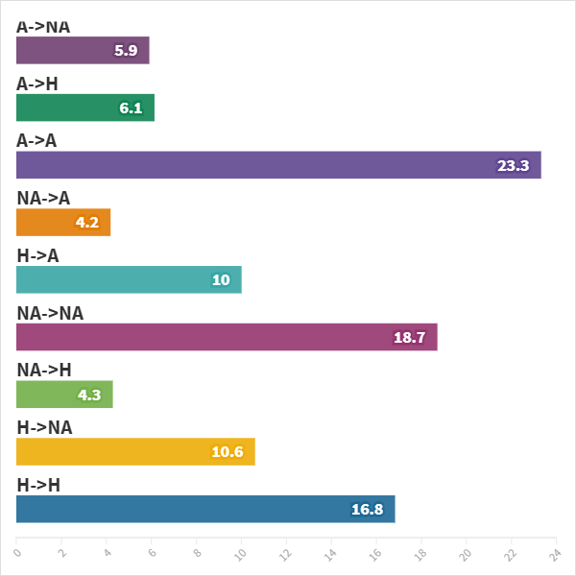
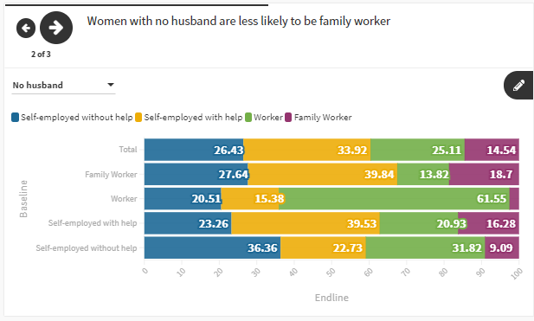
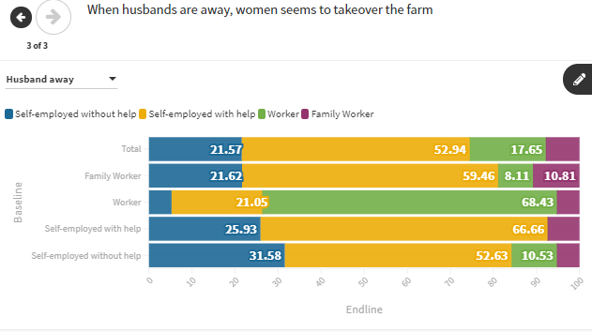
Scrutinizing the ‘feminization of agriculture’ hypothesis: A study on the gendered evolution of labor force participation in agriculture in Indonesia 1993 – 2014
The ongoing processes of rural (male) outmigration and exit out of agriculture is not driving feminization in agriculture in Indonesia
BUT significant degrees of movement by rural women and men between different work categories over time
Exit 12%
Stay 23.3%
Enter 14.2%
Women who are older, poorer, less educated, and located in less advanced region are has higher probability to stay in agriculture.
Never 50.4%
Notes:
GRAPH RIGHT:
while agriculture accounts for roughly 40% of rural married women’s labor in any given year, 71% of women worked in agriculture at least once during the survey period. Conversely, out of the men working in agriculture at the 1993 baseline, 40% shifted to non-agricultural jobs over time, with more than half eventually returning to agriculture as they aged. While younger women were increasingly likely to engage in non-agricultural work, older women who had been working in agriculture were more likely than their male counterparts to move into housekeeping.
Study of feminization of agriculture at the households level only focus on those who stay or enter in agriculture, missing out those rural women with options outside agriculture.
By looking at national statistics data, there is no sign of feminization of agriculture in Indonesia, and also among households in general in the IFLS sample
Maybe contributed by different role of agriculture sector in the economy, urbanization and migration pattern, intrahousehold norms compared with other countries in which feminization of agriculture shown in national statistics
GRAPHS TO THE LEFT
The study identified significant differences between women with a husband at home, those with an absent husband and those with no husband (divorced or widowed). For instance, women whose husbands are present are likeliest to work in family labor while farming women with absent spouses (de facto female heads-of-households) tend to be self-employed with help, with this likelihood increasing with wealth. In comparison to women with absent husbands, women with no husbands are likelier to be self-employed with no help or work as casual agricultural labor. This finding cautions against conflating de jure and de facto female-headed households when discussing the gendered implications of men’s exit from farming (FAO 2019).

Slide 7
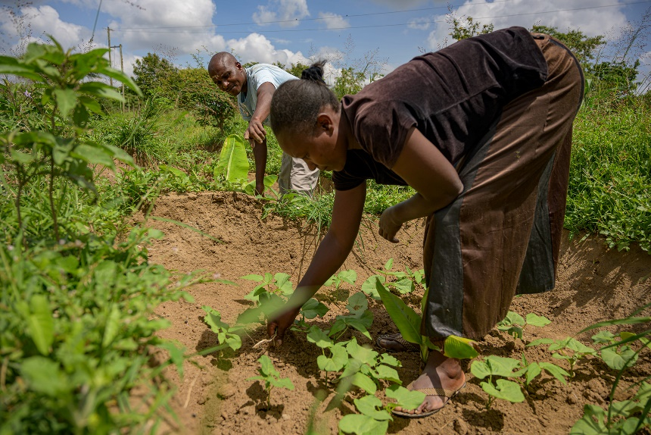
Gender and generational dynamics in land restoration amid male out-migration: Strengthening the evidence base through cross-country analyses
Failure to capture dynamism in studying feminization of agriculture => partly due to research methods used
Movement in and out of agriculture throughout life cycle
Seasonal movements in and out of agriculture
Movements of different HH members in and out of agriculture …
Mixed methods, developed iteratively, to grapple with temporal and socially heterogeneous effects and dynamics of migration on gender relations in agricultural households in Burkina Faso and Kenya
survey
sex-segregated FGDs
community profile
timelines
semi-structured interviews
Photo: K Trauman/ICRAF

Slide 8
Exploring feminization of agriculture through gender dynamics across scales
Research question: ‘what are the key gender dynamics and norms at intra-household level, that affect the feminization of agriculture in Sub-Saharan Africa?’
Goal: develop a methodology to identify drivers of feminization using 3 databases on Sub-Saharan Africa
Approach: Identified …
Possible key drivers of FoA: desk work (inductive)
Proxy indicators for each driver and related datasets (DHS; World Bank Indicators; OECD-SIGI)
African countries characterized by FoA or MoA using existing datasets (DHS)
Patterns of drivers in FoA /MoA countries (deductive): statistical analysis and machine learning
Validation of drivers at community level.
Adjustment of our model of interacting drivers.
Alessandra Galiè, Team Leader – Gender, ILRI, a.galie@cgiar.org

Slide 9
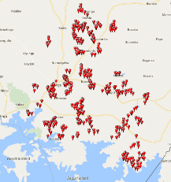
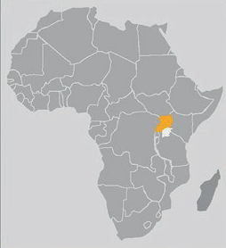
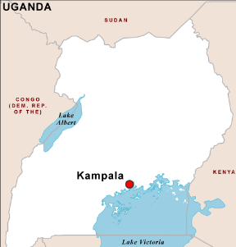
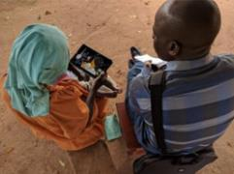
Empowering women through targeting information or role models: Evidence from an experiment in agricultural extension in Uganda
Intra-household constraints to women’s participation, agency, and benefits from agriculture
women’s information disadvantage
women’s role as agricultural producers rarely recognized
Can reducing such constraints enable women to turn Feminization of Agriculture to their advantage?
Impact of providing women with direct access to extension information (vs men )
In couple Woman alone
Impact of women as messenger/role model in extension videos (vs men )
In couple Woman alone
 |  | Messenger
 |  | M | F | Cpl
Recipient | M
 | F
 | Cpl
 |  | Messenger
 |  | M | F | Cpl
Recipient | M
 | F
 | Cpl
 |  | Messenger
 |  | M | F | Cpl
Recipient | M
 | F
 | Cpl
 |  | Messenger
 |  | M | F | Cpl
Recipient | M
 | F
 | Cpl
Tablet-based extension information video shown by enumerator
 | F | M | Joint
Knowledge | +
Decision making |  | -
Adoption |  |  | +
Production
F | M | Joint
+ | -
+ | -
+
+
F | M | Joint
 | -
F | M | Joint
 | (-)
Els Lecoutere CGIAR Gender Platform
David J. Spielman IFPRI
Bjorn Van Campenhout IFPRI/LICOS KU Leuven
https://academic.oup.com/ofid/article-abstract/6/3/ofz001/5272497
www.mapsopensource.com

Slide 10
Conclusions
Many potential conclusions, but to highlight:
Select and develop methodologies with a critical eye. They create the data on which policies and planning responding to FoA are based.
Be careful! Feminization can mean almost anything. Our research points to the need for specificity, explaining feminization (and masculinization) in context and in time – including into the future.
Research processes themselves can empower women by explicitly recognizing the work they already do. Recognizing women as farmers has powerful policy implications.

