Slide 1
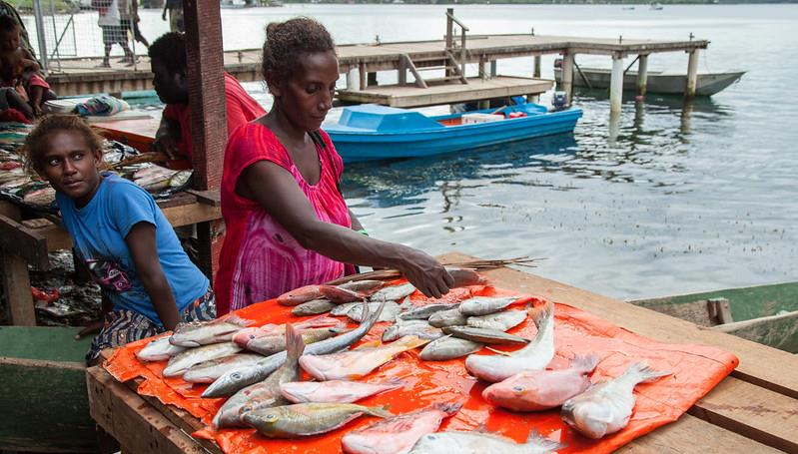







FR1.1 Advancing gender equality in coral reefs social-ecological systems
Cristina Ruano-Chamorro, Jacqueline Lau & Karl Deering
Cultivating Equality 2021 Conference
Reef fish for sale at Gizo market, Western Province, Solomon Islands. Photo by Filip Milovac. Accessed from https://www.flickr.com/photos/theworldfishcenter/19320602776/in/album-72157665820068473/

Slide 2
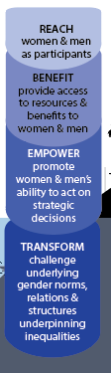
INTRODUCTION

Slide 3
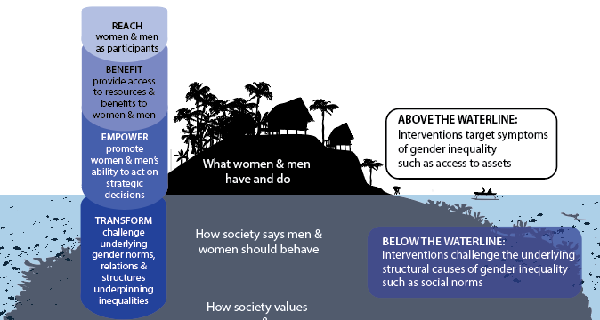
INTRODUCTION

Slide 4
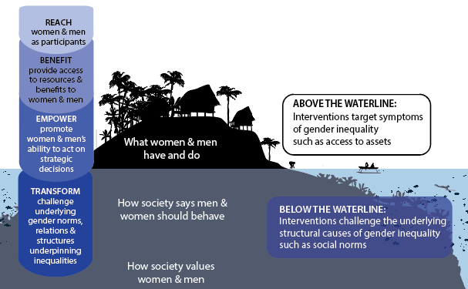
INTRODUCTION

Slide 5
INTRODUCTION
Gender Transformative Approaches (GTAs)

Slide 6







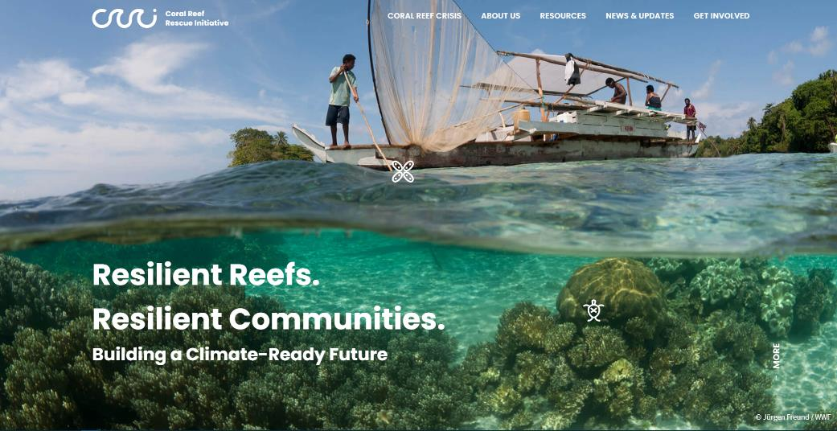
http://coralreefrescueinitiative.org

Slide 7
Project aims:
Understanding how gender equity has been promoted in coral reef social-ecological systems.
Examine to what extent these projects have been gender transformative.
http://coralreefrescueinitiative.org

Slide 8
METHODS
Literature Review :
  Lau, J & Ruano-Chamorro, C. 2021. Gender Equality in Coral Reef Social-ecological systems: Literature Review. CARE International (https://coralreefrescueinitiative.org/resources/gender-equality-in-coral-reef-socio-ecological-systems).
Peer-reviewed and grey literature on gender equality in coral-reef and related social-ecological systems

Slide 9
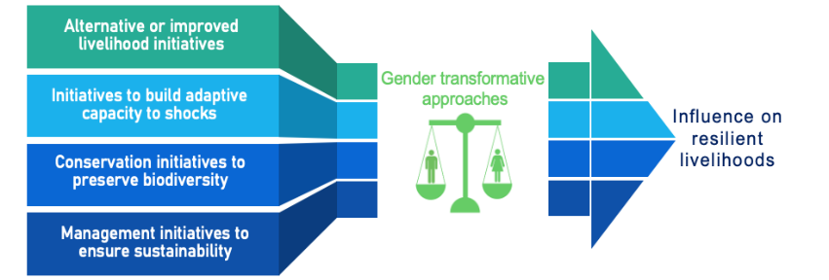
METHODS
Literature Review :
  Lau, J & Ruano-Chamorro, C. 2021. Gender Equality in Coral Reef Social-ecological systems: Literature Review. CARE International (https://coralreefrescueinitiative.org/resources/gender-equality-in-coral-reef-socio-ecological-systems).
Peer-reviewed and grey literature on gender equality in coral-reef and related social-ecological systems
Impact Pathways

Slide 10
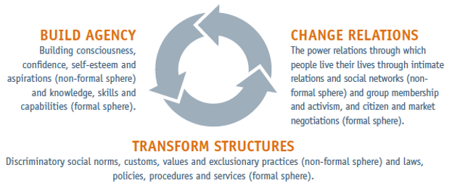
METHODS
Literature Review :
  Lau, J & Ruano-Chamorro, C. 2021. Gender Equality in Coral Reef Social-ecological systems: Literature Review. CARE International (https://coralreefrescueinitiative.org/resources/gender-equality-in-coral-reef-socio-ecological-systems).
Peer-reviewed and grey literature on gender equality in coral-reef and related social-ecological systems
Impact Pathways
CARE’s Gender Equality framework (GEF)

Slide 11
KEY RESULTS
Studies on gender are rare in tropical seascapes (increasing attention).
Many studies of gender concern small-scale fisheries, and coral reef-based livelihoods more broadly are rarely examined.
No studies focused directly on gender equity and resilience.
We found little literature on the practical application of or research into gender transformative approaches.
  Some projects engaged with different aspects of CARE’s gender equality framework.

Slide 12
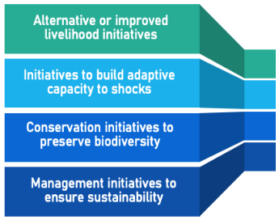
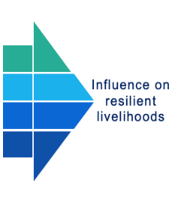

KEY RESULTS
Gender equity approaches in
coral reef social-ecological systems
Access financial resources
(e.g. Saving clubs, microcredit)
Training
Women’s leadership
Women associations & networks
Gender
equity
Alternative livelihoods
Impact pathways
Market access
Family planning services
Equitable participation in management & conservation
(e.g. increase women participation)

Slide 13
KEY RESULTS
Reach, benefit & empower women
Access financial resources
(e.g. Saving clubs, microcredit)
Training
Women’s leadership
Women associations & networks
Gender
equity
Alternative livelihoods
Market access
Family planning
Equitable participation in management & conservation
(e.g. increase women participation)

Slide 14
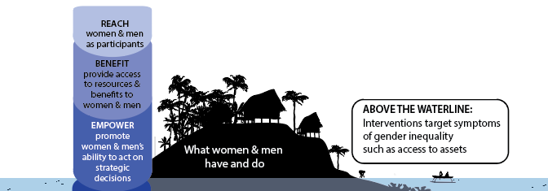
KEY RESULTS
Reach, benefit & empower women
Access financial resources
(e.g. Saving clubs, microcredit)
Training
Women’s leadership
Women associations & networks
Alternative livelihoods
Market access
Family planning
Equitable participation in management & conservation
(e.g. increase women participation)

Slide 15
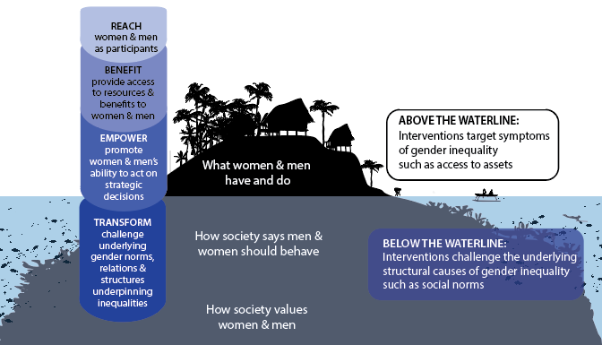
KEY RESULTS
Reach, benefit & empower women
Access financial resources
(e.g. Saving clubs, microcredit)
Training
Women’s leadership
Women associations & networks
Alternative livelihoods
Market access
Family planning
Few projects were
gender transformative
Equitable participation in management & conservation
(e.g. increase women participation)

Slide 16
KEY RESULTS
Reach, benefit & empower women
Access financial resources
(e.g. Saving clubs, microcredit)
Training
Women’s leadership
Women associations & networks
Alternative livelihoods
Market access
Family planning
Tanga Project (Tanzania)
IPOPCORM (Philippines)
Equitable participation in management & conservation
(e.g. increase women participation)

Slide 17
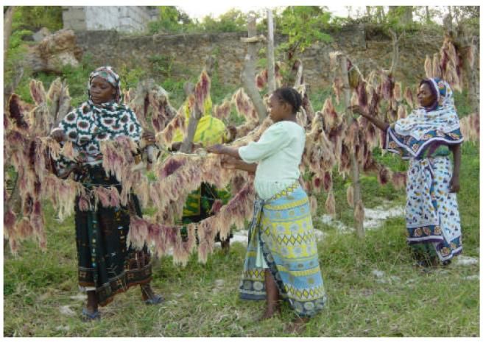
Tanzania: Tanga Project
(Tanga Coastal Zone Conservation Development Programme)
Photo from Report Van Ingen et al. 2002. Gender Equity in Coastal Zone Management: Experiences from Tanga, Tanzania. IUCN.

Slide 18




Tanzania: Tanga Project
(Tanga Coastal Zone Conservation Development Programme)

Slide 19

Tanzania: Tanga Project
(Tanga Coastal Zone Conservation Development Programme)
Change
relationships
Transform
structures
Build agency
Gender transformative elements
Engage men and women
Critical consciousness
Equity awareness & responsibilities in multiple scale and actors
Women and men’s agency & participation
Gender equity accountability
Equitable representation all levels
Women’s leadership
(Torrell et al. 2000; Van Ingen et al. 2002; Wells et al. 2007; Samoilys & Kanyange 2008).

Slide 20
Tanzania: Tanga Project
(Tanga Coastal Zone Conservation Development Programme)
Change
relationships
Overall the project focused on building agency, changing relationships and transforming structures by challenging gender norms, making institutions and individuals responsible for gender equity, encouraging women’s leadership and responsibility in monitoring, and promoting equitable representation at all levels.
Transform
structures
Build agency
Gender transformative elements
Engage men and women
Critical consciousness
Equity awareness & responsibilities in multiple scale and actors
Women and men’s agency & participation
Gender equity accountability
Equitable representation all levels
Women’s leadership
(Torrell et al. 2000; Van Ingen et al. 2002; Wells et al. 2007; Samoilys & Kanyange 2008).

Slide 21

Tanzania: Tanga Project
(Tanga Coastal Zone Conservation Development Programme)
Change
relationships
Gender awareness increased
Gender attitudes shifted
Gender equity in fisheries management
Women’s empowerment and access to alternative livelihoods
Transform
structures
Gender equity outcomes
Build agency
Gender transformative elements
Engage men and women
Critical consciousness
Equity awareness & responsibilities in multiple scale and actors
Women and men’s agency & participation
Gender equity accountability
Equitable representation all levels
Women’s leadership
(Torrell et al. 2000; Van Ingen et al. 2002; Wells et al. 2007; Samoilys & Kanyange 2008).

Slide 22

Tanzania: Tanga Project
(Tanga Coastal Zone Conservation Development Programme)
Change
relationships
Gender awareness increased
Gender attitudes shifted
Gender equity in fisheries management
Women’s empowerment an access to alternative livelihoods
Transform
structures
Gender equity outcomes
Build agency
Gender transformative elements
Stakeholders’ awareness & understanding on marine resources
Community engagement and DM power increased
Support for reef closure
Stakeholder representation
Increase in catches
Livelihood improvements
Engage men and women
Critical consciousness
Equity awareness & responsibilities in multiple scale and actors
Women and men’s agency & participation
Gender equity accountability
Equitable representation all levels
Women’s leadership
Resilience
outcomes
(Torrell et al. 2000; Van Ingen et al. 2002; Wells et al. 2007; Samoilys & Kanyange 2008).

Slide 23
Conclusions
Several projects did address some elements of the GEF, rarely are interventions holistic enough to progress all three domains.
CARE’s Gender Equality Framework (GEF)

Slide 24
Next steps
There is a need to:
  understand better gender dynamics in coral reef social-ecological systems.
  understand how to promote GTAs in coral reef social-ecological systems
  trial and evaluate gender transformative approaches in coral reef contexts.
    E.g. Good practice paper guide
      Lau, J., Ruano-Chamorro, C., Lawless, S. & McDougall, C. 2021. Gender transformative approaches for advancing gender equality in coral reef social-ecological systems: Good Practice and Technical Brief. CARE International.
  ensure policies support GTAs.
    E.g. Policy brief.
      Lawless, S., Lau, K., Ruano-Chamorro., C & Corcoran, E. (forthcoming). Advancing gender equality and equitable livelihoods in coral reef social-ecological systems: Policy Brief. Care International

Slide 25
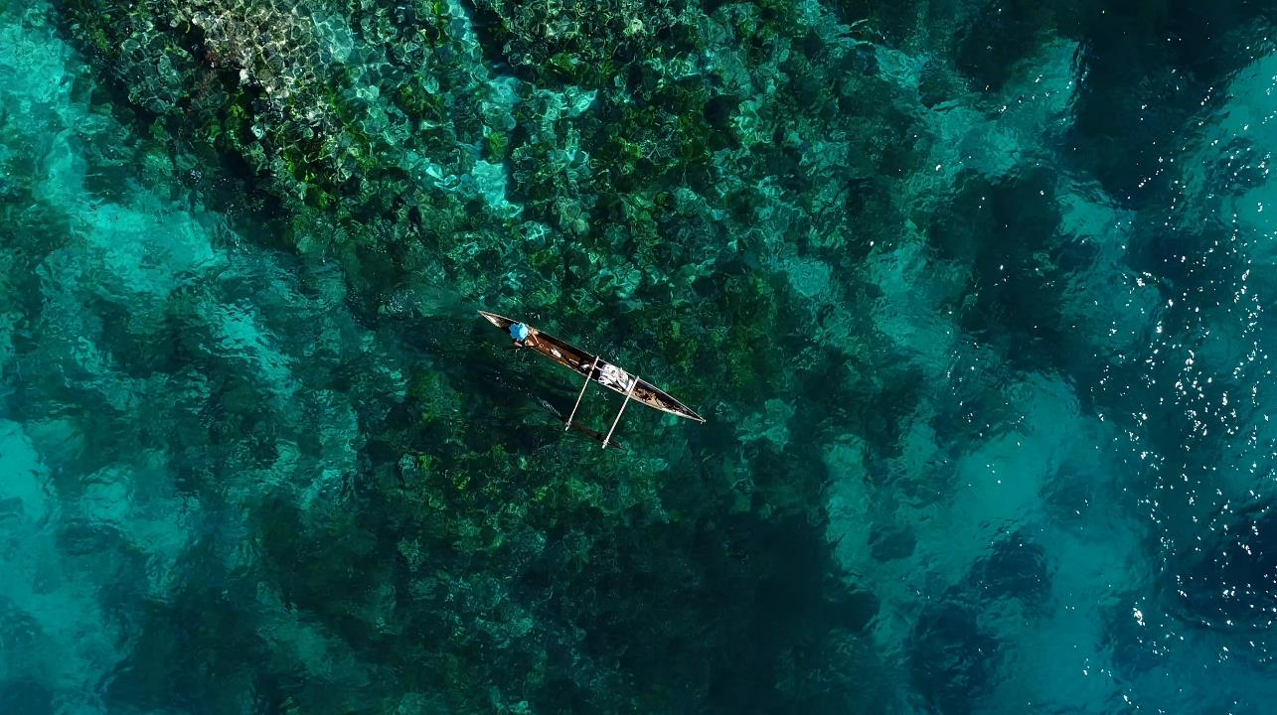




Thank you!
Acknowledgements:
Philippa Cohen, Cynthia McDougall & Sarah Lawless
Arthur M. Blank Family Foundation
CGIAR Research Program on Fish Agri-Food Systems
(FISH)
CGIAR Trust Fund
Cristina Ruano-Chamorro ,
Jacqueline Lau & Karl Deering
cristina.ruanochamorro@my.jcu.edu.au
Photo: Dean Miller

