Slide 1
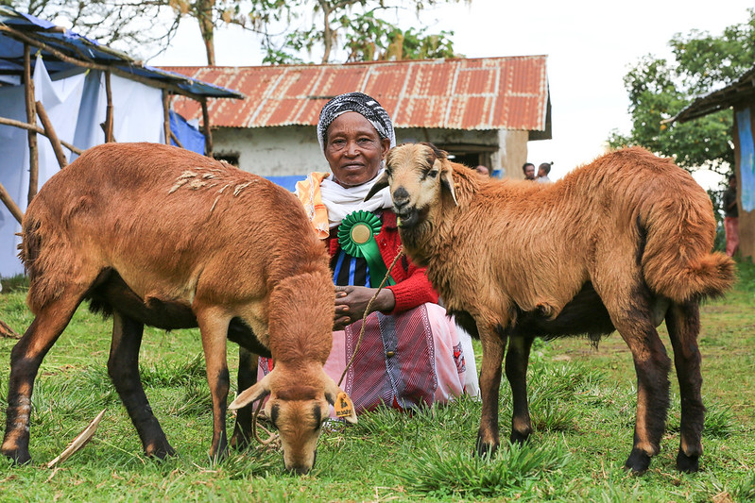
Livestock technological innovation adoption: challenges and opportunities – Africa lens
Karen Marshall
Principal scientist, International Livestock Research Institute
Interim deputy director, One-CGIAR Sustainable Animal and Aquatic Foods Science Program
FAO inaugural science webinar
Virtual, 27 March 2025

Slide 2
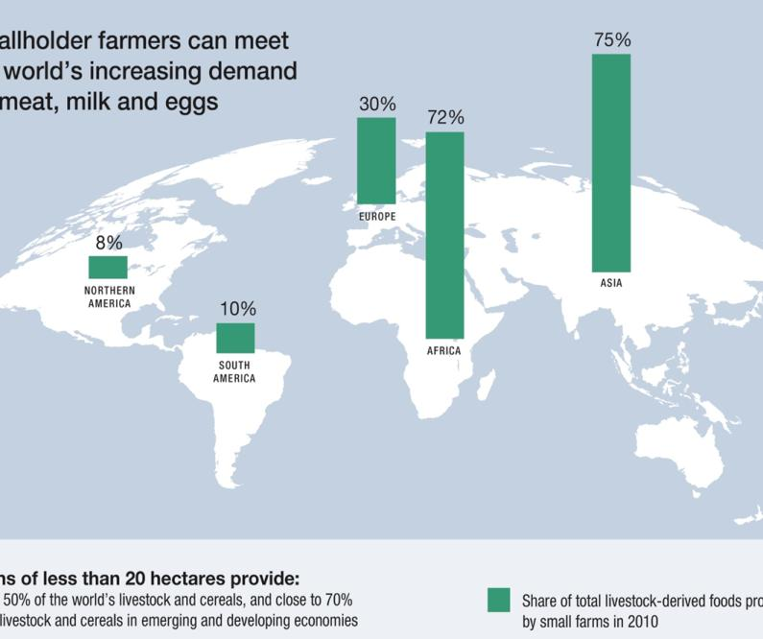
Share of total livestock-derived foods produced by small farms in 2010
Smallholder farmers currently provide most of the meat, milk and eggs AND staple cereals in LMICs
1.7 billion people derive some livelihood from livestock; over half a billion depend on livestock
Livestock are fundamental to many economies; provide income, jobs, and supporting risk mitigation
Livestock are the basis for farm sustainability, integrated livestock-food farms make food crop farming even possible for many in the Global South – circular bioeconomy in action!
Farms of less than 20 hectares provide:
Did you know...
Nearly 50% of the world’s livestock and cereals, and close to 70% of the livestock and cereals in emerging and developing economies
Livestock are integral to ‘circular bioeconomy’ which is the basis for most livestock production in LMICs
Slide credit: S. Tarawali, ILRI

Slide 3
Demand for food will keep growing
Especially in LMICs
Demand for milk, meat, eggs is increasing fastest in LMICs driven by population, rising incomes and urbanization
Not based on significant over-consumption in LMICs (attention: ‘double burden’)
70% of livestock-derived foods consumed in LMICs are sourced in informal markets
Percentage changes in demand 2010 to 2030
Projections based on IMPACT model, Dolapo Enahoro (ILRI)
Slide credit: S. Tarawali, ILRI

Slide 4
There are numerous livestock innovations within Africa - examples
Technological
Capacity sharing
Social behaviour change communication (SBCC) approach, through social media, for promotion of gender-transformative change including more equitable engagement in, and benefit from, agribusiness for women and youth in Tanzania
Feed Assessment Tool (FEAST) & Gendered-FEAST (G-FEAST) – optimizing feed interventions based on local feed resources, including with gendered lens
High-quality Peste des Petits Ruminants (PPR) thermotolerant vaccine to reduce small ruminant mortality in Mali
Training package for animal health service providers for improved herd-health service delivery to smallholder dairy farmers in East Africa
Genomic selection-based breeding programs for dairy cattle in East Africa
PigSmart extension platform in Uganda (best practices in pig breeding, feeding, and health-care)
Institutional
Enabling
Pig multistakeholder platforms (MSPs) for enhancing value chain actor and stakeholder interactions for shared learning and enhancing visibility of the pig sector
Business models for multiplication and dissemination of farmer-preferred and tropically-adapted chicken breeds
Evidence based recommendations for policy makers and investors for a supportive regulatory framework on forage seed supplies in Tanzania.
Business models for small-scale feed processing and marketing by youth and women groups in Ethiopia
Livestock Master Plan for multiple countries - sector analysis of current situation and predictive analysis to set long-term strategies
https://cgspace.cgiar.org/

Slide 5
But innovation adoption is variable
Innovation | % households or respondents adopting | Year | Reference
Pig AI in Uganda (4 districts) | 3% to 10% | 2021 | https://hdl.handle.net/10568/117698
Improved pig breeds in Uganda (4 districts) | 51% to 90% | 2021 | https://hdl.handle.net/10568/117698
Quarantines newly purchased cattle Ethiopia smallholder dairy | 12.0% | 2023 | https://hdl.handle.net/10568/132575
Use of fertilizers on forages in Ethiopia | 37% | 2021 | https://hdl.handle.net/10568/115056
Feed supplementation of chickens in Tanzania (6 sub-national zones) | 91% to 100% | 2018 | https://hdl.handle.net/10568/97039
Veterinary vaccines in Southwest Ethipoia (cattle, sheep, goats, poultry) | 31% | 2024 | https://www.sciencedirect.com/science/article/pii/S0167587724000291
Disinfection of tests before miking in smallholder dairy farmers in Central kenya ( 3 sites) | 17% to 33% | 2021 | https://www.sciencedirect.com/science/article/pii/S0956713521004412
Antibiotic use in small ruminant by pastoralists in Kenya (3 sites|) | 32% to 66% | 2021 | https://hdl.handle.net/10568/113999
Current herd vaccination against CBBP or PPR for ruminant livestock in Ghana (3 sites) | 4% to 35% | 2023 | https://www.sciencedirect.com/science/article/pii/S0167587723000831
Mobile phone and internet use by smallholder livestock farmers in Nigeria (Nasawara state) | 32% and 13% | 2024 | https://www.jvbs.net/publication/vol_6/issue_2/paper_3.pdf

Slide 6
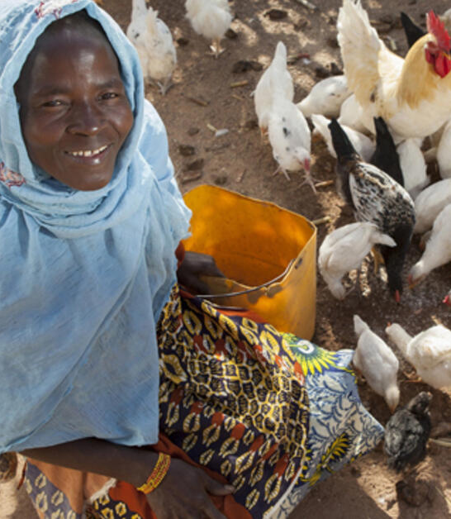
Why some innovations don’t achieve expected adoption levels?
May not meet the needs and preference of certain groups of people (women, youth etc.)
Not profitable; high uncertainty on returns
Poor marketing opportunities: prices (average levels and volatility), trading partners (transparency, reliability), costs (transport, transactions etc.)
Lack of availability and accessibility (including affordability)

Slide 7
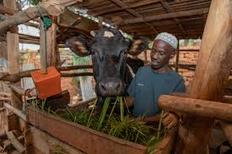
Why some innovations don’t achieve expected adoption levels?
Lacking capital – financial, human (including knowledge and capabilities), social
May have unintended consequences – e.g. increased labour
Poor enabling environments; lack of institutional support (relative size of public investment into livestock development)
Other ….

Slide 8
How can we incentivize / promote innovation adoption
Continual co-design with users, partners, and stakeholders - shared understanding of needs and preferences to meet these, foster a sense of ownership, and potentially drive higher adoption rates
Market systems approaches - modify incentives and behavior of market actors so they are better able and motivated to deliver basic services and solutions that improve performance of the poor in markets (not just providing technologies, but considering systemic issues like market failures and enabling conditions)
Capacity sharing – collaborative knowledge exchange and skill building
Gender integrated and strategic approaches - gender integrated work to ensure innovations are gender-responsive and that access to innovations and benefit sharing is equitable; gender strategic approaches for increased women’s empowerment and gender norm changes to enhance equity. Also youth and other minority groups.

Slide 9
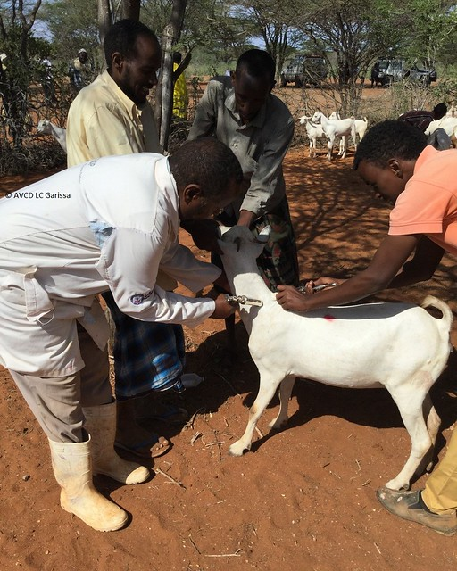
Challenges to livestock innovation adoption
Meeting demand and conditions for adoption
More data required for learning
  From innovation adoption (some data) to impacts such as on productivity livelihoods and food security (scarce data)
  Learning from success stories (e.g. Napier grass in Kenya)
Broader issues, including the livestock discourse (which may misrepresent Africa)

Slide 10
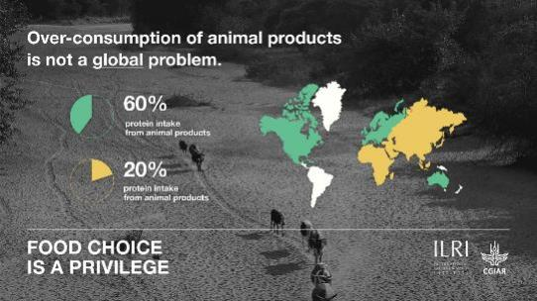
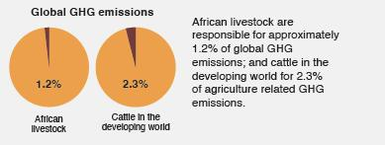
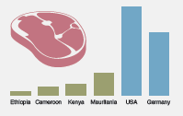
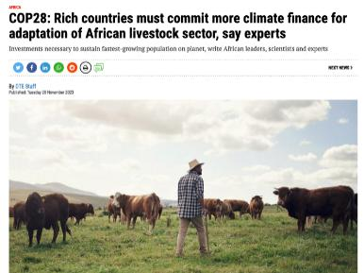
The livestock discourse
Consumption patterns
Climate and livestock
Slide credit: S. Tarawali, ILRI

Slide 11
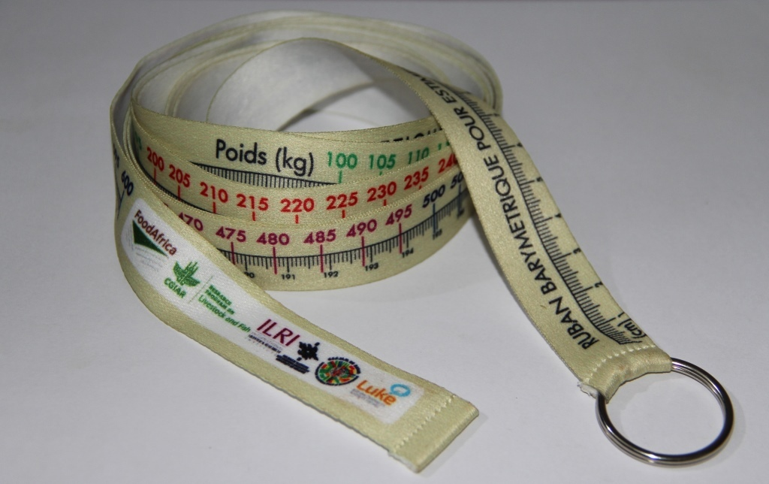
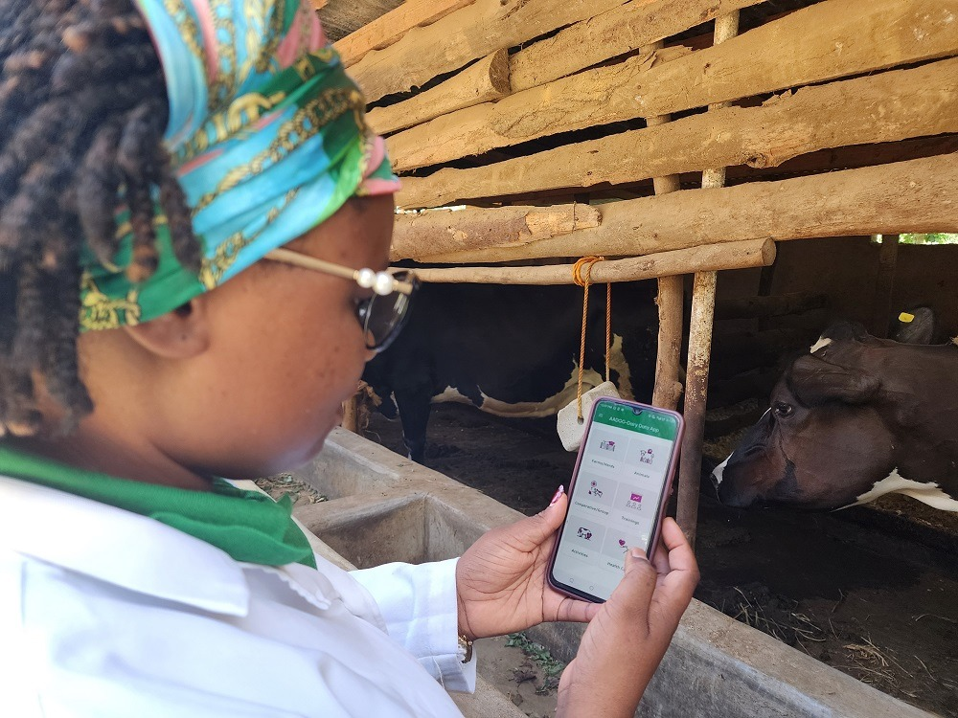
Opportunities for livestock innovation adoption
Meeting demand and conditions for adoption (also a challenge)
Integrated innovations:
  Improved productivity by combinations of innovations on genetics, herd-health and feed
  Innovations for Improved productivity with strengthened markets + addressing climate and environment issues ….
  Innovation packages = innovations + capacity sharing + enabling
From simple to high-tech … contextualizing existing innovations to developing novel ones
Digital innovations – especially supporting decision making (feedback to producers and other VC actors)
Climate-smart innovations – addressing challenges posed by climate change (livestock offer adaptation opportunities)

Slide 12
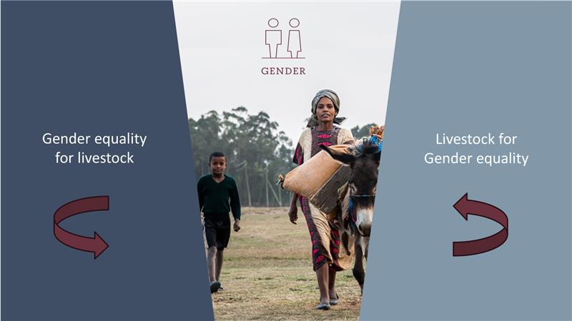
Opportunities for livestock innovation adoption (continued)
Innovations meeting the needs and preferences of women, youth and other minority groups, that increase women’s (and others) empowerment and help ensure equity
Illustration credit: A. Galie, ILRI

Slide 13
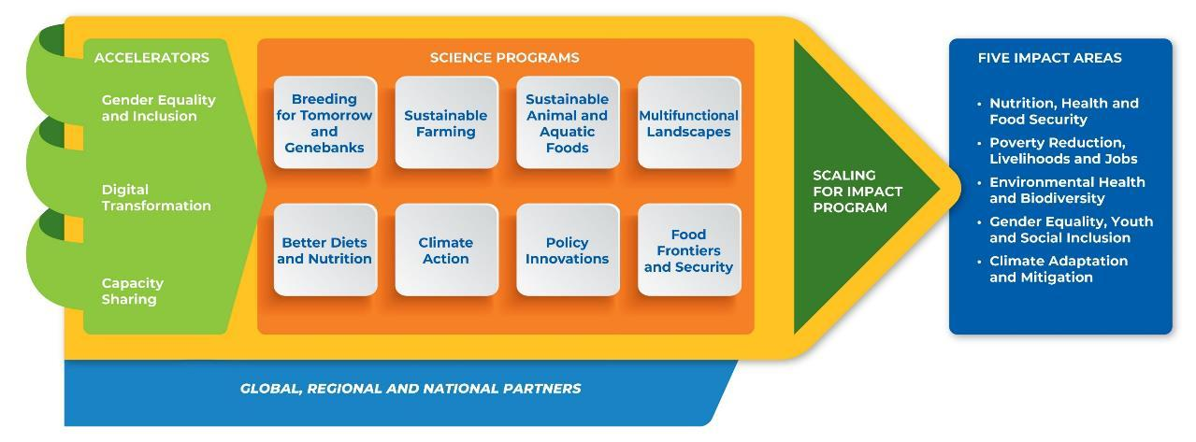
How the CGIAR is addressing this: 2025-2030 portfolio – programs and accelerators
(portfolio)

Slide 14

THANK YOU

