Slide 1
Global food safety: Situation and challenges
Kebede Amenu¹ and Theo Knight-Jones²
¹Addis Ababa University; ²International Livestock Research Institute
World Food Safety Day celebration in Ethiopia
Addis Ababa, Ethiopia
7 June 2021

Slide 2
Contents
Global foodborne disease situation
Causes of foodborne diseases
COVID-19 pandemic and food safety
Food safety systems: diverse supply chains
Current food safety research – Ethiopia
Solutions?

Slide 3
Global foodborne disease situation
Foodborne disease (FBD) causes a massive global health burden
  Similar to the disease burden of HIV/AIDS, tuberculosis or malaria
  1 in 10 people in the world affected each year
  About half a million deaths a year in the world
The poor, with few food choices, and the young are particularly affected
  Children under 5 years of age experience 40% of burden but make up only 9% of the global population
In Africa
  135 million cases of FBD a year (rate 20% above global average)
  But high death rate (140,000 deaths/year), 2.5 times global average
Havelaar et al. 2015, WHO-FERG

Slide 4
Global foodborne disease situation
Foodborne disease has a massive economic cost
  People cannot work
    Cost from lost productivity due to FBD = US$17billion/year for Africa
    Also, children cannot go to school
  Cost of treatment
    US$3.5billion/year for Africa
FBD related diarrhoea thought to contribute to childhood stunting
Food safety is a factor in food export market access
FBD has been greatly neglected but this is slowly changing
  CANNOT HAVE FOOD SECURITY WITHOUT FOOD SAFETY
  ➔ If it isn’t safe, it isn’t food, ‘twin threats’
Grace and Cassou (2019) World Bank

Slide 5
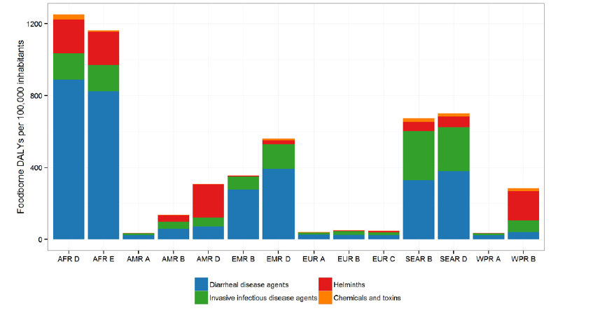
What are the causes?
Bacteria and viruses are the most important cause (75% of burden)
About 70% of FBD in Africa is diarrhoeal
      Especially non-typhoidal Salmonella enterica, EPEC, and ETEC; also, pork tapeworm
Chemicals about 3% of global burden
Worms about 10%
East and southern Africa

Slide 6
Many myths and misconceptions
Consumers tend to be very concerned about chemicals in foods
  From agricultural chemicals, fungal toxins or industrial contamination
  (but cause only 3% of burden)
However, they are often less concerned about foodborne disease caused by germs, such as bacteria and viruses
  Which cause 75% of burden!
E.g. aflatoxins are often present in food and milk but at low levels
  risk of disease from milk is low
Nutritional benefits of drinking milk massively can outweigh aflatoxin risk
  Especially in children - So drink milk

Slide 7
COVID-19 pandemic and food safety
COVID-19 has NOT been spread by food
But COVID impacted on food systems in ways that affected safety
  Bulk purchasing of foods meant customers stored foods for longer before consumption bringing risks for perishable foods
  Also delays in food supply chains (local and international), meant perishable foods took longer to reach markets
  But we also observed improved hygiene in markets and consumer awareness of germs and the importance of hygiene (could this be further leveraged for food safety?)

Slide 8
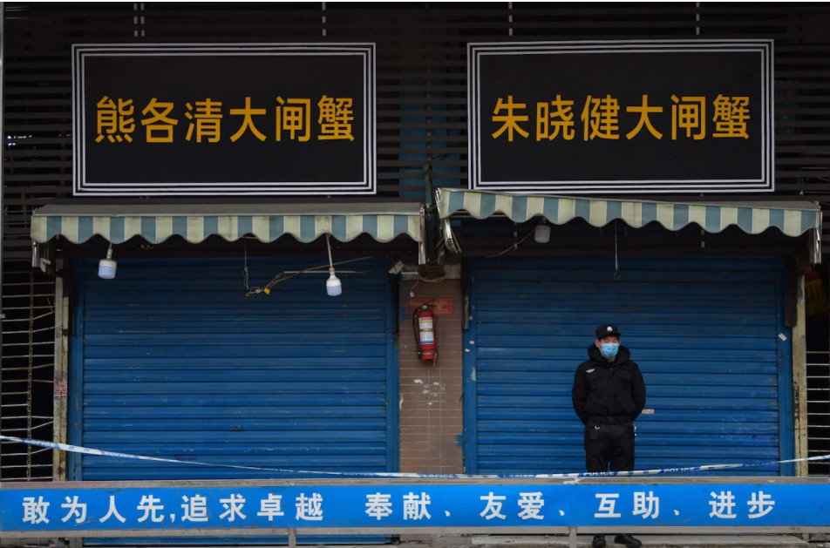
COVID-19 and food safety
But COVID-19’s suspected origin in wet markets with mix of food and wild and domestic animals highlights the role of food systems in pathogen emergence
One Health approaches are needed throughout the food system from production to consumption
Farm-to-fork, Field-to-bowl (Africa)

Slide 9
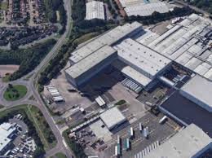
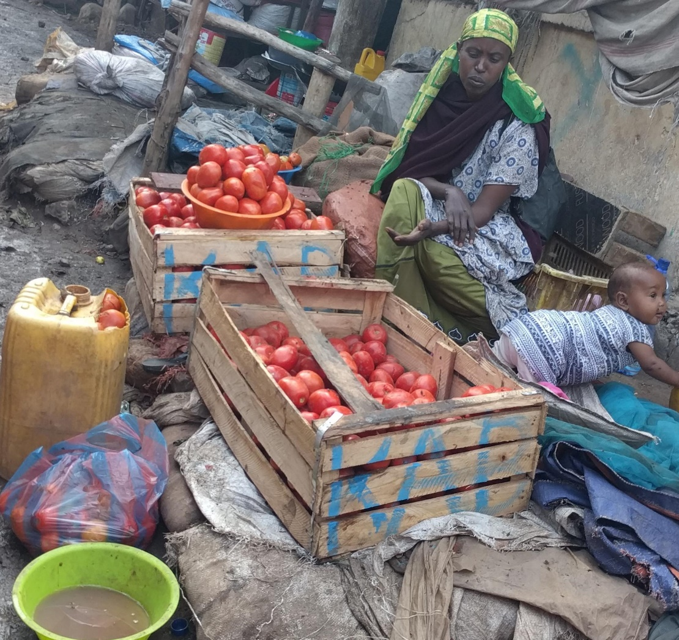
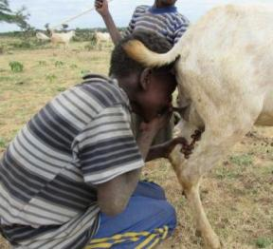
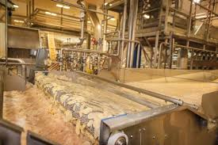
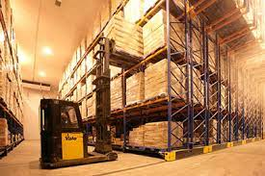
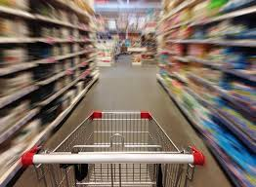
Food safety systems: diverse supply chains
High-income countries typically have long, complex but highly regulated and audited supply chains with standards driven by enforcement and more importantly consumer demand
But in LMIC, 90% of food is supplied through informal food markets
Supply chains are often simple, sometimes short supplying local food, but have limited food safety controls, regulation and monitoring

Slide 10
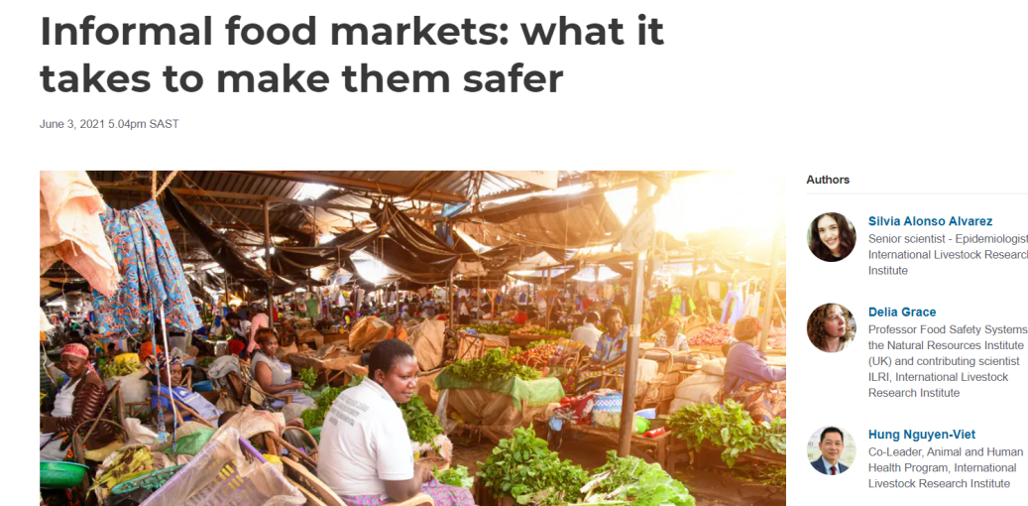
Food safety systems: diverse supply chains
But foods from the formal sector are not necessarily safer in LMICs as there are many opportunities for food safety controls to go wrong in a long complex supply chain with many different suppliers, actors and greater dependency on systems, infrastructure and technology
Need to work to improve the informal sector
https://theconversation.com/informal-food-markets-what-it-takes-to-make-them-safer-161601

Slide 11
Current food safety research in Ethiopia
Bill & Melinda Gates Foundation and UK government, with others including CGIAR investing heavily
  Pull-Push project, TARTARE, ENSURE, FOCAL, CAGED, EXCAM
  US$ 10 millions invested
Look at various commodities and aspects and innovative solutions
  In Pull-Push, we run a consumer awareness campaign to see if greater consumer demand for food safety can be used to drive markets and value chains to supply safety food
Also provide burden of FBD estimate for Ethiopia (out soon!)

Slide 12
Pull-Push project: Attribution
Disease attribution to food groups, food types and food products
For example, suggests about half Ethiopia non-typhoidal Salmonella burden from chicken and eggs
Knowledge of burden and attribution is key when setting control policies
Notes:
Disease Burden Epidemiology Reference Group (WHO FERG)

Slide 13
So, what can consumers do?
Observe basic hygiene
  Keep food and hands clean
  Avoid cross-contamination
  COOK THOROUGHLY (if food is contaminated this will kill almost all germs)
  Store appropriately
  Use safe water and ingredients
What if one cannot afford quality foods or lacks refrigeration?
  Consume food quickly without extended storage
  Minimize handling
  Cook thoroughly
  Grow your own food

Slide 14
What can be done to improve the supply of safe food?
Enabling environment
  Regulators support producers and traders to improve standards without shutting down vital supply chains and livelihoods
Increase capacity
  Of those in the food sector to supply safe food; knowledge and improved infrastructure is key
Provide incentives
  Making safer food is more expensive and this needs to be covered by developing market incentives for the food sector invest in food safety
    With knowledge, will more consumers pay for safer food?
    Will this lead to self-regulation as happens in most high-income food sectors?

Slide 15
Pull-Push approach
Key innovation
Reduced burden FBD, professionalizing informal sector, appropriate governance
Pull approach (demand for safe food)
Push approach (supply of safe food)
ENABLING
ENVIRONMENT
Consumers recognize & demand safer food
VC actors respond to demand & incentives
Consumer campaign for empowered consumers (Primary Outcome 3)
Build capacity & motivation of regulators
(Primary Outcome 1)
Inform, monitor & legitimize VC actors
(Primary Outcome 2)
Gather baseline information for detailed intervention planning and advocacy

Slide 16
Work together for a brighter and safer tomorrow
The massive preventable burden of unsafe food has been ignored for too long
  THIS HAS TO END
Achieving safer food requires broad engagement and collaboration
  Government, industry, formal and informal food sectors, research institutes
  and consumers (they have the biggest influence on farm to fork safety)
What is needed for safe food is simple and well understood
But instilling this along food value chains in LMICs is complex
Things are starting to improve…BUT WE NEED LONG-TERM COMMITMENT AND COLLABORATION

Slide 17
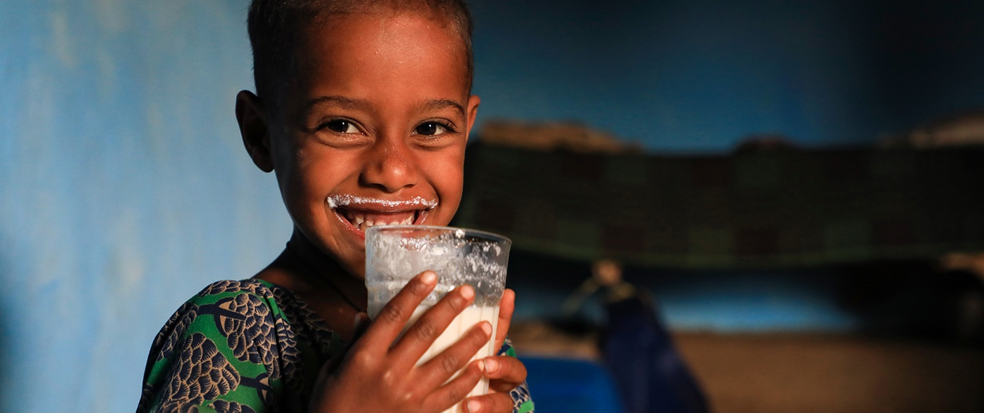
THANK YOU

