Slide 1
Operationalizing One Health in pastoralist settings

Slide 2
Module 1: Principles and applications of One Health

Slide 3

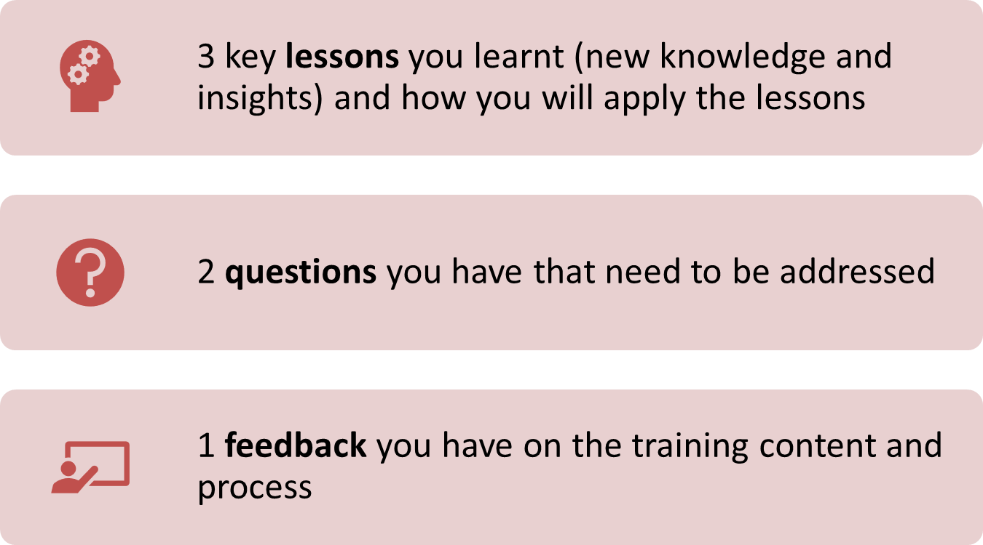
Re-cap Day 2
Reflection
Write down your key lessons from yesterday
Be prepared to share your responses in plenary
30 minutes

Slide 4
Data-driven decision making in One Health

Slide 5

Intended learning outcomes
By the end of this session, you will be able to:
list the steps of DDDM;
formulate key questions that can be answered with data;
describe important considerations for data collection and analysis; and
make recommendations based on data

Slide 6
Topics
What is data-driven decision making?
Steps in DDDM

Slide 7
Information sources
Interactive plenary discussion
What types of data and information sources do human, animal and environment sectors use to make decisions about programming?
What types of data and information sources do pastoralist communities use to make household decisions?
15 minutes

Slide 8
What is evidence?
Interactive plenary discussion (video analysis)
Facilitator will play a video
Video 5: Evidence-informed policy
https://www.youtube.com/watch?v=75djvHfs5pw
OR
Video 6: Data driven decision making (GBV)
https://www.youtube.com/watch?v=zDMhRWUsLvw&t=9s
15 minutes

Slide 9
What is evidence?
Interactive plenary discussion (video analysis)
As you watch consider:
  What do you understand by the terms ‘data-driven decision making’ or ‘evidence-informed decision making’?
  What is the alternative to evidence-informed decision making?
  What is evidence? What are some different words for ‘evidence’?
Be prepared to share your answers in plenary
15 minutes

Slide 10
Data-driven decision making (DDDM)*
Process for deciding on a course of action based on data, experimentation, and evidence rather than opinions or intuition
Data is used to drive decisions that improve programs, activities, or strategies
Helps move from reactive to proactive approaches
Can be applied at program, organization or system level
* Similar terms: evidence-based decision making, evidence-based practice, evidence-informed policy

Slide 11
Benefits of DDDM
Helps decision-makers and communities to:
  Identify and manage risks (e.g. outbreaks, drought)
  Identify and manage priorities (e.g. strategic, operational, resources)
  Identify potential changes in needs and expectations of interested parties in the long term;
  Identify which existing services, products and processes provide the most value;
  Identify which new services, products and processes are needed;
  Identify new capabilities and experiences that may be needed

Slide 12
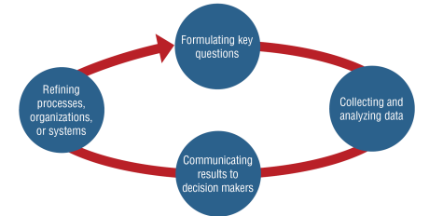
Steps in DDDM

Slide 13
Case study on DDDM
Community-Based Observatories Network (CBON) in the framework of the HEAL project
Facilitator will hand out copies of the case study
At your table, discuss the case study using the questions on the next slide as prompts
Be prepared to share your discussion in plenary
90 minutes

Slide 14
Case study on DDDM
Small group discussion
Discussion questions:
  Can you identify the 4 main steps of DDDM in the development of the CBON as described in the case study?
  What data is collected as part of the CBON? How is it collected?
  What challenges and problems might you anticipate in the implementation of data collection and analysis stages?
  Who are the stakeholders in the CBON? How are key findings communicated to stakeholders?
  Which elements contribute to effective participation of local communities?
90 minutes

Slide 15
Formulating key questions
Defines the problem you want to answer
Important to consider what the project/program/organization intends to accomplish, e.g.
  Assess opportunity
  Diagnose a problem
How question is formulated should assist in identify what data should be collected
PICO | P: Population – recipients or beneficiaries of a service or intervention I: Intervention – service or planned action to be delivered C: Comparison – alternative service or action (optional) O: Outcome – way in which service or action can be measured to see if it had the desired effect

Slide 16
Examples of questions
What are the impacts of One Health Units (intervention) on pastoralists in the Horn of Africa (population)?
versus
Do One Health Units (intervention) increase health service utilization (outcome) in pastoralist areas of the Horn of Africa (population) compared to the standard model of health service delivery (comparison)?

Slide 17
Other examples of questions
COCOPOP | When you want to assess the prevalence of a condition, disease, problem when there is no intervention e.g. What is the prevalence of brucellosis in adult patients presenting with fever in this woreda/district? Co: Condition – what disease or problem you are looking at (brucellosis) Co: Context – when/where is this happening (this woreda/district) Pop: Population – how is the population defined (adults presenting to healthcare facility with fever)
SPICE | When you want to investigate attitudes or opinions e.g. What do community members think about One Health Units in this woreda/district? S: Setting – where this is happening (this woreda/district) P: Population or perspective – from whose perspective the investigation is done (community members) I: Intervention – service or action (One Health Units) C: Comparison – alternative service or action (optional) E: Evaluation – outcome measure (attitudes)

Slide 18
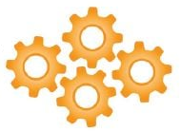
Collecting data
Important considerations:
  What data are most relevant and available?
  How will data be collected and by whom?
  When is the information to be collected, analyzed, and delivered?
  What indicators will you use to assess progress and change?
Tips for One Health practitioners:
  Consider all components and processes in the socio-ecological system as they affect the problem being addressed (systems thinking)
  Consider whether you need to collaborate with other sectors (health, agriculture, environment, nutrition, water…) to obtain relevant data
4Cs

Slide 19
Data analysis
Process of interpreting (making sense of) data
Data quality is important
  Clean data prior to analysis e.g. remove incorrect/incomplete/missing/ duplicate data)
  Consider improvements to data collection systems to reduce above
Types of data analysis:
  Quantitative – numbers based (how many, how often…)
    Descriptive statistics – describe characteristics of the data
    Inferential statistics – draw comparisons and make predictions
  Qualitative – language-based (why, how…)

Slide 20
Data analysis (continued)
Final step is coming to conclusions i.e. identifying key findings and suggested action/recommendations
Tips:
  Ensure recommendations are clearly supported by the data analyses and results
    Focus on 3-5 key findings
  Organize recommendations by potential timeline (e.g., short-term, long-term)
  Present multiple options - consider risks and benefits of implementing and not implementing the recommendations
  Focus on actions that stakeholders have the power and resources to implement

Slide 21
Turning questions into answers
Small group activity (brainstorming)
Identify an important ‘One Health problem’ in your woreda/district that requires multi-sectoral collaboration to address
Using question prompts on the next slide, brainstorm how you would implement the first 2 stages of DDDM:
  formulating key questions
  collecting and analyzing data
Capture group discussion on flip chart
40 minutes
Notes:
If groups are finding it difficult to come up with an example from their woreda/district, suggest one of the following:
Rabies outbreak in humans
Anthrax outbreak in livestock
Wildlife die-off due to unknown causes
Response to drought
Pollution of community water source
Increased malnutrition rate in children aged under-5 years

Slide 22
Turning questions into answers
Small group activity (brainstorming)
Discussion prompts
  Identify and define the problem by writing out an answerable question
    Check: can question be answered with data?
  Identify the types of data that are needed to answer the question
    Check: do all data address the question?
  Identify how data will be collected (or if it is already available how it will be located) – consider location, time
  Identify who will collect the data (or if it is already available how it will be shared)
40 minutes

Slide 23
Turning questions into answers
Feedback session
Walk around the room and read what other groups have done
Write down 1 piece of feedback (question or comment) on a sticky note and leave it for the group to consider after the feedback session
20 minutes

Slide 24
Communicating results to stakeholders
Important considerations:
  Who are your key audiences?
  What results will most inform their understanding and decision making?
  How will the information be used?
  What are the most important messages to convey?
Tips for One Health practitioners:
  Need to communicate to a range of stakeholders with different technical backgrounds and from different parts of society
  Knowledge of different stakeholder perspectives, how stakeholders interact and influence each other as well as how political and cultural contexts affect the problem and proposed actions are all important (systems thinking)
4Cs

Slide 25
Implementation and follow-up
Remember: DDDM is not complete until the information it generates leads to action
Actions might include changes to activities, programs, organizations, and entire systems
Follow up once actions are implemented to determine whether change has been effected, e.g.
  Are new services, activities, and policies being developed and implemented as intended?
  Are changes in knowledge, beliefs, attitudes, behaviors, or status occurring because of the actions taken?
If no change, formulate key question (i.e. cycle continues)

Slide 26
From recommendations to action and follow-up
Small group activity (brainstorming)
In the same groups, consider the feedback and adjust as needed
Using question prompts on the next slide brainstorm how you would implement the final 2 stages of DDDM:
  communicating results to stakeholders
  implementation and follow-up
Capture group discussion on flip chart
Be prepared to present your discussion in plenary and vote on the best plan
60 minutes
Notes:
If groups are finding it difficult to come up with an example from their woreda/district, suggest one of the following:
Rabies outbreak in humans
Anthrax outbreak in livestock
Wildlife die-off due to unknown causes
Response to drought
Pollution of community water source
Increased malnutrition rate in children aged under-5 years

Slide 27
From recommendations to action and follow-up
Small group activity (brainstorming)
Discussion questions
  Who are your key audiences?
  What methods will you use to convey the key recommendations?
  How will they use the information?
  Who will implement the recommendations and follow-up on progress?
60 minutes
Notes:
If groups are finding it difficult to come up with an example from their woreda/district, suggest one of the following:
Rabies outbreak in humans
Anthrax outbreak in livestock
Wildlife die-off due to unknown causes
Response to drought
Pollution of community water source
Increased malnutrition rate in children aged under-5 years

Slide 28
Summary of key learning points from day 3
Key steps in DDDM are: (1) formulating key questions, (2) collecting and analyzing data, (3) communicating results to decision makers, (4) implementation and follow-up of key recommendations
Key questions must be formulated so they can be answered with data
In One Health contexts, data collection across sectors and communication with diverse stakeholder groups is needed

Slide 29
Multi-sectoral collaboration and coordination in One Health
Coming up:

