Slide 1
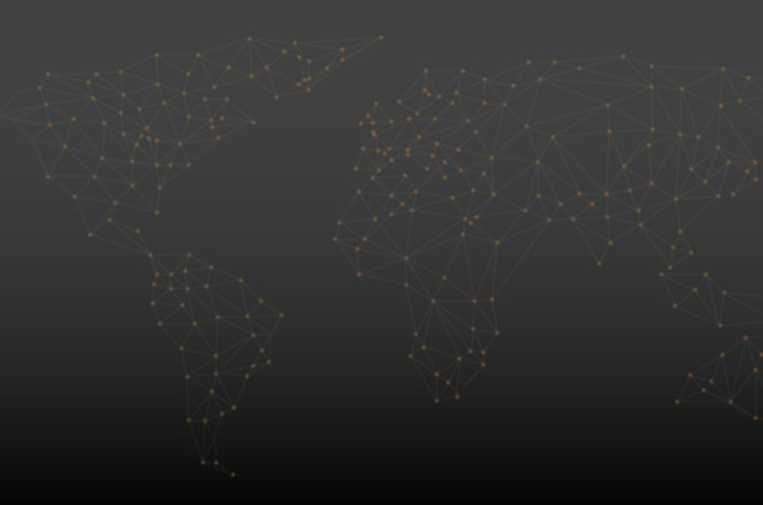

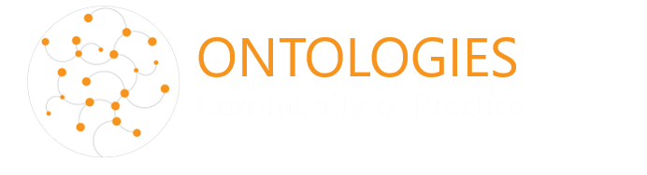
Small-Scale Fisheries and Aquaculture Ontology (SSFO)
Labeling Fish Science Data
Elizabeth Arnaud, Marie-Angélique Laporte, Jerome Delamare-Boutteville, Alex Tilley
Fishbase and SeaLifeBase Symposium, 5 September 2022
Notes:
.

Slide 2
Context
Rapid development of the digitalization of research in fishery and aquaculture sector
Huge numbers of multidisciplinary research data and survey data available online but not easily findable and reusable due to a lack of standardization and proper labeling.

Slide 3
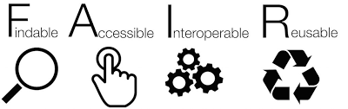
FAIR Data principles
TO BE INTEROPERABLE:
I1. (meta)data use a formal, accessible, shared, and broadly applicable language for knowledge representation.
I2. (meta)data use vocabularies that follow FAIR principles.
I3. (meta)data include qualified references to other (meta)data.
https://www.force11.org/group/fairgroup/fairprinciples

Slide 4
What is an Ontology
provides
  a shared vocabulary for a knowledge domain (all the terms)
  textual definitions for the intended meaning of the terms
  standard reusable identifiers for concepts
  machine-readable semantics axioms between concepts and definitions– logical representation of human knowledge
  facilitate data publication, data access and analysis, when it is used to annotate data

Slide 5
Benefits of using ontologies
When using ontologies data is:
  Easily shared and understood among scientists as ambiguity is reduced;
  Integrated easily with existing resources;
  Searchable in an efficient way, using different views and contexts;
  Of better quality, as quality check can be run easily.

Slide 6
What semantic resources exist?
FISHO = ichthyology, diversity, and adaptation (Ali, et al., 2017)
Draft ontologies developed by Food and Agriculture Organization (FAO) (Caracciolo, et al., 2012)
AGROVOC thesaurus = around 38,000 concepts.
Thesaurus on Aquatic Science and Fisheries Abstracts (ASFA): Multilingual controlled vocabulary to index the content of the Aquatic Sciences and Fisheries Abstracts, not data. Being integrated into AGROVOC
Agronomy ontology, Environmental Ontology: part of these resources have defining terms that are relevant to fish research

Slide 7
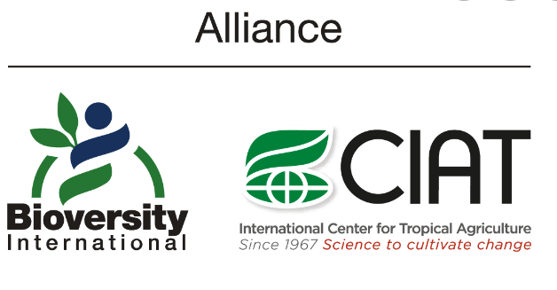

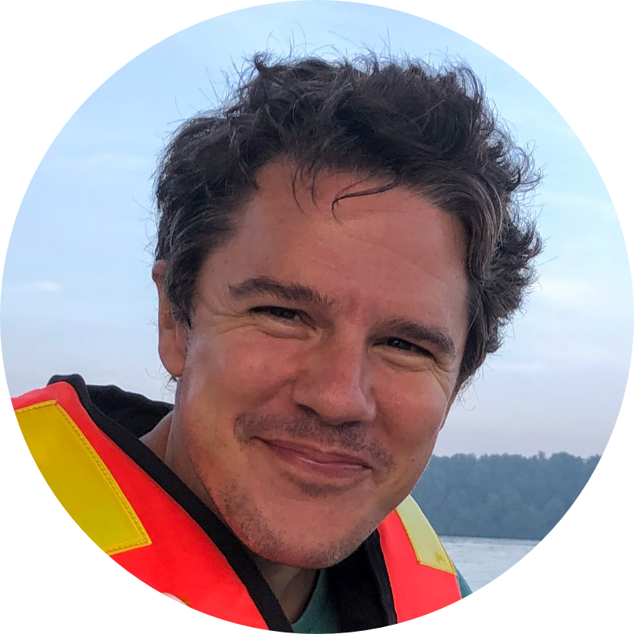
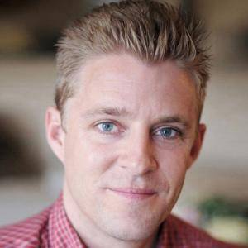
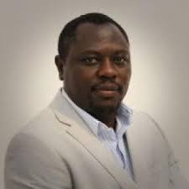
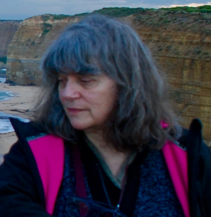
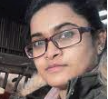
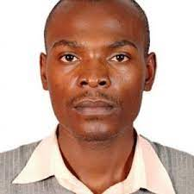
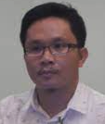
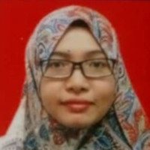
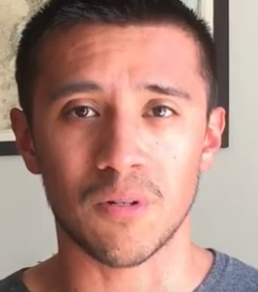
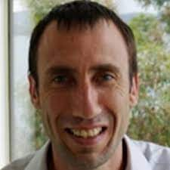
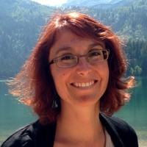
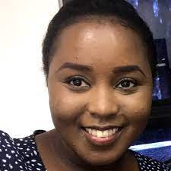
Team
Tusnuva Jahan
Master student, University of Lille, France
Jerome Delamare-Deboutteville
Scientist
Alex Tilley
Senior Scientist
Rodrigue Yossa
Scientist (Fish Feeds & Nutrition)
Elizabeth Arnaud
Senior scientist – Alliance Biodiversity-CIAT
Kelvin Mashisia Shikuku
Economist
Saadiah Ghazali
Data Management Specialist
E. Fernando Cagua
Consultant Data Scientist
Matthew Hamilton
Genetics
Daryl Lustracion Superio
Consultant, Philippines
Marie-Angelique Laporte
Associate Scientist - Alliance Biodiversity-CIAT
Jacqueline Muliro – ex-data manager

Slide 8
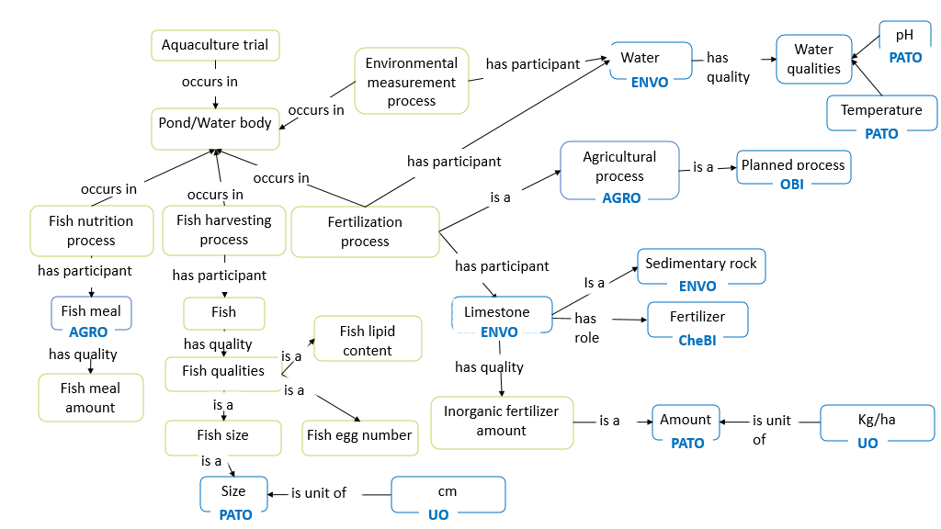
A new ontology
Design the knowledge model with experts in fisheries, genetics, aquaculture
Extraction of 380 Small-scale Fisheries and Aquaculture Ontology concepts from publications : papers, thesauri, data files
Validation with domain experts
Adding definitions to concepts
Reuse of terms from existing ontologies (potential mappings with existing standards have been identified and recorded)

Slide 9
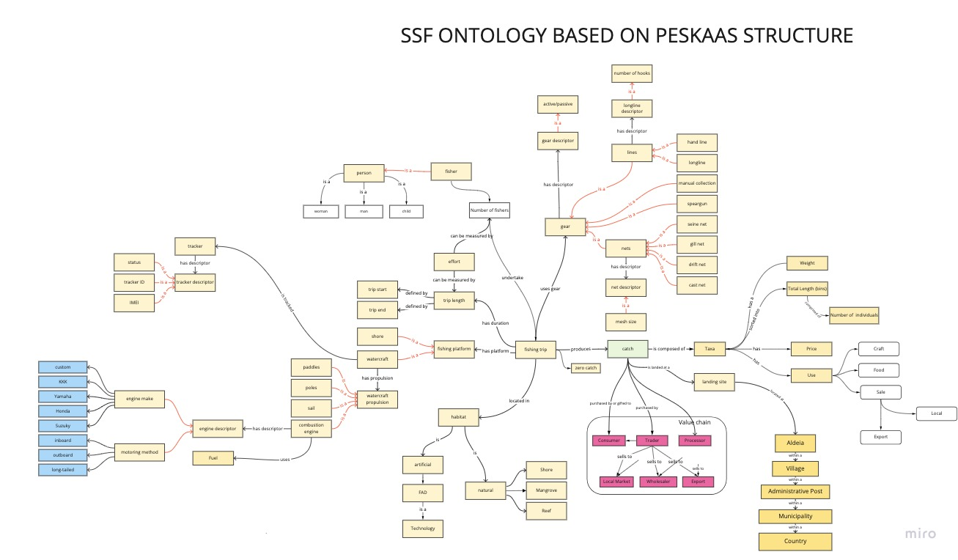
PeskAAS: A near-real-time, open-source monitoring and analytics system for small-scale fisheries
An interactive web application to facilitate data exploration and decision-making processes in small-scale fisheries.
Cloud-based MySQL database called ‘peskaDAT’
Source for the conceptual design of the ontology 's module on small fisheries
Tilley A, Dos Reis Lopes J, Wilkinson SP (2020) PeskAAS: A near-real-time, open-source monitoring and analytics system for small-scale fisheries. PLOS ONE 15(11): e0234760. https://doi.org/10.1371/journal.pone.0234760

Slide 10
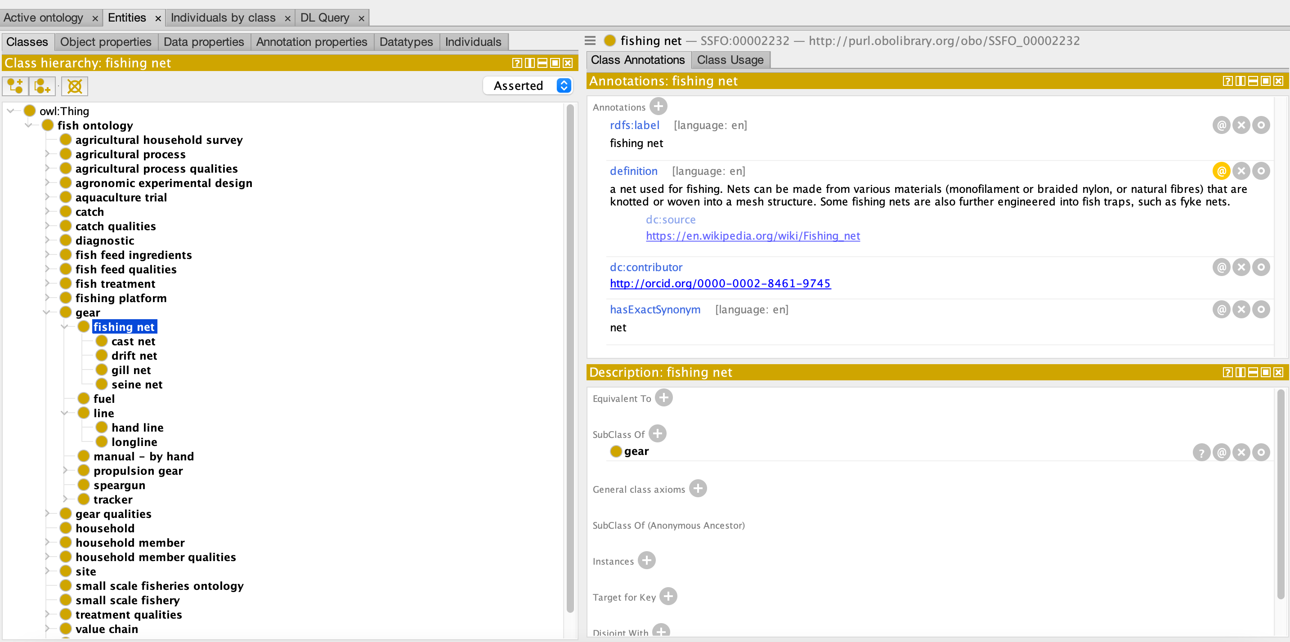
Small Fisheries & Aquaculture Ontology
From small-scale fisheries to aquaculture trials, fish nutrition, disease detection, fish characteristics, ….
Notes:
Development of a hierarchy of classes
Classification of the concepts extracted from data
Definition of the concepts’ properties using a statement method.
From the most general concept of the domain followed by subsequent specialization concepts.

Slide 11
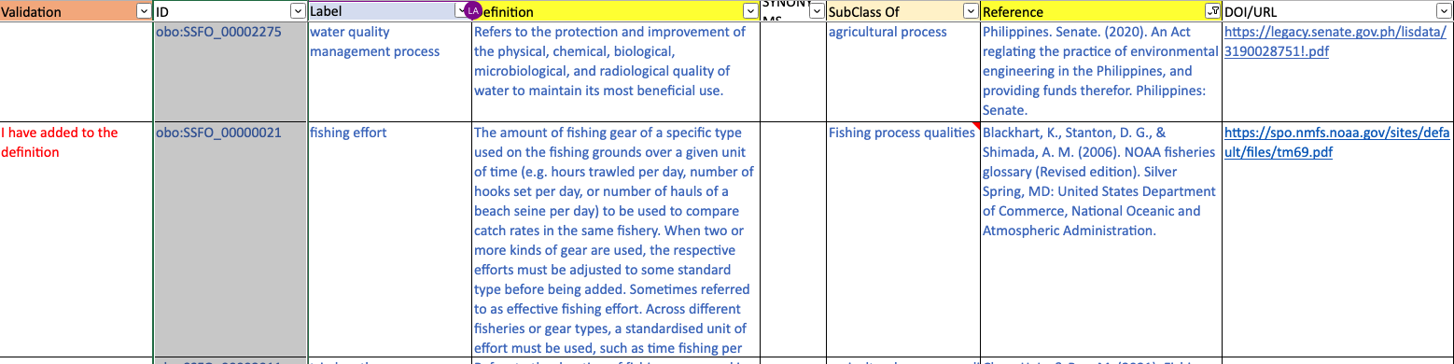
Curation process with experts

Slide 12
Conclusion and next steps
Draft of the ontology is published on GitHub:
  https://github.com/WorldFishCenter/fish-ontology
  engage more experts: GitHub issue tracker can be used to collect feedback; easy to use, require a GitHub account (just need an email and a username for that)
Next steps
  Integrate Fishbase Taxonomy
  Publish online the draft version in WorldFish website
  Define new use cases

Slide 13


Thank you
Contacts
e.arnaud@cgiar.org
m.a.laporte@cgiar.org
a.tilley@cgiar.org

