Slide 1
Operationalizing One Health in pastoralist settings

Slide 2
Module 2: Gender, culture and One Health

Slide 3

Warmup
Stand up and move around the room
Meet other participants and share why you think culture and gender are important in One Health
15 minutes

Slide 4
Participant expectations and intention to apply lessons
Individually
Write down 2-3 learning expectations and 1 intention to apply the lessons.
By table
Share your learning expectations and intention to apply the lessons.
Agree on
2-3 learning expectations and 1 intention to apply the lessons as a group.
In plenary
Share your group learning expectations and intentions to apply the lessons.
15 minutes

Slide 5

Intended training outcomes
By the end of this training, you will be able to:
Appreciate
The values of cultural diversity, relativism, and responsivity in a One Health context.
Apply
Concepts of cultural diversity and relativism as analytical tools in One Health practices.
Strive
For cultural diversity as a source of exchange, innovation, and creativity in One Health practices.
Frame
The concepts of culture and One Health within the healthcare context in pastoralist settings.
Demonstrate
Ability to assess and integrate culture and gender issues in One Health practices in pastoralist communities.
Demonstrate
Culturally competent knowledge, skills, and attitudes in working across disciplinary, organizational and cultural boundaries.

Slide 6
Training content
Over the next 3 days we will cover:
  Culture, values, norms, beliefs
  Socialization, agents of socialization, importance and drawbacks of socialization
  Ethnocentrism and its consequences
  Cultural diversity, relativism, responsivity, competence
  Gender roles, norms, relations
  Gender stereotypes and inequalities
  Gender integration approaches in One Health

Slide 7
Pre-training assessment
Your facilitator will distribute a pre-training self-assessment form
The form is anonymous and will be compared with the post-training assessment
Be as objective as possible in your self-assessment
5 minutes

Slide 8
Training approach and process
Experiential, reflective and collaborative learning process
Enriching learning through case study analysis, videos, and role-plays
Small group work and presentations
Personal reflections and journaling of key lessons and insights

Slide 9
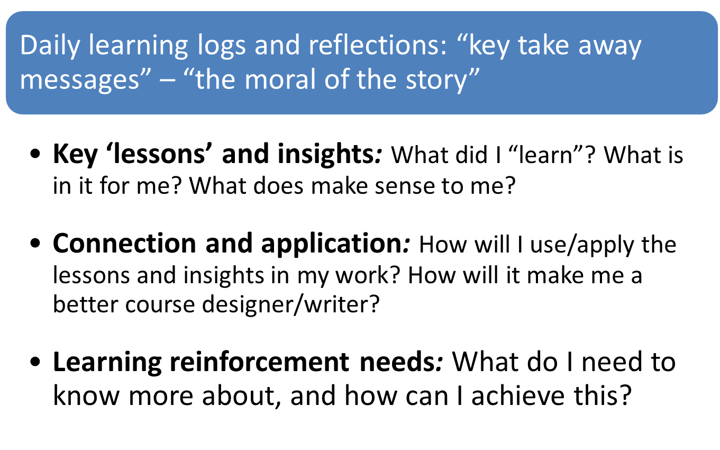
Self-learning management

Slide 10
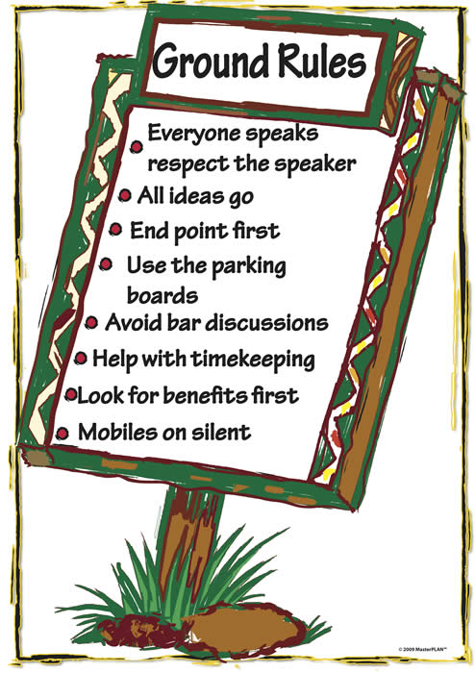
Ground rules
Be punctual
Be prepared
Every idea counts
Phones on silent mode
No side conversations
Active participation
Keep an open mind
Build connections

Slide 11
Feedback teams
Volunteers needed for each day
Purpose:
  Obtain participant feedback on the training content and process
  Energizers
  Time keeping

Slide 12
Concept and role of culture in One Health

Slide 13
Intended learning outcomes
By the end of today you will be able to:
  explore your own attitudes, values, beliefs, and biases and explain how this can affect your ability to work in multicultural and transdisciplinary teams in a One Health context;
  explore the relationship between the individual and society drawing on the concepts of socialization, culture, and social identity;
  develop a culturally competent approach in understanding the interconnectedness between animal, human and environmental health; and
  demonstrate self-reflective practices for continual learning by assessing and recognizing your own values, beliefs, attitudes, and experiences in One Health.

Slide 14
Topics
Culture, norms, values, belief systems
Socialization and agents of socialization
Ethnocentrism and its consequences
Cultural diversity and competence

Slide 15

Understanding culture
Interactive plenary discussion
What comes to your mind when you see or hear the word ‘culture’? Think of words, expressions, or objects that can describe culture
15 minutes

Slide 16
The culture wheel
Think-Pair-Share
Facilitator will distribute an image
In pairs, work on the following questions:
What do you learn from the picture?
Can you define culture by any one thing?
15 minutes

Slide 17
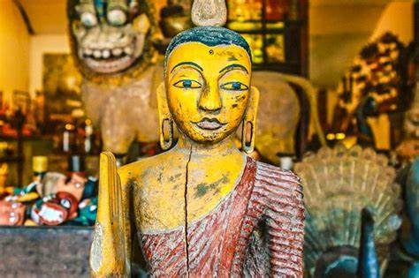
Concepts of culture
Culture is a multifaceted, intersectional concept that each of us will understand, define, and experience differently
It is the system of shared beliefs, values, customs, behaviors, and artifacts

Slide 18
Concepts of culture
Culture encompasses many things (ranging from tradition to ethnicity to technology) and influences our choices as individuals, households, and groups in many ways
Culture influences the perceptions and behaviors of people

Slide 19
Socialization and why it is important
Interactive discussion
Think of your childhood life and reflect on how you have learned what is right or wrong in your culture
For example, how did you learn how to behave as boys and girls in your culture?
20 minutes

Slide 20
Socialization and why it is important
Small group discussion
Your facilitator will play a video about socialization
Work on the following discussion questions:
  What do you understand by socialization?
  What are agents of socialization?
  Why do you think socialization is important? What could be the drawbacks?
  How does socialization shape the way we think and behave?
Be ready to share your reflections in plenary
30 minutes

Slide 21

Socialization and why it is important
Socialization is how we learn culture (what society expects of us)
It is the process of internalizing the norms, values, beliefs, and ideologies of society
It is through teaching culture to new members that society perpetuates itself

Slide 22
Socialization and why it is important
Agents of socialization are social institutions (e.g., family, school, peers/groups, organizations, religion, the media) that are responsible for the process of socialization
While socialization is a necessary part of society, it also has drawbacks

Slide 23
Ethnocentrism and its consequences
Small group discussion
Facilitator will display an image and distribute discussion questions
Work on the discussion questions
Be ready to share your reflections in plenary
30 minutes

Slide 24
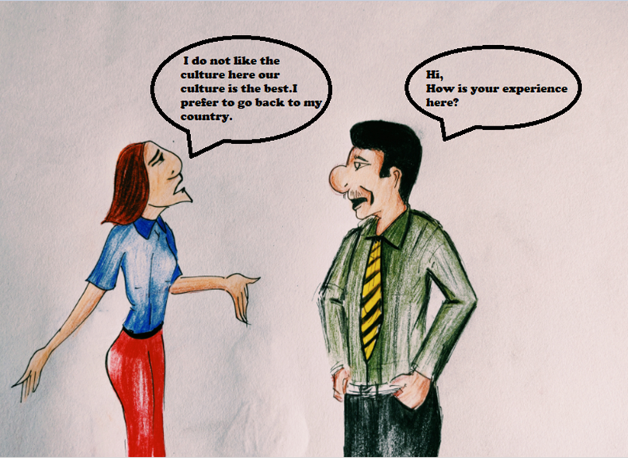
Ethnocentrism and its consequences

Slide 25
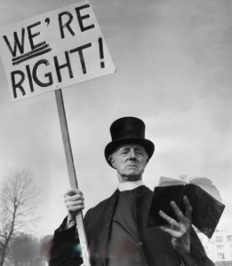
Ethnocentrism and its consequences
Brainstorming:
What do you understand by ethnocentrism?
What could be the drawbacks of ethnocentrism?
10 minutes

Slide 26
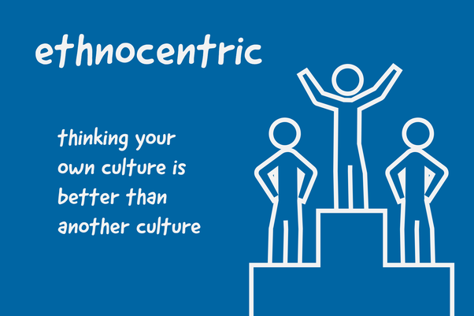
Ethnocentrism and its consequences
We live in a world of vast cultural diversity
Every group of people from different cultures has different beliefs, values, and actions
Ethnocentrism is the use of one’s own culture as a yardstick for measuring other cultures generally leading to a negative evaluation of those cultures
Ethnocentrism can lead to prejudice and discrimination and limit one’s ability to work in culturally diverse contexts and groups

Slide 27
Cultural diversity and competence
Brainstorming
What do you understand by the following terms:
  Cultural relativism
  Cultural diversity/multiculturalism
  Cultural sensitivity/responsivity
  Cultural competence
How can understanding these concepts help you work with people of different cultures and disciplines in One Health?
15 minutes

Slide 28
Cultural diversity and competence
Cultural relativism is the ability to understand a culture in its own context and not to make judgments using the standards of one’s own culture
Cultural diversity (multiculturalism) is a system of beliefs and behaviors that recognizes and respects the presence of all diverse groups and values what other cultures offer

Slide 29
Cultural diversity and competence
Cultural responsivity is an ability to learn from and relate respectfully to people from your own and other cultures. It involves exploring and honoring your own culture while learning about and honoring other people’s cultures
Cultural competence is an ability to interact and work effectively with people of different socio-cultural and disciplinary backgrounds at different levels

Slide 30
Continuum of cultural competence
Think-Pair-Share:
Facilitator will distribute a description of the continuum of cultural competence
First, individually study the description of cultural competence levels, and then discuss it in pairs
Be ready to share your interpretation of the levels of cultural competence in plenary
20 minutes

Slide 31
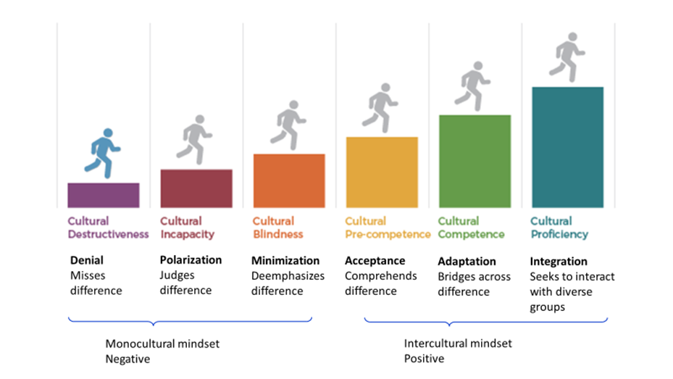
Continuum of cultural competence

Slide 32
Voting with the feet
Facilitator will display paper labels of each level of cultural competence on the floor
Indicate where you fall along the continuum of cultural competence by standing on the paper labels of your choice
Chat among yourselves about why you stood on a particular paper label
Describe which level of cultural competence along the continuum you are now, which level of cultural competence you would aspire to reach, and why, and what it will require you to reach there for One Health practice
20 minutes

Slide 33
Cultural competence in One Health
Small group discussion
In small groups, discuss the following questions:
  What are the practical implications of cultural competence for you as a One Health practitioner? Why is it important to become culturally competent in work and social environments?
  How does socialization, including your disciplinary culture, influence your ability to work across different cultures and disciplines in a One Health context?
  What could you do to develop the required mindset, skills, and behavior to work across disciplinary, organizational, and cultural boundaries in a One Health context?
Be ready to share your results in plenary
30 minutes

Slide 34
Summary of key learning points from Day 1
Culture affects how communities understand and express their health conditions and interact with healthcare service providers
Culture shapes the role of the community in health promotion and disease prevention
Culture influences teamwork and collaboration in One Health practices

Slide 35
Coming up
Culture and gender concepts in One Health

