Slide 1
Exploring smallholder farm decisions through typologies and serious gaming
Mirja Michalscheck
Wageningen University & Research
Tropentag 2019
20 September 2019, Kassel, Germany

Slide 2
Smallholders: 83%

Slide 3
Household types

Slide 4
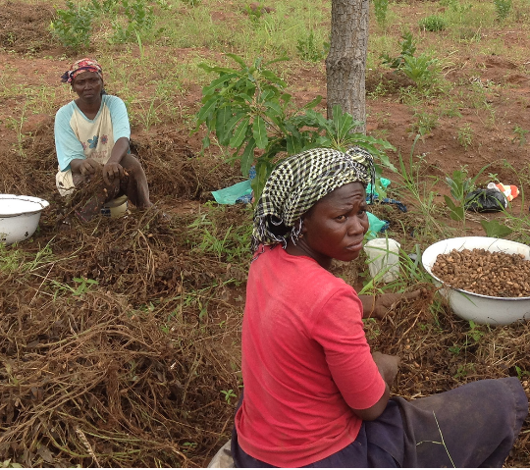
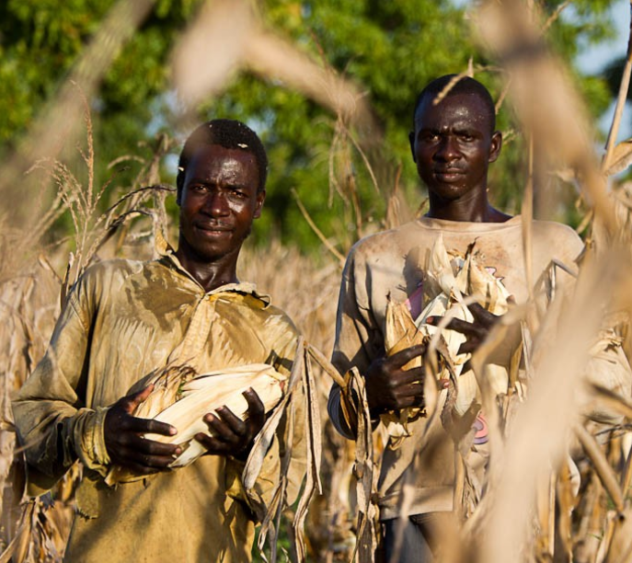
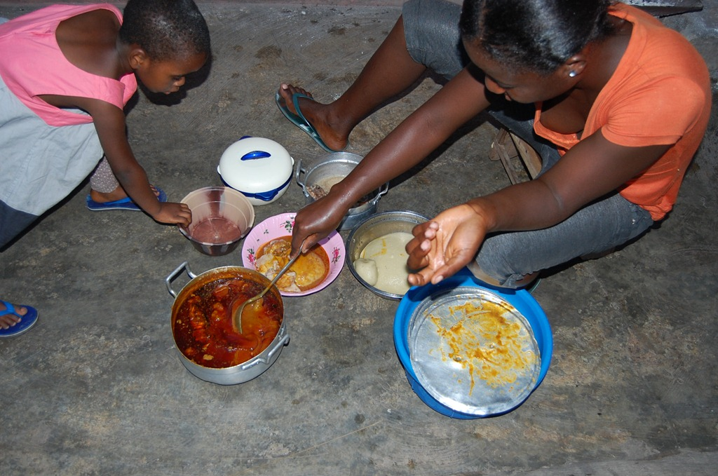
Gender norms

Slide 5
Household types and composition

Slide 6
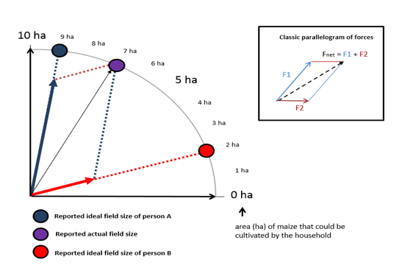
Decision-making dynamics: social physics

Slide 7
Serious game: Simulate a negotiation

Slide 8
Men – Women – Oldest Son

Slide 9
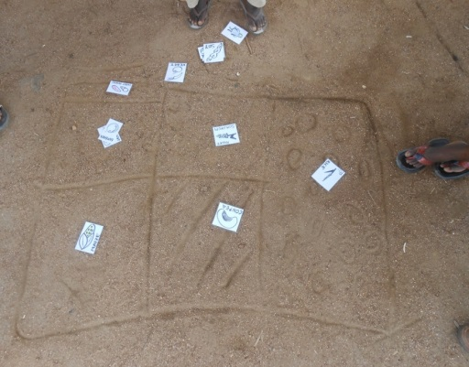
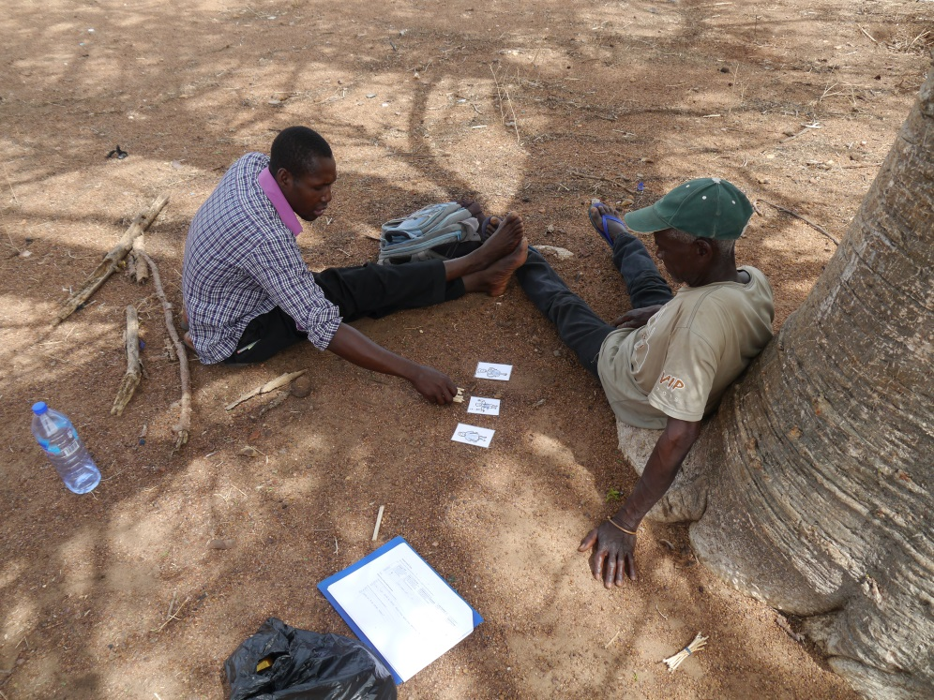
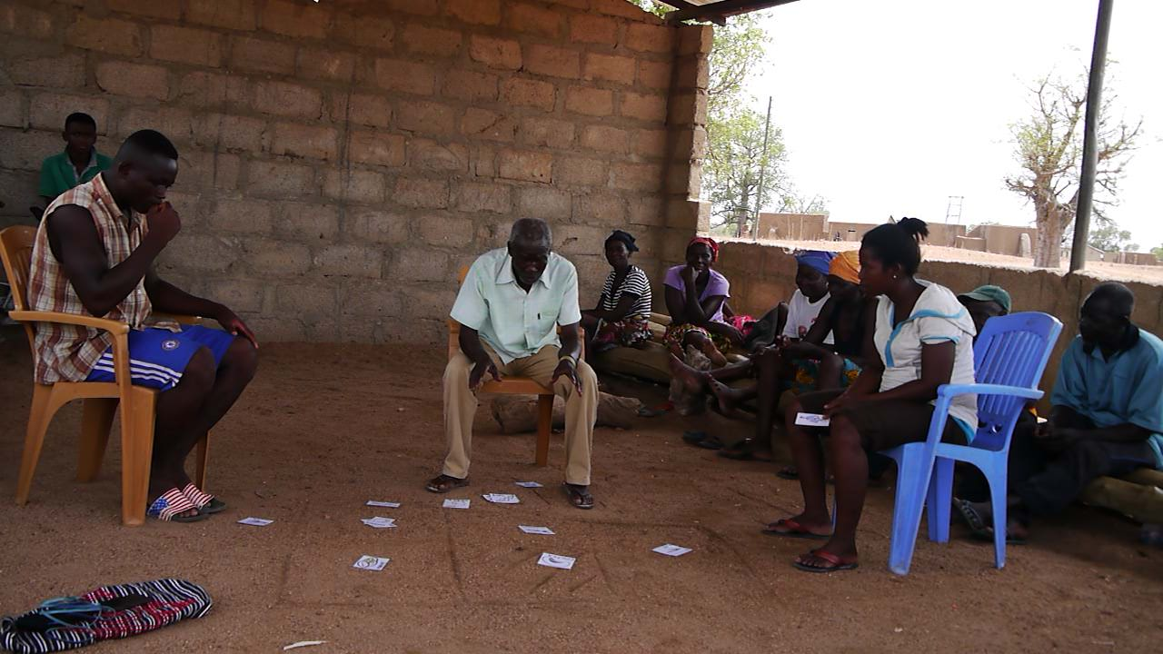
Negotiation - Evaluation

Slide 10
Interests and power distribution per farm type

Slide 11
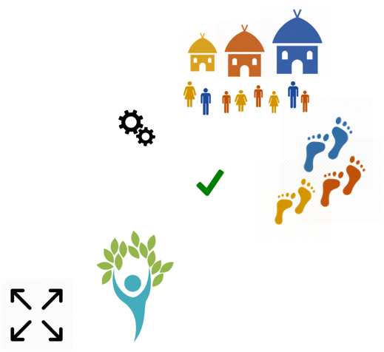
Key findings
Farm and farmer typology: new insights!
Complex systems: meaningful patterns
Pathway ‘out of poverty’: many steps, many people
Non-adoption might be the best choice for a farmer.

Slide 12


