Slide 1

Designing Appropriate Strategic Knowledge Management Approaches
Unit 3 of the Knowledge management in agriculture and rural development (KM4ARD) course

Slide 2
Overview of Unit 3
Purpose:
• Understand how KM can be strategically approached within organisations
• Understand the basic steps to developing a KM strategy
• Identify three methods to assess and map key knowledge assets, flows and gaps

Slide 3
What is a KM strategy?
A structured plan that describes concretely how an organisation will manage its knowledge
Benefits both the organisation and its stakeholders
Closely aligned with the organisation's overall strategy and objectives
Product or document but also a process
Should NOT be a static document…
Notes:
Trainers notes
Product or document…: the development of the KM strategy is probably more important than the document at the end. Make sure that it is a participatory process, that involved every one in your organisation. This will help you to get buy-in.
Should not…: emphasize that a KM strategy is a living document, that it is a plan but not written in stone. It should be adapted and updated regularly.

Slide 4
Focusing your KM interventions
KM is broad, where will you focus your energy, resources, etc. ?
What will bring maximum impact? for e.g:
  Internal vs external focus
  Collect vs connect focus
Identify the key knowledge needs within the organisation and provide a plan for addressing these
Notes:
Trainers notes
Link from last slide: … so why would you want a KM strategy? For one thing, it helps to focus your KM interventions
KM is broad…: for e.g internal vs external: some organisations start with a “getting the house in order” focus. Collect vs connect: some organisations focus more on capturing explicit knowledge, while others create more spaces for tacit knowledge exchange, for e.g. in communities of practice, where practitioners share their expertise.
Identify the key…: emphasize that the end goal is to have a stronger organisation.

Slide 5

Structure of a KM strategy document
KM definition
Vision statement
Strategic objectives
Activities or initiatives associated with each objectives
Annex: Implementation plan
Annex: M&E plan
Notes:
Trainers notes
Link from last slide: … so what does a KM strategy document look like? KM strategy documents encompass different content but usually have a similar format that includes these elements.
KM definition: YOUR own KM definition, the one that better represents your context and your work.

Slide 6

Do we really need a KM strategy?
Not if just a document on a shelf
Process is what is important
Assess needs, engage people, obtain funds
Alternative:
  Needs assessment and consultations
  “Just Do It”: integrate in work plan, project or program
Notes:
Trainers notes
Link from last slide: … so now that you know what is the content of a KM strategy document, the question you may have is, do we really need one?
Alternative: example for “Just Do It”: in 2006, FAO did not want to launch into a KM strategy process right away but wanted to focus on three knowledge areas, which they called “pillars” (Knowledge Networks, Best Practices and Ask FAO). Their idea was to work on the low hanging fruit, get some focused work done and results before launching into a KM strategy process.

Slide 7
Linking KM to institutional goals
Use most recent organisational strategy or strategic planning
Use organisational objectives or goals
Look for those that can be supported by creating, sharing and applying knowledge
Align the KM objectives to the strategic objectives
Notes:
Trainers notes
Link from last slide: … this was a strategic decision at FAO based on the organisational objectives at the time.
The linkage is what is most important, KM cannot be done in a vacuum. KM initiatives need to support an organisation’ strategic objectives.

Slide 8
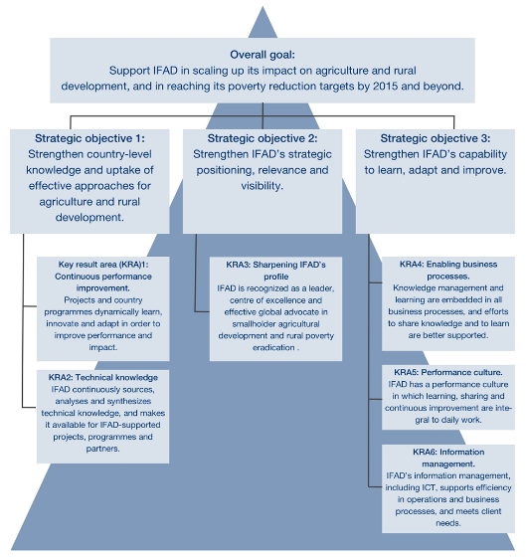
Diversity of KM strategies: IFAD
IFAD 2014
Overall goal
3 Strategic Objectives
6 Results-areas
that can be monitored
Activities within each
Notes:
Trainers notes
Link from last slide: … here are three examples of how diverse KM strategies can be according to organisational objectives or priorities. The first one is from IFAD.
Start from the top, with the overall goal, down to the three strategic objectives (can read them out loud). Then only mention the 6 results areas and activities, no need to read those.

Slide 9

Diversity of KM strategies: UNDP
UNDP Knowledge Management Strategy Framework 2014-2017
Defines UNDP’s principles, objectives and priorities in KM
Six priorities:
  Organizational Learning and Knowledge Capture
  Knowledge networking
  Openness and public engagement
  South-South Cooperation and External Client-Services
  Data Analytics, Measurement and Incentives
  Talent management and KM capacity
Notes:
Trainers notes
Link from last slide: … the second one comes from UNDP.
The UNDP is a framework that is based on the organisation’s strategic objectives. They have identified 6 KM priorities (you can read them), where they have different activities and actions.

Slide 10
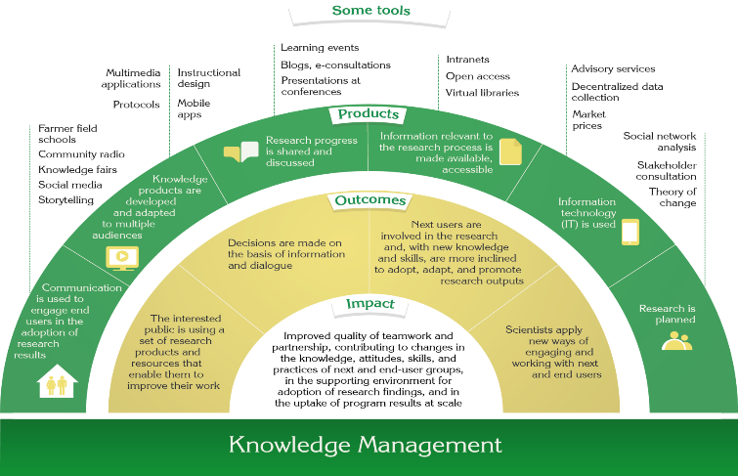
Diversity of KM strategies: CIAT
Different approach based on outcomes
Notes:
Trainers notes
Link from last slide: … the last example is from CIAT (one of the CGIAR centres).
The CIAT framework is based on a Theory of Change model, where they start with the impact they want to achieve at the center, as well as the outcomes they want. From there stems their activities, actions, products, methods and tools.

Slide 11
Exercise: linking KM to institutional objectives
Individually, think of your own organisation’s strategic objectives or goals
In the next10 -15 minutes, think of one (or more) way(s) KM could support these strategic objectives or goals
20 minutes - discussion at tables
15 minutes - plenary debriefing
Notes:
Trainers notes
Link from last slide: … so let’s start to think concretely about how this can apply to our context.
See Unit 3 Exercise notes.

Slide 12
Questions? Comments?

Slide 13

Rationale for a KM strategy
Increase awareness and understanding of KM in my organisation
Help gain senior management commitment and buy-in from colleagues
Make it easier to attract resources for KM implementation
Have a clear, communicable plan about where we are now, where we want to go, and how to get there
Have a basis against which to measure KM progress
Notes:
Trainers notes
Link from last slide:.. let’s start to look a bit more in-depth at the KM strategy process. Here is the rationale as to why you might want to launch a KM strategy process in your work environment.
If you agree with the importance of these statements, then developing a KM strategy might be worthwhile.

Slide 14
KM strategy process - stages
Align KM goals with organisational goals
Assessment of knowledge activities, capacities, knowledge flow and knowledge assets
Analysis of what exists, needs, gaps, etc.
Consultation with staff/partners
Drafting of strategy document and action/implementation plan (activities, tools, processes, deliverables, timescale, resources, responsibilities)
Validation with stakeholders
Implementation, monitoring, evaluation and reviewing alignment
Notes:
Trainers notes
Link from last slide: … so how would you go about it? There are seven basic stages to a KM strategy process.
We will be looking at each of these in more detail.

Slide 15

KM strategy process - stages
Align KM goals with organisational goals
Use organisational objectives or goals
Look for those that can be supported by creating, sharing and applying knowledge
Notes:
Trainers notes
Link from last slide: … so the first stage is…
Basically, this is what we started to think through during this morning’s exercise.

Slide 16
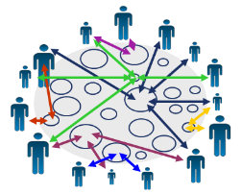
KM strategy process - stages
Assessment of knowledge activities, capacities, knowledge flow and knowledge assets
Examples of methods:
Knowledge audit
Social Network Analysis
KM scan
Notes:
Trainers notes
Link from last slide: … once you have determined your KM goals (that are aligned with your organisations goals), you can move to the second stage, which is the …
Examples of.. : we will look at these three methods in more detail a little later.

Slide 17

KM strategy process - stages
Analysis of what exists, needs, gaps, etc.
Examples of methods:
Knowledge audit
Social Network Analysis
KM scan
Notes:
Trainers notes
Link from last slide: … once you have identified and mapped the knowledge activities and assets, it is time to…
Examples of…: as you can see those are the same methods used for the assessment and we will look at these in more detail a little later.

Slide 18

KM strategy process - stages
Consultation with staff/partners
Examples of methods:
Interviews
Focus groups
Workshops
Notes:
Trainers notes
Link from last slide: … once you have a better picture of the situation, you can bring it to your colleagues and partners.
Develop a questionnaire on knowledge needs and try to identify strengths and weaknesses. This is a very important step; try to talk to as many stakeholders as possible, from different parts of your organisation as well as partners.

Slide 19

KM strategy process - stages
Drafting of strategy document and action/implementation plan (activities, tools, processes, deliverables, timescale, resources, responsibilities)
Example:
Slide 5 – structure of a KM strategy document
Notes:
Trainers notes
Link from last slide: … once you have consulted all appropriate stakeholders, it is time for a first draft of the strategy document.
(Slide 5 is repeated next so you can briefly review the content).

Slide 20
Structure of a KM strategy document
KM definition
Vision statement
Strategic objectives
Activities or initiatives associated with each objectives
Annex: Implementation plan
Annex: M&E plan
Notes:
Trainers notes
Link from last slide: … so here is a typical KM strategy document structure once again.
(Briefly review).

Slide 21

KM strategy process - stages
Validation with stakeholders
Examples of methods:
Presentation to organisation with feedback session
Online consultation with stakeholders
Workshops
Notes:
Trainers notes
Link from last slide: … once you have a first draft of the document, it is always advisable to bring it back to stakeholders for validation.
Again, this is key to build buy-in and support for the KM strategy and its content. It has to correspond to needs already expressed and resonate with your stakeholders.

Slide 22

KM strategy process - stages
Implementation, monitoring, evaluation and reviewing alignment
Examples of methods:
Quantitative tools (e.g. indicators)
Qualitative tools (e.g. Most Significant Change)
Notes:
Trainers notes
Link from last slide: … once validated, the implementation can start but it is really important to build in M&E within the strategy and review regularly. We will be looking at M&E methods and tools in Unit 4.
The process may seem linear but is actually a loop (illustration).

Slide 23
Methods to develop a KM strategy: Knowledge Audit
What: an inventory to identify knowledge activities, capacities and assets
How:
  Develop an audit questionnaire
  Can be administered through a combination of approaches: face-to-face and telephone interviews, workshops and focus groups, electronic consultations and discussion groups
Notes:
Trainers notes
Link from last slide: … so now let’s look at the methods mentioned in stages 2 and 3, that is those to assess and analyze knowledge in your organisation. You don’t need to use all of them, you can decide which one is more appropriate in your context. The first is the Knowledge Audit.
How…: there are examples of audit questionnaires online (see Unit 3 Resources).

Slide 24
Methods to develop a KM strategy: Knowledge Audit
Why:
To identify what and where key knowledge assets, activities and capacities can be found
To identify knowledge gaps (what the organisation should know but doesn’t)
Assets:
Documents/data
Methods
Skills
Experience
Relationships
Natural talent
Notes:
Trainers notes
Link from last slide: … so why would you do this and to identify what exactly?
Assets: it is important to include all these assets in the Audit. A lot of organisations only assess documents/data and methods, which gives a limited picture.

Slide 25
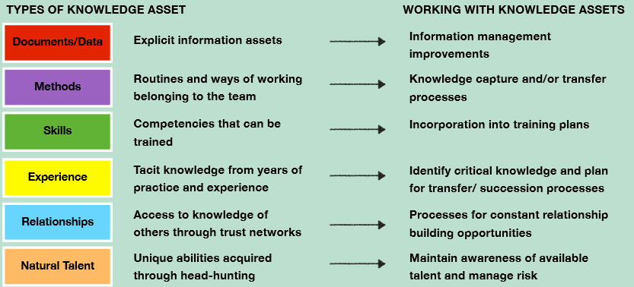
What it looks like: Knowledge Audit
© Straits Knowledge 2014
Notes:
Trainers notes
Link from last slide: … here is an illustration of what you can find in a Knowledge Audit.
On the left, you have the different types of knowledge that we are assessing. The right hand column is what we want to identify/obtain through the Knowledge Audit.

Slide 26
Methods to develop a KM strategy: Social Network Analysis (SNA)
What: a tool to map and analyse knowledge flows and communication channels in organisations and networks, revealing good practices and identifying gaps
How:
  Develop a SNA questionnaire
  Can be administered through face-to-face interviews, workshops and focus groups
  Analyse with SNA software
Notes:
Trainers notes
Link from last slide: … the second method that we are looking at is Social Network Analysis.
How…: As you can see, this method also uses a questionnaire. You can find an example in Unit 3 Resources.

Slide 27
Methods to develop a KM strategy: Social Network Analysis
Why:
  To identify individuals and groups playing central roles (thought leaders, key knowledge brokers, etc.)
  To identify bottlenecks and those isolated
  Spot opportunities to improve knowledge flow
  Target those where better knowledge sharing will have the most impact
  Raise awareness of the significance of informal networks
Notes:
Trainers notes
Link from last slide: … so why use this method?
For example, when using Social Network Analysis, it becomes clear who the connectors are, as you will see illustrated in the next slide.

Slide 28
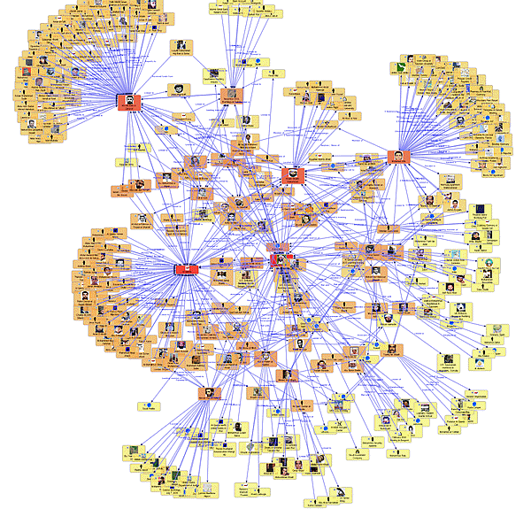
What it looks like: Social Network Analysis
Notes:
Trainers notes
Link from last slide: … so here you see in red the people who are the connectors, linking different groups together. You can also see where people are more isolated. There are reasons for that and it is interesting to analyze why that is.
Free SNA software is available online to create illustrations like this one (see Unit 3 Resources).

Slide 29
Methods to develop a KM strategy: KM Scan
What: a scan of KM awareness and activities/challenges
How:
  Fill out a KM scan questionnaire
  Analyse results with software
Why:
  To (self)-assess the level of knowledge management implementation and understanding within an organisation or network
Notes:
Trainers notes
Link from last slide: … the third method that can be used to develop a KM strategy is the KM scan.
The software is also available online on the CTA website (see Unit 3 Resources).

Slide 30
Methods to develop a KM strategy: KM Scan
A KM scan instrument developed to be applied at the level of the institution, network and individual
More than 20 aspects of KM addressed in the instrument, with coherence across three levels
Organisation and network KM scan carried out by members, combined with workshop to discuss the self-assessment
Notes:
Trainers notes
Link from last slide: … more specifically, the KM scan…

Slide 31
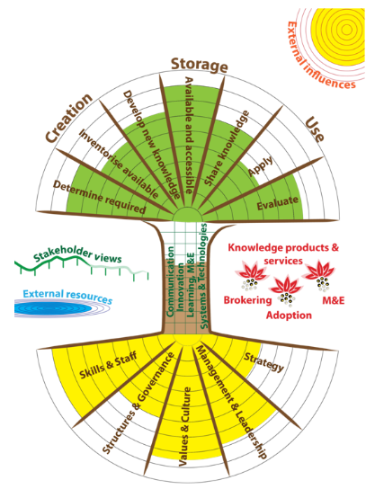
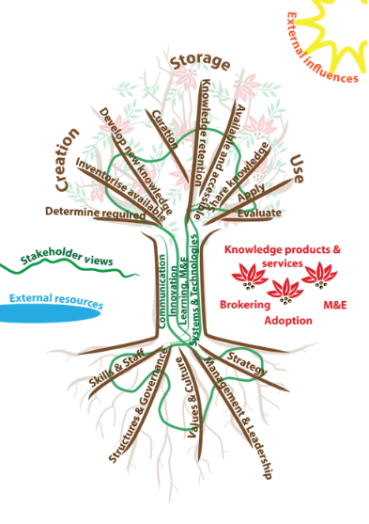
What it looks like: KM scan
Notes:
Trainers notes
Link from last slide: this is an illustration of the CTA KM scan, with the different elements.
The one on the right is the visual representation of a completed KM scan.

Slide 32
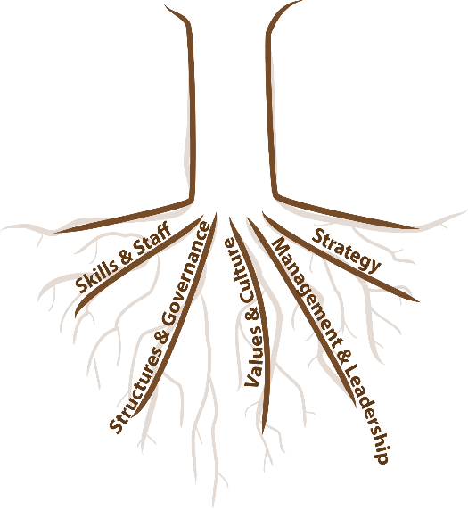
Building strong foundations of KM
competence management
knowledge retention practices
master-apprentice
develop subject matter experts
…
strategy development
vision - mission - ambition
SMART objectives
action planning
…
structure scan
project-organization
(Belbin) team roles, governance roles / responsibilities
…
Developing situational leadership
Optimising management roles
…
culture scan
Implement culture interventions
…
Notes:
Trainers notes

Slide 33
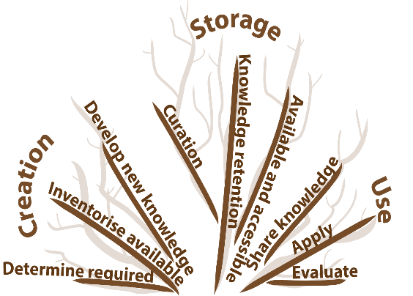
Develop the KM processes
Master apprentice, retention schemes, exit interviews...
research, desk studies, pilots, hiring of external experts, ...
stewardship, subject matter specialists, databases, ...
data and content curation ...
web portals, Brown Bag sessions, master-apprentice, CoP, learning communities, web 2.0, internal training and coaching, KS ...
Develop your KM tree, knowledge matrix, mapping exercises,...
Training, capacity development, Media campaigns, back-stopping
Web platform development,
content management, ...
strategy development, scenario planning, M&E of external services,...
Good/Best practices, lessons learned, Capitalization,
balance sheets, audits,...
Notes:
Trainers notes

Slide 34




Strengthening the enablers of KM
Internal communication strategy
Brown bag lunches, meetings, intranet
…
Internal think thank, idea box, ..
…
After action review, evaluations, peer assist,
…
Notes:
Trainers notes

Slide 35
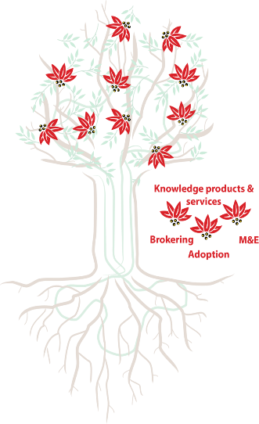

Operate within a given environment
Create value and share knowledge
Analysis of competition, economical context, natural factors, political factors…
country assessments, evaluation of training
consultations, partner organizations, donors, clients…
training, capacity building, publication of resources, web portals...
training and follow up, network support, webinars,
...
External expert input, facilitation,
Notes:
Trainers notes

Slide 36
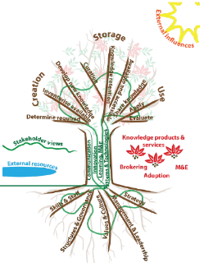
Exercise: Personal KM scan
Take 20 minutes to fill out a section of the KM scan questionnaire individually
At your table, discuss what you learnt while filling in your section and share with others (20 minutes)
15 minutes – general debriefing and discussion
Fill in the questionnaire online later (kmscan.cta.int)
Notes:
Trainers notes
Link from last slide: … in order to try out the KM scan, we will be doing an exercise using the personal questionnaire (you can see the similarities with the organisational one online).
See notes Unit 3 Exercises

Slide 37
Questions? Comments?

Slide 38
Credits
This learning material was prepared by Lucie Lamoureux for CTA.
The Technical Centre for Agricultural and Rural Cooperation (CTA) is a joint international institution of the African, Caribbean and Pacific (ACP) Group of States and the European Union (EU). CTA operates under the framework of the Cotonou Agreement and is funded by the EU. For more information on CTA, visit www.cta.int
Disclaimer
This work has been made with the financial assistance of CTA. However, it remains under the sole responsibility of its author and never reflects CTA's nor the European Union's opinions or statements whatsoever. The user should make his/her own evaluation as to the appropriateness of any statements, argumentations, experimental technique or methods as described herein.
Copyright notice
Reproduction and the dissemination of these modules and supporting materials is encouraged under the terms of the Creative Commons Attribution License (https://creativecommons.org/licenses/by/4.0/legalcode), provided that appropriate acknowledgement is made:
  – of CTA's copyright, in accordance with the license Creative Commons 4.0, by including the name and the title of the article or chapter,
  – and that CTA's or the EU's endorsement of authors' views, products or services is not implied in any way, by including the disclaimer.
March 2015

