Slide 1
Experiences in Implementing Public-Private Partnership Approach for Contagious Caprine Pleuropneumonia Vaccination in Borena Zone
Sileshi Mekonnen
Private Sector, Abyssinia AgroVet PLC
Public-Private-Partnership for delivery of veterinary services
Review and validation of PPP models for scaling out
ILRIETH campus, Azage Auditorium, Addis Ababa 27 March 2025

Slide 2
Introduction
Goats are essential livelihood resources for pastoral communities in Ethiopia.
Contagious Caprine Pleuropneumonia (CCPP) is endemic in Ethiopia and significantly affects goat production, resulting in high mortality and morbidity rates.
Objectives
To design and test an innovative, effective, and efficient model for delivering the CCPP vaccine, led by the private sector.
To generate evidence for policy and institutional changes to support private-sector vaccine delivery for livestock diseases in Ethiopia.

Slide 3
Approaches
Obtain consent from the Authorities
Identification of intervention areas
Study on the willingness of pastoralists to pay for the CCPP vaccine and vaccination services
Selection of Franchisees
Provision of refresher training for CAHWs
Broadcasting of vaccination programs through local FM Radio in Afan Oromo
Conducting vaccination

Slide 4
Key achievements
An innovative PPP franchise business model has been developed.
Vaccination of goats against CCPP was successfully implemented where 89% of the total population of goats vaccinated
Pastoralists voluntarily paid for the CCPP vaccine and vaccination services.
Certificates were provided to goat owners as evidence that their goats had been vaccinated against CCPP.
CCPP vaccination has been scaled up by Borena Zone Administration
PPP implementation by the private sector has been successfully proven

Slide 5
Challenges
Provision of free vaccination services by the Government and NGOs.
Poor awareness about PPP
Illegal activities in veterinary service delivery
Lessons learned
Collaboration with Aba Gedas, zonal and district task forces, and community leaders and elders was essential for effective community mobilization and the successful implementation of the CCPP vaccination campaign.

Slide 6
Conclusion and Recommendation
CCPP vaccine delivery through an innovative PPP Franchise Model was successfully implemented in Borena zone.
Pastoralists willingly covered the costs for the CCPP vaccine and the vaccination services.
CCPP vaccination has been scaled up by Borena Zone Administration
This achievement can be considered as a significant breakthrough in advancing PPP efforts ensuring the delivery of high-quality CCPP vaccines by the private sector.
Practical evidence generated can be recommended to support policymakers in developing a national CCPP vaccination and other disease intervention strategies.

Slide 7
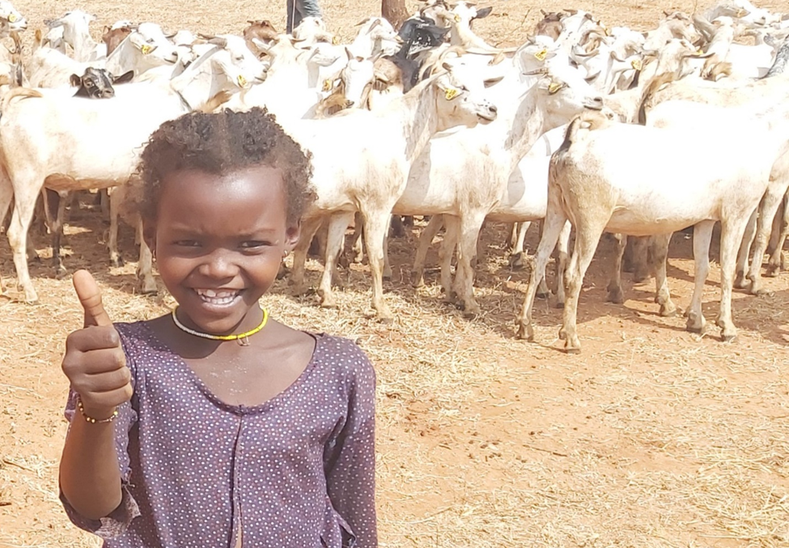
Thank You

