Slide 1
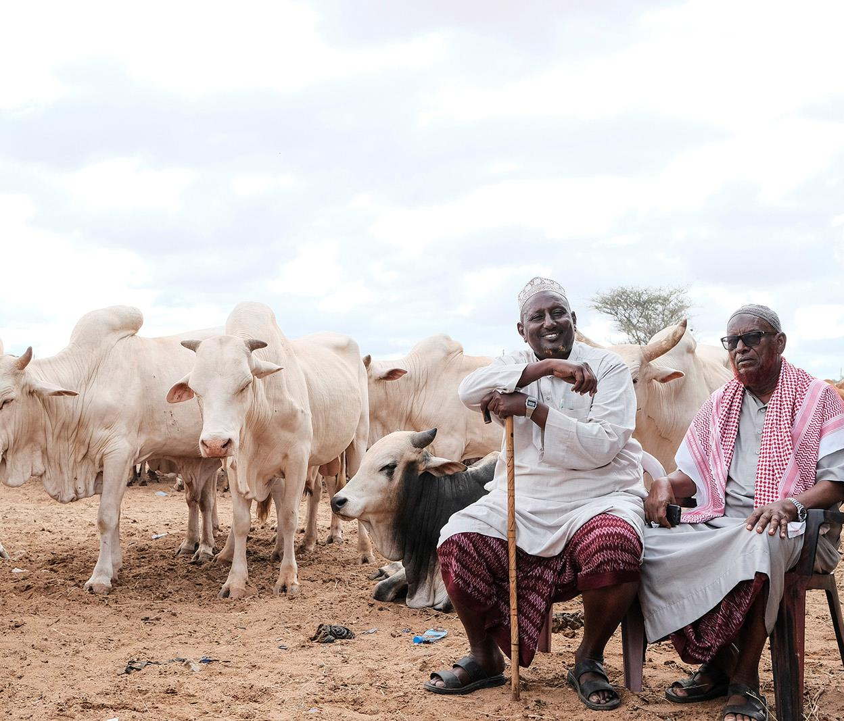
Reviewing and planning the CRP: Setting the scene
Tom Randolph
CGIAR Livestock review and planning meeting, 10 June 2020

Slide 2

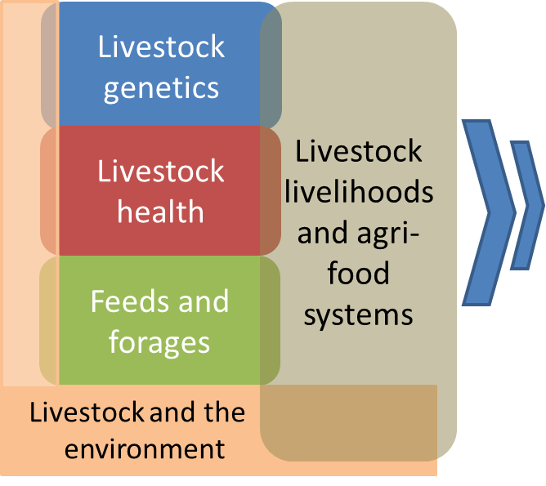
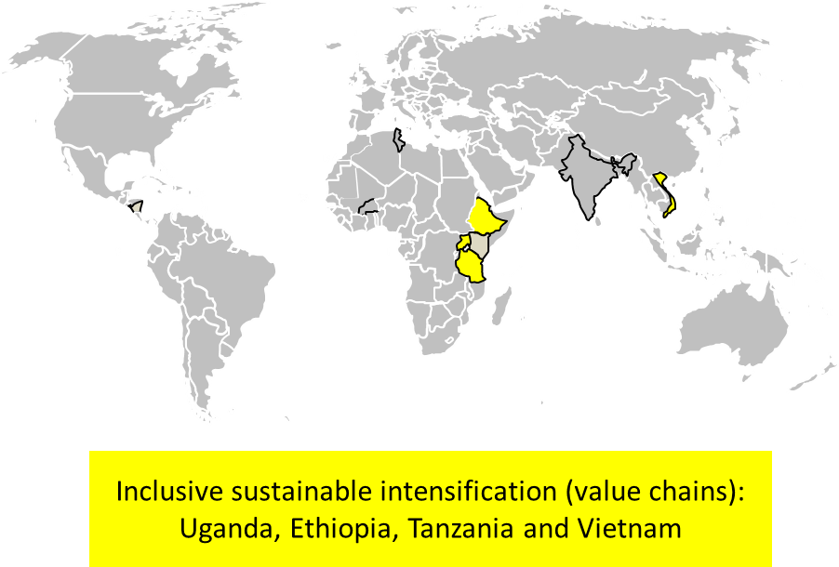

The Livestock Agri-Food Systems CRP
Structured as 5 Flagship Projects:
Notes:
What are we about as a CRP?
Core components are the 5 flagships – each team has been given the space and resources to do the research as they had proposed consistent with their ToC to get impact – and we’re excited to see and hear about the progress made so far.
In addition, the CRP had an overarching ToC that getting our research results taken up to transform livestock systems requires an integrated approach, so we also had a CRP-level ‘experiment’ to demonstrate how we could foster that integration by giving ourselves the challenge of working together to design and test integrated interventions on the ground in selected countries. It took a while to get that in place, but is now up and running.

Slide 3
Where are we?
70% of the road completed
Gearing up to take stock and plan final year
Challenges:
  W1/2 funding cut in 2017
  Shortened horizon by 1 year
  …and now COVID-19
More than the normal exercise!
  Adjusting to COVID-19
  Counting down W1/2 activities
  Making the case for next steps
  Prioritizing what to achieve
2017
2019
2021
Outputs
Outcomes
Impact Targets
2018
2020

Slide 4



This meeting sets the stage for your planning
Outcome: Reinforcing our identity and mission, while raising awareness of what you need to have in mind as you do your research planning at this point of the CRP -- and what is at stake.
8-17 June 2020
OBJECTIVES
TAKING STOCK
Understanding implications of COVID-19
Explaining our progress using Theory of Change
Identifying promising achievements for focus
PLANNING FOR THE FINISH
Anticipating bottlenecks catching up from COVID-19
Making sure key W1/2 activities finish in good time
Prioritizing evidence for our key achievements
POSITIONING NEXT STEPS
Identifying product lines to be taken forward or put on back burner
Prioritizing evidence to make the case for next steps
Notes:
Explaining our progress using ToC – mention CRP Review later this year will be looking exactly at this – so it will help us prepare.
SUM UP – everything we’re doing is meant to help us move forward – including posters – which will become our innovation and outcome stories when reporting later

Slide 5
Translated into Focus areas
LIVING LEGACIES
LIVESTOCK FUTURES THINKING
SCIENCE REPORT
& REVIEW
How science from the CRP can continue to deliver benefits post 2021; the pathways to uptake and how this can be readied through our plans
Understand wider CGIAR and beyond trends and changes and what they mean for the CRP and the livestock sector; and how we will adapt to these
Flagship open spaces to report, review and share insights from selected product lines; setting out results, prospects and potential legacies along impact pathways
EXHIBITION
Innovations4change
CROSS-CUTTING SESSIONS
PLANS AND BUDGETS
Spaces for flagships and country projects to review and update plans, deliverables and budgets for 2020 and 2021; introduce any Covid-19 adjustments; taking account of wider ‘futures’ and ‘legacies’ discussions
Self-organized ‘workshops’ or conversations on cross-cutting topics: gender, scaling, partnerships, MELIA and communications
An interactive forum where CRP teams and scientists can showcase their innovations, results and other activities; and the outcomes that they lead to.
Notes:
The points highlighted in the previous slide have been translated into the structure for the meeting – it is all to support us to address those objectives

Slide 6
And the One CGIAR process?
Evolving!
Executive Management Team to begin in July
Dalberg providing Transition management support unit
Common Board to be constituted in October
Research strategy and modalities to replace CRPs still getting formulated
Can expect pace to pick up over rest of this year and project proposals to prepare next year

Slide 7

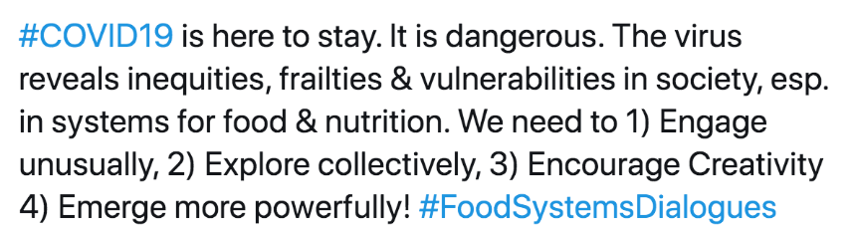
Implications for us
With great change come some questions:
  How will centres make adjustments in capacity to prepare for the next phase?
  While COVID-19 creates some budget uncertainty, how can we meet the challenge to execute what we already have on our plate?
Let us look for the opportunities and ways to strengthen the case now for our research interests
Posted on Twitter

