Slide 1
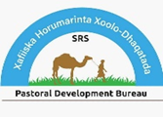

Somali Regional State
Pastoral Development Bureau
Somali Public-Private Partnership Approach experience sharing
Dr Ahmed Yusuf
Somali Region
Public-Private-Partnership for delivery of veterinary services
Review and validation of PPP models for scaling out
ILRIETH campus, Azage Auditorium, Addis Ababa 27 March 2025

Slide 2
1
Introducation PPP services delivery
2
PPP Models implemented in Somali Region
Outline
Lesson Learned, Challenges& Recommendation
3
4
What next-

Slide 3
Introduction
Animal Health Facilities in the region
Livestock population in Region (41.5 million)
  Cattle4.9 millio
  Goat: 15.16 million
  Sheep:15.2 million
  Camel: 5.5 million
  Equine: 510,424
  Source;
Animal Health Post(1,164)
Veterinary Clinics(14)
Laboratory (2 )+ 4 under construction
Slaughter houses( 5)
Vet drug wholesales(20)
Private pharmacy(220)

Slide 4
Key Public and Private Veterinary Services delivery
  Public Vet Services
  Prevention and control of diseases of economic and/or public health importance- only vaccination service and awareness creation
  Laboratory diagnostic service
  Purchase of veterinary inputs to public veterinary service providers
  Provision of capacity building to animal health professional
Private Vet Services
Veterinary drug & Equipment sell service
Vaccination and treatment services
Community awareness services
Disease reporting
There is no private veterinary clinic service providers

Slide 5
PPP Models implemented in Somali Region
The animal healthcare system in Somali Region is generally unsatisfactory; coverage, quality, and reliability. Services are delivered by the public sector.
The region exacerbate veterinary service inaccessibility to pastoral/agro-pastoral communities. Enhancing the role of private sector and public-private partnerships are useful alternatives for optimizing animal healthcare.
Therefore, (GoE) developed veterinary service rationalization roadmap (VRRM), which aims to maximize the efficiency and effectiveness of veterinary services. to pilot the implementation of the VRRM, the EU-funded HEARD project was implemented in Somali regions. The EVA and ILRI component piloted 8 feasible models involving PPP arrangement, 4 models were piloted in the Somali Region

Slide 6
PPP Models implemented in Somali Region
Model II
Sanitory mandate with district private (Vaccination)
Model III
Sanitory mandate with regional and district(Vaccination)
Model V
. Clinical Service linking region-district-kebele(Teatment service)
Model VII
Community based Ecto and endo parasite

Slide 7
PPP Developmental Process
  National stakeholders’ workshop to introduce PPP concept in the veterinary domain
  Gap analysis: priority diseases and service gaps
  Consultative meetings with livestock keepers, private service providers and public offices
  PPP taskforce formation
  Designing alternative PPP models
  Capacity Building
  Voucher system

Slide 8
PPP Model-II
Sanitary Mandate involving Woreda Private Service provider
  PPP Model- II . Partnership where the public sector contracts private sectors at woreda level (including CAHWs) to provide vaccination service for specific animal diseases in such as CCPP, CP and Ovine Past in Degahabour Woreda at Bulale Kebele. The public sector pays for the services provided by the private sector, however [ HEARD project]. The woreda private clinic contracts/links with CAHWs at kebele level to provide the vaccination services
    Cost recovery arrangement:
      Pastoralists: pay 30% of vaccination cost which gradually increases, finally ending up with full cost-recovery;
      HEARD project: 70% of cost, which gradually decreases, and implementation to be taken over by regional government

Slide 9
Partners engaged in the pilot PPP activities
Partners | Key roles/responsibilities
Regional Vet Services (SRS-PDB) | Create enabling environment Arrange cold chain facilities and avail vaccines Regulate overall activities, with ILRI/EVA
Woreda PD office and Kebele adminis | Overall coordination of vaccination services; Supervision and monitoring Community mobilization
Al-Nasri and CAWHs | Deliver vaccination services, organize performance reports Handle vaccines utility &collect vouchers and submit to EVA/ILRI
Pastoral Community | Actively participate in the vaccination campaign Share cost of vaccination service with the Project
ILRI/EVA (HEARD project) | Catalyze PPP pilot activities; Pay for authorized vouchers Regulate overall activities, with regional partners;
Regional Vet Lab | Conduct pre/post-intervention activities (samples)

Slide 10
Preparatory activities
Activities | Beneficiary , Number
Understanding and signing of MoU | Regional, woreda and private actors Public actors: RPDB and Deghabour Woreda PDO Private: Al Nasri, and CAHWs
Capacity Building | Woreda AH staff, Private and CAHWs
Vaccines facilitation | A Region, woreda and village levels
Input supplies for vaccination | Al Nasri PVP : drugs, vaccination materials, first aid kits, surgical and obstetrical Kits CAHWs (Bulale): shoes, supplies/vaccination materials,
Awareness creation about the PPP models | pastoral communities and CAHWs Bulale: 39 community representatives and CAHWs

Slide 11
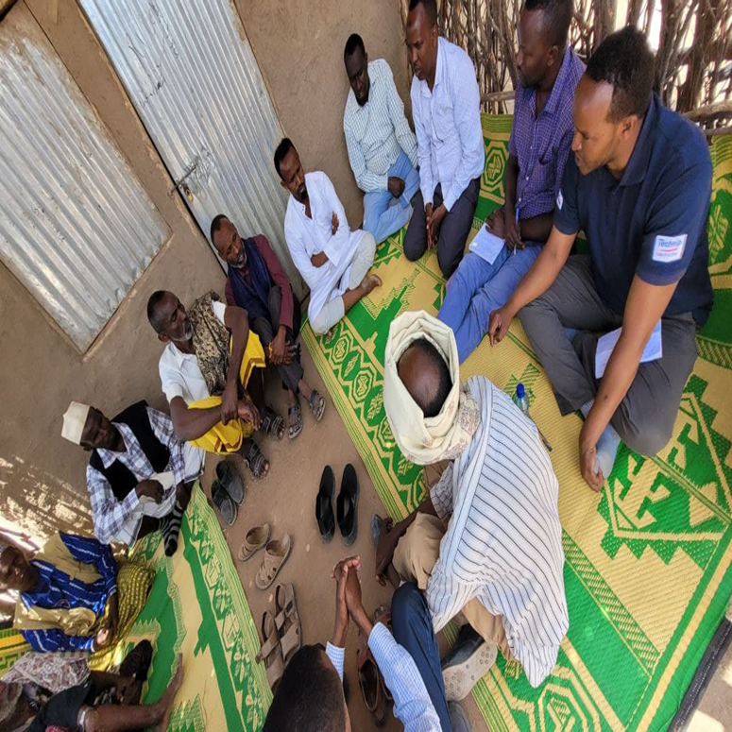
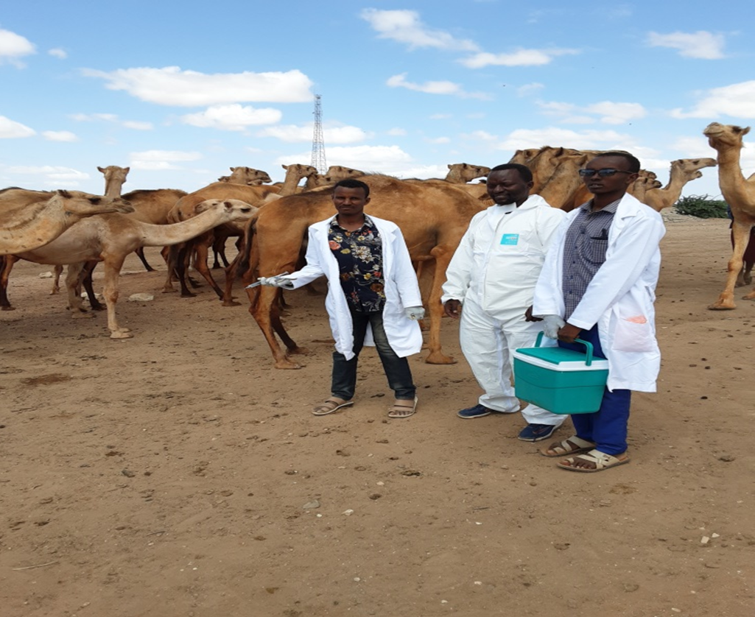
Activities performance
Pilot diseases | Achievement
CCPP Camel pox Ovine Pasteurellosis | Vaccination
 | CCPP: 35,520
 | Camel Pox: 15,769
 | Ovine Pasteurellosis: 35,375
 | Total: 86,664 animals (70,895 Shoat)
 | Beneficiary HHs: 3,600 (F=1,289)

Slide 12
PPP Model –III
Sanitary Mandate with linked regional-woreda-Kebele Private service Providers
    PPP Model III (Vaccination Service)
    Partnership where the public sector contracts Regional private service providers (linked regional-woreda-village actors) to provide vaccination service for specific animal diseases such CCPP SGP, CP and BP in Hargelle Woreda (Oman village). The regional VSP firm delivers vaccines to private clinics at the woreda level; cold chain services provided to private clinics at both woreda and kebele levels.
    Cost recovery arrangement:
      Pastoralists: pay 30% of vaccination cost which gradually increases, finally ending up with full cost-recovery;
      HEARD project: 70% of cost, which gradually decreases, and implementation to be taken over by regional government

Slide 13
Partners engaged in the pilot PPP activities
Partners | Key roles/responsibilities
Regional Vet Services (SRS-PDB) | Create enabling environment Arrange cold chain facilities and avail vaccines &regulate overall activities, with ILRI/EVA
Kul -Agri-cooperatives (Regional PS Provider) | Overall coordination of vaccination services, organize performance reports Collect vouchers and submit to EVA/ILRI
Woreda PD Office | Create awareness to pastoral communities Supervision and monitoring
Bilal PVP and CAWHs | Deliver vaccination services Handle vaccines under standard conditions
Pastoral Community | Actively participate in the vaccination campaign Share cost of vaccination service with the Project
ILRI/EVA (HEARD project) | Catalyze PPP pilot activities; Pay for authorized vouchers Regulate overall activities, with regional partners;
Regional Vet Lab | Conduct pre/post-intervention activities (samples)

Slide 14
Preparatory activities
Activities | Beneficiary , Number
Understanding and signing of MoU | Regional, woreda and private actors Public actors: RPDB, and Hargelle Private: Kulmiye, Bilal and CAHWs
Vaccines facilitation | At regional, woreda and village levels
Vets equipment supplies | Bilal PVP (Hargelle): drugs, vaccination materials, first aid kits, surgical/obstetrical Kits CAHWs (Oman): Boot shoes, supplies, vaccination materials, etc.
Awareness creation about the PPP models | pastoral communities and CAHWs Oman: 37 community representatives and CAHWs

Slide 15
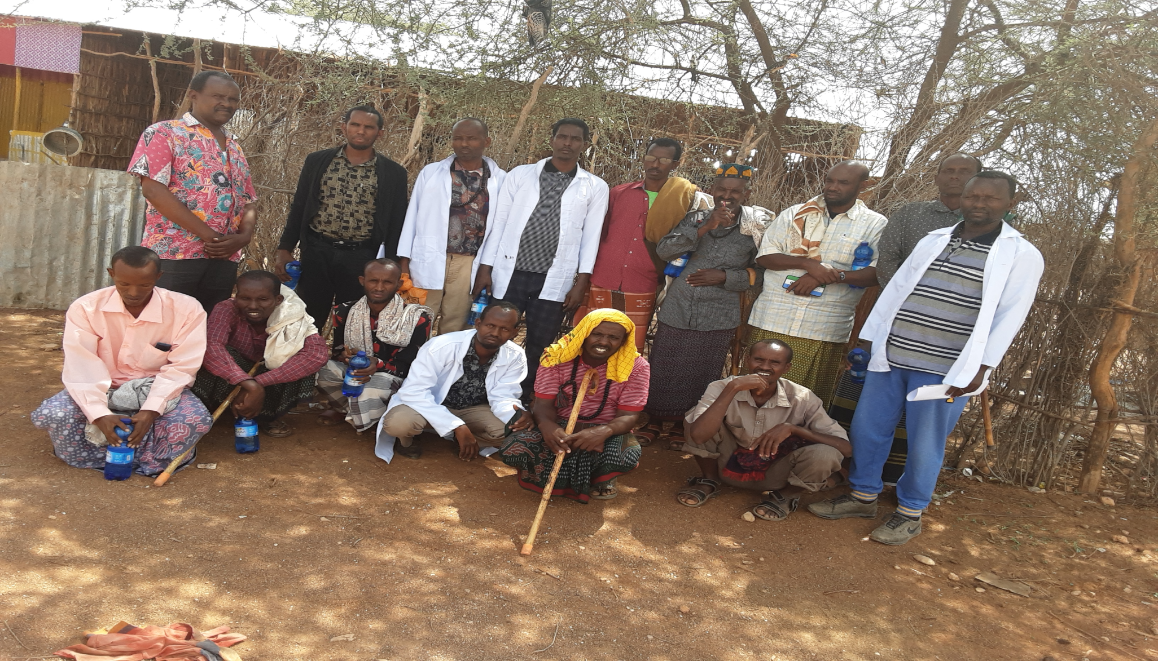
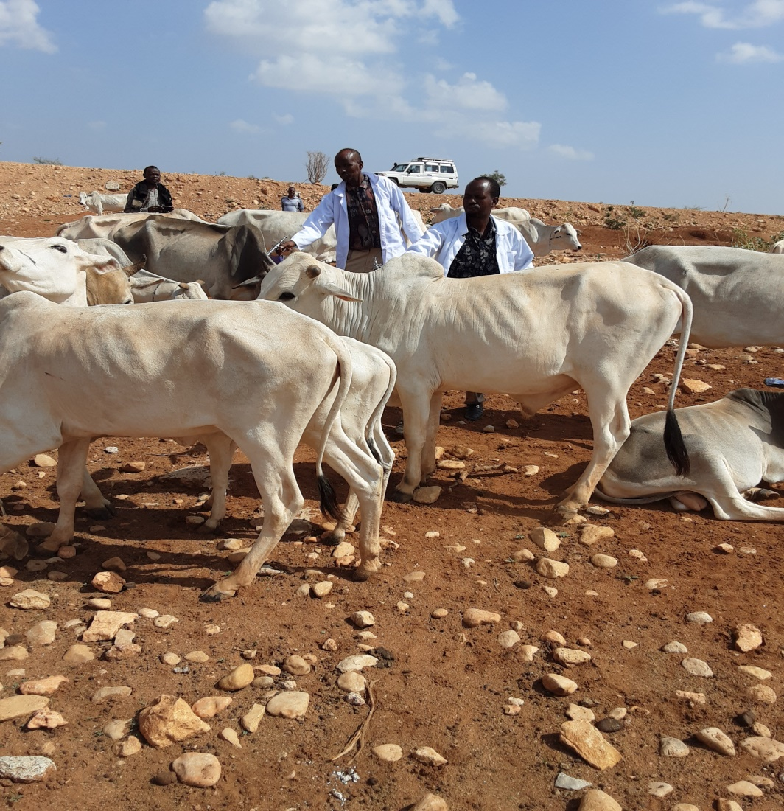
Activities performance
Pilot diseases | Achievement
CCPP SG Pox Camel pox Bovine Pasteurellosis | Vaccination
 | CCPP: 31,920
 | S/Goat Pox: 28,520
 | Camel Pox: 22,930
 | Bovine Pasteurellosis: 2,720
 | Total: 86,090 animals
 | Beneficiary HHs: 4,308 (F=1,988)

Slide 16
PPP Model V
Clinical Service By Linked Regional-woreda-kebele Pivate Clinics
PPP Model ; This is for a business partnership between regional veterinary service provider firm, private clinics at woreda level, CAHWs at kebele level and the public sector. [Transformative].
The public sector; create enabling environment for
        the private sector to provide all clinical services in Hargelle kebeles [ Oman Kebele]
        facilitates operation of private service providers in kebeles, including recognition of their services in the kebeles to be covered by the private sector.
The regional service provider will supply clinical supplies (mainly drugs) to woreda clinics that are linked to kebele CAHWs who will deliver the clinical services to pastoralists. [ Loan facilitation scheme ]

Slide 17
Partners engaged in the pilot PPP activities
Partners | Key roles/responsibilities
Regional Vet Services (SRS-PDB) | Create enabling environment Arrange cold chain facilities and avail vaccines &regulate overall activities, with ILRI/EVA
Kul -Agri-cooperatives (Regional PS Provider) | Overall coordination of vaccination services, organize performance reports Collect vouchers and submit to EVA/ILRI
Woreda PD Office | Create awareness to pastoral communities Supervision and monitoring
Bilal PVP | Receive vaccines and drugs from Kulmiye clinic Supply to CAHWs to serve the community Store vaccines in cold chain facility (collaboration Woreda Public or Private medical clinic
CAHWs Service provider | Provide vaccination and clinical service to the pastoral community Prepare monthly report and submit to Woreda Private service
Pastoral Community | Actively participate in the vaccination campaign Share cost of vaccination service with the Project
ILRI/EVA (HEARD project) | Catalyze PPP pilot activities; Pay for authorized vouchers Regulate overall activities, with regional partners;
Regional Vet Lab | Conduct pre/post-intervention activities (samples)

Slide 18
Lessons Learned
Indications to Sustainability of PPP models
  MTE indicates strong linkage between the public and private sector
  PPP taskforce is key to sustained collaboration between stakeholders
  Bureau of livestock and woreda offices providing full support
  Sanitary mandate contracting (SMC) delivered by private sector proved effective in controlling livestock diseases in the remote pastoral environments.
  Pastoral communities were paying for services, including for services previously provided for free.
  Voucher system facilitated cost-sharing of services
  Pastoralists were willing to pay for services, including for services previously provided for free
Community-based ectoparasite control helped more users (than usual) to prescribe for the services
Herd health approach introduced a new approach
  Integrated services for priority health problems (vaccination, ecto-parasite control, clinical/treatment services),
  Capacity development (training) of private service providers with basic equipment and business skills and pastoralists with training on herd health

Slide 19
Challenges
01
Drought and in Security (Hargelle) in the region has delayed implementation of the PPP pilot interventions, and also cost sharing.
02
Limited No of PVS and investment in private veterinary service providers
03
The government policy for trans-boundary diseases vaccination (considered a public good)
04
Weak coordination and working relation between different Developmental actors
05
Illegal drugs and price fluctuation

Slide 20
Recommendation
  The Regional PDB need to own the PPP pilot initiatives and incorporate into the region’s livestock development plan
  The PPP taskforce needs to continue as a platform for interaction between the public and the private sector
  Devise cost-recovery mechanism in the region to ensure sustainable provision of veterinary services including vaccination initiatives
  Livestock keepers’ willingness to subscribe to paid services (which some were provided free by the public sector) is key for sustainability of the PPPs
  Community mobilization by the public offices is crucial to success of PPP arrangement
  Strengthening the private service providers to be proactive in the PPP is needed
  Sustainable vaccine supply chain (which currently is dependent on the public sector) is key for sustainability
  Linking private clinics with drug wholesalers to alleviate the perceived or real high service charges, interaction with livestock keepers and service provider is important, including in service charge setting

Slide 21
Mahad-sanidiin

