Slide 1

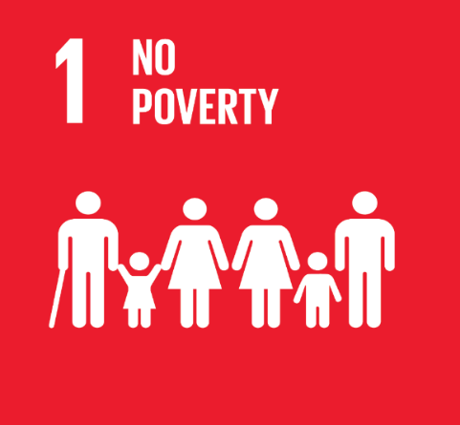
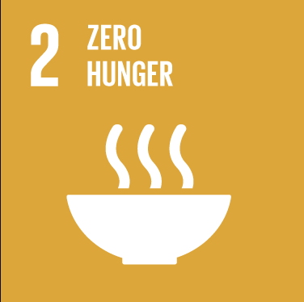
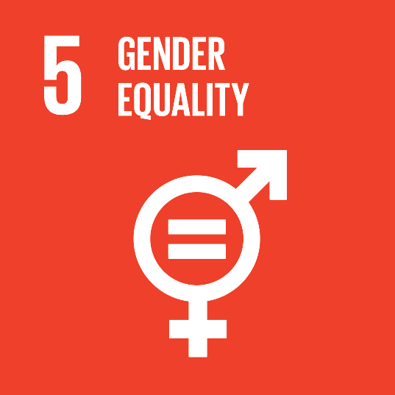

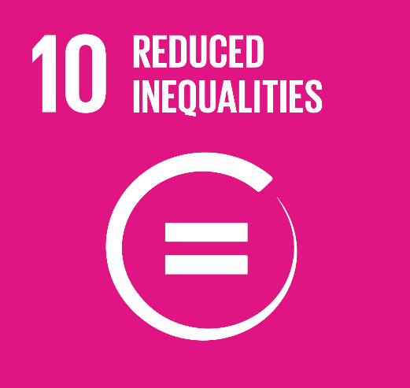

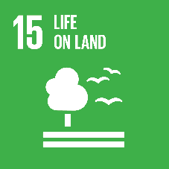
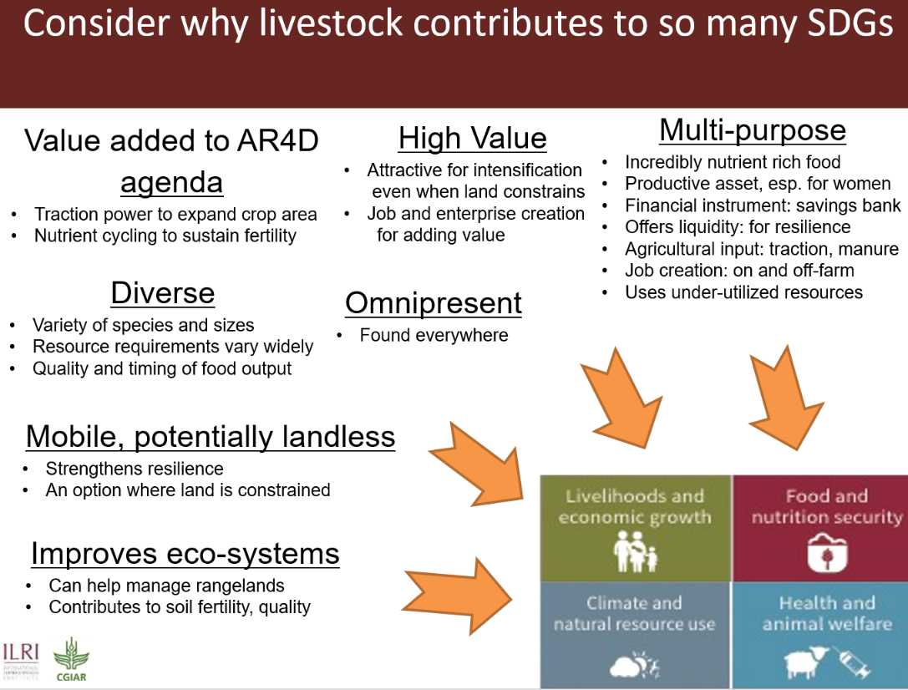
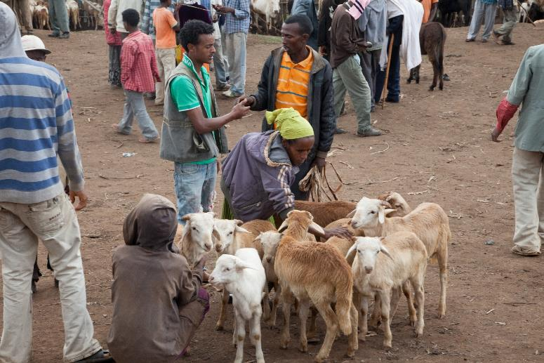
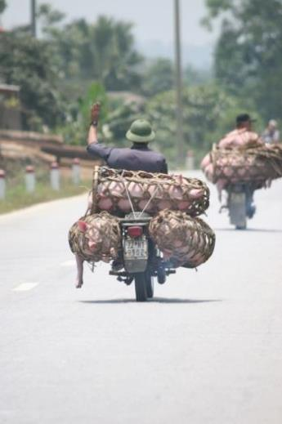

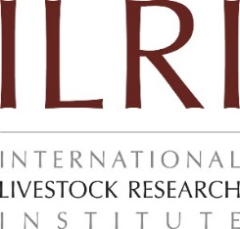
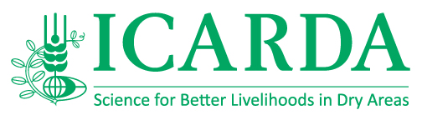



CGIAR Research Program on Livestock
Goal
Create a well-nourished, equitable and environmentally healthy world through livestock research for development
How?
Innovative science to provide new solutions
Focus on the drivers of livestock productivity – health, genetics and feed – within the environmental and socio-economic context
Join up capacity within the CGIAR together with other key partners
Balance of short-term solutions and a pipeline of longer-term break-through reesearch
Being more intentional about translating research into impact
Accelerating research into use by working toward integrated livestock development interventions in a few selected sites for
  Animal-source food value chain development: facilitating the transition from smallholder livestock keeping and informal markets to more productive and higher-value professional agri-business opportunities for both women and men
  Strengthening resilience of livestock-based livelihoods: Protecting and enhancing other critical roles that livestock play where intensification may not be possible, including as part of crop-livestock and backyard systems
Partnering with development actors early to tap into their knowledge and create ownership
Generating the type of evidence needed to attract development investment to take to scale
What?
5 ‘flagship projects’ generating international public good research while designing transformational interventions in specific contexts and geographies
Animal
genetics
Livestock livelihoods and agri-food systems
PRIORITY COUNTRIES selected for integrated approach based on potential to demonstrate impact in short term
Livestock and the environment
Animal
health
Animal
feeds
2nd TIER COUNTRIES where specific subject work is undertaken and opportunities for integrated approach are sought
Contact
Tom Randolph
Director
T.Randolph@cgiar.org
This document is licensed for use under the Creative Commons Attribution 4.0 International Licence. June 2018.
The Program thanks all donors and organizations which globally support its work through their contributions to the CGIAR system

