Slide 1
Important!
This module is designed to potentially serve a wide variety of audiences (nutritionists and agronomists, policymakers, extension workers, farmers).
Not all of the material will be relevant to all audiences.
Please refer to the accompanying Facilitator’s Guide for guidance on how to adapt these materials to your audience and facilitation best practices.

Slide 2




Legend
Icon | Description
 | Expected Duration, minutes
 | Quick Review/Survey Questions
 | Brainstorming Session
 | Discussion Session
 | Group Activity
 | Animated Slide
 | End of Animation
Xm

Slide 3
Legal
Unless otherwise noted, all images copyrighted to International Potato Centre.
Attribution-NonCommercial-ShareAlike 2.0 Generic (CC BY-NC-SA 2.0)

Slide 4
Everything You Ever Wanted to Know About Sweetpotato
Topic 7: Pest and Disease Management

Slide 5
Introduction
Pest and Disease Management

Slide 6
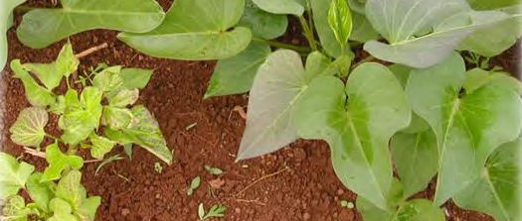
Welcome
During this session, we will examine how recognising the lifecycles of the damaging insect pests, as well as diseases and viruses can help farmers learn how to manage them more successfully.

Slide 7
Where Do Sweetpotato Pests and Diseases Come From and How Do They Spread?
Unit 1

Slide 8
Objectives
By the end of this unit, you should be able to:
Cite the main origins of disease and pest problems in sweetpotato crops.
Tell why it is important to understand pest and disease lifecycles.
Explain why phytosanitary officers are essential to disease control.
Compare the two types of insect lifecycle.
Describe the lifecycle of a typical virus and fungus.
Name common sources of virus and fungus contamination.
Describe how sweetpotato viruses are spread.
Define and describe Integrated Pest Management.

Slide 9
Origin of Pest and Disease Problems
Pests
Disease
Blown in wind
Movement of infested soil
Plant materials
Tools
Shoes
Vehicles
Livestock
Spores
  Blown in wind from diseased crops
  Splashed up by heavy rain from leaf litter
Diseased planting material

Slide 10
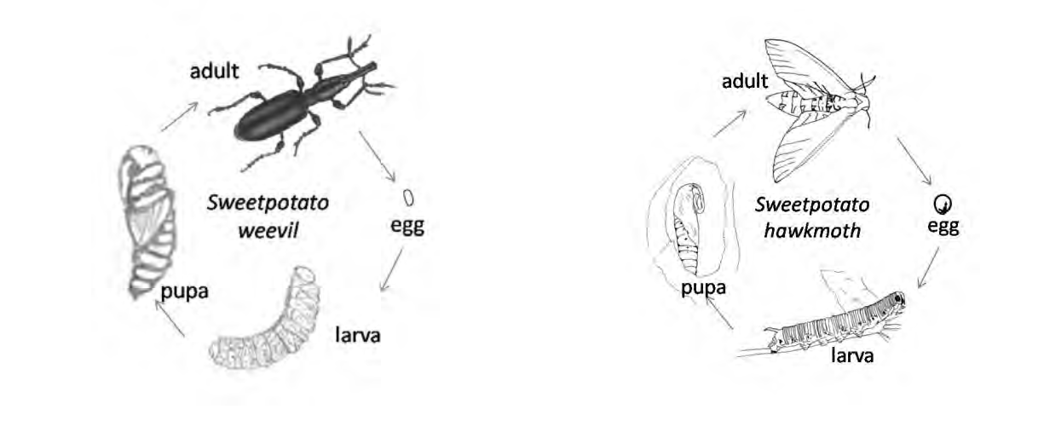
Insect Lifecycles
It is important for farmers to understand lifecycles so that they can recognise pest presence and damage before it reaches serious levels.

Slide 11
Stages of Insect Lifecycles
Adult stage
  Capable of reproduction
  May or may not feed
  Stage most easily recognizable
Deposit eggs in select places
  Under leaves
  Soil surface
Eggs hatch
  Insects are immature
  Often look completely different than adult insect

Slide 12
Metamorphosis: Process of Changing Form
Complete
Incomplete
Adult -> egg -> larva -> pupa -> adult
Example: Sweetpotato weevil
Adult -> egg -> nymph -> adult
Juvenile form (nymph) hatches and gradually gets to adult size
Example: Sweetpotato hawkmouth

Slide 13
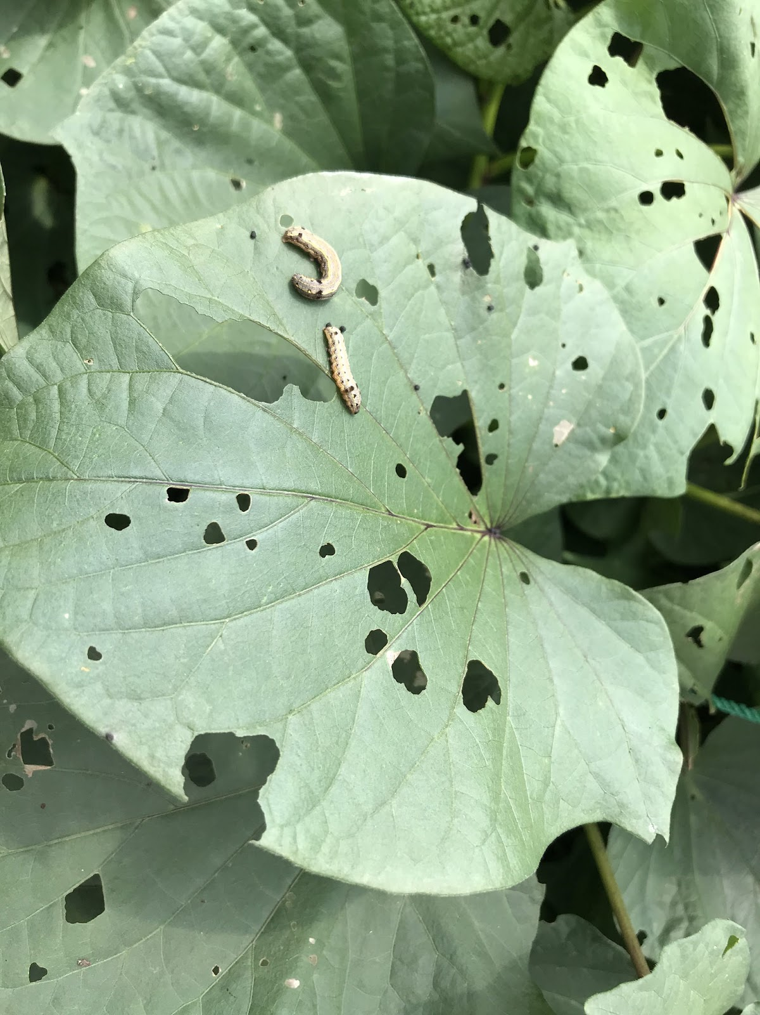
Environmental Effects on Insect Development
Temperatures
  Warmer temperature typically means faster development
  Extremely hot temperature could prevent survival
Type of food
  Some can feed on different plants and different plant parts

Slide 14
Controlling Pests
Pathogens
  Micro-organisms that cause disease
    Bacteria
    Fungi
    Viruses
  Live and multiply within insect
  Sometimes grown and used for biological control
Predators
  Animals or insects that hunt, kill, eat other creatures, e.g. spiders and ants
Parasites
  Organisms enter body of victims and feed before killing them, e.g. tiny wasps or flies

Slide 15
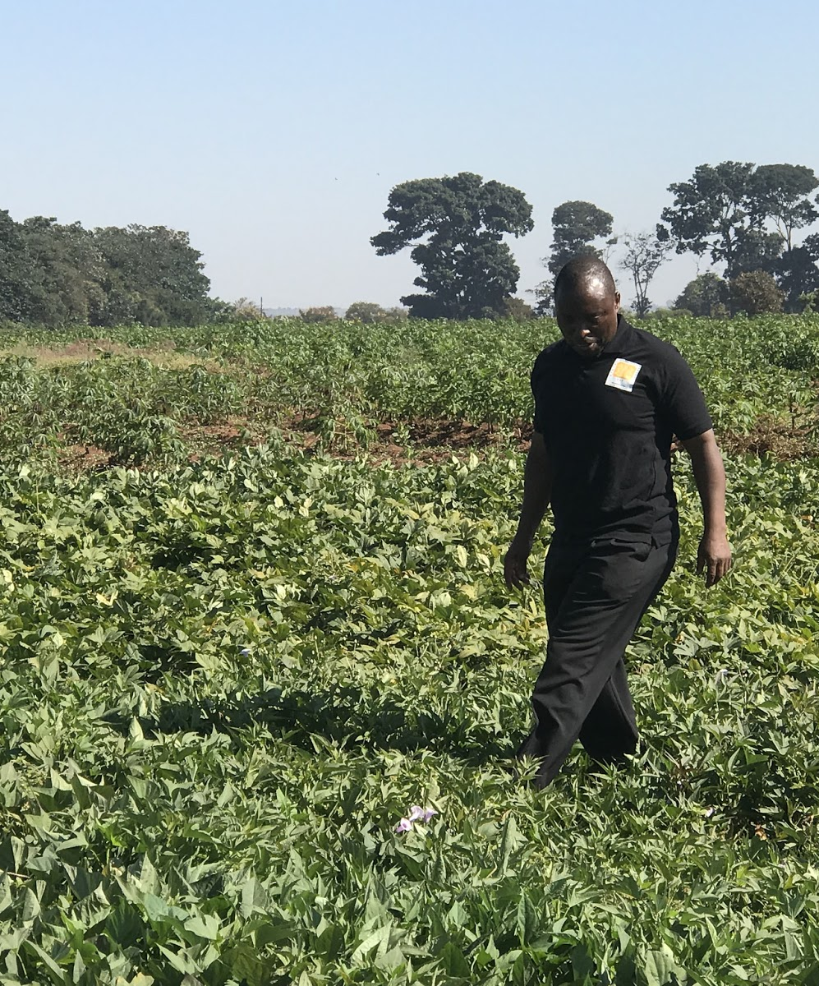
The Role of Phytosanitary Officers
Inspect samples of food and other plant materials transported within and between countries.
Reduce and prevent chances of pests spreading by also checking shoes, tools, people and livestock.

Slide 16
Types of Plant Diseases
Plant Diseases are varied and complex.
Fungal and bacterial diseases
  Can survive for long periods of time in resting phases
    Example: dead leaves can move in wind and infect crops
  Germinate and penetrate new host plant
  Vegetative planting techniques make OFSP vulnerable to spreading dormant fungal disease
  Fungal diseases present as fine dot at tip of fine hairs on diseased leaf
Viruses
  Transported by plant-sucking insect (vector), e.g. whitefly, leafhopper, aphid
  Multiplies and spreads

Slide 17
Integrated Pest Management (IPM)
Combines an understanding of ecology and pest lifecycles with techniques for pest control.
Encourages consideration of human health concerns in use of chemical pesticides.
Involves a combination of:
  Monitoring
  Crop sanitation
  Cultural, mechanical, biological control methods
Methods differ by farm, depending on:
  Crops grown
  Climate
  Soil
  Surrounding landscape

Slide 18
What is the difference between the complete and incomplete metamorphosis of insects?
What are some common ways that plants get infected by fungal and bacterial diseases?
What is Integrated Pest Management (IPM) a combination of?
Notes:
Answers
A complete metamorphosis means the insect has larval and pupal forms which do not resemble the adult insect; an incomplete metamorphosis means a nymph hatches from the egg and then gradually gets bigger until it reaches adult size.
By spores blown in the wind from older diseased crops; from spores splashed up by heavy rain from leaf litter; and from diseased planting material.
It combines monitoring, crop sanitation, and cultural, mechanical and biological control methods to discourage the development of pest populations, thus limiting the need for pesticides.

Slide 19
Key Points
Adult forms of insects are the form we most readily recognise. Recognising all forms of all pests is essential to control.
Pests such as the sweetpotato weevil undergo a complete metamorphosis that includes larval and pupal forms which do not resemble the adult.
Pests such as the sweetpotato hawkmouth have an incomplete metamorphosis, where a juvenile form called the nymph grows to adult size.
Most insect populations can grow very quickly. Warm temperatures speed up the growth cycle, but extreme heat can stop it.

Slide 20
Key Points (cont.)
Movement of planting and agricultural materials from place to place can spread disease. Phytosanitary officers are essential to check shoes, tools, people, livestock, etc. for the possible movement of pests.
The vegetative planting techniques used with sweetpotato make it vulnerable to spreading dormant fungal disease stages.
Viruses need another agent such as a feeding insect to inject them into the sweetpotato plant. This is another reason to promote insect control.
Integrated Pest Management (IPM) combines an understanding of the ecology and lifecycles of pests with multiple techniques for pest control.

Slide 21
Key Points (cont.)
IPM pest control methods include crop sanitation, cultural control, mechanical control, and biological control (including the use of natural enemies and beneficials to control pests and diseases.
IPM encourages consideration of human health concerns in the use of chemical pesticides.

Slide 22
How to Recognise and Manage Sweetpotato Weevils
Unit 2

Slide 23
Objectives
By the end of this unit, you should be able to:
Identify the sweetpotato weevil and its male and female adult forms.
Describe the weevil’s life cycle and life stages (eggs, larvae).
Name the symptoms of a sweetpotato weevil infestation.
Explain sweetpotato weevil control techniques and tell why root protection is important.
Compare the sweetpotato weevil to the rough sweetpotato weevil.

Slide 24
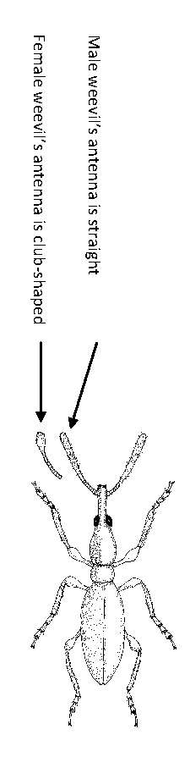
Identifying Sweetpotato Weevil (Adult Stage)
Elongated, small black or metallic blue coloured beetle
  5-6 mm long
  Looks like a large ant
Female
  Antennae have a club-shaped end
Male
  Antennae are straight

Slide 25
Lifecycle of a Sweetpotato Weevil
The weevil life cycle takes roughly 32 days.
Female lays all eggs (50 to 250) within 2 months of life
Eggs are laid singly in vines or leaves
  Prefers exposed storage roots (if available).
  Typically hatches within 3-7 days
Larvae are whitish, curved, legless with dark brown head
  Will immediately feed, causing damage to OFSP
  Live for 11-33 days before pupate
Pupate
  Occurs within larval tunnels
  Lasts 3-28 days
Adult
  Leaves root to search for mate

Slide 26
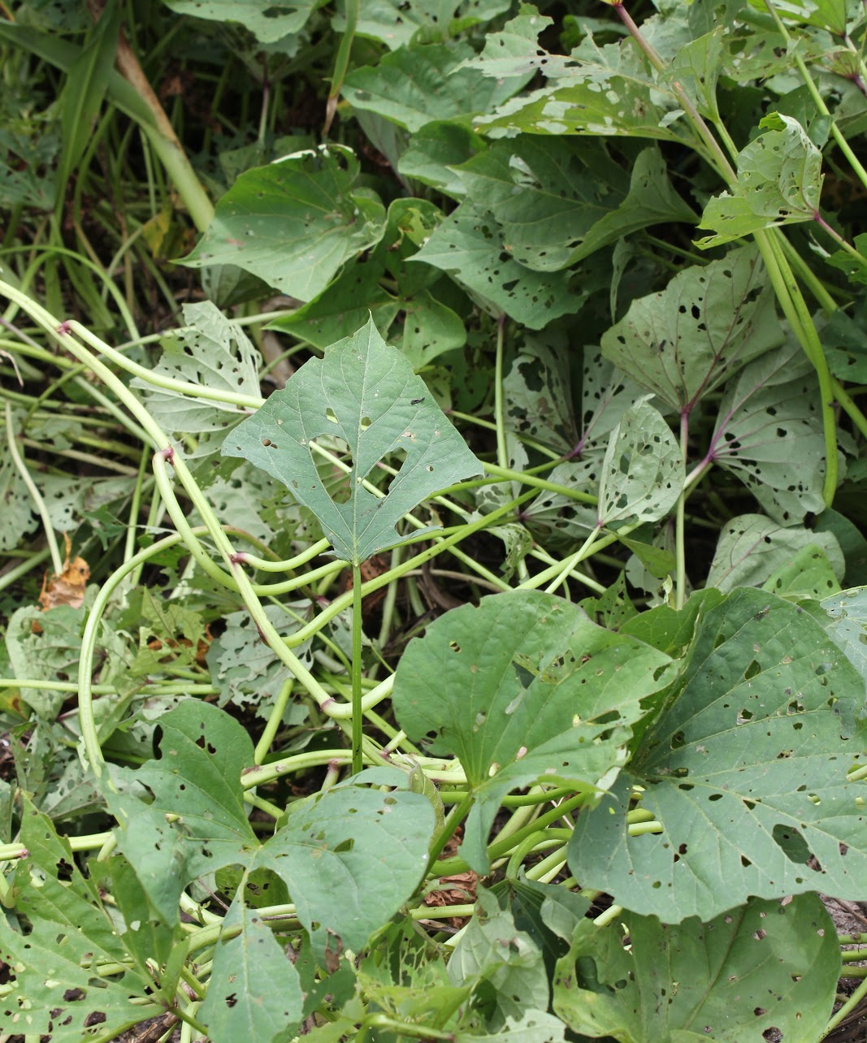
Infestation Symptoms
Many weevils found on foliage
  Indicates roots heavily infested
In vine and roots
  Feeding and egg laying punctures
  Tunneling

Slide 27
Weevil Pest Management
Roots are key in weevil control. “Hilling up” soil around the roots protect them from infestation
Crop rotation
Field sanitation: Destroying volunteer plants and old plant material
Use of natural enemies
Use of clean planting materials
Timely harvesting
Plot separation
  OFSP weevils do not fly farther than 500m to 1000m

Slide 28
Rough Sweetpotato Weevil
Not as serious a pest as sweetpotato weevil
Adult size 8-9mm
  Appears much larger than weevil
Eggs
  Yellowish
  Laid around edges of leaves
Same pest management techniques as sweetpotato weevil

Slide 29
How can the male and female sweetpotato weevil be told apart?
What is a clear indication that roots are heavily infested with sweetpotato weevil?
How does hilling up help protect crops from sweetpotato weevil?
Where do weevils tend to lay their eggs?
Why will planting your new field of sweetpotato some distance from existing and recently-harvested fields of sweetpotato help reduce the likelihood of weevils invading your crops?
Notes:
Answers
By the shape of their antennae: The males’ antennae are straight while the females’ have a club-shaped end.
If many weevils are found on the foliage.
Hilling up soil around the base of the plant and on the sides of the ridges prevents or fills soil cracks, and thus provides some protection.
In the older, woodier parts of the vine, making it essential to use clean (uninfested) planting materials.
Because sweetpotato weevils do not fly very often and generally only for short distances of 500 to 1000m in order to find new sweetpotato plants.

Slide 30
Key Points
The adult weevil is a black or metallic blue beetle with an elongated shape and straight (male) or clubbed (female) antennae.
The life cycle takes roughly 32 days. The eggs are laid singly in vines, leaves, and exposed storage roots; larvae are legless and whitish with a dark brown head.
A large number of adults in the foliage indicates heavily infested roots.
The roots are key in weevil control. “Hilling up” soil around the roots can protect them from infestation.
Crop rotation, field sanitation (destroying volunteer plants and old plant material), use of natural enemies, clean planting materials, and timely harvesting are other key weevil control practices.

Slide 31
Key Points (cont.)
Flooding the field can drown the various life stages of the weevil; mulching, pesticides, plot separation, pheromone traps, and weevil-resistant varieties all help fight the sweetpotato weevil.
Most of these practices are also effective against the rough sweetpotato weevil.

Slide 32
How to Recognise and Manage Sweetpotato Viruses
Unit 3

Slide 33
Objectives
By the end of this unit, you should be able to:
Explain the biology and lifecycle of a typical plant virus.
Describe the symptoms of common sweetpotato viruses.
Identify the two most common sweetpotato viruses in SSA.
List and describe prevention techniques.

Slide 34
Biology and Lifecyle of a Virus
Survive inside host plant
  Multiply and cause damage
Spread from plant to plant via insect that feeds on infected plant then feeds on new plant.
Once infected, virus takes over management and control of cell’s processes.
  Forces cell to produce identical virus instead of crop yield

Slide 35
Virus Recognition
Too small to see with human eye, one of the most damaging sources of sweetpotato disease in Africa.
Common symptoms of infected plants:
  Diminished growth (stunting)
    Plant and leaves remain small
  Chlorosis (paleness) leaf tissue
    Diseased plants stand out
    General or pattern
  Misshapen leaves
    Uneven or curled appearance
  Pigmented leaves
    Purple or yellow generally
    Spots or rings
  Reduced production of storage roots

Slide 36
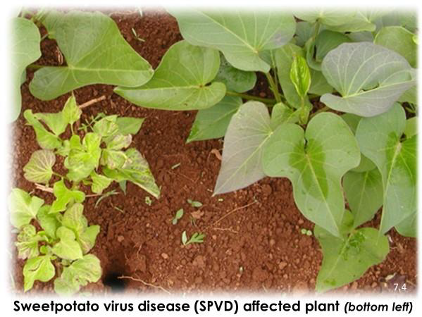
Main Types of Virus in Africa
Sweetpotato feathery mottle virus (SPFMV)
  Often transmitted by aphids
Sweetpotato chlorotic stunt virus (SPCSV)
  Often transmitted by whiteflies
Sweetpotato virus disease (SPVD)
  Plant infected with both SPFMV and SPCSV

Slide 37
Prevention Techniques
Use clean planting materials
Destroy any plants showing signs of infection
Use resistant strains
Rotate crops by season
Plant new crops at a distance from old crops
Take cuttings from young plants
  Infection is harder to spot in older plants

Slide 38
Once a virus enters a cell in a new host, how does it affect the cell?
What are some common symptoms of virus infection in plants?
When choosing new planting materials, why is it important to collect cuttings from young sweetpotato crops?
Notes:
Answers
It takes over the management and control of that cell’s processes and forces the cell to produce more viruses identical to itself – instead of the crop yield.
Diminished growth; chlorosis (paleness) of the leaf tissue; misshapen leaves with an uneven or curled appearance; pigmented leaves, often purple or yellow; and reduced production of sweetpotato storage roots.
Because sweetpotato virus disease symptoms are harder to see in older plants.

Slide 39
Key Points
Viruses are too small to see with the human eye, but they are one of the most damaging sources of sweetpotato disease in Africa.
Virus symptoms include stunting; pale or misshapen leaves; purple or yellow leaves, spots, or rings; and reduced storage root production.
Sweet potato feathery mottle virus (SPFMV), which is transmitted by aphids, and Sweet potato chlorotic stunt virus (SPCSV,) transmitted by whiteflies, are the most prevalent sweetpotato viral infections.
These diseases are fairly mild on their own, but an infection by both viruses produces the serious condition called sweetpotato virus disease (SPVD).
To prevent SPVD, farmers should use clean planting materials, destroy any plants showing signs of infection, use resistant strains, rotate crops by season, plant new crops at a distance from old crops, and take cuttings from young plants, as infection is harder to spot in older plants.

Slide 40
How to Recognise and Control Fungal Diseases
Unit 4

Slide 41
Objectives
By the end of this unit, you should be able to:
List symptoms and mode of spread of the three major sweetpotato fungal diseases.
Describe recommended fungal management techniques.

Slide 42
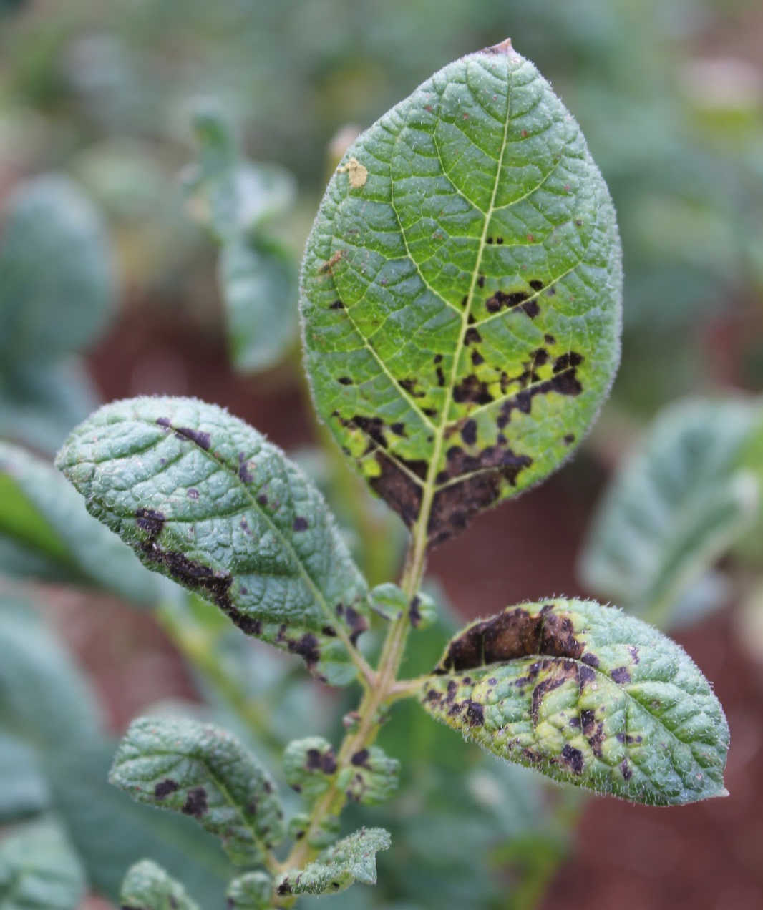
Recognizing Fungal Disease
Circular brown or blackened areas (lesions)
  Occur on leaves and stems
Powdery areas - fungal spores
Masses of filaments (way the fungus spreads to new plant parts)

Slide 43
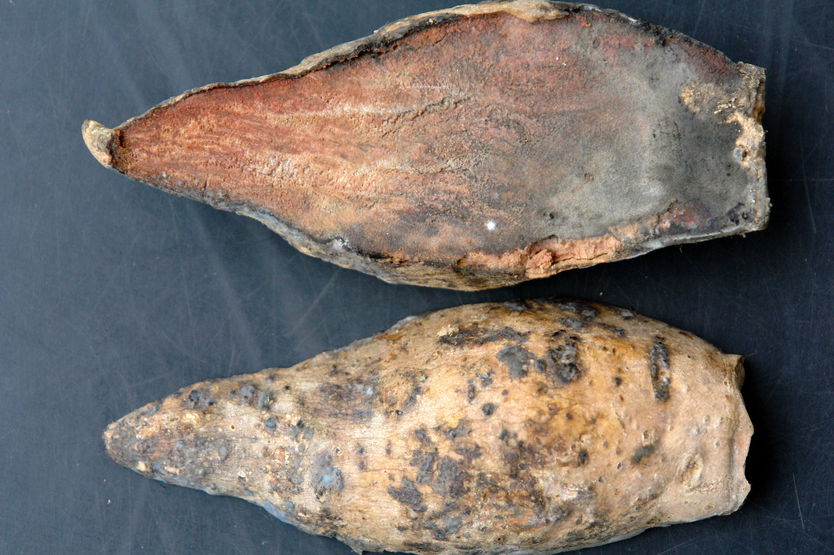
3 major fungal infections
Alternaria
Phomopsis
Black Rot Disease

Slide 44
Alternaria Fungal Infection
Symptoms
  Brown necrotic lesions surrounded by chlorotic halo on leaves, stems or petioles
Spread
  Fungus remains in soil, releasing spores in moisture (e.g. via rain splash, irrigation water), wind, insects
  Spreads easiest in high relative humidity
Management
  Avoid overhead irrigation
  Potential fungicides
    Mancozeb, chlorotalonil, dyrene

Slide 45
Phomopsis Fungal Infection
Symptoms
  Older leaves with irregularly shaped whitish to tan brown lesions
  Surrounded by dark purple to brown margin
  Black pinhead-like structures in centre
Spread
  Fungus remains in plant debris on soil
    Spores released when field receives moisture
Management
  Field sanitation

Slide 46
Black Rot Disease (Ceratocystis sp.)
Symptoms
  On storage roots
    Brown sunken spots, which become firm, dry, and black and may cover entire root
    Appears stunted and chlorotic
Spread
  Fungus remains in soil and plant debris
  Penetrates through lenticels
  Infected roots result in infected sprouts
Management
  Use less susceptible cultivars
  Carefully select roots to be stored
  Control insects and rodents in stores

Slide 47
General Fungal Management
Rotate fields
Destroy, burn crop residue after harvest
Use clean planting materials

Slide 48
How might you spot fungal diseases on sweetpotato plants?
What are three serious fungal diseases of sweetpotato?
Notes:
Answers
Circular brown or blackened areas called lesions will show up on the leaves and stems.
Alternaria, Phomopsis and Black Rot.

Slide 49
Key Points
Fungal and bacterial diseases typically cause brown or blackened lesions on sweetpotato leaves and stems.
Alternaria, Phomopsis and Black Rot are the three major sweetpotato fungi diseases.
Powdery areas are composed of fungal spores. These spores will spread disease to other plants.

Slide 50
How to Recognise and Manage Mole Rats
Unit 5

Slide 51
Objectives
By the end of this unit, you should be able to:
Describe the mole rat and its typical habits.
Identify signs of mole rat infestation.
List and explain effective mole rat control techniques.

Slide 52
Animal Infestation Description and Signs
Both domestic and wild animals can damage sweetpotato crops.
Mole rat description
  Live in rodent burrows
  Small, vertebrate pest
Signs of mole rat infestation
  Small mounds of freshly dug soil
  OFSP vines being pulled back down into the soil
  Holes in the sides of ridges or mounds

Slide 53
Rodent Control
Works best on large scale
  Farmers should work with neighbours, combine forces
Destroying rodent burrows
Keeping field and surrounding areas clean of vegetation and rubbish.
Digging deep ditch around perimeter of field to prevent rodents from digging tunnels.
Using of repellent materials inside the rodent’s unblocked burrows, such as:
  Leaves of some plants
  Mixture of burning cow dung and pepper to smoke the rodent out or human faeces

Slide 54
Rodent Control (cont.)
Planting deep rooted poisonous shrubs such as Tephrosia vogelli in field as repellant.
Planting of sesame all around the perimeter of the field
  Roots are thought to be poisonous to mole rats
Scalding and drowning by pouring water or hot water and pounded chili pepper mixture into the burrow.
Setting of traps
  Choose locations where children will not get hurt by them
Poisoning is not recommended
  As rodents are mammals, any poison that is toxic to them will also be toxic to humans and livestock

Slide 55
What are the signs of rat mole infestation?
What are some of the methods for rodent control?
Notes:
Answers
Small mounds of freshly dug soil; OFSP vines being pulled back down into the soil; Holes in the sides of ridges or mounds
Destroying rodent burrows; Keeping field and surrounding areas clean of vegetation and rubbish; Digging deep ditch around perimeter of field; Using repellent materials inside the rodent’s unblocked burrows; Planting deep rooted poisonous shrubs; Planting of sesame all around the perimeter of the field; Scalding and drowning by pouring water or hot water and pounded chili pepper mixture into the burrow; Setting of traps; Poisoning is not recommended

Slide 56
Key Points
Domestic animals and wild animals can both damage sweetpotato crops.
Mole rats burrow through sweetpotato beds to feed on roots; they spoil more sweetpotato root than they consume.
Mole rats can be recognized through evidence such as mounds of freshly dug soil, vines being pulled down into the earth, and holes in the sides of ridges and mounds.
Neighboring farmers should cooperate for more effective large-scale rodent control.
Repellent materials such as human dung and certain plant leaves can be placed in burrows; burning dung and pepper can smoke out the mole rats, or boiling water can be poured into burrows.

Slide 57
Key Points (cont.)
Deep rooted poisonous plants or sesame plantings can also deter the animal, along with traps, ditches, and field sanitation.
Poisons should be used with care (and are generally not recommended), as they can also affect humans and domestic animals.

Slide 58
How to Recognise and Manage Erinose/ Hairiness/ Eriophyid Mites
Unit 6

Slide 59
Objectives
By the end of this unit, you should be able to:
List symptoms and mode of spread of erinose.
Differentiate the condition called erinose from the Eriophyhid mite.
Describe recommended management techniques.

Slide 60
Recognizing Erinose/ Hairiness/ Eriophyid Mites
Condition where OFSP leaves and vines are covered in dense, felt-like layer of white hairs
  Caused by the Eriophyid mite
Symptoms
  Leaves and plants slightly stunted
  Vines and leaves thicken
  Poor plant yield
  Can affect one or multiple plants

Slide 61
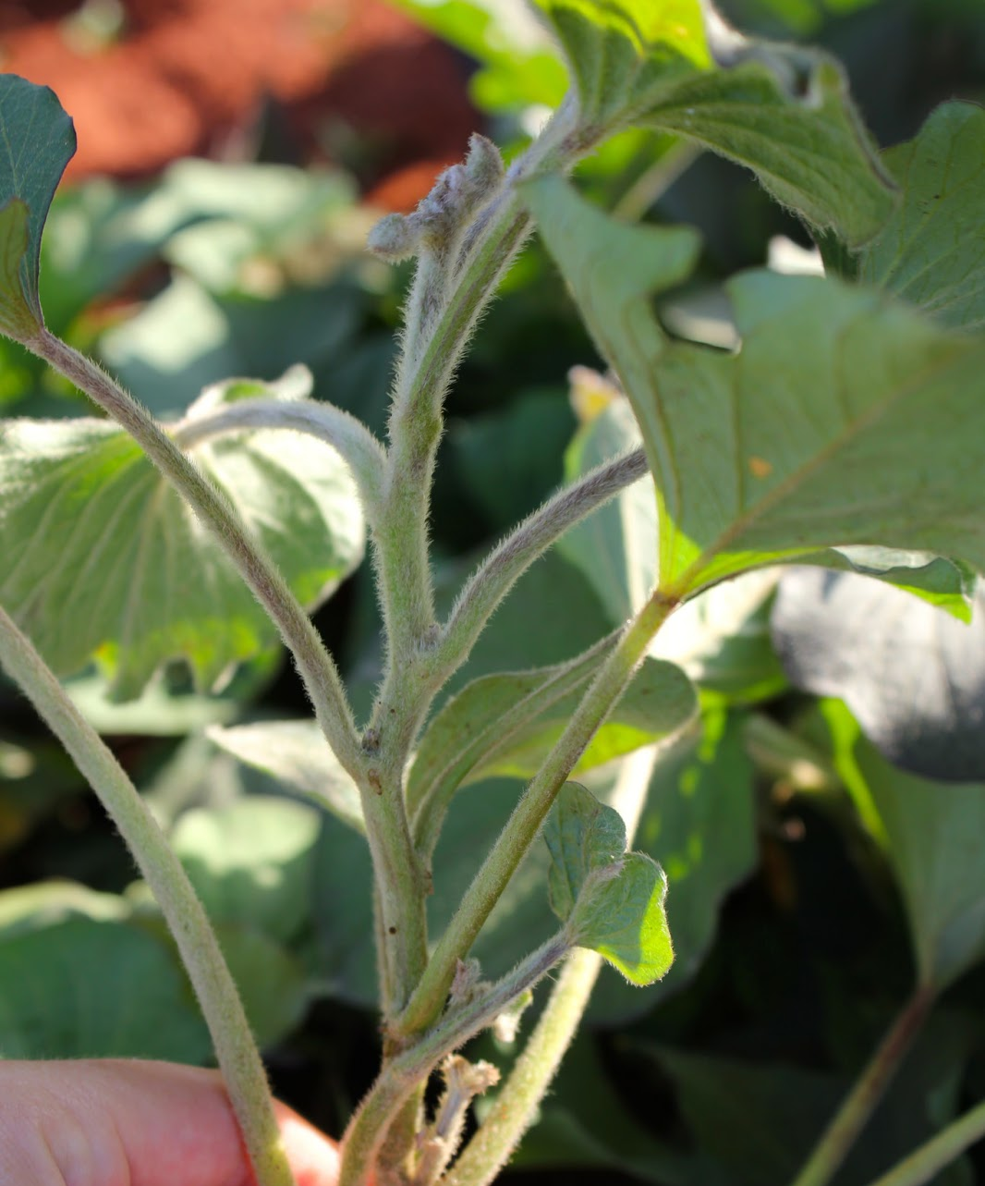
How Erinose/ Hairiness/ Eriophyid Mites Spread
Adult mites look like speck of dust
Are blown in wind to other crops

Slide 62
Management of Erinose/ Hairiness/ Eriophyid Mites
Scout fields regularly
  Look for hairy shoot tips
  Remove and destroy any found
If infestation reoccurs, use
  Pruning
  Foliar fertilizer
  Miticide (Mitigan/dicofol spray)
If erinose found on infected shoot tips, bury vine at 30cm for 4-5 days before planting.
Cut infested vines and leave in shade until leaves drop off, before planting.

Slide 63
What are some of the symptoms of erinose mites?
How can erinose mites be prevented?
Notes:
Answers
Leaves and plants slightly stunted; Vines and leaves thicken; Poor plant yield; Can affect one or multiple plants
Scout fields regularly, remove and destroy hairy shoot tips; Use Pruning, Foliar fertilizer, Miticide; Bury vine; Cut infested vines and leave in shade until leaves drop off, before planting

Slide 64
Key Points
Erinose, which covers sweetpotato plants in a layer of white hairs, is caused by the Eriophyid mite.
Erinose causes sweetpotato plant stunting and poor yield. It usually affects one plant or a patch of plants.
The mites are so small they look like a speck of dust in their adult form.
Control measures include scouting for the appearance of hairy shoot tips and quickly removing them to allow re-growth of healthy shoots.
Pruning and a mitocide spray are the second line of defense.
Some farmers find that burying the affected vines or cutting them and leaving them in the shade till the leaves drop off result in a newly healthy vine that can be re-planted.

Slide 65
How to Recognise And Manage Sweetpotato Storage Pests
Unit 7

Slide 66
Objectives
By the end of this unit, you should be able to:
Explain the risk factors that attract and nurture sweetpotato storage pests and diseases.
Tell how to best prevent storage pest infestation and attack.

Slide 67
Initial Product Condition and Monitoring
Ensure product stored is in good condition, e.g.
  Products are undamaged and uninfested by pests or diseases
  Dried products are sufficiently dried
Regularly monitor the stored produce and inspect for signs of damage, e.g.
  Small feeding holes in product
  Large amounts of dust
  Insect presence
  Strange smells

Slide 68
Condition of Storage Containers
Enables product to be kept relatively cool
Free from rodents
  Should be raised 1m from the ground
  Rat guards fitted on legs
  No overhanging branches
Away from birds, livestock and thieves
Free from water damage
  Under a roof that keeps water out
  Not sited in an area prone to flooding

Slide 69
Good Storage Hygiene
Keep the area around the store clean of rubbish
All residue of previous seasons crop must be removed
Storage container cleaned thoroughly
Sacks should be turned inside out, brushed, dipped in boiling water, and hung to dry
Stores with mud walls should be re-plastered each year to destroy any insects or spores hiding in crevices
If storage pests are found, larger grain borer Prostephanus truncates, have bored in wooden parts of the store, wood will need to be destroyed by burning prevent cross infestation.

Slide 70
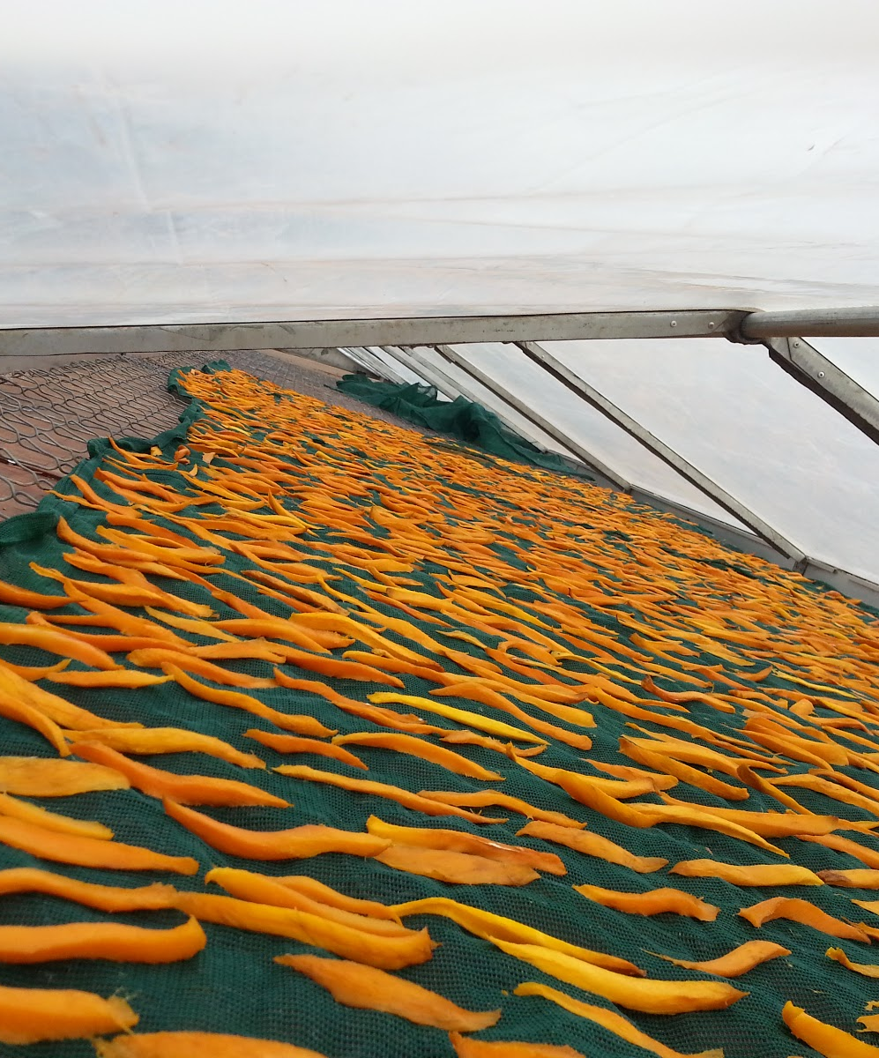
Making Dried Sweetpotato Insect Resistant
Sun-drying
Parboiling
Salting
Rolling and shaking sacks or containers periodically
Adding traditional protectants, such as ash

Slide 71
What are the recommendations for good storage hygiene?
What are some of the ways to make dried sweetpotato insect resistant?
Notes:
Answers
Regular inspections; keeping the area clean of rubbish; removing residue of previous crop; thoroughly cleaning containers and sacks
Sun-drying; Parboiling; Salting; Rolling and shaking sacks or containers periodically; Adding traditional protectants, such as ash

Slide 72
Key Points
Fresh or dry sweetpotatoes in storage are vulnerable to pests and diseases.
Losses can be reduced by steps such as using secure containers, raising containers 1m off the floor to deter rodents, using rat guards, and practicing good storage hygiene.
Regular and continual monitoring is also key. Grain borers can do a great deal of damage very quickly.
Dried sweetpotato can be made insect resistant through practices such as sun-drying, salting, rolling & shaking, parboiling, and adding traditional ash and plant materials.

Slide 73
Gender and Diversity Aspects of Sweetpotato Pest and Disease Management
Unit 8

Slide 74
Objectives
By the end of this unit, you should be able to:
Identify gender and diversity issues in sweetpotato pest and disease management.

Slide 75
Determining What Each Gender Already Knows
Find out who does which activities and what the typical information pathways are
Discover what understanding of pests and diseases and their management already exists, e.g.:
  May have a great deal experience observing pest behaviours in field, and understanding patterns of disease spread
  Evaluated different pest management practices
  May or may not recognize pest lifecycle
  They may have knowledge about appropriate pest management strategies

Slide 76
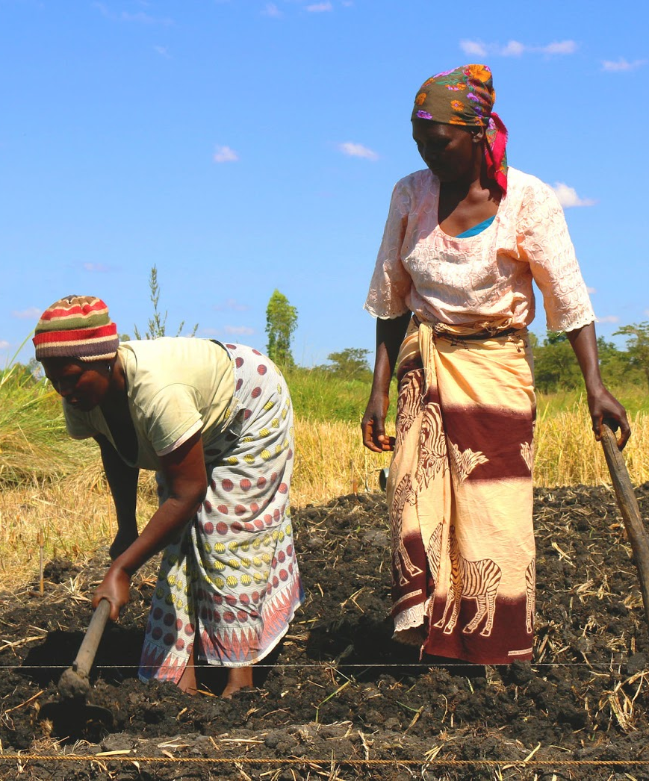
Gender and Pesticides
Women shouldn’t be involved in spraying pesticides if they are pregnant, breastfeeding or prepare food
Pesticides are poisons. Children should be kept away at all times.
Exposure can result in medical complications

Slide 77
Key Points
Different people have different experiences and understanding when it comes to sweetpotato pests and disease.
Women who do most of the labor in weeding, etc., may have had many opportunities to observe pest and disease symptoms.
Some farmers are unaware of different pest life cycles. Sharing this information can help them begin the process of experimenting with control techniques.
Pregnant and nursing mothers as well as children should avoid contact with pesticides. Child and uterus exposure to these chemicals can result in severe medical complications.

Slide 78
Field Hunting for Sweetpotato Pests and Diseases
This activity is designed to be carried out in the field.
Follow the instructions from your facilitator.

Slide 79
Importance of Understanding Lifecycles
Working in pairs, cut open the open the roots (and vines) which you collected during your field visit or which have been provided by your facilitator.
Look for different life cycle stages of the insect pests inside the roots.
Share your findings and lessons learned with the rest.

Slide 80
Training Others on Sweetpotato Pests and Diseases
In groups of 3, prepare a 5-minute presentation on your assigned sweetpotato pest or disease.
You have 20-minutes.

