Slide 1
Operationalizing One Health in pastoralist settings

Slide 2
Module 2: Gender, culture and One Health

Slide 3

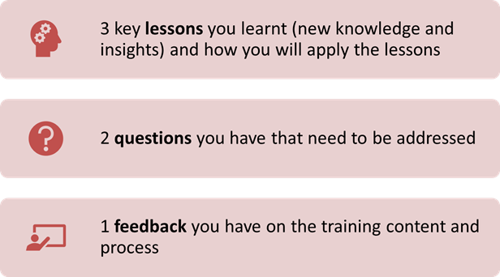
Recap of Day 2
First individually and then in pairs, reflect on the key lessons you have learned and the questions you have on the previous day
In plenary, share your reflections
30 minutes

Slide 4
Gender perceptions, gender analysis and integration into One Health

Slide 5

Intended learning outcomes
By the end of today, you will be able to:
apply critical analytical skills as you explore how gender and One Health intersect
conduct gender analysis to identify and address gender-based constraints of women, men, boys, and girls in One Health practices
design and implement One Health interventions that promote equality and empowerment for women, men, boys, and girls
explore ways to integrate gender into One Health

Slide 6
Topics
Recognizing and combating gender biases and stereotypes
Gender roles and needs
Gender analysis framework and tools
Gender integration approaches and their potential consequences

Slide 7
Exploring one’s own gender attitudes, perceptions, and biases
Picture gallery and feedback
Draw either a pastoralist, a veterinarian, a medical doctor, or an environmentalist
Post your drawings on the wall of the training room
Tour around the drawings. Let the drawing owner explain her/his drawing
Be ready to share your reflection in plenary
20 minutes
Notes:
Note the words and expressions participants used when describing their pictures.

Slide 8
Exploring one’s own gender attitudes, perceptions, and biases
Picture gallery reflection:
How many of the drawings are about women?
How many of the drawings are about men?
What words and expressions did you use to describe your drawings?
What does this say about your gender attitudes and how you work with women, men, boys, and girls in a One Health approach?
10 minutes
Notes:
Engage participants in reflections by questioning their gender attitudes, stereotypes, and biases and how these influence the way they work with women, men, boys, and girls in providing One Health services.

Slide 9
Combating unconscious biases
Think-Pair-Share:
You will watch a video about unconscious bias
In pairs, reflect on the following questions:
  What are the problems and consequences?
  How does this reflect your experience in One Health?
  How can you address gender perceptions and biases in One Health in pastoralist communities?
Be ready to share your reflections in plenary
20 minutes

Slide 10
Gender roles and needs
Brainstorming:
What do you understand by the following terms:
  Gender roles
  Gender needs
5 minutes

Slide 11
Gender roles
Tasks, activities, and responsibilities culturally assigned to women, men, boys, and girls in society
Three categories:
  Productive role: relating to the production of goods for consumption or income through work in or outside the home
  Reproductive role: relating to domestic or household tasks associated with creating and sustaining children and the family
  Community management role: relating to tasks and responsibilities carried out for the benefit of the community)

Slide 12
Gender needs
Practical gender needs: the immediate necessities of women and men due to their gender roles, for example, water, health, firewood, technologies, and information
Strategic gender interests: related to structural changes in society regarding women’s position and equity, for example, decision-making power, ownership, and representation in community governance structures

Slide 13
Community gender perceptions
Role play
Volunteers: 5 participants to act out a situation (scenario) on gender perceptions of pastoralist communities
  Husband, wife, 3 community members
Task: Prepare a 5-minute roleplay on how the husband and wife can change the community’s mindsets
10 minutes

Slide 14
Community gender perceptions
Role play
Reflection questions:
  What is the gender issue?
  How does the role-play reflect the situation in pastoralist communities?
  What are the gender perceptions and practices in pastoralist communities?
  What can you do to influence community gender perceptions and practices in a One Health context?
20 minutes

Slide 15
Gender analysis
Brainstorming:
What do you understand by “gender analysis”?
What gender analysis tools do you know and apply?
Why is gender analysis important in One Health? Share stories from your experiences
10 minutes

Slide 16
Gender analysis
Gender analysis aims to identify sociocultural constructs that might enhance or inhibit gender equality and women’s empowerment
Notes:
A gender analysis framework provides a structure for organizing information about gender roles and relations. There are many different gender analysis frameworks. Examples: The Harvard Gender Roles Framework, Moser Framework, Gender Analysis Matrix, Women’s Empowerment Framework, Social Relations Approach, and Socio-Economic and Gender Analysis.

Slide 17
Gender analysis
Gender analysis explores the relationships between women, men, boys, and girls and the inequalities in those relationships, by asking:
  Who does what?
  Who has what?
  Who decides?
  Who gains?
  Who loses?
Notes:
A gender analysis framework provides a structure for organizing information about gender roles and relations. There are many different gender analysis frameworks. Examples: The Harvard Gender Roles Framework, Moser Framework, Gender Analysis Matrix, Women’s Empowerment Framework, Social Relations Approach, and Socio-Economic and Gender Analysis.

Slide 18
Gender analysis
A gender analysis framework provides a structure for organizing information about gender roles and relations
Gender analysis uses different frameworks and methods to understand the relationships between women and men, their access to resources, their activities, and the constraints they face relative to each other

Slide 19
Gender analysis
Group discussion
In small groups, discuss the following questions:
  What do women, men, boys, and girls do in healthcare, livestock husbandry, and environmental/rangeland protection in pastoralist communities?
  What resources and benefits do they have access to and control over in healthcare, livestock husbandry, and environmental protection?
  What opportunities and constraints do they have in healthcare, livestock husbandry, and environmental protection?
Document your discussion results on flipchart papers
Be ready to present your results in plenary
30 minutes

Slide 20
Why gender analysis in One Health?
Women, men, boys, and girls in pastoralist communities often have different roles which can expose them differently to zoonotic health risks
Gender analysis provides a lens through which One Health practitioners can explore and assess the differences between the roles that women, men, boys, and girls play, the varying levels of power they hold, their differing needs, constraints, and opportunities, and the impact of these differences on their lives and opportunities

Slide 21
Why gender analysis in One Health?
Effective gender analysis can identify:
  Social relations (normative roles, duties, and responsibilities)
  Activities (a division of labor within the household and community)
  Access and control over resources, services, and decision making
  Gender needs both practical (current, immediate) and strategic (what needs to change)

Slide 22

Gender integration approaches and their potential consequences
Interactive discussion:
What does ‘integrate’ mean?
What do you understand by ‘gender integration’?
Why is gender integration into One Health important?
How are you currently integrating gender into OHU services?
10 minutes

Slide 23
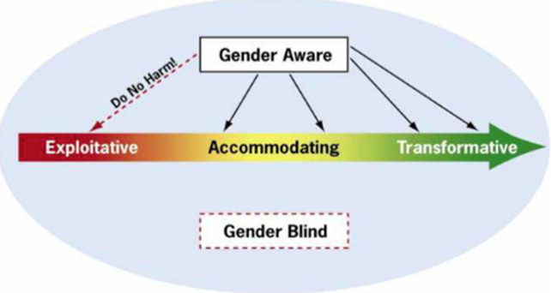
Gender integration continuum

Slide 24
Gender integration continuum
Think-Pair-Share
First, individually read the description of the gender integration continuum
Then work in pairs to share your understanding or interpretation, enriching it with examples from HEAL implementation
Be ready to share your understanding of gender integration approaches in the plenary
20 minutes

Slide 25
Where your OHUs lie along the gender integration continuum
Voting with the feet:
Cards on the floor along a line with one gender integration approach written on each card
Stand around the cards and indicate where your OHUs lie along the gender integration continuum by standing on a specific card or between cards
Chat among yourselves about why you stood on a particular card. Give examples of gender inclusion activities in OHU services
Describe which gender approach along the continuum you are using now, which approach you would aspire to use, why, and what it will require you to implement the approach in One Health practice
Be ready to share your reflections in plenary
20 minutes

Slide 26
Gender integration case study
Small group discussion
Facilitator will distribute a case study
Read the case study and determine where you would locate it and why along the gender integration continuum.
In plenary, share your results
20 minutes

Slide 27
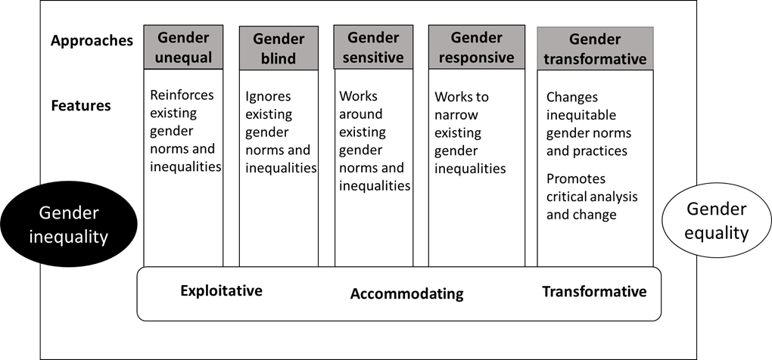
Summary of gender integration approaches

Slide 28
Summary of key learning points from day 3
Gender analysis provides a lens through which One Health practitioners can explore and assess the differences between the roles that women and men play, the varying levels of power they hold, their differing needs, constraints and opportunities and the impact of these differences on their lives

Slide 29
Summary of key learning points from day 3
A gender analysis uncovers gender relations and inequalities by asking:
  Who does what?
  Who has what?
  Who decides?
  Who gains?
  Who loses?

Slide 30
Summary of key learning points from day 3
Effective gender analysis can identify:
  Social relations (normative roles, duties, and responsibilities)
  Activities (a division of labour within the household and community)
  Access and control over resources, services and decision making
  Gender needs both practical (current, immediate), and strategic (what needs to change)

Slide 31
Action plan
Small group discussion
In groups by woreda/district:
  Make action plans to apply the training
  Record your discussion on a flipchart
  Place flip chart on wall
Be prepared to review and vote on the best action plan
15 minutes

Slide 32
Evaluation
Your facilitator will distribute two forms:
  Post-training evaluation – measures the level of learning achievement relative to the baseline you completed on day 1
  End-of-training survey – gathers participant feedback on the relevance, effectiveness of the content and training process
Both forms are anonymous and will help us improve the training
5 minutes

