Slide 1
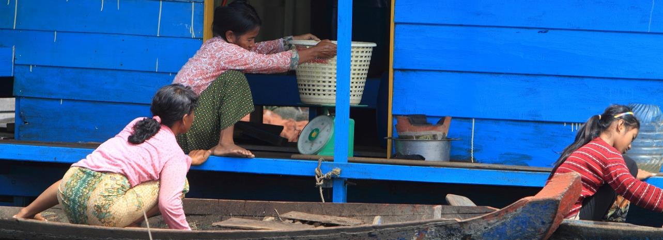

WE2.1: Humanizing Wetlands ‘ Wise Use’
Sanjiv de Silva, Deepa Joshi, Arunima Hakhu, Bryce Gallant, Cynthia McDougall, Mark Dubois
Cultivating Equality: Advancing Gender Research in Agriculture and Food Systems
Session: The Challenges of Interdisciplinary Projects
13 October, 2021

Slide 2
How are social dimensions conceived and applied in practice?

Slide 3
Who sets the agenda?
Dissonance between intentions and practice
External biophysical scientists, [male] State representatives
Removed from local stakeholders
Pre-conceived notions of wise-use
Stakeholder engagement and measurement mostly quantitative
Superficial understanding of social, economic, cultural, historical and structural drivers of marginalization
Trade-offs unequal, with costs borne disproportionately
Notes:
These factors translate to the fact that:
The understanding of social, economic, cultural, historical and structural drivers of marginalization is superficial (in RC documents)
Trade-offs tend to be unequal, with ‘costs’ that are not just economic.
That these costs are borne disproportionately

Slide 4
Social justice approaches add nuance to the practice of wetlands wise use
Fairness in distribution of goods and opportunities (Rawls 1972)
Human rights, egalitarianism of opportunity, where all human beings can participate fully in society Gidley et al. (2010)
Help us unpack complexity:
Histories of marginalization, vulnerability
Hidden power structures that determine who sets the agenda e.g. masculinities
Pathways that challenge these structures and systems that subvert social justice = transformative change
FPE & other tools
Notes:
One option is using Social Justice - fairness and equal opportunity are central notions, which help us to unpack…

Slide 5
Digging Deeper: Knowledge & Exclusion in the GoM
“Women don’t have knowledge about wetland and they tend to focus on personal feelings. Women are less experienced.”
A male respondent
Knowledge types and hierarchy shapes agency:
  Experiential dominates; theoretical/received – not so
Who acquires what knowledge is very gendered, class-based and occupational e.g. men fish
  Agency ascribed and self-perceived: power over and power within
Translates into engagement in public spaces - intersecting with class and age = wealthier, older, male
“There are some people in the village who talk to us in different way and our words are useless everywhere. We can’t also deny them because we are poor. I don’t participate in decision making… because we are poor and our opinions doesn’t have influence or matter.”
A fisher classed as poor
Notes:
Knowledge hierarchy shapes agency
Experiential knowledge interwoven with social norms of age = experience = power
Agency ascribed and self-perceived: power over and power within
Power over: poor women found that that they had little influence. Poor fisher example also apt here
Power within: women fishers with businesses reported being taken seriously - confidence seems to play a key role in women’s participation
Who acquires what knowledge and gender norms:
Men fish = experiential and suited for decisions
Women attend training = theoretical, and limited to traditional female domains
This has implications on (effective) engagement in public spaces - intersecting with class and age = wealthier, older, male

Slide 6

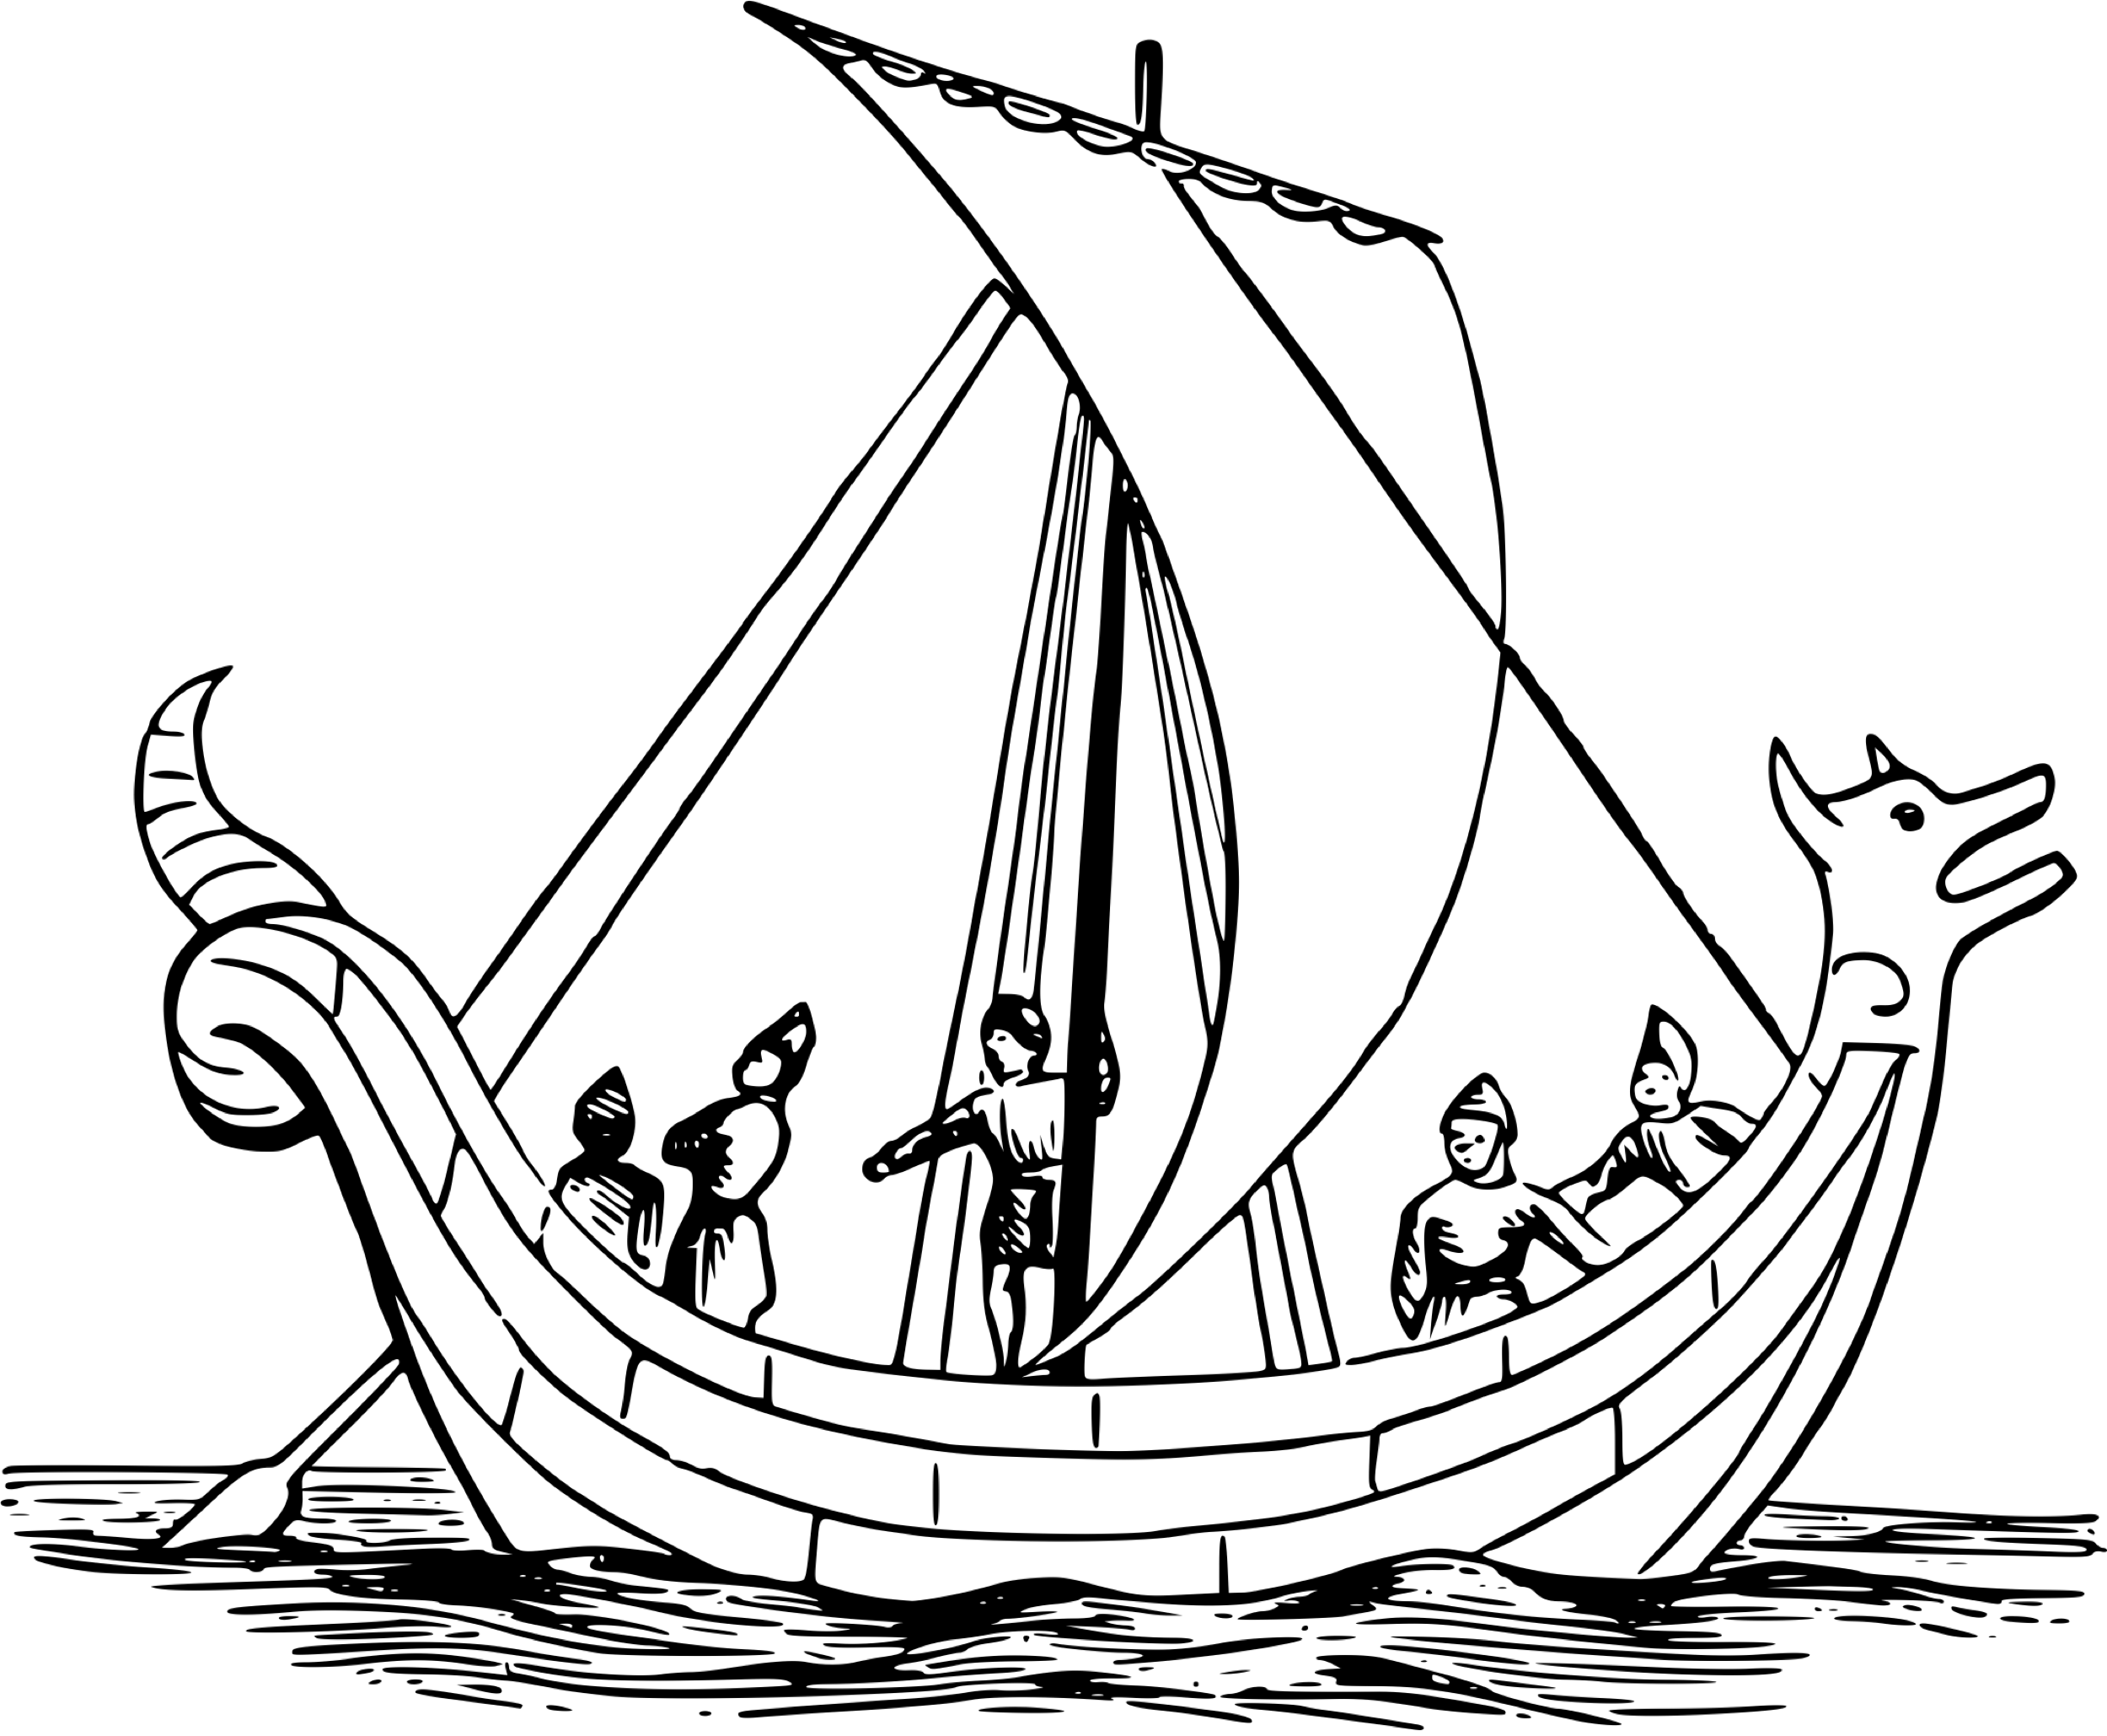

Bridging the Ecological and Social
Wiser use of wetlands
Governance
Social sub-system
More inclusive governance
Greater sharing of costs and benefits
Reflect local knowledge
Ecological sub-systems
Biotic and abiotic elements
Ecosystem processes
Use of institutionalized power to shape wetland condition and change
  Built infrastructure and assets
  Norms and belief
  Formal and informal institutions
Acknowledge diversity & complexity
Move from binaries to intersectionality; technocratic to socio-technical
Explore the visible/hidden ‘realities of others’
Strategize & measure for transformative change

Slide 7
Guiding Questions:
Despite engagement with national governments, what are key challenges to socially inclusive restoration?
How do intersectional inequalities complicate nature-society interrelations, how might restoration initiatives be made inclusive?
What will it take to put into practice a social-ecological framing of restoration? What are key systemic, structural barriers, what are possible opportunities for transformative change?

