Slide 1
Important!
This module is designed to potentially serve a wide variety of audiences (nutritionists and agronomists, policymakers, extension workers, farmers).
Not all of the material will be relevant to all audiences.
Please refer to the accompanying Facilitator’s Guide for guidance on how to adapt these materials to your audience and facilitation best practices.

Slide 2




Legend
Icon | Description
 | Expected Duration, minutes
 | Quick Review/Survey Questions
 | Brainstorming Session
 | Discussion Session
 | Group Activity
 | Animated Slide
 | End of Animation
Xm

Slide 3
Legal
Unless otherwise noted, all images copyrighted to International Potato Centre.
Attribution-NonCommercial-ShareAlike 2.0 Generic (CC BY-NC-SA 2.0)

Slide 4
Everything You Ever Wanted to Know About Sweetpotato
Topic 3: Varietal Selection and Characteristics

Slide 5
Introduction
Sweetpotato Varietal Selection and Characteristics

Slide 6
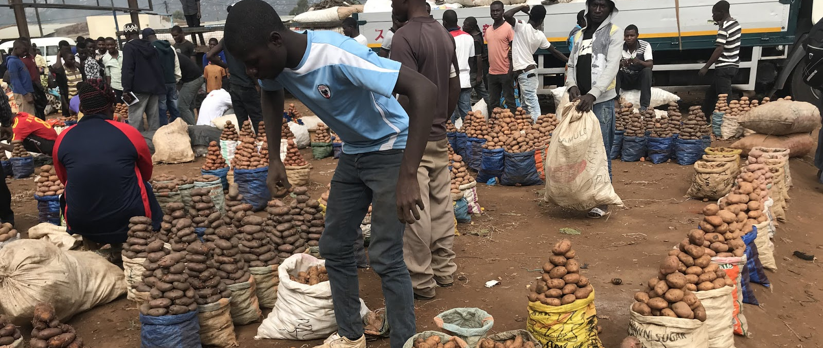
Welcome
During this session, we will examine different varieties of sweetpotato and their key characteristics.

Slide 7
Natural Diversity of Sweetpotato
Unit 1

Slide 8
Objectives
By the end of this unit, you should be able to:
List identifying characteristics of varieties of sweetpotato
Describe typical flesh colours of sweetpotato varieties

Slide 9
Characteristics of Sweetpotato
Leaf
  Shape
  Colour
Growth
Root
  Shape
  Colour
Flesh colour
Taste
Texture
Dry matter content
Resistance
  Pest
  Disease
Yield

Slide 10
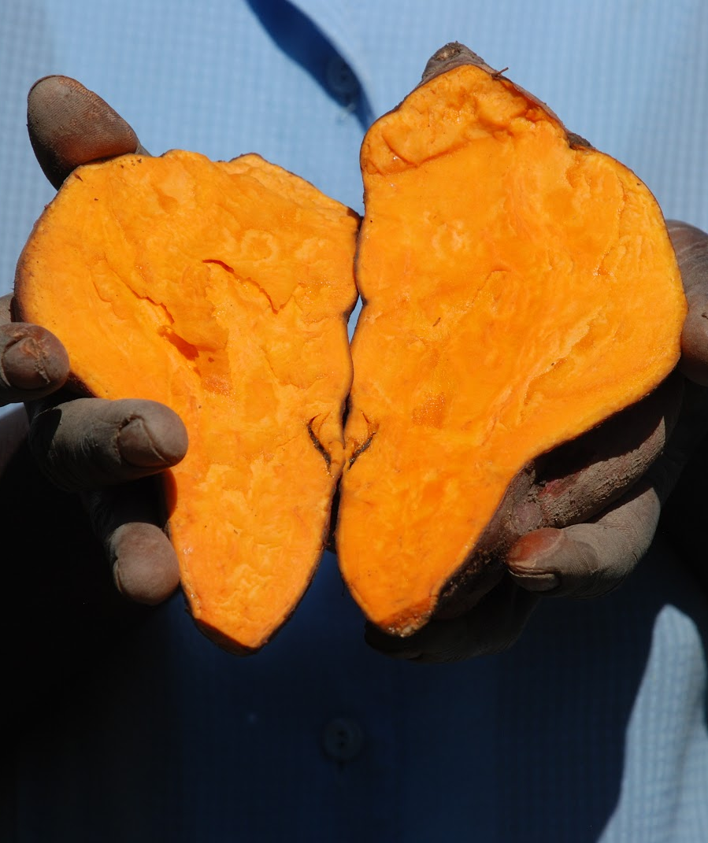
Typical Flesh Qualities
Colours
  White – yellow
  Orange – purple
Tastes
  Sweet – bland
Dry matter
  Below 20% - above 40%

Slide 11
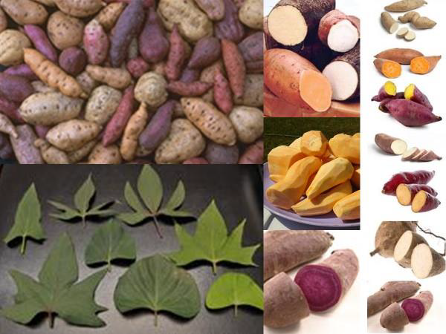
Myth: OFSP varieties are GMO
Variety of striking flesh colours led to a myth that OFSP is genetically engineered.
All OFSP varieties are the result of natural selection.

Slide 12
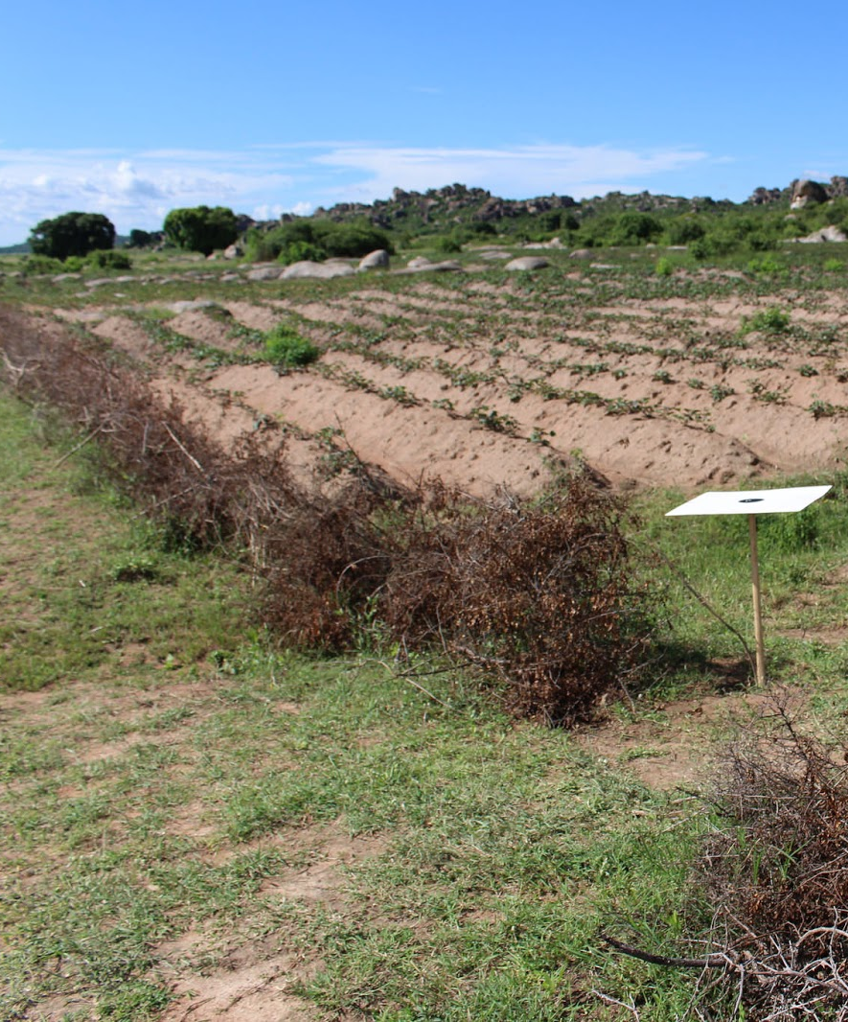
Geographical Diversity
Usually just a few varieties grown in a specific geographical area
Selection criteria
  Market demand
  Planned use

Slide 13
What are some of the ways sweetpotato varieties differ from each other?
Are genetically engineered sweetpotato varieties being commercially produced?
Notes:
Answers
Differences include leaf shape and colour, growth habit, root shape, root skin colour, flesh colour, taste, texture, dry matter content, resistance to pests and diseases, and yield.
While the wide range of flesh colours may seem to indicate otherwise, there is currently no genetic engineering of sweetpotato.

Slide 14
Key Points
There are thousands of sweetpotato varieties
They differ by leaf and root shapes, growth habit, skin and flesh colour, texture, dry matter content etc.
Flesh colours range from white > yellow > orange > purple
These are natural flesh colours, as no genetically engineered sweetpotato varieties are being commercially produced yet.
In any one area, just a few dominant varieties are typically grown.

Slide 15
What Characteristics Are You Looking for In Your Sweetpotato Plants?
Unit 2

Slide 16
Objectives
By the end of this unit, you should be able to:
List characteristics that farmers are looking for in sweetpotatoes
Distinguish between important features of different varieties
Explain the impact of beta-carotene on sweetpotato flesh colour
Summarise how sweetpotatoes are selected for drought tolerance

Slide 17
Characteristics Farmers Want
Determined by farmer’s
  Location
  Seasonal conditions
Yield
Root characteristics
Resistance
  Drought
  Temperature
  Disease
  Pests
Market price
In-ground storability
Harvest period
Dry texture

Slide 18
Important Characteristics
Beta-carotene content
  Deeper orange flesh
    Increase beta-carotene
Drought tolerance
  Evaluate performance
  High harvest index

Slide 19
Sweetpotato Taste Test
View and compare varieties of uncooked sweetpotato
Pick a recipe that is best for each variety
Cook!
Notes:
Notes
The instructor should bring in uncooked varieties of sweetpotato to view and compare.
Pick a recipe that is best for each variety and cook while at the learning centre.
If it is not possible to cook together, prepare outside of class and bring in to share.

Slide 20
What are some of the characteristics that farmers prefer?
Does a darker sweetpotato flesh colour indicate a higher or lower concentration of Beta-Carotene?
Notes:
Answers:
Location, Seasonal conditions; Yield; Root characteristics; Resistance to Drought, Temperature, Disease, Pests; Market price; In-ground storability; Harvest period; Dry texture
Darker colour indicates higher concentration of beta-carotene

Slide 21
Key Points
Farmers prefer varieties with higher yield potential, resistance to pests and diseases, a higher market price and other characteristics.
Sweetpotato varieties differ by leaf, root, colour (beta-carotene content) and other characteristics
Breeding for drought tolerance is often done by evaluating performance under both adequate soil moisture and dry conditions.

Slide 22
How to Access and Test Different Sweetpotato Varieties
Unit 3

Slide 23
Objectives
By the end of this unit, you should be able to:
List different ways for farmers to access new sweetpotato varieties
Explain the purpose of conducting on-farm participatory testing of different sweetpotato varieties
Summarise seven steps of conducting on-farm participatory testing

Slide 24
Farmer Access to OFSP Varieties
Neighbours
  Swap or trade
Agricultural extension office
NGO office
Traders
  Local
  Long-distance
Research station
Specialised seed producers
  Decentralized vine multipliers (DVMs)

Slide 25
Purpose of Participatory Testing
Introduce varieties
Test performance
Farmers acceptance
Feedback
Build farmers knowledge

Slide 26
7 Steps On-Farm Participatory Testing
Situation Analysis
Identification of Local Partner(s) and Areas for On-Farm Trials
Identification of Farmers or Farmers’ Groups
Planning the Trials with the Farmers
Planting the Trial
Monitoring of the Trial
Evaluation of the Trials

Slide 27
Step 1: Situation Analysis
Learn local farming livelihood systems
Investigate genders
  Diversity issues
  Roles
  Responsibilities

Slide 28
Step 2: Identify Partners and Areas
Local partners facilitate trials
  NGOs
  CBOs
  Government extension staff
Area
  Different ranges
    Rainfall
    Soil
    Temperature
  Socio-economic conditions
    Poorer
    Better-off
    Roads
    Cultural groups

Slide 29
Step 3: Identify Farmers’ Groups
Farmer criteria
  Diversity
  Willing
    Host visitors
    Manage trial
  Experience
Location criteria
  Accessible
  Homogeneous soil
  Invest after trial
  Awareness
    Past animal destruction
    Theft

Slide 30
Step 4: Planning with Farmers
Initial meeting
  Goals
  Activities
  Expected contributions, both sides
    Land, labour, management, selection, equipment
  Plan of action throughout trial
    Action
    Responsibilities
    Who?
    How?
    When?

Slide 31
Step 5: Planting Trial
Maximum 8 varieties
Plot 30 square metres
  5 rows
  6 metres long per variety
  1 metre between rows
  100 cuttings per plot
Explain to farmers
  Middle 3 rows cannot be harvested during growing period
    Keep all but 10 roots
  1st row on outside, can piecemeal harvest
  Last row must not be piecemeal harvested

Slide 32
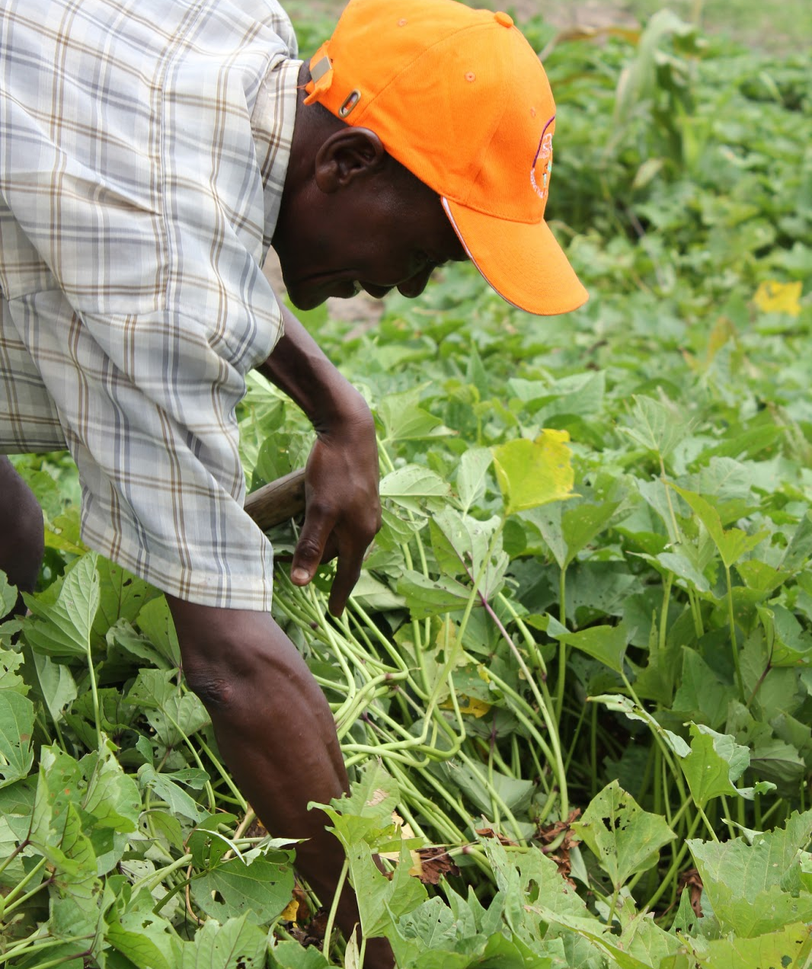
Step 6: Monitoring
Completed by stakeholders
  Farmers
  Local partners
  Researchers
Purpose
  Timely gap filling
  Weeding
  General good progress

Slide 33
Step 7: Evaluation
Virus assessment
  Farmer, local partners present
  Acknowledge virus symptoms if present
First weeding
  3 weeks post planting
Leaf taste-test
  3 months post-planting
  While on plant, have farmers evaluate cooking potential
  Harvest leaves border row to cook local fashion
  Evaluate
    Taste
    Appearance
    Texture (using colour card system)

Slide 34
Final Evaluation Stages
Stage 1: Quantitative root assessment
Stage 2: Field variety evaluation
Stage 3: Consumer acceptability assessment
Stage 4: In-ground storability assessment

Slide 35
What are some of the ways that farmers can access new varieties of sweetpotato?
What are the advantages of participatory testing?
What are the 7 key steps of participatory testing? Summarise what happens at each step.
What are the stages of final evaluation?
Notes:
Answers
Through neighbouring farmers, the local agricultural extension or NGO offices, local or long-distance traders, nearby research stations or specialised seed producers.
Introduce varieties; Test performance; Farmers acceptance; Feedback; Build farmers knowledge
7 steps are: 1) Situation Analysis; 2) Identification of Local Partner(S) and Areas for On-Farm Trials; 3) Identification of Farmers or Farmers’ Groups; 4) Planning the Trials with the Farmers; 5) Planting the Trial; 6) Monitoring of the Trial; 7) Evaluation of the Trials
Stages of final evaluation are: Stage 1: Quantitative root assessment; Stage 2: Field variety evaluation; Stage 3: Consumer acceptability assessment; Stage 4: In-ground storability assessment

Slide 36
Key Points
Farmers can access new varieties through neighbours, agricultural extension or NGO offices, local or long-distance traders, research stations or specialised seed producers
The seven steps of conducting on-farm participatory testing are:
  Situation analysis
  Identification of local partner(s) and areas for on-farm trials
  Identification of farmers or farmers’ groups
  Planning the trials with the farmers
  Planting the trial
  Monitoring of the trial
  Evaluation of the trials

Slide 37
Gender and Diversity Aspects of Sweetpotato Varietal Selection
Unit 4

Slide 38
Objectives
By the end of this unit, you should be able to:
Describe differences in male and female preferences of characteristics
Summarise the importance of conducting sweetpotato needs assessment

Slide 39
Male and Female Preferences
Women
Men
Cooking qualities
  Time
  Absorption
  Crumble potential
  Taste
Market-related qualities
  Potential sales
  Income
Both: Yield, root size

Slide 40
Importance of Needs Assessment
Workers understand OFSP role
  Livelihoods
  Health
Improves
  Yield
  Income

Slide 41
What characteristics are more important for women? Men? Both?
Why should a sweetpotato needs assessment be done prior to starting development in a new location?
Notes:
Answers
Women: Cooking characteristics (time, absorption, taste); Men: marketing characteristics (sales, income); both – yield, root size
So that development workers can understand the role sweetpotato plays in the livelihoods of the different groups in the community.

Slide 42
Key Points
Men and women may value different characteristics, e.g. women are more likely to prefer cooking qualities, while men favour sweetpotatoes with a higher market value.
A sweetpotato needs assessment is done prior to starting sweetpotato work in a new location, in order for the development workers to understand the role sweetpotato plays in the livelihoods of the different groups in the community.

Slide 43
Selecting Sweetpotato Varieties
Using half a flip chart page, create an advertising poster showing and describing the different characteristics of the two main sweetpotato varieties grown in your work location.
On the second half of the flip chart page, add two new varieties of sweetpotato that you have learnt about and could promote in your work location.

