Slide 1
Operationalizing One Health in pastoralist settings

Slide 2
Module 2: Gender, culture and One Health

Slide 3
Culture and gender concepts in One Health

Slide 4

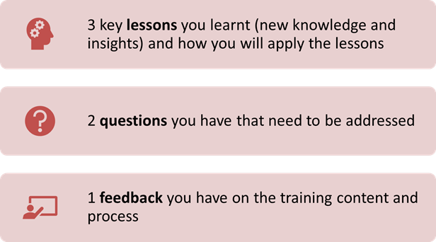
Recap of Day 1
First individually and then in pairs, reflect on the key lessons you have learned and the questions and feedback you have on Day 1
In plenary, share your reflections
30 minutes

Slide 5

Intended learning outcomes
By the end of today, you will be able to:
show sensitivity in your interactions with groups of different cultural backgrounds
develop more self-awareness and knowledge of others
recognize the intersectionality of gender with culture in One Health
identify and address gender issues in One Health in pastoralist communities
take action to develop your cultural and gender competence

Slide 6
Topics
Self-awareness, recognizing biases and stereotypes
Becoming culturally competent One Health practitioners
Why gender matters in One Health

Slide 7
Influence of cultural and religious beliefs in health care
Video analysis:
Facilitator will play a video about cultural and religious beliefs
In pairs or trios, reflect on the video using the discussion questions:
  What is happening in the video?
  Why did the woman refuse to remove her hijab?
  What would you do if you were the doctor or the patient in this situation?
  What did you learn from the video about the role of culture in One Health?
Be ready to share your reflections in plenary
25 minutes

Slide 8
Culture and related concepts
Multiculturalism is key to achieving a high degree of cultural diversity and inclusion
It encourages the integration of various cultures and the mutual exchange of ideas and viewpoints
Communication, sharing ideas, and collaboration across levels (e.g., from community to service providers, policymakers to researchers) can lead to new opportunities, innovations, creativity, and more productive working relationships

Slide 9
Culture and related concepts
Understanding culture and how it influences one’s perspectives, beliefs, and behavior helps One Health practitioners:
  work across different cultural and disciplinary boundaries and
  explore multiple perspectives of different stakeholders to achieve optimal health outcomes for humans, animals, and the environment

Slide 10

The iceberg model of culture
Plenary interactive discussion
What do you understand by the phrase ‘blind spot’?
Share a situation where you have given feedback to others or received feedback on your improvement areas
20 minutes

Slide 11
Recognize your biases
Video analysis:
You will watch a video about blind spots
In pairs, reflect on the following questions:
  What is the problem? Why does it arise?
  What is the consequence?
  Why cultural diversity is important for people and society?
  How can we create an inclusive environment?
Be ready to share your reflections in plenary
30 minutes

Slide 12
Be aware of yourself
Think-Pair-Share
Facilitator will distribute an image
In pairs, work on the following questions:
  What did you learn from the picture?
  How does it help you develop self-awareness?
  What is the implication of understanding yourself and others in working with culturally diverse individuals and groups in One Health?
Be ready to share your reflections in plenary
30 minutes

Slide 13
Surface and deep culture
A blind spot is something we do not see about ourselves that others do see
What we think we know about ourselves is what is seen from the outside (what we say and do) but our blind spot is hidden in our attitudes, beliefs, and values (biases and thoughts that are unavailable to introspection)

Slide 14
Surface and deep culture
The surface culture (the way we do things) is what is observable (behavior, artifacts, practices)
The deep culture (why we do the things we do) is the invisible (underlying beliefs, attitudes, values patterns)
Our thinking and feelings about something (such as health) are reflected in the deep culture

Slide 15
Becoming culturally competent One Health practitioner
Think-Pair-Share:
First, individually assess your level of cultural competence using the self-assessment checklist
Then, work in pairs to reflect on the following questions:
  How can the cultural competence self-assessment tool help you know yourself?
  How can it help you recognize what you can do to become more effective in working with culturally diverse groups in a One Health context?
  How can you become a culturally competent One Health practitioner? What attitudes, skills, and behaviors are required to work in a multicultural context?
Be ready to share your reflections in plenary
30 minutes

Slide 16
Role of culture in One Health
Culture can influence people’s health-seeking behavior and choice of a service provider (e.g., traditional vs biomedical, public vs private) human and animal health service providers
People’s perceptions about others and how others also perceive them can influence processes of collaboration and health outcomes for humans, animals, and the environment
It is important that One Health practitioners are aware of the role of culture in their services and be culturally competent in working with culturally diverse individuals and groups

Slide 17
Role of culture in One Health
Working in an inclusive way requires One Health practitioners to have:
  open-mindedness, self-critical awareness, and a growth mindset (recognizing and combating biases and stereotypes)
  cultural literacy
  valuing and leveraging cultural differences
  a willingness to learn about the cultural practices and worldviews of others
  a positive attitude toward cultural differences and a readiness to accept and respect those differences

Slide 18
Why does gender matter in One Health?
Small group discussion
You will watch a video about gender in One Health
Then, in small groups, discuss why gender matters in One Health, giving examples from your HEAL project experience:
  Why is it important to consider gender in One Health?
  What are the gender issues in One Health in pastoralist communities?
Record your discussion results on a flipchart
Be ready to share your reflections in plenary
60 minutes

Slide 19
Arguments for gender integration into One Health
The social justice argument
  an intrinsic value (i.e., realizing gender equality as a right)
  strives to address gender inequalities and empower women and girls
The efficiency argument
  an instrumental value (i.e., realizing gender equality to achieve outcomes related to societal development and well-being)

Slide 20
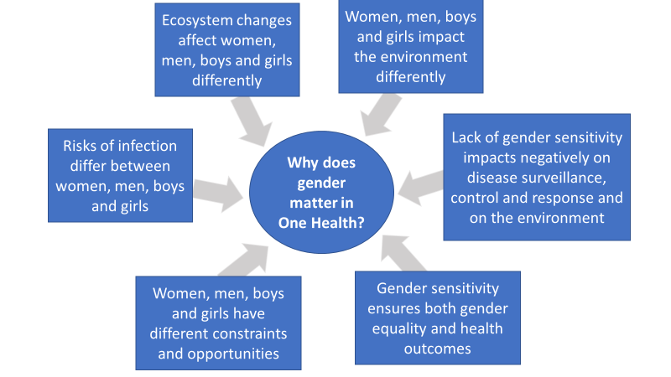
Arguments for gender integration into One Health

Slide 21
Understanding sex and gender
Voting with the feet
Facilitator will place paper labels of ‘sex’, ‘gender’, and ‘not sure’ on the floor
Facilitator will read statements aloud
If you think the statements refer to ‘sex’, stand on the paper labeled ‘sex’, otherwise on the paper labeled ‘gender’. If you are not sure, stand on the paper labeled ‘not sure’
Chat about why you stood on a particular paper label among yourselves
Be ready to share your reflections in plenary
20 minutes

Slide 22
Sex, gender, and the difference
Interactive discussion:
Label the columns in the table
In your childhood, what messages did you receive about being a boy or a girl?
Why does the difference between sex and gender matter?
Sex/gender? | Sex/gender?
Biological attributes | Culturally constructed
Given by birth | Learned through socialization
Universal and unchanged | Culture-specific and can be changed
15 minutes

Slide 23
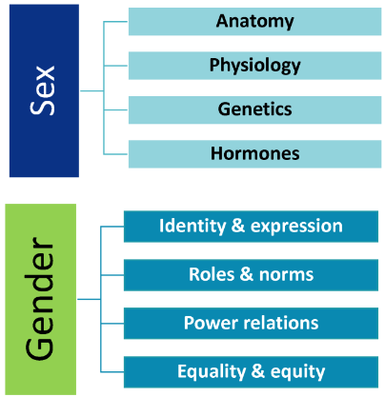
Sex, gender, and the difference
A sex- and gender-based analysis can be used to determine how diverse groups of women, men, girls, boys, and gender-diverse people are being differentially affected by One Health practices

Slide 24

Summary of key learning points from day 2
People are born male or female but learn how to behave as men, women, boys, and girls from their society through the process of gender socialization
Gender is a social and cultural construct that encompasses several domains
Culture plays a significant role in shaping gender identity and behavior by providing social norms and expectations for how individuals should express and perform their gender

Slide 25
Summary of key learning points from day 2
Different cultures deal differently with gender roles in society
Gender intersects with many other social identities and must be analyzed in an intersectional manner to better understand the different opportunities and risks of women, men, boys, and girls in a One Health context
Inequalities are not only based on gender alone but also on the interplay of several identities such as age, ethnicity, education, marital status, etc.

Slide 26
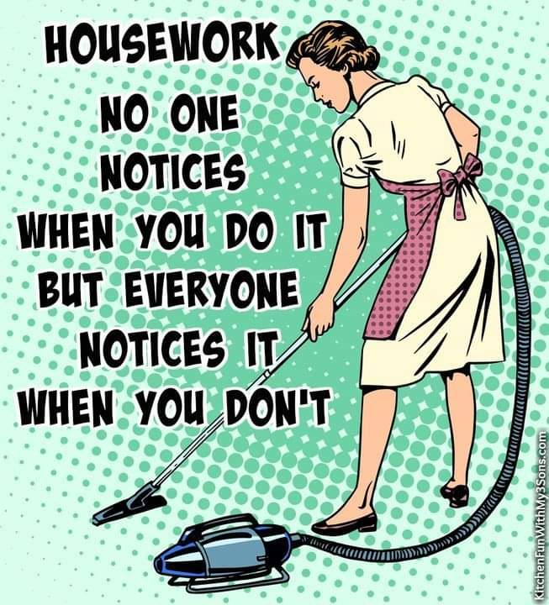
Summary of key learning points from day 2
Women, men, boys, and girls have different roles, needs, opportunities, and risks in One Health practices (e.g., veterinary and human healthcare, environmental protection)
The gender division of labor can shape mobility, access to information, ability to participate, and consultation and networking in One Health

Slide 27
Coming up:
Gender analysis and integration into One Health

