Slide 1


Gender and Climate Smart Agriculture:
Co-creating a Learning Agenda
5-6th April
ILRI, Nairobi, Kenya
https://gender.cgiar.org/

Slide 2
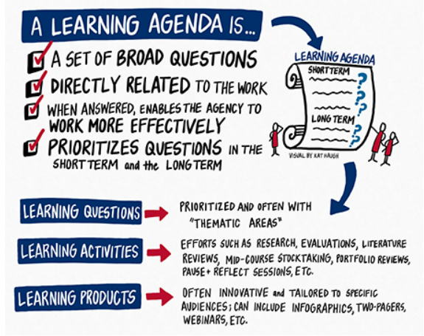
What is a Learning Agenda?
A set of questions, planned activities and products that facilitate learning and decision making within an organization or project/programme around a specific theme.
A coordination tool for identifying knowledge gaps and answers a range of priority questions within a given budget and timeframes.
Source: USAID

Slide 3
Learning Activities
Systematic and Scoping Reviews
Outcome and Impact evaluation
Mixed methods Research Studies
Action Research
Situational analysis
Case studies
Training workshops
Reflection and Learning Sessions
Peer and learning exchange
Communities of practice

Slide 4
Why a Learning Agenda on CSA and Gender?
Inform a six-year gender research for development (R4D) strategy on the theme
Form a basis for research projects/programs focused on filling priority knowledge and evidence gaps and developing actionable strategies and approaches that would enhance the synergies between development and application of climate smart agriculture and gender equality and women’s empowerment
To align with the One CGIAR strategy and provide options and opportunities to integrate this work in the R4D agenda
Highlight the capacities needed to implement the agenda

Slide 5
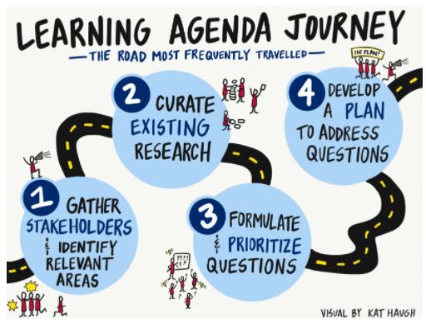
Learning Agenda Development Process
Taken from Baker M., 2017
Notes:
https://usaidlearninglab.org/lab-notes/learning-agendas-five-most-important-things-you-need-know

Slide 6
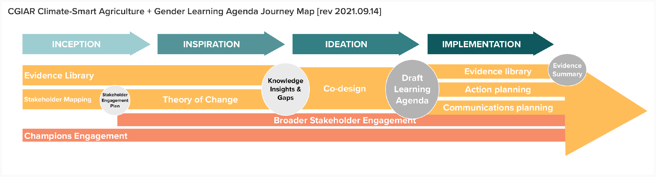
CSA+Gender Learning Agenda Journey

Slide 7
This workshop..
Prioritise Learning Questions
Identify Learning Activities
Identify Capacity Needs to implement the activities and answer the questions
Identify communication products and strategies

Slide 8
Working Theory of Change
&
Evidence Summary Highlights

Slide 9
Purpose of a TOC in the LA development process
To support the generation of insights useful for informing the LA
Provides a structure for the development and prioritization of learning questions and activities
Helps surface assumptions and knowledge insights useful for programmatic and strategic decision making

Slide 10
Process
Stakeholders co-created a working TOC for use specially during LA development using a human centered design.
Draws on existing and relevant TOCs on CSA and gender transformative change (CGIAR Research Program on Aquatic Agricultural Systems, 2012; World Bank, FAO and IFAD, 2015; Nelson & Huyer, 2016; Huyer, et al., 2019; Huyer, et al., 2021).
Notes:
Highlight that this is not a definitive, detailed or very rigorous TOC.

Slide 11
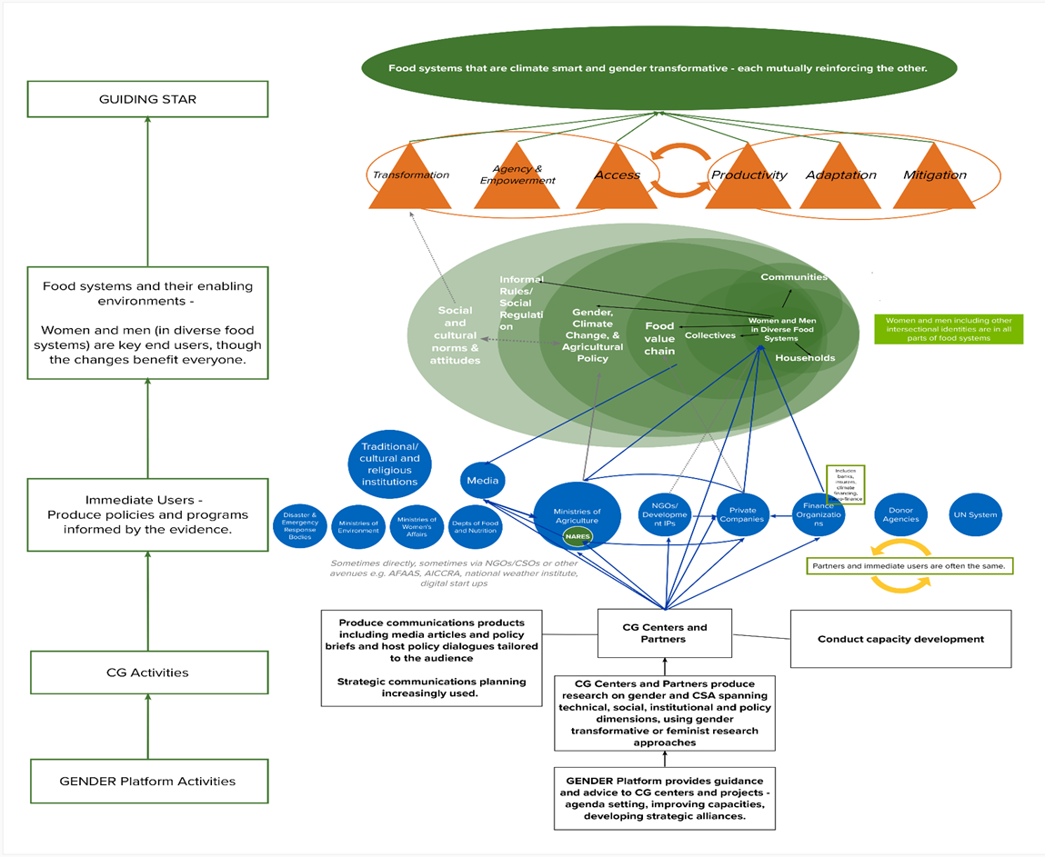
Working TOC

Slide 12
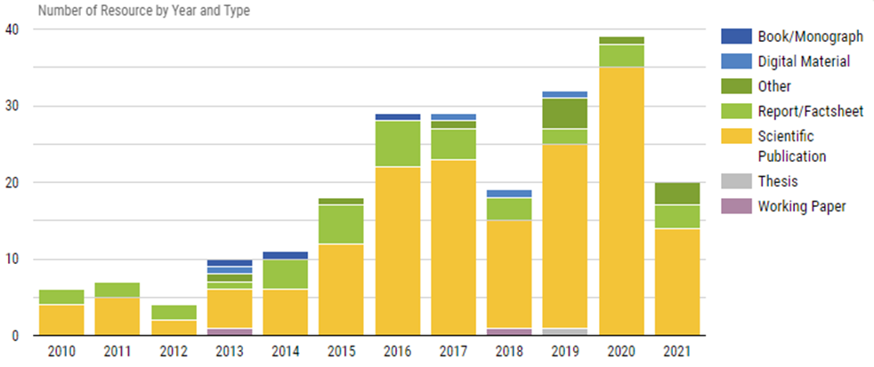
Evidence Library Highlights
227 relevant resources published in English between 2010-2021

Slide 13
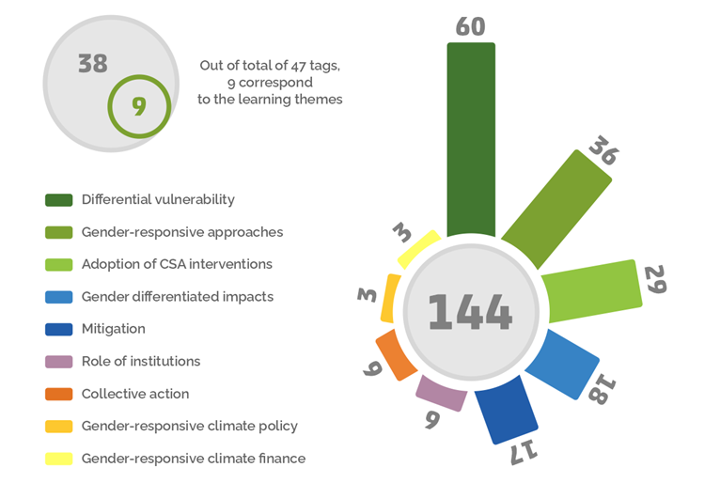
Tags and related number of resources
Notes:
The point to make here is that while a lot has been studies and diagnosed with regard to differential vulnerability, we have very little evidence on impacts, role of institutions, policy and finance.

Slide 14
Highlight of Evidence Summary
Evidence suggests that climate smart food systems transformation and gender equality are mutually reinforcing. An example for this is CSV implemented in India, resulted in enhanced knowledge and capacities of women farmers and promotion of gender equality in households.
The need for multi-sector, multi-agency coordination mainly within the same region to exchange learnings, best practices.
Call for further research, especially to address structural inequalities and gaps in capacities for gender-responsive policymaking and practices. Gender budgeting is key.
The summary suggests that GTA is not well represented. Important to differentiate between gender transformation, gender equity and gender equality outcomes.
Need for better knowledge about inter- and intra-gender differences in needs, priorities, constraints, and outcomes related to creating intersectional climate smart policies and practice
The summary highlighted that more research is needed to understand the impact of collective actions and social networks as platforms on women empowerment and gender equality under a changing climate.
The summary also highlighted the need for region specific gender gaps in agriculture

Slide 15
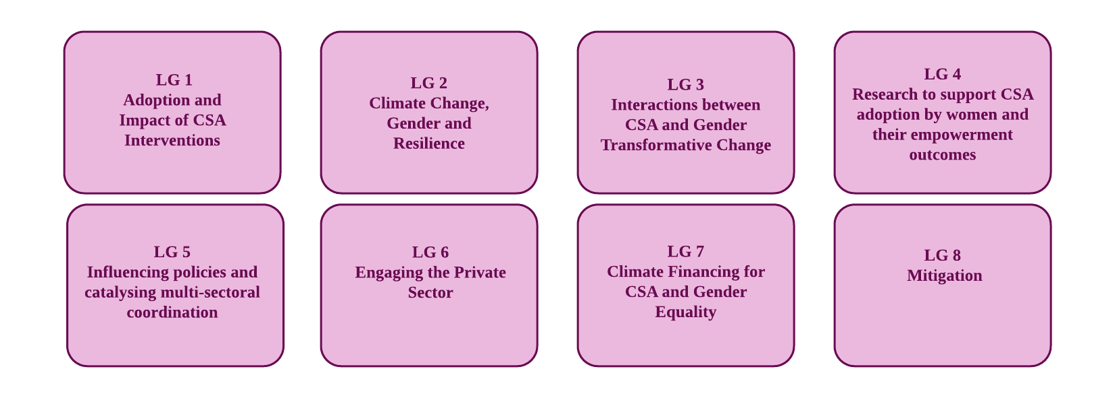
Learning gaps identified

Slide 16
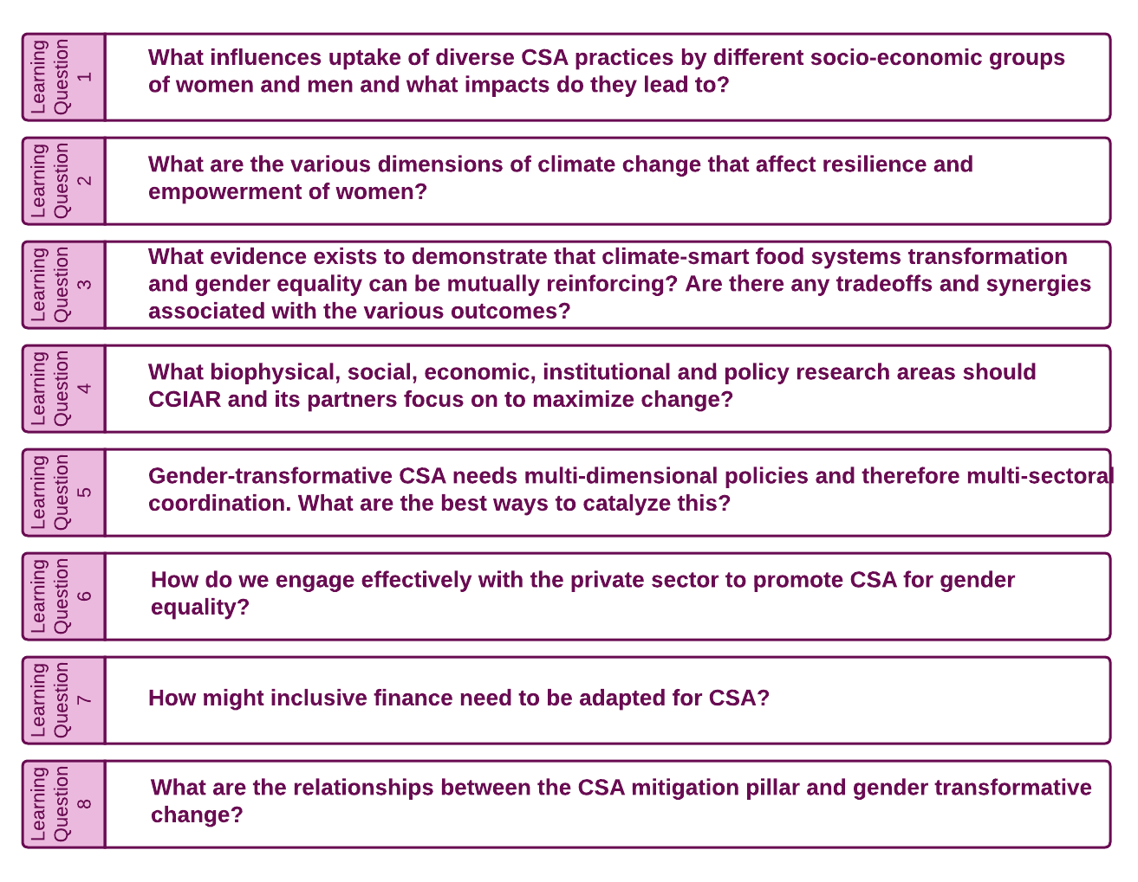
Primary Learning Questions

Slide 17

Prioritising Learning Questions
&
Identifying Learning Activities and Outputs

Slide 18
4 Break Out Groups – The Task
Review the primary and secondary learning questions developed and prioritise them based on their relevance and importance.
Drop those that are not relevant, add any that might be missing, reframe as required to make them sharper.
Rank the final secondary questions you have in order of priority.
For the final learning questions, identify learning activities that you think would be most effective in answering the questions and what outputs would be envisaged.

Slide 19
4 Break Out Groups – Process
In your groups, assign a facilitator, note taker and a presenter
Use flip charts or laptops as convenient to record the changes and choices and to use for presentation.
The note taker should capture detailed notes (in a word document) capturing the discussion and decisions and share with facilitators after the session.
Present in the Plenary Session

Slide 20
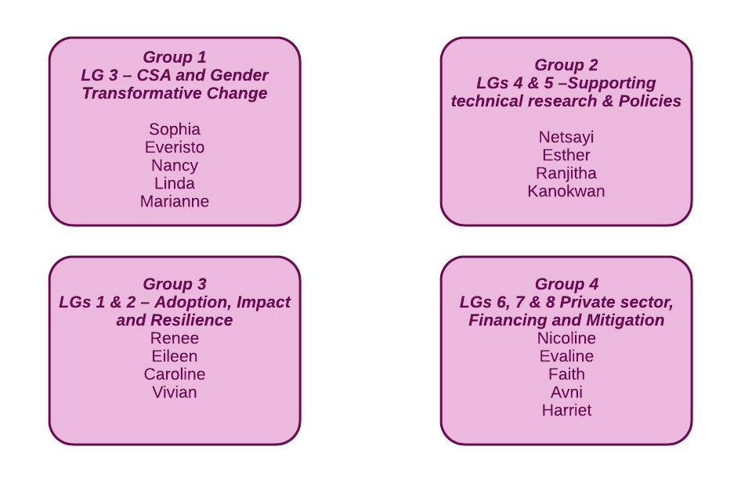
Groups

Slide 21
Gender and Climate Smart Agriculture:
Co-creating a Learning Agenda
6th April
ILRI, Nairobi, Kenya
https://gender.cgiar.org/

Slide 22

Identification of Capacity Needs and Activities

Slide 23
4 Break Out Groups – The Task
For the prioritized learning questions and activities, identify if any capacity gaps exist (CG and its partners) that would hinder their implementation.
Identify relevant and effective capacity development activities that would help fill these gaps.

Slide 24
4 Break Out Groups – Process
In your groups, assign a facilitator, note taker and a presenter
Use flip charts or laptops as convenient to record the changes and choices and to use for presentation.
The note taker should capture detailed notes (in a word document) capturing the discussion and decisions and share with facilitators after the session.
Present in the Plenary Session

Slide 25
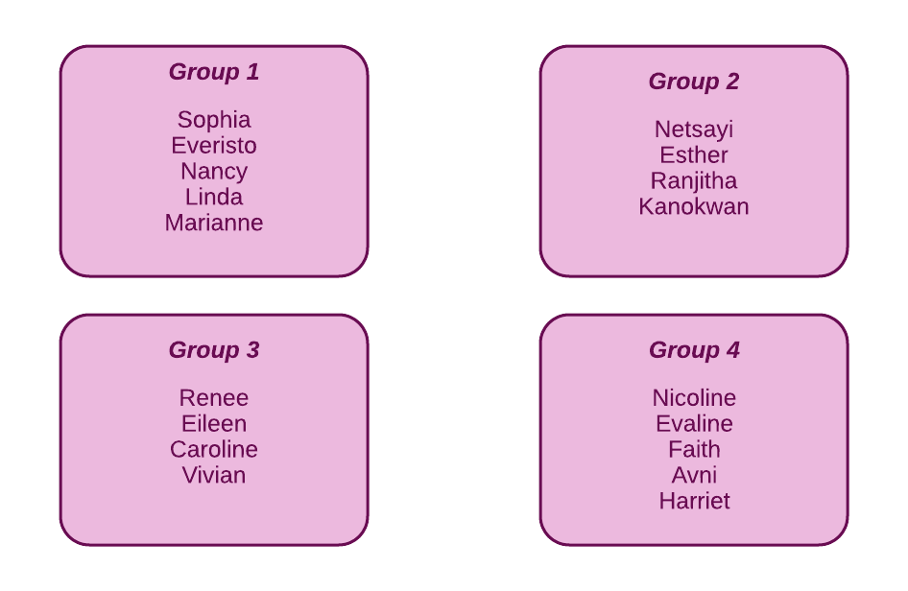
Groups

Slide 26
Identifying Effective Communication Products and Strategies

