Slide 1





Impacts of Climate Extremes and Land Use Land Cover Dynamics on Water Resources in West Africa
Salomon Obahoundje (Ph.D)
Post-Doctoral Fellow- Spatial Tools for Water Management
International Water Management Institute – West Africa
Council Cl, CSIR, Airport Residential Area
PMB CT 112, Accra, Ghana
s.obahoundje@cgiar.org
+233 30 278 4752 - 4 (office), +233-533816976 (cell)
https://www.linkedin.com/in/salomon-obahoundje-20211588/
Prospective Afrique de l'ouest 2040 / Climat, adaptation, habitabilité, aménagement du territoire et des littoraux
Paris, 16 Dec 2024

Slide 2

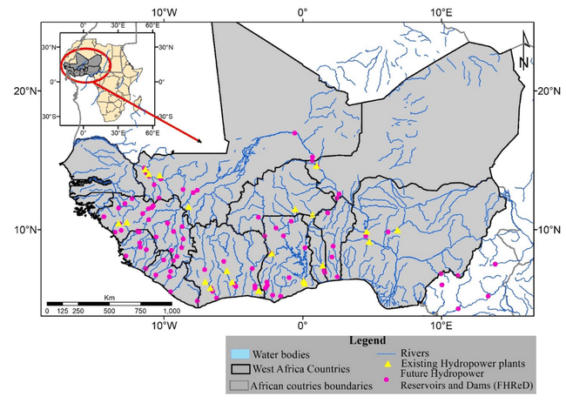
WEST AFRICA REGION
Predominantly tropical climate, ranging from arid in the north (Sahel region, one rainy season from Jul-Sep) to humid in the south (coastal areas with two rainy seasons May and Sep to October).
Average temperatures range from 25°C to 35°C, with hotter conditions in the Sahara and cooler temperatures in higher altitudes like the Guinea Highlands.
Rivers (Niger, Volta, Bandama, Sassandra, Senegal, etc) key driver of socio-economic development of the region
Rainfed Agricultural and Hydropower plants (existing and planned)
Key Drivers Pressuring Water Resources: Rapid population growth, agriculture dependence, frequent droughts, low adaptive capacity, soil degradation, urbanization, and increasing climate variability.
Geographical location of West Africa and countries
Climate controlled by the West African Monsoon driven by the movement of Inter Tropical Convergence Zone (ITCZ),
2

Slide 3

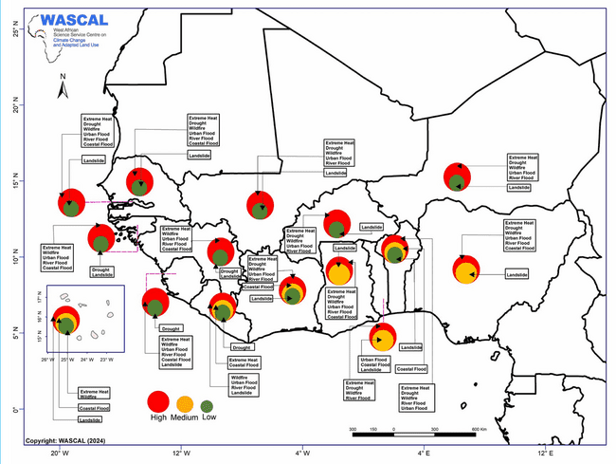

CLIMATE EXTREMES IN WEST AFRICA
SAHEL
Extreme Heat
Drought
Wildfire
Urban flooding
River flooding
COASTAL
Extreme Heat
Drought
Wildfire
Urban flooding
Coastal flooding
The prominence of climate change related Mult-hazards in West Africa
Notes:
Multiple historical climate trends show that the West African climate became increasingly variable since the beginning of the century. These climatic components include long-term changes in the local temperature, increases in interannual rainfall variability, low-frequency climatic variability, and increasing frequency of extreme weather events in the region.

Slide 4
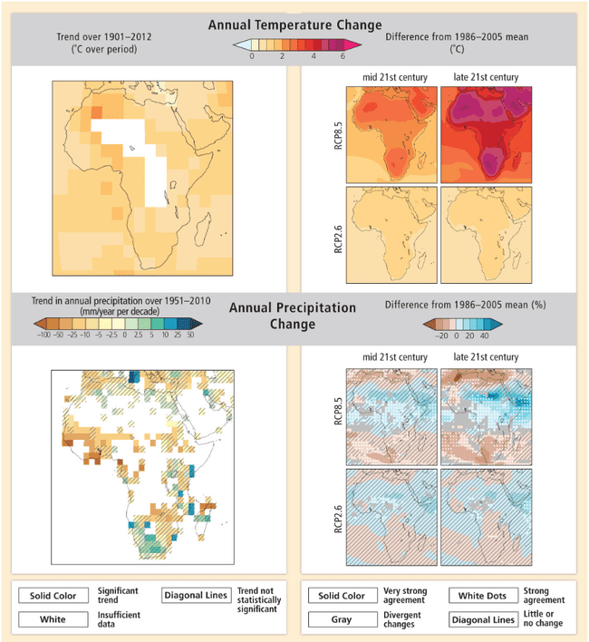
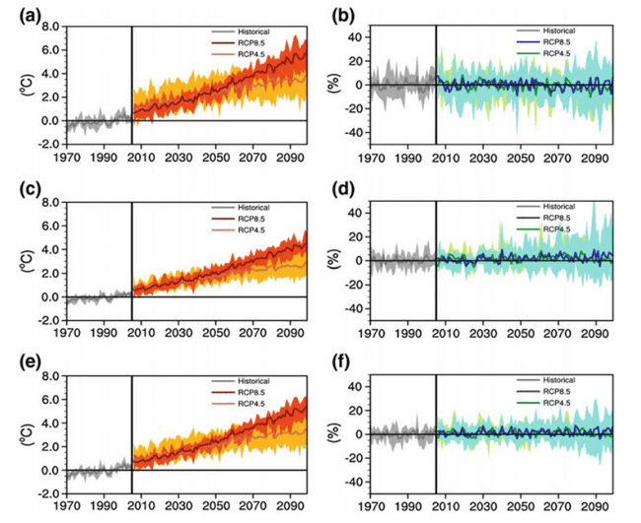
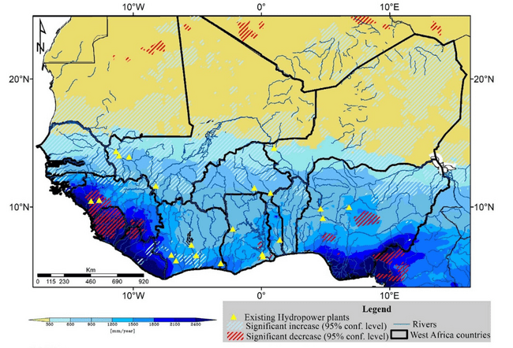
OBSERVED AND PROJECTED CLIMATE VARIABLES
2046-2065
2081-2100
SAHEL
West African Sahel has become wetter during the last 30 years, but dry spells are shorter and more frequent.(Bichet and Diedhiou., 2018a)
COASTAL
Less frequent and more intense rainfall along the coast of the Gulf of Guinea in West and Central Africa (1981−2014). (Bichet and Diedhiou., 2018b)
WAF
Past change in the spatial distribution of precipitation 1981-2018 (Obahoundje and Diedhiou, 2022)
Observed projected changes in temperature and precipitation (Jones and Hartley., 2015)
seasonal (May–September) mean Tas and Precip. Sylla et al., 2016

Slide 5
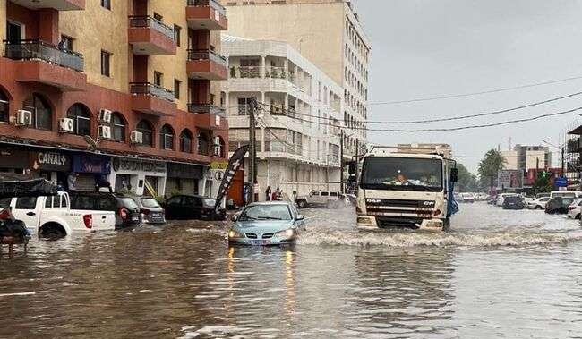
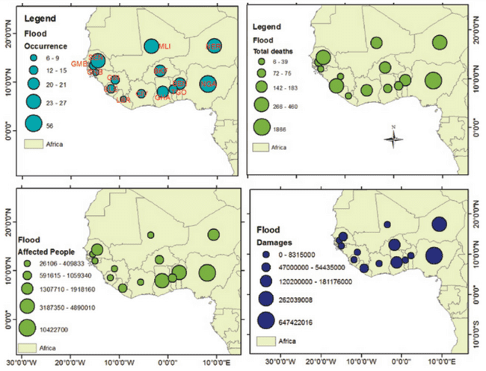
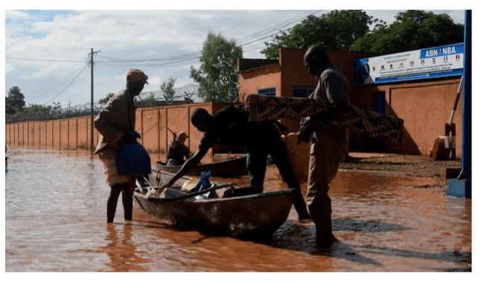
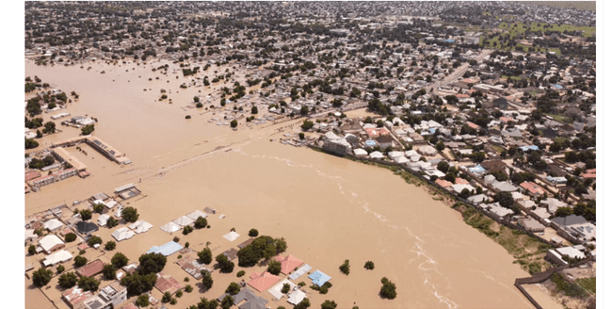
IMPLICATON OF FLOODING ON WATER RESOURCES
Observations show a rise in extreme rainfall events in parts of West Africa, particularly along the Gulf of Guinea and Sahel regions. (IPCC, AR6)
More than 5 million people in West and Central Africa have been impacted by floods so far this year, UN OCHA, 2024
CAUSES
These trends are linked to a combination of natural variability and anthropogenic climate change, resulting in heightened flood risks.
Rapid urbanization combined with inadequate infrastructure has heightened flood risks in many West African cities.
ABIDJAN, JUNE 23, 2024
FLOODING
Water Infrastructure
Economic & Livelihood
NIAMEY, August 23, 2024
Health
(Cholera, Malaria)
Water Quality
Country-based statistics of floods in West Africa during 1966-2017 (EM-DAT, 2017) (Badou et al., 2019)
MIADUGURI, SeP 12, 2024

Slide 6
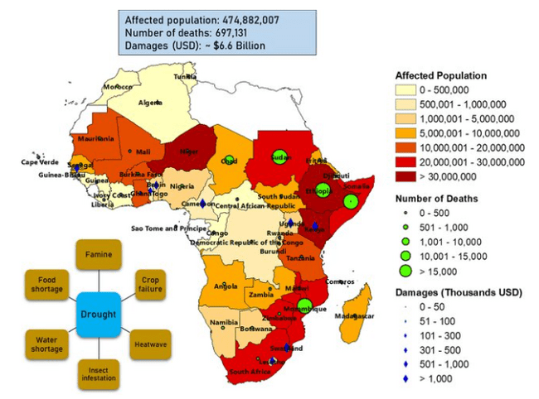
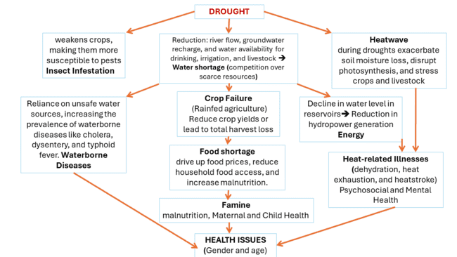
IMPLICATION OF DROUGHT ON WATER RESOURCES
1950-2021
https://public.emdat.be/
Droughts have become more frequent and intense in West Africa due to climate change and variability.
These changes are driven by rising global temperatures and associated shifts in precipitation patterns. (AR6)

Slide 7
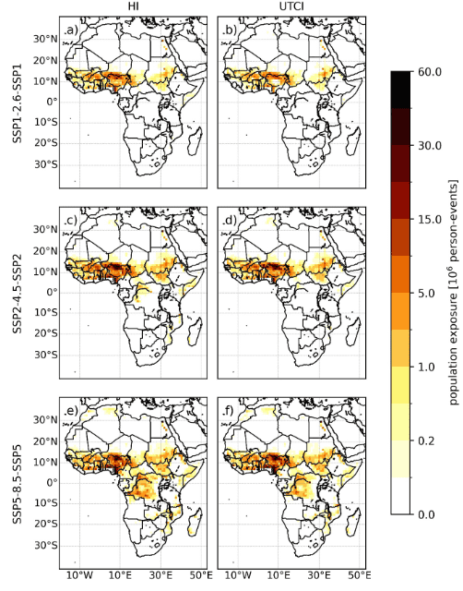
HEATSTRESS AND WATER RESOURCES
Observations reveal a significant rise in the frequency and intensity of heatwaves across West Africa, driven by anthropogenic climate change. (AR6)
Heat stress events will increase further under future warming scenarios, particularly in the Sahel and coastal regions.
Universal Thermal Climate Index
IMPLICATION
Heat Index
Projected Heat Stress Under 1.5 °C and 2 °C Global Warming Scenarios Creates Unprecedented Discomfort for Humans in West Africa (Sylla et al., 2018a)
Exposed population to heat stress will increase in future (Fotso-Nguemo et al., 2023, Dajuma et al., 2024)
Increased Evaporation
Reducing water availability,
Reduce Water Quality,
Decline in Groundwater Recharge
Amplifying drought conditions
Stress on Water-Dependent Sectors (Domestic, Agriculture and hydropower)
Intensifying water scarcity
competition over scarce resources
Compounding Risks
population growth
urbanization
infrastructure deficits
Changes (2070–2100 minus Ref :2010) In heat stress indicators. (Dajuma et al., 2024)

Slide 8
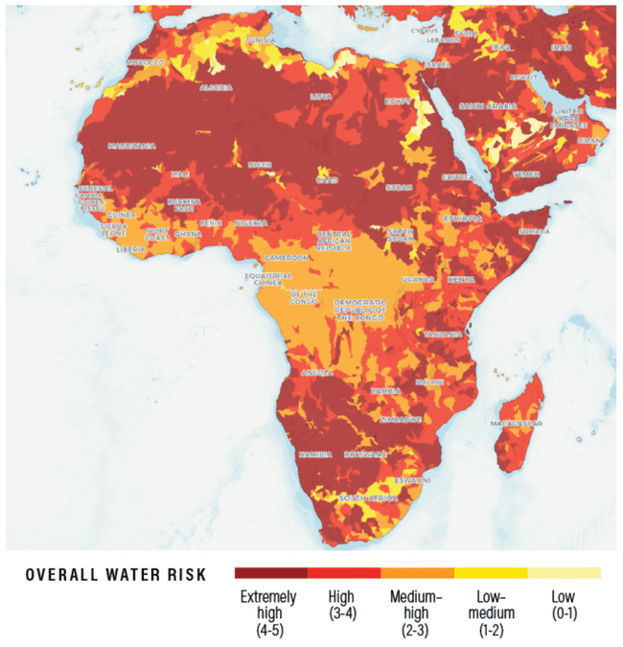
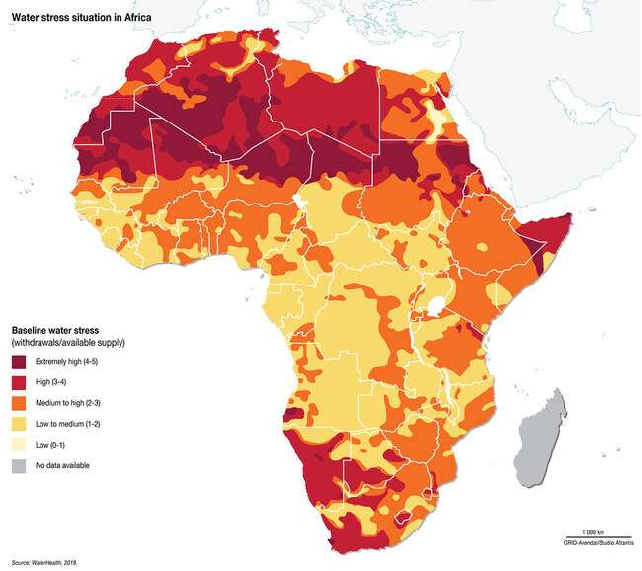
CURRENT IMPACTS ON WATER RESOURCES
climate change and poor management of water resources and services: Africa’s water stress.
The Water risk and stress indices vary according to the continent
Sahel: from Higher to extremely high risk and stress
Gulf of Guinea (Togo, Benin, Nigeria) higher risk and medium stress
Western coastal medium risk and from low to medium stress
Stress=f(water demand and availability)
Risk=f(vulnerability to floods and droughts, water stress, and seasonal variability)
UNEP., 2020

Slide 9
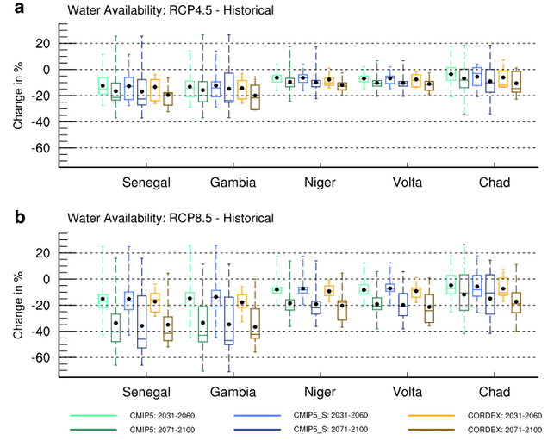
FUTURE IMPACTS ON WATER RESOURCES
Water availability
Both RCP4.5 and RCP8.5 scenarios show significant reductions in water availability across all river basins (Senegal, Gambia, Niger, Volta, Chad) relative to historical periods.
The impacts are more severe under RCP8.5, reflecting the higher greenhouse gas emissions and associated climate stress.
The decline intensifies in the latter period, particularly under RCP8.5, suggesting worsening conditions over time.
Ref: 1976–2005
Potential water availability for each river basin (Sylla et al., 2018b)

Slide 10
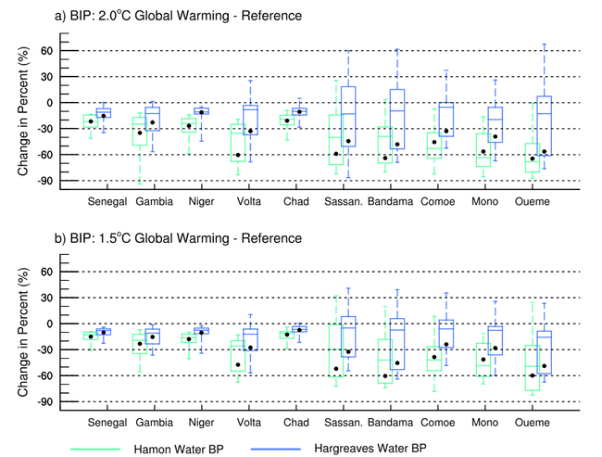
FUTURE IMPACTS ON WATER RESOURCES
Basin irrigation Potential (BIP)
General Decline in Basin Irrigation Potential: All basins experience a decline in Basin Irrigation Potential (BIP), with the magnitude increasing as global warming intensifies.
Higher Impact in Coastal Basins: Coastal basins such as Volta, Sassandra, and Bandama face more significant declines and greater variability in BIP under higher warming scenarios.
Lower Impact in Sahelian Basins: Sahelian basins like Senegal, Gambia, Niger, and Chad show relatively lower declines in BIP, with less variability compared to coastal regions.
This indicates that West African river basins will likely face severe freshwater shortages thus limiting sustainable agriculture
Basin irrigation potential for each river basin (Sylla et al., 2018c)

Slide 11
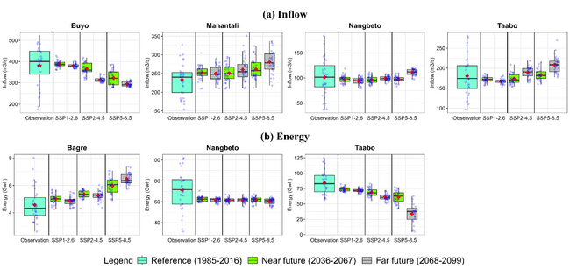
FUTURE IMPACTS ON WATER RESOURCES: HYDROPOWER GENERATION
Climate change and variability could also affect the inflow of water to the reservoir as well as the energy generation,
The changes depend on the basin, the size of the hydropower plant, the emission scenario
The energy generation will decline for both Nangbeto and Taabo
Akafou et al., 2024

Slide 12
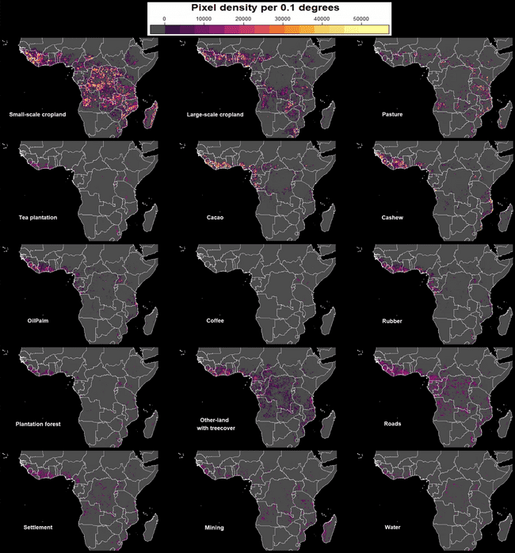
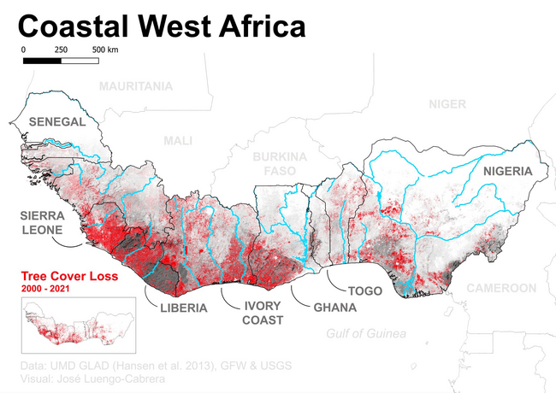
DEFORESTATION
Small-scale cropland
Large-scale cropland
Pasture
Coastal West Africa forest loss
Tea Plantation
Cocoa
Cashew
Around 1.9 million hectares/year of forest were lost in the 2015-2020 (Saifaddin Galal, 2024).
Key Drivers of LULCC: Agriculture, mining, and infrastructure development, unsustainable logging practices, and charcoal production (Obahoundje et al.,2018).
Oil-Palm
Coffee
Rubber
Implication on water resources
Disrupts the water cycle ⬅Reducing evapotranspiration& rainfall recycling
Reduce regional precipitation
Water Availability
Soil Erosion & Siltation
reduces reservoir capacity and affects water quality
Forest
Other-land with tree cover
Roads
Reduces infiltration rates, leading to less groundwater availability for agriculture and drinking water
Groundwater Recharge
Flooding and Hydrological Imbalance
more vulnerable to flash floods during heavy rainfall events
Mining
Water Bodies
Settlement
Temperature and Drought Amplification
Mapping the diversity of land uses following deforestation across Africa; (Masolele et al. 2024)

Slide 13
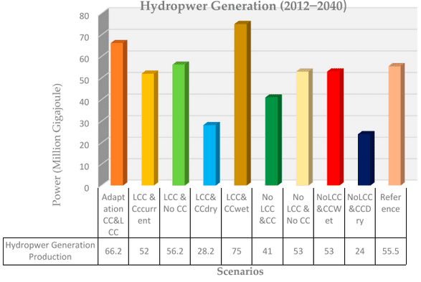
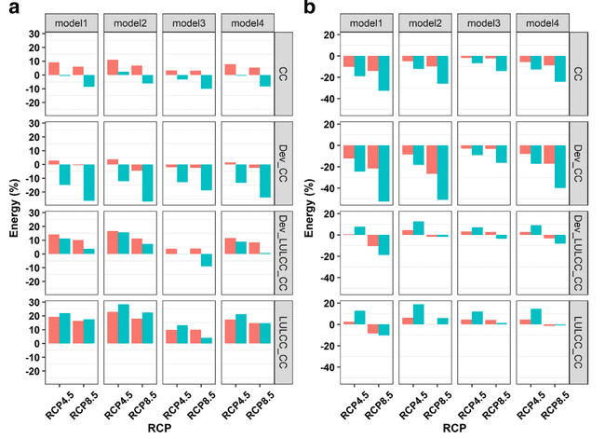

CLIMATE-LAND-ENERGY-WATER NEXUS
Adjarala
Nangbeto
Bui
Dry conditions due to climate change could reduce hydropower generation, while wet conditions may boost it.
Land-use and land-cover changes can help mitigate the impacts of climate change on hydropower production. (Obahoundje et al., 2018)
Climate change impacts on hydropower will intensify with higher GHG emissions and over future periods.
Projected development conditions could further decrease energy production from hydropower.
Land-use and land-cover changes (LULCC) can mitigate climate change impacts on dams, with effectiveness varying by dam (Obahoundje et al., 2021)

Slide 14
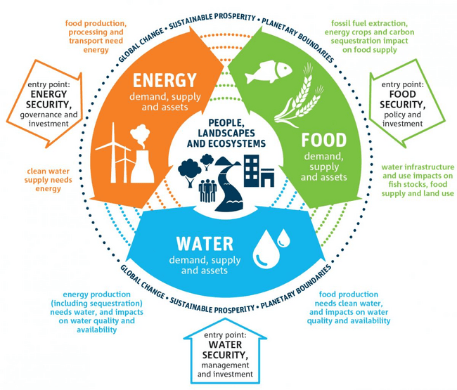
CLIMATE-LAND-ENERGY-WATER NEXUS
The Water-Energy-Food (WEF) Nexus is deeply influenced by land use practices and climate extremes, requiring a holistic, integrated approach to address climate change impacts.
Effective management of climate change impacts on livelihoods depends on considering the interconnectedness of water, energy, food, and health sectors, as changes in one sector can affect others.
A systems-based approach is critical for developing adaptive strategies that strengthen resilience and sustainability, particularly in regions vulnerable to climate-related challenges.
https://geographycasestudy.com/the-water-food-energy-nexus/
SENSITIVE TO CLIMATE EXTREMES
& LULCC

Slide 15
KEY CHALLENGES
Despite the growing risks, adaptation efforts in the region face significant barriers, including :
limited financial resources, weak governance, and insufficient access to technology.
Lack of Infrastructure (non-operational and/or low coverage weather stations, management issue),
Data gap, lack of existing methods, and technologies for river discharge estimation in Africa (Apkoti et al., 2024)
Data accessibility,
Data uncertainties (observed, satellite, reanalysis, models etc.)
Mistrust among stakeholders (Researchers, Decision makers and end users),
Misunderstanding of the data sharing policy
Data commercialization concerns
Historical data digitalization

Slide 16
CONCLUSION
Climate Extremes in West Africa: Climate extremes are significantly impacting water-dependent sectors in West Africa, and these effects are expected to worsen in the future, potentially leading to greater loss and damage.
Vulnerability of Local Communities: Local communities in the region have low adaptive capacity and are highly vulnerable due to fragile infrastructure, making them especially susceptible to the increasing risks posed by climate change.

Slide 17
RECOMMANDATIONS
  Enhance Governance and Infrastructure: Strengthen governance frameworks and invest in robust infrastructure to improve resilience to climate extremes.
  Strengthen Disaster Risk Reduction (DRR) Capacities: Build capacity for disaster risk reduction (DRR), focusing on anticipatory actions and early warning systems.
  Invest in Climate Information Services: Expand investments in climate information services, including early warning systems and anticipatory actions to prepare for future climate risks.
  Develop Harmonized Data Sharing Frameworks: Establish harmonized data-sharing frameworks for better coordination and accessibility of climate-related information.
  Promote Open Access to Local Data: Support the development of open-access datasets tailored to local contexts to enhance decision-making at all levels.
  Foster Joint Initiatives and Partnerships: Strengthen cross-border cooperation and build joint initiatives to address shared vulnerabilities, promoting science-policy partnerships for sustainable solutions.

Slide 18



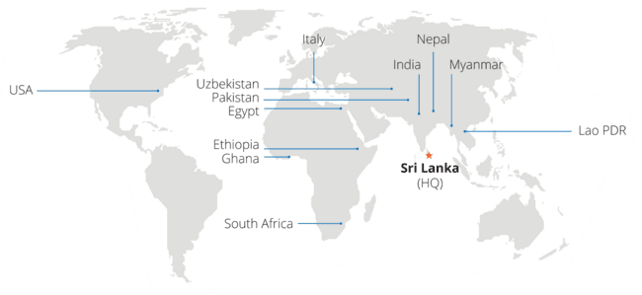
IWMI is Part of the CGIAR
CGIAR a global research partnership dedicated to reducing poverty, enhancing food and nutrition security, and improving natural resources through global and regional initiatives.
Presence in over 75 countries, mostly in developing countries.
Network of more than 3000 partners from national governments, academic institutions, global policy bodies, private companies & NGOs.
IWMI’s role in the partnership is to deliver evidence-based approaches and water solutions for sustainable climate-resilient development.
Science for a Transformative Agenda
IWMI Strategic Programs Addresses Global Water Challenges
Water, food & ecosystems
Water, climate
change & resilience
Water, growth
& inclusion
Water data science & digital innovation How can water management decision-making be supported through data science and digital innovation services

Slide 19
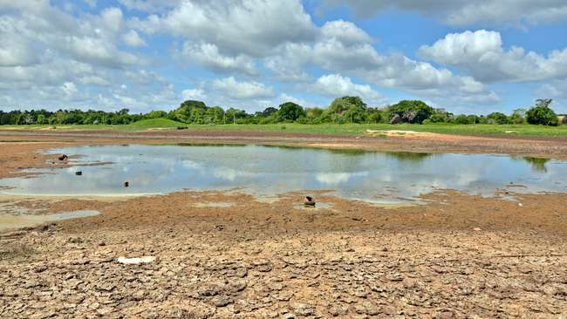

THANK YOU FOR YOUR ATTENTION

Slide 20
REFERENCES
Dajuma, A., Sylla, M. B., Tall, M., Almazroui, M., Afiesimama, E., Dosio, A., ... & Giorgi, F. (2024). Projected intensification and expansion of heat stress and related population exposure over Africa under future climates. Earth's Future, 12(12), e2024EF004646.
Sylla, M. B., Faye, A., Giorgi, F., Diedhiou, A., & Kunstmann, H. (2018a). Projected heat stress under 1.5 C and 2 C global warming scenarios creates unprecedented discomfort for humans in West Africa. Earth's Future, 6(7), 1029-1044.
WASCAL, (2024); Migration Under (Multi)Hazards; BULLETIN NO 1, ISSUE 1
Fotso‐Nguemo, T. C., Weber, T., Diedhiou, A., Chouto, S., Vondou, D. A., Rechid, D., & Jacob, D. (2023). Projected impact of increased global warming on heat stress and exposed population over Africa. Earth's Future, 11(1), e2022EF003268.
UNEP 2020 Water risk and water stress for Africa ; https://www.grida.no/resources/13697
Badou, F. D., Hounkpè, J., Yira, Y., Ibrahim, M., & Bossa, A. Y. (2019). Increasing devastating flood events in West Africa: who is to blame?.
Sylla, M. B., Faye, A., Klutse, N. A. B., & Dimobe, K. (2018b). Projected increased risk of water deficit over major West African river basins under future climates. Climatic Change, 151(2), 247-258.
Sylla, M. B., Pal, J. S., Faye, A., Dimobe, K., & Kunstmann, H. (2018c). Climate change to severely impact West African basin scale irrigation in 2 C and 1.5 C global warming scenarios. Scientific reports, 8(1), 14395.
Obahoundje, S., & Diedhiou, A. (2022). Potential impacts of climate, land use and land cover changes on hydropower generation in West Africa: a review. Environmental Research Letters, 17(4), 043005.
Janes, T., Jones, R. and Hartley, A. 2015. Regional Climate Projections for West Africa. UNEP-WCMC technical report
Akafou et al., (2024). Modeling climate change impacts on inflow and hydropower generation in West Africa using ensemble learning with CMIP6. Under Internal Review
Masolele, R. N., Marcos, D., De Sy, V., Abu, I. O., Verbesselt, J., Reiche, J., & Herold, M. (2024). Mapping the diversity of land uses following deforestation across Africa. Scientific Reports, 14(1), 1681.
Obahoundje, S., Youan Ta, M., Diedhiou, A., Amoussou, E., & Kouadio, K. (2021). Sensitivity of hydropower generation to changes in climate and land use in the Mono Basin (West Africa) using CORDEX dataset and WEAP model. Environmental Processes, 8(3), 1073-1097.
Obahoundje, S., Ofosu, E. A., Akpoti, K., & Kabo-bah, A. T. (2017). Land use and land cover changes under climate uncertainty: Modelling the impacts on hydropower production in Western Africa. Hydrology, 4(1),
Akpoti, K., Mekonnen, K., Leh, M., Owusu, A., Dembélé, M., Tinonetsana, P., ... & Velpuri, N. M. (2024). State of continental discharge estimation and modelling: challenges and opportunities for Africa. Hydrological Sciences Journal, 1-29.
Intergovernmental Panel on Climate Change (IPCC). (2021). Regional Fact Sheet - Africa. In Climate Change 2021: The Physical Science Basis. Contribution of Working Group I to the Sixth Assessment Report of the Intergovernmental Panel on Climate Change. Retrieved from https://www.ipcc.ch/report/ar6/wg1/resources/factsheets/
Intergovernmental Panel on Climate Change (IPCC). (2022). Chapter 9: Africa. In Climate Change 2022: Impacts, Adaptation and Vulnerability. Contribution of Working Group II to the Sixth Assessment Report of the Intergovernmental Panel on Climate Change (pp. 1285-1366). Cambridge University Press. doi:10.1017/9781009325844

