Slide 1
The Donkey Sanctuary: Experiences in implementing public-private partnerships
Tilahun Haile
The Donkey Sanctuary
Public-Private-Partnership for delivery of veterinary services: Review and validation of PPP models for scaling out
ILRI Ethiopia campus, Azage Auditorium, Addis Ababa 27 March 2025

Slide 2
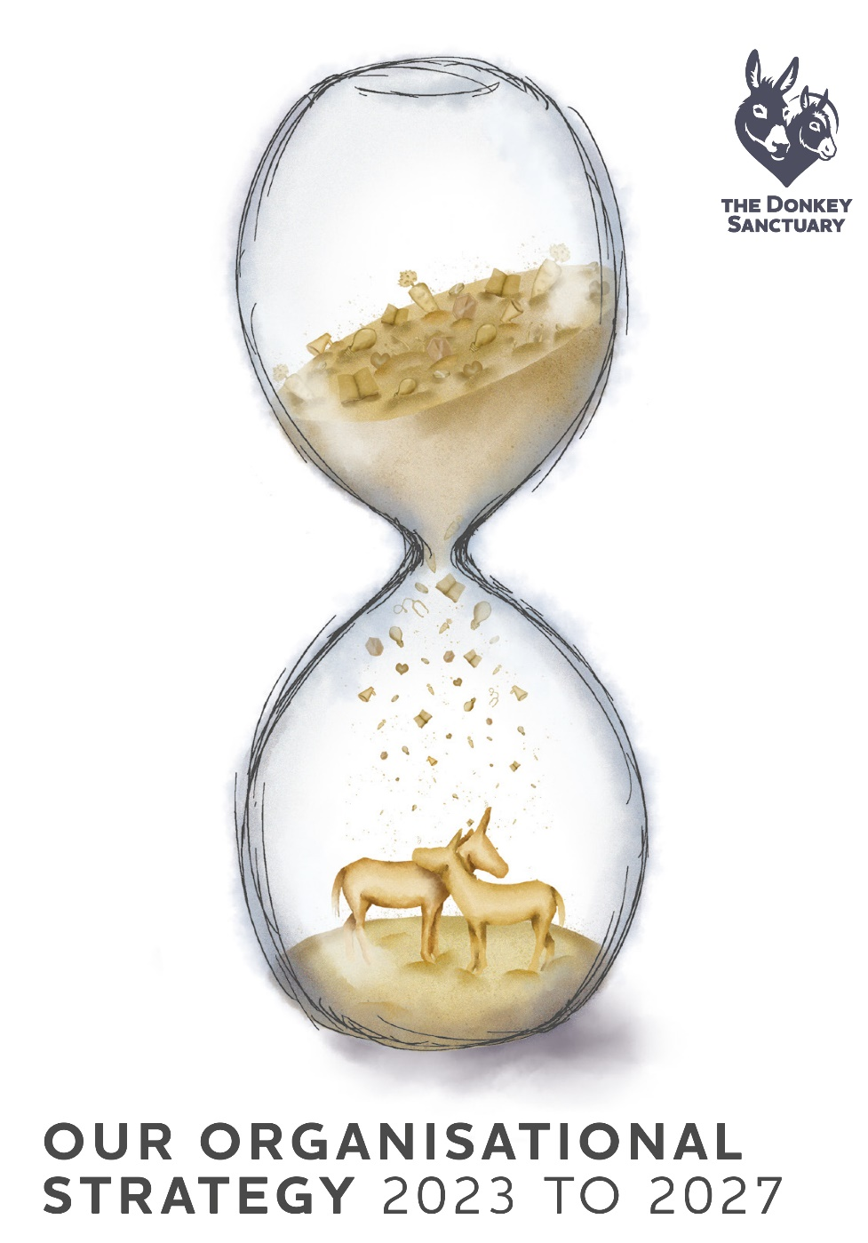
Vision
A world where every donkey has a good quality of life
Mission
Improving the lives of donkeys every day

Slide 3
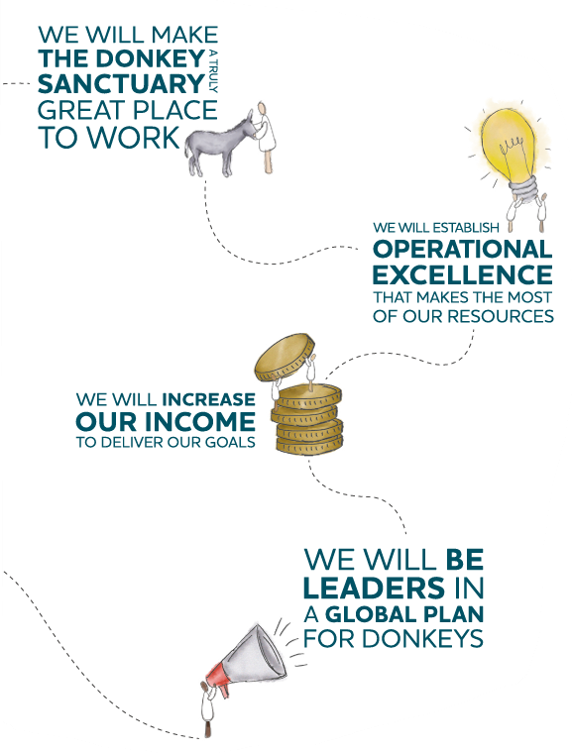

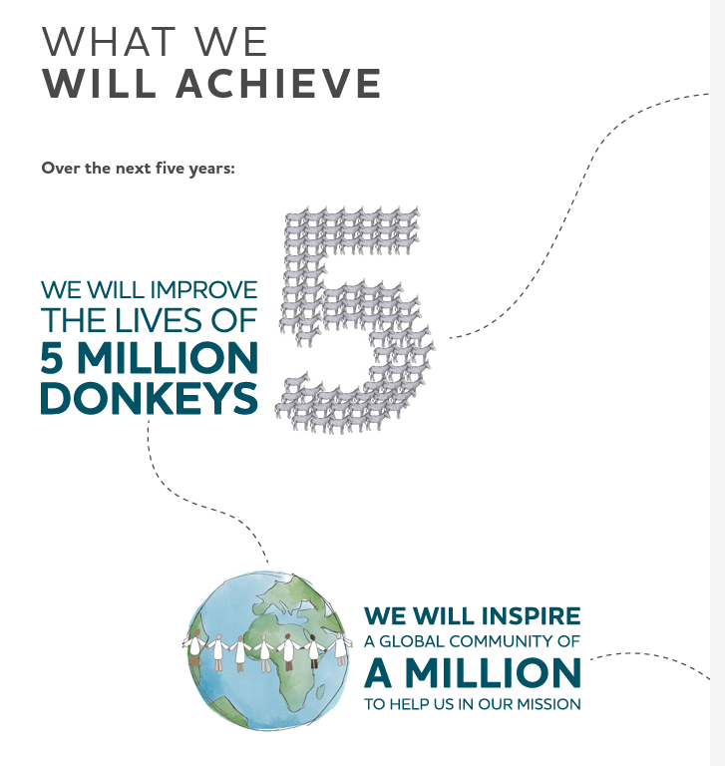

Slide 4
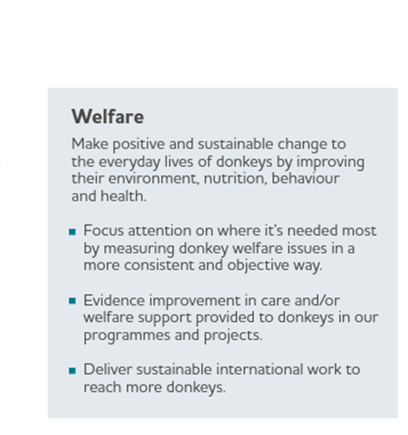
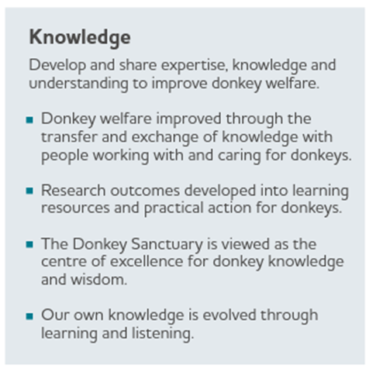
Our strategic Pillars

Slide 5
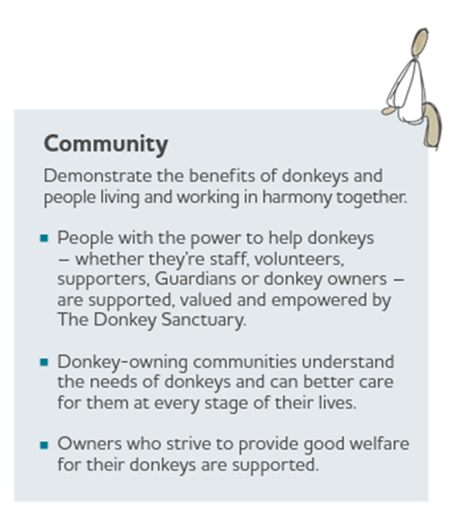
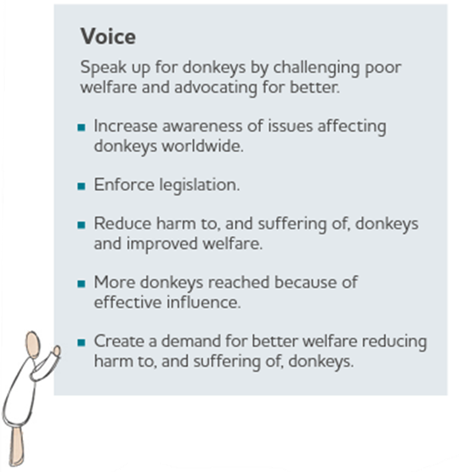

Slide 6
Our International Theory of Change

Slide 7
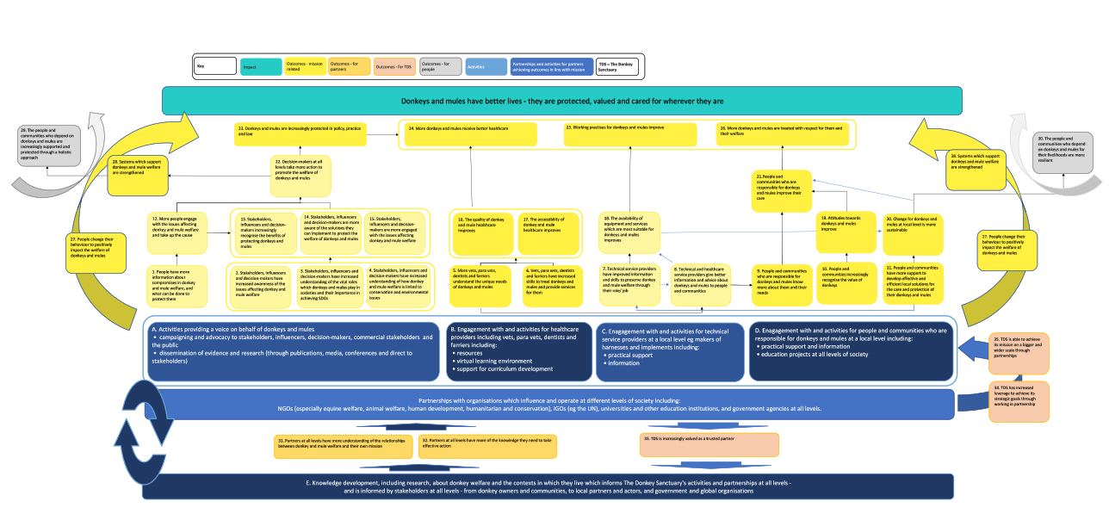

Slide 8
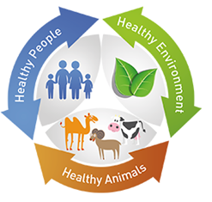
We need to work together to create change
Governmental & non-governmental stakeholders
Animal Healthcare system (demand & supply)
Communities
Owners & handlers

Slide 9
Why does partnering makes sense?
We have more impact through local solutions
We create long lasting sustainable change
We increase our reach
We influence different sectors & communities
We bring others on board our mission
We have access to more resources & expertise

Slide 10
TDS –Integrated Community Based Donkey/Mule Welfare Approach (TDS Direct Implementation Model 2014-2020)
Donkey Health and Welfare
Community Partnership and Education
School Animal Welfare Education
Harness Development
Support govt vet clinics
Establish Model welfare friendly clinics
PP AHP Training (CPD)
Develop Training Resources
Teachers Training
Support Animal Welfare Clubs
Establish Model Club Centers
Training and resources support for local cart and harness makers
Training LS Extension Workers
Community Education
Animal Welfare Committee
Animal Welfare bylaw

Slide 11


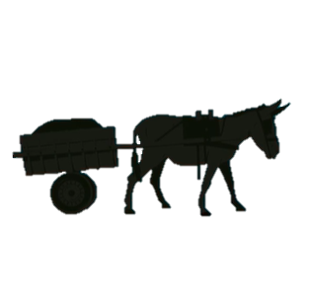

Alage ATVT Partnership Project since 2013- Present
Training components
Practical Training on Donkey Health and Welfare for Animal Health Students
College Instructors’ CPD Training On Donkey Health and Welfare
Students’ Corporate (Real Time) Training in communities
On Job Training for PP Animal Health Workers around the college
Work in Collaboration with MoLS for Curriculum Inclusion and Scaling up
Donkey Cart and Harness Training for Animal Science Students and Local Artisans

Slide 12
TDS -AAU/CVMA Partnership Program
Vet Stu. Eq. Welfare & Med
Veterinary Service Provision
Veterinary Education
Community Engagement
Donkey Health and Welfare (Vet Service)
Clinical Infrastructure & Standard dev’t
CPD for Instructors
CPD for PP AHPs
Support Equ. Research
Community Education
Local Cart & Harness Makers
School AWC
Working with LS Extension & Community Institutions

Slide 13
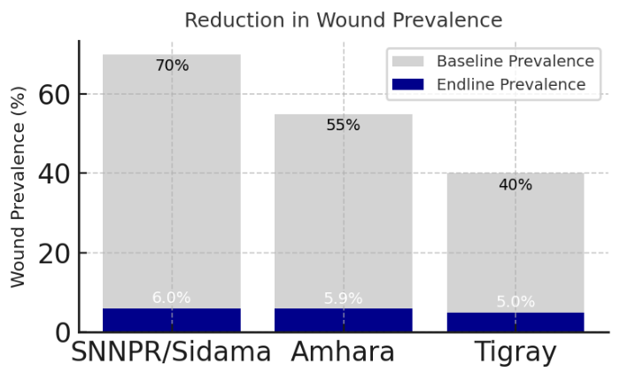
Our Impact (Sample )
Reduction in Wound

Slide 14
Challenges of PPP
Weak (lack of) political and legal framework
Lack of sustainable funding and resources allocation
Weak communication and coordination
Lack of capacity, enabling institutional environment and support system
Lack of monitoring evaluation and learning
Different organizational culture and transparency

Slide 15

Capacity Building
Clear Legal and Regulatory Framework
Sustainable Funding Mechanisms
Effective Communication and Coordination
HR
Co-planning and implementation
Effective and Sustainable Public Private Partnership
Deliver TDS vision and mission internationally
Recommendations
Stakeholder Engagement
Building transparent organizational culture
Finance
Performance Monitoring and Evaluation
Innovative Approaches
Pilot Projects and Scaling Up.

Slide 16
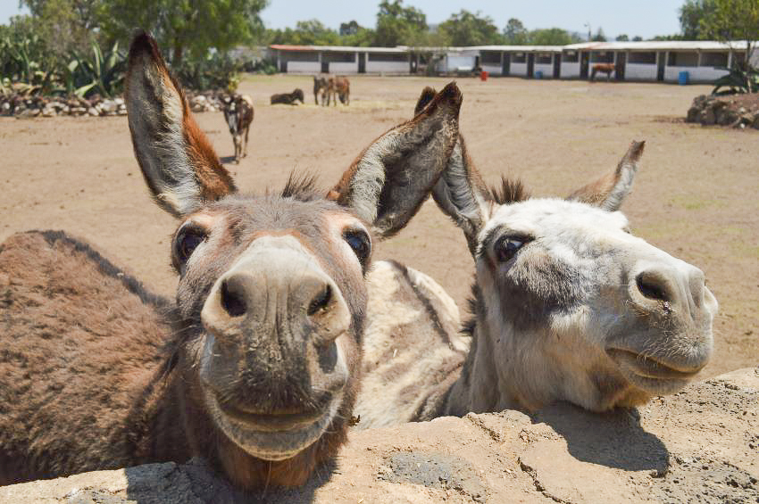
“One plus one makes eleven.”
Kashmiri proverb
Introducing International Meeting 2023

Slide 17
Thank you!

