Slide 1
Employment and inclusive economic growth
Thematic session 1: Sustainable livestock transformation for improved livelihoods, food security and nutrition, and enhanced resilience
Sub-session 1.1: Improved livelihoods, and food security and nutrition
Isabelle Baltenweck, International Livestock Research Institute

Slide 2
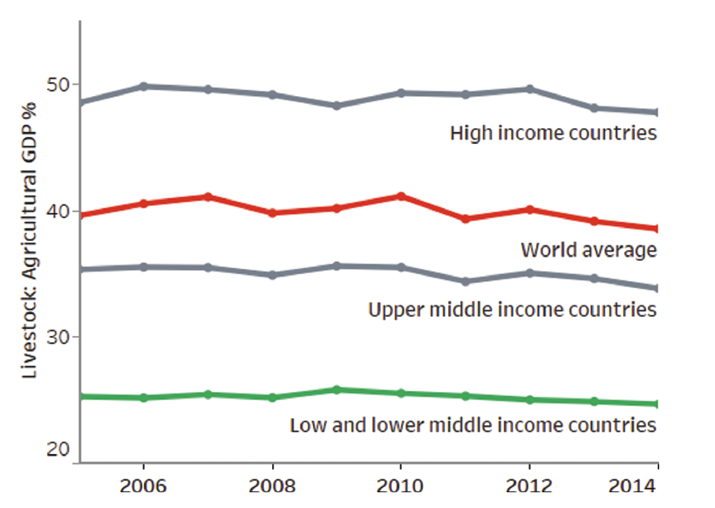
At national level: livestock contributes significantly to agricultural Gross Domestic Product—everywhere
Livestock contributions to agricultural GDP:
Global average: 40%
HIC average: 50%
LMIC average: from 15–80%—and this is growing
As economies grow, the proportion of:
agriculture’s contribution to total GDP shrinks
livestock’s contribution to agriculture GDP rises
Caveat! GDP measures exclude many ‘hard-to-measure’ livestock functions (e.g. manure fertilizer, ecosystem services), especially important in LMICs.
Salmon, G. 2018. Fact Check 2: Livestock and Economy. Does the livestock sector make up 40% of total agricultural GDP globally? http://hdl.handle.net/1842/30115

Slide 3
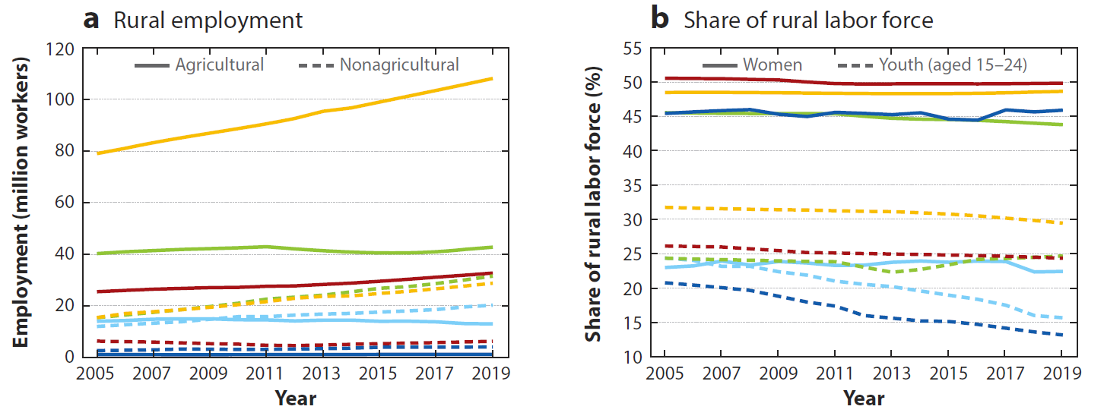
Employment
Overall, livestock sustains the livelihoods of 1.7 billion people globally
  This includes on-farm (households and hired labour) and workers along the livestock value chains
  Scanty data on employment in the LMIC livestock sector
In Africa, agriculture (including livestock) employs most people in the rural areas
FAO (n.d.) Contribution of the livestock sector to food security and sustainable agrifood systems. Draft for consultation. Chapter 4.3
Christiaensen and Maertens (2022) Rural Employment in Africa: Trends and Challenges. Annu. Rev. Resour. Econ. 2022. 14:267–89

Slide 4
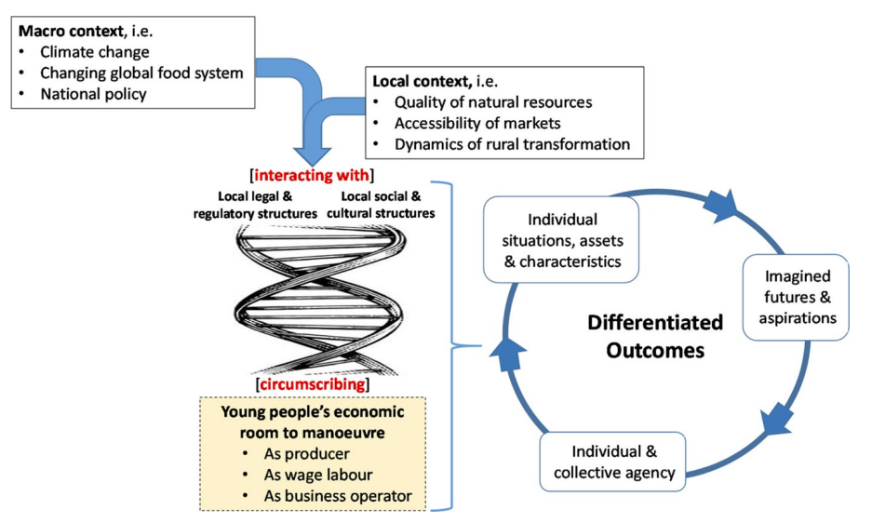
Case of youth employment in livestock
How to provide decent jobs to the growing population, given that Africa population will continue to grow at 2.5% per year in the next decades?
How to support youth’s participation in livestock?
  Various factors at play
  Analysis of youth versus non-youth livestock ownership in East Africa shows no systematic youth-specific trends across the asset ownership, levels of commercialization or market participation
  Education more than age is a determinant factor of market participation
Bullock et al. 2023. Youth engagement in livestock production and marketing in East Africa. Outlook on Agriculture 52(4): 424–433. https://doi.org/10.1177/00307270231215368
International Livestock Research Institute (ILRI). 2019. CGIAR Research Program on Livestock: Youth strategy. Nairobi, Kenya: ILRI.

Slide 5
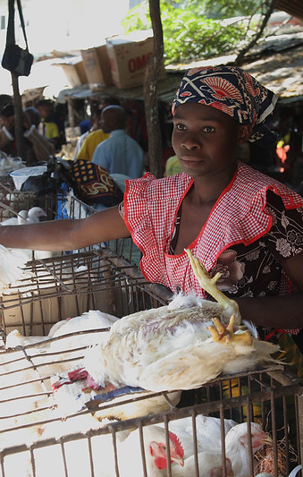
Livestock for gender equity and social inclusion
Animals are often the only productive asset that women are allowed to own and manage
Studies show that increasing women’s roles in livestock decisions is associated with positive impacts on women’s welfare, increased livestock assets, reduced debt, and increased incomes, as well as decreased anxiety symptoms and improved subjective health scores
But development interventions have mixed effects
  Most asset transfer projects combined with extension had positive effects
  Interventions focusing on output markets negatively impacted women’s empowerment
  Gender accommodative approaches had negative or unclear impacts on women’s labour and workloads as the focus is often on increasing incomes
Baltenweck I et al. (2024). Livestock as a Pathway to Women’s Empowerment in Low and Middle-Income Countries: A Scoping Review. The Journal of Development Studies, 60(6), 813–830. https://doi.org/10.1080/00220388.2024.2319072

Slide 6
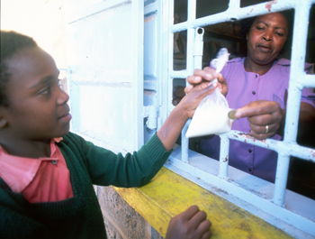

Case of milk traders in Nairobi (Kenya)
Milk is key in people’s diets and most households buy milk from traders due to convenience and lower price
Women represent ~45% of informal milk traders in peri-urban Kenya
Intervention: training-certification-marketing of traders (TCM) to improve children nutrition and health outcomes. How to make the training gender-responsive?
Gender norms restrict women’s mobility, use of public transport, independent use of private motorbikes, interaction with unrelated men
Also, women feel unsafe travelling in remote areas and can’t lift heavy jerry cans (and metal ones compulsory for transport)
Galiè et al., 2022. https://www.tandfonline.com/doi/full/10.1080/09718524.2022.2084491

Slide 7
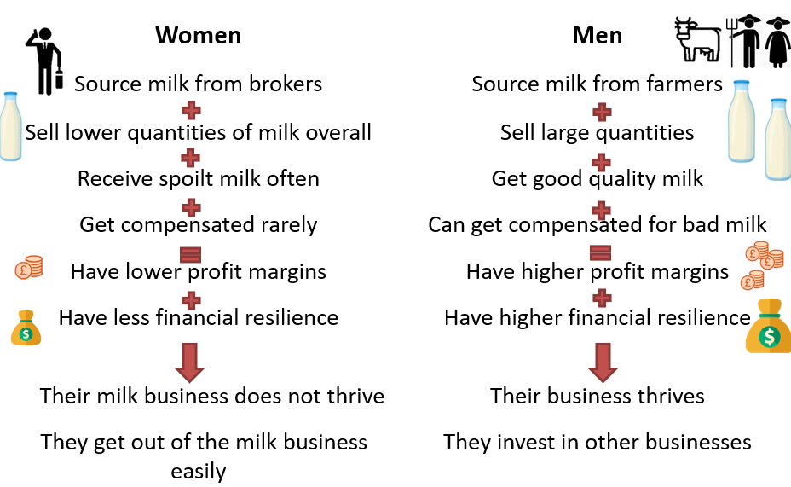
Findings
Men sell milk in large quantities and as main commodity & their milk business thrives
Women sell some milk and other commodities & ‘survive in the milk business’

Slide 8
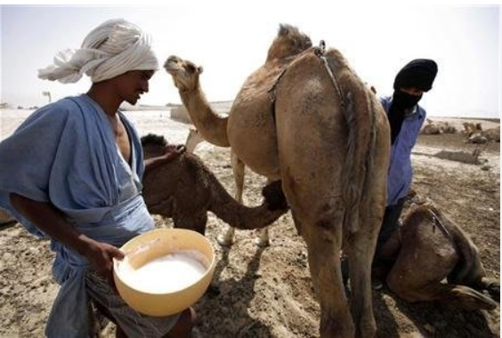
Towards a sustainable and inclusive livestock sector: 5 dimensions of sustainability
Innovations to maximise livestock for nutrition, health & food security
While recognizing the risk of animal-human/emerging diseases and unsafe foods
Innovations for poverty reduction, livelihoods and jobs
While ensuring that the benefits are not restricted to few people
Innovations to enhance gender equity, youth and social inclusion
As gender neutral interventions don’t work and will delay progress towards a sustainable livestock sector
Innovations to achieve climate adaptation & greenhouse gas reduction
While acknowledging barriers to uptake
Innovations towards better environmental health and biodiversity
While mitigating negative impact of livestock on pollution, land/water degradation

Slide 9
Thank you
Contact
Isabelle Baltenweck
i.Baltenweck@cgiar.org

