Slide 1

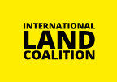
CGIAR-ILC Collaboration
Ruth Meinzen-Dick with Fiona Flintan,
Elizabeth Garner, and Emily Gallagher
Webinar presentation
17 July 2024

Slide 2
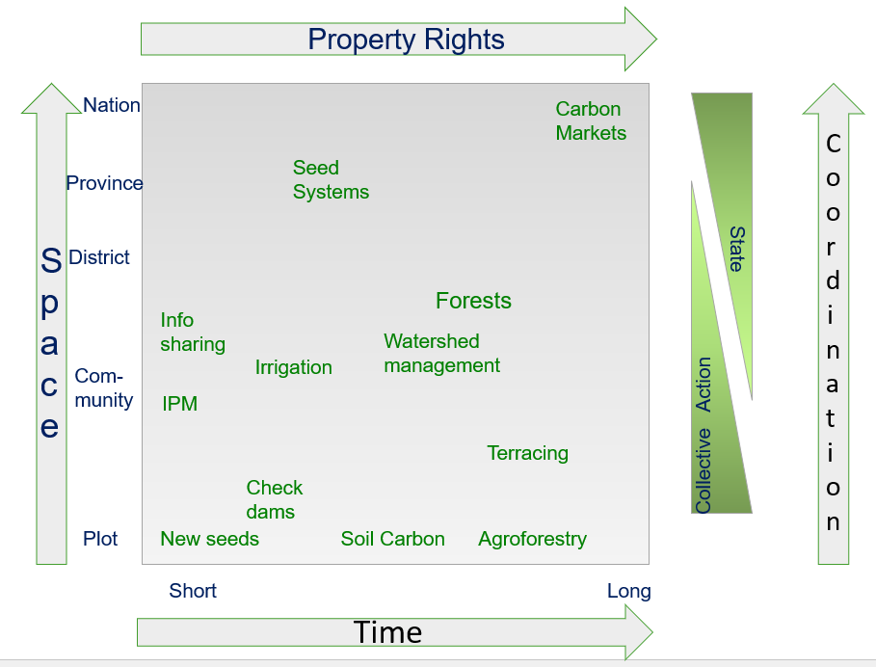
Why CGIAR works on property rights
Technology adoption
Natural resource management
Poverty reduction
Empowerment
  Of women
  Of marginalized communities

Slide 3
CGIAR System-Wide Program on Collective Action and Property Rights
Collaboration with ILC
Importance of common property
Understanding tenure
  Legal pluralism
  Bundles of rights
Commercial pressures on land
Community and Indigenous land rights
Women’s land rights’
Land and water rights
Data
Land Portal
Multistakeholder Platforms

Slide 4
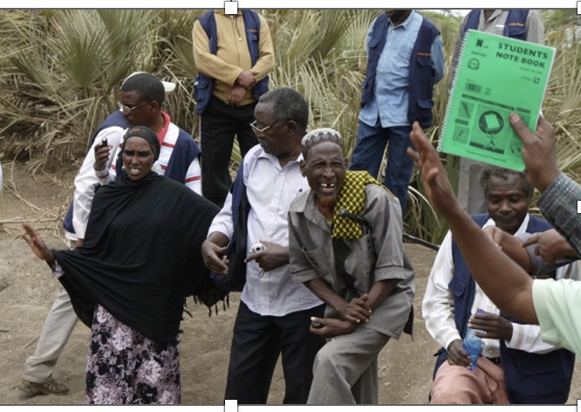
ILC Rangelands Initiative
As a member of ILC, ILRI led the ILC Rangelands Initiative (RI) Africa (and later RI Global.
RI Africa grew from a series of cross-stakeholder learning routes
Now a network of around 30 ILC members, with other regional chapters

Slide 5
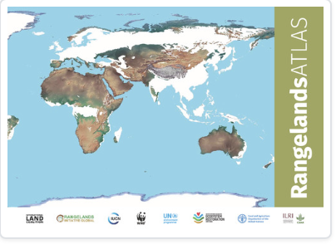
Global Rangelands Initiative
Collaboration between global agencies, CG centers and others on rangelands
Rangelands Atlas
Ongoing collaboration at UNFCCC and UNCCD COPs.
Working together for International Year of Rangelands and Pastoralists 2026

Slide 6
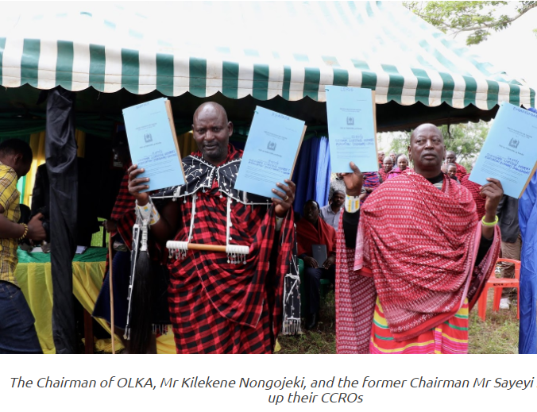
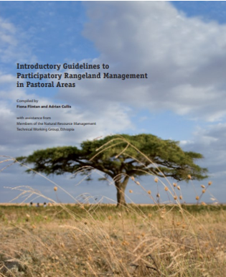
Sustainable rangeland management project
Joint ILRI-ILC-IFAD work to develop new modes of land use planning to secure land rights for pastoralists
Developed CGIAR innovations participatory land use planning across borders and participatory rangeland management
Notes:
This has been really impactful, establishing a new form of land tenure that would recognize pastoralists’ collective land rights. It’s a great example of the collaboration between CGIAR and ILC, because the practice with members informed the development of the guidelines publication, and that approach led to those tenure certificates for the pastoralists

Slide 7








SECURING WOMEN’S RESOURCE RIGHTS THROUGH GENDER TRANSFORMATIVE APPROACHES
Notes:
Objectives: To enhance the recognition and protection of women's land rights in targeted countries.
To contribute to the creation of conditions that would enable women's enjoyment
of land rights over time

Slide 8
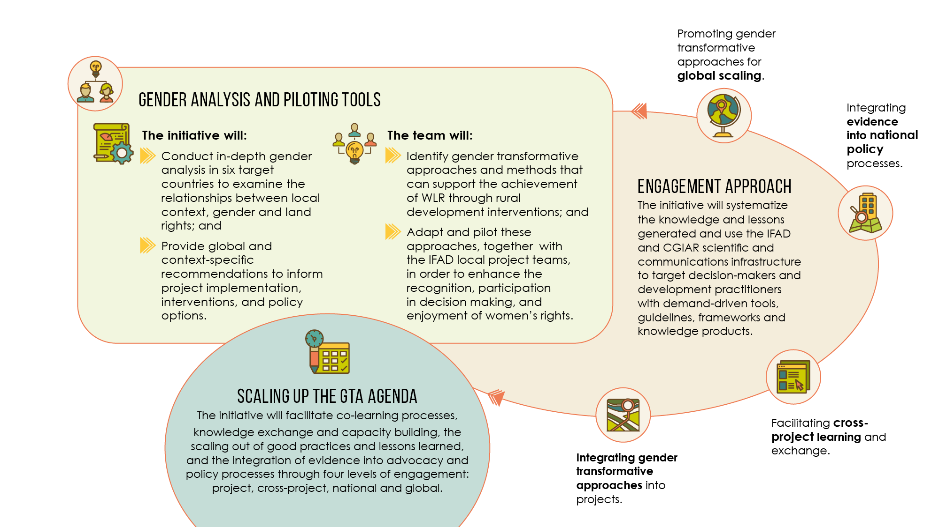

How?

Slide 9
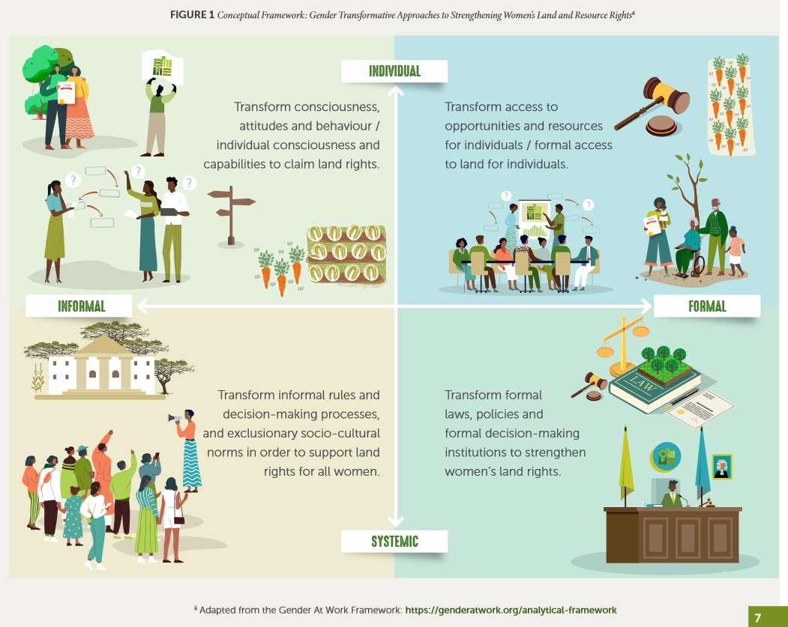
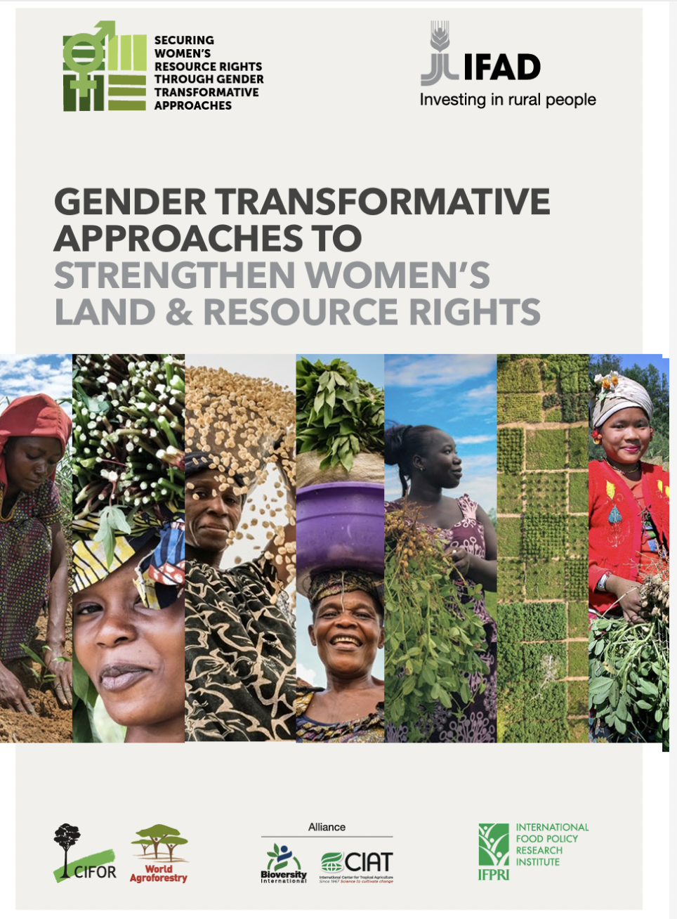
Gender Transformative Approaches
(Morgan et al. 2023)
https://forestsnews.cifor.org/83972/new-strategies-needed-to-uproot-deep-barriers-to-land-resource-rights-for-women?fnl=en
Notes:
Results included: High level conceptual consideration of GTAs and their relationship to women’s land and resource rights
New strategies needed to uproot deep barriers to land, resource rights for women
Adding to the conversation:
Multiple definitions and approaches
Applying conversation to land and resource rights
Adapting Gender @ Work:
Formal – Informal;
Individual – Systemic

Slide 10
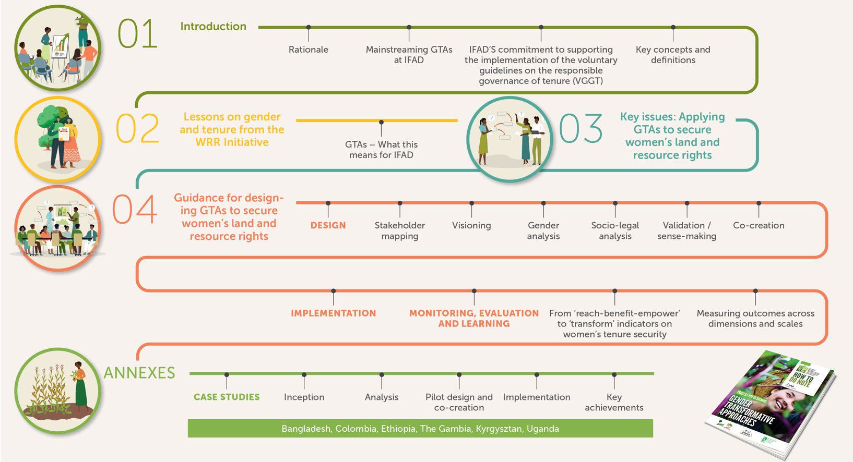
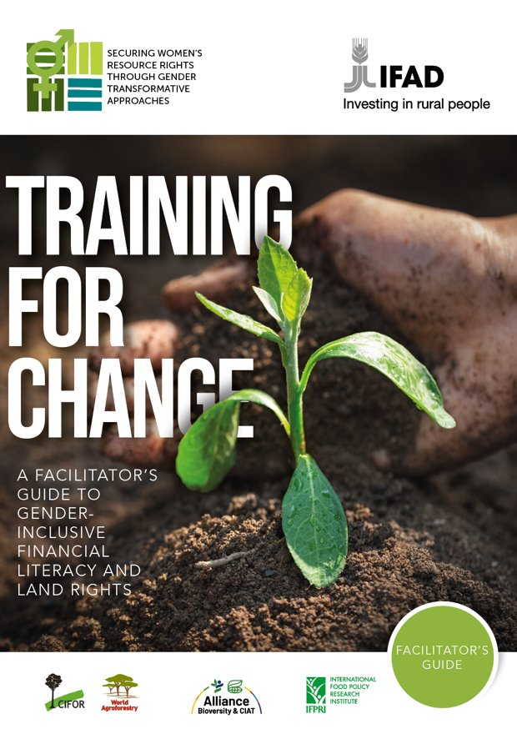
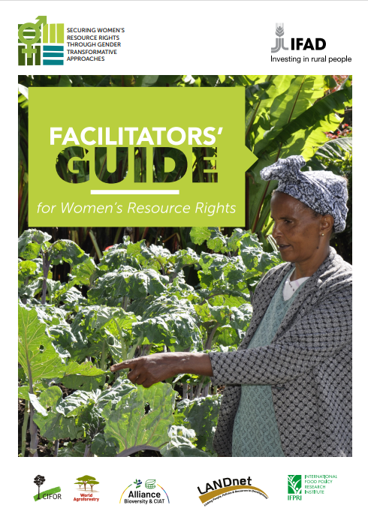
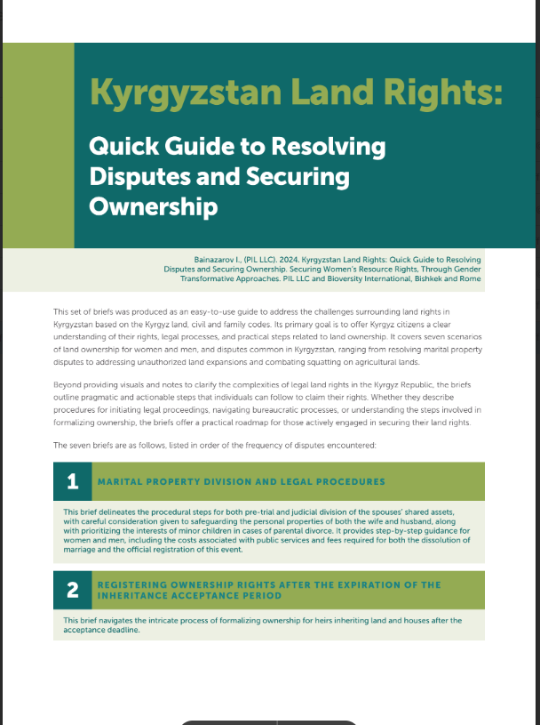
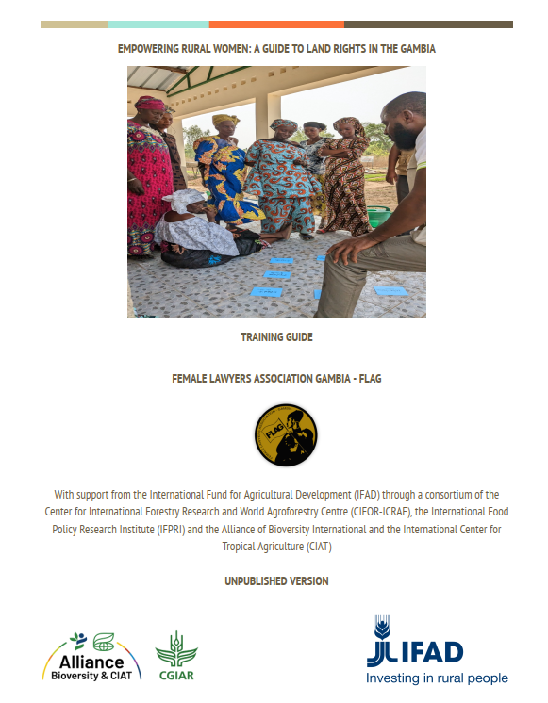
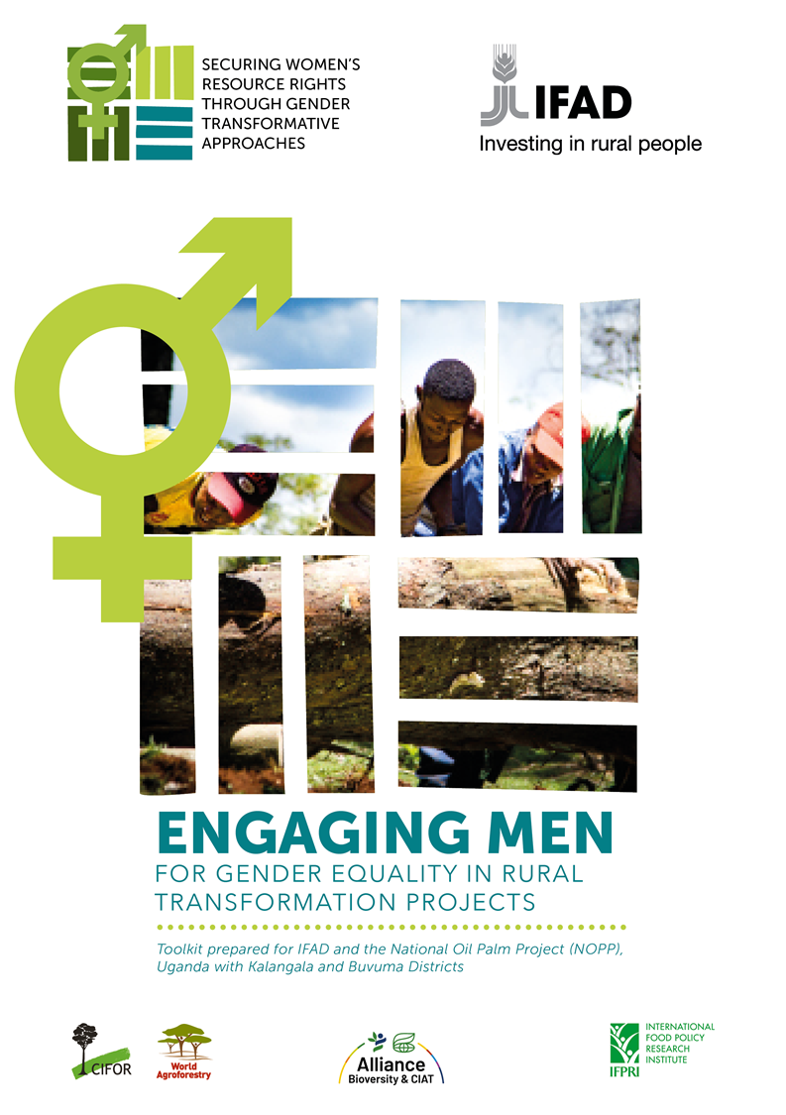
WRR Knowledge Outputs: Tools and Guidance
Financial Literacy
Legal Guidance
Addressing Social Norms
How-to-do Note: Process for designing and integrating GTAs

Slide 11
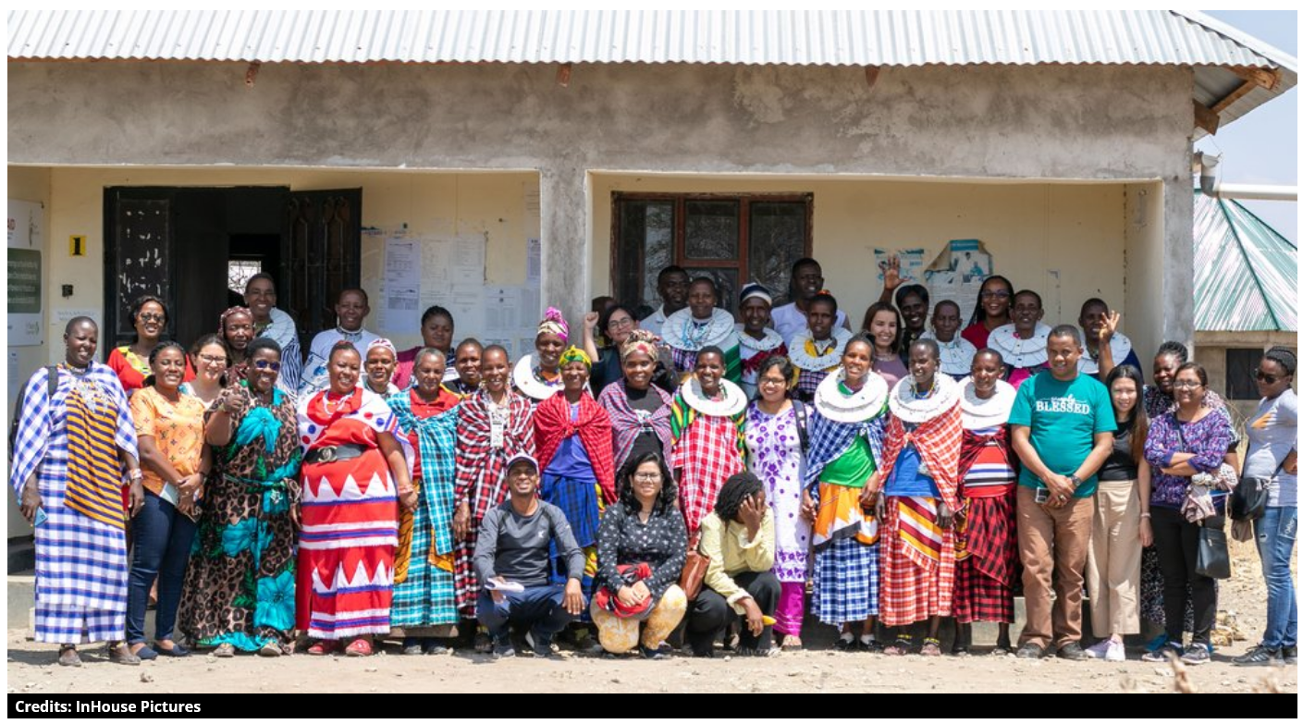
ILC Vision for Gender Transformative Change
Summary of vision from WRR-ILC workshop in Tanzania:
Knowledge, demand, security, and enaction of women’s land rights
Everyone is aware of the benefits of women owning land and recognize women in their role as farmers and producers
Women are respected and listened to and actively and meaningfully participate in and lead in making decisions and influencing change
Men are champions and supporters of women as landowners
Women enact their collective power to influence
change that reaches all women, in all their diversity
Notes:
Vision: https://www.landcoalition.org/en/latest/gender-transformative-change-tanzania/
Miranda’s blog: https://alliancebioversityciat.org/stories/principles-for-gender-transformative-approaches
Benefit of partnership:
Part of the workshop was to co-create a vision for ILC members on what gender transformation would look like in the future. The insights and experiences of ILC members became a critical influence in our process in co-creating gender transformative approaches to integrate into IFAD projects.

Slide 12
CGIAR-ILC collaboration on this project
Hosting regional ILC office
Collaboration on COP side event
Workshop about ILC at project final workshop
Uganda National Learning Exchange led by LANDNet, with NLC
ILC review of socio-legal analysis
Participated in validation of Legal Empowerment Clinic Tookit
Participation in World Bank Land Conference session

Slide 13
Value(s) of CGIAR-ILC Partnership
Identifying key research questions, needs, demands
Partners with civil society, development partners on the ground
  Knowledge of local conditions
  Review and validation
  Mutual learning
Amplifying impact
  Local, national, global level dialogues
  Mutual benefit for CGIAR and ILC

Slide 14
Resources
McLain, Rebecca. 2021. Tenure security research: Key findings and lessons learned. https://ebrary.ifpri.org/utils/getfile/collection/p15738coll2/id/134937/filename/135146.pdf
Kristjanson, Patricia. 2021. Gender, tenure security, and landscape governance: Synthesis of studies of PIM’s Governance of Natural Resources flagship program 2013-2020 https://ebrary.ifpri.org/utils/getfile/collection/p15738coll2/id/134933/filename/135145.pdf
Swallow, Brent M. 2021. Tenure security: Why it matters. https://doi.org/10.2499/p15738coll2.134784
Jhaveri, Nayna. 2021. Gender, tenure security, and landscape governance. https://doi.org/10.2499/p15738coll2.134790
Johnson, Nancy L. 2021. Natural resource tenure and governance for human nutrition and health: Linkages and priorities for agricultural research and development. https://doi.org/10.2499/p15738coll2.134786
McCarthy, Nancy. 2021. Tenure security, landscape governance, and climate change: A research agenda. https://doi.org/10.2499/p15738coll2.134776
Oyono, Phil René. 2021. Poverty, tenure security, and landscape governance: Exploring inextricable interdependencies for science, policy, and action. https://doi.org/10.2499/p15738coll2.134791
Resources, Rights and Cooperation: A Sourcebook on Property Rights and Collective Action for
Sustainable Development http://www.capri.cgiar.org/sourcebook.asp
https://pim.cgiar.org/research/f5/

