Slide 1


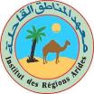
Webinar series on:
Land and Natural Resource Governance, Planning and Management
Research investments in institutional innovations: the case of rangeland governance in Tunisia:
1 - Background on IFAD-CGIAR-NARS collaboration in South Tunisia
July 2020.
Team: Aymen Frija, Mongi Sghaier, Mariem Sghaier, Mondher Fetoui, and Boubaker Dhehibi.

Slide 2
Projects led by ICARDA and NARS (INRAT-IRA) to support IFAD investments in South Tunisia
“Developing Sustainable Livelihood of Agropastoral Communities of West Asia and North Africa Mashreq-Maghreb” (M&M projects)
  Start year 1998. Three phases 1998- 2010.
  Six (06) countries involved: Algeria, Iraq, Jordan, Lebanon, Libya, Morocco, Syria, and Tunisia Co investment from AFESD
2008-2010, Project on « Réhabilitations, conservations et promotion des plantes aromatiques et médicales ».

Slide 3
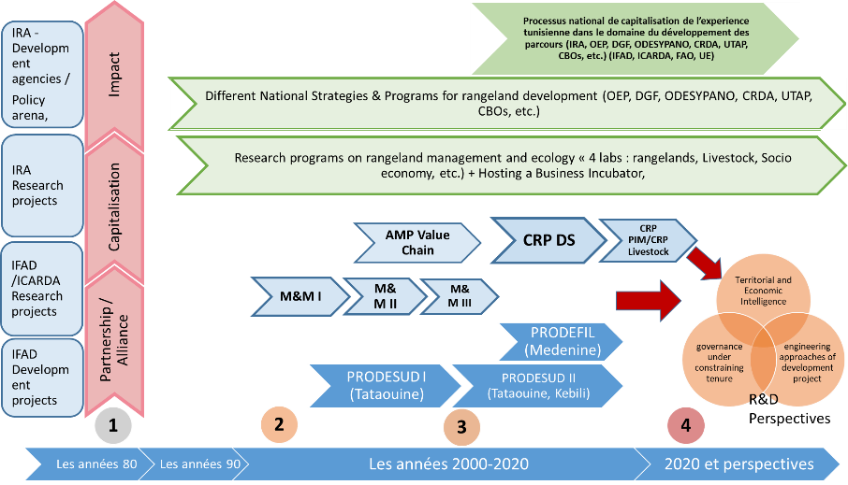
How these projects have been embedded into an overall R&D landscape?
?
CGIAR-IFAD-NARS (INRAT & IRA)
CGIAR-NARS
Nested into larger national programs and investment projects,

Slide 4
Research themes – in relation to land tenure security
Most of these projects were focusing on the below key questions :
How can we ensure enhanced livelihoods of agropastoral communities through better crop-livestock practices
Technologies are not sufficient! Land tenure is a constraint, and there is a need for collective action and communities organizations.
What is the best way to organize communities and which empowerment activities are needed?
    Increasing understanding that the problem of pastoral development is highly intricated into social and economic development dimensions

Slide 5
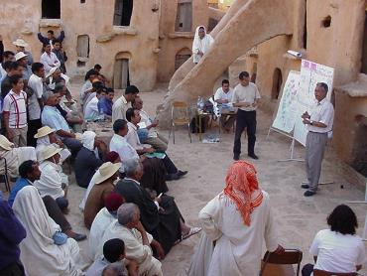
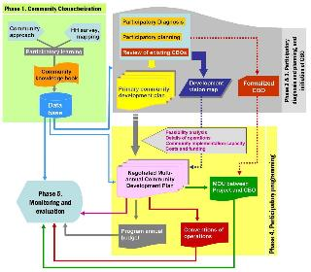
Some Examples of Achievements – Guides for “Community Development Plans”
Development of methodological approaches for participatory community development (Tunisie/ICARDA/FIDA)
Development of a protocol (Guide/manual) for the elaboration of participatory community development plans.
Training and assistance to the project management unit.
Credit. ICRDA, Nefzaoui A.
Nefzaoui et al., 2006

Slide 6
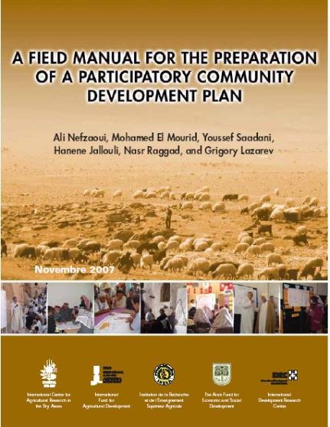
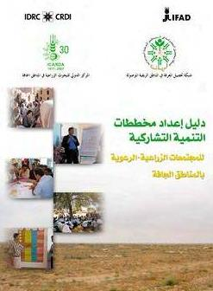
Some Examples of Achievements
Source: Nefzaoui et al., 2009. Presentation.

Slide 7
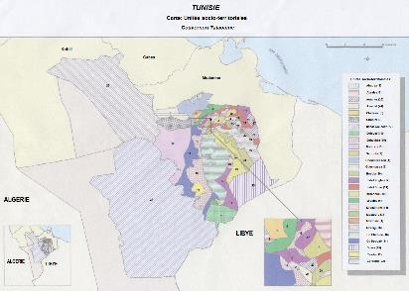
Some Examples of Achievements – “UST”
Use of the concept of « Social-territorial units » (Les Unités Socio - Territoriales UST) as a basis for the definition and creation of farmers associations (for rangeland management)
Early tentative to provide a solid basis for the newly created rangeland farmers associations.
The objective is to ensure a social and territorial harmony and avoid conflicts over collective rangelands.
It gave a good start – some revisions are needed today!
Source: M&M Project reports

Slide 8
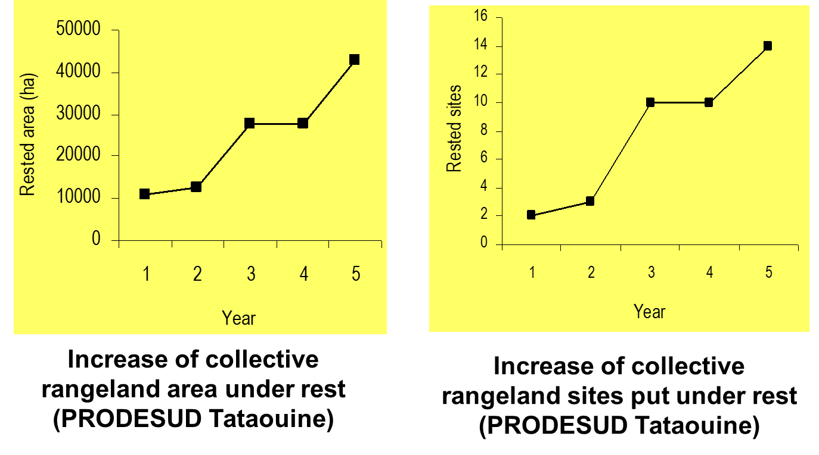
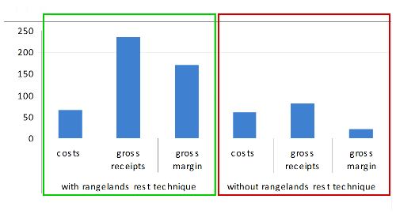
Some outcome stories – Large areas rested and impact on income
Increase in the number of rangelands areas and sites under rest.
Positive impact on farmers income and livelihood were assessed at that time.
Change of mindset and practices towards larger collective participation
Source: Nefzaoui et al., 2009. Presentation.

Slide 9
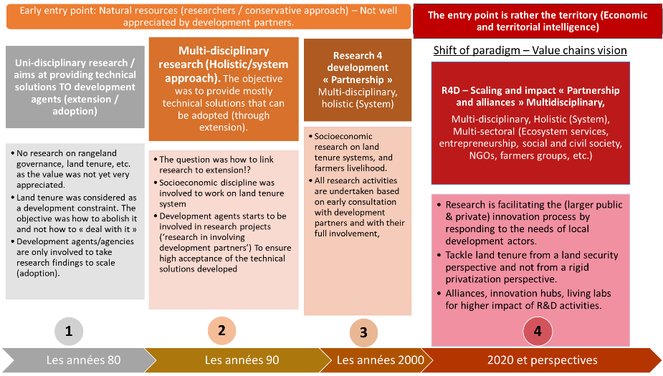
Entry points of R&D projects: a change of paradigms
Source: Own Elaboration by Sghaier & Frija 2020..

Slide 10
Main conclusions
Mixed performances of GDAs, which continue to have a strong effect on rangeland governance (as will be shown in the next presentation).
Many of the tools, manuals, approaches which have been developed through previous projects are being used, but we also need up to date development engineering tools.
Need for new value chain and entrepreneurship guidelines to align with the new IFAD approaches.

