Slide 1




Co-infection with Rift Valley fever virus, Brucella spp. and Coxiella burnetii in humans and animals in Kenya: Disease burden and ecological factors
Bernard Bett
International Livestock Research Institute
Inaugural workshop of a bio-surveillance project on Rift Valley fever, brucellosis and Q fever
Nairobi, Kenya, 3 September 2019

Slide 2
Institution
International Livestock Research Institute | Bernard Bett, Sam Oyola, Johanna Lindahl, veterinary epidemiologists, Elisha Mutinda, Stella Ikileng
Washington State University (WSU) | Kariuki Njenga, microbiologist
Zoonosis Disease Unit/Ministry of Agriculture, Livestock and Fisheries | Mathew Muturi, veterinary epidemiologist
Zoonosis Disease Unit/Ministry of Health | Athman Mwatondo, medical epidemiologist
Kenya Wildlife Service | Francis Gakuya, Wildlife veterinarian and scientist
Los Alamos National Laboratory | Patrick Chain, Jeanne Fair, Tracy Erkkila (molecular scientists), Andrew Bartlow, postdoc scientist
University of Nairobi | Joshua Amimo, molecular scientist, Sally Bukachi, anthropologist
Kenya Medical Research Institute | Konongoi Limbaso, Victor Ofula, Lubano Kizito

Slide 3
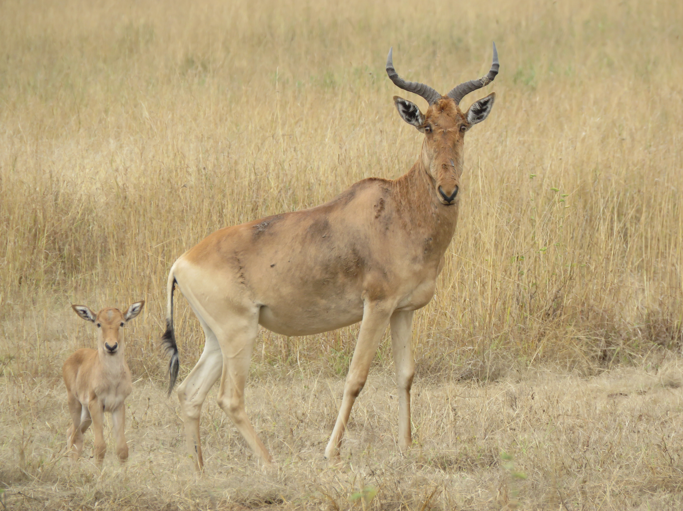
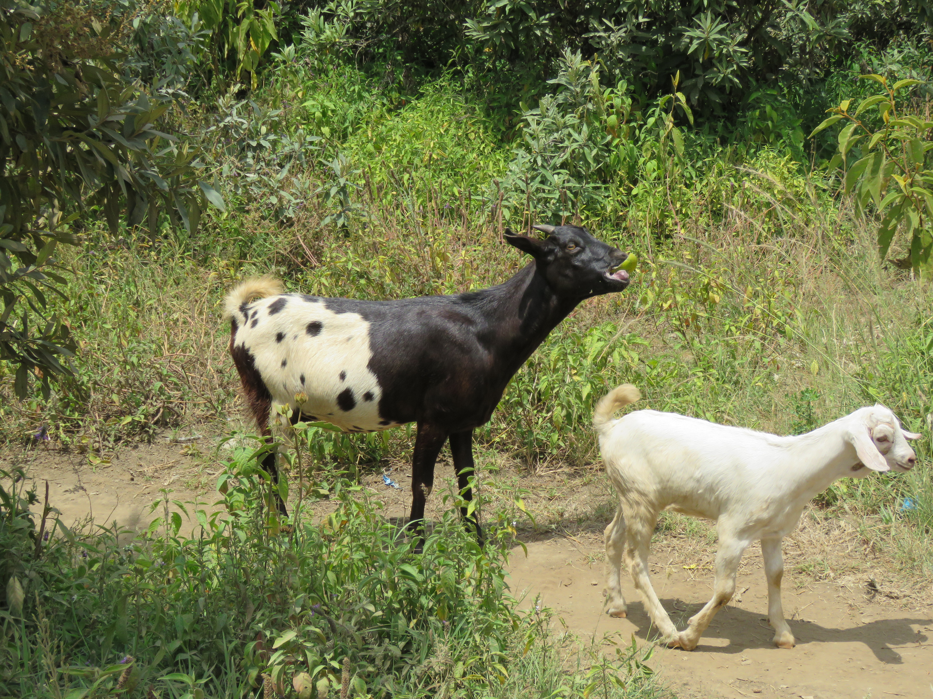
The project
Three-year bio-surveillance study in northeastern Kenya
  Rift Valley fever virus, Brucella spp. and Coxiella burnetii
  All are priority zoonotic pathogens in Kenya (ZDU)
Components:
  Retrospective analysis of archived human and animal samples from various sources – risk mapping
  Active surveillance for these agents in selected humans, livestock and wildlife – estimate burden
  Genotyping isolated pathogens – characterize pathogens
  Biosafety and biosecurity trainings will also be offered to key personnel - first line responders, animal and human health workers and wildlife personnel - build capacity
This project contributes to objectives of C-WMD by:
  Establishing the burden of these pathogens and defining their ecological drivers to inform interventions
  Building capacity on biosafety and biosecurity practices

Slide 4







Key Partners and regions of study
ILRI – overall implementation and reporting
Zoonosis Disease Unit – surveillance in animals and humans
Kenya Wildlife Service – surveillance in wildlife
Kenya Medical Research Institute – biosafety and biosecurity training/human health research
Washington State university – Serology of stored serum samples
Los Alamos National Laboratory – Sequencing and bioinformatics
University of Nairobi – anthropology/gender studies

Slide 5
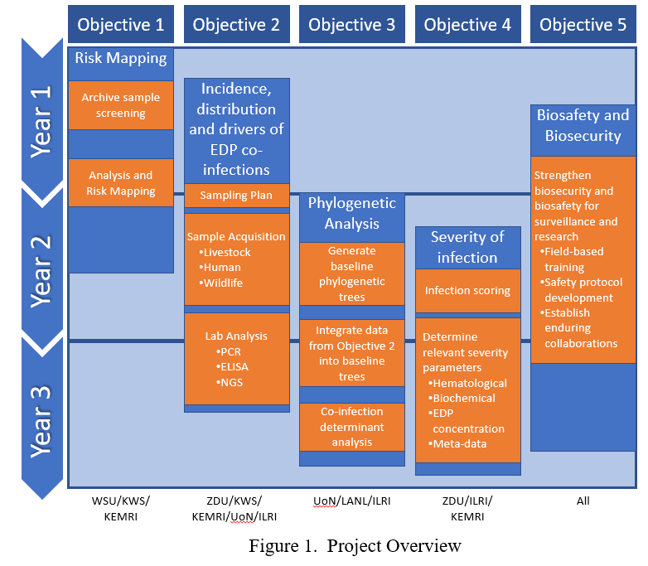
Timeline and major milestones
Year 1: September 2019 – August 2020
Conduct biosafety and biosecurity trainings
Complete serological analyses of stored human, livestock and wildlife samples
Develop risk maps for the three target pathogens
Select study areas for bio-surveillance work
Year 2: September 2020 – August 2021
Commence bio-surveillance activities (field and laboratory work)
Conduct metagenomic and phylogenetic analyses of detected pathogens
Train local researchers on metagenomic and phylogenetic analyses
Year 3: September 2021 – August 2022
Complete bio-surveillance activities (field and laboratory work)
Complete metagenomic and phylogenetic analyses of detected pathogens
Conduct severity studies in humans
Project overview

Slide 6
Project management tools
Communication plan – 1st quarter
Internal communications
External communications
Risk communication
Data management plan
Identify all the sources of data, data types, formats, storage
Data sharing and roles
Animal use and ethics
Commenced filling out the requisite forms
Compliance monitoring

Slide 8
Task 1: Risk mapping of RVFv, Brucella spp. and C. burnetii based on analysis of stored serum samples
Prof. Njenga Kariuki, WSU
Objective
  To develop risk maps for RVFv, Brucella spp. and Coxiella burnetii based on serological analysis of stored serum samples
Background
  Maps of disease distribution/intensity useful for:
      Visualizing the extent and magnitude of a public health problem
      Evaluating advantages and disadvantages of alternative surveillance and control options
      Documenting baseline levels of disease before an intervention is conducted
  Maps of RVF have been produced, but requires refinement. Development of maps for brucellosis using DDSR data -- ongoing. No plans have been made to map Q fever
  However, maps based on disease outbreaks/clinical cases alone (such as those for RVF) have some limitations – biased to conditions that favour “disease presence”, and hence low predictive power
  Serological data – added advantage of identifying areas where endemic transmissions occur
  A comparison of various types of maps – based on serological data, disease occurrence, vulnerability indices provide useful insights on the distribution of disease risk

Slide 9
Task 1: Risk mapping
Approach:
  Prepare an inventory of projects that have collected serum samples in livestock, human and wildlife throughout the country and establish required partnerships for the work
  Review the list of samples that are available and select a subset based on predetermined criteria such as:
    Sample storage conditions
    Geographical regions covered
    Ethical approvals
      Number of samples required: ~2000 each from humans and cattle, and wildlife samples that will be available
  Conduct serological analyses for all the three pathogens
  Use spatial statistical analyses to generate risk maps – considering current socio-ecological scenarios and those for the future 30 – 50 years based on predicted changes in climate, land use change and socio-economic scenarios
  Disseminate risk maps through journal publications, stakeholder meetings and conferences, trainings e.g. those for FELTP

Slide 10
Task 1: Risk mapping
Schedule:
  Year 1
Output:
  Refined risk maps for each pathogen for the current and future (30 – 50 years)

Slide 11
Task 2a: Burden of of RVFv, Brucella spp. and C. burnetii in livestock
Dr. Mathew Muturi, ZDU/DVS
Objectives
  To determine the incidence and risk factors for RVFv, Brucella spp. and C. burnetii in single/joint infections in livestock in selected counties in northern Kenya
  To estimate economic impacts associated with these diseases in these livestock production systems
Background
  Multiple cross-sectional serological studies on RVFv, Brucella spp. and C. burnetii have been done in various parts of the county
  Prevalence estimates obtained – variable, ranging 3 – 20%. RVFv prevalence often higher in cattle while Q fever often higher in goats
  Data gaps – incidence, drivers and socio-economic impacts to determine burden to individual diseases as well as their co-infections
  Evidence from recent studies show these diseases co-occur either at the host or area levels

Slide 12
Task 2a: Burden in livestock
Approach:
  Characterization and selection of study villages (n = 22) in 4 counties - Isiolo, Marsabit, Wajir, Garissa
    Sample size estimated using standard epidemiological approaches
    Field visits to all the target counties to obtain background information for site selection
    Collation of secondary/surveillance data
    Participatory epidemiological studies to obtain perceptions on the prevalence of these diseases from pastoral communities
  Establish active surveillance teams at each county.
    1 vet, 2 AHAs and 6 community disease reporters per county to cover 6 villages
    ZDU unit – technical team to lead biological sampling
  Active surveillance
    Selected villages will be put under active surveillance for one year
    Syndromic surveillance and biological sampling

Slide 13
Task 2a: Burden in livestock
Approach:
  Syndromic surveillance
    Sensitize communities on lay case definition for cases of interest
    Develop SMS codes or USSD lines which communities can report cases
    Routine visits to the study sites by AHAs (motor-bikes to be provided)
    Vets collect reported syndromes and post them to an on-line portal managed by DVS
  Biological sampling
    Systematic random sampling of every 10th case that fits the case definition for sampling
    ZDU team – visit for sample collection based on reports received from the county vets
    All the required metadata will be collected on the host, household, village at the time of sampling
    All samples will be screened using ELISA tests and those that turn positive will be screened further with PCR at ILRI
  Data management and analysis
    A relational database will be established and shared with all the partners
    The database will contain scripts for automated analyses to show trends
    Other datasets from meteorological department, census, on-line GIS databases will be collated for multivariable analyses

Slide 14
Task 2a: Burden in livestock
Schedule:
  Year 1 – selection of study sites
  Year 2 – commencement of longitudinal surveillance study
  Year 3 – completion of longitudinal surveillance study
Outputs:
  Estimates of burden attributable to the target pathogens as well as their co-infections
  Refinement of the existing surveillance systems at the county level

Slide 15
Task 2b: Occurrence patterns of RVFv, Brucella spp. and C. burnetii in wildlife
Dr. Francis Gakuya, KWS
Objectives
  To determine the prevalence and occurrence patterns of RVFv, Brucella spp. and C. burnetii in various species of wildlife in selected counties in northern Kenya
Background
  About 5% and 11% of buffaloes have been found to have both Brucella spp. and C. burnetii and RVFv/C. burnetii antibodies (Cook et al., 2017)
  Other hosts that can act as reservoirs for these pathogens are wildebeests, various antelopes e.g. impalas, etc. A lot of effort has particularly been directed at identifying wildlife reservoirs for RVF
  Interaction between livestock and wildlife is common in pastoral communities and back-and-forth transmission of these pathogens is thought to occur routinely
  Knowledge on occurrence patterns of these pathogens in livestock, and their transmission patterns between wildlife and livestock is relevant for surveillance and control policies

Slide 16
Task 2b: EDPs in wildlife
Approach:
  Participate in the selection of the study sites
  Surveillance plan: opportunistic sampling of clinical cases identified from KLWSS and affected animals will be captured and sampled
    Opportunistic sampling
    The DVS works with the KWS on disease surveillance under the KLWSS
    Cases in wildlife with abortion, emaciation, weakness, and fever and other related disease syndromes will be sampled and screened for these pathogens using ELISA and PCR kits at ILRI
    Routine procedures for immobilizing animals will be used
    Capture and sampling of target species (Active surveillance – longitudinal studies)
  Data management and analysis

Slide 17
Task 2b: EDPs in wildlife
Schedule:
  Year 1 – selection of study sites
  Year 2 – commencement of longitudinal surveillance study
  Year 3 – completion of longitudinal surveillance study
Output:
  Prevalence of EDPs in selected wildlife species

Slide 18
Task 2c: Burden of of RVFv, Brucella spp. and C. burnetii in humans
Dr. Athman Mwatondo, ZDU/MoH
Objectives
  To determine the incidence and risk factors for RVFv, Brucella spp. and C. burnetii in single/joint infections in humans in selected counties in northern Kenya
  To determine whether the severity of illness varies with pathogen strains and number of EDP infections observed
Background
  The prevalence of RVFv, Brucella spp. and C. burnetii in pastoral areas in Kenya is quite high. A study conducted by Osoro et al. showed a high prevalence of >40% of brucellosis in humans
  A strong association between the presence of livestock and human seropositive cases at the household and area levels – an observation that can be used to design One Health surveillance
  No studies have been done to determine the incidence of these diseases and their impacts on human health – this can aid decision making, especially on levels of investments required to mitigate health impacts

Slide 19
Task 2c: Burden in humans
Approach:
  Characterization and selection of study areas
    Field visits to all the target counties to obtain background information for site selection
    Collation of secondary/surveillance data
    Participatory epidemiological studies to obtain perceptions on the prevalence of these diseases from pastoral communities
  Establish surveillance facilities
    11 facilities will be used as sentinel units
    2 clinicians will be engaged in each unit to help with subject identification and sampling
    The units will have dry shippers for temporary storage of collected samples
  Subject identification
    Non-malaria cases with fever (>37.5C), with headache, muscle and/or joint pains
    Above 5 years of age and not suffering from traumatic conditions or chronic conditions, organ failure or heart disease
    One in five cases will be selected for sampling and the standard procedures for consenting process will be followed
    All samples collected will be screened with ELISA kits while those that turn positive will be screened further with PCR at KEMRI

Slide 20
Task 2c: Burden in humans
Approach:
  Severity of infection
    A total of 224 subjects will be selected for severity study. Groups to be considered are:
      Those testing negative for all pathogens
      RVFv positive cases only
      Brucella spp. cases only
      Coxiella burnetii cases only
      Subjects with mixed infections
    Severity scores will be generated based on severity of clinical signs and haematological parameters at weekly intervals (Table below)
Clinical sign |  |  | Score
 |  | None | Mild | Moderate | Severe |  | Total
 |  | 0 | 1 | 2 | 3
Fever Headache Abdominal pain Joint pains/myalgia Fatigue |  |  | Temperature gradient based on thermometer readings Mild/intermittent – throbbing headache -- chronic headache Mild/no major consequence - acute – chronic/longstanding Mild – moderate – severe with loss of function Fatigue questionnaire

Slide 21
Task 2c: Burden in humans
Schedule:
  Year 1 – selection of facilities
  Year 2 – commencement of longitudinal surveillance study
  Year 3 – completion of longitudinal surveillance study
Outputs:
  Estimates of health burden attributable to the target pathogens as well as their co-infections in humans
  Refinement of One Health surveillance systems

Slide 22
Task 2d: Socio-economics and gender studies
Objective
  To determine socio-economic practices that promote exposure to each of the pathogens
  To determine how to incentivise local communities and other relevant institutions for improved EDP surveillance
Background
  Social factors influence exposure and vulnerability to zoonotic diseases
  Exposure factors include: livelihood practices e.g. herding animals, milking, slaughtering, food preparation, etc. Determinants of vulnerability include access to health services, poverty, education levels, etc.
  There is potential to reduce human exposure through KAP interventions but a recent study in Kenya showed that community trainings improved knowledge but not practices on RVF
  Uptake of control measures also influenced by gender and socio-economic factors

Slide 23
Task 2d: Socio-economic studies
Approach:
  Questionnaire surveys before, during and shortly after the longitudinal studies at quarterly intervals. Questions will aim to identify exposure factors
  Community sensitization activities as part of the communication plan. Feedback messaging through USSD/short SMS services will be piloted
  Data analysis
    Descriptive statistics and risk factor analyses
    Agent-based modelling which relates livelihood activities and EDP risk
    Extrapolation of risk to population level for socio-economic impact assessments

Slide 24
Task 2d: Socio-economic studies
Schedule:
  Year 2 – commencement of longitudinal surveillance study
  Year 3 – completion of longitudinal surveillance study
Output:
  Identification of socio-economic factors influencing exposure to EDPs
  Identification of incentives for surveillance at community and county levels

Slide 25

Task 3: Sequencing, metagenomics, and bioinformatics
Objective
  Metagenomic and phylogenetic analyses of detected EDPs and training to improve the capacity of local researchers on sequencing and molecular techniques for EDP surveillance
Approach
  Subset of positive samples will be subjected to Next Generation Sequencing (NGS) and a series of analyses
    56 human samples, 88 livestock samples, and 45 wildlife samples
  Pathogens will be detected using GOTTCHA2, KRAKEN, PanGIA in EDGE
  EDP genotypes will be assessed to give information on the diversity and distribution of each genotype
  Phylogenies of each EDP will be inferred
  Host microbiomes will be analysed using various statistical methods
Outputs
  Confirmation of PCR pathogen detection
  Information on additional pathogens not assayed for by PCR
  Phylogenies for each EDP with whole genome sequencing
  Host microbiome characterization
Schedule
  Years 2 and 3

Slide 26
Task 4: Biosafety and biosecurity trainings
Dr. Victor Ofula, KEMRI
Objective
  To build capacity on biosafety and biosecurity practices among human and animal health workers across the target counties
Background
  The target pathogens present a lot of risk to human and animal health workers especially in pastoral areas
  These workers, being the frontline staff, play a major role in the control of these pathogens
  Training manuals on biosafety and biosecurity practices have been developed and are available for use

Slide 27
Task 4: Biosafety and biosecurity trainings
Approach
  Refine the existing training materials with inputs from experts from Sandia Laboratories who have been involved in ToT trainings in the country
  Work with counties to select 10 – 16 people to be trained per county (Wajir, Mandera, Garissa, Isiolo, Isiolo)
  Administer a pre-training KAP assessment to be used later for assessing impact of training
  Offer trainings to groups of 20 participants – mixed groups of public and animal health professionals to promote interdisciplinary interactions during trainings
  Conduct post-training KAP assessments
  Conduct statistical analyses to determine impact of training

Slide 28
Task 4: Biosafety and biosecurity trainings
Schedule:
  Year 1 – selection of facilities
Output:
  Improved knowledge and practices on biosafety and biosecurity practices among public and animal health workers

Slide 30
Role of counties in the project
Implementation of the project:
  Required approvals for the project to be implemented on the ground
  Identification of surveillance sites – villages, health centers, parks
  Approve participation of staff in the project
  Participate in trainings – e.g. biosafety and biosecurity
Utilization of research outputs
Participation in review workshops and scientific conferences

