Slide 1
2022 Learning and Optimization
Focus Group Discussion on the QA process
20 June 2023

Slide 2
Objectives
Understand
what went well
what didn’t
how we might improve
Focusing on the QA process developed for 2022 Tech Reporting and completed in February 2023
… but with space to think and talk more widely

Slide 3
Provisional agenda
9-9:30 am: Introduction, round of presentations and summary of the 2022 QA experience
9:30- 11:00 am: 3 working sessions:
QA system and product challenges: timeline and PRMS bottlenecks and needs
QA process challenges: governance, the 3rd party mechanism, IDT involvement
QA capacity and content challenges: need for training, re-organize result indicators
11-11:30 am: Conclusions and prioritizing next steps

Slide 4
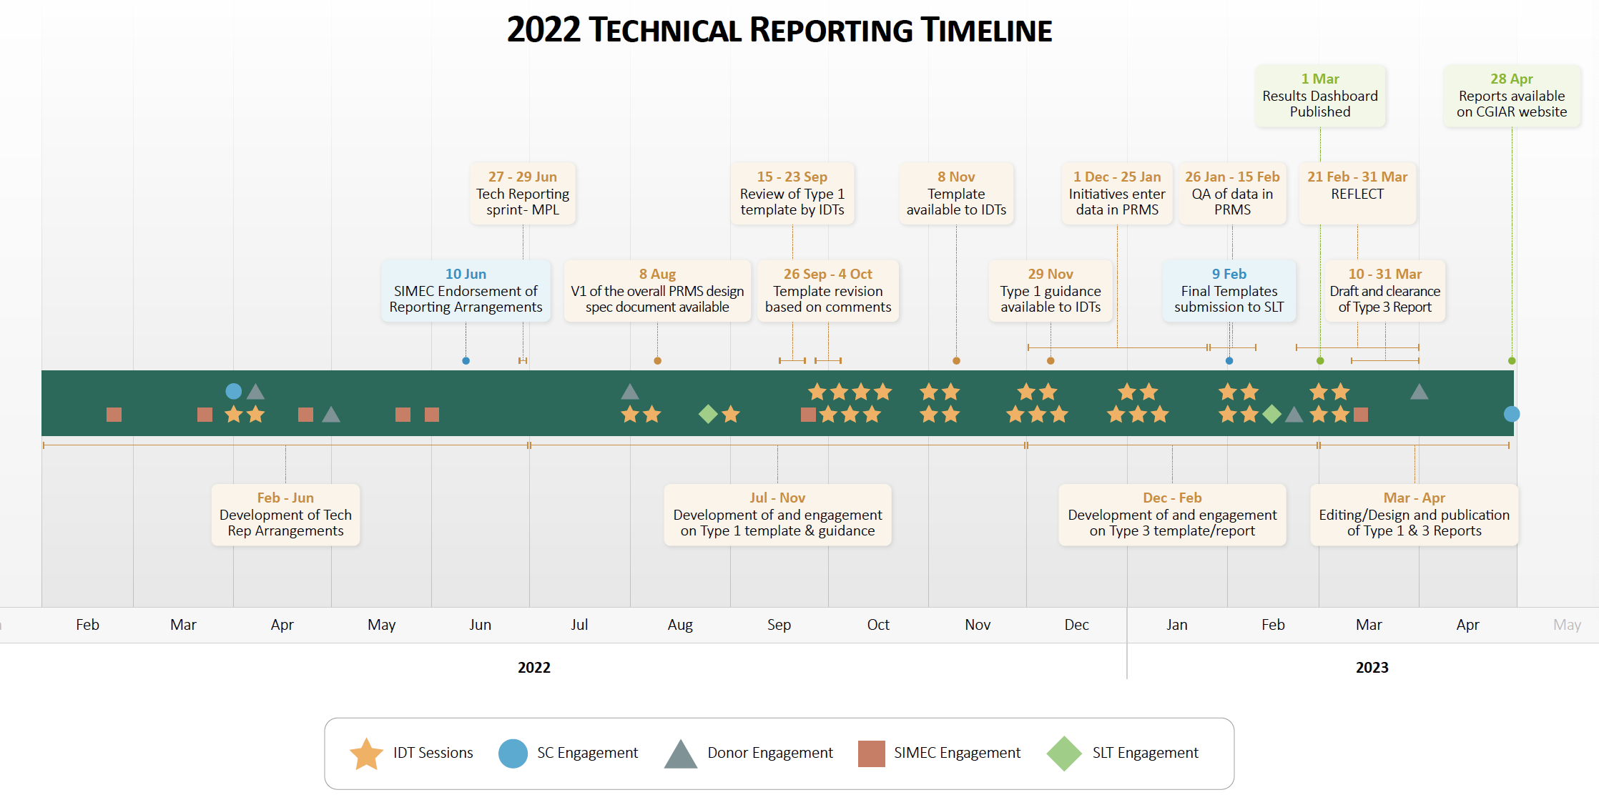

Slide 5
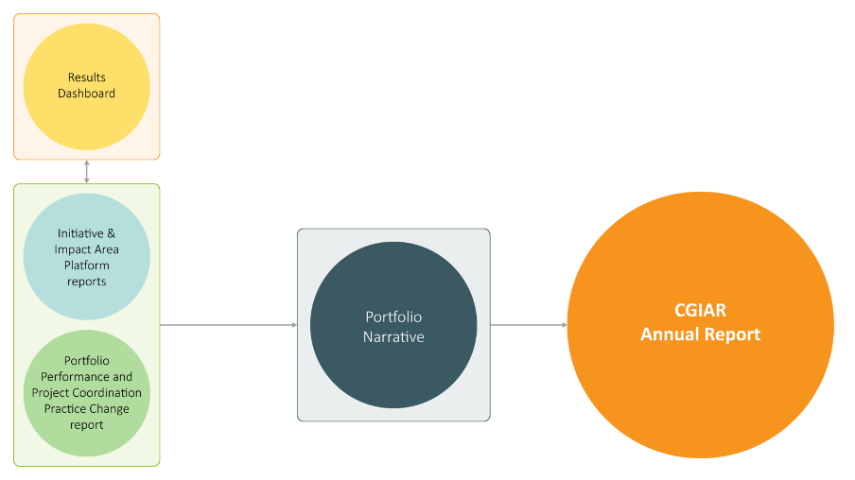
Technical Report components
Notes:
Update the table

Slide 6
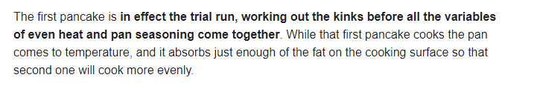
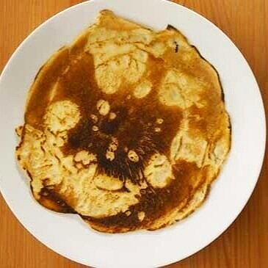
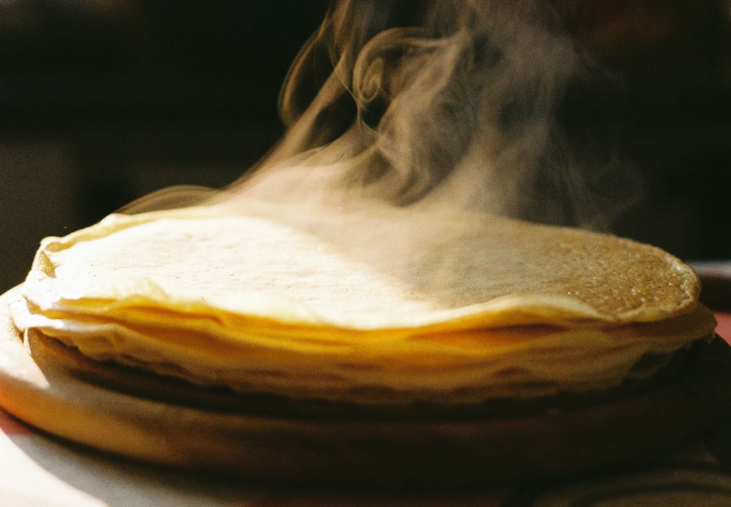
The First Pancake
Common Results Framework
Quality Assured Data
Common template
Dashboard
PRMS
Q2
Reflect Adaptive Management
Innovation Packages & Scaling Readiness
Results linked to TOC

Slide 7
Learning and Optimization – Q2
X-cutting themes
Conceptual
Capacity
Stakeholder groups
Data collection and sensemaking Tools
System
Survey
Focus groups
Deep dive interviews
Pillars
Reflect
IPSR
QA,
PRMS,
etc
Workflow
Process
Report &
Action Plan
Product

Slide 8
Learning and optimization process
Today’s FGD
Week of 26 June: report drafted and circulated for input to this group
26/06 – 7/07: Sensemaking of all data from L&O process
Week of 3/07: Information session of results of L&O process
Mid-July: Release of L&O report and Action Plan for 2023 Reporting

Slide 9
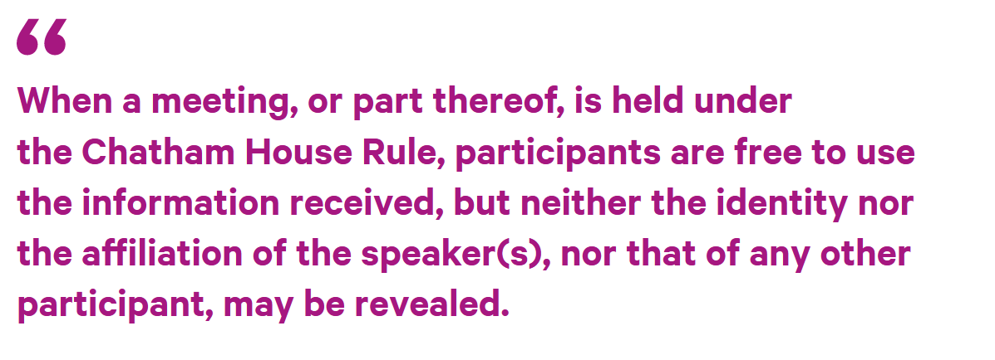

Methodological choices for inclusive and open dialogue
It allows people to speak as individuals, and to express views that may not be those of their organizations, and therefore it encourages free discussion.
Use of Miro for the working session/open for late submission
Role of an impartial facilitator
MIRO LINK

Slide 10
QA 22 process: an overview

Slide 11
Quality assurance: process and timeline
ROUND 1: for all fields
ROUND 2: for core fields
Jan 25
Jan 26 – Feb 2nd
Feb 3rd – 12
Feb 13 – Feb
Feb 14 - Feb 15
Feb 16 - 17
Initiatives (IDTs)
10 Anonymous assessors
Initiatives (IDTs)
Lead assessors
3rd party
PPU/PCU
Data submission
Two assessments are made
Agree/disagree and adjust, holding responsibility for the data on regular fields
Highlight:
- unresolved disagreement
- unimplemented changes
Final decision is taken on unresolved disagreements
Implementation of changes in the PRMS
Main improvements implemented for 2022 QA:
Introduction of the 3rd Party mechanism to ensure the quality of priority data for QA – e.g., result type, level, evidence based, and readiness/maturity levels - and broker an agreement in case of disagreement between assessors and Initiatives.
Process streamlined to 3 weeks, from the original 6 weeks.
Harmonized reporting guidance/QA criteria, and reporting system (PRMS) requirements.
User friendly QA platform linked to the PRMS.
Improved support to IDTs (1 Deep Dive, 1 customized training for IDTs, 2 drop/in sessions, 6 support cases successfully addressed, 3 days extension of IDT window)

Slide 12
Quality assurance: key stats
# items that received at least one comment (round 1+2) | 1496
# comments left by assessors (round 1) | 3365
Ratio reported results/comments left by assessors (round 1) | ~ 1:1,5
Top commented indicators | Innov dev Cap Dev Other Output
Top commented fields | Title (652 comments) Description (501) Evidence (314)
# Items added during the initiative round | 119
# comments referred to 3rd party | 285 (243 results)
# Instructions of change left by 3rd party | 161
# total removed results | 315 following the 3rd party decision: 93

Slide 13
Type of Initiative replies to assessor comments
Note: this chart refers to round 2. It includes added results and doesn’t include removed results.

Slide 14
3rd Party round: type of instructions
Total number of comments referred to the 3rd Party: 283 (243 results)

Slide 15
Variation in the # of reported results following the QA process
Indicator | # results reported on Jan 25 | # results reported after QA
Impact contribution | 1 | 0
Capacity Change | 17 | 25
Other Outcome | 13 | 7
Other Outputs | 561 | 407
CapDev | 537 | 509
Innov Dev | 474 | 476
Policy Change | 38 | 48
Innov Use | 61 | 58
KP to be QAed | 206 (incl. ~50 MELIA) | 198
TOT reported results to QA | 1908 | 1728
KP automatically validated (M-QAP validated Journal Articles) | 516 | 534
KP not added to QA (Non-Journal article and non-MELIA) | 967 | 1097
Tot reported results | 3391 | 3359

Slide 16
Other Output category: An insight

Slide 17
General overview: Other Output (OT)
# Submitted items | # Validated without comment | # Comments left | Removed after round 1 | Added after round 1 | # Items after QA
570 | 147 | 601 (19% of the total) | 199 | 33 | 404
199 Other Outputs (>1/3) that were reported on Jan 25 were unsubmitted as a result of the QA process.
>100 OT that were reported on Jan 25 were re-submitted as KP in round 2.

Slide 18
Breakdown of results by main types (Round 2)
Main reasons for reporting in the wrong indicator:
Uncompleted products - too early to publish on CGSpace
Drafted internal document, e.g., a mission report
Products not matching the requirements of Centers to be reported in CGSpace
The CGSpace handle was missing due to time constraints
The Initiative is not willing to report the Innovation (early stage) in the next years
Missing data (# participants) to qualify as a CapDev
Established partnerships are understood as an output rather than outcome
Innovation dev were mostly Cap Dev type
Methodological note: this analysis was conducted on the excel file comprising all results/comments available in Round 2, after the 3rd Party mechanism took place (16/02/23).
Notes:
, e.g. several types o KP might not be accepted, or lack of required quality.
IDTs ask to change this afterwards.

Slide 19
Working groups: challenges and possible solutions

Slide 20
Working session 1
QA system and product challenges:
  Scope and quality
  Timeline
  PRMS bottlenecks and needs
  QA Platform
  Other technicalities

Slide 21
Lessons and challenges faced in ‘22 (MG)
Timeline
Time constraint to conduct the QA in the allocated windows.
PRMS
To change a result type/level, it was necessary to unsubmit and re-enter a new result. For IDTs: this was time consuming and did not allow for getting approval of partners in a timely manner. For QA assessors: it was hard to check if the initial result was deleted, risk of duplications.
Difficulties in spotting duplications
Other technicalities
Geographic scope was reported in an inconsistent way, listing (or not) regions/countries
Limited QA of ToCs: sometimes, Initiatives just put the number of outcomes and the meaning was unclear to assessors.

Slide 22
Possible implementations (MG)
Timeline
Introduction of a preliminary QA batch in October/November, to reduce the final workload and introduce/experiment with the QA on a quarterly basis.
PRMS
Possibility to change result type/level without re-entering the full result.
QA Platform fully embedded in the PRMS.
Other Technicalities
Improve functionalities of the Platform for the second round, e.g., to have a button that indicates nothing to address for the third party.
Avoiding two people assessing the same result at the same time.

Slide 23
Questions for discussion (Laura)
Satisfaction with the product
Are you satisfied with the current QA scope and quality? Which aspects of the QA could be improved, e.g.,
accuracy, believability, objectivity, good reputation. completeness, accessibility, and timeliness?
Desired frequency of QA, and when
This year:
Reporting will start in August. Is it desirable to have 3 rather than the 2 suggested batches?
  One in October, a second in December, and a third in January/February.
  But this will make the process heavier and costlier, without real improvement.
In the future:
Should Initiatives/Platforms report on an ongoing basis?
  The PRMS would act as a repository and Initiatives would track development against their ToCs on an ongoing basis.
  Time constraints for reporting would be reduced significantly.
Should the QA be conducted on a quarterly basis, or other options?
PRMS and QA Platform
Are you satisfied with the general functionalities provided by the PRMS, regarding the QA tasks? Any major development requests?

Slide 24
ROUND 1: for all fields
ROUND 2: for core fields
BATCH 1: submission in October
1 week
1 week
2 days
2 days
2 days
BATCH 2: submission on in January
1 week
1 week
2 days
2 days
2 days
Initiatives (IDTs)
4 Anonymous assessors
Initiatives (IDTs)
Lead assessors
3rd party
PPU/PCU
Data submission
Two assessments are made
Agree/disagree and adjust, holding responsibility for the data on regular fields
Highlight:
- unresolved disagreement
- unimplemented changes
Final decision is taken on unresolved disagreements
Implementation of changes in the PRMS
Highlights:
Introduction of a preliminary QA batch in October/November, to reduce the final workload and introduce/experiment the QA on a quarterly basis.
The QA process will be streamlined to 3 weeks in January/February in order to timely provide the QAed data to the Reflect process/Dashboard.
The 3rd Party mechanism is confirmed for both batches - This is to: - anticipate some 3rd party workload (especially if we are having only 2 batches), ensure IDTs timely see their QAed results on the dashboard.
The first batch (October/November) will be relatively small, and this will allow for testing and further implementing the process.

Slide 25
Working session 2
QA process challenges:
  Governance
  The 3rd party mechanism
  IDT involvement
  How to streamline the process

Slide 26
Lessons and challenges faced in ‘22 (MG)
3rd party
The ^{3rd} party mechanism ensured the quality of priority data for QA and brokered an agreement in case of disagreement between assessors and Initiatives
Process
Streamlined process but still time/effort demanding
Evidence
High number of results with no evidence or restricted access evidence in round 1.
Unclear action needed if changes were not made (evidence not made available, result type not changed)
Adapt to IDTs need of extending their window
Unexpected high number of OT and need to squeeze their QA

Slide 27
Possible implementations (MG)
3rd party
The 3rd party mechanism is confirmed
Process
Searching for increased automation of QA tasks (ex. PR Journals).
Evidence
Find a way to share evidence with assessors before the QA, not possible to “ask for permission” during the QA
Improve reporting guidance and emphasize that evidence must be publicly available.
Reiterate the need to specify where evidence can be found (e.g., table, para, page,...)
The 3rd party will be (again) designated by the SGDs of each AA.
Not allowing submission of innovations if no evidence is provided and it is an innovation above the idea stage

Slide 28
Questions for discussion (Laura)
Are you satisfied with the improved governance system with the 3rd party mechanism to broker agreements on priority fields – and the way in which this is conducted?
Is it better to have only one person or one per each AA, designated by each SGD? (composition, coverage, number of brokers, etc.)
Which tools should be used to streamline the process and increase automation of QA tasks (ex. PR Journals)?
Are the existing tools sufficient (e.g., M-QAP)?
How can we avoid Initiatives providing evidence with restricted access? (and ensure easy and timely access to evidence during the QA process?)
Should repositories other than CGSpace be accepted?
Do you think it would be useful to align the QA process to international standards for QA (ISO)?

Slide 29
Working session 3
QA capacity and content challenges:
  Knowledge Management
  Re-organization of the result indicators
  Guidance improvements
  Need for training

Slide 30
Lessons and challenges faced in ‘22 (MG)
KM
Different policies on what a KP is and what should be uploaded to CGSpace (e.g., scoping reports)
Reporting indicators
The OT and OO categories were often used to report results that could have been placed under other categories or that deserve a new category
Guidance
Difficulties in defining the right indicator for CapDev-related results
For PR journals, it was confusing to have both CGIAR and Scopus for each item.
Time to get a CGSpace handle
Delayed sync between PRMS and CGSpace
Many policy changes were reported under other outcomes as well as other outputs
M/F disaggregation (Innov Use) with estimates which cannot be found in the evidence, are inconsistent or "1"
Very poor descriptions of CapDev results were provided
Titles not matching with the result type
KPs that are not JA or MELIA were not QAed, but their quality was checked by Center librarians.

Slide 31
Possible implementations (MG)
KM
Clarify the types of KP to be accepted in CGSpace
Reporting indicators
For PR journals, have only CGIAR information
Define the minimum quality for KP to be reported as such (and uploaded to CGSpace) and whether reporting them under OT.
Include a specific indicator for partnership/engagement, at outcome level.
Include a specific indicator for events that result in correlated outputs.
Further implement the guidance on titles and description with ad hoc examples.
For M/F disaggregation, add the N/A option
Guidance
Improve guidance for results, esp. events, that could alternatively fit CapDev or KP or Innov Dev CapDev type, or OO.
Need to provide examples of OT and OO
Clarify what policy change implies in various contexts.
Need to agree what is output and what is outcome.
Improve Capacity Change and CapDev guidance with definitions and examples.

Slide 32
Questions for discussion (Laura)
What must be considered a KP?
How can we clarify the types of KPs to be accepted in CGSpace and the minimum quality requirements?
Do you think that the QA for KPs other than JAs should be done by independent assessors or – as last year – by CGSpace librarians?
For PR journals, it was confusing to have both CGIAR and Scopus for each item.
What are possible solutions to this?
Is it important to provide a shared definition of a predatory journal?
How do we handle emerging indicators and reporting guidance? (this is largely covered in the RF FGD, but any feedback/comments?)
What training is needed, especially for IDTs, to better align the reporting process with the QA criteria (e.g., writing titles and descriptions, based on ad hoc examples, others)?
Do you see value in establishing a QA CoP across CGIAR to ensure a consistent QA approach?
Who should be part of this?

Slide 33
Thank you!
Miro board open until Friday 23 June
Also welcome to email further comments to
Mariagiulia (m.mariani@cigar.org)
Laura (l.reumann@cigar.org)
Next step: we will send the draft FGD report for input

