Slide 1

Digital Applications Enhancing Livestock Genetic Improvement in Low-Input Systems
Julie M. Ojango and Ally Okeyo Mwai
Livestock Genetics Program,
International Livestock Research Institute,
Nairobi, Kenya

Slide 2
Context for improving livestock productivity in low input systems
Climate change ; Feed Resources ; Emergence of new diseases; Desired Productivity
Socio-cultural, Political and Religious diversity
Digital Literacy, Technological innovations
New Genomic and Reproductive Technologies
Notes:
In low input systems, livestock productivity levels are generally low. Factors that continue to reduce the productivity include changing climatic conditions, feed resources, the emergence of new diseases, and the use of wrong genotypes in a desire to obtain a higher level of productivity without requisite investments in inputs and changing the production environment
Different livestock keeping communities are greatly influenced by social cultural, political and religious diversity
However, in the space of science and technology there are great advances that can be harnessed and adapted to catalyse change across all livestock production systems. These include New genomic and reproductive technologies, rapidly growing digital literacy and several technological innovations.

Slide 3
Livestock Genetics
Targeting
Gene Discovery
Delivering Genetic Gains
Proritizing geography, environment, climate and social change, traits, species, breed
What and Where
Adaptive alleles, characterization, conservation, Genome editing
Understand adaptation
Digital recording platforms. Phenotyping and farmer feedback.
Breed performance characterization
Provide evidence to decision makers
Promote science based strategies
Co-create capacity
Notes:
The Livestock Genetics program at ILRI seeks to influence and drive change in productivity in low input systems through three main strategies: Targeting; Discovery and Delivery

Slide 4





Transforming the Dairy Sector through ICT
Digital platforms for large-scale data management at national and regional levels (https://portal.adgg.ilri.org/)
Digital tools for recording and monitoring (Mobile devices)
Crowd-source information
Develop and promote Electronic training and learning resources
Adopt Digital sensors for monitoring behavior and physiological changes
Simultaneously provide management information and feedback on performance data for farmers
Recording and monitoring
Crowd sourcing information
Electronic learning resources
Management and feedback
Notes:
In the dairy sector, there are several different ways in which we adopt and use ICT technologies while addressing each strategic area.

Slide 5
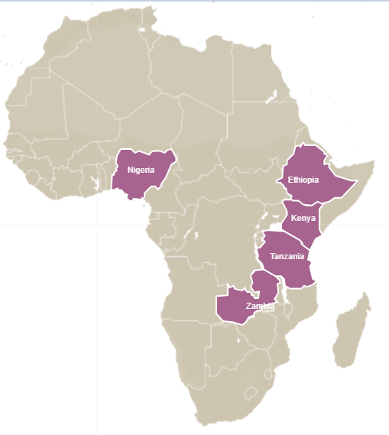
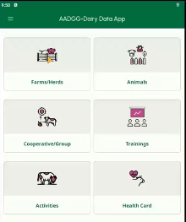
Inclusive dairy cattle improvement platform
Agile, robust & scalable systems exist
  Farming systems characteristics
  Characteristics of dairy animals on farms
  Monitor animal performance
  Monitor use of technologies (eg Artificial Insemination, vaccination)
  Input/market Service providers
  Costs of production
Analytics
E-Learning tools
Other data-sets & data bases
Customized data summaries
Genomic evaluation
Customized indexes for animal selection
Managing reproduction
Managing calves at different stages
Using livestock data for decisions
Managing animal health
i-Cow
KAZNET
URUS
Data capture
Data Validation
System Administration
API Management
Data Extraction
Information and Feedback
Country Data platforms
HAMONIZED
DATA PLATFORM
  Productivity parameters
  Animal management
  Local, Regional and National level Decision Support
https://portal.adgg.ilri.org/

Slide 6

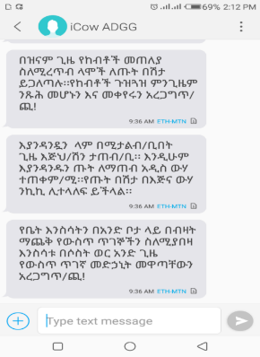
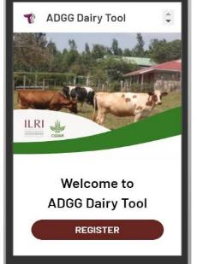

ICT-based farmer education and advisory: Ethiopia
Digital advisory system
Educational messages
10 M SMS
Cow calendar
165 K SMS
26,500 farmers
5,300 farmers
Four digital training courses developed
https://m.learn.ink/ilri

Slide 7
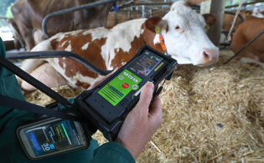
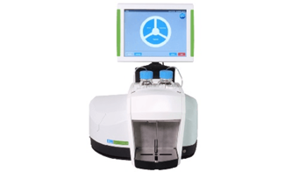

Adopting digital sensors
A. Genetic approach for methane reduction
Direct selection for methane
  CH4 captured on 900 cows from 230 dairy farms in Ethiopia and Tanzania using Laser Methane Detector (LMD)
  Heritability estimates obtained about 0.20 for CH4 ppm-m
  Indicate genetic variation for direct selection
Capture mid-infra-red spectrum (MIR) from milk samples using Lactoscope300
  MIR captures the chemical signature in the milk and
  Therefore, enable indirect prediction of CH4 from milk sample
Indirect prediction of methane from MIR
  Accuracy of indirect prediction of CH4 from fat%, protein% and MIR about 0.43 showing feasibility to predict CH4 for many animals

Slide 8
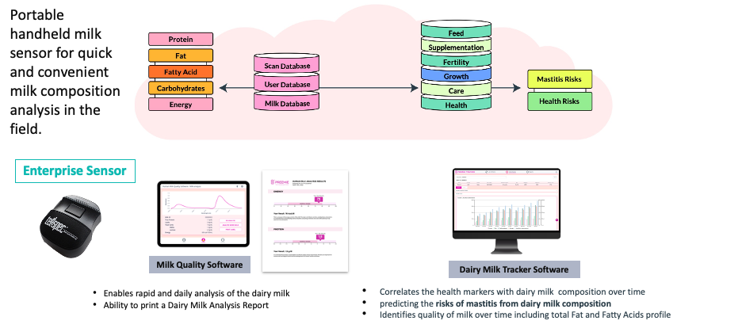
B. Tellspec sensor for milk quality analyses

Slide 9
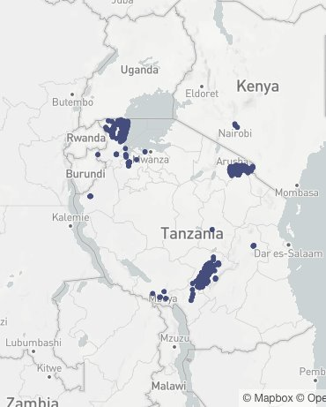
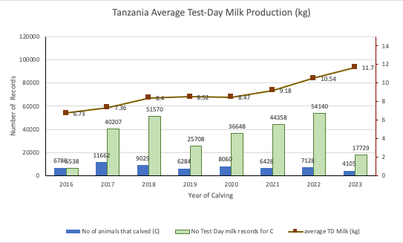
Change in milk production
Productivity gains achieved
https://www.gatesfoundation.org/ideas/articles/partners-uk-cows?utm_source=email&utm_medium=email&utm_campaign=partnerpotential2024&utm_content=TO

Slide 10
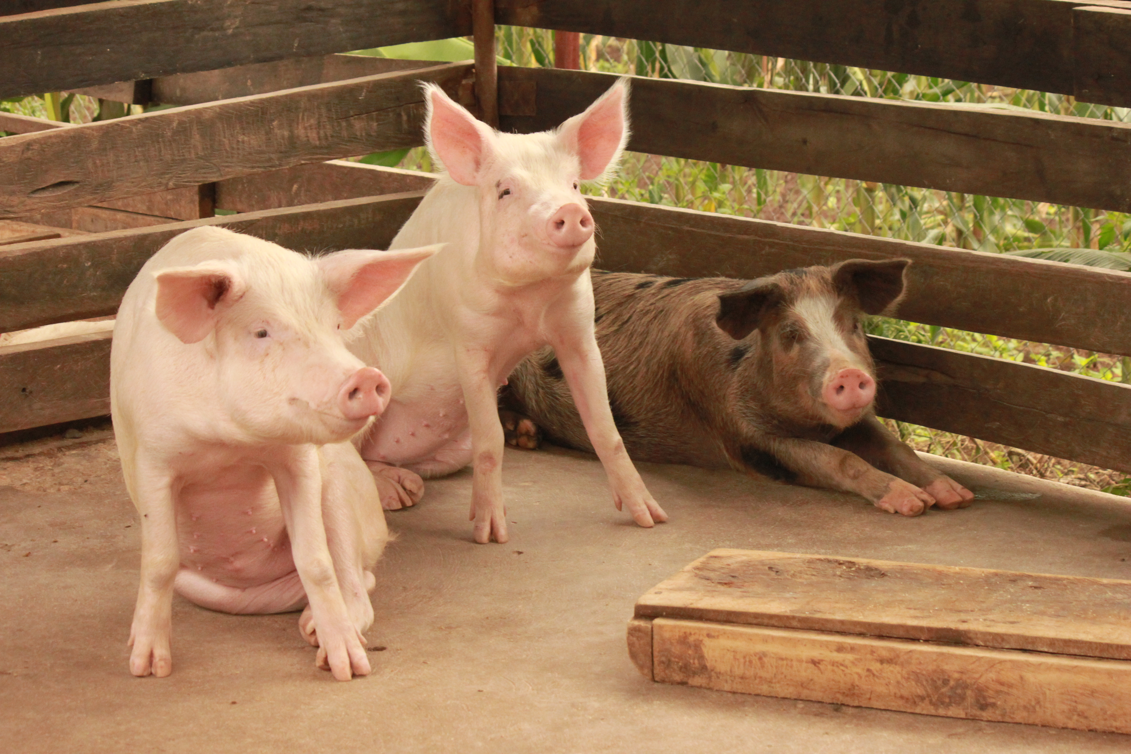
Strengthening the Uganda pig value chain (SAPLING)
At the production node, the emphasis is to improve farmer access to, and uptake of:
best herd-health products and practices,
high quality feeds and forages
preferred pig breeds through artificial insemination
A key incentive for farmers to adopt these innovations is increased profit from their household pig enterprise
But farmers rarely have data on this

Slide 11
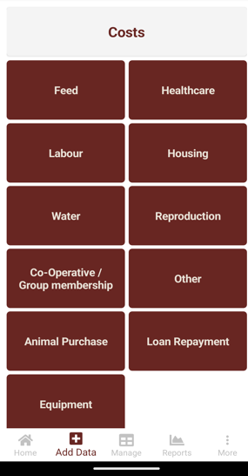
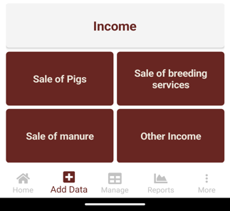
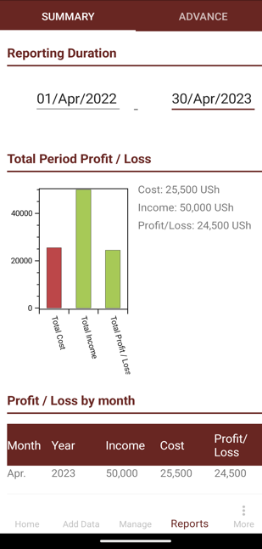

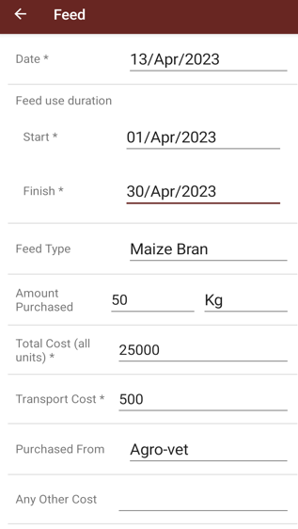
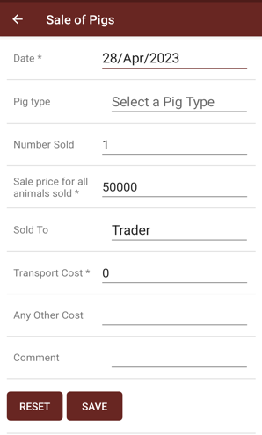
PigProfit$ app for smallholder pig keepers
The PigProfit$ app allows smallholder pig keepers to track their profit (or loss) for more informed decision making.
The tool is farmer friendly are currently in 4 languages (English, Luganda, Kinyarwanda and Vietnamese)
Example form to capture details on a cost (feed)
Example form to capture details on a income (sale of pigs)
Feedback to farmers on profit / loss

Slide 12
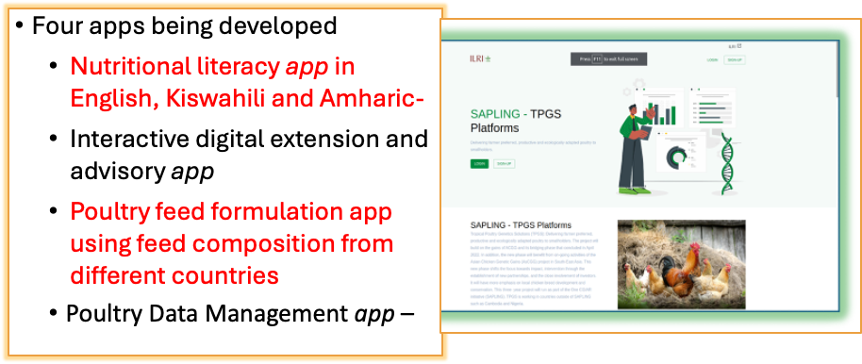

Tropical Poultry Genetic Solutions (TPGS)

Slide 13
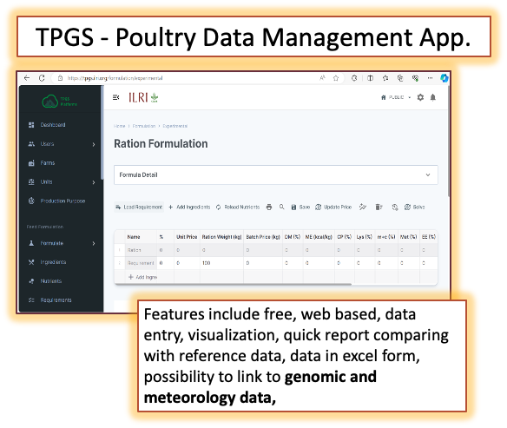
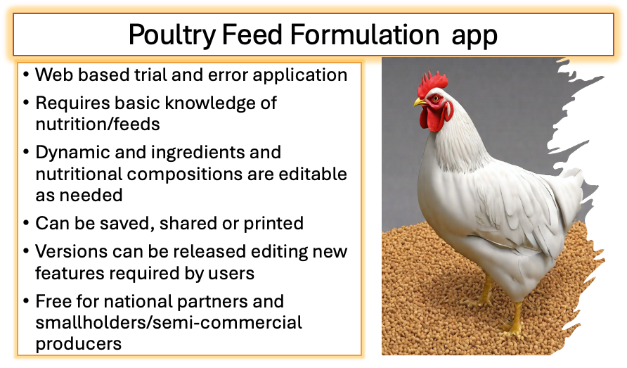

TPGS Apps

Slide 14

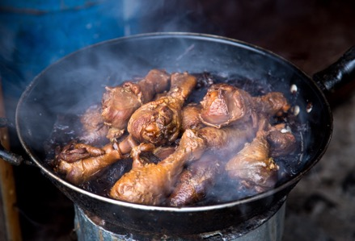
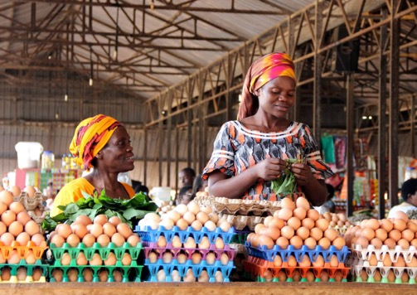
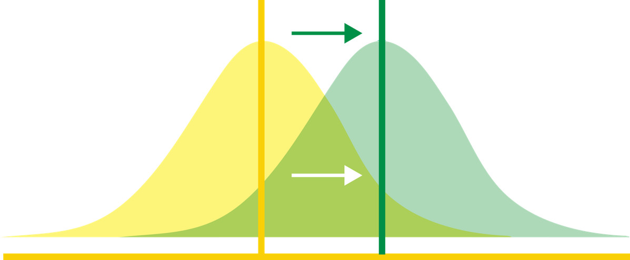
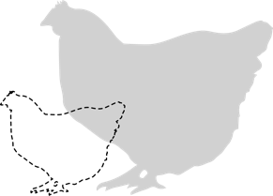

TPGS Productivity & Nutrition Gains
Increase in production, productivity and nutrition levels from indigenous to tropically adapted and more productive chicken breeds
200-300%
in body weight
US$ 288 profit per batch of 30 birds
100-200%
in egg production
https://www.frontiersin.org/articles/10.3389/fsufs.2023.1305799/full

Slide 15
Concluding remarks
ICT technologies provide a catalytic effect in accelerating genetic gains in livestock raised in low-input systems
Combining ICT technologies with genomic tools and emerging reproductive technologies offers new opportunities to identify and utilize superior, resilient, and productive animals suitable for low-input livestock production systems in middle- and low-income countries.

Slide 16
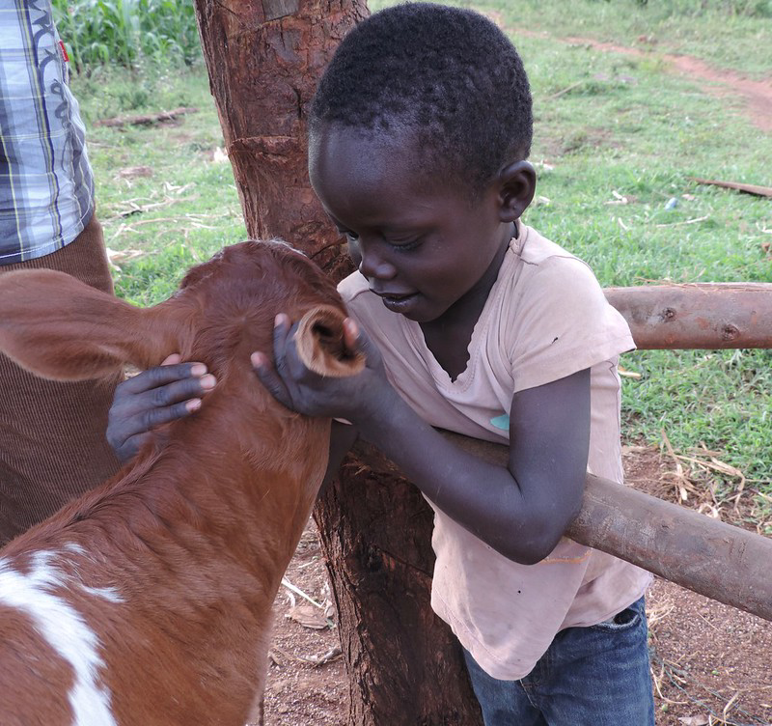
Acknowledgement
We acknowledge all colleagues and partners in the Livestock Genetics Program at ILRI; The Bill and Melinda Gates Foundation; and the CGIAR program on Sustainable Animal Productivity for Livelihoods, Nutrition and Gender Inclusion (SAPLING)

