Slide 1

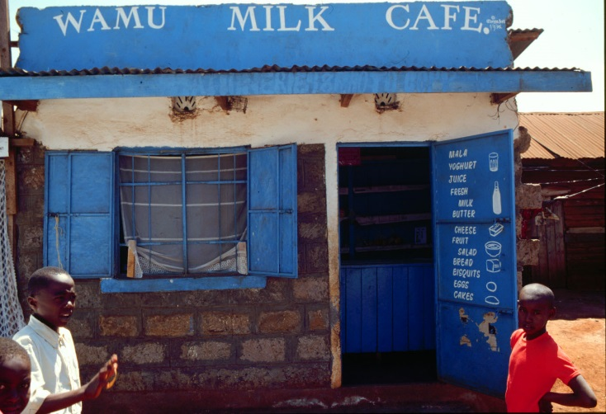
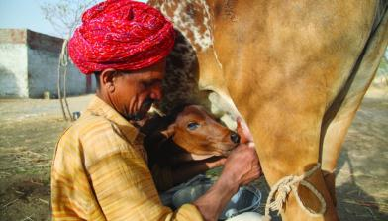
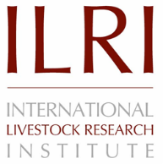

Is my milk safe? Quality and safety of the milk consumed in low-income households in Nairobi
Silvia Alonso, Hannah Varnell, Rachel Keefe, Martin Wainaina, Kristina Roesel and Delia Grace
The 15th International Symposium on Veterinary Epidemiology and Economics
Chiang Mai, Thailand
13 November 2018

Slide 2
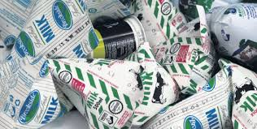
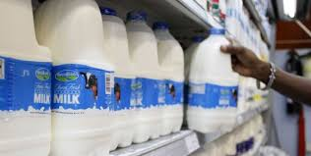
The dairy sector…

Slide 3
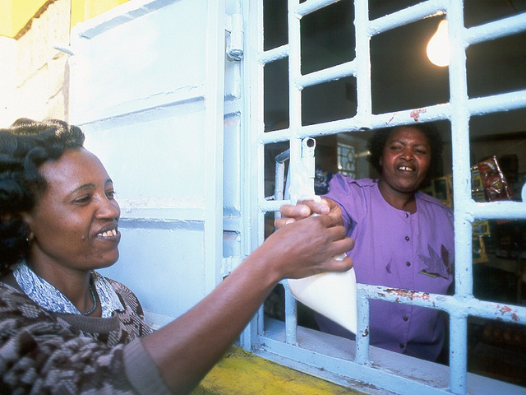
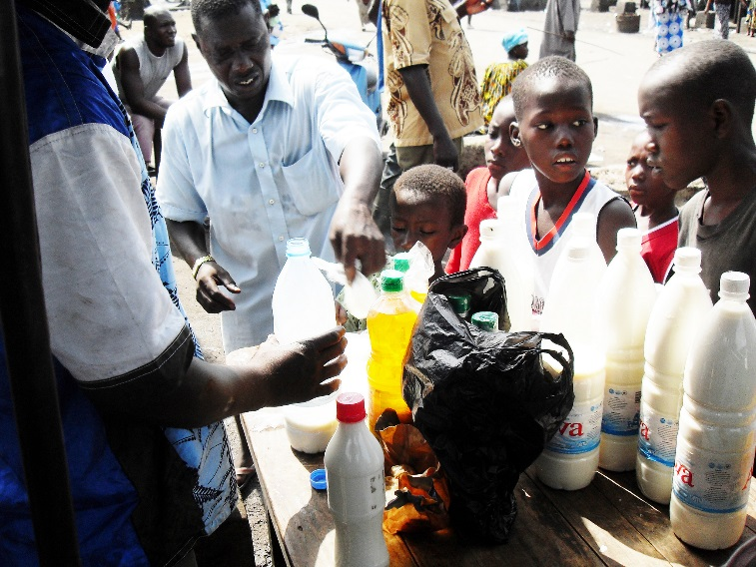
The dairy sector… in Kenya

Slide 4

The dairy sector in Kenya
4.3 million dairy cattle
20% large farms/cooperatives
80% smallholders
3.5 billion litres milk
75% informal markets
25% formal markets
Low-income (rural/peri-urban)
Middle and upper classes (urban/peri-urban)

Slide 5
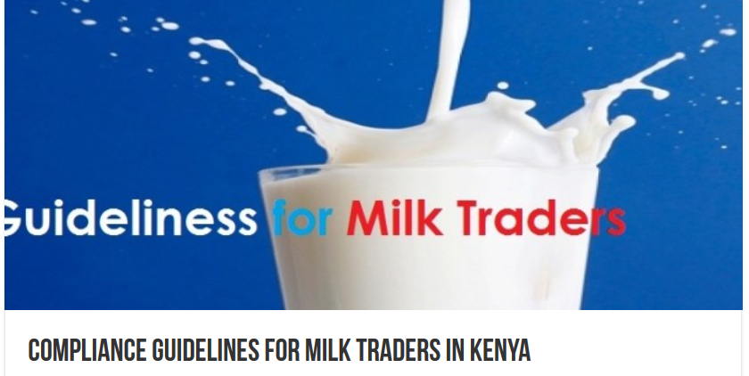
Informal dairy markets in Kenya
An ‘inconvenient truth’ for regulators
  Un-regulated
  No taxes paid
  Food safety concerns
But an important contributor to society
  Nutrition of poorest families
  Livelihoods of many

Slide 6


Slide 7
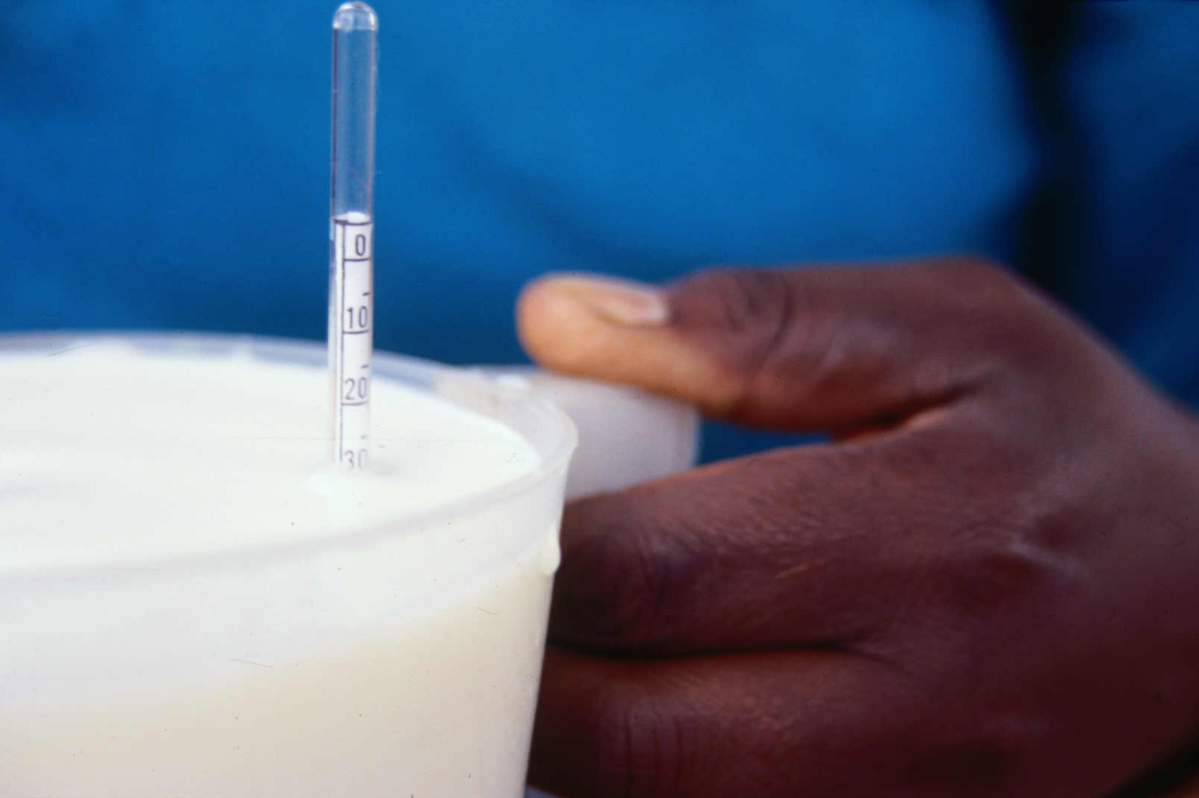
Materials and methods
100 ml milk samples from low-income households
Laboratory analysis:
  Microbiology
  Aflatoxin M1
  Milk composition

Slide 8
Results: microbiology and aflatoxin M1
 |  | n. samples (N=121)
Salmonella spp. | raw | 0
 | boiled | 0
L. monocytogenes | raw | 1
 | boiled | 0
Coagulase positive Staphylococcus | raw | 5
 | boiled | 0
70% purchased on the day
50% boiled milk right after purchase
7% had a fridge
80% kept it in plastic containers
82% samples - Aflatoxin M1 levels ABOVE EAC standards (50.00 pg/ml or 0.05µg/kg)
 |  | median (cfu/ml) | % meet EAS*
Total plate count (TPC) | raw | 20M | 67%
 | boiled | 0.065M | 85%
Enterobacteriaceae | raw | 3M | --
 | boiled | 0.003M | --
* East African Standards; -- not applicable

Slide 9
Results: milk composition
 | Milk Source
 | Mean value (± SD) | Quality Standard | % Informal Milk Compliant
Fat (%) | 3.62 ± 1.74 | ≥ 3.25¥
Protein (%) | 3.08 ± 0.62 | ≥ 3.3§
SNF (%) | 8.35 ± 1.44 | ≥ 8.5¥
Lactose (%) | 4.62 ± 0.68 | ≤ 4.7§
Casein (%) | 2.28 ± 0.46 | ≥ 2.57§
Acidity (pH) | 5.41 ± 1.93 | < 6.9¥ | 90%
Lactic Acid | 0.12 ± 0.04 | ≤ 0.17¥ | 93%
Density (g/ml) | 1.021 ± 0.007 | 1.028 – 1.036¥ | 9%
ASM | 24.40 ± 59.30 | ≤ 3.0* | 0%
^{[i]} FOSS. (May 2014). Abnormal spectrum screening (ASM). A White Paper from FOSS,P/N 1026513(2).

Slide 10
Milk composition: informal and formal markets
Alonso et al. 2018. Beyond food safety: Socioeconomic effects of training informal dairy vendors in Kenya. Global Food Security 18: 86–92.

Slide 11
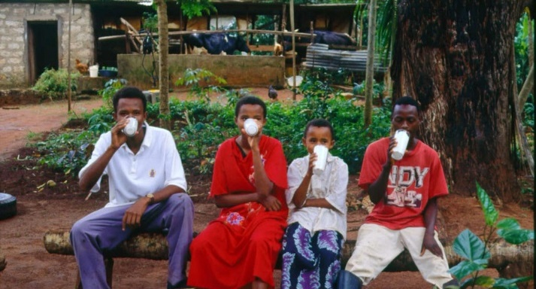
Main conclusions
Limited pathogen contamination of milk – but health risk not quantified
Boiling still an effective risk mitigation practice
Need for East Africa milk composition standards
Alternative strategies beyond pasteurization could protect consumers and preserve nutritional benefits for vulnerable groups
Check out our MoreMilk project
https://www.ilri.org/node/53709

