Slide 1



Using mobile syndromic surveillance at slaughter in Kenya and Uganda
Elizabeth Cook, Denis Mugizi, Innocent Obilil, Kristina Roesel and Bernard Bett
International Livestock Research Institute
17th International Symposium on Veterinary Epidemiology and Economics
Sydney, Australia, 11–15 November 2024

Slide 2
Purpose of slaughterhouse surveillance
Animal health
Prevalence of livestock diseases, drug residues, and animal welfare
Public health
Prevalence of zoonotic agents and food borne pathogens
Data collection
Data on diseases that are hard to detect (bTB, Taenia solium)
Disease prioritization
Information for disease prioritization, resource allocation, and program implementation.

Slide 3
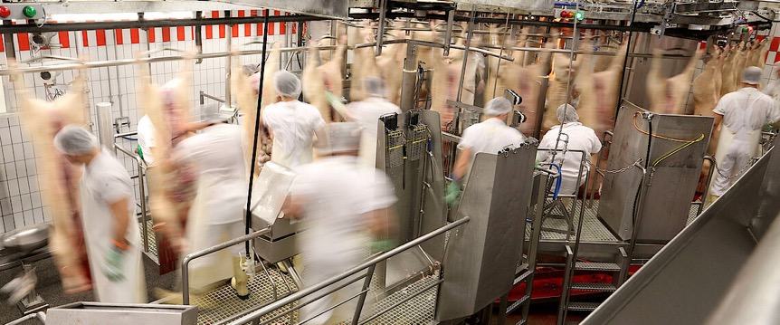
What is a slaughterhouse?
https://www.ips-journal.eu/regions/europe/a-slaughterhouse-for-workers-4477/

Slide 4
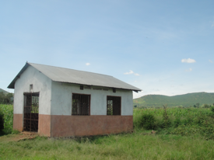
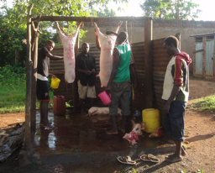
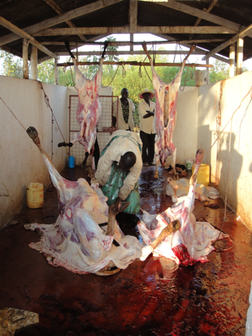
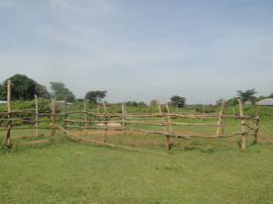
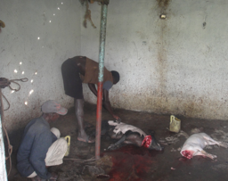
Slaughterhouses in rural East Africa

Slide 5
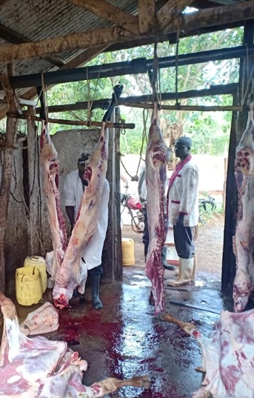
Slaughterhouses in rural East Africa
Hygiene standards in non-export slaughter facilities are poorly enforced
 | Mean | Percentage
Animals processed per day | 5
Number of workers | 11.5
Source of water - well |  | 70
Water conveyed by bucket |  | 80
Soap available |  | 42
Workers wash knives with soap |  | 20

Slide 6
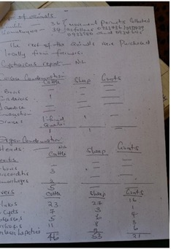
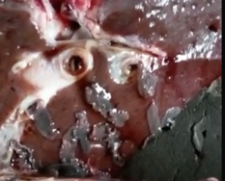
Limitations to meat inspection
Insufficient number of meat inspectors – assigned to multiple facilities
Government meat inspectors visit daily, focus on checking meat for parasites
Antemortem inspections rarely practiced at smaller facilities
Shut-downs could result in slaughter outside of inspected facilities
Paper-based recording
No laboratory support

Slide 7
Objectives
Pilot an electronic, mobile syndromic surveillance system as an alternative model of collection, storage and retrieval of data on livestock diseases at abattoirs
Develop capacity in electronic syndromic disease surveillance
Establish a disease data base in slaughter animals
Develop capacity in meat inspection

Slide 8
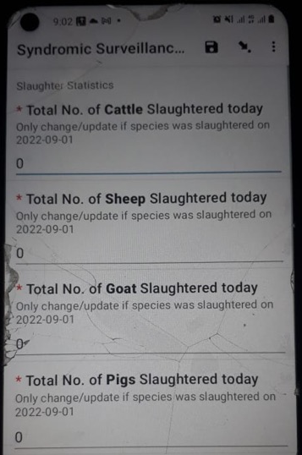
Approach
Digitise data collection tools
Train meat inspectors
  Meat hygiene and food safety
  Meat inspection regulations and standards
  Digital syndromic surveillance (DSS)
Embed within government owned data repositories

Slide 9
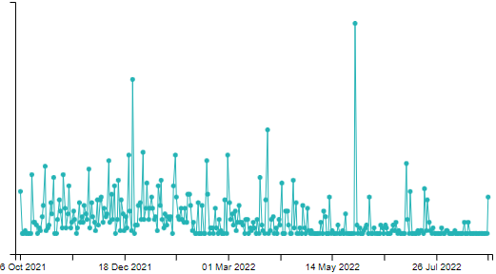
Findings
Inconsistent reporting
Some diseases were localized e.g. Cysticercosis in Kitgum and Gulu
Diseases of public heath importance (Tuberculosis, Cysticercosis)
District | Submissions | District | Submissions
Busia | 102 | Mukono | 96
Jinja | 247 | Soroti | 48
Kampala | 328 | Kisoro | 1
Kamuli | 252 | Mpigi | 28
Kitgum | 94 | Mbarara | 3
Kumi | 286 | Kiryandongo | 42
Luwero | 28 | Kiboga | 1
Totally Condemned (196)
Cause | % | Districts
Cysts | 1 | Amuria, Mityana, Gulu, Masaka
TB | 7.1 | Masaka, Kampala, Luwero, Mukono

Slide 10
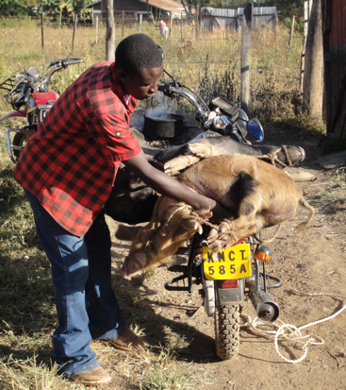
Challenges
Insufficient meat inspectors – responsible for up to 8 facilities
No diagnostic support
No traceability/no feedback
Duplication of effort
Fatigue - too many digital tools
No incentives for reporting
Server (data storage) costs

Slide 11
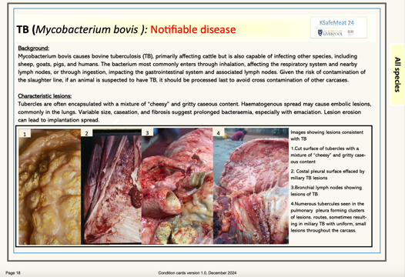
Next steps - Training
Virtual training for meat inspectors

Slide 12

THANK YOU

