Slide 1
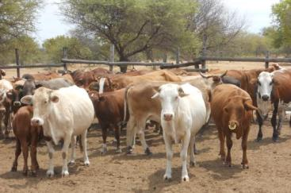
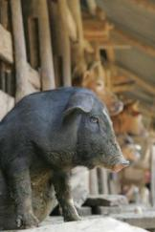
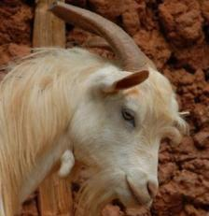
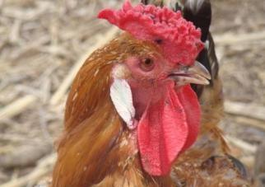


Livestock’s role in food security and resilience
Iain Wright
Deputy Director General, ILRI
USAID, 15 November 2019

Slide 2
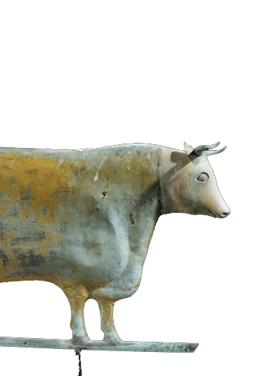
GLOBAL
CONTEXT

Slide 3
Global commodity values: on average animal source foods, five of the top ten
Notes:
Meat: Production from slaughtered animals: all animals of indigenous and foreign origin, slaughtered within the national boundaries.
Indigenous meat: Production from indigenous animals: indigenous animals slaughtered plus the exported live animals of indigenous origin.

Slide 4
% growth in demand for livestock products to 2030
Beef
Pork
Poultry
Milk
Increases not because of overconsumption!
OECD average 2018 = 69 kg/capita meat
SSA average 2018 = 10 kg/capita meat
Estimates of the % growth in demand for animal source foods in different World regions, comparing 2005 and 2030. Estimates were developed using the IMPACT model, courtesy Dolapo Enahoro, ILRI.
Notes:
FAO. 2011. Mapping supply and demand for animal-source foods to 2030, by T.P. Robinson & F. Pozzi.
Animal Production and Health Working Paper. No. 2. Rome.
IMPACT results generally suggested smaller changes in demand compared to FAO. Among other drivers of the results, the observed differences may be related to the underlying assumptions on how future demand will respond to prices and incomes. FAO projections could for example be assuming big shifts to Chicken Meat consumption (e.g., from pork) as incomes grow in Asia. IMPACT makes the same assumption in terms of direction, but with the expected shifts a bit more dampened.
High income countries include much of Europe. In fact, if one looks at individual European nations in many cases there is a DECLINE in demand (Switzerland for beef (-22%) and pork (-14%) for example)
Figures for meat consumption: https://data.oecd.org/agroutput/meat-consumption.htm

Slide 5
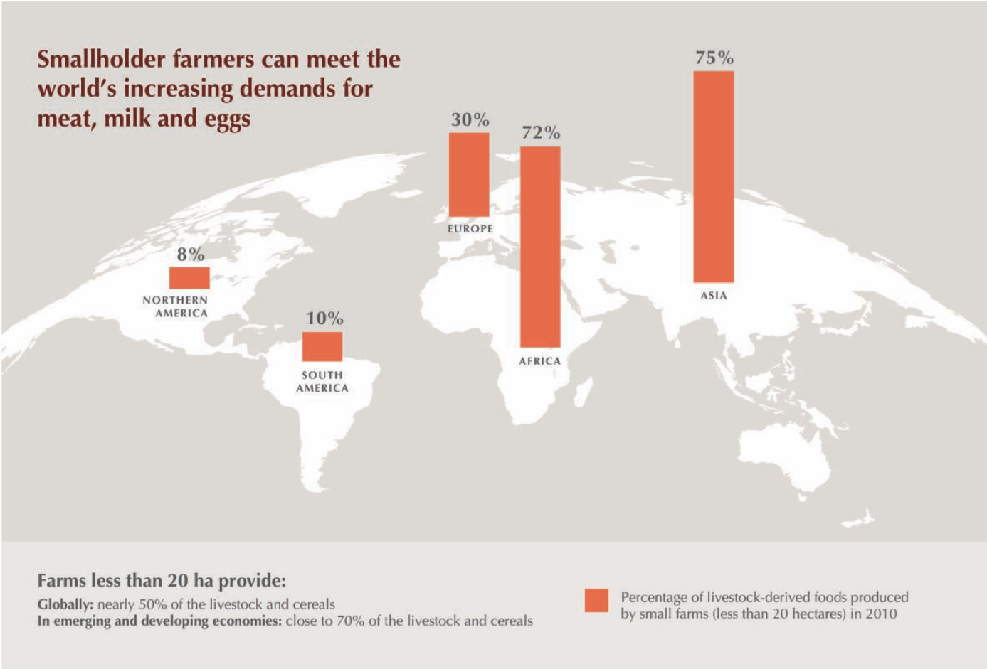
Proportion of livestock-derived foods produced by small farms in 2010
Notes:
Source: Options for the Livestock Sector
in Developing and Emerging Economies
to 2030 and Beyond. World Economic
Forum White Paper January 2019

Slide 6


















Food and nutrition security,
SDGs and livestock
Food and nutrition
security

Slide 7
Total Official Development Assistance disbursements to developing countries, USD million
Notes:
Note that the data is for disbursements to developing countries extracted from http://stats.oecd.org/ [under ‘Development’ the ‘Flows based on individual projects’ and ‘Creditor reporting system (CRS) [The objective of the CRS Aid Activity database is to provide a set of readily available basic data that enables analysis on where aid goes, what purposes it serves and what policies it aims to implement, on a comparable basis for all DAC members. Data are collected on individual projects and programmes. Focus is on financial data but some descriptive information is also made available.].

Slide 8
Percentage ODA disbursements for agriculture and livestock

Slide 9
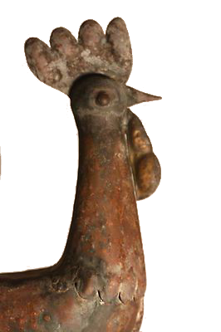
NUTRITIONAL
SECURITY

Slide 10
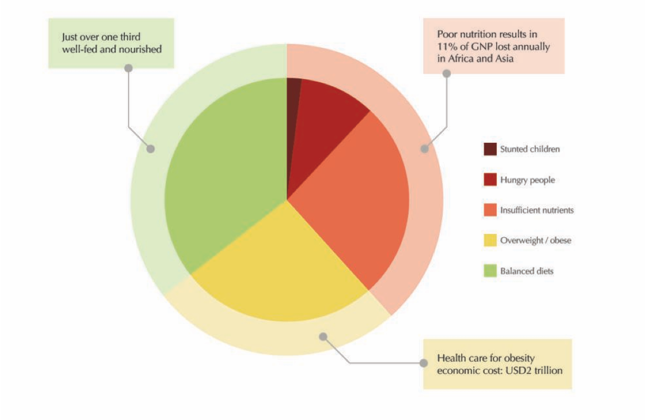
Nutritional divides among the world’s 7.5 billion people
Notes:
Data from FAO, IFAD, UNICEF, WFP and WHO, “The State of Food Security and Nutrition in the World 2018: Building Climate Resilience for Food
Security and Nutrition”, 2018, http://www.fao.org/3/I9553EN/i9553en.pdf; Development Initiatives Poverty Research Ltd, Global Nutrition Report 2017:
Nourishing the SDGs, 2017, https://reliefweb.int/sites/reliefweb.int/files/resources/Report_2017.pdf.

Slide 11
Diverse nutritional status demands diverse solutions
Low income countries
Middle income countries
Reduce
micro-nutrient deficiency
Reduce excessive net energy and unhealthy diets
Reduce energy deficiency
High income countries
% population
Notes:
Data extracted from: Robert F. Townsend, Steven Jaffee, Yurie Tanimichi Hoberg, and Aira Htenas, with inputs from Meera Shekar, Zia Hyder,
Madhur Gautam, Holger Kray, Loraine Ronchi, Sarwat Hussain, Leslie Elder, and Gene Moses. Overall guidance was
provided by Juergen Voegele and Ethel Sennhauser (2106) Future of Food: Shaping the Global Food System to Deliver Improved Nutrition and Health. The World Bank Group, USA.

Slide 12
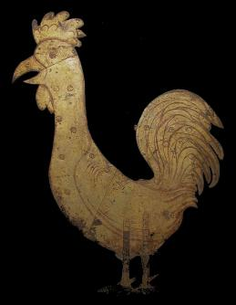
Animal-source foods are critical for both physical and cognitive growth
Livestock-derived foods are critical for human health, especially for new mothers and young children
150 million young children are stunted
Milk, meat and eggs provide key nutrients (vitamins A, B12, choline, iron, zinc) in highly bioavailable forms for humans
Especially critical for addressing nutrient deficiencies in undernourished people
One egg a day can reduce stunting (by 47%) among in 6–9 month-old babies where stunting levels are high
Growing evidence that it is impossible for babies to achieve adequate nutrition in the first 1000 days of life without access to
livestock-derived foods
And that livestock-derived foods are essential for at least 3000 days, and important in appropriate amounts for a healthy diet throughout life

Slide 13
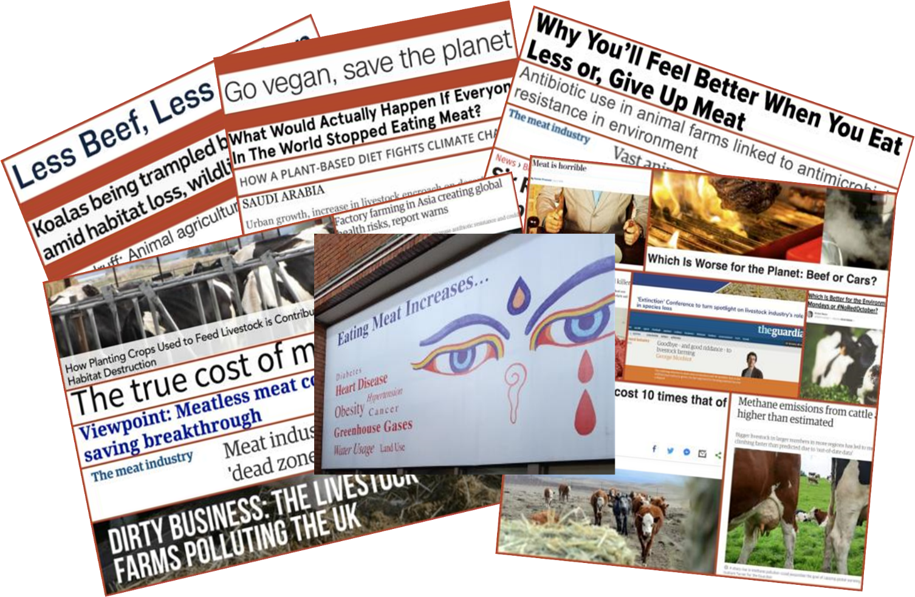
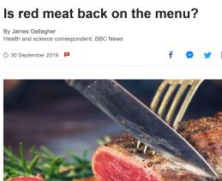

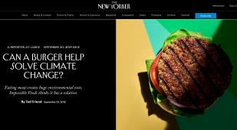
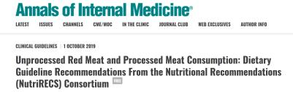
Are we confused?
Belgian guidelines endorse milk as a vital part of daily diets -
Plant-based drinks are not equivalent alternatives

Slide 14
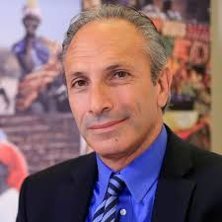
No one size fits all
‘’Too many people whose health would benefit from eating a more plant based diet want to impose this on populations whose health would benefit from eating more animal sourced foods’’
Lawrence Haddad
Executive Director
Global Alliance for Improved Nutrition (GAIN)
World Food Prize Laureate, 2018

Slide 15
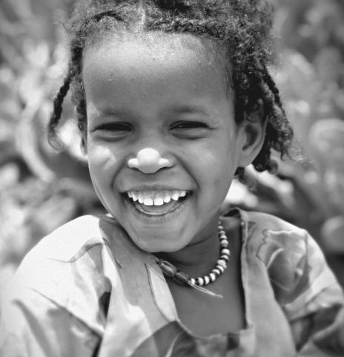
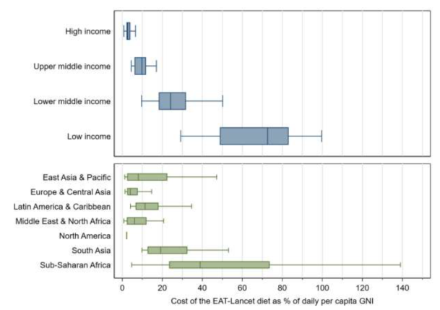
Improve access to animal source foods
Hirvonen et al. in press

Slide 16
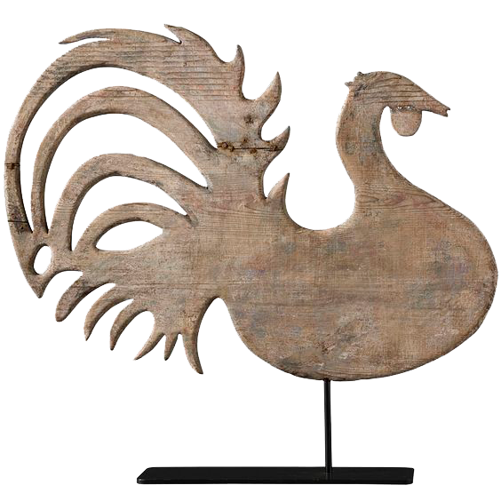
FOOD
SECURITY

Slide 17
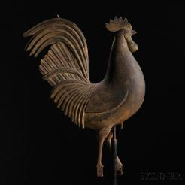
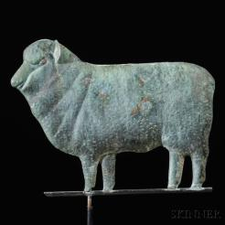
Multiple roles of livestock
Source of critical nutrients
Income from livestock buys nutritious foods
The livestock sector provides jobs for millions (mostly in the informal sector in developing countries)
Drives economic development - 40% of agricultural gross domestic product (GDP); and 15–80% in developing countries
Over half the cereals in the world can only be produced with livestock in the system (soil fertility, traction, cash for inputs)
Of the over half a billion small holder mixed crop-livestock farmers in the world
Notes:
Business and livelihoods in African livestock. Investments to overcome information gaps, 2014. An output of the Livestock data innovation in Africa Project. Sponsored by the BMGF and jointly implemented by the World Bank, FAO, ILRI and AU-IBAR. World Bank Report no. 86093-AFR.

Slide 18
Competition for land and grains?
Maybe not!
Latest for 1 kg boneless meat:
2.8kg human-edible food for ruminants
3.2kg human-edible food for monogastrics
Notes:
Anne Mottet, Cees de Haan, Alessandra Falcucci, Giuseppe Tempio, Carolyn Opio, Pierre Gerber. 2017. Livestock: On our plates or eating at our table? A new analysis of the feed/ food debate. http://dx.doi.org/10.1016/j.gfs.2017.01.001

Slide 19
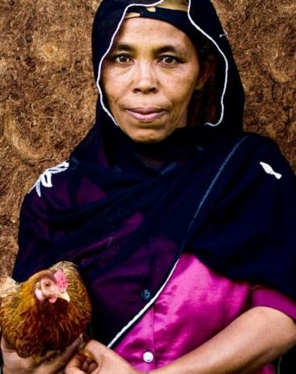
Women at the nexus
Two-thirds of the small holder mixed crop-livestock farmers in the world are women
Women have essential roles in household nutrition
Livestock can be the means to bring about transformative change in millions of womens’ lives
Notes:
Business and livelihoods in African livestock. Investments to overcome information gaps, 2014. An output of the Livestock data innovation in Africa Project. Sponsored by the BMGF and jointly implemented by the World Bank, FAO, ILRI and AU-IBAR. World Bank Report no. 86093-AFR.

Slide 20
LIVESTOCK
AND THE
ENVIRONMENT

Slide 21
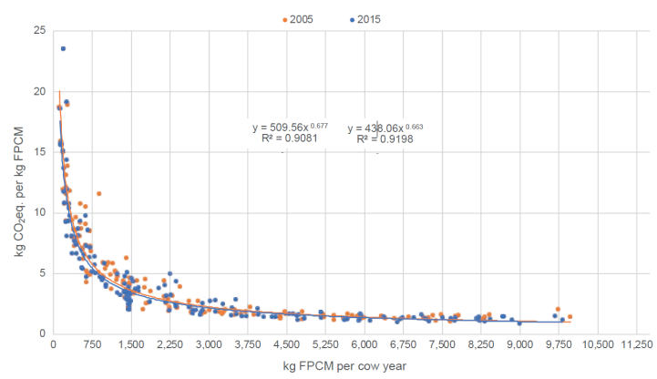
Mitigate environmental harms
Notes:
FAO and GDP. 2018. Climate change and the global dairy cattle sector – The role of the dairy sector in a low-carbon future. Rome. 36 pp. Licence: CC BY-NC-SA- 3.0 IGO

Slide 22
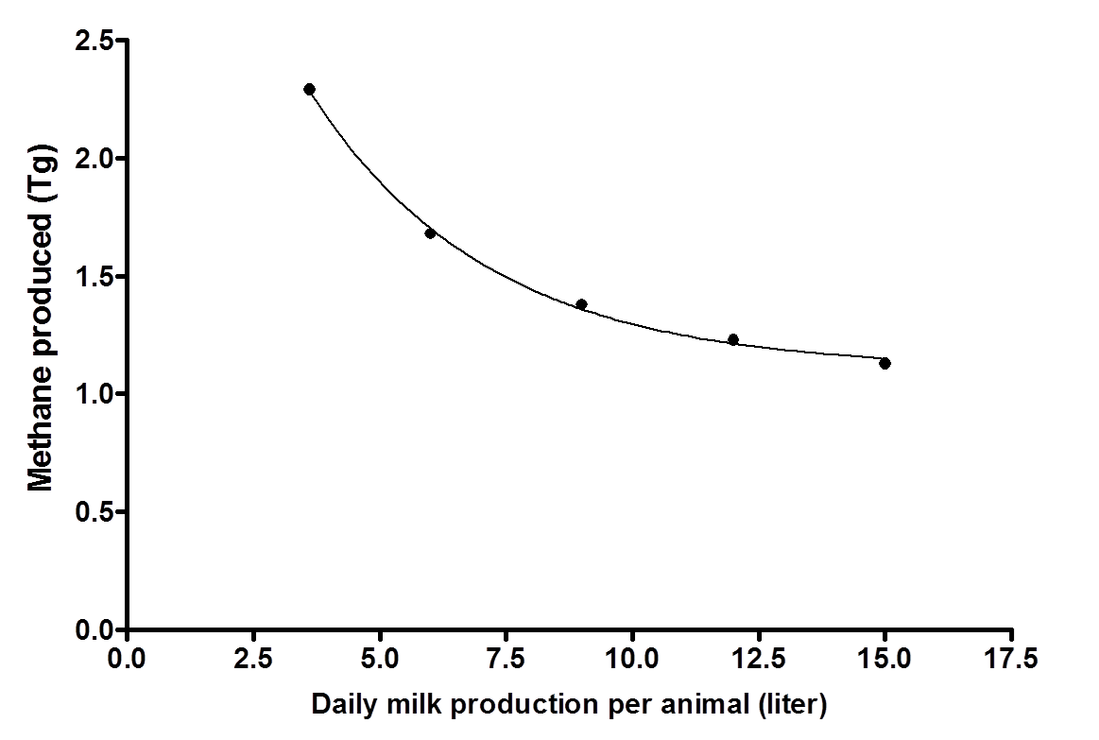
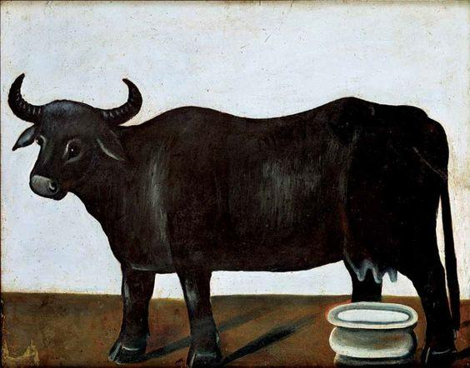
Production of the greenhouse gas methane falls as animal productivity rises

Slide 23
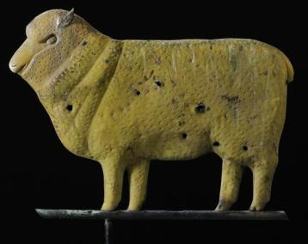
LIVESTOCK
AND
HUMAN HEALTH

Slide 24
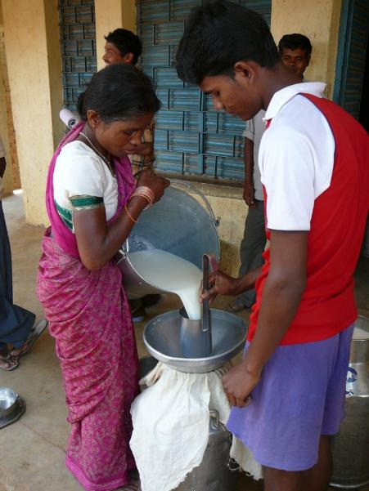
Promote food safety
Food borne diseases (many associated with animal-source foods) each year:
  600 million people are sickened
  420,000 people, mostly children die
  US95M economic loss for low- and middle-income countries
Focus on informal markets
  70-80% of animal source foods sold in informal markets in developing countries
  Adopt a risk based approach
  Use market incentives to build capacity in food safety among value chain actors

Slide 25

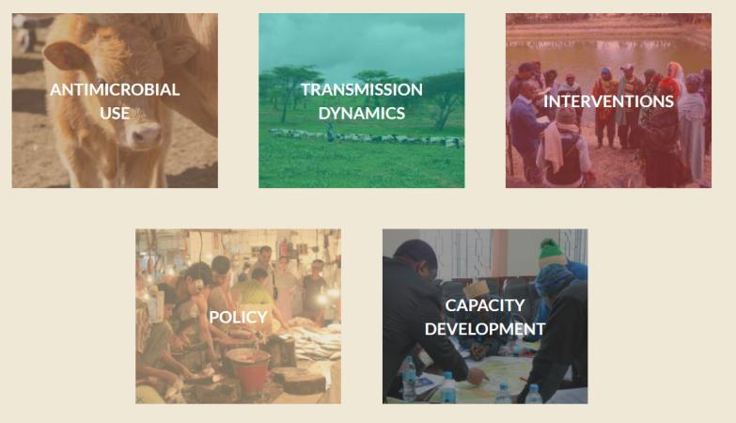
Antimicrobial resistance
https://amr.cgiar.org/

Slide 26
LIVESTOCK
AND
RESILIENCE

Slide 27
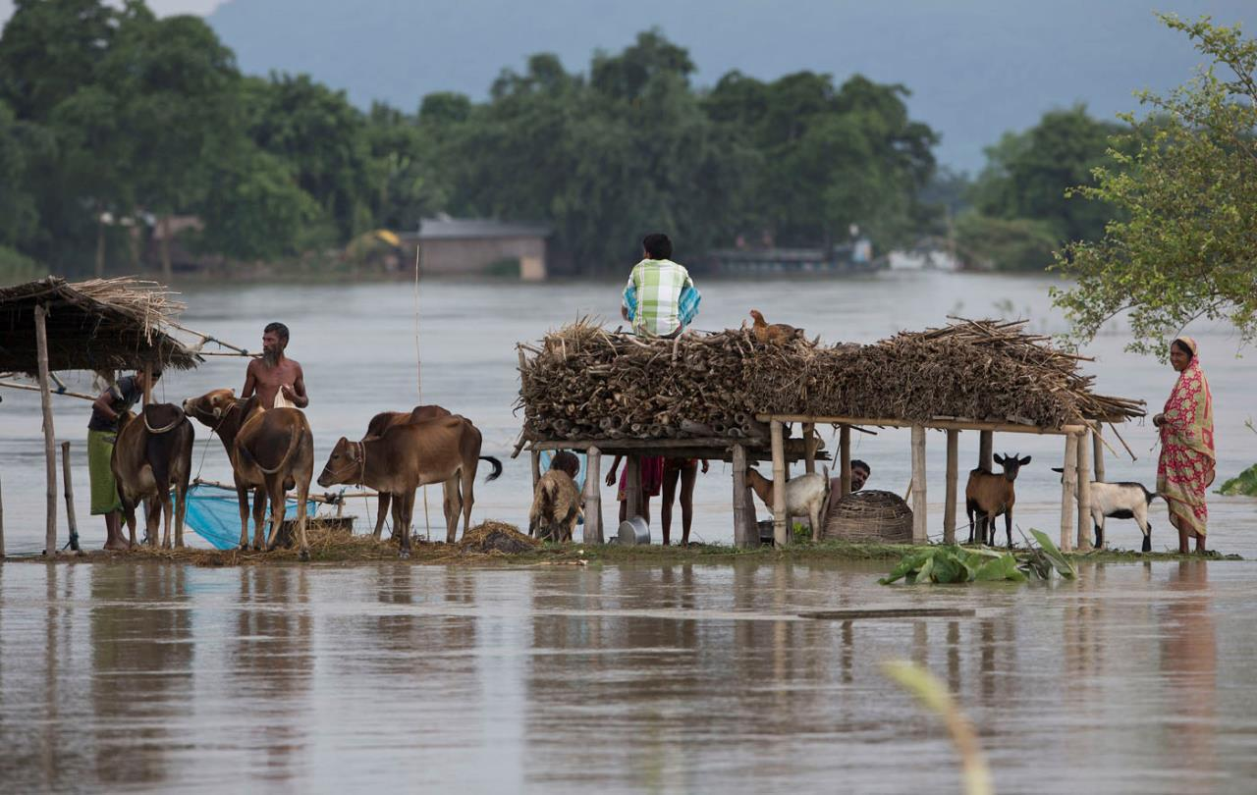
Livestock as insurance

Slide 28
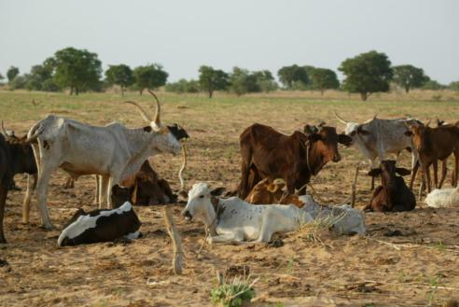
Mixed crop-livestock systems
Diverse outputs – risk spreading
Use the power of animal agriculture to promote a robust circular bioeconomy
23% of nitrogen for crop production
in crop-livestock systems comes from manure
15% farms in southern Africa and 81% in northern Africa depend on traction for ploughing
7 million oxen are the main source of power for tilling in the Ethiopian highlands

Slide 29
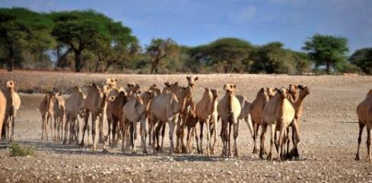
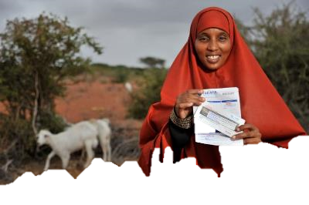
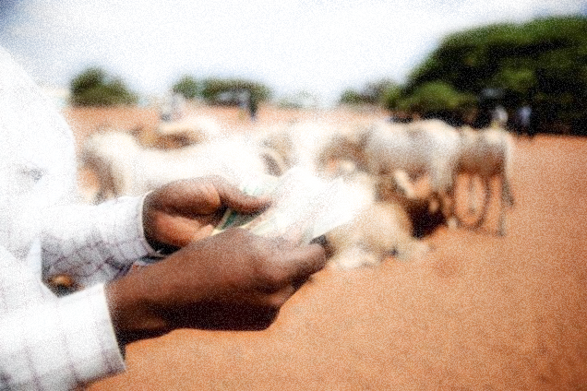
Protecting assets - Insuring pastoralists against catastrophic drought
Index-based livestock insurance (IBLI)
Insures livestock assets
Based on satellite weather data
Taking to scale:
The Government: Kenya Livestock Insurance Program (KLIP): underway and targets 80,000 households by 2019
The private sector: several insurance companies, including Takaful which insured over 36 000 animals valued at over 100M KES in 2016 and recognises the 20M pastoralists in the Horn of Africa as an important insurance market
Those who purchased insurance:
36% drop in distress sales of livestock
25% reduced likelihood of having to eat significantly smaller meals
33% reduction in dependence on food aid

Slide 30
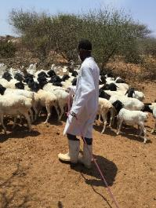
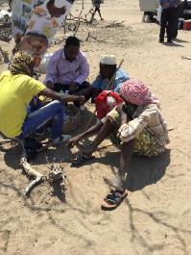
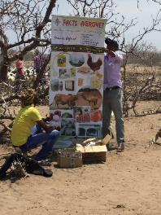




Public-Private Partnership in Animal Health Delivery
Private sector joining Public sector during vaccination campaigns
Provide additional services-drugs, clinical services, information
Pilots
  CCPP vaccination in Shimbirey, Garissa
  PPR vaccination in Marsabit
The Result
More than 90% of livestock keepers bought additional services
Resources were more efficiently shared

Slide 31
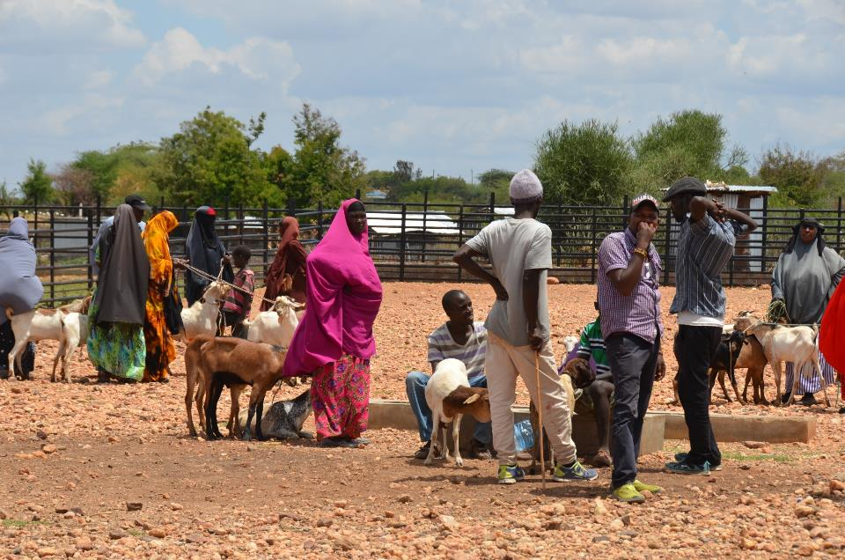
Market facilitation – Business to Business (B2B) linkage
County | Value of Trade (US$)
Marsabit | 406,774
Wajir | 783,358
Isiolo | 891,058
Total | 2,081,200

Slide 32
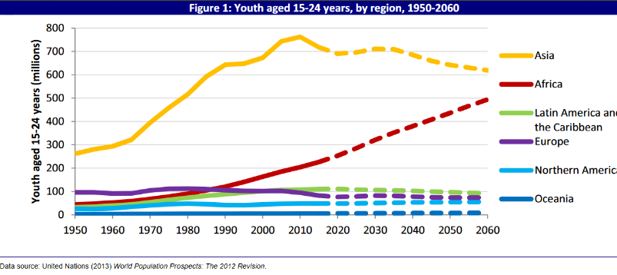
Big opportunities for livestock development to contribute to solving migration
Migration
Half the 247 million migrants are under the age of 18
65% are in developed economies
Numbers are growing at 3% annually since 2000
80% come from developing economies seeking jobs and opportunities
Increasing % unemployed

Slide 33
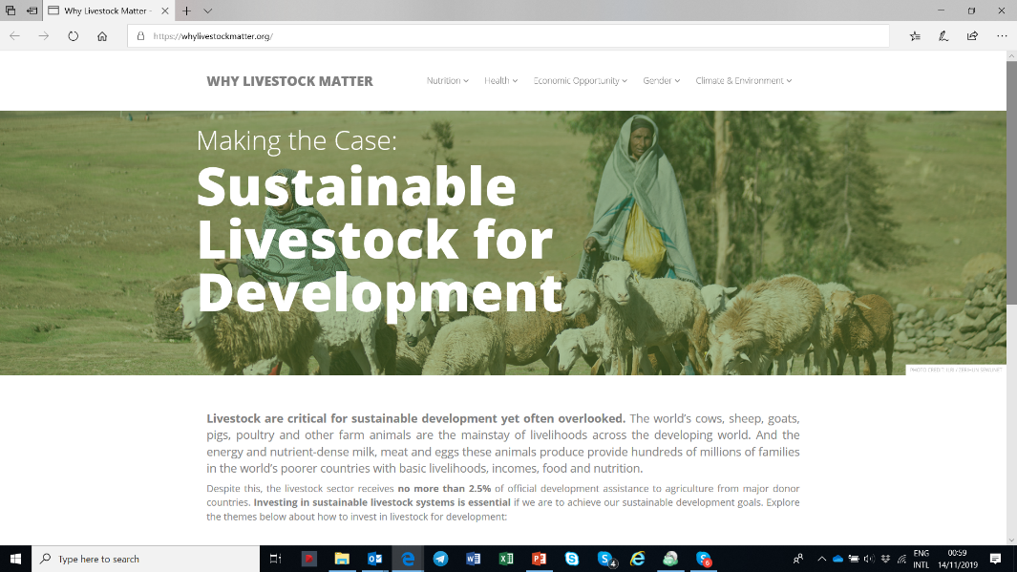
Why Livestock Matter Website

Slide 34
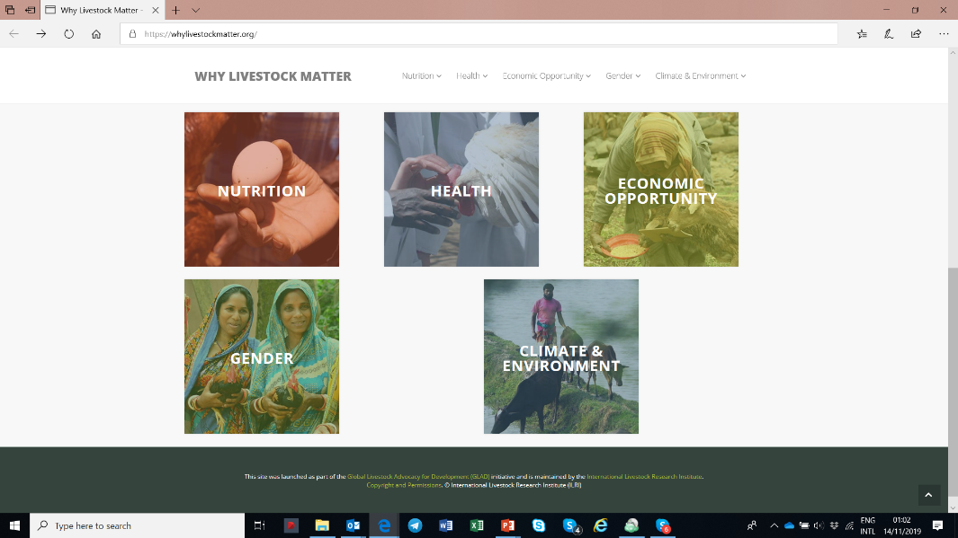
Why Livestock Matter Website

