Slide 1
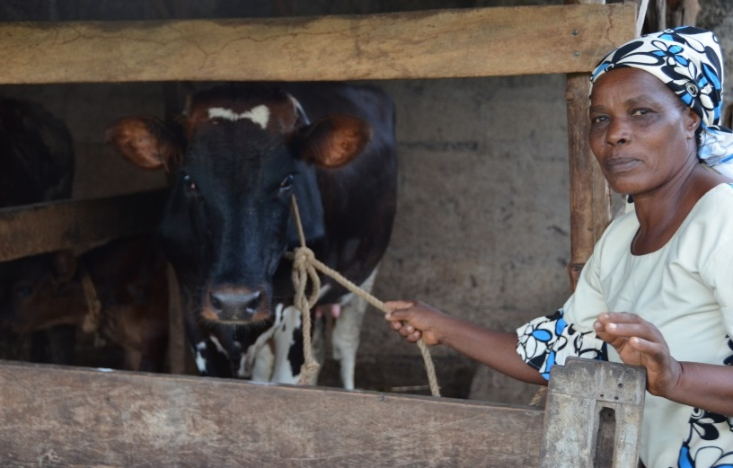

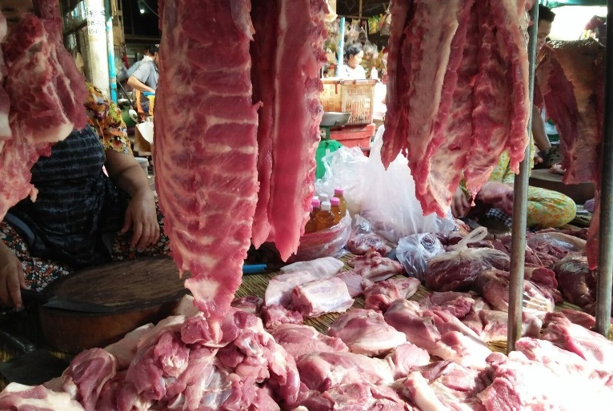






African Food Safety Index: Evaluation and validation
Silvia Alonso, Winta Sintayehu, Abraham Getachew, Wezi Chunga, Florence Mutua, Kebede Amenu, Filipe De Souza, Peace Mutuwa, Ibrahim Gariba, Yohannes Zelalem, Ian Dohoo, Delia Grace and Amare Ayalew
A collaboration between the International Livestock Research Institute and the African Union Partnership for Aflatoxin Control in Africa
ANH Academy Week
1 July 2020
http://www.anh-academy/ANH2020
#ANH2020

Slide 2
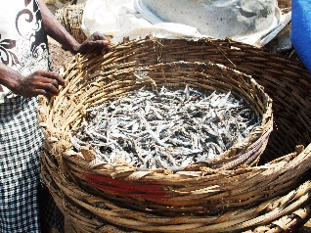

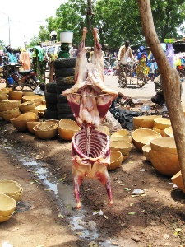
The CAADP Biennial Review
Tracking progress on agriculture in Africa (2015-2025)
43 indicators (7 nutrition)
African food safety index (AFSI) introduced in 2019
What is there in this for you!?

Slide 3
AFSI: 3 (sub) indexes
Food safety systems index (FSSI)
Food safety health index (FSHI)
Legal framework
Surveillance programs
Laboratory infrastructure
Foodborne diarrheal disease
FBD-related child death
Prevalence aflatoxin-related liver cancer
Export rejections (foodborne hazards)
Food safety trade index (FSTI)
AFSI

Slide 4
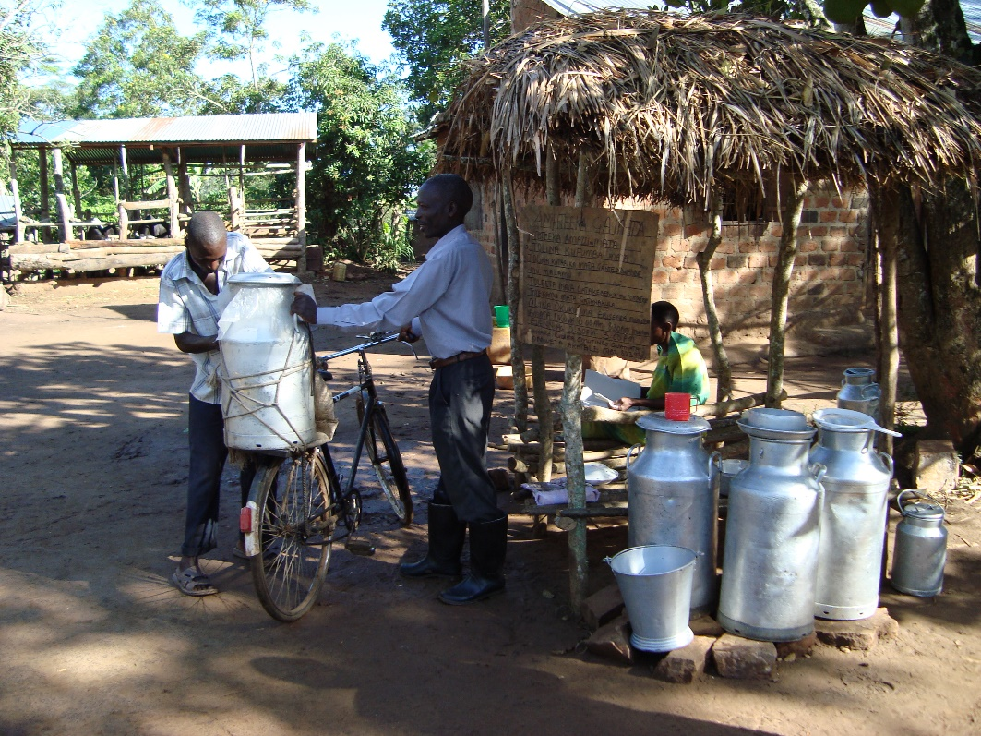
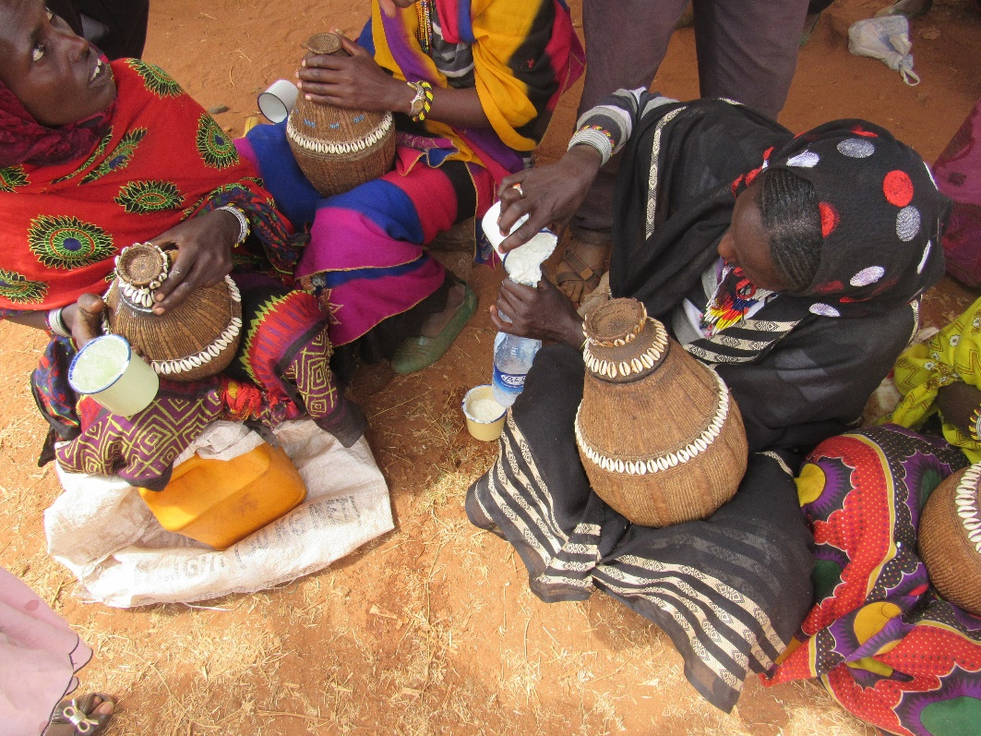
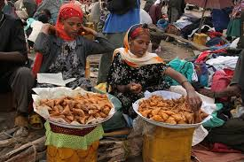
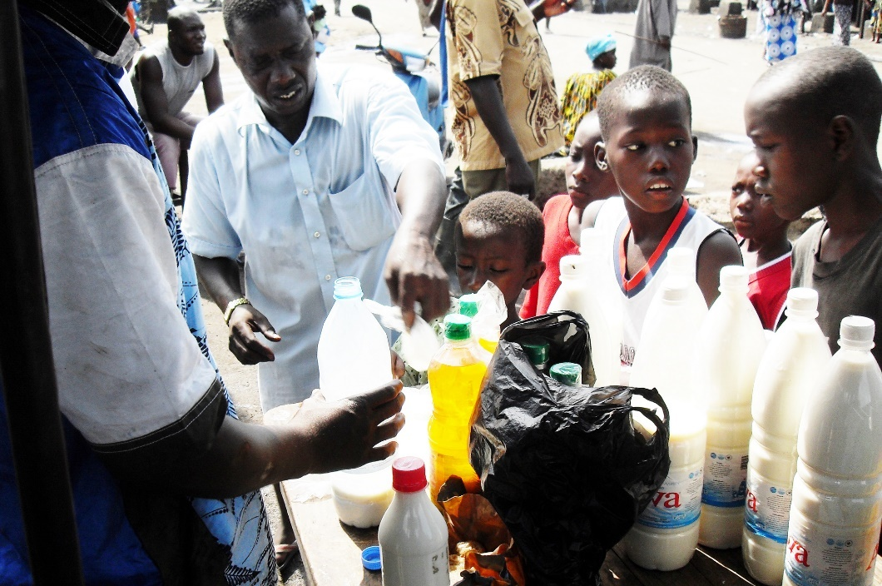
Objectives of the study
Meaning and robustness of the index
Identify keys to success and keys to failures
Propose recommendations for improvements

Slide 5
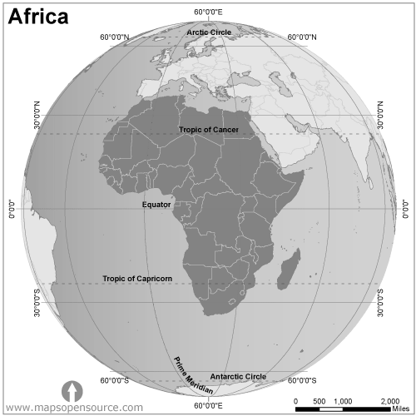
Evaluating and validating AFSI - METHODS
Quantitative analysis CAADP AFSI data
Qualitative analysis in-country visits (9)
  Group consultation
  Data hosting institutions
  KII CAADP and Codex FP
Online questionnaire (ongoing)

Slide 6
Quantitative analysis
High countries buy-in: 50/55 countries submitted data
Food safety systems index (FSSI)
Legal framework
Surveillance programs
Laboratory infrastructure
Combined indicators - No underlying food safety systems scale
Capture well presence/absence of elements
Do not capture functionality of processes
Index does not discriminate within “very good” / “very bad”
Food safety health index (FSHI)
Only 9 countries submitted enough data (data availability/accessibility)
Foodborne diarrheal disease
FBD-related child death
Prevalence aflatoxin-related liver cancer
Export rejections (foodborne hazards)
Partial submission of data
Large variability on quality of submitted data
Low quality of submitted data
Food safety trade index (FSTI)

Slide 7
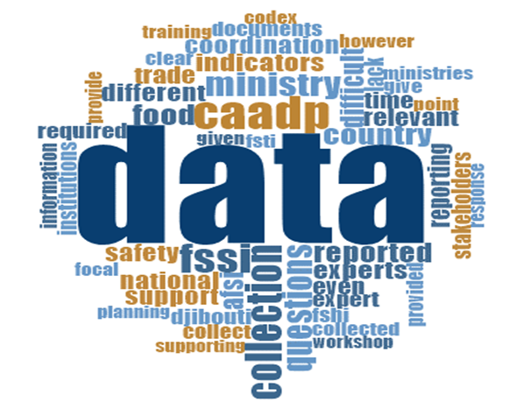
Qualitative analysis in-country visits
“Areas of enquiry”:
Data availability
Data accessibility
Data quality
Data submission
Relevance of AFSI for country

Slide 8
Qualitative analysis in-country visits - findings
Keys to success:
Inter-ministerial and inter-institutional collaboration
Existence of reliable health monitoring systems
Involvement of Codex focal points
Perceived as a useful metrics to raise the profile of food safety in African countries
Keys to failure:
Financial limitations
No FBD-specific surveillance
Limited electronic databases
Limited sensitization of relevant institutions

Slide 9
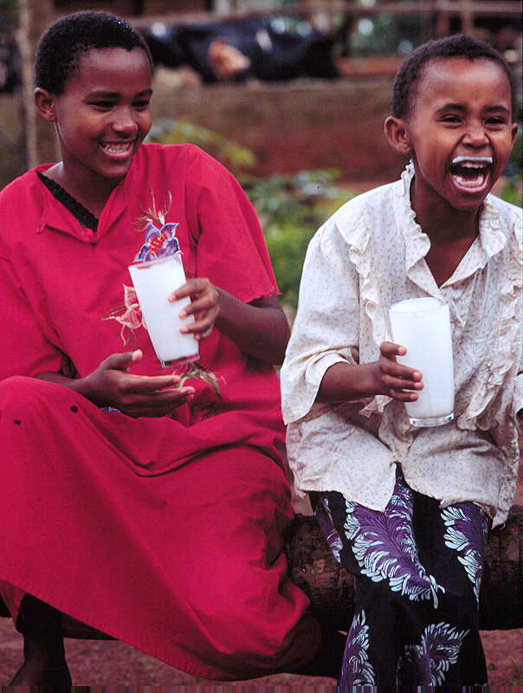
What do we conclude so far?
Opportunity to up-scale food safety in Africa: high interest and buy-in.
AFSI needs some tweaks to make it more functional and useful (benchmarking across continent; promote investments on food safety)
Countries need support: financial and sensitization of institutions
Create linkages with existing surveillance platforms, strengthening food safety-specific monitoring.

Slide 10
Acknowledgments
This study is undertaken with the financial assistance of the
Technical Centre for Agricultural and Rural Cooperation (CTA)
within the framework of the project entitled “Building Capacity for Institutionalizing Food Safety Tracking in the African Union Member States” implemented by the African Union through the Partnership for Aflatoxin Control in Africa (PACA).
We thank members of the working group for the development of the index as well as the food safety experts’ network that supported the project.
The views expressed herein are those of the authors and can therefore in no way be taken to reflect the official opinion of CTA or African Union.

