Slide 1





The importance of “collectivity” for transformative pastoral food systems
Presentation at Tropentag 2023: Competing pathways for equitable food systems transformation: trade-offs and synergies (Poster session on Climate Change). September 20 - 22, 2023 organised by
The Leibniz Centre for Agricultural Landscape Research (ZALF),
Fiona Flintan and Kelvin Shukuku, ILRI

Slide 2
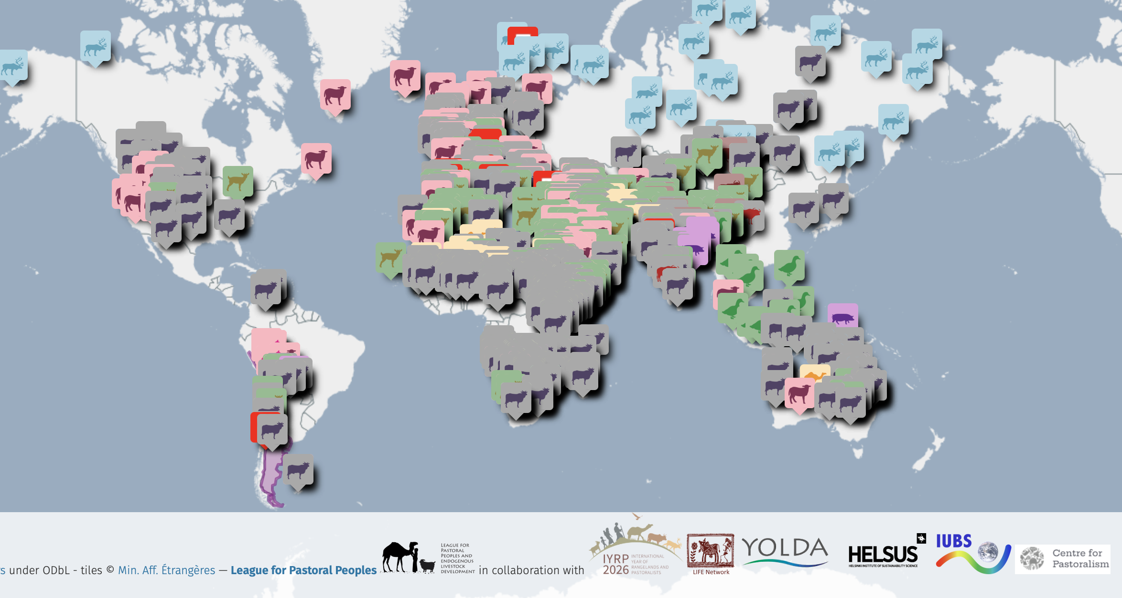
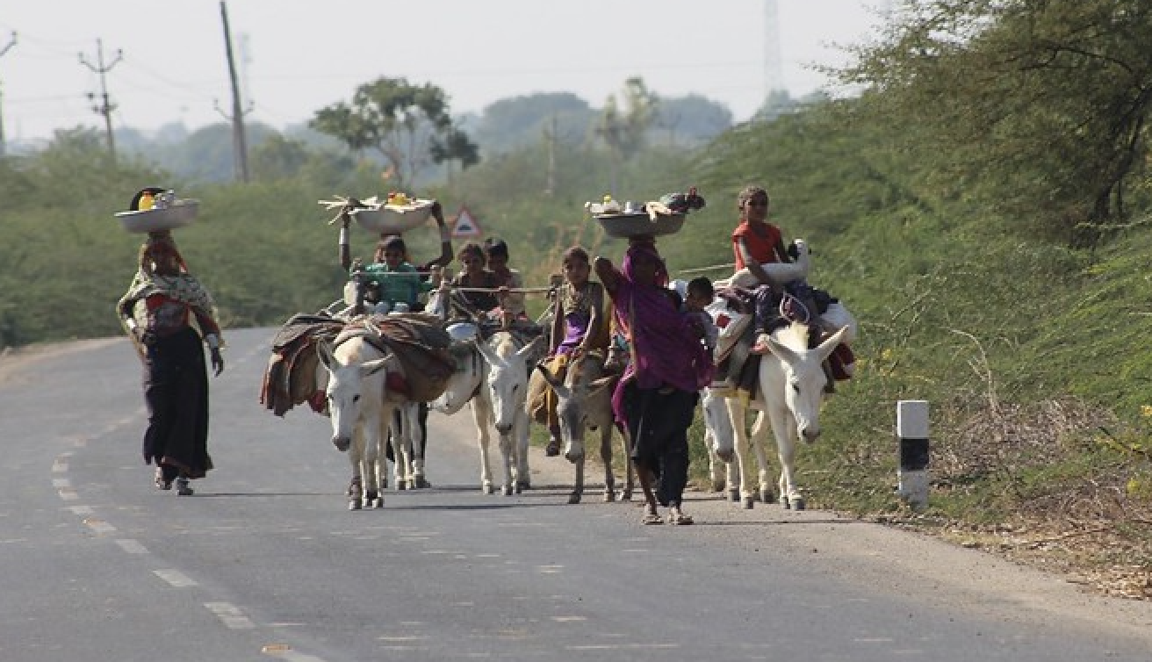
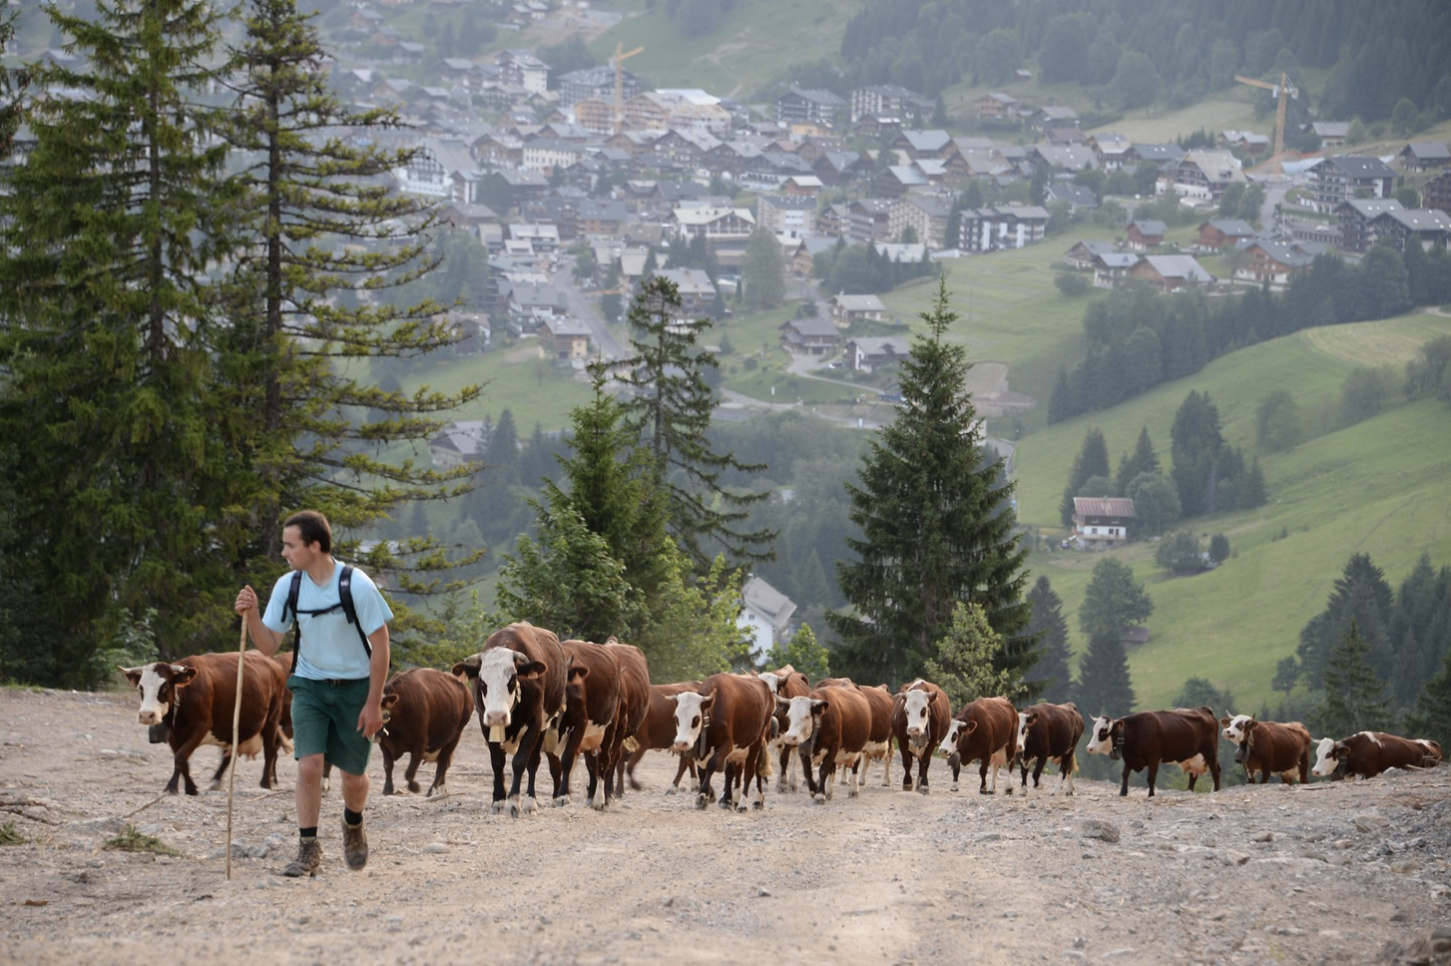
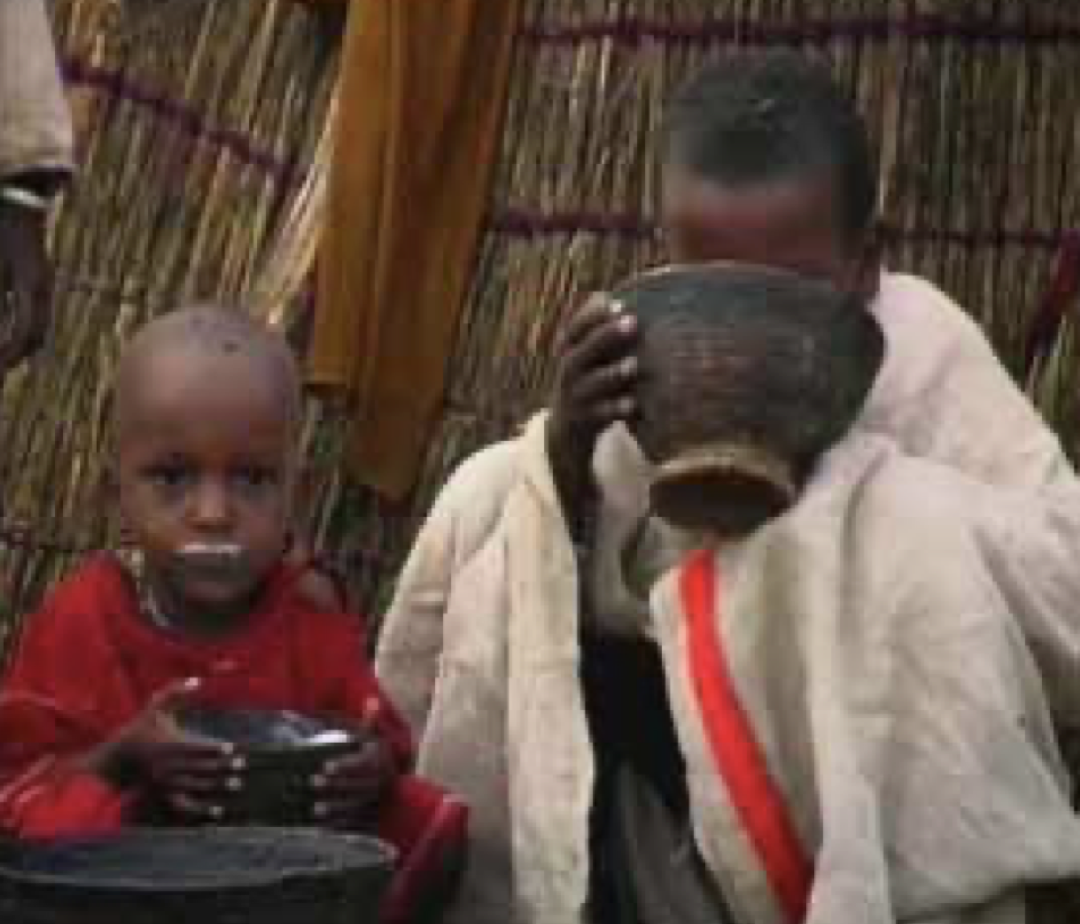
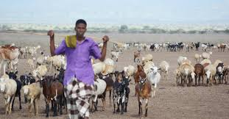
Pastoral food systems
Notes:
Pastoral food systems can be found across 50% of the world. Optimise production from rangelands – known for dry, variable and patchy climate and vegetation. Estimates of numbers of pastoralists range from 120-500 million worldwide. Food systems is mainly subsistence, but increasingly becoming more commercial which has risk of compromising animal welfare through such as live exports. Pastoral food system converts what would be otherwise unpalatable-to-humans vegetation into food and milk and is vital for the majority of people in LMICs and many others.

Slide 3
Collectivity
Collectivity refers to the state of being collective, which means being in a group. A group can also be referred to as a collective. A collective, such as a community, society, family, or other body, is formed through its members' shared purpose, culture, social networks, or social institutions.
Collective action, in the broader sense of the coordination of often actors in a space around a common objective, "asserting an issue affecting the production or use of a portion of space, itself understood as a material framework" (Pailloux, Rippoll, 2020).
Pastoral food systems are characterised by collectivity and are a collective action to produce food, generate wealth and maintain diversity including biodiversity.

Slide 4
The importance of collectivity in pastoral food systems
Using, managing and governing variable resources across a large territory.
As a risk management (spreading) strategy, maintaining flexibility and options. The risk of loss of resource access, livestock disease, conflict, and response to critical events spread across many group members - not just sitting with one individual.
To support vulnerable members through redistribution of wealth
To hold power – group power is stronger than the sum of the individual parts
To consolidate and protect wealth – livestock and land/resources cannot be owned so working as a collective prevents tragedy of the commons
To establish and maintain identity, sense of belonging, protection of territory and name
To maintain peace – a more collective society is likely to have less conflict within
As a safety-net in time of crises – sharing of labour, household items, money, livestock and food aid.

Slide 5
Multiple pressures on collectivity
Individualism, emphasis on monetary wealth and gain, reduced value of family, increased competition for resources, survival of the fittest have all taken a toll on collectivity.
Colonial powers and subsequent governments have tried to settle pastoralists breaking down collective management of land, policies of devolution and liberalization set up parallel administrative structures
Development projects by agencies, NGOs and government have promoted individualism (advertently or not)
Challenges to traditional governance structures from youth, women and external actors.
Pastoral systems are more exposed, facing multiple challenges, repeated crises including drought, loss of resources and land – have all put pressure on the system

Slide 6
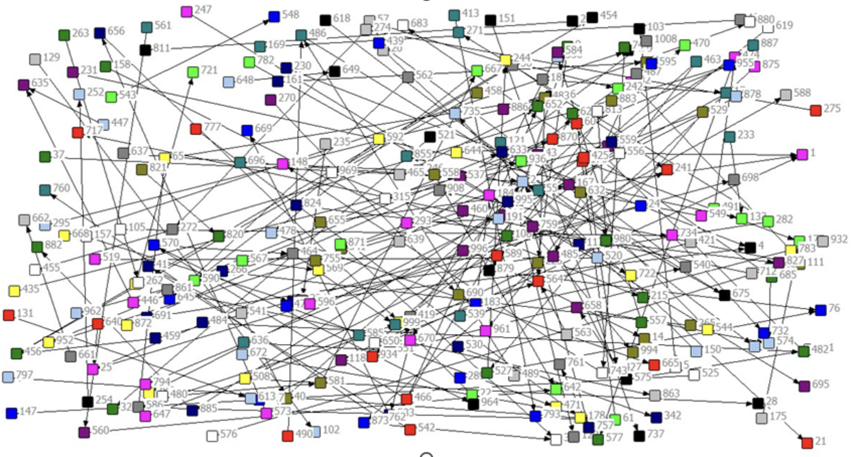
Is the collective still relevant? Yes!
Figure 1: Giving of food aid in Asli kebele, Somali region (986 HHs interviewed) (Flintan et al 2019)

Slide 7
And is directly linked to resilience of pastoral systems
Effect of community food redistribution on households' ability to cope with climatic shocks: IVREG results
 | Dependent variable: ability to cope with drought
 | Received aid and gave food to another household | Received aid and did not give food to another household
Household received food aid | 0.592*** (0.185) | -0.680*** (0.221)
Control variables | YES | YES
Region fixed effects | YES | YES
Constant | 2.950*** (0.154) | 3.465*** (0.141)
Number of observations | 1,983 | 1,983
^{Notes: ***} indicates statistically significant at 1%; in parentheses are robust standard errors.
Notes:
"We investigated the impact of food aid sharing on household (HH) capacity to cope with drought using an instrumental variables (IV) regression model, and we found that there was a positive relationship with the HH's own observation of how they coped with drought"????

Slide 8
Research on the importance of collectivity for transformation of pastoral food systems
How important is collectivity to resilience? Can collectivity be an indicator of resilience? Development of indicators of resilience.
Is collectivity and connectivity changing? Repeat food aid study in Ethiopia 2023/4.
What is relationship between collectivity, conflict and food systems? Farmer-herder conflict case studies
How to measure collectivity? Study on collective land tenure to identify indicators for inclusion in Prindex and other global land indicators.
Role of collectivity? What kind of collective management)is needed to support a sustainable transition of pastoral systems? Study in Tunisia and Senegal.
What impact do interventions have on collectivity? Study on impact of participatory rangeland management (PRM) on collectivity. Study on WFP’s humanitarian interventions in Kenya.
What is relationship between collectivity and social equity? How can collectivity be used to promote gender equality? Work on community conversations. Testing of social equity framework.
Notes:
What promotes collectivity? How can interventions be better designed to promote collectivity?
Important relevance with the UN International Year of Rangelands and Pastoralists coming up in 2026!

Slide 9

This presentation was produced as part of the CGIAR Research Initiative on Livestock and Climate which is supported by contributors to the CGIAR Trust Fund. cgiar.org/funders

Slide 10
Empirical analysis
We investigate the impact of food aid resharing on household (HH) capacity to cope with drought using an instrumental variables (IV) regression model:
$Y_{ik}=α+β{FoodShare}_{ik}+δX_{ik}+ε_{ik}$ (1)
$Y_{ik}$ = Capacity of HH $i$ in kebele $k$to cope with drought.
${FoodShare}_{ik}$ = The treatment variable.
Eq (1) estimated separately for two treatment dummy variables:
  1= HH received food aid and reshared; 0=otherwise.
  1= HH received food aid but did not reshare; 0=otherwise.
$X_{ik}$ = Control variables & $ε_{ik}$ = Error term.
Instrument = Average kebele-level food aid sharing links in the woredas, leaving out their own kebele.

Slide 11
Data
A household (HH) survey conducted in Ethiopia in 2018.
  Covered three regions: Somali, Oromia, Afar.
  Targeted kebeles that had received food aid during 2016-2017.
  A sample of 1,983 HH surveyed.
  Survey interviewed every HH in the selected Kebele.
  A few areas in Afar and Somali regions not accessible due to flooding.
  Survey included a detailed social networks module.
Survey complemented by key informant interviews (KIIs).

