Slide 1
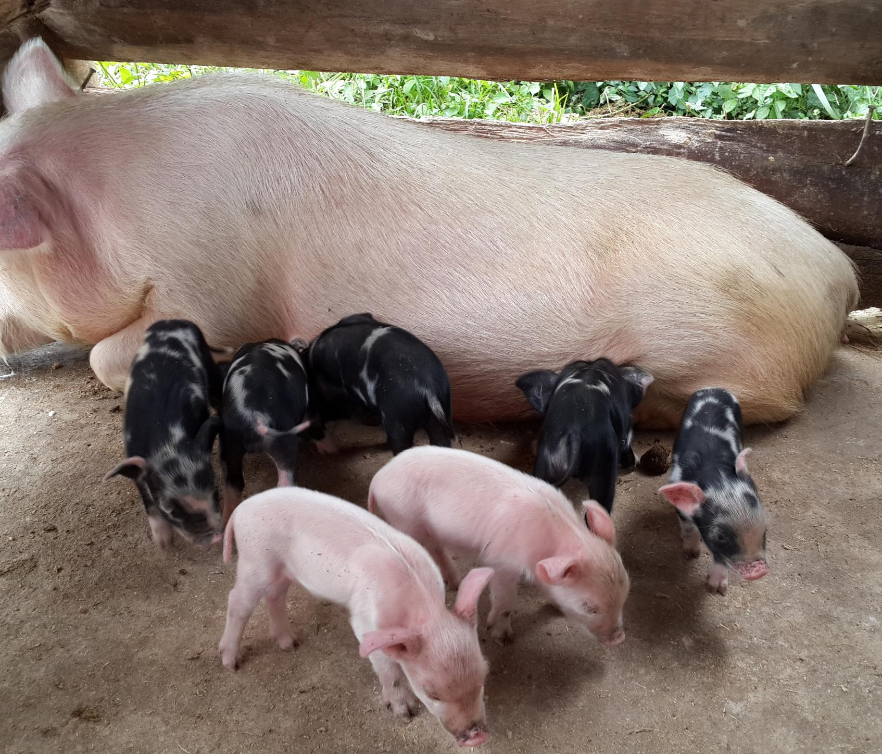
Accelerating sustainable safe pork production in Uganda
Michel Dione, ILRI
CGIAR Livestock CRP and GASL joint side event on national partnerships for sustainable livestock systems at the 7th All-Africa Conference on Animal Agriculture, Accra, Ghana, 30 July 2019

Slide 2
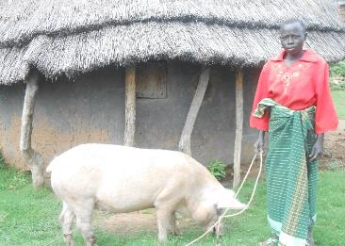
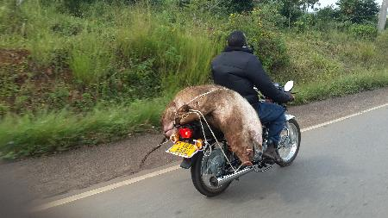
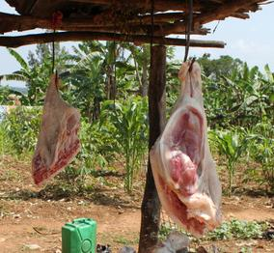
OUR AIMS
Critical challenges that the value chain faces
  Piggery is important source to livelihoods and income especially for the rural poor, but attract limited attention by the government
  Large informal sub-sector with not organised value chains, thus low efficiency
The key transformation(s) we seek to achieve in the value chain
  Development of an efficient, all-inclusive and sustainable pig value chain for safe and affordable products
Women pig farmer in Moyo
A trader transporting live pig in Hoima
Pork butchery in rural area (Masaka)

Slide 3
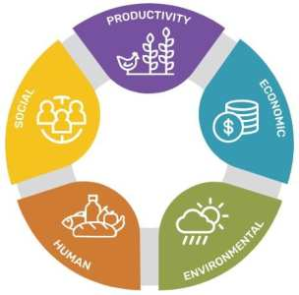
SUSTAINABILITY
Productivity: Improved productivity
  Increased sow productivity (number of piglets born per litter– for piglet producers; and number or piglets entering the fattening phase – for fatteners
  Improve weight gain
Economic: Improved farmer’s access to quality inputs, services and markets
  Improve bargaining power for better prices (enhances farmer resilience against price shocks)
  Access quality inputs and services at discounted prices (and better terms)
Environmental: Better management and disposal of pig waste
  Mitigate climate change (captures GHG emissions from decomposing waste)
  Generate clean energy, leading to reduced deforestation and disposal of waste into waterways
  Use bio-slurry for fertilisation of crop fields
Human: More safe and healthier pork
  Exposure to zoonotic disease risks reduced
  Capacities of value chains actors strengthened
Social: Gender equitable and inclusive
  Increase knowledge of roles of gender in the pig value chains
  Target vulnerable communities (women, children and youth)

Slide 4
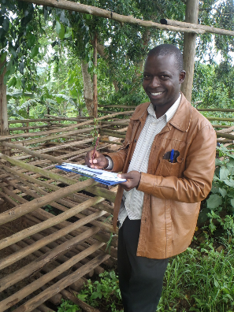
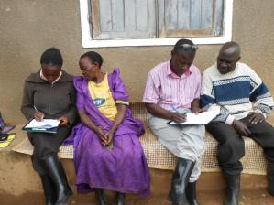
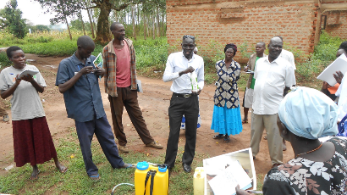
RESULTS
Value chain assessments, leading to:
  Increased interest in knowledge acquisition on the pig enterprise (challenges, opportunities and recommendations for research and development)
Tested interventions to upgrade the value chain at various nodes, leading to:
  Improved farmer resilience (increased farmer’s knowledge, access to market and change in practices)
  Better waste management and climate change mitigation at slaughter node (Biogas)
  Reduced exposure to zoonotic disease risks (Change in practices and improved hygiene and biosecurity)
  More equitable benefits (gendered interventions)
  Increased visibility of the smallholder pig sector (establishment of pig multi-stakeholder platforms)
Uptake of interventions by private sector, leading to:
  Interventions up taken by private companies (turned our products into training that they deliver and run)
Data collection during value chain assessment in Makara
Capacity building of farmers in biosecurity in Lira

Slide 5
PARTNERSHIPS
Partner | Roles | Roles |  | Why
Public sector
Ministry of Agriculture, Animal Industry and Fisheries* | Research compliance (ethical approvals of protocols and movement of genetic materials) Access to national statistics Development, enforcement and review and of policies and regulations Guide national priorities and interests to better target research Main target for policy recommendations |  | Need for institutional reforms to accommodate new technologies Need for Government champions | Need for institutional reforms to accommodate new technologies Need for Government champions
Local governments of district project sites | Support implementation of field activities (assessments, pilot testing) Facilitate interaction between value chain actors and researchers Disseminate research results |  | They are in direct interaction with value chain actors on the ground – key partner for upscaling interventions | They are in direct interaction with value chain actors on the ground – key partner for upscaling interventions
Research/education institutions
National Livestock Resources Research Institute (NaLIRRI)* | Partner in research development and implementation Support the project by availing reach facilities (labs, field trial, etc..) |  | Tap into the strength of NARS (they feel valued) Technology and knowledge transfer in country | Tap into the strength of NARS (they feel valued) Technology and knowledge transfer in country
Makerere University | Capacity building of nationals in pig research (MSc, PhD) |  | Knowledge transfer and local capacity development in country | Knowledge transfer and local capacity development in country
Iowa State University | Specific skills in pig breeding and genetics |  | Feel skills gaps | Feel skills gaps
Swedish University of Agricultural Sciences (SLU) | Specific skills in Herd Health |  | Feel skill gaps | Feel skill gaps
Private sector*
Pig Production and Marketing | Up-scale interventions (capacity building) |  | Need for additional investment to ensure access of value chain actors to technologies and profitability | Need for additional investment to ensure access of value chain actors to technologies and profitability
OrgaFarms | Up-scale interventions (Indigenous Micro-organismes models)
Wambizzi Coop. | Pilot testing of interventions (Biogas)
NGOs
Uganda Volunteers Efforts for Development (VEDCO)- Local | Implement field work (facilitation interaction with communities) |  | Service delivery | Service delivery
SNV | Lead the Multi-Stakeholder Platform (MSP) process |  | Advocacy – civil society | Advocacy – civil society
*Critical partnership for 'accelerating' research to use: Government, National Research Institutes and private sector

Slide 6
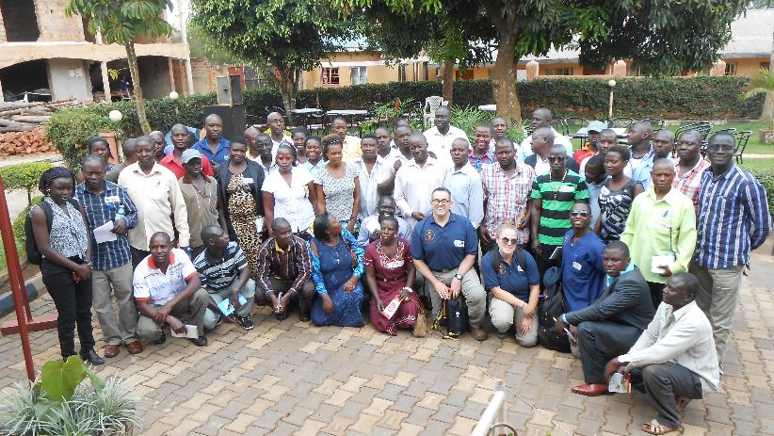
SELF-ASSESSMENT
What did we bring
  Funds through donors
  Knowledge and research skills
  Desire to accelerate research uptake through partnerships
What did the partners bring
  Competencies, efficiencies
  Knowledge (of local realities)
  Capital to improve public assets or services
How could we do it better
  Involve partners right from the development of the project (clarify scaling options)
  Engage partners in long term projects to achieve goals (ensure long term funding)
  Be willing and flexible to switch or add new partners if new expertise required
Training pork butchers in best practices in pig slaughtering in Mukono
(training delivered by an NGO – Veterinarians Without Borders)

Slide 7
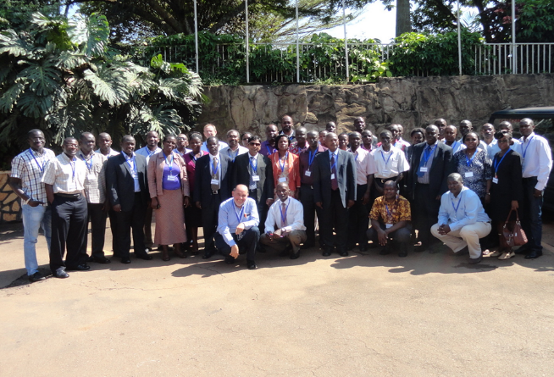
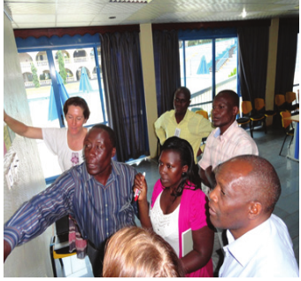
RECOMMENDATIONS
Effective partnership need trust between project team and partners - brought by ethical relationships and reliability, commitment to deliver from both parties
Common vision and road map to achieve aims - once partners feel valued (with specific roles and tasks) and they know how they can benefit, as well as their communities, it creates momentum
Need for champions (especially from the government side) to lobby and advocate policy reform to accommodate new agricultural technologies
Outcome mapping of the smallholder pig value chains development (SPVCD) project
Worksop with partners for validation of interventions in the SPVCD

Slide 8
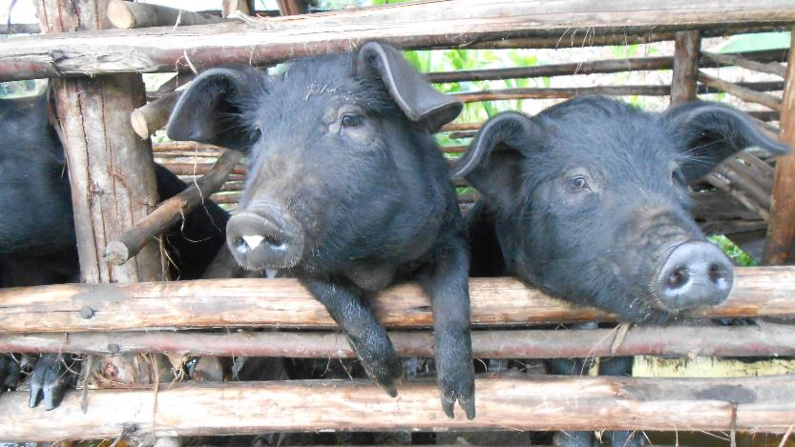
Acknowledgments
Emily Ouma
Danilo Pezo
Kristina Roesel
Ben Lukuyu
Peter Lule
Brian Kawuma
The ILRI Uganda team
Local and international partners
Smallholder pig value chain actors and stakeholders
CGIAR Research Program on Agriculture for Nutrition and Health (A4NH)
Our investors – IFAD, Irish Aid, GIZ, USAID

