Slide 1
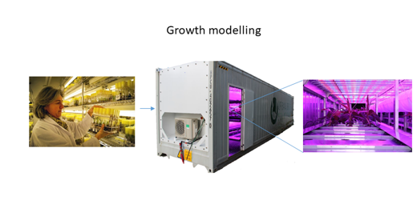
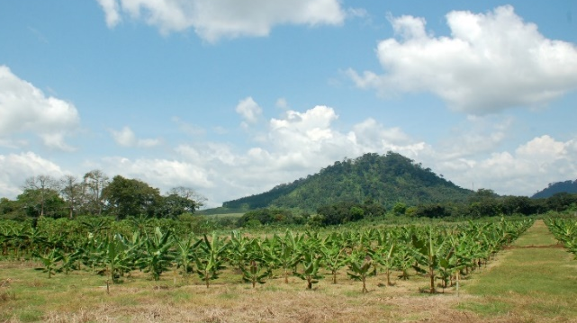


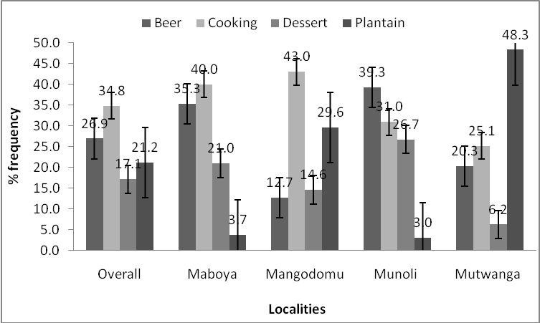
More Fruit Diversity for Food Security
Sebastien Carpentier¹, Lewis Machida², Anthony Frederick Tazuba², and Daan Van Gils¹
¹Alliance of Bioversity International and CIAT Leuven, Willem Decroylaan 42 3001 Leuven Belgium, ²Alliance of Bioversity International and CIAT Africa-Kampala Office – Kampala, c/o National Agricultural Research Laboratories (Kawanda), 15 km Along Bombo-Gulu Road – Box 24384, Kampala, Uganda, Email: l.machida@cgiar.org
Banana (Matooke) is a staple crop in Uganda and the east and central African region (Tanzania, Rwanda, Burundi, Kenya, and Democratic Republic of Congo).
Climate change is expected to increase the growing area of bananas in general but for Matooke this is expected to decrease due to the increased evaporative demand.
To avert climate change and drought-induced food shortages and hunger in the Matooke growing areas, mapping the current banana diversity in function of the environment is, therefore, urgently needed to give atooke farmers more cultivar options for improved on farm diversity and resilience to climate change .
More than 1600 germplasm accessions kept at the International Transit Centre are currently available for this mapping exercise
Strengthening of collaboration with partners is currently going on, with NARO, TARI and IITA endorsing the need for the mapping exercise for the benefit of breeding programs
A proof of principle of diversity funded by the Belgian Development Cooperation has been delivered but we need more resources to scale up jointly with NARO, TARI and IITA for the benefit of farmers in different agro-eco zones of the East African Great Lakes region
In Vitro Culturing and Multiplication
Bananatainer Evaluation & Screening
Greenhouse Evaluation & Screening
Field Characterization, Evaluation & Screening
Breeding Program Parents, crop wild relatives (CWR), new hybrids, are multiplied for high throughput phenotyping in the Bananatainer
Controlled environment where light, temperature, CO₂ and moisture are controlled to simulate future climates. Genotypes are first phenotyped and screened in the Bananatainer, and the best genotypes are advanced to the greenhouse for further phenotyping and genetic characterization. Best genotypes from greenhouse are advanced to the field for validation and consumer acceptance evaluation.
Systematic morphological and physiological field characterization of diverse sets of germplasm from the Bananatainer under irrigated and non irrigated regimes. Soil moisture sensors, plant canopy sensors. (photosynthesis), complete weather data collection will be used for crop growth modelling to produce farmer preferred varieties
More control and speed
More agricultural relevance

Slide 2
More Fruit Diversity for Food Security

