Slide 1
2023 Learning and Optimization Process
Focus Group Discussion on the Results Framework
Online, 22 June 2023

Slide 2
Objectives
Understand
what went well - why
what didn’t – why and
how we might improve
Focusing on the Results Framework

Slide 3
Proposed Agenda
Introductions and setting the Results Framework FDG stage - 15’
Discussions on celebrating and framing a brighter future - 55’
  MIRO board
  Survey
Bringing the small group discussions together - 15’
Wrapping up and what next - 5’

Slide 4
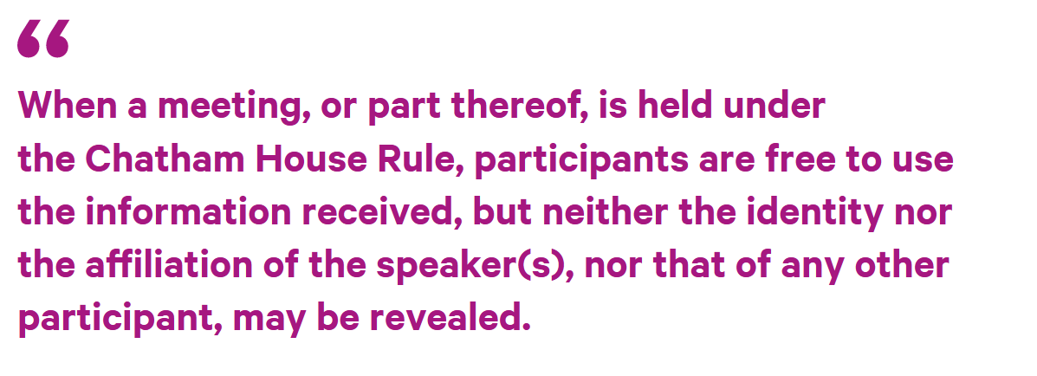

used around the world to encourage inclusive and open dialogue in meetings.
It allows people to speak as individuals, and to express views that may not be those of their organizations, and therefore it encourages free discussion.
People usually feel more relaxed if they don’t have to worry about their reputation or the implications if they are publicly quoted.

Slide 5
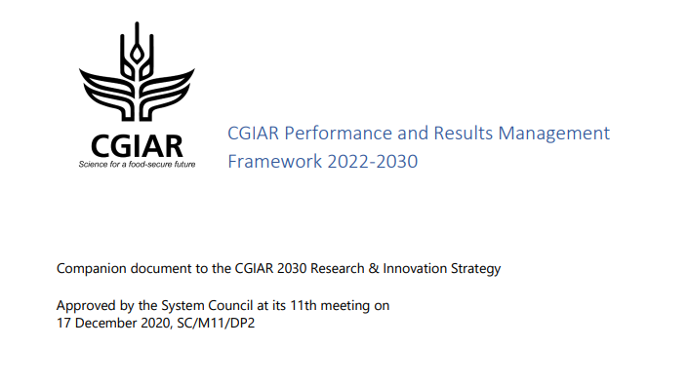
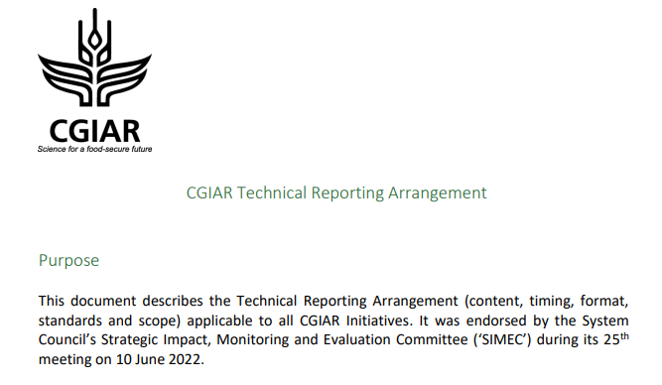



Overview: Technical Reporting progress
Develop and activate a fit for purpose performance and results management solution for CGIAR
Dec 2020
September – November 2022
June 2022
IDT Engagement
Template finalisation
Performance & Results Management System build
https://cgspace.cgiar.org/bitstream/handle/10568/113793/SC11-03b_CGIAR-Performance-and-Results-Management-Framework-2022-30_postmeeting.pdf?sequence=8
https://storage.googleapis.com/cgiarorg/2022/06/CGIAR-Technical-Reporting-Arrangement-June2022.pdf
Pooled funding Technical Reporting
Process & Product
Kicked off in Dec.
Published Type 1, Type 3 and Portfolio Narrative reports
Started the Learning and Optimization exercise (Global Survey, Focus Group Discussions, and 1:1 interviews)
December 2022
April – June 2023
Big picture: We are globally on track
June 2023
Notes:
IDT engagement plan in Annex
Links to draft templates
RF next steps in Annex

Slide 6
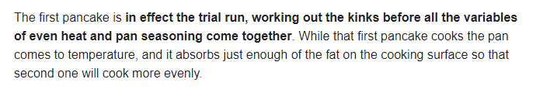


The First Pancake
Common Results Framework
Quality Assured Data
Common template
Dashboard
PRMS
Q2
Reflect Adaptive Management
Innovation Packages & Scaling Readiness
Results linked to TOC

Slide 7

Learning and Optimization – Q2
X-cutting themes
Conceptual
Capacity
Stakeholder groups
Data collection and sensemaking Tools
System
Survey
Focus groups
Deep dive interviews
Pillars
PRMS
RF
Etc.
Reflect
IPSR
QA
Workflow
Process
Report &
Action Plan
Product

Slide 8
Stop here for Intro session

Slide 9
Results Framework – setting the scene
Delivery promise of the One CGIAR Portfolio in the PRMF
All CGIAR Initiatives within these Investment Plans will develop an accountability framework of the results that CGIAR intends to deliver or demonstrably contribute towards. Initiatives will systematically measure and be accountable for Initiative outcomes and associated outputs and will use the theory of change to demonstrate progress along impact pathways towards the ultimate collective global targets.
CGIAR will invest in obtaining causal evidence of impact on specific targets that can be jointly attributed to CGIAR and its partners acknowledging that such impacts are not obtained by CGIAR alone. The research strategy envisioned to obtain such causal evidence will be integrated in the research design of each Initiative.
CGIAR Initiatives will:
  Plan and report annual progress against a theory of change (ToC) that incorporates results and indicators across the spheres of control, influence and interest as detailed above,
  Develop annual plans of work and budget, track progress and provide an annual report against their stated objectives and results achieved,
  …
Source: CGIAR PRMF, 17.12.2020

Slide 10
Results Framework – setting the scene
What is the One CGIAR Results Framework?
Results framework – tables
Table A Impact Areas, collective global 2030 targets, common impact indicators and SDGs
Table B Action Area Outcomes and Outcomes Indicators
Table C Initiative and Work package outcomes, outputs and indicators
… related
Table D MELIA studies and activities
Standard Indicator Definition Sheets (SIDS) for
1. outputs and
2. outcomes
Focus for our discussions
Sources: Guidance for Monitoring, Evaluation, Learning and Impact Assessment (26.10.2021), Type 1 Reporting template v4 (29 Mar 2023); Output level SIDS, draft v3 (3 Dec 2022); Outcome level SIDS, draft v2 (9 Nov 2022)
Notes:
We are reviewing the current impact area indicators in order to provide a clear definition of each and suggested good methods for measuring them. We are also collecting feedback on how to improve upon these indicators for a next version.
We had reviewed and revised the AA outcome statements and indicators in late 2022.
GI discussed them with their key funders and thus began to use them in 2022.
ST and RAFS did not integrate them into the 2022 reporting and are now finalizing them for use in 2023 reporting.
AA outcomes will focus on next users of research outputs.

Slide 11
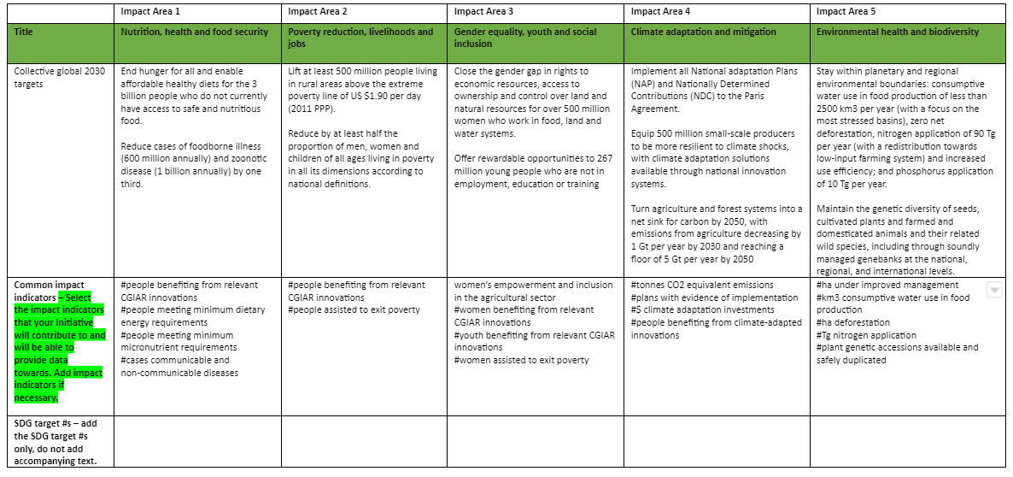
Results Framework – setting the scene
Table A Impact Areas, collective global 2030 targets, common impact indicators and SDGs
Current impact area indicators are under review to provide a clear definition of each and suggested good methods for measuring them. We are also collecting feedback on how to improve upon these indicators for a next version.

Slide 12
Results Framework – setting the scene
Table B Action Area Outcomes and Outcomes Indicators Used For 2022 Technical Reporting
Genetic Innovations | Resilient Agri-food Systems | Systems Transformation
GI 1 - Farmers, researchers, breeders, and others worldwide access and use germplasm managed by genebanks, generating and sharing benefits equitably. | RAFS 1 - Smallholder farmers use resource-efficient and climate-smart technologies and practices to enhance their livelihoods, environmental health and biodiversity | ST 1 - Farmers use technologies or practices that contribute to improved livelihoods, enhance environmental health and biodiversity, are apt in a context of climate change, and sustain natural resources.
GI 2 - CGIAR-NARS-SME networks use market segments, product profiles and pipeline investment cases to orient variety development and deployment towards those that provide larger scale benefits across the 5 impact areas | RAFS 2 - Research and scaling organizations enhance their capabilities to develop and disseminate RAFS-related innovations | ST 2 - Consumers have the information, incentives and wherewithal to choose healthy diets.
GI 3 - National and private seed company breeding programs accelerate the development of varieties that provide larger scale benefits across the 5 impact areas. | RAFS 3 - Public and private financial resources are invested to fund climate smart business models | ST 3 - Governments and other actors take decisions to reduce the environmental footprint of food systems from damaging to nature positive.
 |  | ST 4 - Food system markets and value chains function more efficiently, equitably, and sustainably and lead towards healthier diets.
GI 4 - Integrated public and private seed systems increase the quantity of seed of improved varieties available to farmers in priority crops and geographies. | ST & RAFS 1 - Smallholder farmers implement new practices that mitigate risks associated with extreme climate change and environmental conditions and achieve more resilient livelihoods.
GI 5 - Integrated public and private seed systems increase the rate of adoption by farmers of new varieties for priority crops and geographies. | ST & RAFS 2 - National and local governments utilize enhanced capacity, skills, systems, and culture to assess and apply research evidence and data in policy making process. | ST & RAFS & GI 1 - Women and youth are empowered to be more active in decision-making in food land and water systems
We had reviewed and revised the AA outcome statements and indicators in late 2022.
GI discussed them with their key funders and thus began to use them in 2022.
ST and RAFS did not integrate them into the 2022 reporting and are now finalizing them for use in 2023 reporting.
AA outcomes will focus on next users of research outputs.

Slide 13
Results Framework – setting the scene
Table C Initiative and Work package outcomes, outputs and indicators
Result type (outcome or output) | Result | Indicator (use the common indicator list above) | Unit of measurement | Geographic scope | Data source | Data collection method | Frequency of data collection | Baseline value (outcome only) | Baseline year (outcome only) | Target value | Target year
Mostly related to the ToC, planning and updating
… related Standard Indicator Definition Sheets (SIDS) for
1. outputs level and 2. outcomes level

Slide 14
Results Framework – setting the scene
… related Table D MELIA studies and activities
Type of MELIA study or activity planned | State the result or indicator that the MELIA study or activity will contribute to – Select from Tables A, B or C. | Anticipated year of completion (based on 2022-25 Initiative timeline) | Co-delivery of planned MELIA study or activity with other Initiatives | How the MELIA study or activity planned will inform management decisions and contribute to internal learning

Slide 15
Stop here for Setting the Scene session

Slide 16
Questions to reflect on
Broad
Considering the reporting against the One CGIAR Results Framework, …
1) *… the one/first thing that comes to you mind that you really liked about the Results Framework is …
… any other things that worked well (for you) and why? i.e. we should maintain doing this in the next reporting cycle.
Do we need to do more of this or just keep up?
2) *… the one/ first thing that comes to your mind what we need to tackle and improve is …
… any other things that did not work (for you) and why? How can we improve this?
How important crucial is this (L/M/H)?
3) *… anything else that needs to be taken note of?
Notes:
Summary:
The Report -> Reflect -> Plan sequence is intended to:
Give structured space for Initiatives to exercise learning-driven adaptive management during implementation
Reduce burden on Initiatives by integrating reporting, program management and planning processes
Background:
CRP leaders reportedly found it difficult to adjust financial and staff plans in the year ahead in light of experience gained from the previous year. The systems were complex and slow, and annual reports for the previous year were submitted after the planning was completed for the year ahead.
Changing the annual sequence of reporting and planning for Initiatives gives us the opportunity to change this, and to create a formal process for adaptive management by Initiative leads and co-leads.
This new sequence, set out in the figure below, will see Initiatives report on the previous year’s progress by 25th January. This means that each year, before plans and budgets are set in February, each Initiative will have a window of opportunity to reflect on progress in the current year, on any changes in their operating context, and on any changes to the outlook. On the basis of those reflections, the Initiative can make recommendations to reprioritize budgets and planned activities for the year ahead, between their work packages and within their overall budget envelope. The recommendations would be approved by Science Group Directors, and both reflections and recommendations would be documented in a light-touch way. We are calling this process the ‘reflect’ process.
This process would give Initiative leaders a clear process and mandate to adjust Plans of Results and Budgets for the year ahead – shifting the delivery priorities for their teams, and shifting budgets between Work Packages if necessary, to help the Initiative best navigate towards delivering their End of Initiative Outcomes and maximize their ultimate contribution to impact.

Slide 17
Questions to reflect on
Details for consideration
Considering the reporting against the One CGIAR Results Framework, did you have any difficulties in …
… mapping some outputs to your initiative? [yes/no/ n/a] What were the particular cases and how did you make your decision?
… deciding whether to report certain types of outputs? [yes/no/ n/a] Which ones and what did you decide to do?
… identifying the appropriate type of output for some outputs? [yes/no/ n/a] Which were particularly challenging and what did you decide?
… identifying whether certain knowledge products were MELIA related? [yes/no/ n/a] Provide an example and how you made the decision.
… scoring any of your outputs as principal/significant for gender and/or climate? [yes/no/ n/a] Please elaborate on the particular challenges.
… conducting quality reviews (content and editing) of outputs that did not receive any quality review by a center or peer-review process? [yes/no/ n/a] What do you recommend to address this issue?
There were many outputs reported as ‘other outputs’.
  Did you have any outputs that were related to engagement with partners and other stakeholders? [yes/no/ n/a]
  Would it be useful to create an explicit category for engagement [yes/no/ n/a]
  What other categories of outputs that could be created to reduce the number of ‘other outputs’? [open text]
Notes:
Summary:
The Report -> Reflect -> Plan sequence is intended to:
Give structured space for Initiatives to exercise learning-driven adaptive management during implementation
Reduce burden on Initiatives by integrating reporting, program management and planning processes
Background:
CRP leaders reportedly found it difficult to adjust financial and staff plans in the year ahead in light of experience gained from the previous year. The systems were complex and slow, and annual reports for the previous year were submitted after the planning was completed for the year ahead.
Changing the annual sequence of reporting and planning for Initiatives gives us the opportunity to change this, and to create a formal process for adaptive management by Initiative leads and co-leads.
This new sequence, set out in the figure below, will see Initiatives report on the previous year’s progress by 25th January. This means that each year, before plans and budgets are set in February, each Initiative will have a window of opportunity to reflect on progress in the current year, on any changes in their operating context, and on any changes to the outlook. On the basis of those reflections, the Initiative can make recommendations to reprioritize budgets and planned activities for the year ahead, between their work packages and within their overall budget envelope. The recommendations would be approved by Science Group Directors, and both reflections and recommendations would be documented in a light-touch way. We are calling this process the ‘reflect’ process.
This process would give Initiative leaders a clear process and mandate to adjust Plans of Results and Budgets for the year ahead – shifting the delivery priorities for their teams, and shifting budgets between Work Packages if necessary, to help the Initiative best navigate towards delivering their End of Initiative Outcomes and maximize their ultimate contribution to impact.

Slide 18


Celebrating what went well what I liked about the Results Framwork
  Go to
  MIRO board or
  Survey
  to share your recommendations and feedback
Right amount or more of?

Slide 19

Results framework: imagining a brighter future
Framing 2024
A copy of the MELIA guidelines including the Standard Indicators Definition Sheets (SIDS) for outputs and outcomes – here - to place your improvement suggestions
  Go to
  MIRO board or
  Survey
  to share your recommendations and feedback

Slide 20
Identifying priority areas
Stop here for celebration and framing the future

Slide 21
Next steps
We will review all the inputs and then to send a follow-up email to all participants to acknowledge their suggestions and note how we intend to respond. Perhaps in some cases we will have already started taking actions.
Results Framework Focus Group Discussion report will feed into overall Learning & Optimization (L&O) report
Presentation (to Initiative teams + Senior Managers) of feedback gathered on 2022 Technical Report – early Jul. 2023
Publication of L&O report – mid-Jul. 2023
Acting on items list resulted from learning process: Jul. – Jan. 2024

Slide 22
Thank You!

