Slide 1
Gender Transformative Approaches in agrifood systems
A course in four modules
Version 1 (2024)
Anjalee Kohli, Elizabeth Costenbader, and Steven Cole

Slide 2
Welcome

Slide 3


Introductions
Introduce yourself in chat
Name, where you are located, role/institution
Notes:
Read slide

Slide 4

Introductions
In chat:
What are you hoping to learn today?
Notes:
Read slide, ask a few people to share in chat and verbally.

Slide 5
Introductions
In chat:
What is something that made you smile today?
Notes:
Read slide, ask a few people to share in chat and verbally.

Slide 6
COURSE Learning Objectives
Objective 1
Objective 2
Objective 3
Objective 4
Understand the value of using gender transformative approaches in agrifood systems
Understand concepts important to gender transformative approaches
Understand how gender transformative approaches are operationalized
Understand how to measure gender transformative change
Notes:
Read slide

Slide 7

Our Roadmap
We are here!
1
2
3
4
Gender transformative approaches
in agrifood systems
Characteristics important to gender transformative approaches
Operationalizing gender transformative approaches
Measuring gender transformative change
Notes:
Read slide.
This is module 1.

Slide 8
The importance of gender and approaches to gender in agrifood systems
Module 1

Slide 9
Learning Objectives
1
Explore the importance of gender in agrifood systems
2
Explore the continuum of gender approaches used by researchers and practitioners and their strengths and limitations
3
Define gender transformative approaches and their characteristics
Notes:
Read slide

Slide 10
CONTENTS
1
Gender in agrifood systems
2
Core areas of gender equality
3
Gendered agrifood system framework
4
The continuum of gender approaches
5
Gender transformative approaches
Notes:
Introduce the contents of Module 1

Slide 11
Gender in agrifood systems
Section 1

Slide 12
What do agrifood systems mean to you?
Notes:
Interactive, ask the participants to describe/name examples

Slide 13
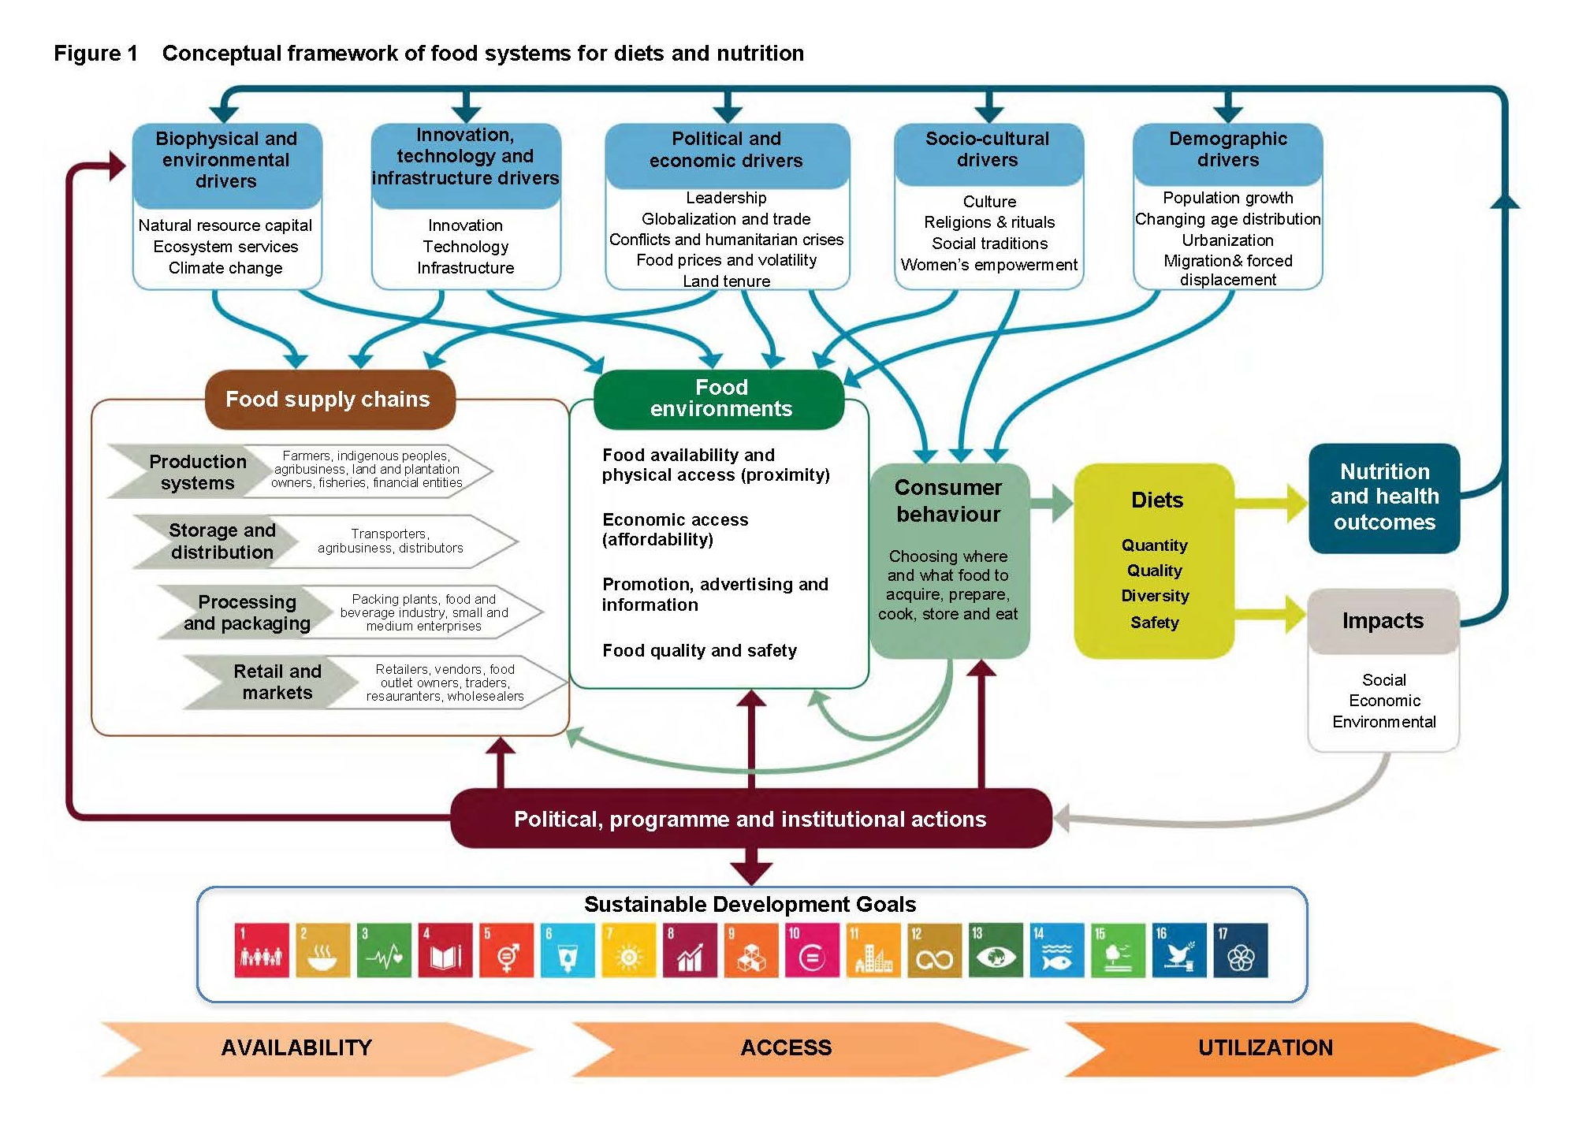
AGRIFOOD
SYSTEMS
Sources: HPLE 2017. https://openknowledge.fao.org/server/api/core/bitstreams/4ac1286e-eef3-4f1d-b5bdd92f 5d1ce738/content
Notes:
The Agrifood systems framework was developed in 2017 by a high-level panel of experts. It demonstrates the complexity of agrifood systems.
The overall framework is guided by the idea that all people have the right to adequate food that meets the minimum requirements for survival and is nutritionally adequate for health and well-being.
The framework shows the elements of the agrifood system and the interactions of these elements with each other and with other systems such as health, energy and transportation.
This framework is different than earlier models of the agrifood system as it (1) highlights the central role of the food environment (see green box in the middle of the framework) in facilitating nutritious, healthy and sustainable consumer food choices; (2) emphasizes the role of diets as a core link between agrifood systems and their nutrition and health outcomes; and (3) takes into account the impact of agriculture and food systems on sustainability in three dimensions (economic, social and environmental).
The framework details the constituent elements of food systems – with their drivers, actors and elements as wella s their interactions with each other and other systems (e.g., health, energy, transportation). These systems are not stagnant, they are changing, evolving and interlinked.
• As compared to earlier models of the food system, this framework highlights the central role of the food environment in facilitating nutiritous, health and sustainable consumer food choices (green box in the middle of the framework); emphasizes the role of diets (see yellow box in the middle of the framework) as a core link between food systems and their nutrition and health outcomes; and accounts for the impacts of agriculture and food systems on sustainability in its three dimensions (economic, social and environmental)
The 5 main categories of drivers of agrifood systems change are at the top of the framework in the blue boxes.
• Examples of biophysical and environmental drivers: natural resource and ecosystem services, climate change
• Examples of innovation, technology and infrastructure drivers include new methods of farming, seeds, and roads.
• Examples of political and economic drivers: globalization, trade, food policies, etc
• Examples of sociocultural driers include culture, religion, social tradition
• Examples of demographic drivers include population growth, urbanization, and migration.
The three core constituents of food systems – shown in the middle of the framework – are food supply chains, food environments and consumer behavior. These are influenced by 5 drivers. They and shape diets and determine final nutrition, health, economic and social outcomes of food systems.
• Food supply chains include the activities and actors that take food from production to consumption and to the disposal of waste. There are many actors in the food supply chain – private, public, small and large scale – and they work across production to markets. Changes in one element of the food supply chain affect the other elements. The food supply chain has a role in the nutritional value of food, for example through food storage, fortification and decreasing food loss.
• Food environments are another core constituent of food systems. These are the physical, economic, political and sociocultural surroundings, opportunities and conditions. They shape people’s preferences, food choices and nutritional status. The food environment includes food that is purchased or that a person produces. It also includes the infrastructure that gives people access to food environments and the individual determinants of a persons’ food choices (such as their income) and the norms underlying what is available and their choices.
• The third core constituent is consumer behavior. This includes all the choices and decisions made by consumers at the household or individual level – what to acquire, store, prepare, cook and eat and the allocation of food in a household (age, gender, etc.). This is influenced by personal preferences and elements of the food environment (eg food prices, income, knowledge, etc)
The outcomes of the framework are diet, nutrition and health outcomes and impacts.
• Diets are the individual foods people consume. Dietary patterns are the quantities, proportions, and combinations and quantities of foods and beverages.
• The nutrition, health, environmental, economic nad social outcomes of diets include a range of factors such as preventing malnutrition and reducing non communicable diseases.
This framework accounts for many elements of the agrifood system. And we see it is missing key elements. Gender is an important lever for progress in all aspects of the agrifood system. It has often been missed and it is not included in this framework. Gender includes women’s empowerment, women’s economic empowerment and gender transformative approaches.
Agrifood systems are anchored in a socio-cultural and gendered system. It is important to consider these elements at the individual and collective level and to understand how they affect a persons engagement with and experience in agrifood systems and their nutrition and health outcomes.
As we go forward, we will continue to explore the importance of gender to agrifood systems and then propose a different framework that explicitly includes gender and women’s empowerment

Slide 14
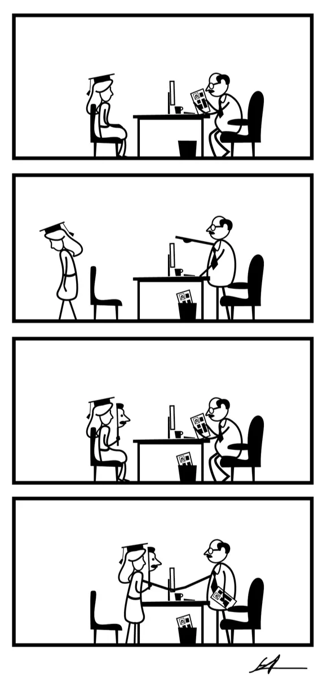
How does gender influence agrifood systems in your area of work?
What are the key gender issues that constrain women and/or men agrifood system actors in your context?
How do these gender issues differentially impact women’s and men’s opportunities and development outcomes?
Image source: Samuel Akinfenwa Onwusa, Spain from UN Women Gender Equality Comic Winners.
Notes:
Interactive, read each question and ask the participants to name examples

Slide 15
Core areas in gender equality
Section 2
Notes:
Before introducing another agrifood systems framework that includes a strong gender perspective, let's unpack the core areas of gender equality.

Slide 16
Gender
Part of a person’s social and personal identity.
Refers to outward social markers, including their name, outward appearance, mannerisms, and dress.
A person’s sex and gender may not necessarily be the same.
An individual’s gender may or may not correspond with their sex assigned at birth, and some people may identify as neither exclusively male nor female.
Definition:
Gender
Notes:
This definition of gender comes from the Human Rights Center. Read the slide

Slide 17
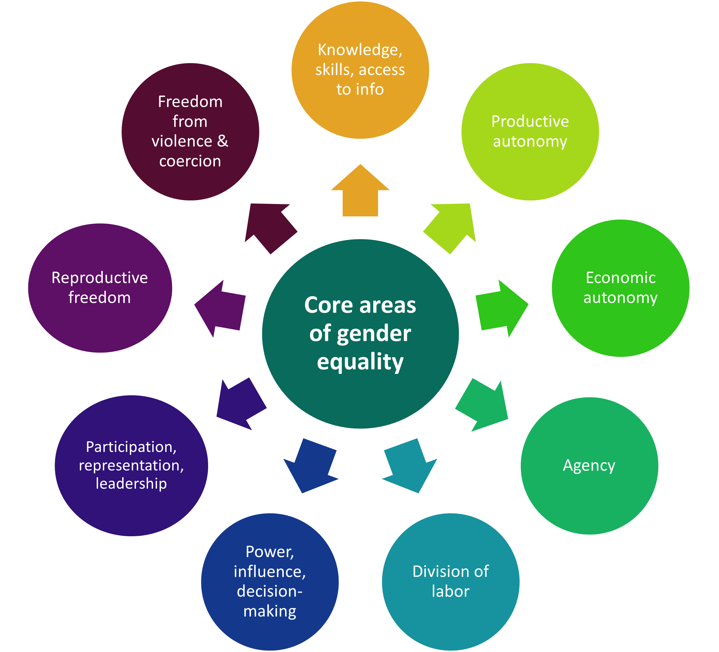
9 core areas of gender equality
Notably, some of these areas are challenges that women face within their households/families.
Others are more specific to workplace and community environments.
Source: FAO 2022
Notes:
According to FAO (2022), there are 9 core areas of gender equality, as shown in this figure.
The Joint Program on Gender Transformative Approaches identified these 9 core areas of gender equality in their theory of change for gender transformative programming. These are the areas they considered important to change as part of gender transformative programming. They include areas where restrictive gender norms disfavor and restrict choices, opportunities and rights.
Improvements in gender relations and gender equality of social institutions will result in empowering women and increasing their choices, opportunities and rights.
These 9 areas of gender equality are interrelated and overlapping. Changes in one area may affect changes in another area.
As we go forward, we will see that some of the areas represent challenges in different environments including the home, workplace and community.

Slide 18
Access to formal employment and a decent wage;
Means of earning an independent personal income;
Markets and value chains;
Financial services;
Social protection;
Informal employment;
Ownership of and control over assets (financial, housing, etc.).
core area: ECONOMIC AUTONOMY
Source: https://www.womanstats.org/maps.html
Notes:
We will start with core areas that affect women in the larger social sphere/public domain.
Read the slide.

Slide 19
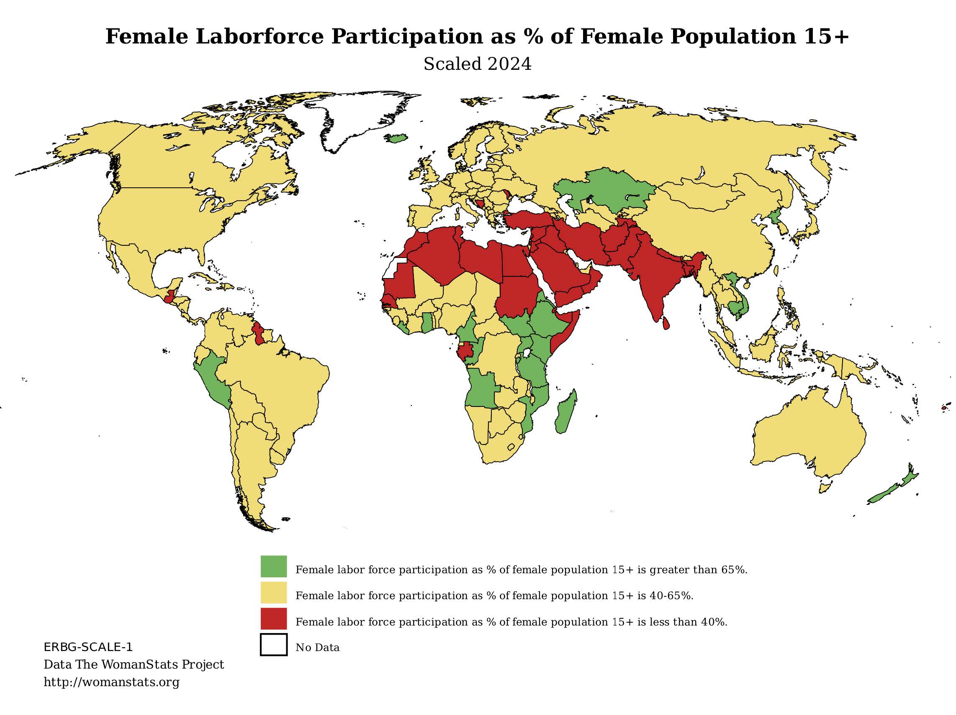
core area: ECONOMIC AUTONOMY
Women in AFSs earn 82 cents for every dollar earned by men in AFSs.
Closing the gender gap in farm productivity and the wage gap in AFSs would increase global gross domestic product by nearly USD 1 trillion and reduce the number of food-insecure people by 45 million.
Sources: FAO 2023a
Image source: https://www.womanstats.org/maps.html
Notes:
This slide shares an example of economic autonomy. The map shows the percent of the female population 15 years and older. The green color indicates that 65% or more of the female population is in the labor force. The red color indicates less than 40% of the female population aged 15+ is part of the labor force.
Read the slide

Slide 20
core area: PRODUCTIVE AUTONOMY
Access to and control over natural productive resources and services including land, water, livestock, fisheries, forestry resources, seeds, fertilizers, tools and technology, such as information and communication technologies (infrastructure and advisory/extension services).
Notes:
Read the slide (definition of productive autonomy).
Women working in agrifood systems often lack access to critical agricultural inputs (seeds, fertilizers), tools (plows, tractors), information and communication technologies (phones, radios) and extension services (agricultural extension workers). As a result, they have less opportunity to produce compared to men.

Slide 21
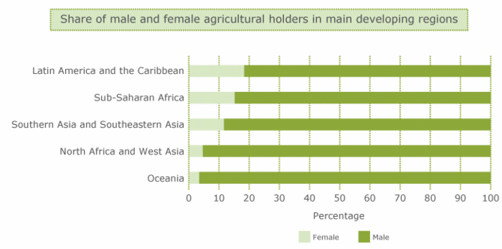
core area: PRODUCTIVE AUTONOMY
Share of male and female agricultural landholders in developing regions
Source: FAO 2011
Notes:
This slide shows the share of male and female landholders in developing regions. We see the darker green is the percent of male landholders. It shows how few women actually own land.
Another example, if needed. A radio campaign in Ghana sought to reduce gender barriers in agricultural work. The campaign was implemented in areas where women farmers take on extension activities that typically engage men. Before the inclusion of women, agricultural extension workers would not include women in activities if their husbands were not available. This limited the reach and influence of programming and systematically excluded women despite their involvement in agrifood systems.

Slide 22
core area: Knowledge, skills and access to information
Knowledge, skills (literacy, financial literacy, soft skills and technical knowledge) and access to information.
Source: Statista 2022
Notes:
Read the slide.

Slide 23
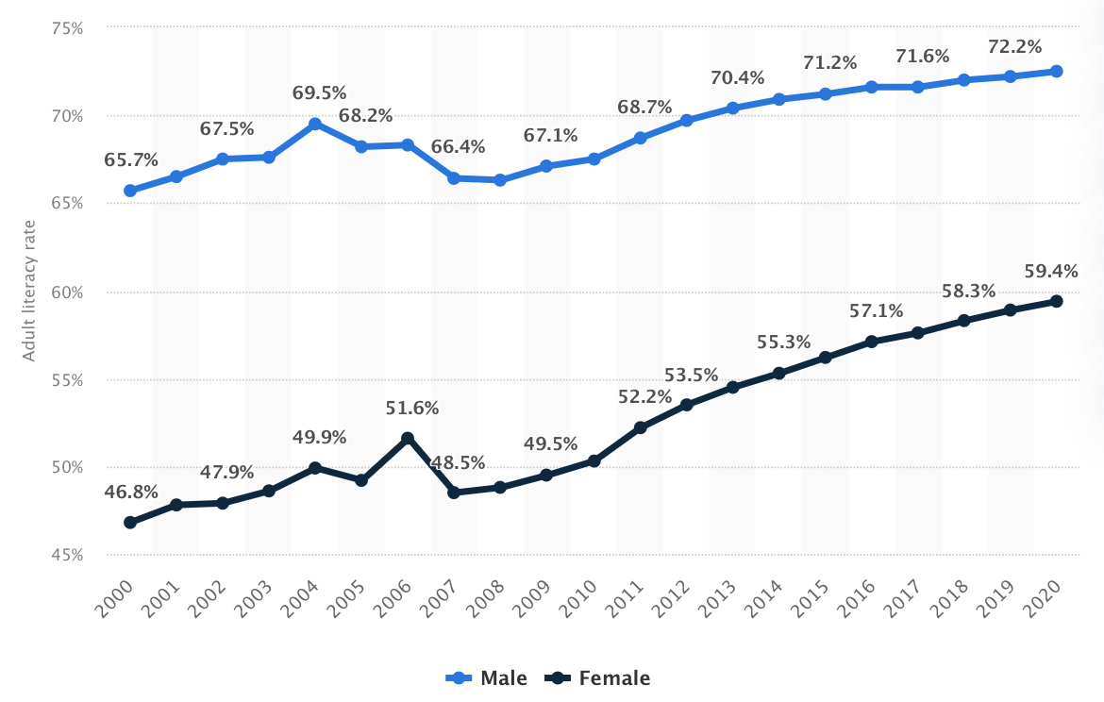
core area: KNOWLEDGE, SKILLS AND ACCESS TO INFORMATION
Adult literacy rate in Sub-Saharan Africa by gender, 2000 to 2020
Source: Statista 2022
Notes:
This slide shows the adult literacy rates in Sub-Saharan Africa by gender. The black line shows women’s literacy rates and the blue line shows men’s. This is relevant to agrifood systems. Some programs, services, or events may rely on a person’s literacy to read the program materials, understand the services they are eligible to participate in, or receive benefits. Men and women who are not literate would be excluded from these programs.

Slide 24
core area: POWER, INFLUENCE AND DECISION-MAKING
Equal participation in decision-making at the household level—over issues such as mobility, economic activity, income, production and nutrition—as well as in the community and other public spheres at the regional and national levels.
Notes:
Read the slide.

Slide 25
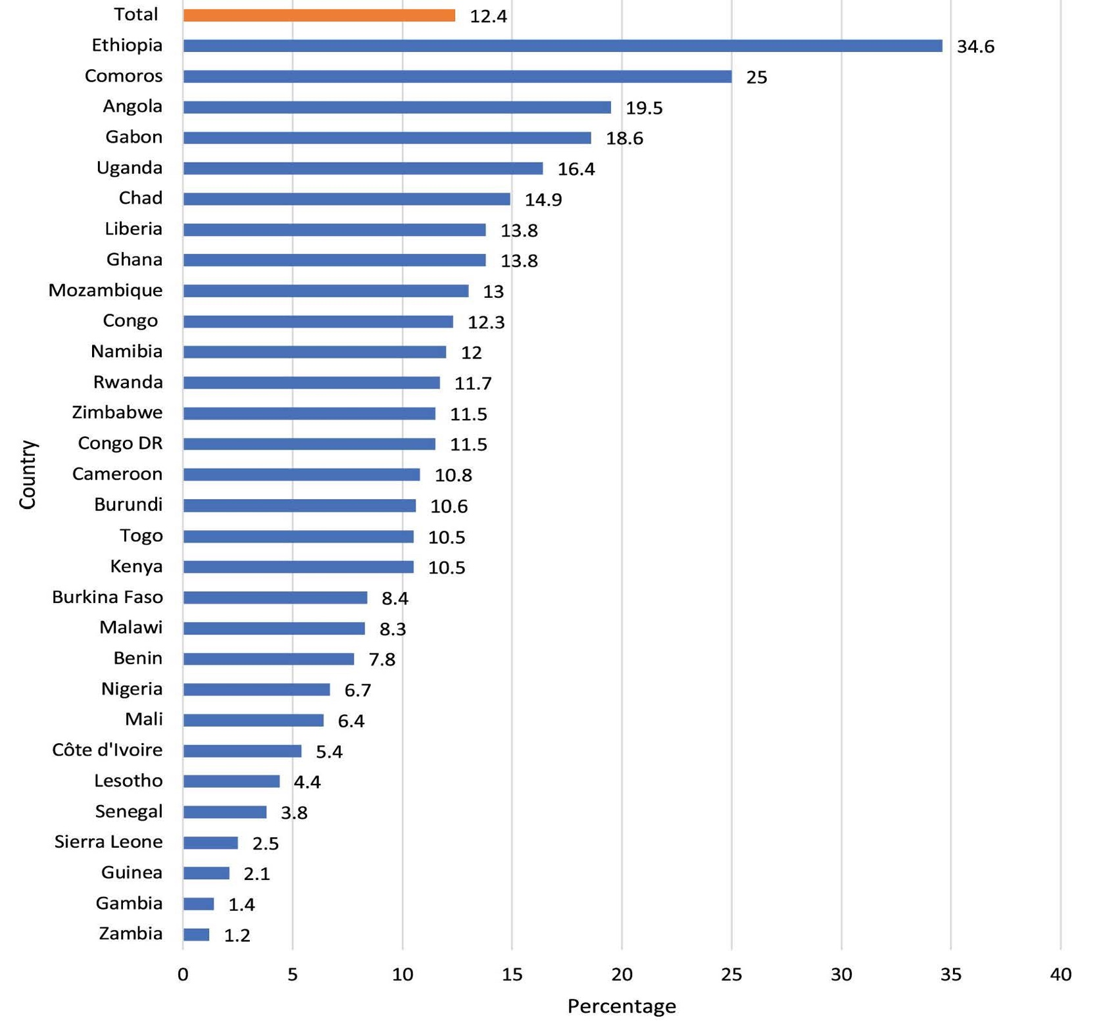
core area: POWER, INFLUENCE AND DECISION-MAKING
Proportion of women who have the capacity to make household decisions in 30 Sub-Saharan Africa countries 2020
Source: Seidu 2020
Notes:
The graph shares an example of this core area, specifically the proportion of women who can make household decisions in 30 sub-Saharan African countries in 2020. Overall, this graph shows that women are not making decisions for the household. This can include decisions on mobility, economic activity, use of income, production, and nutrition. While not shown here, women’s engagement in decision-making in public spaces, including their local communities, is similarly low.

Slide 26
Ability to make own choices and act upon them, including self-esteem, self-efficacy and aspirations:
“I feel empowered when I can take decisions about the cattle I raise and can decide how to use the income from the cattle.”
(Tanzanian livestock and nutrition study participant) (Source: Price 2018)
core area: AGENCY
Source: Price 2018
Notes:
Different definitions of Agency exist. Here we show one definition – read the definition.
Some people define agency synonymously with empowerment – in other words, the capability of women for self-determination. This includes taking control of their circumstances and realizing their aspirations to live a life they have reason to value. We won’t unpack these definitions in this curriculum. If needed, this resources describes the difference between agency and empowerment: https://www.consciouschangestudy.org/empowerment-agency

Slide 27
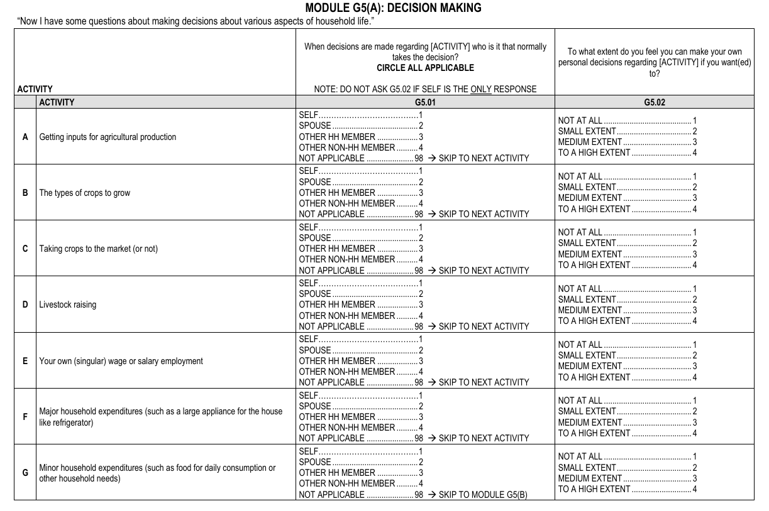
core area: AGENCY
Agency is often measured by assessing the abilities to make decisions and considered critical element of empowerment.
Source: https://2012-2017-uat.usaid.gov/opengov/developer/datasets /2015_Interim_PBS_Questionnaire_ModulesFthruI.pdf
Notes:
As noted, there is overlap in agency and empowerment. Empowerment is a broader term, and agency is an element of empowerment. The tool on this slide shows some measures of decision making that are be relevant to agency.

Slide 28
Capacity to organize;
Equal representation and leadership in formal and informal bodies and organizations and institutions at the community, regional and national levels;
Capacity to negotiate, lead, express opinions and voice demands.
core area: PARTICIPATION, REPRESENTATION AND LEADERSHIP
Notes:
Now we move from core areas that tend to affect women residing within every household to women in larger social spheres/public domain
Read the slide.
The capacity to organize includes equal representation and leadership in formal and informal bodies, organizations and institutions at community, regional and national levels.

Slide 29
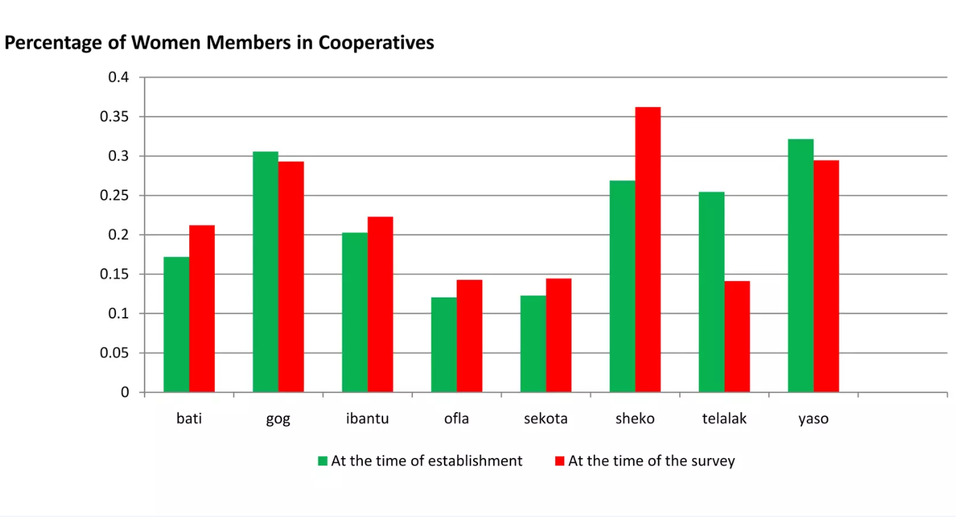
core area: PARTICIPATION, REPRESENTATION AND LEADERSHIP
Women’s participation in cooperatives
Women constitute about 20% of members on average.
5% of the cooperatives do not have women members at all.
The percentage of women has not increased significantly over time (only a 3% increase on average).
Source: Aseefa 2013
Notes:
Women in agrifood systems are underrepresented in agricultural cooperatives and in leadership positions in these cooperatives. Here we see women’s participation in the cooperative at its establishment in green and at the time of the survey in red. Read the stats to illustrate women’s participation in agricultural cooperatives.
This comes from a 2012 study on agricultural cooperatives in Ethiopia.
Source: Women’s Participation in Agricultural Cooperatives in Ethiopia | PPT
From a study conducted in Ethiopia in 2012

Slide 30
core area: DIVISION OF LABOR
Recognition, reduction and redistribution of unpaid care and domestic work.
Source: World Bank Data
Notes:
Now we will discuss core areas of gender equality that are enacted in the household or family system. Still, these affect women’s participation in the agrifood system.
Read the slide

Slide 31
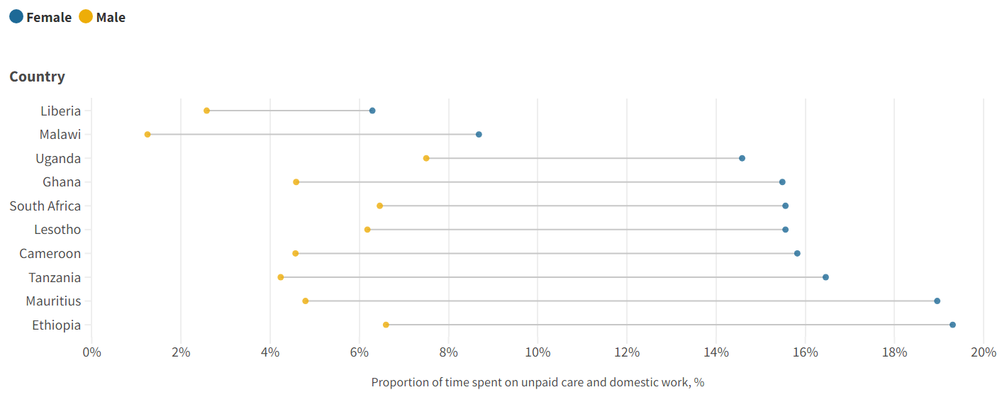
core area: DIVISION OF LABOR
Proportion of time spent on unpaid care and domestic work (2001-2020)
Source: World Bank Data
Notes:
Here we see the time men and women spend on unpaid care and domestic work. Across all countries shown here, and in most or all of the world, we see women spend significantly more time on this work. Gender norms influence how labor is divided, among other factors. This affects men and women in multiple ways, including women’s time and energy to participate in agrifood systems.
One woman participating in a study in Vietnam described the situation women face as “It is challenging for women to do their technical and caring jobs at the same time, unless they are superwomen”. (Female staff, 23 years old, Hanoi, IT).
Source: Nguyen, M. L., Le, T. H. G., Ngo, T. T. H., Tran, H. L. & Mundkur, A. 2020. Investing gendered social norms affecting women’s economic participation related to recruitment and promotion in Vietnam. Vietnam: Investing in Women and CARE International in Vietnam. 96 pp.

Slide 32
core area: REPRODUCTIVE RIGHTS
Decision-making on family planning, contraception, choice of marriage partner and marrying age.
Source: https://www.womanstats.org/maps.html
Notes:
Read the slide.

Slide 33
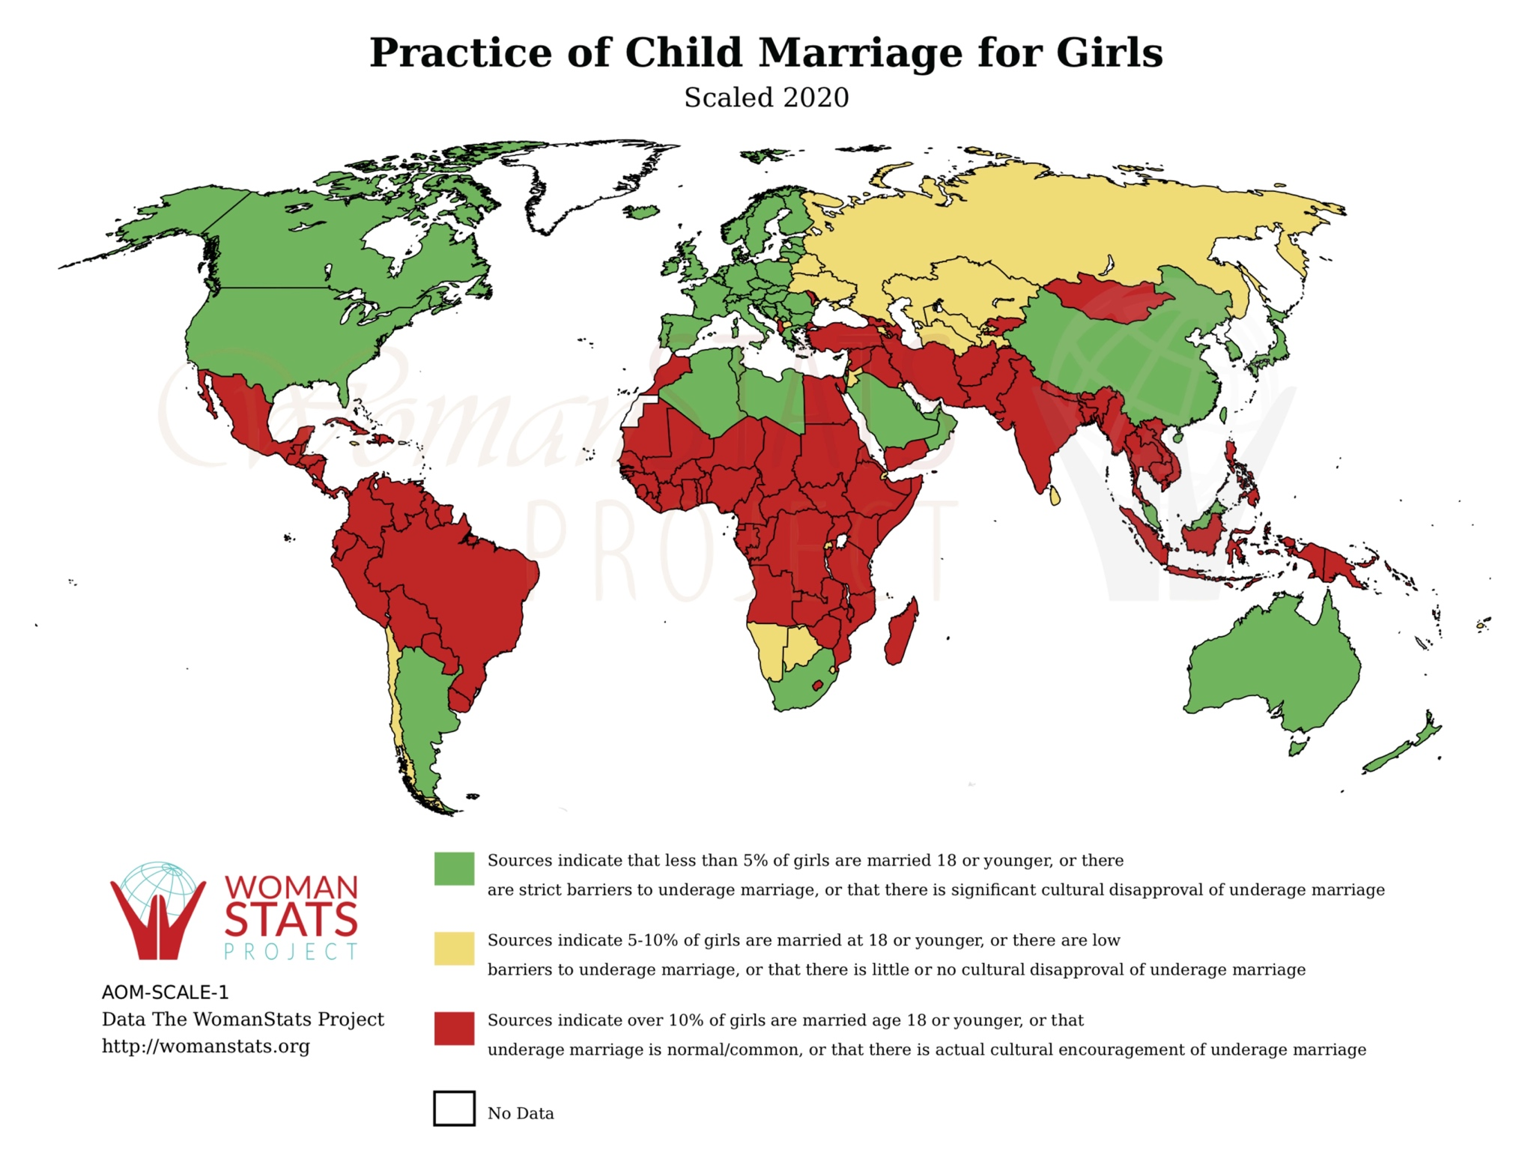
core area: REPRODUCTIVE RIGHTS
An estimated 257 million women would like to limit or delay childbearing but are not using modern contraceptives.
Source: UNFPA 2022
Image source: https://www.womanstats.org/maps.html
Notes:
Reproductive rights are important to agrifood systems as they relate to whether and how long girls and young women stay in school, their age of marriage, childbearing and contraceptive use, and care and domestic labor.
The map shows the practice of child marriage. Countries colored red are places where over 10% of girls are married at age 18 or younger, where underage marriage is common, or where there is cultural encouragement of underage marriage. Those in yellow are countries where 5-10% of girls face this situation.
We also see on the right that an estimated 257 million women would like to limit or delay childbearing but are not using modern contraceptives.
This stat comes from UNFPA (United Nations Population Fund), 2022. “State of World Population 2022: Seeing the Unseen: The Case for Action in the Neglected Crisis of Unintended Pregnancy.” https://www.unfpa.org/swp2022.

Slide 34
core area: freedom from violence and coercion
Freedom from: living in fear; physical, sexual and/or emotional violence and harmful practices; restrictions on mobility.
Notes:
Read the slide.
The experience of violence and coercion, in all its forms, affects women and girls and their ability to live healthy and safe lives. This is true in their interactions with the agrifood systems in all types of roles in agrifood systems – from producers, sellers, and consumers.

Slide 35
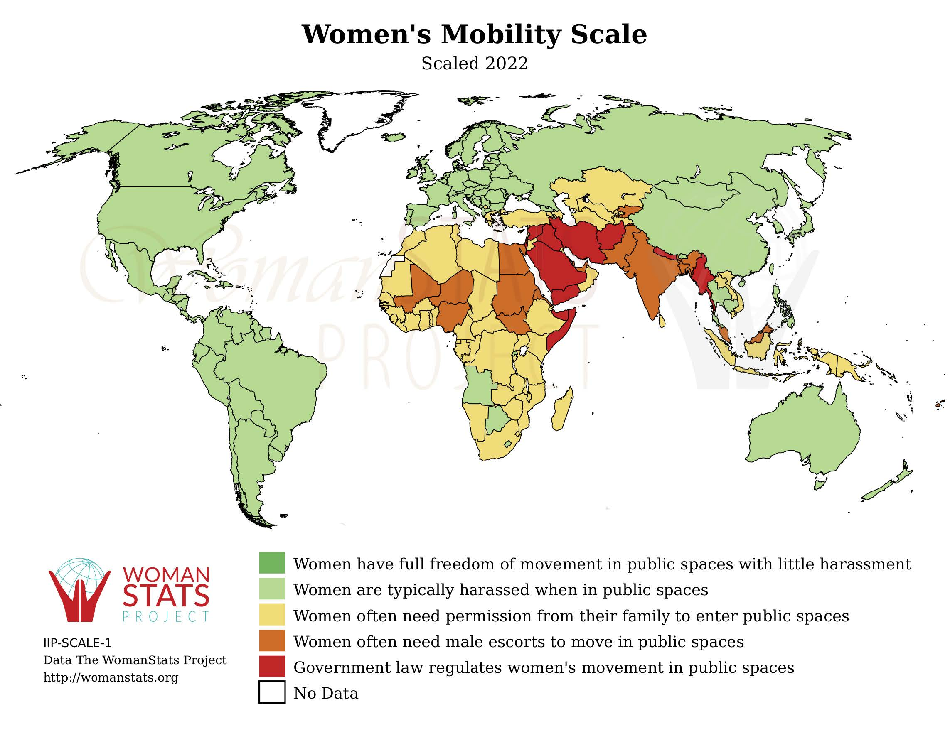
core area: freedom from violence and coercion
Women’s mobility scale
Source: UNFPA 2022. https://www.womanstats.org/maps.html
Notes:
The women’s mobility scale captures women’s freedom and safety to move in public spaces. We see here that countries colored red are where the government regulates women’s movement in public spaces. Those in orange are where women need male escorts to accompany them in public spaces. Those in yellow are where women need permission from their families to enter public spaces.
It’s important to note that countries in green are where women have full freedom of movement with little harassment. This does not mean they are completely safe in public spaces; they are safe relative to women in other countries.

Slide 36
Gendered agrifood systems framework
Section 3
Notes:
Now we are going to discuss the gendered agrifood systems framework. As you’ll recall, earlier in this training, we presented the agrifood systems framework and noted gaps. It did not include a gender equality or social inclusion perspective (or framework) which is important to include to show how agrifood systems work and their outcomes.

Slide 37
GENDER IN AGRIFOOD SYSTEMS
Women are important in agrifood systems, including as producers, wage workers, processers, traders and consumers.
Women face constraints and limitations in agrifood systems. These are “shaped and reinforced by social and structural inequalities in food systems” (Njuki 2022, p2).
Gender inequalities are seen throughout agrifood systems—as both a cause of inequities and an outcome of agrifood systems.
AGRIFOOD SYSTEMS
ARE A MORE IMPORTANT SOURCE OF LIVELIHOOD FOR WOMEN THAN FOR MEN IN MANY COUNTRIES.
Sources: Njuki 2022; FAO 2023a
Notes:
Read the slide.
Examples of gender inequalities in agrifood systems include:
• The working conditions for women are often worse than for men. For example, women may be offered irregular, informal, part-time or low-skilled labor.
• Women earn less than men across areas in the agrifood system, from production to processing. This is because of limitations on their work – for example, that they are hired for informal or irregular roles– or expectations placed on women relative to men. Some think men should earn more because they are the providers and women supplement their income.
• Shocks and crises have a greater negative impact on women than men. For example, during COVID-19, women's food insecurity increased faster than men’s. Reasons for this are many and include that more women lost their jobs than men, meaning they lost their income and had to spend savings, if they have them.

Slide 38
GENDER IN AGRIFOOD SYSTEMS
Food system drivers are anchored in a gendered system with structural gender inequalities and are shaped by shocks and vulnerabilities that affect men and women in different ways. Structural gender inequalities and gendered shocks and vulnerabilities thus influence the ways in which men and women experience these drivers of food systems, which in turn shape the three main components of the food systems: value chains, the food environment, and consumer behavior.”
— Njuki 2022, p. 3
Source: Njuki 2022
Notes:
Read the slide.
Therefore, understanding gender in agrifood systems means understanding that the three components of agrifood systems are connected. This means, we need to work across agrifood systems at the different levels at which agrifood systems operate from the individual to the structural. We’ll cover this in greater detail in the coming modules, but for now we’ll focus on gendered food systems framework which brings these ideas together.

Slide 39
GENDERED FOOD SYSTEMS FRAMEWORK
Conceptualizes and analyzes gender equality and empowerment of women in agrifood systems.
Illustrates the importance of a political and transformative approach to integrating gender into agrifood research and programming to achieve sustained impact.
Source: Njuki 2022
Notes:
Read the slide.

Slide 40
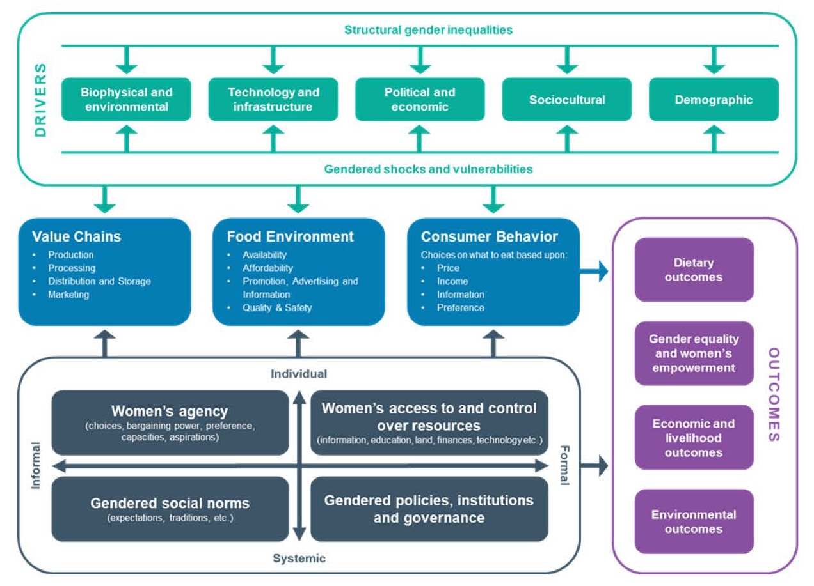
GENDERED FOOD SYSTEMS FRAMEWORK
Source: Njuki 2022
Notes:
The Gendered Food Systems framework was developed by Njuki et al in a paper in 2022.
The blue boxes represent the three components of agrifood systems. These are value chains, food environment and consumer behavior.
The green boxes at the top of the framework are the 5 drivers of inequalities in agrifood systems. These include the structural inequalities that shape how men, women and other groups experience inequities. This is where we also see shocks and stressors that men and women experience, cope with, and adapt to.
The four black boxes describe the cross-cutting gender issues and their influence on agrifood systems and its outcomes.
•Gendered social norms affect the ways that men and women participate in, access and benefit from opportunities and resources. For example, norms related to women’s responsibility for unpaid household caregiving limits her time to sell food, her mobility and her engagement in paid labor. We will discuss social norms in more detail in Module 2.
• Women’s access to and control over resources, services and technology includes many aspects such as land ownership, technology, information, and services, time and labor. For example, in some settings, men have control over the sales and decisions for livestock, even when they are jointly owned or owned by women. In some cases, when women earn more than men or earn a substantial income, the money is transferred to her husband to manage.
• Women’s agency includes decision making and leadership at the household, community and agrifood systems levels. For example, women’s participation in self help groups in India was positively associated with having more information and participation in agricultural decisions. But, it did not affect their agricultural production or agrifood systems outcomes because of her limited time, financial constraints, and social norms.
• Gendered policies, institutions and governance include policies that support women’s empowerment.
The four purple boxes are the types of outcomes that agrifood systems seek to influence. These include
• Dietary outcomes
• Gender equality and women’s empowerment
• Economic and livelihood outcomes
• Environmental outcomes
The framework makes the case for work in agrifood systems to go beyond including women. It shows the importance of facilitating a gender transformative and empowerment process so that women can benefit and be empowered from their participation in the agrifood system.

Slide 41
How can we integrate gender inTO agrifood systemS?
Integrating gender into agrifood systems is important, but not all efforts to integrate, or mainstream, gender are equal.
It is clear that issues of gender pervade all aspects of agrifood systems and require attention.
Drawing from efforts to integrate gender into health and development programming, the continuum of gender approaches was developed.
Notes:
The framework makes illustrates the importance of bringing in a gender perspective in agrifood systems. We now move to how we can integrate a gender perspective into agrifood systems. Read the slide.

Slide 42
The continuum of gender approaches
Section 4
Notes:
Different visuals depict the continuum of gender approaches. We are working with the one developed by McDougall (2023) which is an adaptation from the Interagency Gender Working Group.
The continuum helps us reflect on the different approaches to integrating gender in agrifood systems, health, and development programming.
You may already be familiar with the framework. We are going to work with it step by step to unpack the different elements of the continuum. At the end, we will show the continuum in its entirety

Slide 43


GENDER “BLIND” AND GENDER AWARE
Gender “blind”
Ignores differences in roles, rights, risks and opportunities and power imbalances among people of different genders and/or assumes there is a level playing field
Gender aware
Recognizes that gender inequalities and barriers exist and aims to navigate or address them in some way
Partial figure adapted from McDougall 2021
Notes:
The Continuum categories policies or programs along a continuum ranging from gender “blind” to gender aware. While the language of gender “blind” is outdated, we use it here because it is used in this framework and other frameworks.
Read the description of gender “blind” and gender aware.

Slide 44

GENDER “BLIND”
Ignores gender differences
Ignores differing needs of women, men, boys and girls
Ignores gender power dynamics
By default, tends toward doing harm to women and girls
Example: A development initiative holds training sessions in locations that may require travel outside of a village. Women may face difficulties attending due to their household and child care responsibilities, which are less of a constraint for men. Consequently, only very few women may have the opportunity to attend training sessions and build their skills.
Can you think of other examples?
Partial figure adapted from McDougall 2021. Sources: UINFPA; IGWG
Notes:
Read description of gender “blind”.
Read the description of a gender “blind” program. Ask participants if they understand why this is gender “blind” and whether they have other examples to share. Let 1-3 people share and listen to the examples to be sure they are gender “blind”
If it is helpful for the group, share these examples:
• Women are included in community meetings with men. Yet, men’s voices dominate discussion and women rarely speak, if at all. Gender norms and gender roles inform who is expected to speak at these meetings and who feels confident to speak. While women are included in the meeting, the program may inadvertently reinforce messages of who should speak and be heard in community spaces and the program may not understand the needs of women.
• A program brings agricultural tools to a community. They only work with male farmers even though women farm in this community. As a result, men have greater potential nutritional and economic health compared to women.

Slide 45

GENDER AWARE APPROACHES
Examine and address the set of economic, social and political roles, responsibilities, rights, entitlements, obligations and power relations associated with being male and female.
Examine and address the dynamics between and among men and women, boys and girls.
Partial figure adapted from McDougall 2021
Notes:
Gender aware approaches are policies and programs that read the slide.

Slide 46
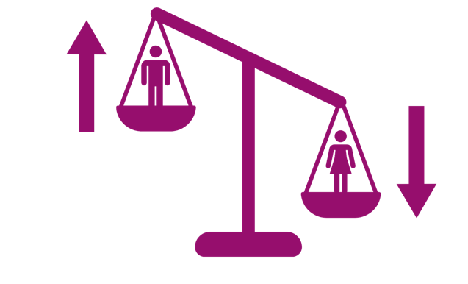
GENDER EXPLOITATIVE
Gender “blind”
Ignores differences in roles, rights, risks and opportunities and power imbalances among people of different genders and/or assumes there is a level playing field
Gender aware
Recognizes that gender inequalities and barriers exist and aims to navigate or address them in some way
Exploitative
Exploits gender roles, stereotypes or inequalities for project or program aims
Reinforce unequal gender norms and dynamics
Examples adapted from IGWG. Partial figure adapted from McDougall 2021
Notes:
There are three types of gender aware approaches. We will start by discussing gender exploitative approaches.
Read the description of gender exploitative and that these approaches reinforce gender norms and dynamics.

Slide 47

Gender Exploitative ApproachES
Approaches to project design, implementation and evaluation that take advantage of rigid gender norms and existing imbalances in power to achieve health program objectives
Can be harmful
Can undermine the objectives of the program
Partial figure adapted from McDougall 2021
Notes:
Read the slide.
Next, we are going to discuss a few examples of gender-exploitative approaches.

Slide 48
Gender Exploitative Approach: An Example
Example: Agricultural extension flyers and posters distributed in rural communities use stereotypes of men’s superior strength and ability to ride motorcycles and provide extension support in a faraway rural setting to describe a typical extension officer.
Why is this gender exploitative?
Source: Capacity Project Gender Workshop Handout
Notes:
Read the example. Ask participants to explain why this is gender exploitative and describe the potential harm.
Note, this is exploitative because it creates or reinforces stereotypes of men. if this is the only visual illustration of extension workers, it can reinforce ideas that men need to behave or look a particular way. Also, if flyers and posters only include images of male extension workers, then it can reinforce beliefs and norms that these are not jobs for women.

Slide 49
Gender Exploitative Approach: An Example
Example: A project wants to increase dietary diversity in food consumption in a community. It hosts cooking events, inviting married women and mothers, to demonstrate how to incorporate a wide range of foods in meals.
Why is this gender exploitative?
Source: McDougall 2021
Notes:
Read the example. Ask participants to explain why this is gender exploitative and describe the potential harm.
The harm here is that it exploits and reinforces stereotypes of women as cooks and caregivers. By not including men, the project implies that this is not men’s work or men’s responsibility.

Slide 50
Gender Exploitative Approach: An Example
Example: To boost agricultural incomes, a project in rural Tajikistan aimed to increase agricultural output among farmer families. The project emphasized men’s traditional role as the primary income earners for their families to encourage men’s participation. Ultimately, men became more insistent about control over household income, and women’s time and energy burden in agricultural production increased. Reports of gender-based violence rose as gender power dynamic imbalances increased.
Why is this gender exploitative?
Source: USAID Advancing Nutrition 2022
Notes:
Read the example. Ask participants to explain why this is gender exploitative and describe the potential harm.
The harm here is described in the example. As the project sought to boost agricultural income – a goal that is helpful for people – it does this by only working with men and reinforcing their traditional role as income earners. This can limit women’s access to the program or their potential benefit. And it can create and reinforce power inequities in the home.

Slide 51

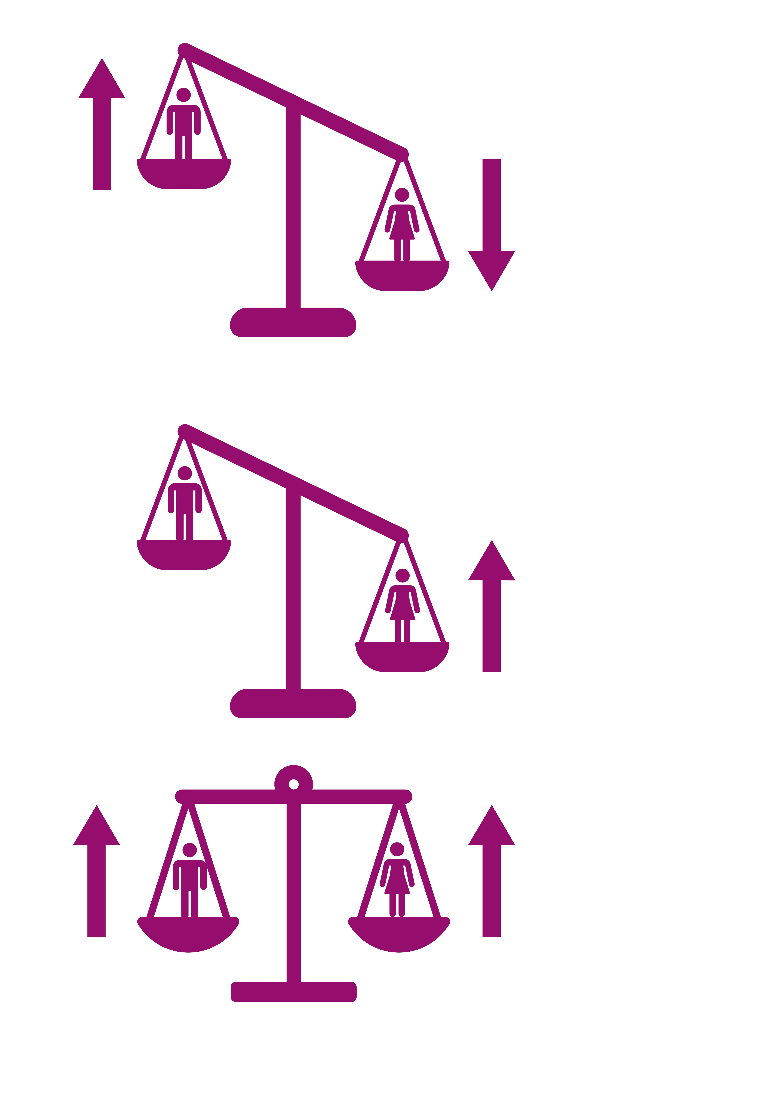
Gender Accommodative Approach
Gender “blind”
Ignores differences in roles, rights, risks and opportunities and power imbalances among people of different genders and/or assumes there is a level playing field
Gender aware
Recognizes that gender inequalities and barriers exist and aims to navigate or address them in some way
Exploitative
Exploits gender roles, stereotypes or inequalities for project or program aims
Accommodative
Works around existing gender barriers and constraints
Includes women,
thus possibly benefiting them and/or making (short-term) contributions
to empowerment
Reinforce unequal gender norms and dynamics
Examples adapted from IGWG. Partial figure adapted from: McDougall 2021
Notes:
Now we will look at another gender aware approach called gender accommodative approaches. Read the description of gender accommodative approaches.

Slide 52
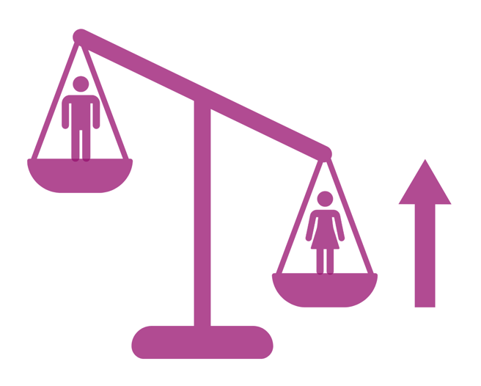
According to the United Nations Food and Agriculture Organization (FAO 2024, p.38)
Gender accommodating interventions acknowledge that women and men, on the basis of their gender, have specific needs, roles, opportunities and constraints. Interventions work around (i.e. accommodate) existing gender dynamics, norms and roles, but do not challenge them. This leaves the system that creates gender inequalities untouched, allowing it to continuously replicate inequalities.
Partial figure adapted from McDougall 2021. Source: FAO 2023b
Notes:
Read the slide.
Because gender accommodating approaches do not challenge gender dynamics, norms and roles, they are a missed opportunity to address the underlying structures that contribute to gender inequality. At the same time, in some settings, they may be a sensible first step to gender integration. If they are relied on as the only effort, then programs will not adequately meet the needs of all people, including women and girls.

Slide 53
Gender Accommodating Approach: An Example
Goal Increase condom use to prevent HIV among sex workers
Problem Sex workers do not have the power to insist that clients use a condom
Strategy Provide education, negotiation skills, and free condoms to sex workers
Enlist brothel owners as proponents and enforcers of a 100% condom
use policy
Result Increased condom use
Source: IGWG 2017
Notes:
We will look at a few examples of programs that use gender accommodating approaches.
Read the slide. Ask participants to describe what makes this approach gender accommodating.
This is gender accommodating because it does not challenge gender norms or power dynamics between brothel owners and sex workers and between sex workers and their clients. It is designed to make it easier for women to fulfill their duties and roles, while using condoms and remaining in the same status.
As we see here, sometimes accommodating gender norms may provide women with benefits – like using condoms, preventing HIV – more quickly than gender transformative approaches.

Slide 54
Gender Accommodating Approach: An Example
Example: A project wants to increase household food diversity and food consumption. It decides to work with women. In this community, women are responsible for caring for the home and children. They prepare food for the family, ensuring that they have a nutritious diet. Most do not work far from the home.
The project team decides to build women’s knowledge and skills of improved agriculture approaches that they can apply them in their subsistence agricultural plots located near the home.
Why is this gender accommodating?
Source: McDougall 2021
Notes:
We will look at a few examples of programs that use gender accommodating approaches.
Read the slide. Ask participants to describe what makes this approach gender accommodating.
This approach is gender accommodating because:
• They work around norms constraining women’s mobility and women’s high domestic roles
• The approach may benefit women and their families but they may not contribute to empowerment, at least in short term
• The approach risks reinforcing unequal gender dynamics
We are also learning from other programs that the positive effects of a project like this one may not be sustained after the project ends.

Slide 55
Gender Accommodating Approach: An Example
Example: A project establishes committees to manage marine areas. In this setting, men are typically in leadership positions making decisions for the community. Men learn from an early age to participate in community meetings and voice their opinions. These are not venues that women typically attend.
The project team decides to encourage equal numbers of men and women in leadership positions, a sign of equitable participation in the committee.
Why is this gender accommodating?
Source: Gender SMART D.6.2
Notes:
We will look at a few examples of programs that use gender accommodating approaches.
Read the slide. Ask participants to describe what makes this approach gender accommodating.
While the program recognizes that women are typically excluded from these settings and that they should be included, they do not go far enough. They include women in the meeting, but do not address the norms of who speaks and who makes decisions. Women can be in leadership positions and lack the skills, confidence or support needed to voice their opinion or make decisions. As a result it may not change what is discussed, how it is discussed, or how decisions are made. There is a risk that women will end up in administrative or secretarial roles with minimal influence or they may be silent observers.

Slide 56
Limitations: Gender Accommodating Approach
GAA approaches seek to close gender gaps to increase agricultural and other development that benefit women and families:
Limitation
Limitation
Limitation
The emphasis is on visible symptoms of gender inequality and ignores underlying factors that cause differences.
Technical innovations and technologies alone will not improve sector outcomes, as they cannot address the complexity of societies, structures and social dynamics.
Program approaches ignore evidence of the social embeddedness of agriculture and gender.
Notes:
We understand that gender accommodating approaches are an entry to working with women, but they do not address the underlying systems and power dynamics that create and sustain inequities. There are limitations to this approach. Read the slide.

Slide 57
Limitations: Gender “Blind”, Exploitative and Accommodating Approaches
“By not viewing gender as part of how society works, mainstream agricultural research and practice accept the ‘social status quo’ without questioning whether and how existing norms, attitudes and distributions of power frame the opportunities and outcomes of women and men to create inequalities.”
— P. Kantor 2013
Source: Kantor 2013a
Notes:
Read the slide.
Therefore, these approaches can offer no assurance that women will be able to take advantage of or benefit from new opportunities or technologies
because society’s understanding of what is acceptable for women and men to be, do, own, and control may continue to impose barriers

Slide 58
Gender Transformative Approach
Gender “blind”
Ignores differences in roles, rights, risks and opportunities and power imbalances among people of different genders and/or assumes there is a level playing field
Gender aware
Recognizes that gender inequalities and barriers exist and aims to navigate or address them in some way
Exploitative
Exploits gender roles, stereotypes or inequalities for project or program aims
Accommodative
Works around existing gender barriers and constraints
Transformative
Recognizes, critically engages with, and seeks to change the underlying root causes of inequalities, including constraining gender norms
Includes women,
thus possibly benefiting them and/or making (short-term) contributions
to empowerment
Addresses the underlying structural factors that create and re-create gender inequalities in food systems and societies
Reinforce unequal gender norms and dynamics
Sources: A continuum of gender approaches. Examples adapted from IGWG. Figure adapted from McDougall 2021
Notes:
The is the full framework framework. Here we see the addition of a gender transformative approach, the third and final approach included in gender aware approaches.
Read the description of gender transformative approaches.

Slide 59
A gender transformative approach
Section 5
Notes:
Now we will move into our final section, where we describe gender transformative approaches.

Slide 60

What does it mean to be transformative?
Transformation represents deep, enduring change:
      “What emerges is fundamentally different from what went before” (Brookfield 2012).
A commitment to transformation is a commitment to the depth and sustainability of change in underlying institutions and practices.
Image source: Medium.com
Sources: Kantor 2013b. Brookfield 2012 (in Kantor 2013b). Metamorphosis: transformation from an immature to adult form.
Notes:
Read the slide.

Slide 61

Transformation is a deep and complex process
The process and outcomes of transformative change are emergent.
Transformation is multi-level.
Transformation is holistic and multi-disciplinary.
Transformation is dependent on partnerships.
Transformation addresses unequal power relations.
Source: Kantor 2013b
Image source: Dreamstime.com
Notes:
Transformative work is deep and complex.
Read the slide.

Slide 62
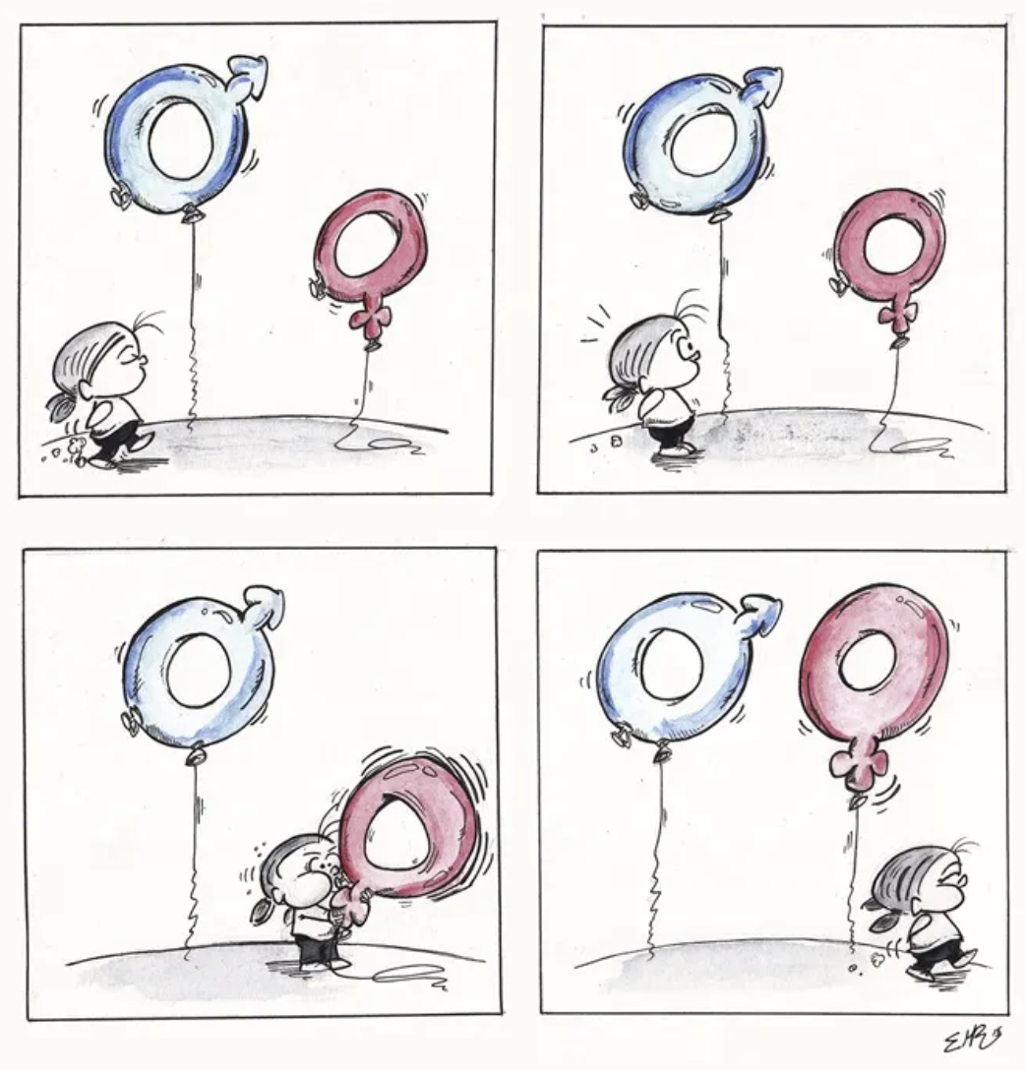
Gender Transformative Approach
Conceptualizes gender as a social construct that infuses all aspects of daily life.
Puts the social context at the center of analysis.
Questions the social status quo and highlights openings for social change.
Image source: Emilio Morales Ruiz, Spain from UN Women Gender Equality Comic Winners
Source: Kantor 2013b
Notes:
Read the slide.
Gender (and other intersecting forms of social difference) affect how people conceive of themselves & their capabilities; how they interact with social
expectations & how opportunities are structures & how resources are distributed. A gender transformative approach works with this complexity and seeks to transform it.

Slide 63
According to the United Nations Food and Agriculture Organization (FAO 2024, p.39)
“A gender transformative approach seeks to actively examine, challenge and transform the underlying causes of gender inequalities rooted in discriminatory social structures. As such, a gender transformative approach aims to address unequal gendered power relations and discriminatory gender norms, attitudes, behaviours and practices, as well as discriminatory or gender-blind policies and laws that create and perpetuate gender inequalities. By doing so, it seeks to eradicate systemic forms of gender-based discrimination by creating or strengthening equitable gender relations and social structures that support gender equality”
(FAO, IFAD and WFP, 2022).
Source: FAO 2023b
Notes:
The definition comes from the UN Food and Agriculture organization. Read the definition.
Many development programs have focused on closing gender gaps. These efforts assumed that closing gender gaps would lead to productivity gains and would benefit women and their families. While many programs have been useful, they have not addressed the underlying factors that cause this difference. Gender transformative approaches seek to address these underlying factors.

Slide 64
Is the program using a gender accommodating or gender transformative approach?
PRACTICE!
Notes:
Let’s try this out. I’ll describe a program. You tell me if it is gender transformative or gender accommodating.

Slide 65
Is this a gender accommodating or gender transformative approach?
Gendered challenges
Program approach
Women are expected to care for young children.
Stereotypes and cultural values give more value to boys.
Boys are seen as more deserving of care, stronger and more capable than girls.
Activities are developed to provide targeted support to mothers as caregivers.
Source: Marcus 2022
Notes:
Read the slide, starting with gendered challenges. The program approach seeks to address these challenges. Then ask, is this gender accommodating or gender transformative? Let participants respond in chat (if a virtual training).
The approach is gender accommodating because it does not challenge norms around who should be caregivers.
Ask participants what they would do to make this gender transformative.
They could :
• strengthen enabling environments through family-friendly policies, with a focus on parental leave, breastfeeding support, affordable, accessible and quality
childcare and child benefits.
• shift norms around gender divisions of labor in care of young children and gender-equitable treatment of young children (feeding, health care,
interaction etc.).

Slide 66
Is this a gender accommodating or gender transformative approach?
Gendered challenges
Program approach
Norms value men and boys above women and girls.
The most nutritious food is reserved for boys and men.
Norms prohibit the consumption of certain foods at certain times.
Mothers lack decision-making power in infant care.
Constraints on women’s mobility limit access to nutritious food in a crisis.
Behavior and norms change strategies’ focus on who can eat which foods, including during times of scarcity.
Group empowerment focused activities on mother’s decision-making in infant care.
Notes:
Read the slide, starting with gendered challenges. The program approach seeks to address these challenges. Then ask, is this gender accommodating or gender transformative? Let participants respond in chat (if a virtual training).
The approach is gender transformative. Ask someone to explain what makes this gender transformative.

Slide 67
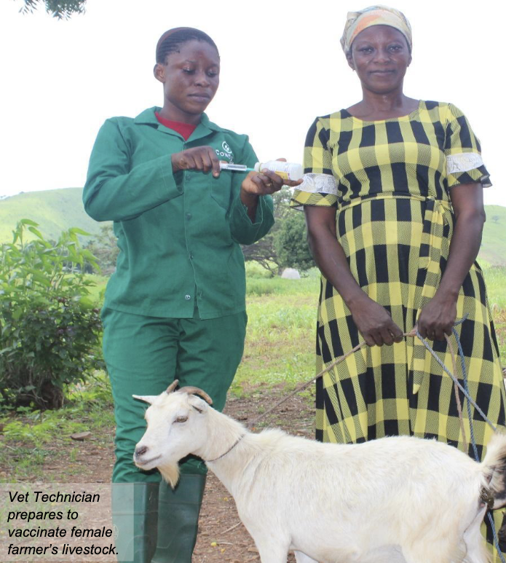
Case Study: Project Example of GAA vs GTA in agrifood systemS
CARE International in Ghana
International Livestock Research Institute
Cowtribe Technology Ltd
Source: Njiru 2024
Notes:
Finally, we will look at a project that tried out both gender transformative and gender accommodating approaches to see their benefit. This project was developed and implemented by CARE International in Ghana, International Livestock Research Institute and Cowtribe Technology Ltd.

Slide 68
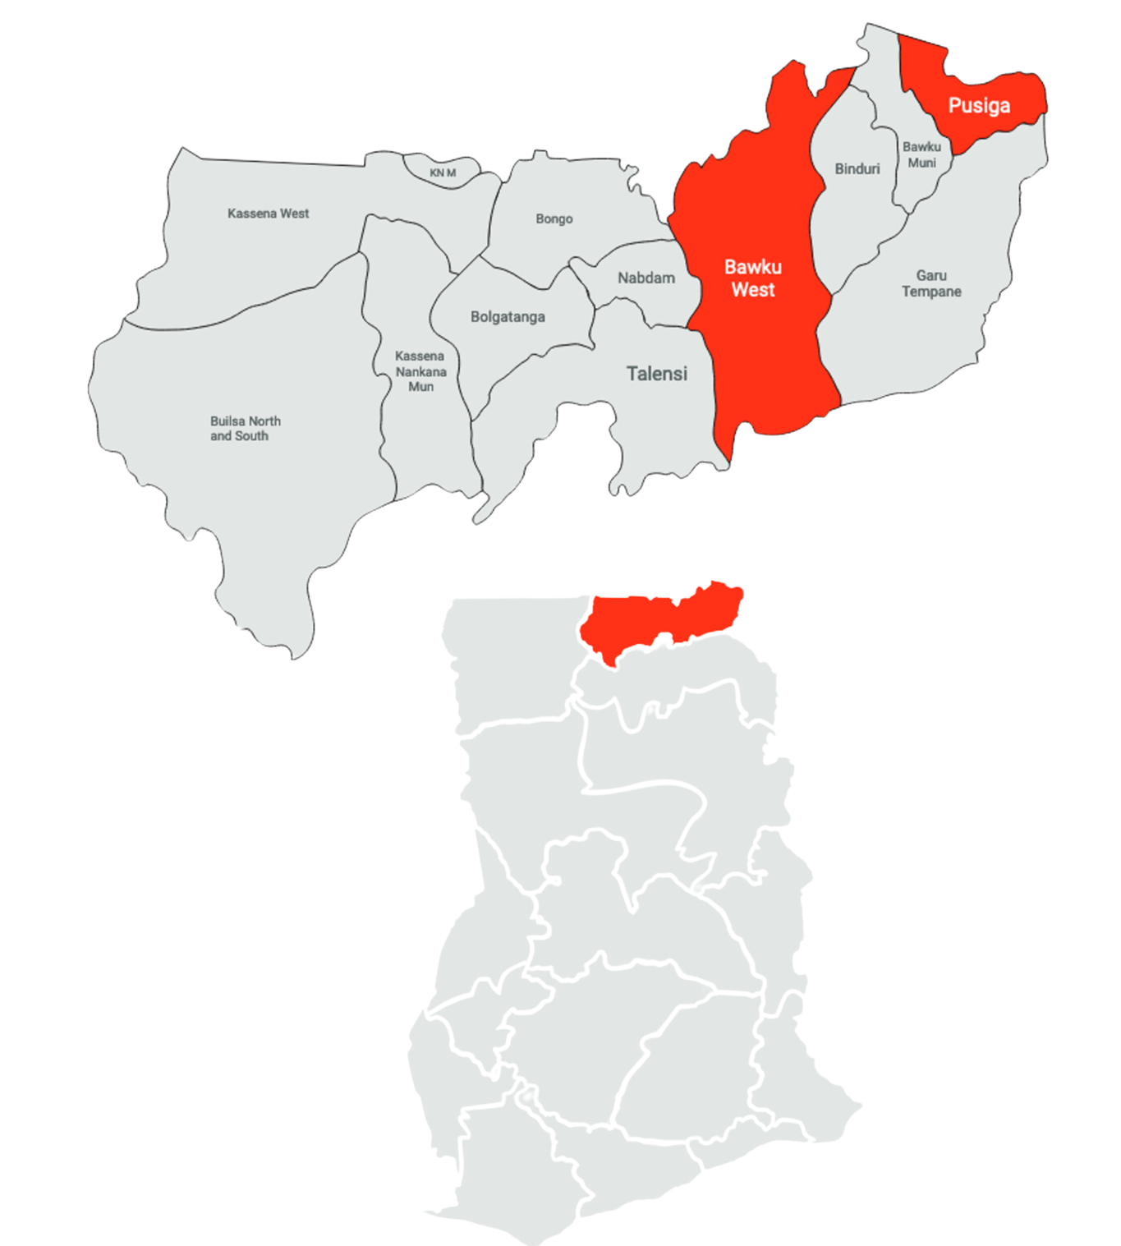
Women Rear Project
Problem Women farmers have low awareness about vaccines, find them expensive and have limited access due to cultural and traditional practices.
Objective Assess the changes conferred by a GAA and GTA on gender norms, women’s empowerment and access to animal vaccines.
Date 2019 – 2023
Location Western District, Ghana
Source: Njiru 2024
Notes:
Read the slide.

Slide 69
INTERVENTIONS
Empowering women through livestock
GAA communities
Improving access
Provide women farmers with access to info about vaccines
Provide digital apps means to access vaccines
Women vets and animal health service providers
Lead farmers at village level
Improve the vaccine delivery system
GTA communities
Addressing discriminating norms
Community dialogues
Social media campaigns
Gender trainings
COMPARISON OF GTA AND GAA COMMUNITIES TO SEE WHAT WORKS BEST
Source: Njiru 2024
Notes:
As mentioned, this project tried a gender accommodating and a gender transformative approach to see what would work best in their setting to achieve change related to their goals.
Both approaches sought to address (1) the barriers faced by all farmers regardless of gender. For example, the availability of animal vaccines; (2) to address barriers faced by women such as their access to animal vaccines; and (3) gender norms related to decision making and women’s mobility that are related to these outcomes.
The project anchored its activities in villages via the village savings and loan associations (VSLA) as they can support women’s access to vaccines (to ensure purchasing power and reach).
Finally, both approaches engaged men and women as gender champions to sensitize community on positive masculinity and benefits of supporting change in restrictive gender norms
Where the project used gender accommodating approaches, they focused on improving access. They did this by read the bullets under GAA communities. They used female veterinarians because gender norms prevent women farmers from interacting with male veterinarians.
Where the project included gender transformative approaches, they added activities to address discriminating norms. They did this by engaging communities in reflection and dialogue to explore the value of local restrictive gender norms. They examine how these norms effect women’s engagement in livestock enterprise and wellbeing of households. The program involved both male and female leaders, in addition to community leaders.

Slide 70
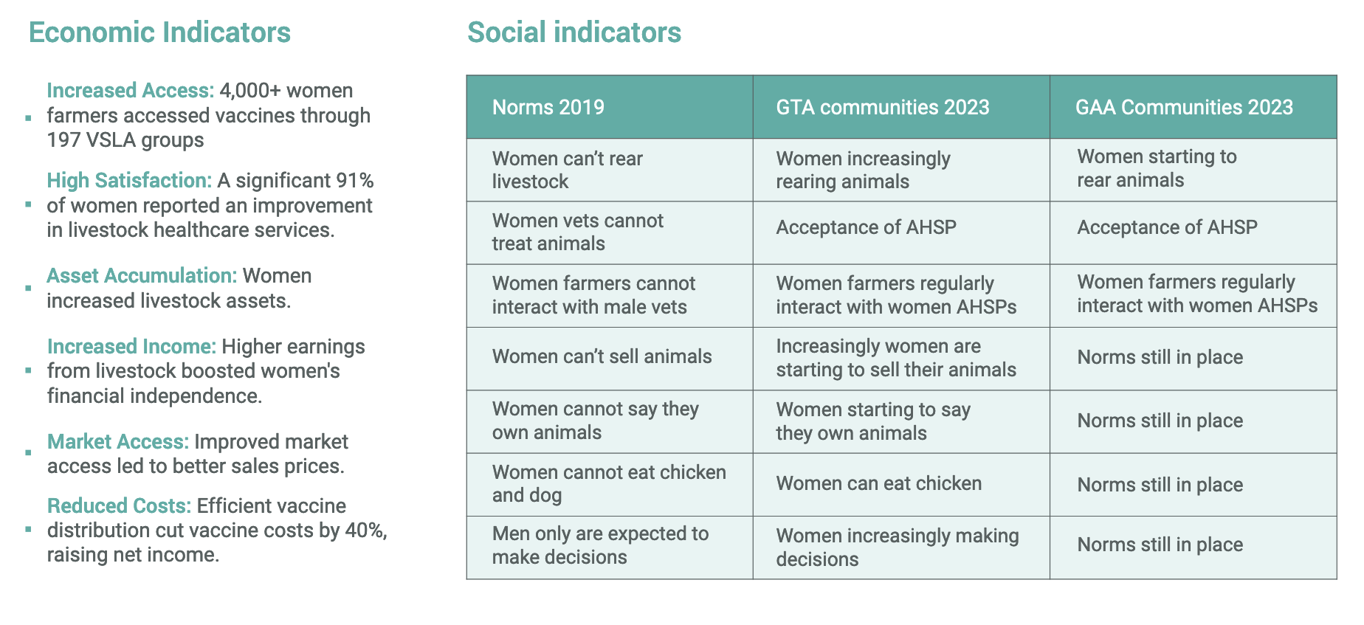
Women Rear Project: RESULTS
Source: Njiru 2024
Notes:
Here we see the outcomes of the project.
In the table, the first column shows the norms the project wanted to change. In terms of changes in gender norms, both GTAs and GAAs were instrumental in reducing the strength of restrictive norms in all communities
In terms of changes in women's empowerment, our qualitative findings revealed progress in key domains of empowerment, from conceptual transformation to decision-making to asset accumulation. These changes were clearly stronger in GTA communities. GTAs appeared to move the needle on empowerment because they changed women's ability to declare that they own livestock essential to control income, take decisions, and accumulate wealth. Similarly, a strong correlation was found between changes in norms and empower- ment.
Finally, changes in women's access to vaccines were shown to be more positive in GTA communities than GAA communities.

Slide 71
Closing

Slide 72


TakeAways
What is one new thing you learned today?
What are you curious about?
Notes:
Before we close, let’s share one new thing you learned today in chat. Read what participants write out loud while participants are entering them in chat.
Then ask what are you curious about related to this course. Ask if anyone wants to come off mute and speak, that’s okay. And ask people to write in chat.

Slide 73
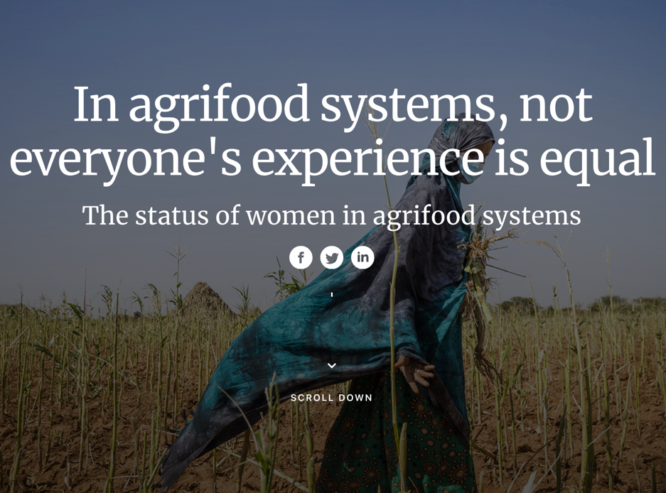
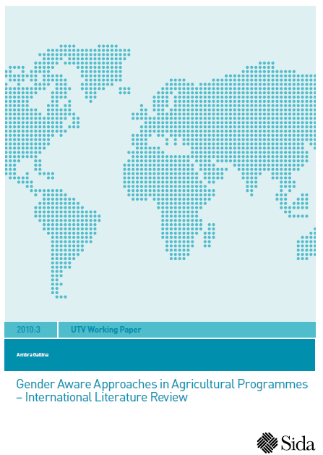
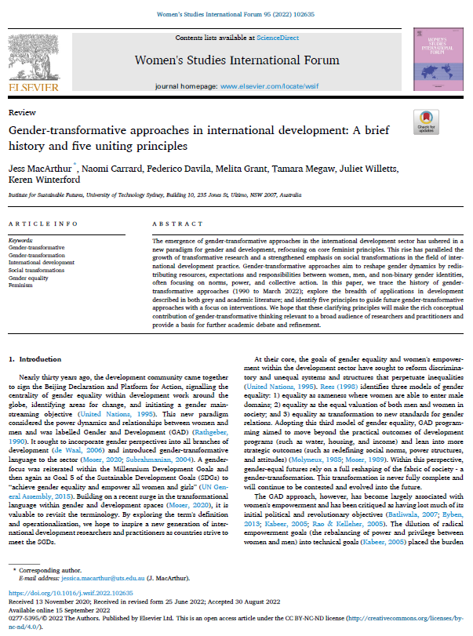
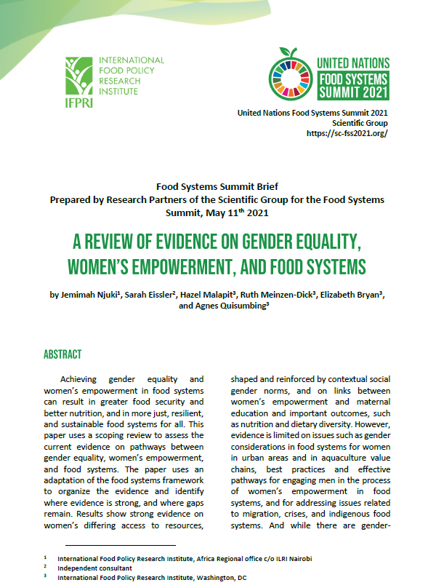
FURTHER READING
FAO Interactive on Women in Agrifood Systems
https://www.issuelab.org/resources/21098/21098.pdf
https://doi.org/10.1016/j.wsif.2022.102635
https://doi.org/10.48565/scfss2021-1q69
Notes:
The module, which you will receive, includes optional further reading related to today’s content. This is followed by a glossary and reference list.

Slide 74
Glossary
Agri-food systems Agrifood systems comprise the entire range of actors and interlinked activities that add value in agricultural production and related off-farm activities such as food storage, aggregation, post-harvest handling, transportation, processing, distribution, marketing, disposal and consumption. Agricultural production refers to primary crop, livestock, fisheries and forestry production. (FAO 2023b).
Consumer behavior reflects all the choices and decisions made by consumers, at the household or individual level, on what food to acquire, store, prepare, cook and eat, and on the allocation of food within the household (including gender repartition and feeding of children) (HPLE 2017).
Food environment refers to the physical, economic, political and socio-cultural context in which consumers engage with the food system to make their decisions about acquiring, preparing and consuming food (HPLE 2017).
Gender refers to the roles, behaviors, activities and attributes that a given society at a given time considers appropriate for men and women (WHO 2023 from FAO 2023b).

Slide 75
Glossary
Gender equality is the state or condition that affords women and girls, men and boys equal enjoyment of human rights, socially valued goods, opportunities and resources regardless of whether they are born female or male (FAO 2017). Pathways to gender equality include expanding the exercise of freedoms and voice, improving power dynamics and relations, transforming gender roles and enhancing overall quality of life so that women and girls, men and boys achieve their full potential (GTFN 2023 from FAO 2023b).
Gender equity refers to the process of being fair to both women and men in the distribution of resources and benefits. It involves recognition of inequality and requires measures to work toward equality of women and girls, men and boys. Gender equity is the process that leads to gender equality (GTFN 2023 from FAO 2023b).
Gender mainstreaming is the process of assessing the implications for women and men of any planned action, including legislation, policies or programs, in any area and at all levels. It is a strategy for making the concerns and experiences of women and men an integral part of the design, implementation, monitoring and evaluation of policies and programs in all political, economic and societal spheres. The ultimate goal is to achieve gender equality (adapted from UN Women 2023, from FAO 2023b).

Slide 76
Glossary
Gender accommodating interventions Gender accommodating interventions acknowledge that women and men, on the basis of their gender, have specific needs, roles, opportunities and constraints. Interventions work around (i.e. accommodate) existing gender dynamics, norms and roles, but do not challenge them. This leaves the system that creates gender inequalities untouched, allowing it to continuously replicate inequalities (FAO 2023b).
Gender aware interventions These consist of gender aware policies and programs that examine and address the set of economic, social and political roles, responsibilities, rights, entitlements, obligations and power relations associated with being male and female, as well as the dynamics between and among men and women, boys and girls (IGWG 2017).
Gender blind interventions In these interventions, gender (in terms of the differentiated and intersectional experiences of women, men, boys and girls) is not considered in the research project, not even in its conceptualization or its rationale (Oxfam 2019). The interventions ignore the set of economic, social and political roles, rights, entitlements, responsibilities and obligations associated with being male and female as well as the power dynamics between and among men and women, boys and girls. Gender blind interventions distinguish little between the needs of men and women, neither reinforcing nor questioning gender roles. This maintenance of the status quo can reinforce existing gender inequalities (IGWG 2017, from FAO 2023b).

Slide 77
Glossary
Gender exploitative interventions Gender exploitative interventions intentionally or unintentionally reinforce, or take advantage of, gender inequalities and stereotypes in pursuit of project outcomes. These interventions exacerbate gender inequalities and accentuate gender injustice (adapted from IGWG 2017, from FAO 2023b).
Gender transformative approach A gender transformative approach seeks to actively examine, challenge and transform the underlying causes of gender inequalities rooted in discriminatory social structures. As such, a gender transformative approach aims to address unequal gendered power relations and discriminatory gender norms, attitudes, behaviors and practices, as well as discriminatory or gender blind policies and laws that create and perpetuate gender inequalities. By doing so, it seeks to eradicate systemic forms of gender-based discrimination by creating or strengthening equitable gender relations and social structures that support gender equality (FAO, IFAD and WFP 2022; from FAO 2023b).
Sustainable food value chain The full range of farms and firms and their successive coordinated value-adding activities that produce particular raw agricultural materials and transform them into particular food products. There products are then sold to final consumers and disposed of after use in a manner that is profitable throughout. This has broad-based benefits for society and does not permanently deplete natural resources (FAO 2014).

Slide 78
References
Aseefa TW, Techane FT, Waller M. 2013. Women’s participation in agricultural cooperatives in Ethiopia. https://www.slideshare.net/slideshow/womens-participation-in-cooperatives-in-ethiopia/20304072
Capacity Project Gender Workshop Handout 1.4.1. https://www.capacityproject.org/genderwkshp/Handout_1.4.1_Continuum_Gender_Strategies.pdf
FAO. 2011. The state of food and agriculture 2010-2011: Women in agriculture. Closing the gender gap for development. Rome.
FAO. 2014. Developing sustainable food value chains – Guiding principles. Rome, FAO. 75 pp. (also available at www.fao.org/sustainable-food-value-chains/library/details/en/c/265156/).
FAO. 2023a. The status of women in agrifood systems 2023. Rome. https://openknowledge.fao.org/server/api/core/bitstreams/e34863d6-a08a-465e-8d65-2b38f611946d/content/status-women-agrifood-systems-2023/chapter1.html
FAO, IFAD and WFP. 2022. Guide to formulating gendered social norms indicators in the context of food security and nutrition. Rome.
FAO, IFAD, WFP & CGIAR GENDER Impact Platform. 2023b. Guidelines for measuring gender transformative change in the context of food security, nutrition and sustainable agriculture. Rome, FAO, IFAD, WFP and CGIAR.

Slide 79
References
FHI360. (2024). Gender integration framework: How to integrate gender in every aspect of our work. https://www.fhi360.org/wp-content/uploads/2024/01/FHI-360_Gender-Integration-Framework_3.8-28no-photos29.pdf
GenderSmart. (2020). D6.2 framework to Gender+-Integration in research, education and funding – 2020 – Gender SMART.
IGWG. (2017). Gender continuum training. https://www.igwg.org/wp-content/uploads/2017/12/17-418-GenderContTraining-2017-12-12-1633_FINAL.pdf
High Level Panel of Experts on Food Security and Nutrition (HPLE). (2017). Nutrition and food systems. A report by the High Level Panel of Experts on Food Security and Nutrition of the Committee on World Food Security, Rome.
Kantor, P. (2013a). Transforming gender relations: Key to positive development outcomes in aquatic agricultural systems (Brief AAS-2013-12). CGIAR.
Kantor, P., & Apgar, M. (2013b). Transformative change in the CGIAR research program on aquatic agricultural systems (Program Brief: AAS-2013-25). CGIAR Research Program on Aquatic Agricultural Systems.
Lau, J., et al. (2021). Gender transformative approaches for advancing gender equality in coral reef social-ecological systems: Good practice and technical brief.
Marcus, R., et al. (2022). Gender-transformative programming. Background paper series UNICEF gender policy and action plan 2022-2025. https://www.unicef.org/lac/en/media/43146/file
McDougall, C., et al. (2021). Gender integration and intersectionality in food systems research for development: A guidance note (Manual: FISH-2021-26). CGIAR Research Program on Fish Agri-Food Systems.
Njuki, J., et al. (2022). A review of evidence on gender equality, women’s empowerment, and food systems. Global Food Security.

Slide 80
References
Njiru, H., et al. (2024). Gender transformative innovation: Women's inclusion in livestock vaccine systems in northern Ghana. Agricultural Systems.
Price, M., Galiè, A., Marshall, J., & Agu, N. (2018). Elucidating linkages between women’s empowerment in livestock and nutrition: A qualitative study. Development in Practice, 28(4), 510–524. https://doi.org/10.1080/09614524.2018.1451491
Seidu, A.-A., Ahinkorah, B., Hagan Jnr, J., Ameyaw, E., Abodey, E., Odoi, A., Agbaglo, E., Sambah, F., Tackie, V., & Schack, T. (2020). Mass media exposure and women’s household decision-making capacity in 30 Sub-Saharan African countries: Analysis of demographic and health surveys. Frontiers in Psychology, 11, 581614. https://doi.org/10.3389/fpsyg.2020.581614
Statista. (2022). Adult literacy rate in Sub-Saharan Africa. https://www.statista.com/statistics/1233102/adult-literacy-rate-in-sub-saharan-africa/
United Nations Population Fund (UNFPA). (n.d.). Gender responsive and/or transformative approaches. Joint evaluation of the UNFPA-UNICEF joint programme on the elimination of FGM: Accelerating Change. Phase III (2018-2021).
United Nations Population Fund (UNFPA). (2022). State of world population 2022: Seeing the unseen: The case for action in the neglected crisis of unintended pregnancy. https://www.unfpa.org/swp2022
USAID Advancing Nutrition. (2022). Integrating gender into nutrition programs: Program guide. Arlington, VA: USAID Advancing Nutrition.
WomanStats. (2024). Maps. https://www.womanstats.org/maps.html
World Bank. (2024). Gender divide: Unpaid care and domestic work across Africa. https://www.worldbank.org/en/data/interactive/2024/03/11/gender-divide-unpaid-care-and-domestic-work-across-afe-afw-africa

