Slide 1

African Dairy Genetic Gains Project Overview
Gebregziabher Gebreyohanes
and Okeyo Mwai (ILRI)
CTLGH Virtual Development Meeting
2-3 December 2021
Notes:
I now present statistics at a glance on the Africa Dairy Genetic Gains platform

Slide 2
Challenges of smallholder dairy system
  Absence of long-term improvement programs and approached
  Limited access to the dairy genetics or breed types/choices that best suit the different production systems (Often wrong breed choices are made)
  Inadequate access to various services and inputs
  Access to information or farmer education and training services
  Profitability is often illusive

Slide 3
What is the African Genetic Gain Program about ?
Addressing the challenges facing smallholder livestock (dairy) systems through novel application of ICT and genomic technology

Slide 4
ADGG’s Approach and Objectives
Establish/Revamp National livestock Performance Recording Centers (DPRCs) or Platforms for herd and cow data management
Develop & scale ICT platforms to capture herd, cow level & other related data & link it to databases
Develop a pipeline for genomic evaluations to identify superior bulls & cows for propagation using Artificial Insemination and natural mating
Establish a digital farmer extension and feedback system using genomic and performance data for improved herd management
Establish private-public partnerships to sustainably resource recording, genetic evaluation and digital extension at county & regional levels

Slide 5
ADGG Achievements and Links to CTLGH

Slide 6
More Robust, Agile and Scalable Digital Data Platform and Data Capture Tools
User management
National governments
Farm Data Capture
Livestock stakeholders
Big Data systems
Data Analytics
Mobile applications
API
Web applications
Data Validation
API
Co-develop and apply
API
System Administration
API Management
API
Data Extraction
API
Country Data platforms
Other Database integration
Data feedback systems
DATA PLATFORM
An agile, robust, flexible & scalable system
API = Application Program interphase
Notes:
Data collected can also be filtered to show the different breeds of animals from which data is being captured
For example we have the well known European dairy breeds, and those that are called by indigenous names
Graphs are used to present the number of milk records in the database from each breed type. It is also possible to get a glimpse of the average daily milk production for a typical animal of a given breed type within each country

Slide 7
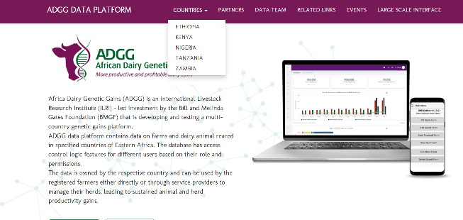
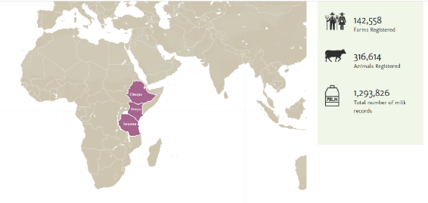
Country Access to ADGG Platform
The ADGG landing page: https://portal.adgg.ilri.org/
Notes:
As you scroll down the front page you see which countries have their data recorded on the platform, and get a glimpse on the quantity of data available from each country

Slide 8
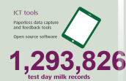
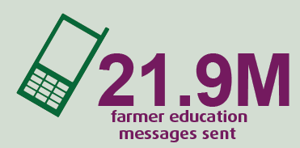
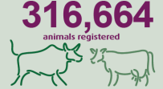
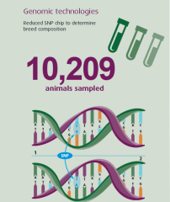
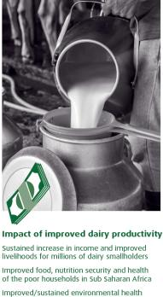
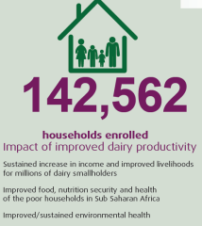
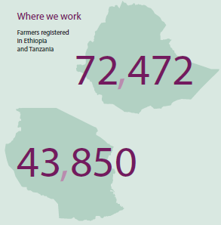
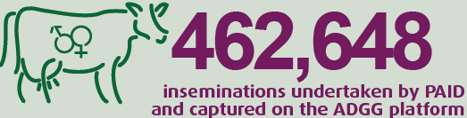
ADGG Achievements

Slide 9
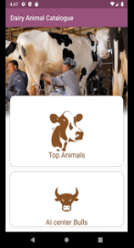
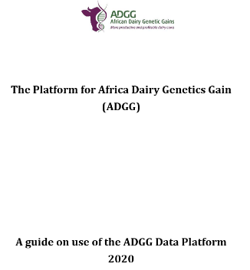
Several Digital tools developed and promoted
https://hdl.handle.net/10568/110179
https://hdl.handle.net/10568/110180
https://hdl.handle.net/10568/98250
https://hdl.handle.net/10568/108942
Dairy tool: https://m.learn.ink/ilri)
Helping your cow to calve: https://my.learn.ink/course/219ccf98-a46c-4d6a-8dcc-a15685a65643
Basic Hygiene for dairy farmers: https://my.learn.ink/course/8773682a-2c0c-4571-a429-ea9bdc56ca11
A Manual to guide collection of data using the ADGG ODK tools: https://cgspace.cgiar.org/handle/10568/108942
ADGG Platform-help Module: https://portal.adgg.ilri.org/sites/default/files/ADGG-platform-help-module.pdf

Slide 10
ADGG links to CTLGH
Enablers from ADGG for CTLGH
  ADGG platform and the database
  National dairy animals' identification and registration system
  Tools for data capture, provision of feedback and extension education messages
  Phenotypic and genotype data and genomic pipeline could be used to superimpose different studies (e.g heat tolerance, disease resistance)
  An increase in the number of animals genotyped increases reference population
  Increase in number of traits: data on milk, milk quality and health traits
  Partnership
  National partners capacity
  Evidences and lessons generated and demonstrated to get buy-in
  Demand for scaling out/up to none ADGG project countries
Expectations of ADGG from CTLGH
  New tools, and technologies for data collection and genotyping will strengthen the ADGG platform to optimize breeding program
  Develop new capacity

Slide 11
Thank you very much!
THANK YOU

